Slide 1
Kootenai Basin Spring/SummerOperations for 2016
Joel Fenolio, P.E.
Upper Columbia Senior Water Manager
11 May 2016

Slide 2
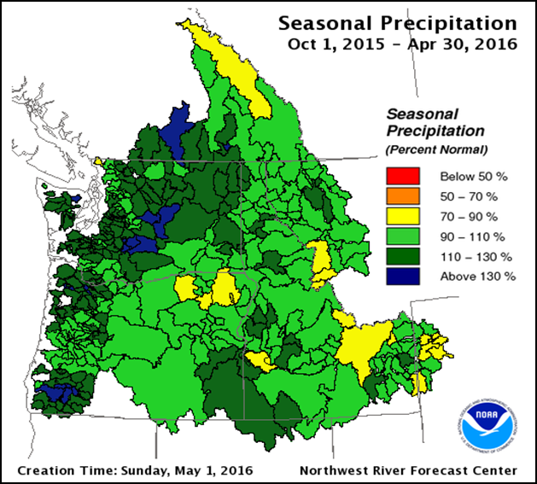

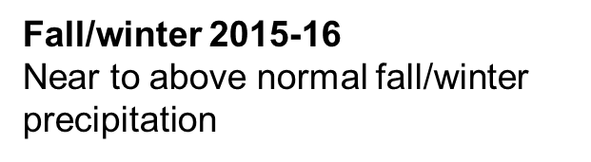
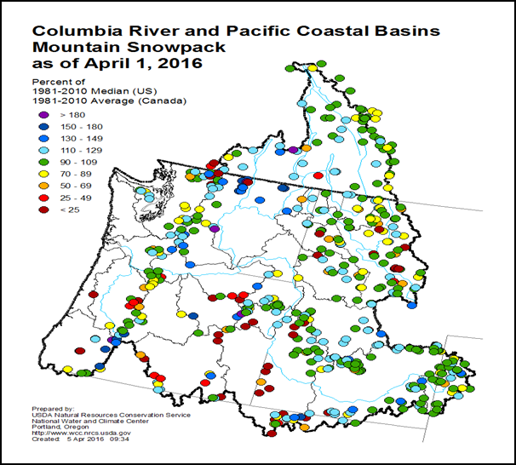

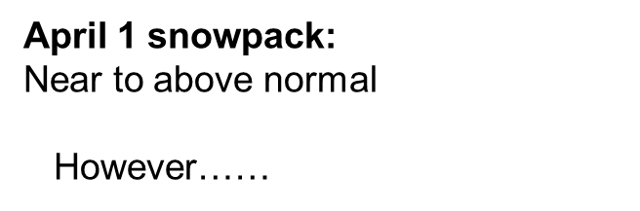
Atmospheric river
intense, focused, steady rainfall
with high snow levels
Atmospheric river
intense, focused, steady rainfall
with high snow levels

Slide 3
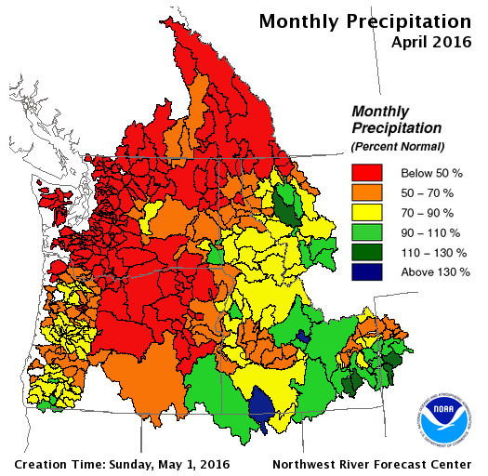
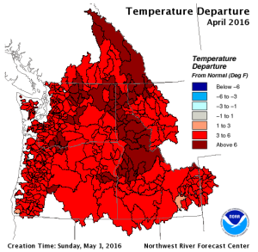
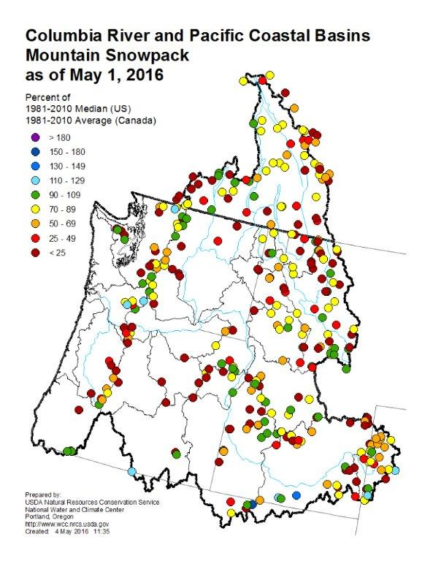

April record warmth and dry
Atmospheric river
intense, focused, steady rainfall
with high snow levels
Atmospheric river
intense, focused, steady rainfall
with high snow levels
Bonners Ferry: Warmest April on record
Snowpack drops
well below normal in a month
With warmth, rapid snowmelt in April
Now less snowmelt and with dry weather: Runoff decreases

Slide 4
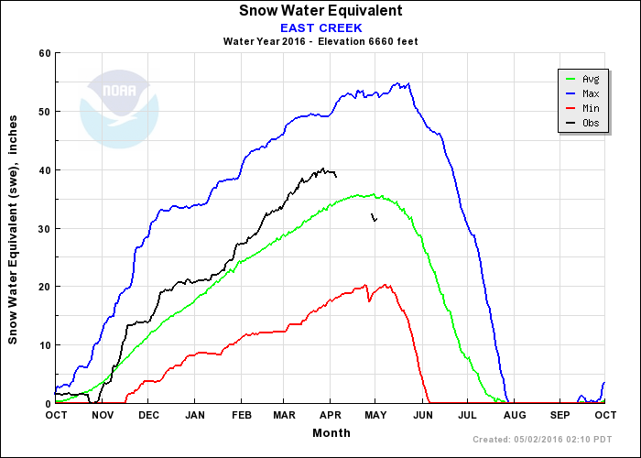
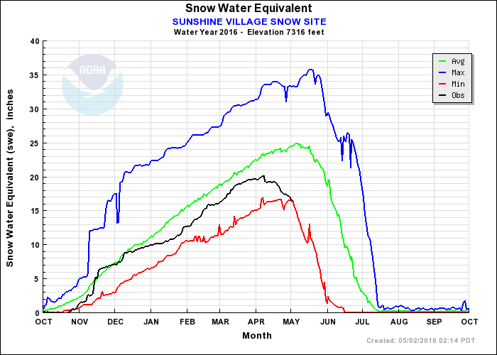
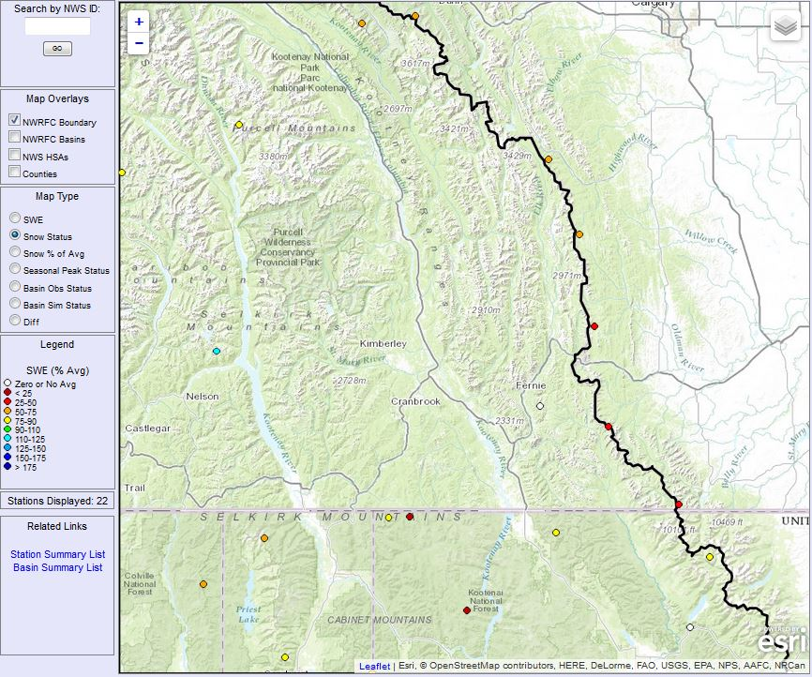
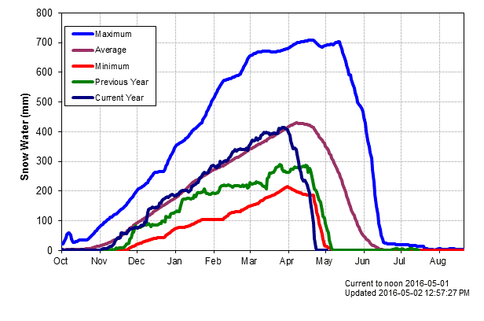
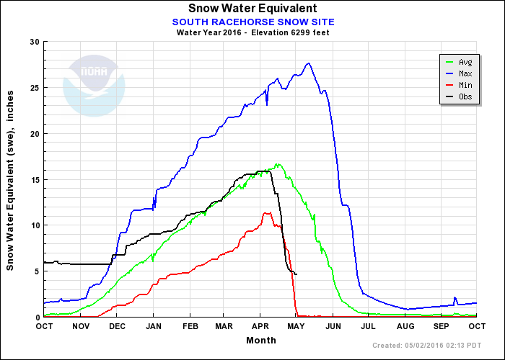
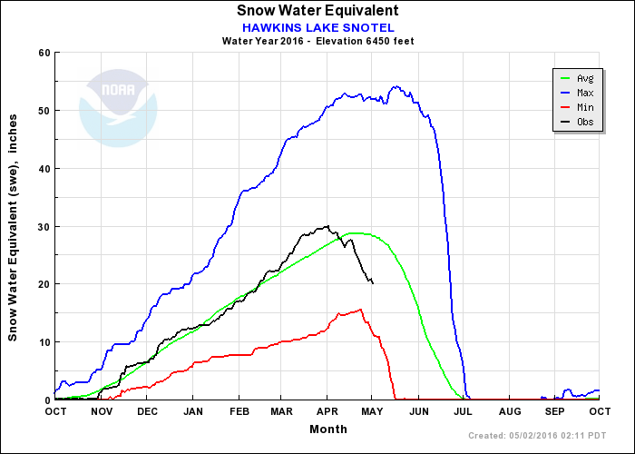
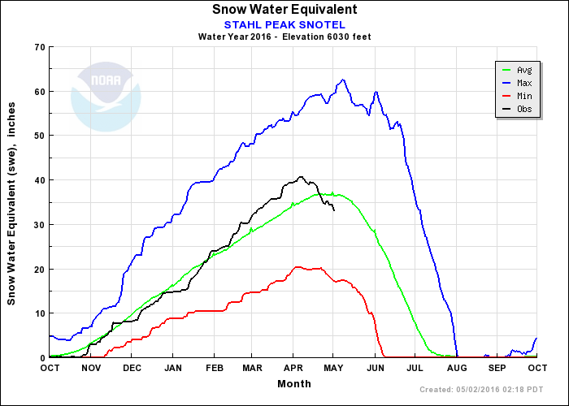
Snowpack Story for 2016

Slide 5
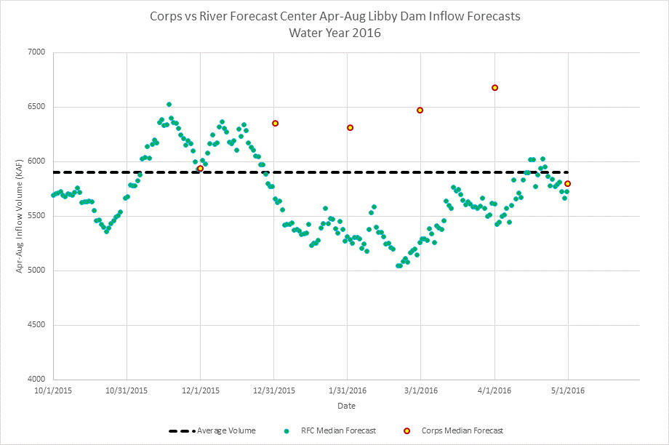
Libby Dam Apr-Aug May Inflow Forecast
Corps forecast is 5.8 MAF (99% or average)
5900 KAF is the average Apr-Aug inflow volume

Slide 6
BiOp Requirements and Habitat Operations
Libby WSF of 5.8 MAF sets the following:
Sturgeon Volume of 0.93 MAF
As measured above 4 kcfs
Bull Trout Minimum after the pulse through August 31st is 7 kcfs
Habitat Operations
6 kcfs minimums in Sept
Target 2449 ft end of August rather than end of Sept

Slide 7
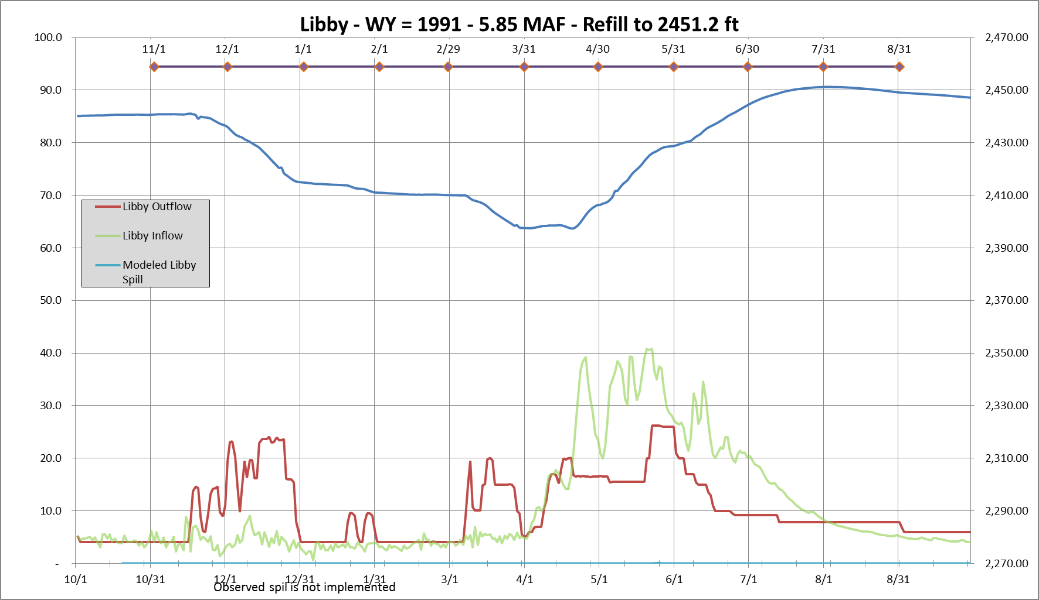
Moderate ESP Inflow Scenario
2449 ft end of August
Refill end of July
7.8 kcfs flat flow
0.93 MAF Sturgein Pulse
Notes:
Will be updated next week

Slide 8
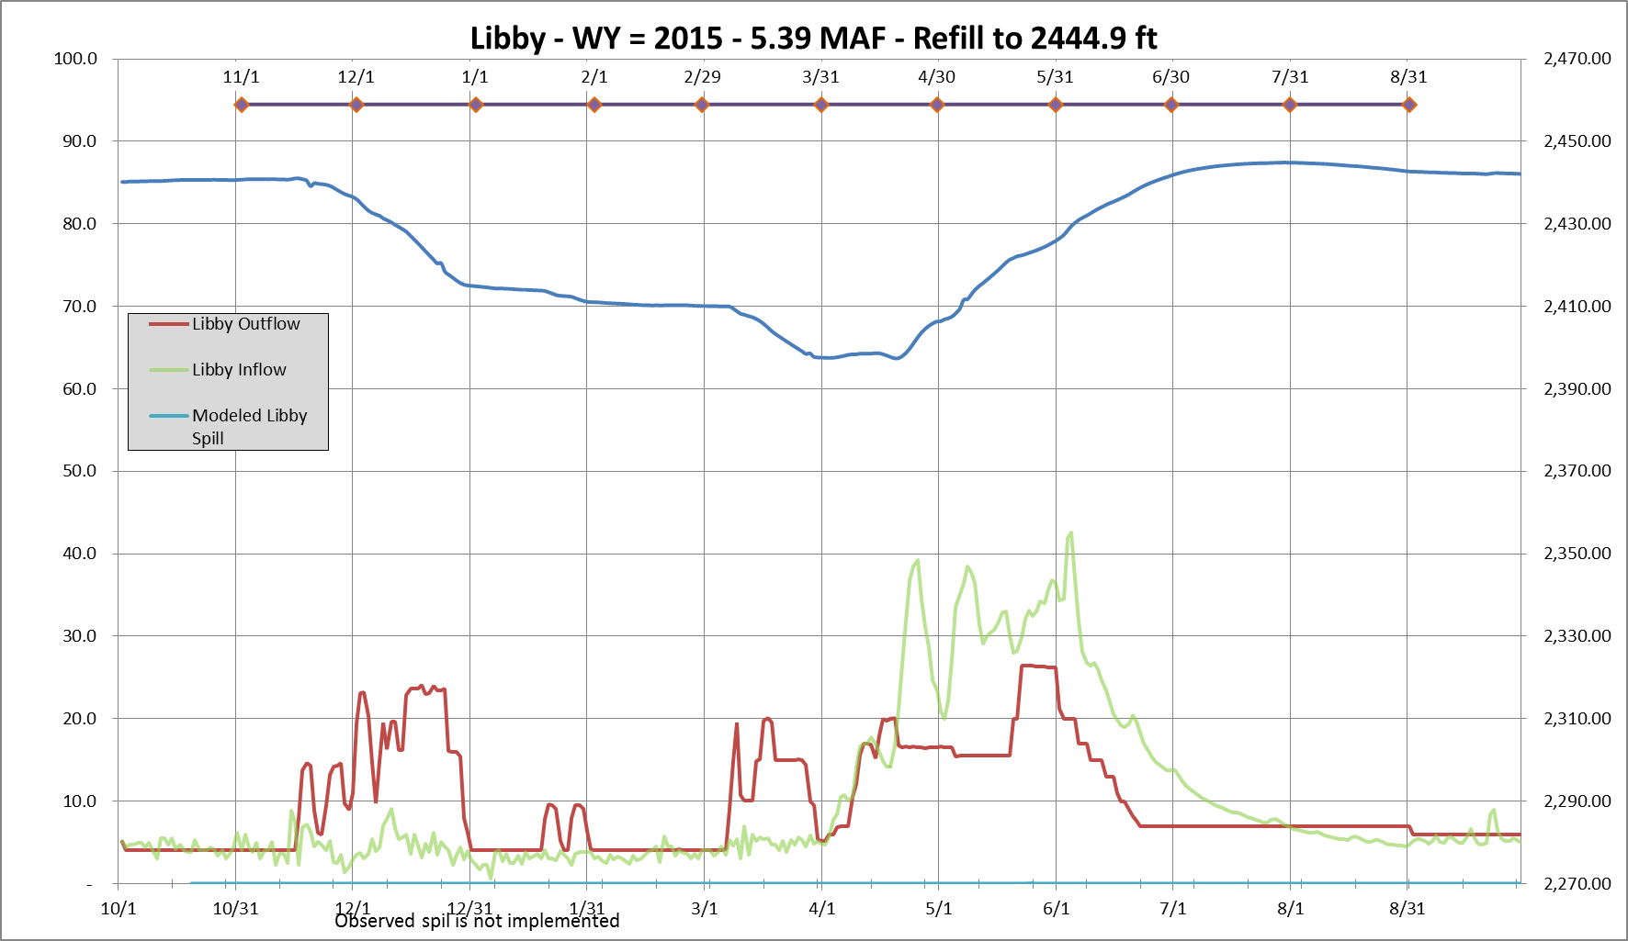
Dry Inflow Scenario
Below 2449 ft end of August
Refill end of July
0.93 MAF Sturgein Pulse
7 kcfs flat flow

Slide 9
Summary
Timing of Inflows shifted up by 4 to 6 weeks
Flood Risk low – based on the below average snowpack
Libby Dam will likely not refill to 2452 to 2454 feet this summer
Anticipated timing of refill late July to August
Seattle District is currently looking at refilling earlier than late July
June precipitation is the wild card in terms of flood risk and refill

