Slide 1
Columbia River Basin 2016 Water Year Review National Weather Service – NW River Forecast Center www.nwrfc.noaa.gov/rfc/
Kevin Berghoff, Senior Hydrologist
kevin.berghoff@noaa.gov
503-326-7291

Slide 2
Presentation Outline
Very strong ENSO signal before start of 2016 WY
2016 Precipitation and Monthly Temperature Departure from Normal
2016 Snowpack Accumulation and Depletion
ESP Water Supply Forecast and Observed Runoff Volumes

Slide 3
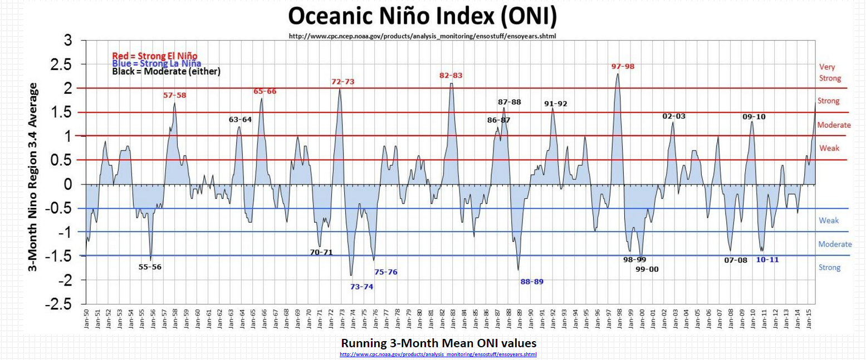
3 Month ONI index values since 1950
Peak ONI wy2016(NDJ)=2.3
Current ONI wy2017(JAS)= -0.5

Slide 4
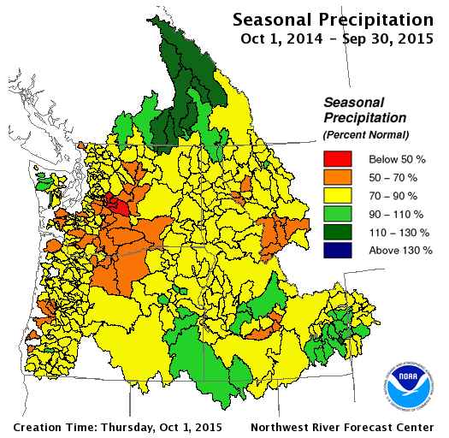
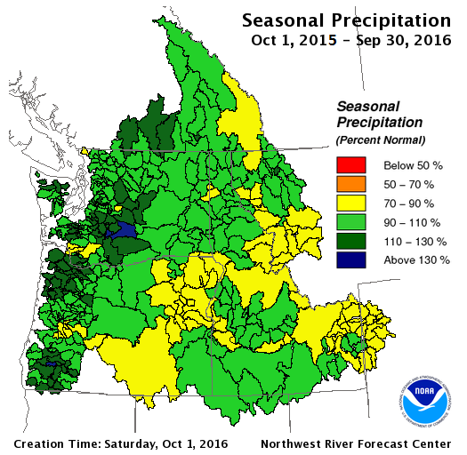
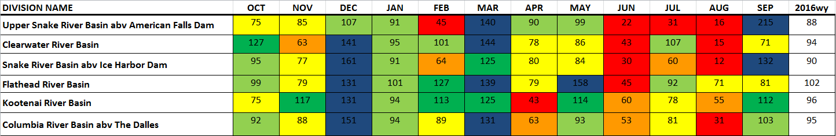
2015/2016 Precipitation Summary % Normal
2016 Water Year % Normal Precipitation
Notes:
Water year summary

Slide 5
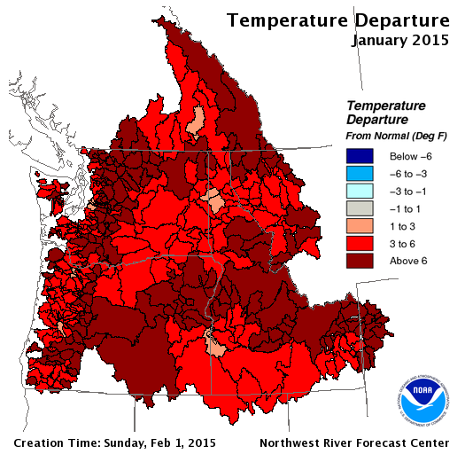
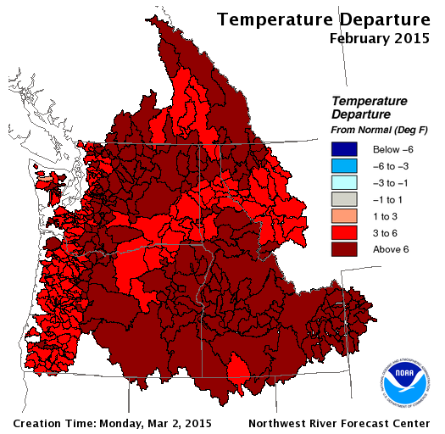
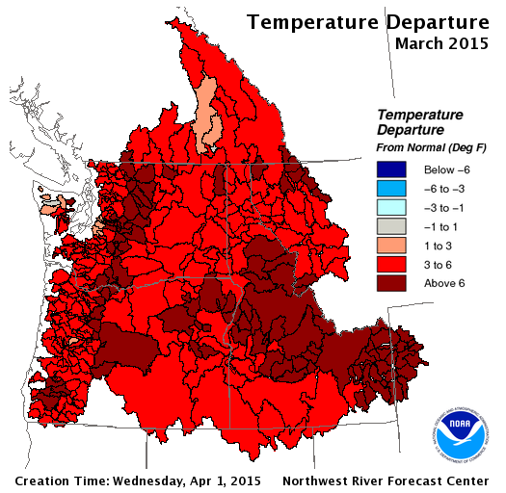
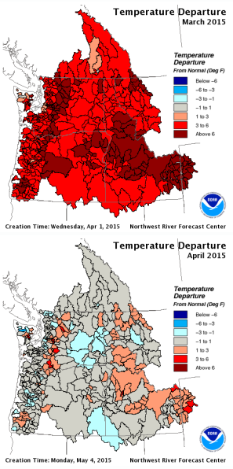
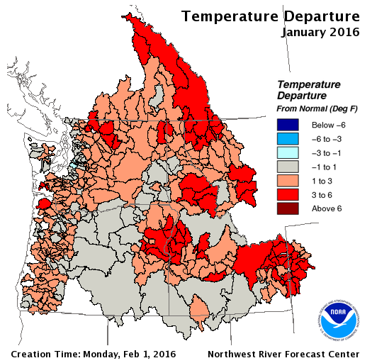
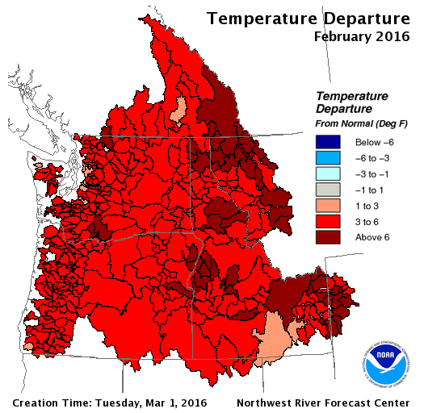
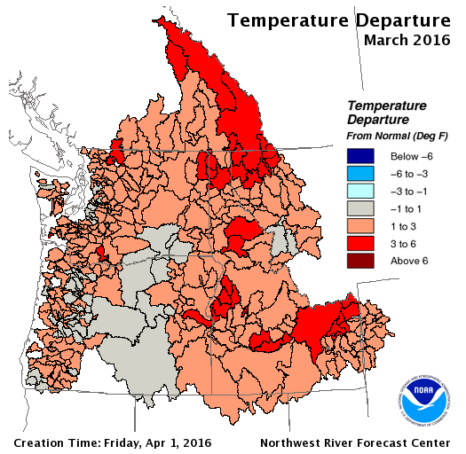
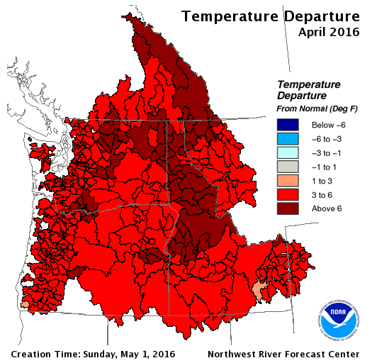
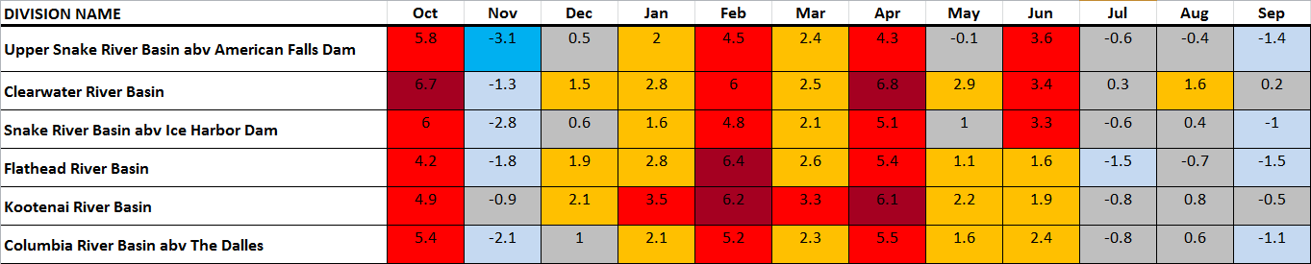
Observed Temperature Departures
Water Year 2015 / 2016 Comparison
2016 Monthly Temperature Departure from Normal - DegF
Notes:
Although not as bad as last year, tempts were still warmer than we would like
Feb and Apr especially warm

Slide 6
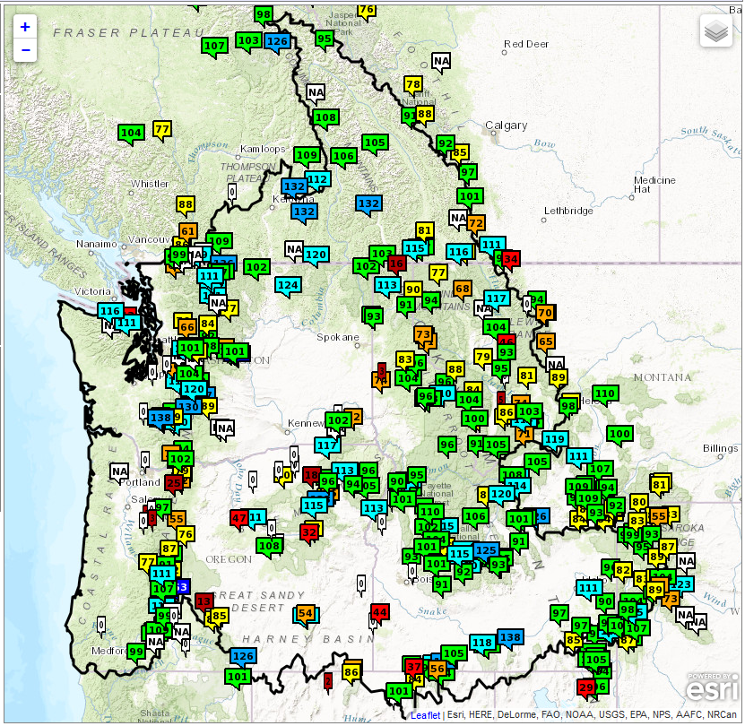
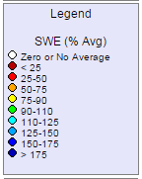
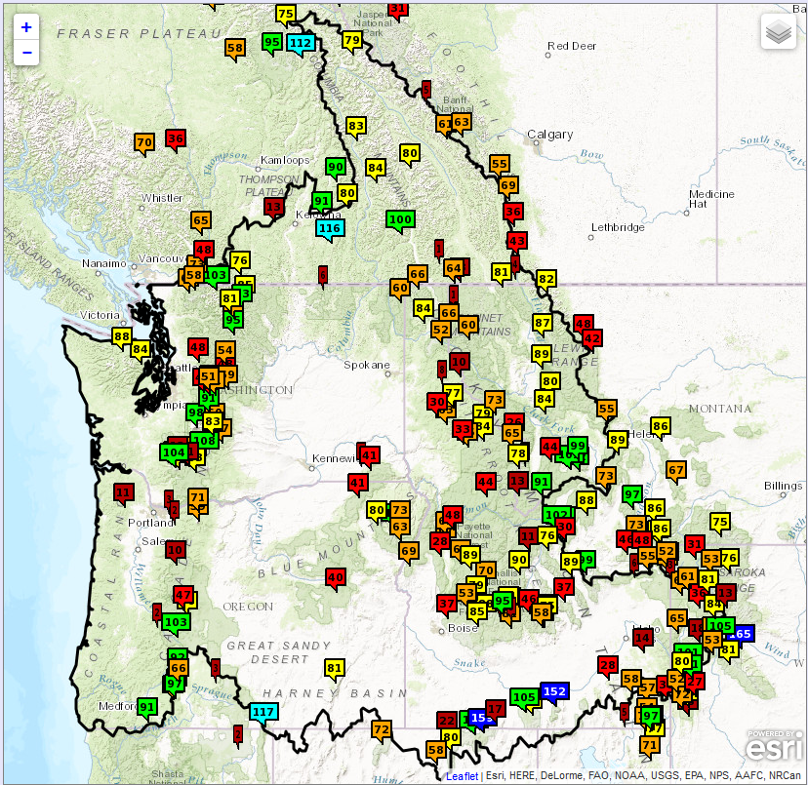
2016 Observed Snowpack Conditions % Normal SWE
Apr 5, 2016
May 4, 2016
Notes:
Warm tempts in April….depleted snowpack relative to %normal
This graphic shows the relative degree of SWE loss since Apr 5.
Low elevation snowpack showing more significant loss, but even higher elev in the upper snake and along crest of the rockies into western mt and north into Canada have lost SWE
Warmer tempts, especially in April, causing a more rapid meltoff of snowpack than we would typically see
6

Slide 7
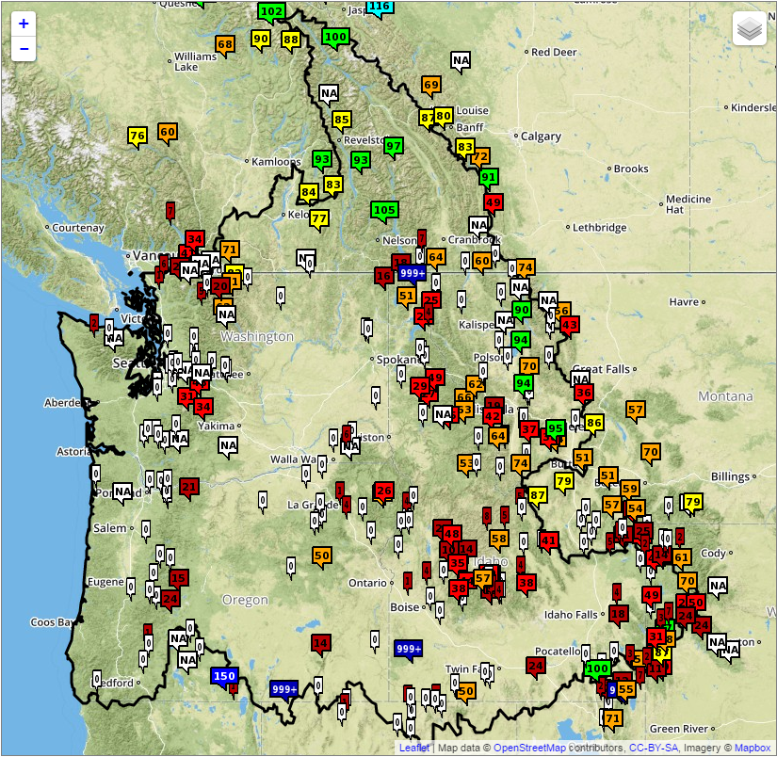
2015/2016 Observed Snowpack Conditions % Normal SWE
May 6, 2015
May 4, 2016
Notes:
Looking better this year compared to last year (record low snowpack in many areas)
7

Slide 8
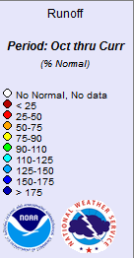
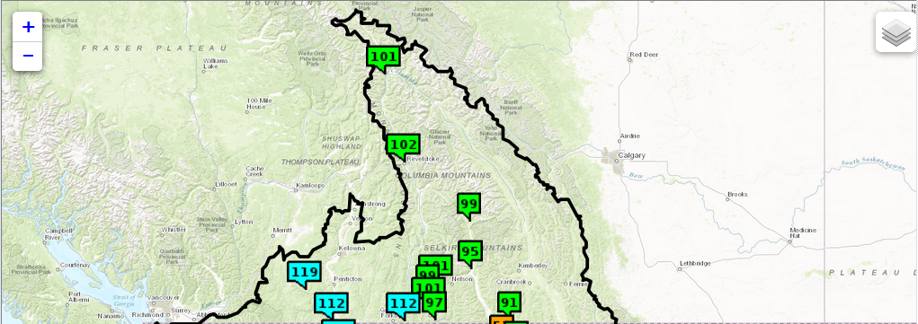
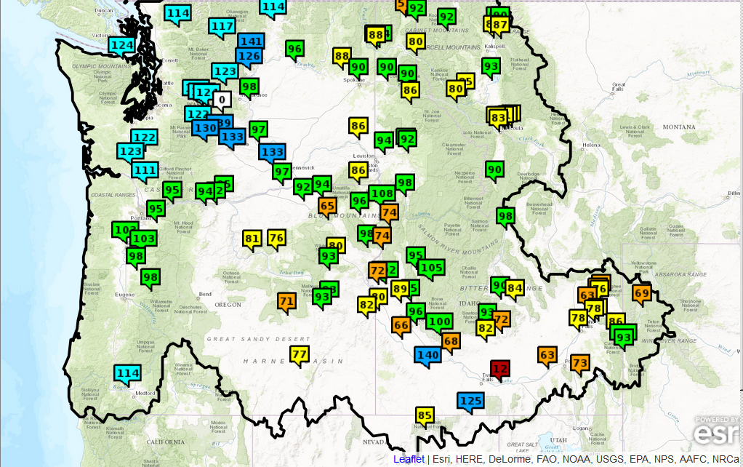
2016 Water Year Runoff Summary
2016 Water Year Runoff - % Normal
2016 Observed Seasonal Runoff - % Normal
 | Oct –Sep | Jan-Sep | Apr-Sep
MCDQ2 Mica Dam | 101 | 98 | 97
LYDM8 Libby Dam | 92 | 92 | 91
HHWM8 Hungry Horse | 87 | 90 | 86
DWRI1 Dworshak | 96 | 98 | 84
PALI1 Palisades | 93 | 93 | 92
LGDW1 Lower Granite | 86 | 87 | 83
TDAO3 The Dalles | 94 | 94 | 89
MCDQ2
LYDM8
GCDW1
HHWM8
LGDW1
DWRI1
TDAO3
PALI1

Slide 9
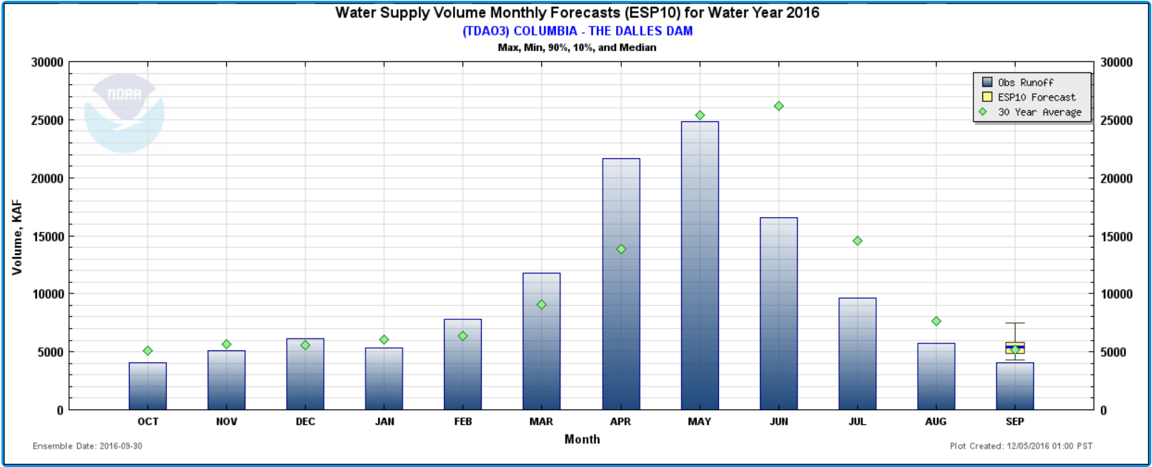
Observed Monthly Runoff Volume – TDAO3
2016WY
Observed Monthly Runoff Volume – WY 2016
TDAO3 – Columbia River at The Dalles Dam
- WY 2015
Notes:
Critical snowpack accum period outlined in red
Excessive tempt departures throughout year
% runoff above normal…sure sign we were losing snowpack to early, to fast

Slide 10
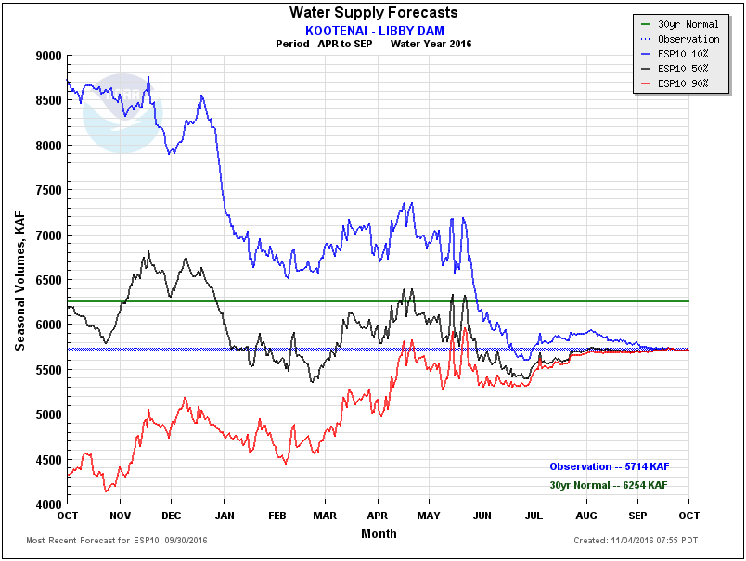
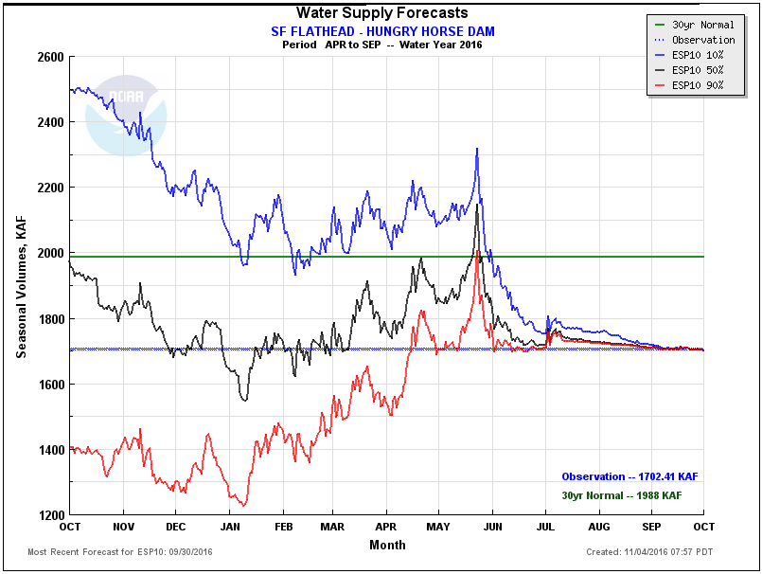
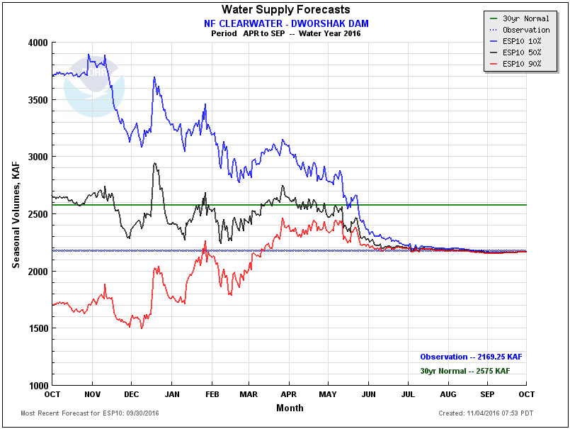
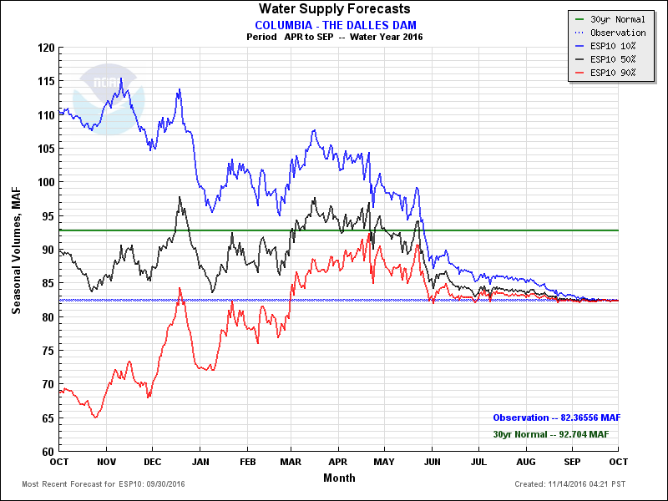
2016 ESP Review
5714 KAF – 91%
1702 KAF – 86%
2169 KAF – 84%
82366 KAF – 89%
Notes:
Warm tempts continuously diminished snowpack thru the WSF season

Slide 11
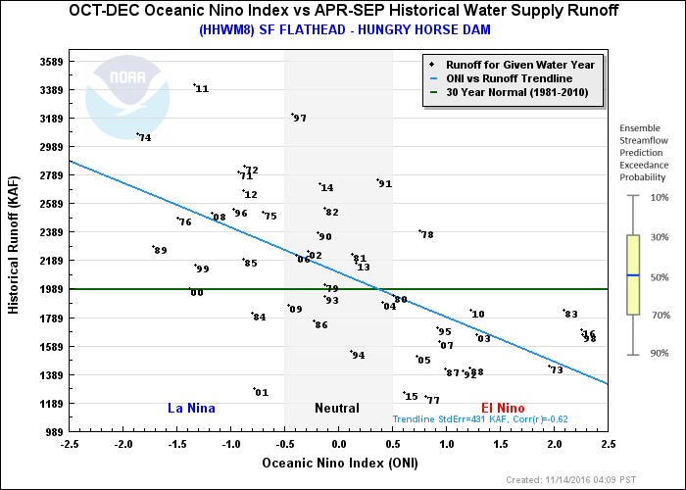
2016 Observed Runoff Volume Historical ONI Perspective

Slide 12
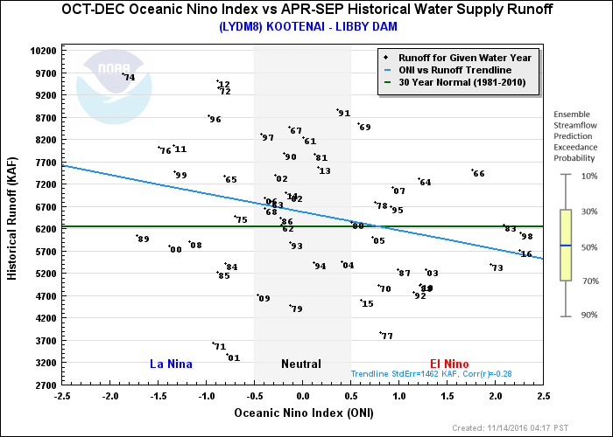
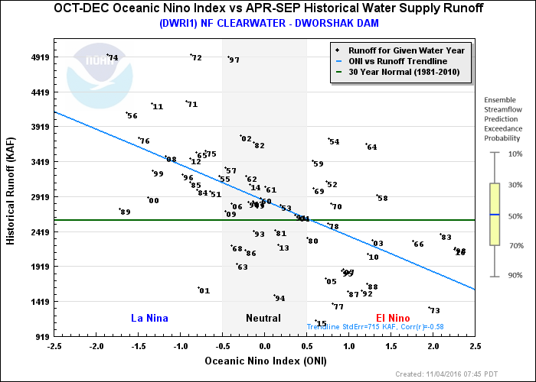
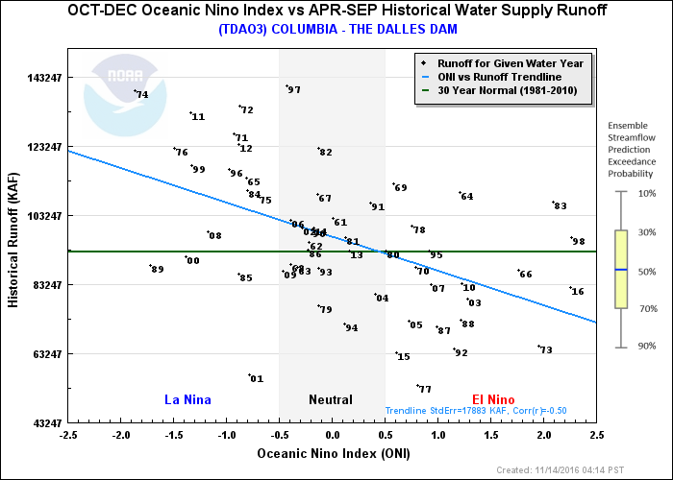
2016 Observed Runoff Volume Historical ONI Perspective

Slide 13
2016 WY Summary
Very strong ENSO signal – Impacts on Columbia River water resources unclear
Precipitation slightly below normal for water year
Near normal in Upper Columbia
90% in Snake
95% above The Dalles
Above normal tempts resulting in early runoff and depleted snowpack
Most areas below normal seasonal runoff
89% Apr-Sep at The Dalles

Slide 14
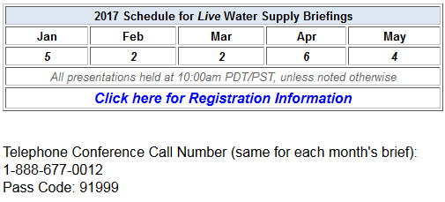
NWRFC 2017 Water Supply Briefing Schedule
https://attendee.gotowebinar.com/rt/8111931086353869315

Slide 15
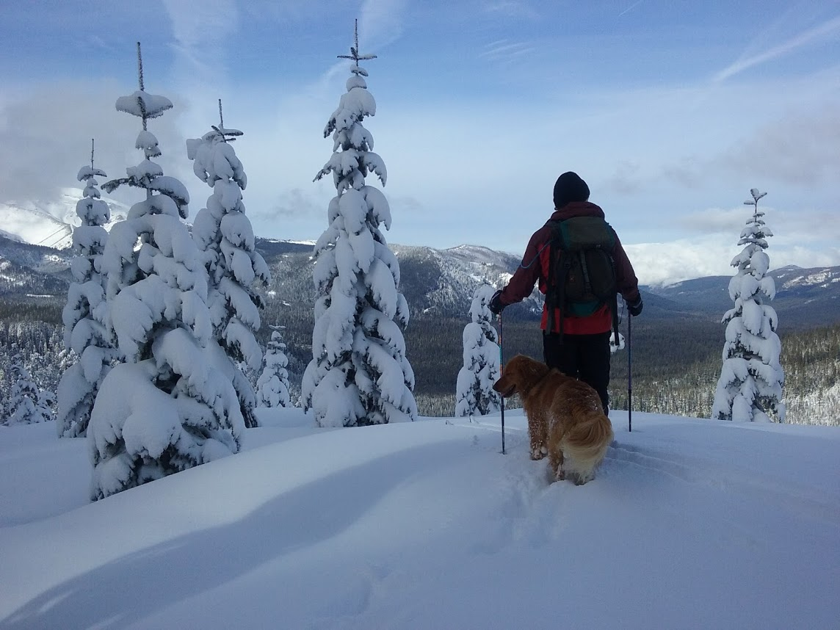
2017 Forecast?
Questions?
NWS/Northwest River Forecast Center
Kevin Berghoff, Senior Hydrologist
Kevin.berghoff@noaa.gov
503-326-7291

Slide 17
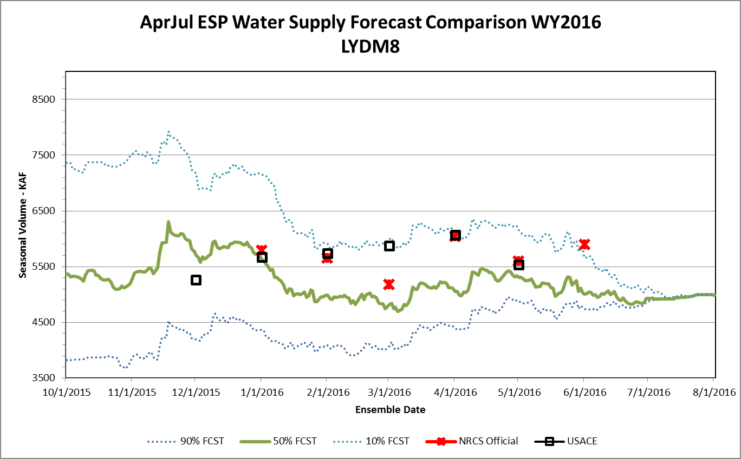
30YR AVG=5342 KAF
OBS=5002.5 KAF

Slide 18
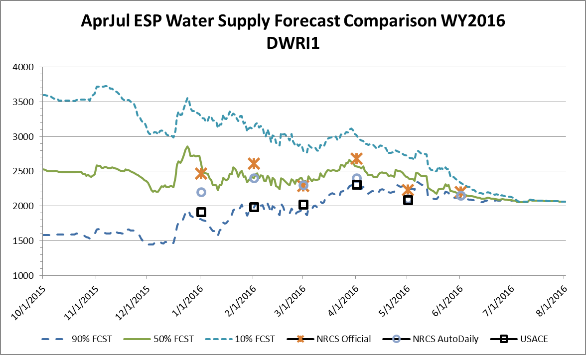
30YR AVG=2419 KAF
OBS=2068.4 KAF

