Slide 1
2016 Smolt Monitoring Program
Juvenile Passage Data and
Noteworthy Events
2016 TMT Year-end Review
December 7, 2016
Brandon R. Chockley
Fish Passage Center

Slide 2
Juvenile Timing
Presenting 2016 timing compared to 10-year average, based on passage index
Several factors can affect juvenile timing at a project:
Hatchery releases (both magnitude and timing)
Flows
Temperatures
Spill volumes
Survival to point of interest
More detailed analyses are needed to identify and explain timing differences

Slide 3
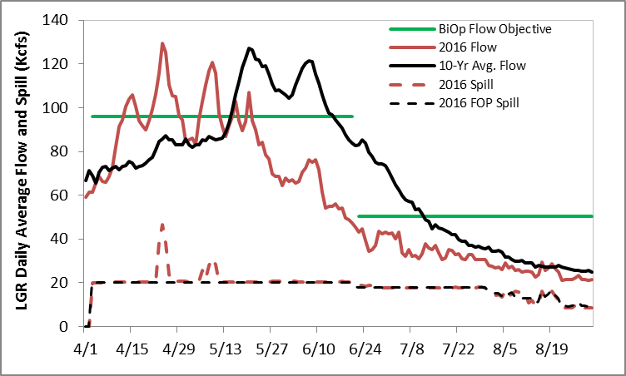
Lower Granite Dam
Snake River runoff volume (Jan-Jul) at LGR ranked 52nd over last 88 years
BiOp flow objectives not met
Two brief periods of spill in excess of FOP
Notes:
Spring Objective = 96 Kcfs (actual 84 Kcfs)
Summer Objective = 50.4 Kcfs (actual 31 Kcfs)

Slide 4
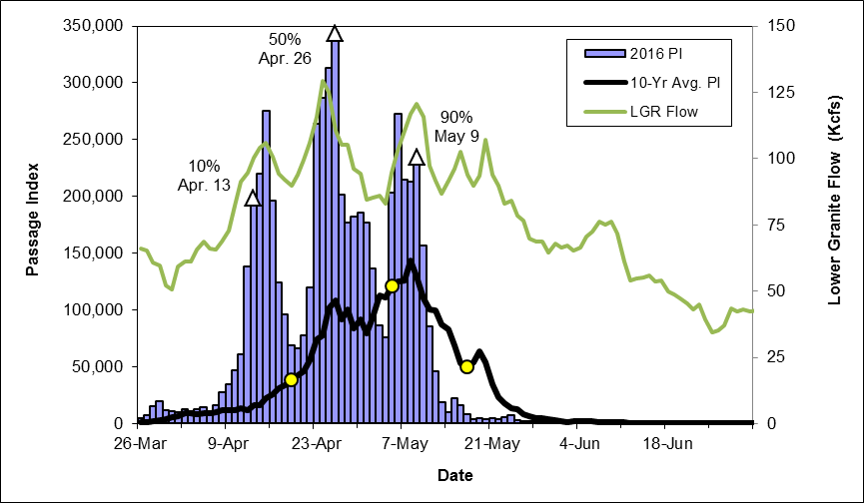
Lower Granite Dam:
Yearling Chinook
Notes:
Collection for transport began on May 1, First barge May 2
Based on PI, ~68% of CH1 passed LGR prior to start of transport

Slide 5
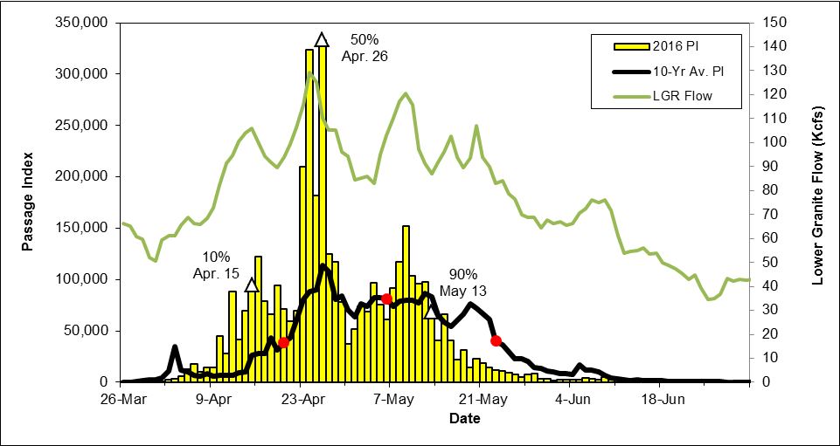
Lower Granite Dam:
Steelhead
Notes:
Collection for transport began on May 1, First barge May 2
Based on PI, ~63% of ST passed LGR prior to start of transport
2016 Hatchery release total similar to last 10-years

Slide 6
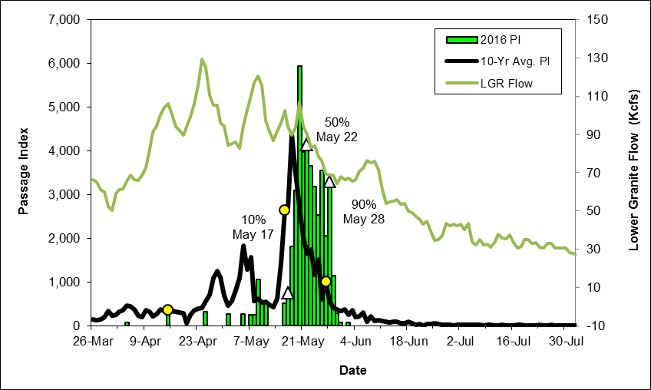
Lower Granite Dam:
Sockeye
1st PIT-tag detection
Apr. 24 (Wild)
Notes:
5-6 Kcfs spill from Dworshak for entire month of April. Most Sockeye collected in early April were likely kokanee from Dworshak reservoir.
Hatchery releases started May 9th.
2016 release total ~635,000 (10-year average is ~260,000)

Slide 7
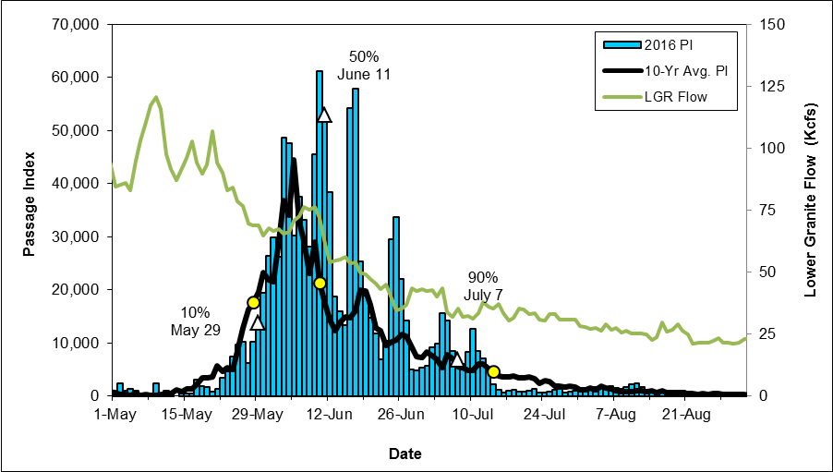
Lower Granite Dam:
Subyearling Chinook

Slide 8
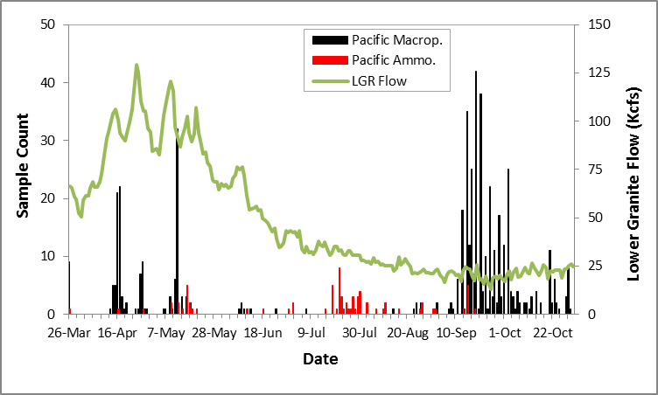
Lower Granite Dam:
Juvenile Lamprey

Slide 9
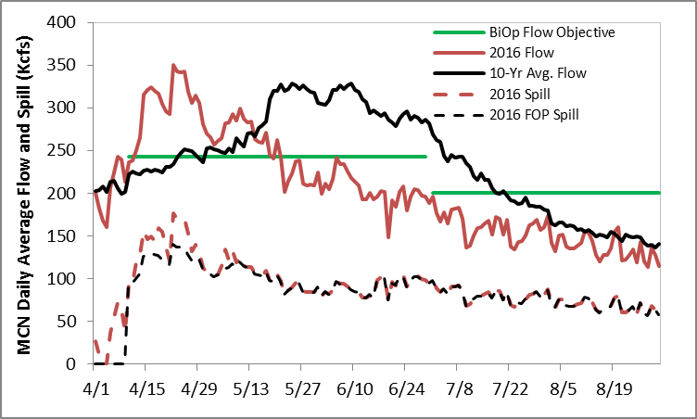
McNary Dam
Mid-Columbia runoff volume (Jan-Jul) at TDA ranked 54th over last 88 years
Average MCN spring flows slightly above flow objective, below in summer
Some excess spill in April, otherwise FOP spill provided
Notes:
Spring Objective – 243 Kcfs (Actual 247.5 Kcfs)
Summer Objective – 200 Kcfs (Actual 149 Kcfs)

Slide 10
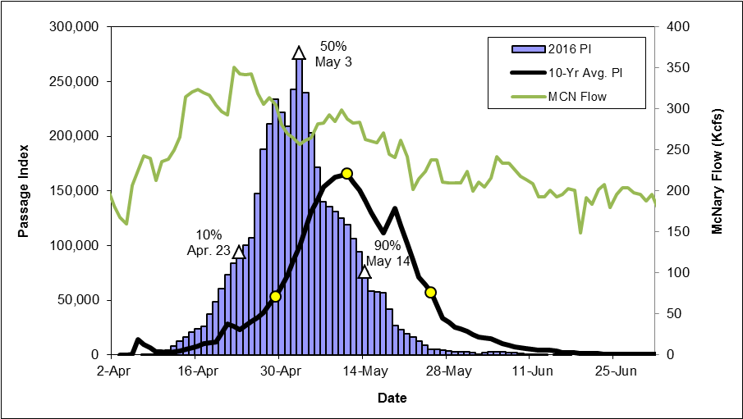
McNary Dam:
Yearling Chinook

Slide 11
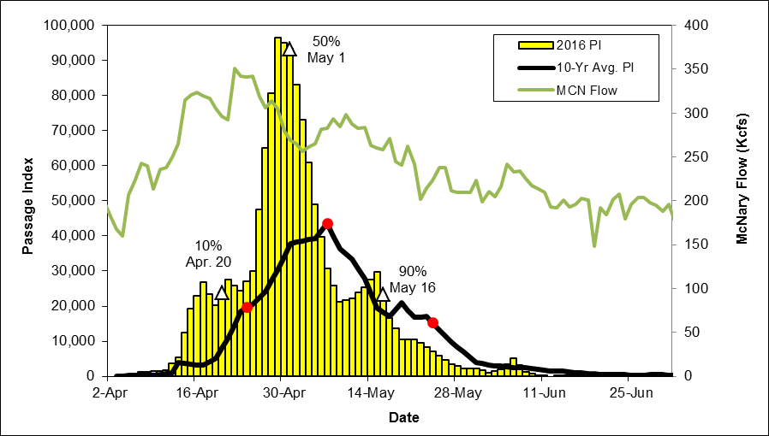
McNary Dam: Steelhead

Slide 12
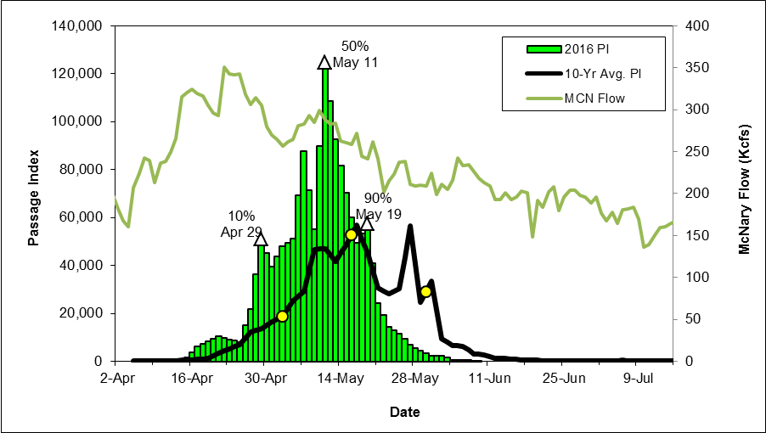
McNary Dam:
Sockeye
Notes:
Okanogan sockeye timing (PIT-tags) appeared earlier than previous years.

Slide 13
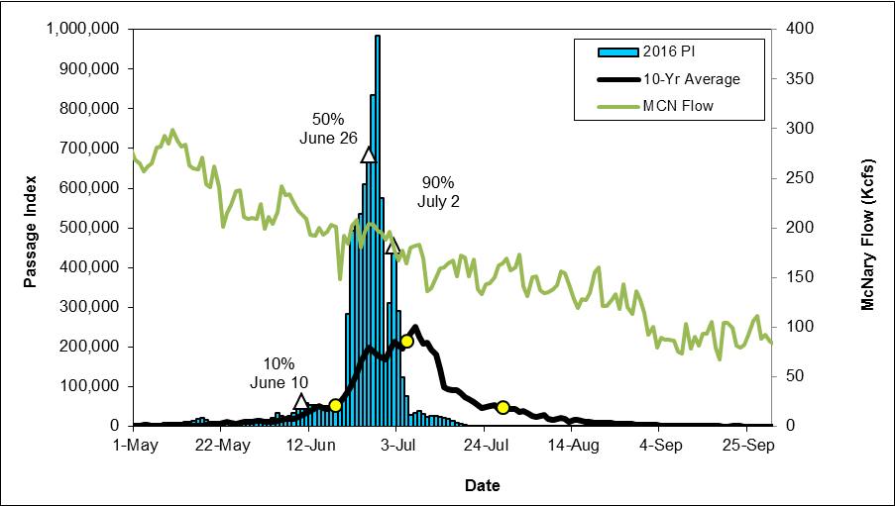
McNary Dam:
Subyearling Chinook

Slide 14
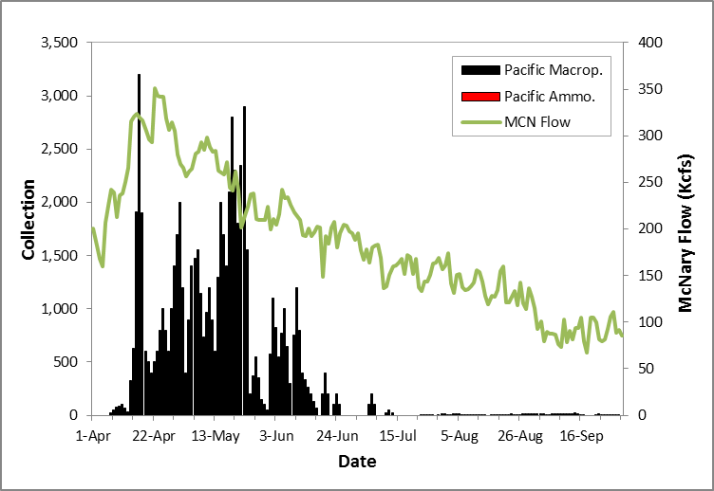
McNary Dam:
Juvenile Lamprey

Slide 15
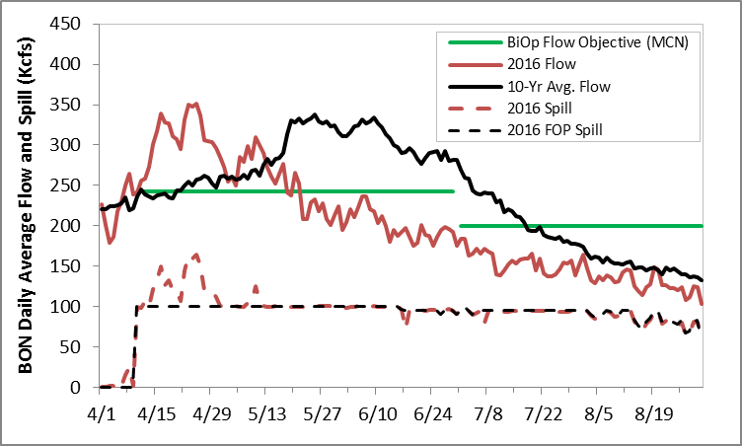
Bonneville Dam
Mid-Columbia runoff volume ranked 54th over last 88 years (1929-2016) (@ TDA)
Average BON spring flows slightly above MCN flow objectives, below in summer
Some excess spill in April, otherwise FOP spill provided
Notes:
Spring Objective – 243 Kcfs (Actual 247.5 Kcfs)
Summer Objective – 200 Kcfs (Actual 149 Kcfs)

Slide 16
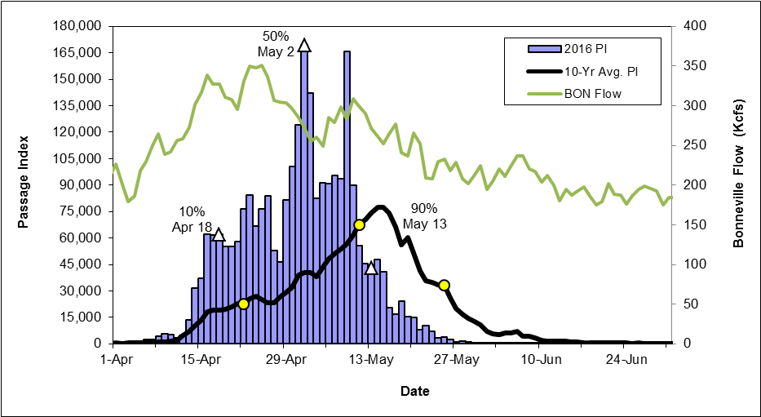
Bonneville Dam:
Yearling Chinook

Slide 17
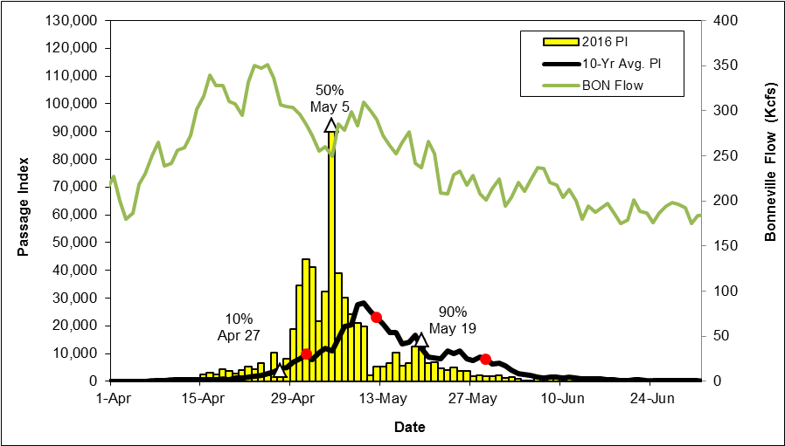
Bonneville Dam:
Steelhead

Slide 18
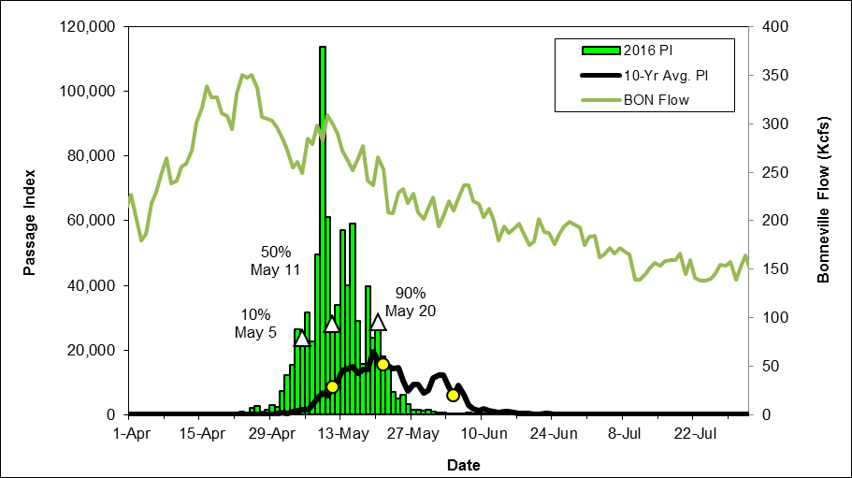
Bonneville Dam:
Sockeye

Slide 19
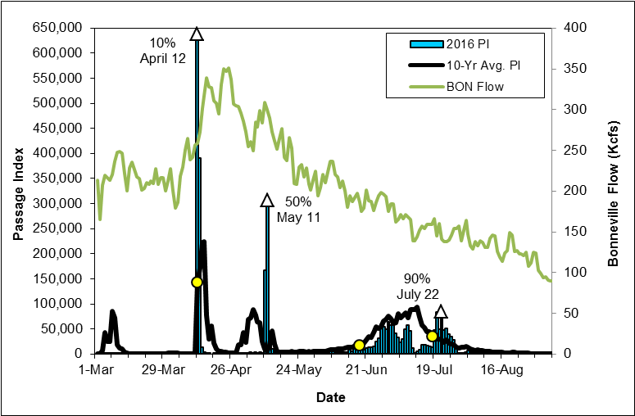
Bonneville Dam:
Subyearling Chinook
High Temp. Sampling
Protocol

Slide 20
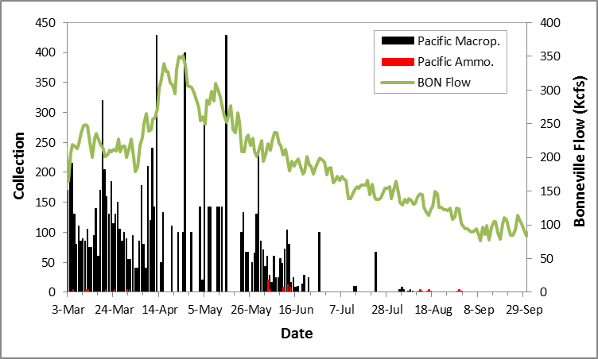
Bonneville Dam:
Juvenile Lamprey

Slide 21
Noteworthy Events:
Weighted Average Mortality
Site | CH0 | CH1 | CO | SO | ST | MP†
LGR | 0.6 | 0.4 | 0.2 | 2.9 | 0.2 | 0.0
LGS | 0.3 | 0.3 | 0.0 | 2.6 | 0.1 | N/A
LMN | 0.4 | 0.6 | 0.0 | 0.3 | 0.2 | N/A
MCN | 0.2 | 0.3 | 0.6 | 0.3 | 0.1 | 1.9
JDA | 0.2 | 0.1 | 0.0 | 0.3 | 0.2 | 1.0
BON | 0.5 | 0.3 | 0.4 | 0.4 | 0.1 | 5.3
RIS | 0.1 | 0.1 | 0.0 | 0.1 | 0.0 | N/A
† Weighted by estimated collection or sample count, instead of passage index
Notes:
Red – Highest when compared to previous 10 years (2006-2015); Lamprey are 5 years (2011-2015)
Green – Lowest when compared to previous 10 years (2006-2015) ; Lamprey are 5 years (2011-2015)
Red Box – Although not necessarily records for lamprey, lamprey mortality still highest among target species at Mid-Columbia Projects.

Slide 22
Noteworthy Events:
Weighted Average Descaling
Site | CH0 | CH1 | CO | SO | ST
LGR | 0.5 | 0.9 | 0.4 | 0.8 | 1.3
LGS | 0.9 | 1.0 | 0.6 | 1.1 | 1.0
LMN | 1.4 | 1.6 | 4.0 | 5.7 | 2.6
MCN | 0.5 | 2.4 | 2.5 | 4.0 | 3.5
JDA | 2.3 | 2.4 | 3.6 | 5.6 | 6.6
BON | 0.2 | 1.8 | 1.0 | 4.8 | 2.4
RIS | 0.8 | 0.4 | 0.6 | 1.1 | 0.8
Notes:
Red – Highest when compared to previous 10 years (2006-2015)
Green – Lowest when compared to previous 10 years (2006-2015)

Slide 23
Noteworthy Events:
Weighted Average Injury
Site | CH0 | CH1 | CO | SO | ST | MP†
LGR | 7.1 | 5.7 | 4.4 | 10.8 | 2.5 | N/A
LGS | 12.5 | 8.7 | 10.8 | 5.1 | 5.5 | N/A
LMN | 5.9 | 8.5 | 1.3 | 31.3 | 7.9 | N/A
MCN | 0.6 | 2.4 | 3.0 | 2.5 | 4.0 | 1.3
JDA | 3.1 | 3.9 | 3.2 | 3.0 | 9.0 | 7.0
BON | 9.3 | 11.6 | 7.9 | 13.8 | 14.5 | 6.4
† Weighted by estimated collection, instead of passage index
Notes:
Red – Highest when compared to previous 7 years (2009-2015); Lamprey are 4 years at JDA (2011-2015) and 3 years at BON & MCN (2012-2015)
Green – Lowest when compared to previous 7 years (2009-2015) ; Lamprey are 4 years at JDA (2011-2015) and 3 years at BON & MCN (2012-2015)

Slide 24
Condition Monitoring: Injuries
According to the Condition Monitoring protocol:
Injury category contains conditions that are attributable to dam operations
Obviously old (i.e., likely not to have occurred at the dam where fish is being examined) should not be recorded as injured.

Slide 25
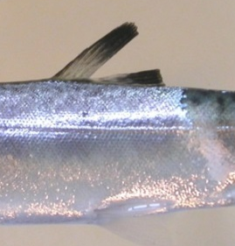
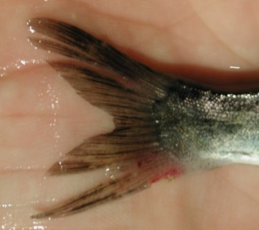
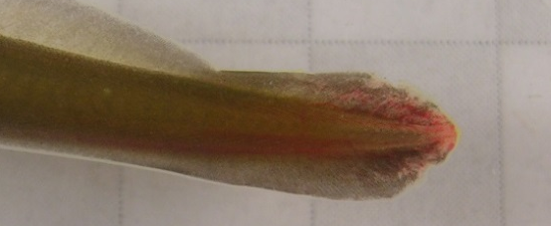
Noteworthy Events:
Injury Types
Most common injury is Fin Injury (at nearly all sites, all species, and all years)
Fin injury is any cut, abrasion, laceration swelling, or other injury to the fins. Split fins should only be reported when the split reaches from the outer margin of the fin to where the fin meets the body.

Slide 26
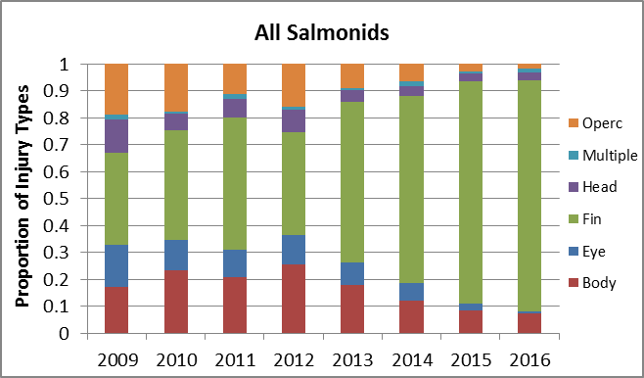
Noteworthy Events:
Injury Types
Example: Lower Granite

Slide 27
Noteworthy Events:
Weighted Average Disease
Site | CH0 | CH1 | CO | SO | ST | MP†
LGR | 4.0 | 1.8 | 2.3 | 13.7 | 2.0 | N/A
LGS | 2.2 | 1.0 | 1.1 | 42.8 | 2.2 | N/A
LMN | 2.1 | 0.5 | 1.3 | 3.3 | 1.6 | N/A
MCN | 10.1 | 0.2 | 3.0 | 0.0 | 2.2 | 0.7
JDA | 10.4 | 1.9 | 1.1 | 0.3 | 5.4 | 0.0
BON | 11.5 | 0.7 | 0.9 | 0.0 | 2.3 | 0.4
† Weighted by estimated collection, instead of passage index
Notes:
Red – Highest when compared to previous 7 years (2009-2015); Lamprey are 4 years at JDA (2011-2015) and 3 years at BON & MCN (2012-2015)
Green – Lowest when compared to previous 7 years (2009-2015) ; Lamprey are 4 years at JDA (2011-2015) and 3 years at BON & MCN (2012-2015)

Slide 28
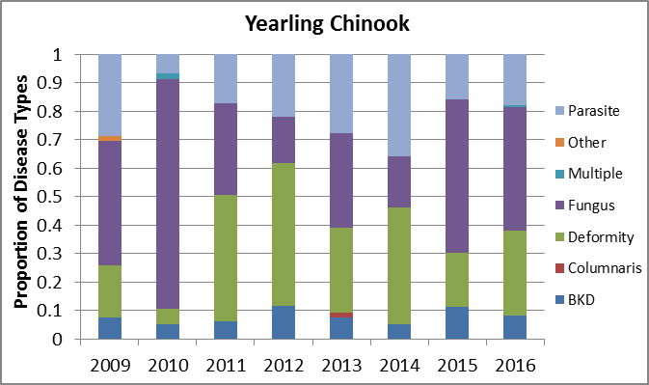
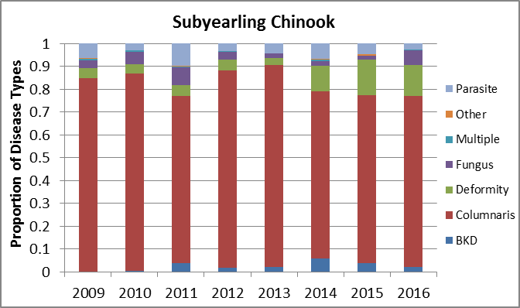
Noteworthy Events:
Disease Types – Snake River
Types appear to be species/timing specific
Spring: parasites, fungus, and deformity most common
Summer: Columnaris most common

Slide 29
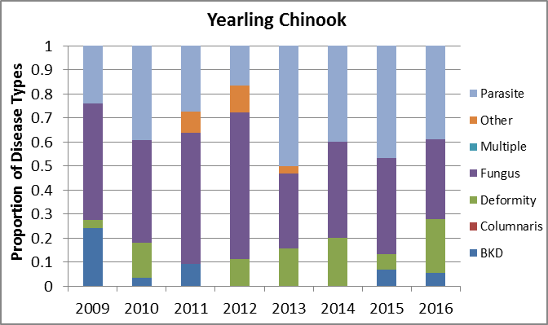
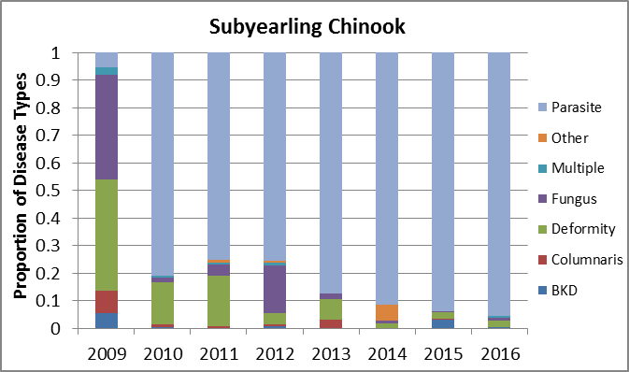
Noteworthy Events:
Disease Types – Mid-Columbia
Types appear less species/timing specific
Spring: parasites, fungus, and deformity most common
Summer: parasite is most common

Slide 30
Noteworthy Events:
Disease Types
Columnaris much more prevalent among Snake River subyearlings than Mid-Columbia subyearlings
Lower Granite Dam
McNary Dam

Slide 31
Noteworthy Events:
LMN SORs for Sockeye Passage
On May 13th, salmon managers submitted two SORs for spill operations at LMN
SORs requested spill at LMN to switch from bulk pattern to flat pattern to increase spillway passage of juvenile sockeye
SORs differed in the requested duration of the operation and justification
Flat spill provided at LMN from May 13-June 3

Slide 32
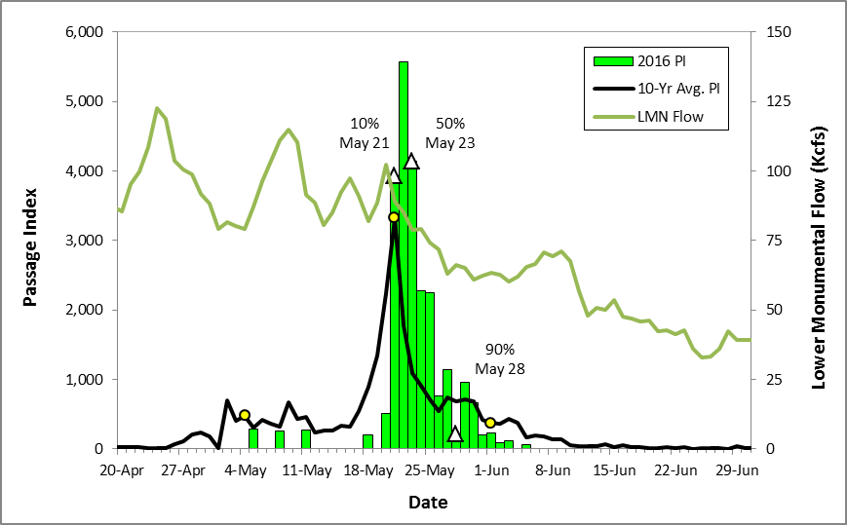
Noteworthy Events:
LMN SORs for Sockeye Passage
1st PIT detection
Apr. 25 (Wild)
Last PIT
detection
June 19
Notes:
Termination date was based on PIT-tag detections. For comparisons, PIT-timing added to plots (red dots)

