Slide 1

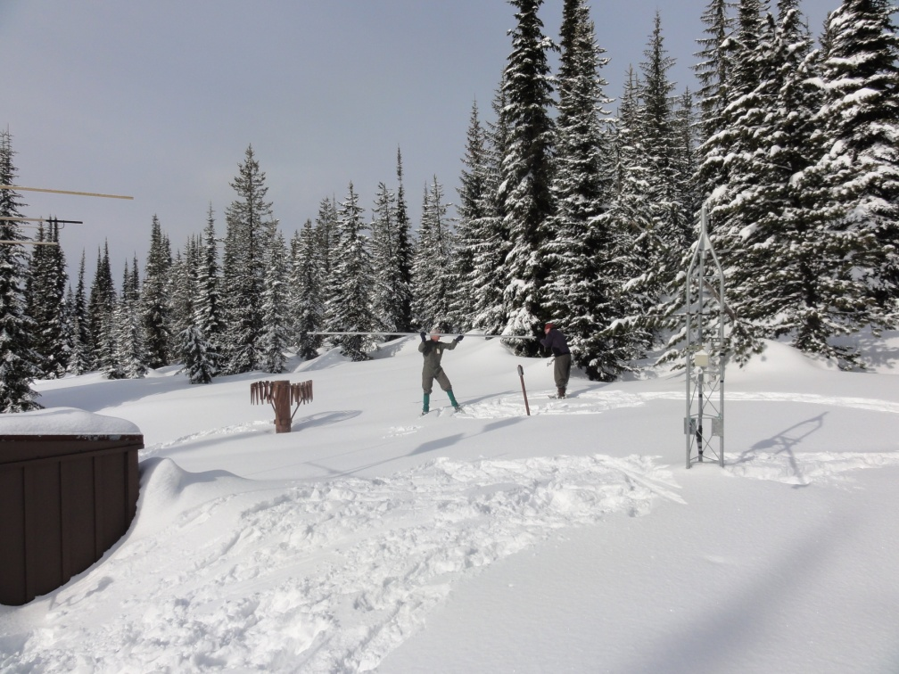



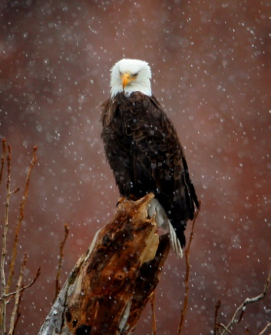
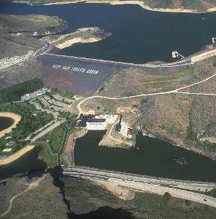
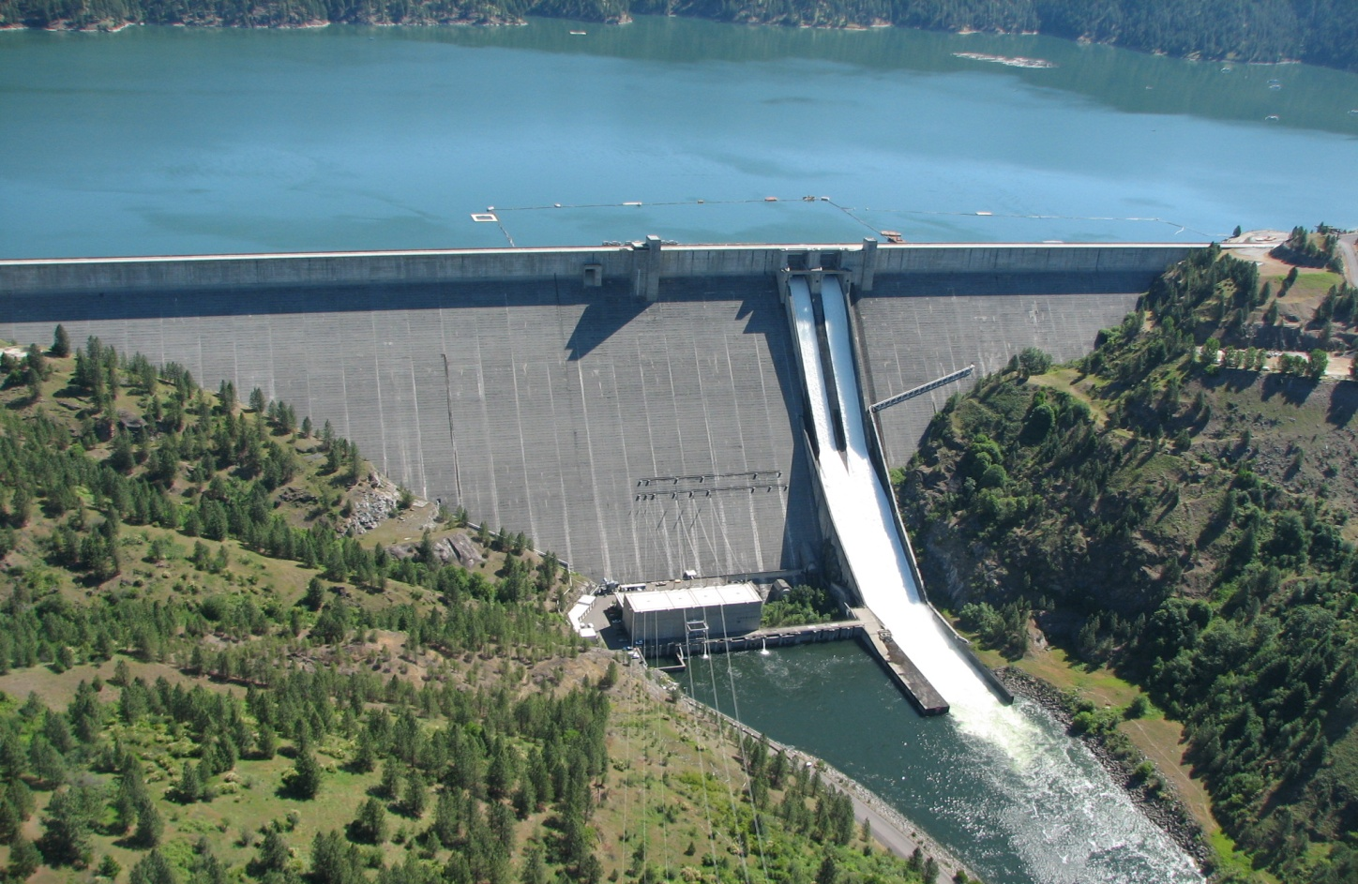
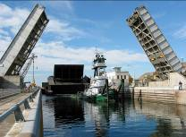

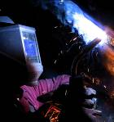
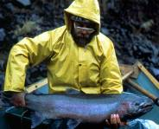

Dworshak Reservoir Regulation
Water Year 2016
Stephen Hall P.E.
Water Management Program Manager
Walla Walla District
December 7th, 2016
US Army Corps of Engineers
BUILDING STRONG®

Slide 2
Dworshak Operations Review
Water Supply Forecast
BiOp Operations
Flood Control Space Shift to Grand Coulee & Spring Flow Augmentation
Final Refill & Temperature Augmentation
Summer Temperature Operations
Total Dissolved Gas Operations

Slide 3
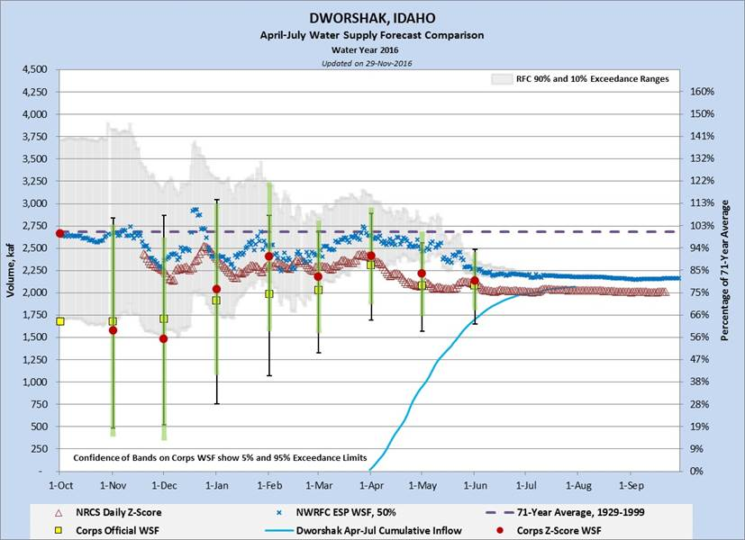

Slide 5
BiOp 1535 ft.

Slide 7
Temperature Augmentation Started on June 28th

Slide 10
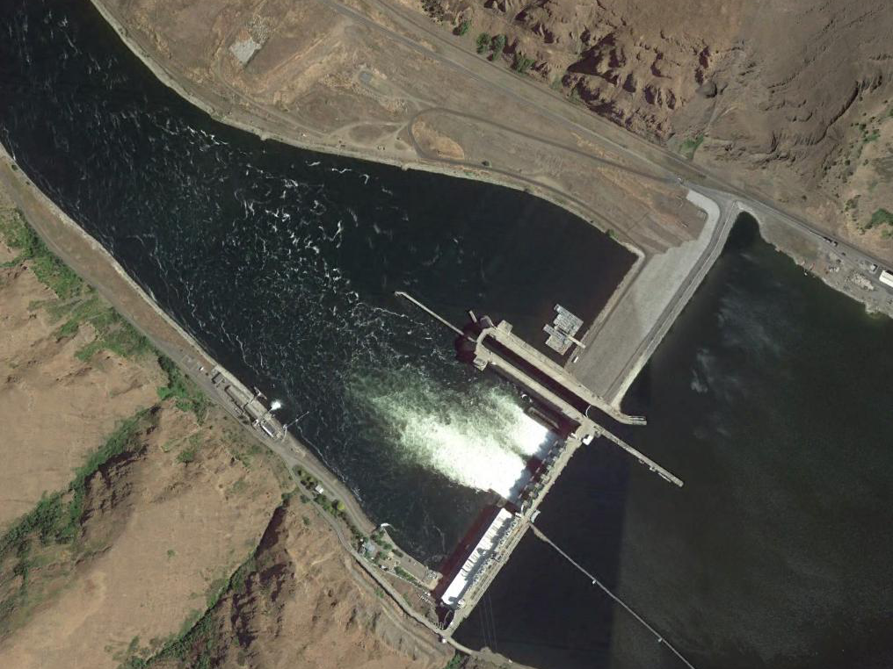

LOWER GRANITE LOCK & DAM
LGNW
TDG STATION
THERMISTER STRING
> 68.0
66.0 - 68.0
65.0 - 66.0
60.0 - 65.0
< 60.0

Slide 11
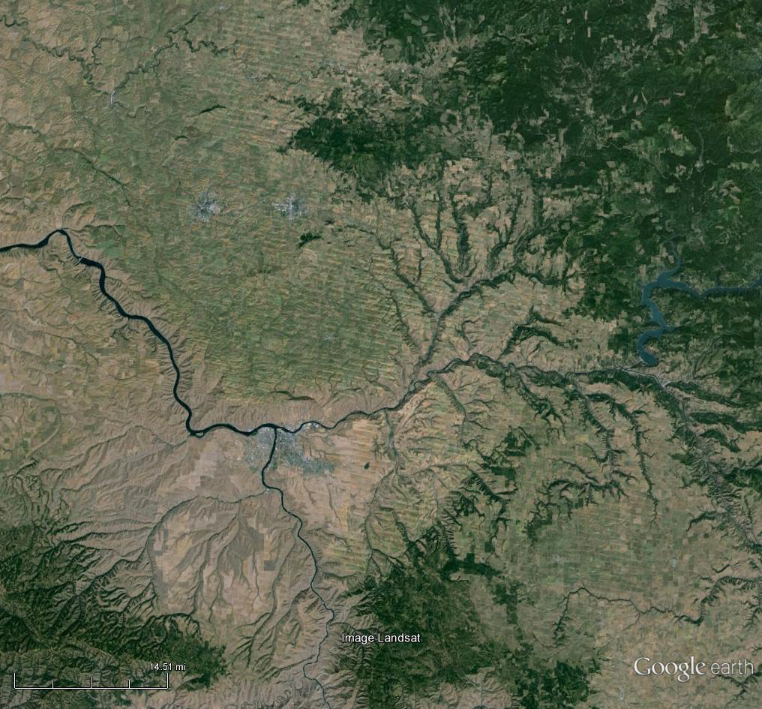
DATA COLLECTION STATIONS USED IN MODELING
SNAKE RIVER BELOW LOWER GRANITE (LNGW)
LOWER GRANITE LOCK & DAM
SILCOTT ISLAND WEATHER
CLEARWATER AT PECK (PEKI)
DWORSHAK DAM
CLEARWATER AT OROFINO (ORFI)
LEWISTON AIRPORT WEATHER
SNAKE RIVER AT ANATONE (ANAW & ANQW)

Slide 27
1565.0
QUESTIONS ????

