Slide 1
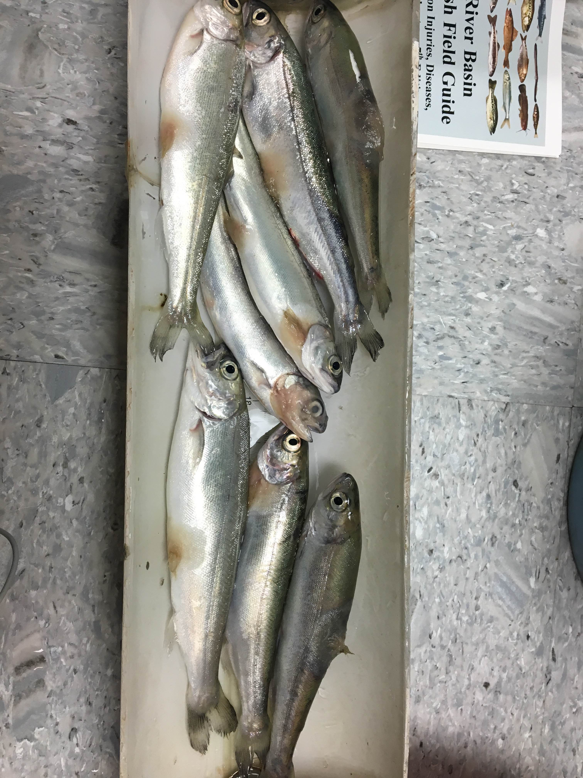
Snake River Sockeye Salmon
2015 & 2016 Smolt Condition Issues

Slide 2
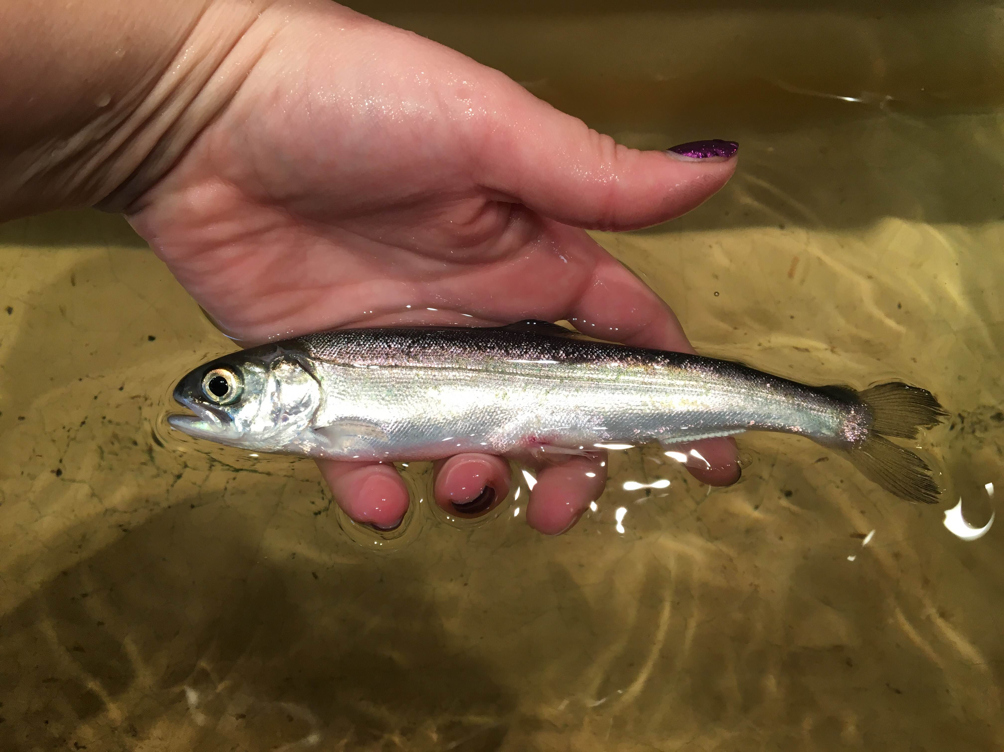
In 2015 believed TDG to be primary cause

Slide 3
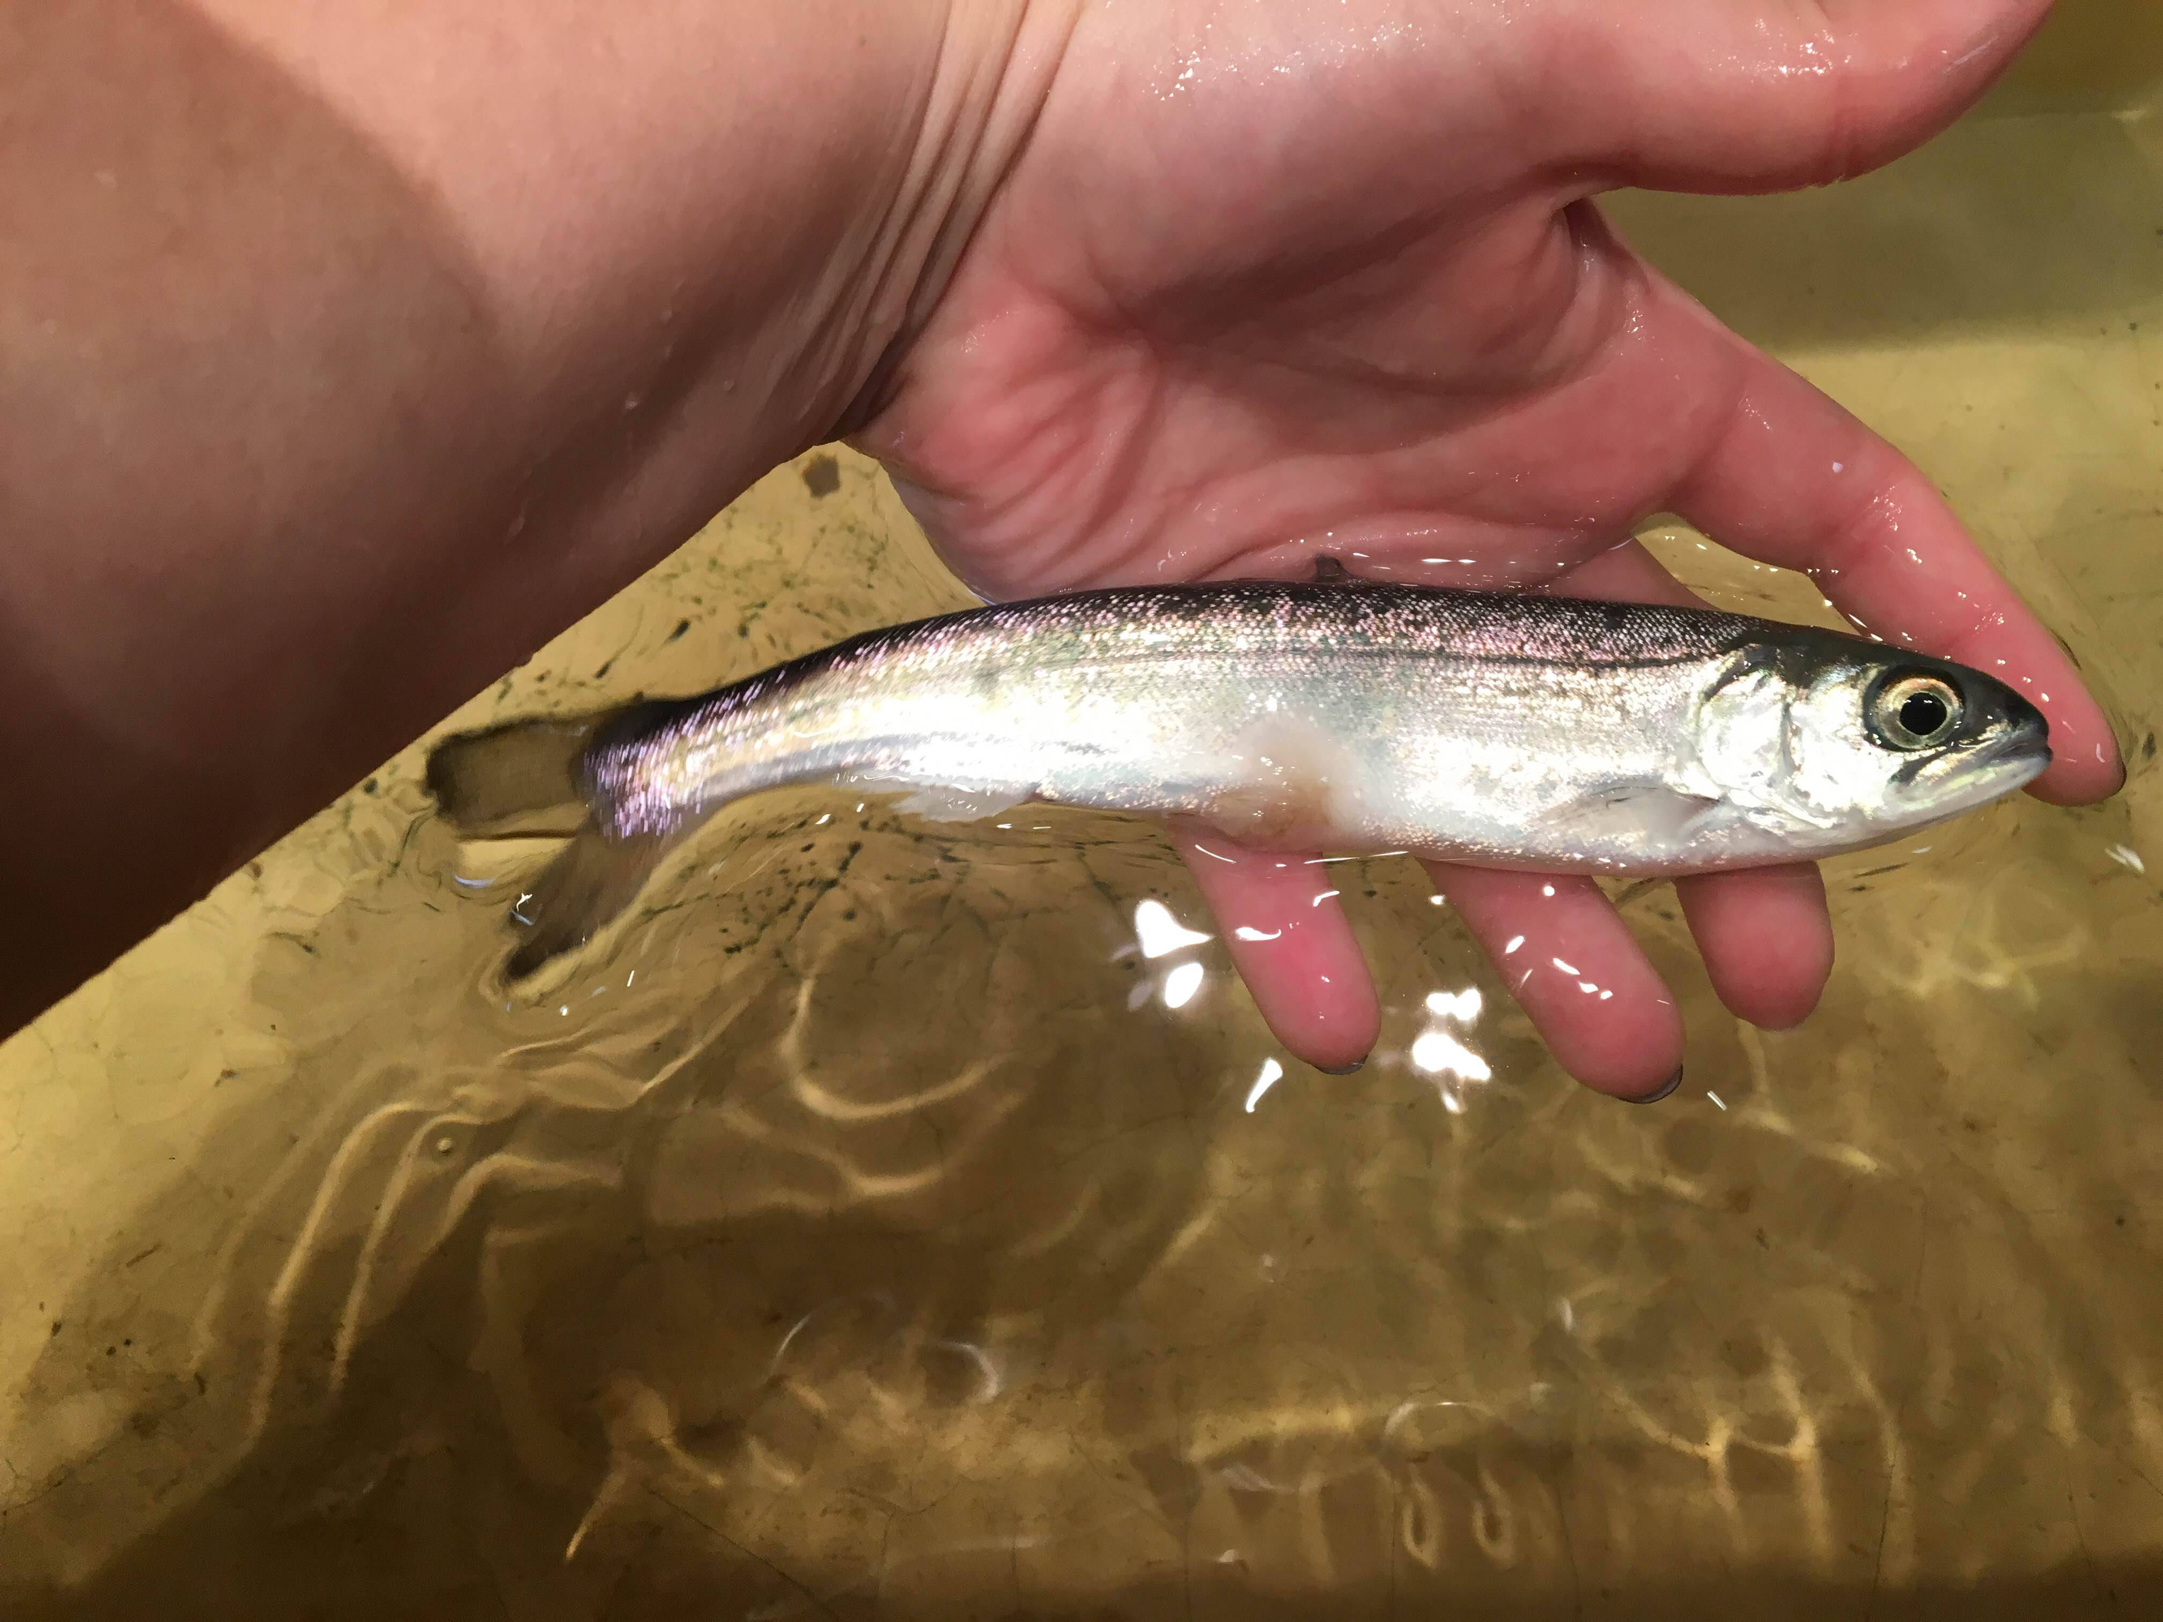
In 2016 problems persisted after taking TDG actions

Slide 4
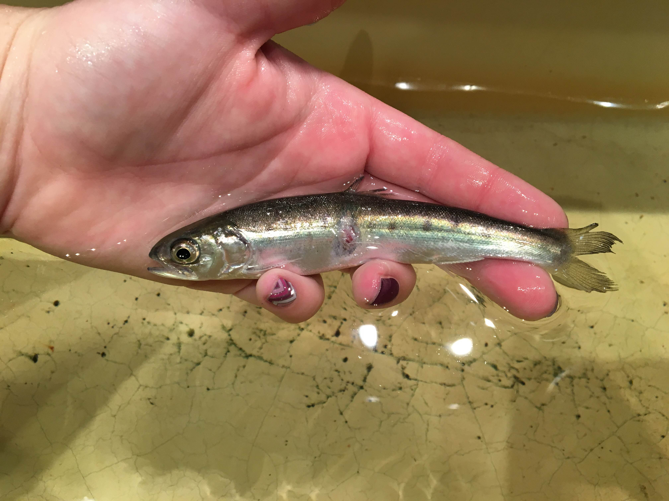
2017 Plans to Address
Purchased 6” Fish Pump to Replace 4” Fish Pump
Smolts will be Transported in late April instead of early May
Additional TDG Measures

Slide 5
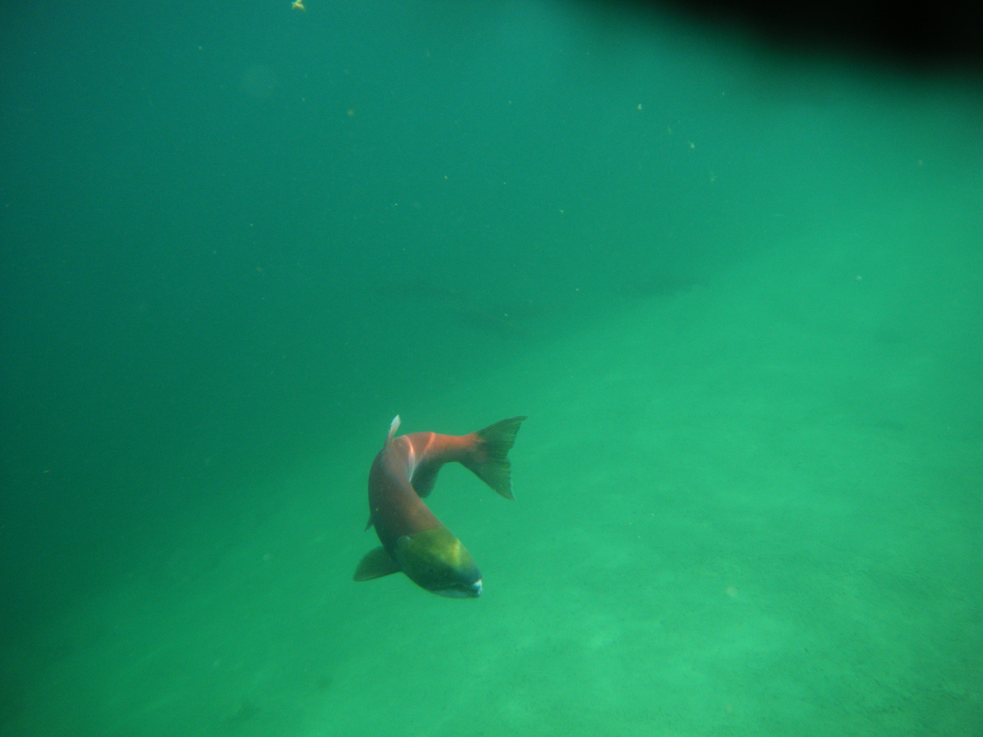
Smolt Questions ?

Slide 6
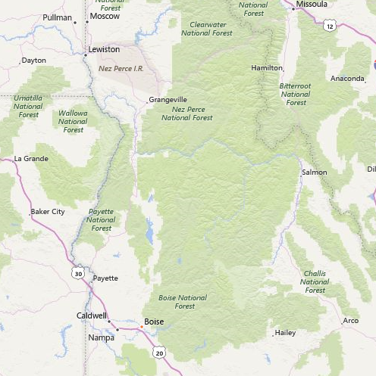
Idaho Update
LGR
LGR to RFL 460 miles
~ 6,000 ft gain
37d travel time
Temp gage @ White Bird
PIT interrogation site
near Salmon
White Bird
PIT
Array
366 mi
RFL

Slide 7
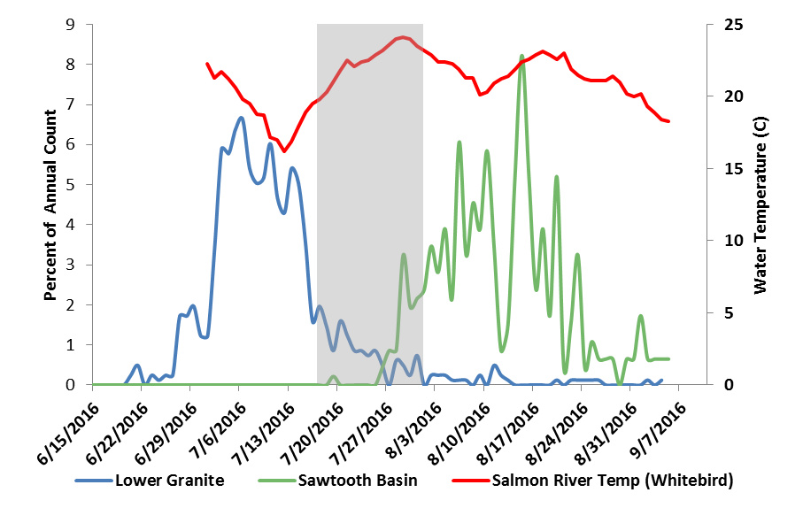
Concern with Whitebird Temperature Indicator

Slide 8
