Slide 1

Grand Coulee Operations Review – 2016
Mary Mellema
TMT Year End Review 2016

Slide 2
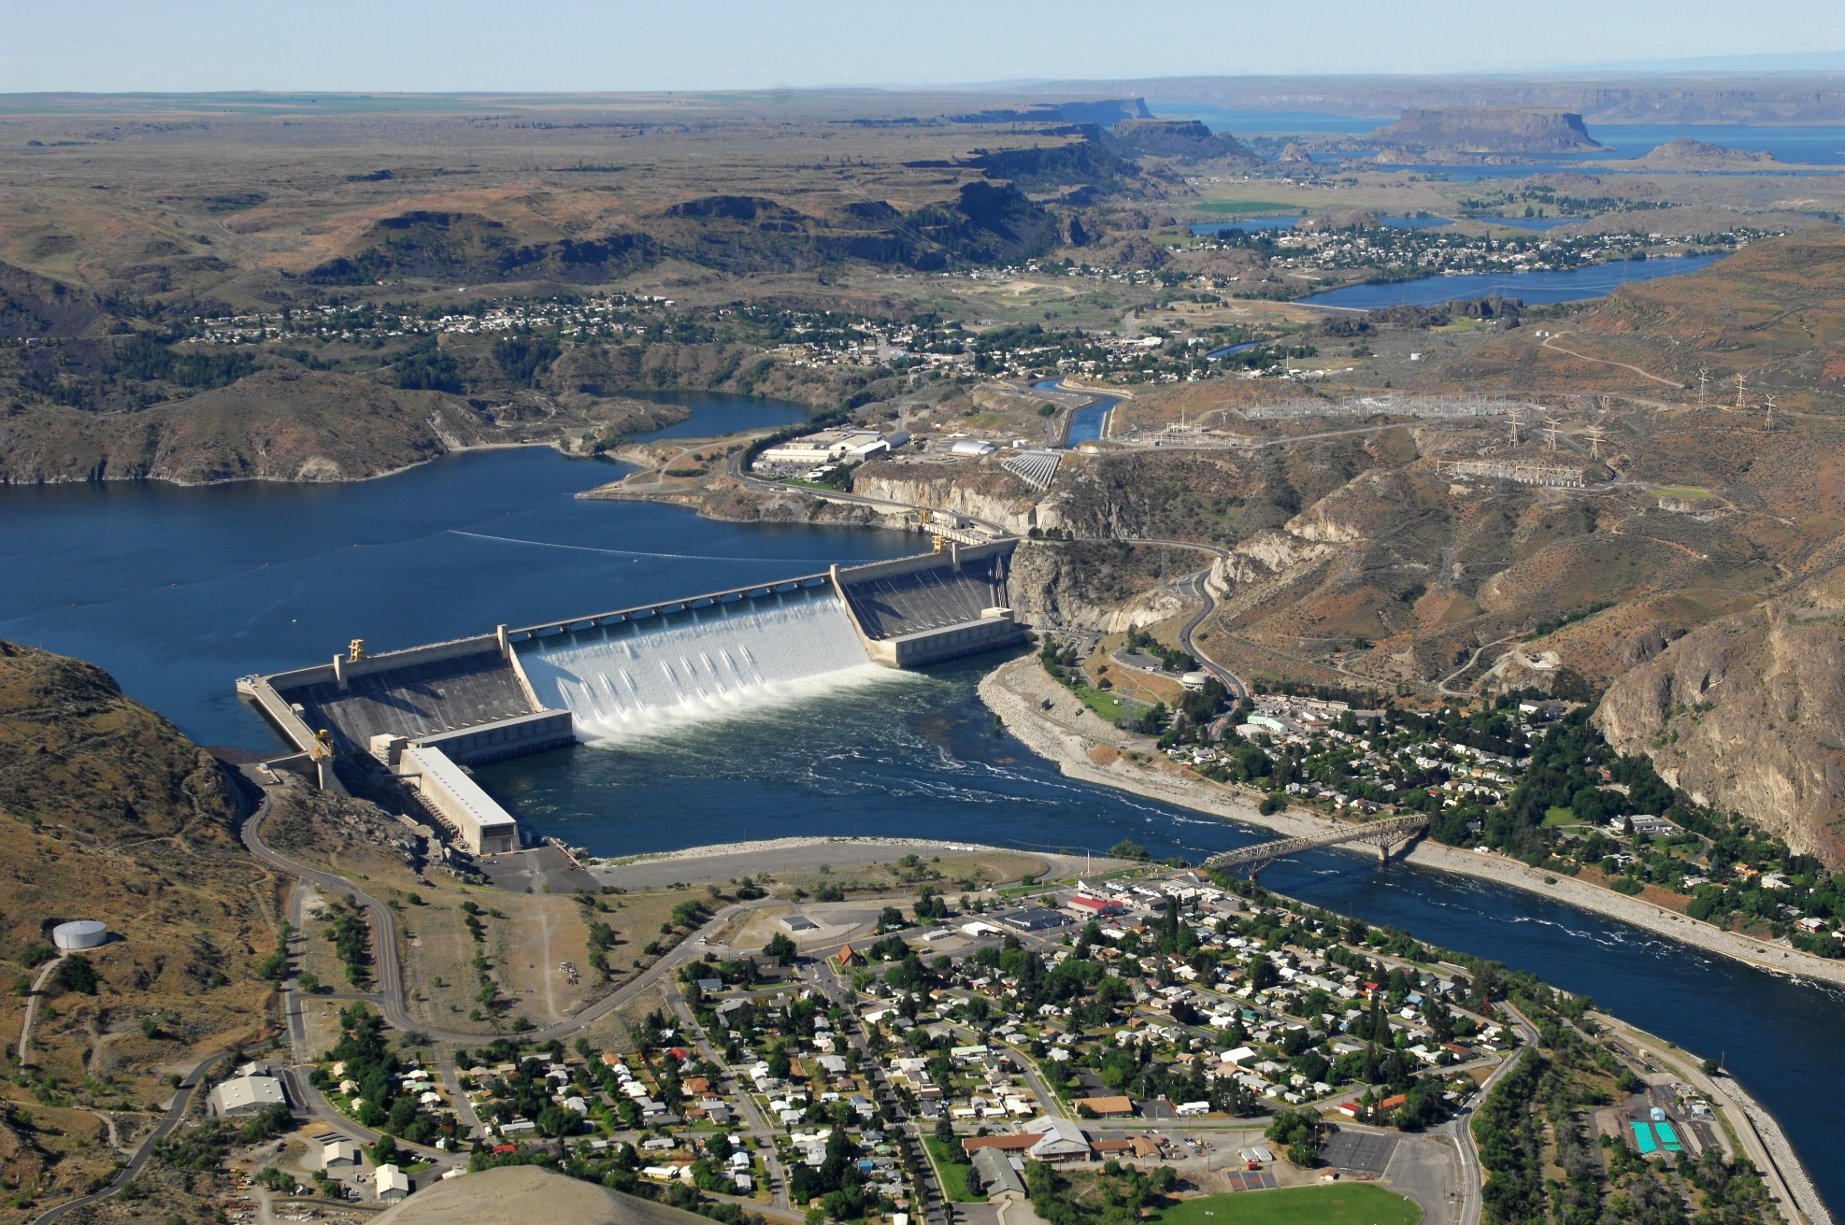

Slide 3
Water Supply Forecasts and Flood Control Elevations
 | Jan | Feb | Mar | Apr | May | Jun | Jul
The Dalles Apr-Aug forecast (% of average) | 94 | 95 | 99 | 99 | 99 | 93 | 91
Grand Coulee Apr 30 flood control elevation (feet) | 1254.6 | 1253.6 | 1244.6 | 1243.8

Slide 4
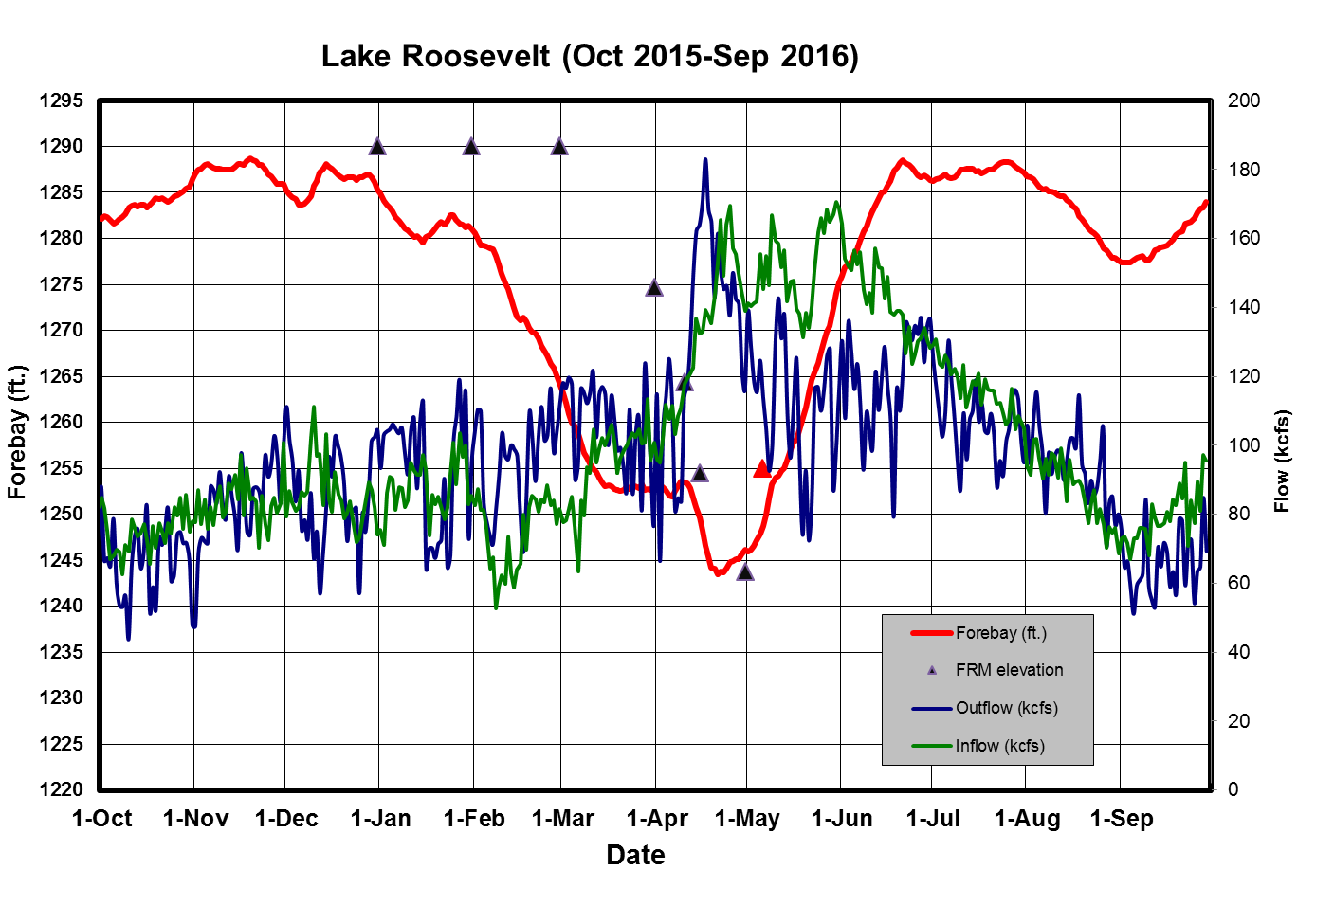

Slide 5
