Slide 1

Smolt Survival and Travel Time & Transportation Analyses Update with 2016 Data
Northwest Fisheries Science Center
Technical Management Team
2016 Year-End Review
Steven G. Smith
December 7, 2016

Slide 2
Outline
Summary of migration conditions, travel time and survival of PIT-tagged smolts through the hydropower system in 2016
September 26 Memo; Draft report to BPA in prep
Only those fish left to migrate in-river
Only juvenile data, not survival to adult

Slide 3
2016 Spring Conditions
Above average flow early, tailed off
Average spill percentage
Water warmer than average (1-1.5º C throughout)
Short travel times (high migration rate) in April
Small percentage (<25%) transported

Slide 4
2016 Spring Survival
Chinook survival from hatchery to LGR above 70% third year in a row
Reach-by-reach mix of higher and lower than average
Overall hydrosystem survival about 3-4% lower than average for both species
Deficit in lower Columbia for both species

Slide 5
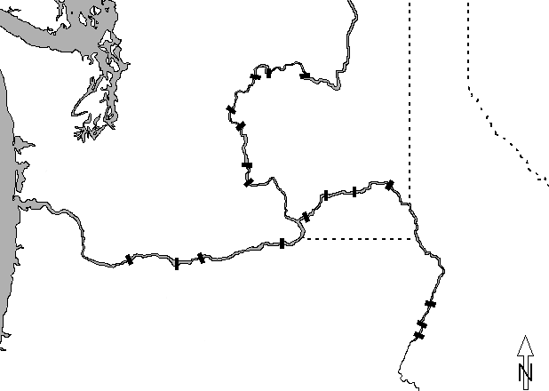


PIT-tag Data Sources
Chief Joseph
Hatchery
Releases
Wells
Grand Coulee
Rocky Reach
Rock Island
Wanapum
Ice Harbor
Priest Rapids
Snake R. trap
Juvenile detectors
Lower Granite
Little Goose
Hatchery &
Trap Releases
PIT tag
trawl
Lower Monumental
McNary
Bonneville
John Day
The Dalles
Hells Canyon
Oxbow
Brownlee
Notes:
Map etc.

Slide 14

Yearling
Chinook salmon
reach survival
LGS
LWG
LMO
SRT
IHR
93.3 (90.6)
93.4 (93.3)
BON
TDA
JDA
MCN
2016
87.1
79.6
87.2
91.2
95.6
93.6
BON
JDA
MCN
LMO
LGS
LWG
SRT
Mean 02-16
82.4
88.3
87.1
94.2
92.9
93.6
Notes:
Source: for most recent year: Table 25 of Report (Table 16 for LMO-ICE, ICE-MCN)
For average: sgs’s “Clean S” spreadsheet – averages for 2002-2011

Slide 15
Steelhead
reach survival
LGS
LWG
LMO
SRT
IHR
84.2 (89.7)
90.2 (88.1)
BON
TDA
JDA
MCN
2016
70.9
92.7
81.3
91.8
99.0
99.8
BON
JDA
MCN
LMO
LGS
LWG
SRT
Mean 02-16
81.2
85.1
77.9
91.4
93.1
96.9
Notes:
Source: for most recent year: Table 25 of Report (Table 16 for LMO-ICE, ICE-MCN)
For average: sgs’s “Clean S” spreadsheet – averages for 2002-2011

Slide 20
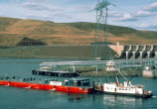

Slide 23
Smolt Transportation Seasonal Analyses
Yearling Chinook & Steelhead
Migration Years 2011-2014
Updated with adult returns through Nov 17, 2016
Added smolt migration year 2014
New accounting (“adult currency”)

Slide 24
Estimating Patterns of SAR vs. Date
Need a “time-stamp” – date of passage/detection
These analyses use fish that entered JBS at Lower Granite Dam
tagged upstream or at the dam
either transported (T) or bypassed (B or “C1”)
can adjust “standards” based on observed C0 > C1

Slide 29
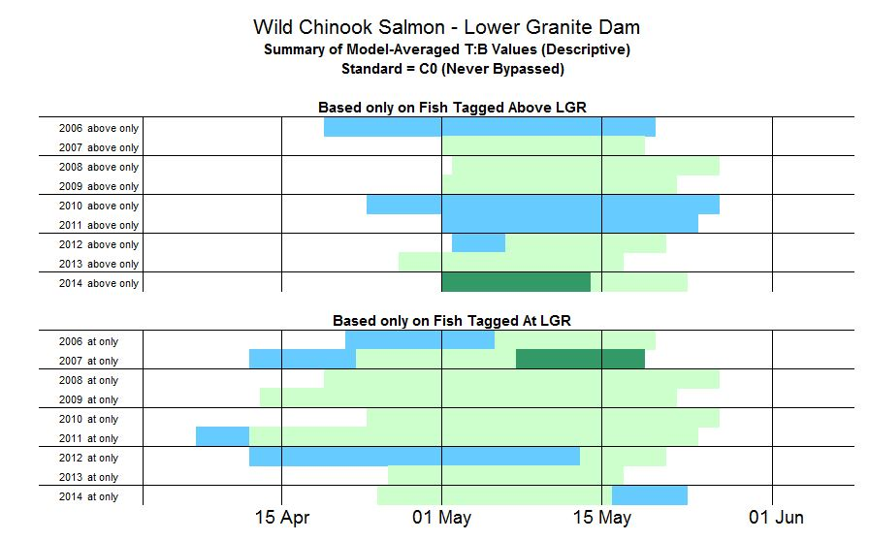

Slide 30
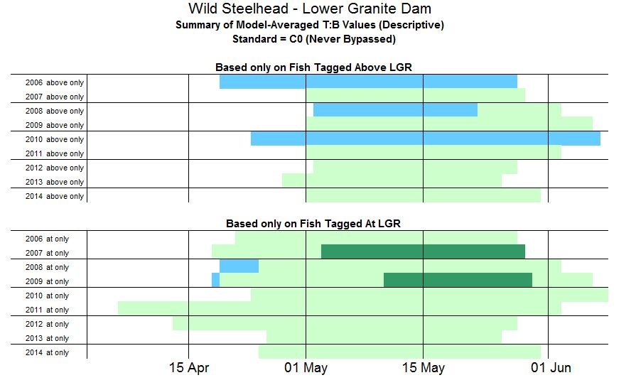

Slide 31
“Adult Currency”
What do all these percentages and ratios of percentages mean
in terms of numbers of returning adults?

Slide 32
Data Sources for “Adult Currency”
Smolt Monitoring Program – “Collection Count”
Estimate of the number of fish (tagged + untagged) in the JBS
(Wild and hatchery steelhead not counted separately)
Daily detection probability estimates from PIT tags
- Estimate of the proportion of all passing fish that entered JBS
Model-Averaged estimates of SARs for transported and bypassed

Slide 33
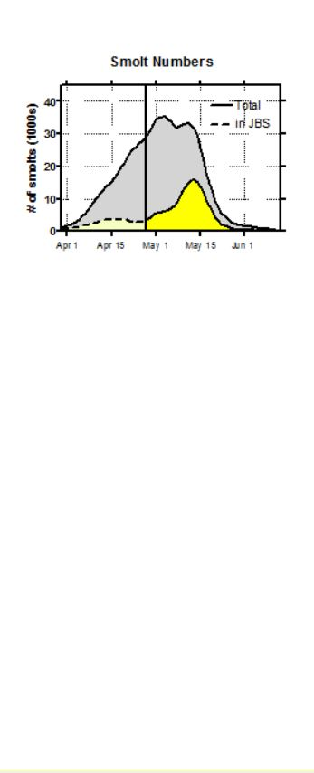
Total arrived at LGR = 1.12 million
Total entered JBS during transport ops = 234,000

Slide 34
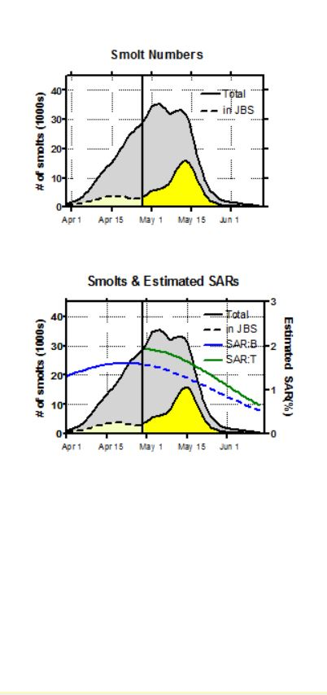
Total arrived at LGR = 1.12 million
Total entered JBS during transport ops = 234,000

Slide 35
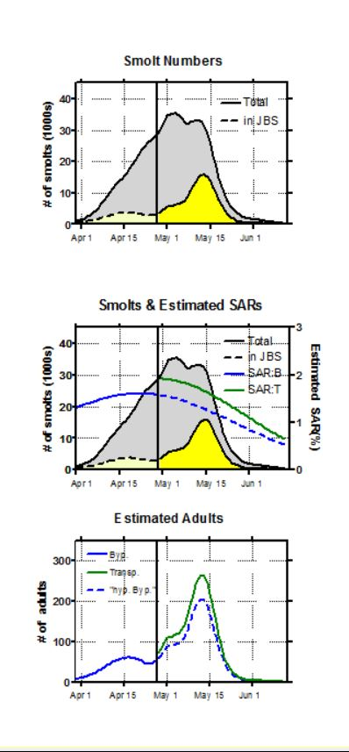
Total arrived at LGR = 1.12 million
Total entered JBS during transport ops = 234,000
Total adults from bypassed smolts in April = 1,170
Total adults from transported smolts in May = 3,985
“Hypothetical” adults if smolts in JBS in May
had been bypassed = 3,105

Slide 36
“Adult Currency” – Transported vs. Bypassed
Assumptions
Bypass percentages and SARs estimated from PIT-tagged fish apply to untagged fish
Spill levels and Transportation start date stay the same (not trying to model these!)
SARs during transport period would not change with different mixture of transported and bypassed fish
15% of total steelhead passage is wild
Everything estimated with no error
(i.e., haven’t yet done the work to characterize error in estimation)
“Conservative” modeling effort

Slide 37
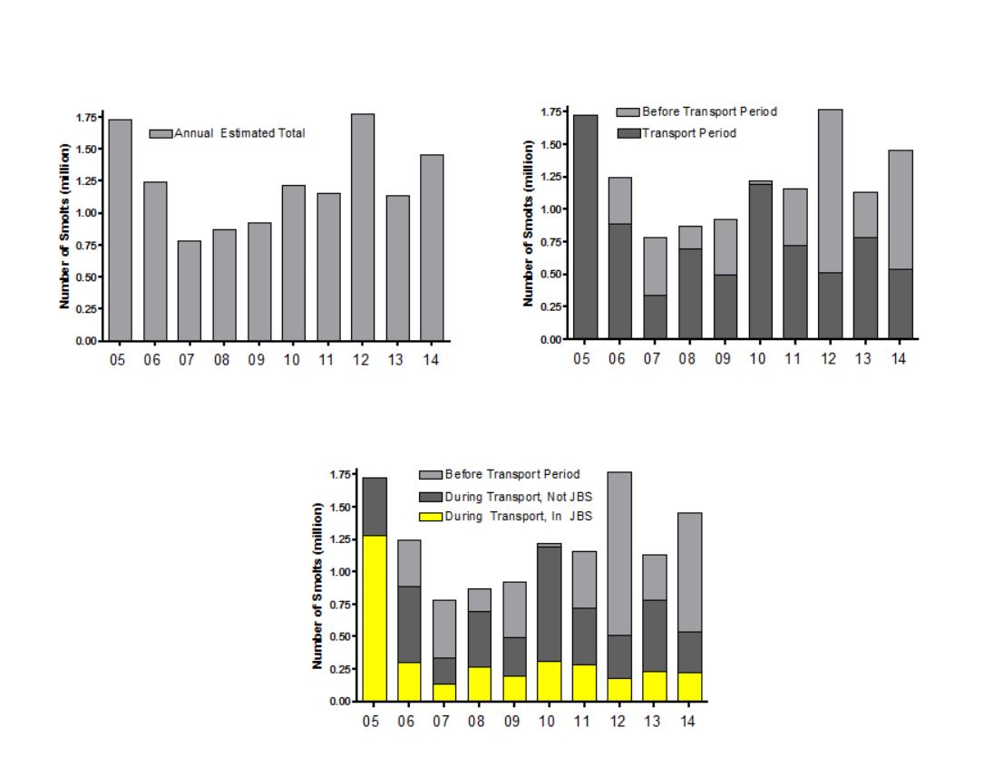
Wild Chinook - Smolts

Slide 38
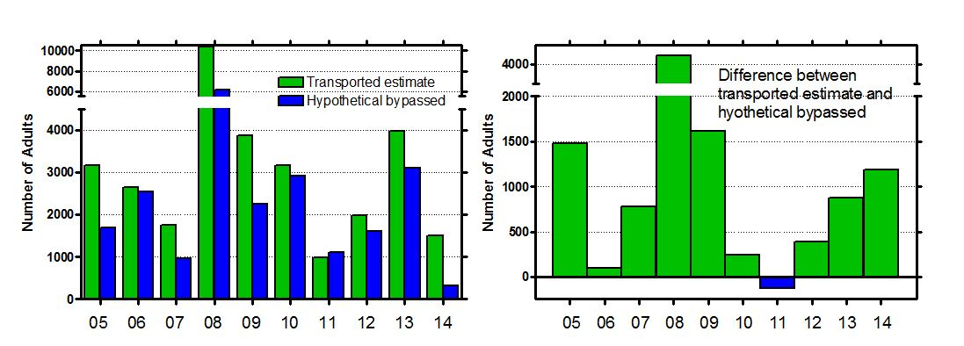
“Adult Currency” – Transported vs. Bypassed Wild Chinook – Lower Granite Dam Mean difference for LGR = 1,033

Slide 39
“Adult Currency” – Transported vs. Bypassed Wild Chinook – Lower Granite Dam Mean difference for LGR = 1,033 Still to come: estimates for Little Goose, Lower Monumental

Slide 40
“Adult Currency” – Transported vs. Bypassed Wild Chinook – Lower Granite Dam Mean difference for LGR = 1,033 Still to come: estimates for Little Goose, Lower Monumental
Mean difference for Hatchery Chinook from Lower Granite Dam = 5,951

Slide 41
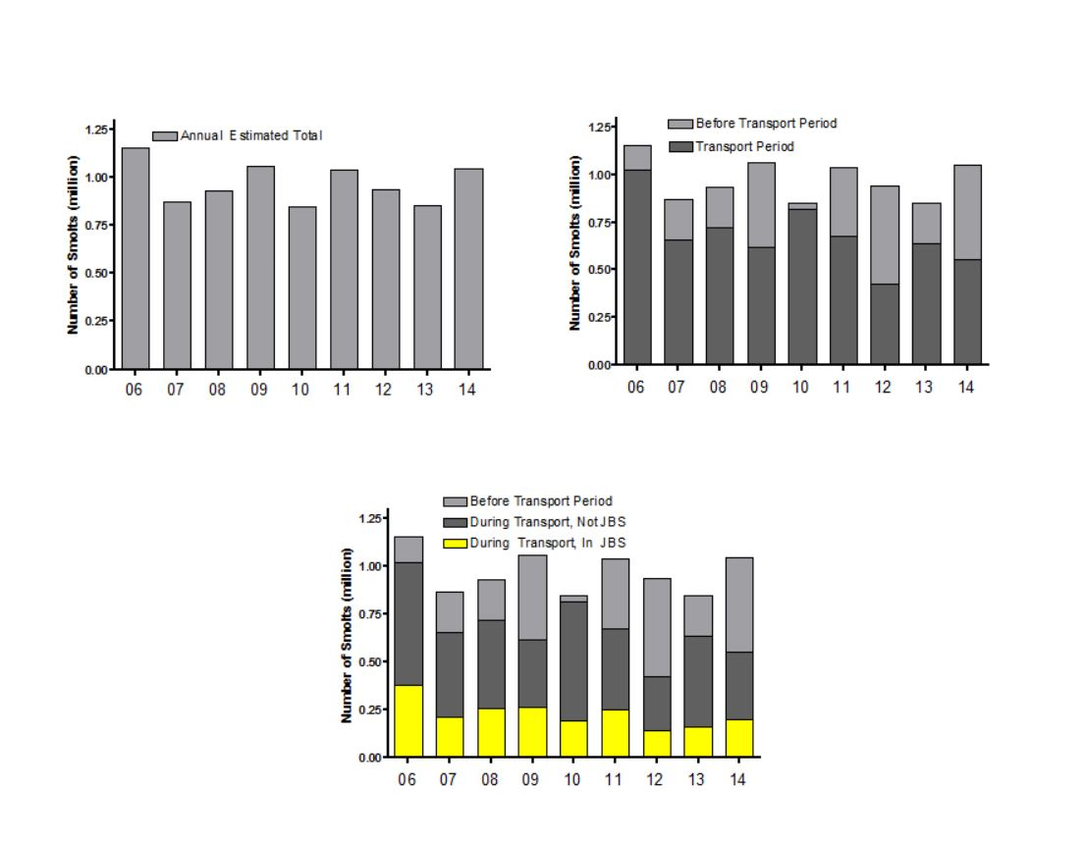
Wild Steelhead - Smolts

Slide 42
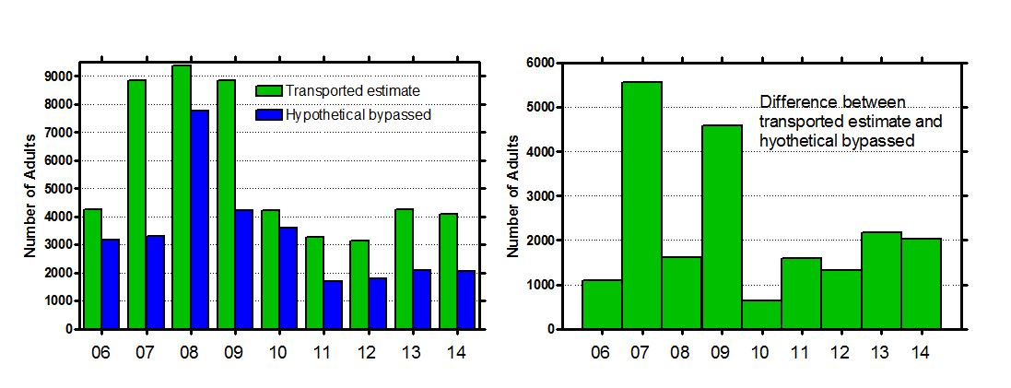
“Adult Currency” – Transported vs. Bypassed Wild Steelhead – Lower Granite Dam Mean difference for LGR = 2,288

Slide 43
“Adult Currency” – Transported vs. Bypassed Wild Steelhead – Lower Granite Dam Mean difference for LGR = 2,288
Mean difference for Hatchery Steelhead from Lower Granite Dam = 7,080

Slide 44
Smolt Transportation Seasonal Analyses
Subyearling Fall Chinook Salmon
Study in Migration Years 2006, 2008-2012
Adults complete except for handful of 5-oceans expected in 2017
Draft report IMMINENT

Slide 45
Types of fall Chinook salmon
Natural
- Not enough of these to conduct a transportation evaluation
Hatchery production subyearlings
Hatchery production yearlings
Released in early April, pass dams before spring transportation program begins.
Hatchery-reared surrogates for natural fish
Lyons Ferry fish specially reared at Irrigon and Dworshak NFH etc.

Slide 46
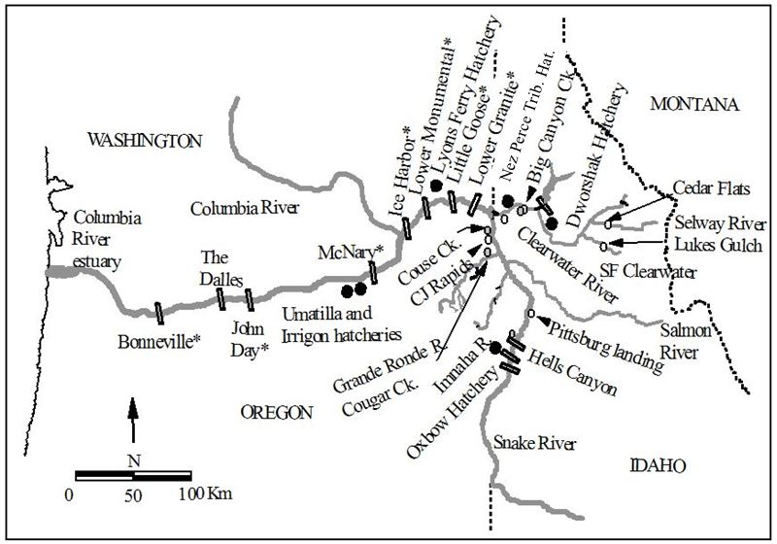

Slide 50
Summary of T:B analyses by dam
Seasonal tendencies for surrogate subyearlings:
Migrate throughout summer and into fall and winter (esp. Clearwater releases)
SAR for bypassed fish increases from earliest to latest
SAR for Transported fish also increases, but has a peak around September 1
Early-arriving minority have higher SAR if Bypassed, all others if Transported
Switch occurs early-to-mid July

Slide 54
Summary of T:B analyses by dam
Seasonal tendencies for production subyearlings:
Migrate mostly in June, a minority into July
Late-arriving minority have higher SAR if Transported, all others if Bypassed
Switch occurs mid-to-late June

Slide 55
Smolt Transportation Analyses
Sockeye Salmon
Migration Years 2009-2014
Return Years 2011-2016
Annual Returns to Bonneville, McNary, and Lower Granite

Slide 56
Sockeye Transportation
Smolts at LGR to Adults to Bonneville Dam
Migration Year | Transported @ LGR | Bypassed @ LGR | T:B (95% bootstrap CI)
2009 | 134 / 4272 = 3.14% | 45 / 3041 = 1.49% | 2.11 (1.54 – 3.05)
2011 | 26 / 3151 = 0.83% | 24 / 8548 = 0.28% | 2.94 (1.67 – 5.24)
2012 | 80 / 6523 = 1.23% | 17 / 4334 = 0.40% | 3.10 (1.96 – 5.78)
2013 | 303 / 6047 = 5.01% | 117 / 5563 = 2.11% | 2.38 (1.94 – 2.96)
2014 | 35 / 2891 = 1.22% | 10 / 1671 = 0.61% | 2.00 (1.07 – 4.73)
Mean/ Geomean | 2.29 | 0.98 | 2.47 (2.02 – 3.21)

Slide 57
Sockeye Transportation
Smolts at LGR to Adults to Lower Granite Dam
Migration Year | Transported @ LGR | Bypassed @ LGR | T:B (95% bootstrap CI)
2009 | 84 / 4272 = 1.97% | 28 / 3041 = 0.93% | 2.13 (1.42 – 3.40)
2011 | 4 / 3151 = 0.13% | 11 / 8548 = 0.13% | 1.01 (0.20 – 2.71)
2012 | 29 / 6523 = 0.45% | 8 / 4334 = 0.19% | 2.37 (1.20 – 6.46)
2013 | 16 / 6047 = 0.27% | 13 / 5563 = 0.24% | 1.13 (0.53 – 2.56)
2014 | 13 / 2891 = 0.46% | 8 / 1671 = 0.49% | 0.93 (0.39 – 2.66)
Mean/ Geomean | 0.65 | 0.39 | 1.40 (0.91, 2.08)

Slide 58
Sockeye Transportation
Adult Conversion Rate – Bonneville To McNary
Return Year | Transported @ LGR | Bypassed @ LGR | Ratio (95% bootstrap CI)
2011 | 80 / 127 = 63.0% | 28 / 45 = 62.1% | 1.01 (0.79 – 1.35)
2013 | 16 / 34 = 47.1% | 18 / 22 = 81.3% | 0.58 (0.36 – 0.85)
2014 | 43 / 89 = 48.3% | 19 / 25 = 75.6% | 0.64 (0.47 – 0.88)
2015 | 13 / 283 = 4.6% | 30 / 110 = 27.3% | 0.17 (0.08 – 0.30)
2016 | 17 / 37 = 46.0% | 10 / 11 = 89.5% | 0.51 (0.33 – 0.75)
Mean/ Geomean | 41.8% | 57.2% | 0.50 (0.41 – 0.60)

Slide 59
Sockeye Transportation
Adult Conversion Rate – McNary to Lower Granite
Return Year | Transported @ LGR | Bypassed @ LGR | Ratio (95% bootstrap CI)
2011 | 75 / 80 = 93.6% | 28 / 28 = 98.8% | 0.95 (0.88 – 1.00)
2013 | 6 / 16 = 37.8% | 10 / 18 = 55.5% | 0.68 (0.27 – 1.40)
2014 | 41/ 43 = 95.0% | 14 / 19 = 73.3% | 1.30 (1.03 – 1.81)
2015 | 0 / 13 = 2.6% | 8 / 30 = 26.9% | 0.10 (0.06 – 0.19)
2016 | 13 / 17 = 81.7% | 8 / 10 = 79.0% | 1.03 (0.73 – 1.63)
Mean/ Geomean | 62.1% | 66.7% | 0.61 (0.48 – 0.78)

Slide 60
Questions?

