Slide 1
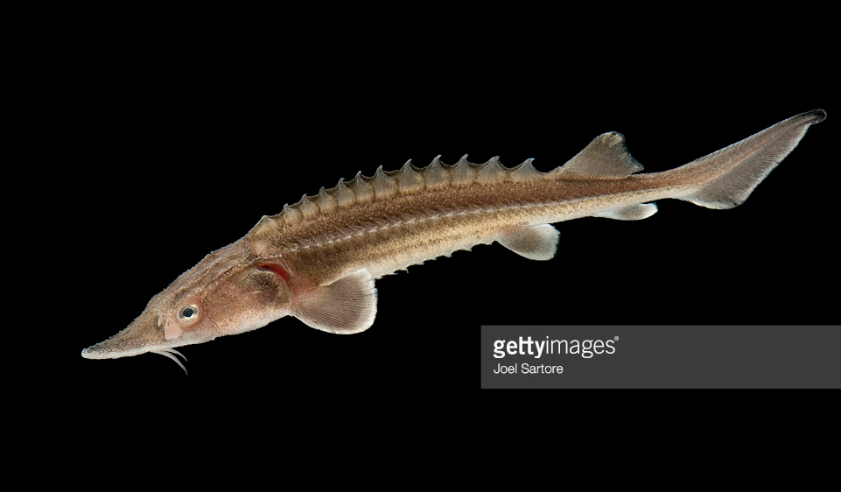
Libby Flows and Kootenai River White Sturgeon
By Pete Rust – IDFG
& Jason Flory – USFWS
Presented by: David Swank - USFWS

Slide 2
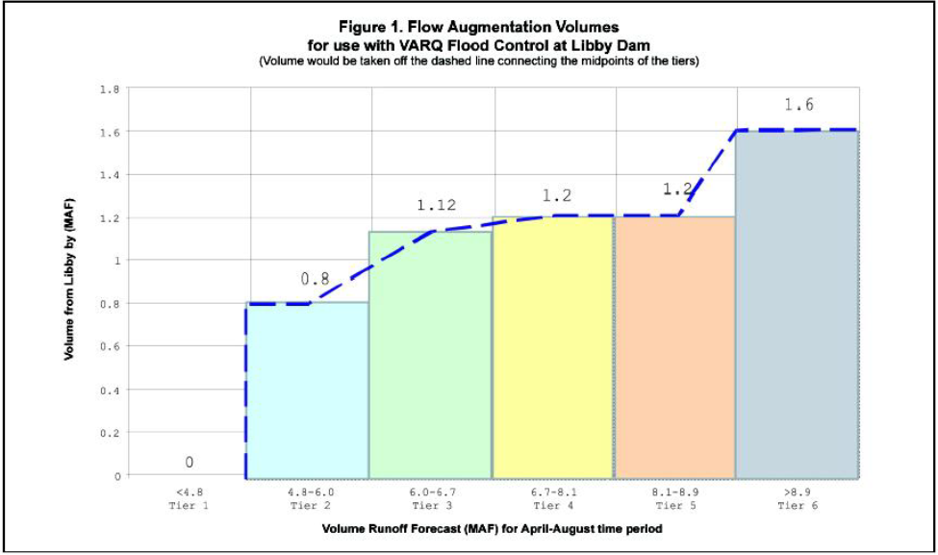
Libby Operations – 2016
May final April-August volume runoff forecast of 5.8 million acre-feet put us in a Tier 2 operations year for Kootenai River white sturgeon.
The minimum recommended release volume for sturgeon conservation in a Tier 2 year is 0.93 million acre-feet

Slide 3
Libby – Recommended Flows for 2016
• Increase discharge (according to ramping rates in the 2006 BO) from VARQ flow to 20,000 cubic feet per second (cfs) upon forecast of peak inflow into Lake Koocanusa.
• Maintain a discharge of 20,000 cfs for 2 days (“pre-peak” flow).
• Increase discharge (according to ramping rates in 2006 BO) from Libby Dam up to full powerhouse capacity, depending on local conditions, e.g. river stage at Bonners Ferry.
• Maintain peak discharge (20,000-25,000 cfs) for a period of 7-10 days.
• After 7-10 days of peak discharge, decrease discharge (according to ramping rates in 2006 BO) towards stable summer flows until the sturgeon volume is exhausted to no less than bull trout minimum flows (7,000 cfs in Tier 2).

Slide 4
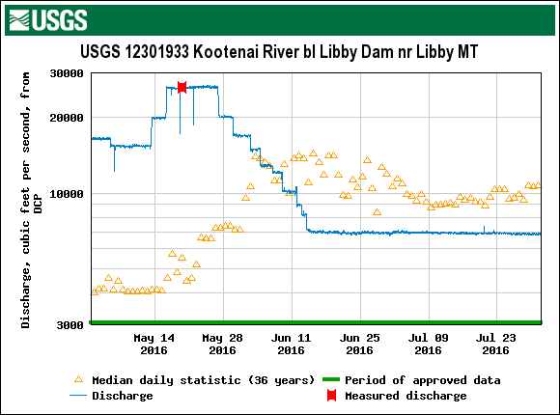
Increase discharge (according to ramping rates in 2006 BO) from Libby Dam up to full powerhouse capacity
Maintain a discharge of 20,000 cfs for 2 days
Maintain peak discharge (20,000-25,000 cfs) for a period of 7-10 days.
After 7-10 days of peak discharge, decrease discharge towards stable summer flows until the sturgeon volume is exhausted to no less than bull trout minimum flows (7,000 cfs in Tier 2).
Increase discharge to 20,000 (cfs)

Slide 5
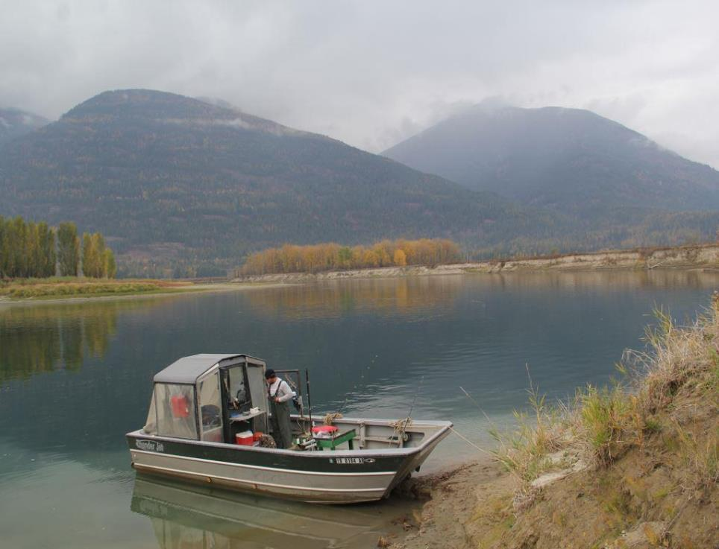

2016 Kootenai River White Sturgeon Recovery Team Update – 2015 data
Adult Capture
Spawning Occurrence
Larval Sampling
Juvenile Gillnetting

Slide 6
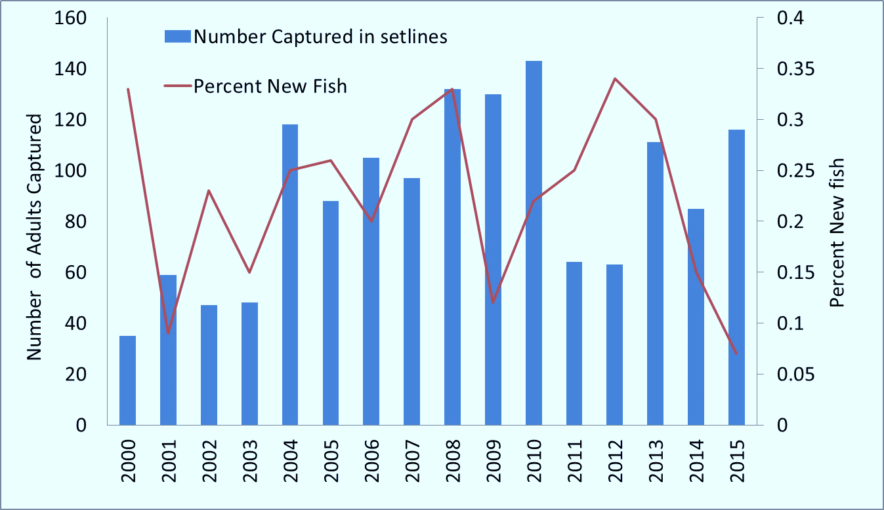
Number of Adult Sturgeon Captured (Setlines) and Percent New Adult Sturgeon Captured in (all Gear) since 2000

Slide 7
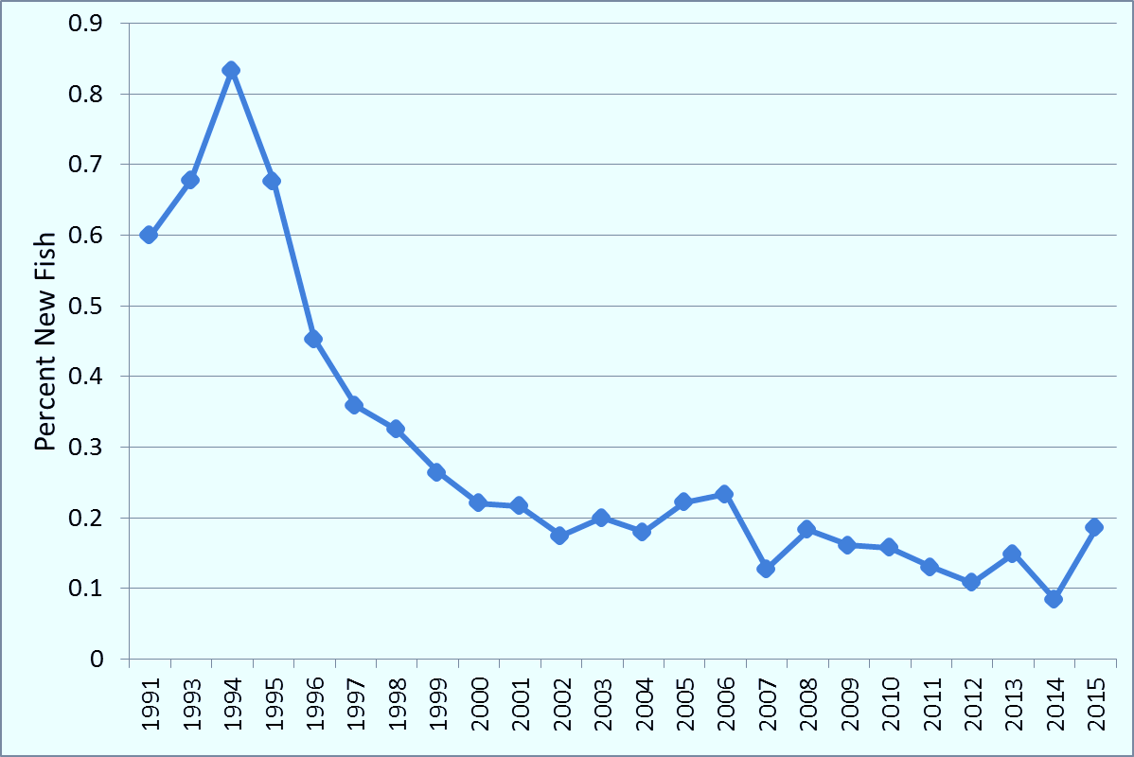
Percent New Adult Sturgeon Captured by KTOI by Angling (1991 – 2015)

Slide 8
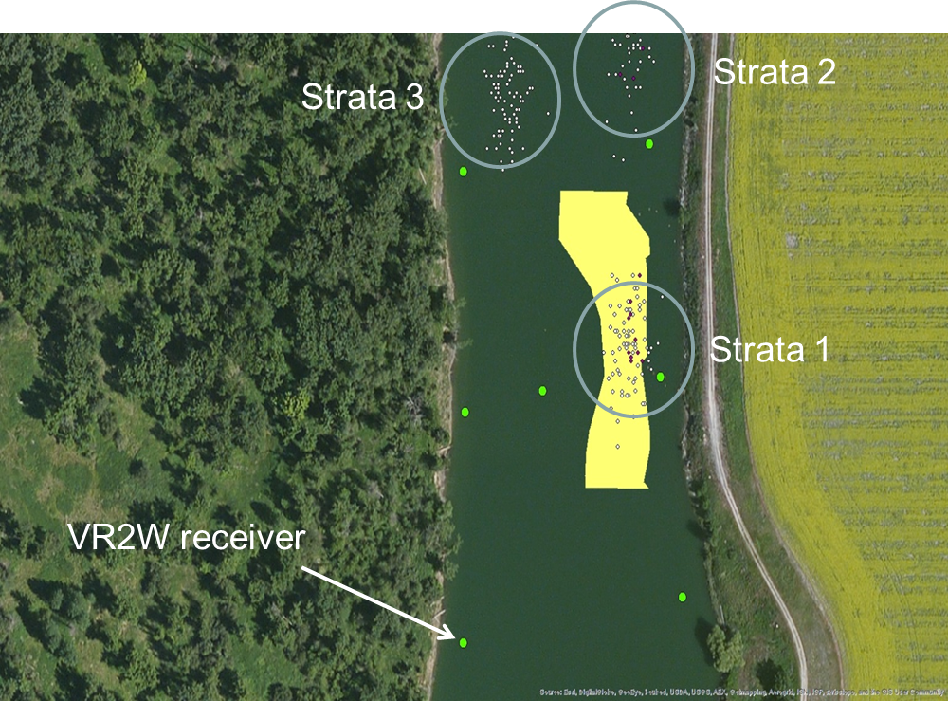
Spawning Occurrence 2015 (egg mats)
S06
S03
S05
S02
S04
S01
May 14 through July 16
3 sites – Shorty’s, Myrtle, Train Bridge
Deployed 21 mats per 3 strata (7 mats per strata) at Shorty’s and Myrtle
Deployed 10 mats at Train Bridge
Collected 317 eggs in 2014, 216 eggs in 2015

Slide 9
Larval Sampling Results 2015
Site | Sum of total time (hours) |  | Sum of water sampled (m³)
 | 2014 | 2015 | 2014 | 2015
Dates | June 17 – July 31 | June 15 – July 29
Shorty’s Island | 1,057 | 5,422 | 556,703 | 1,794,749
Myrtle Creek | 1,031 | 4,620 | 661,645 | 1,858,730
RR Bridge | 277 | 990 | 39,168 | 31,879
Grand Total | 2,366 | 11,032 | 1,257,515 | 3,685,359
Number of larval sturgeon | 3 | 0
24 hr. sets in 2015 increased effort
Good for sampling, bad for drifting or hatching?

Slide 10
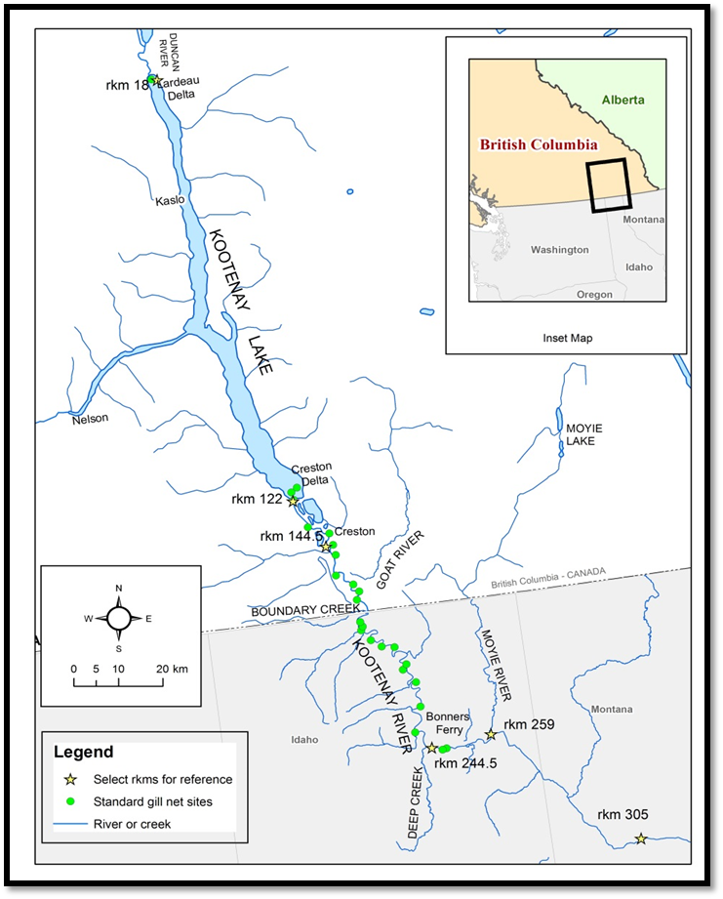
Juvenile WST Sampling with Gillnets 2015
(Idaho and British Columbia)
Standardized Methods:
July 8 through October 1
RKM 18 to 244.5
About 25 Standard Sites
Used 2, 4, and 6 inch stretch nets
Sampled 26 sites RKM 18 to 244.5
Nets fished for hour – no mortality
1,790 juveniles (9 adults >120 cm TL)
13 wild juveniles collected (8 new wild juveniles)

Slide 11
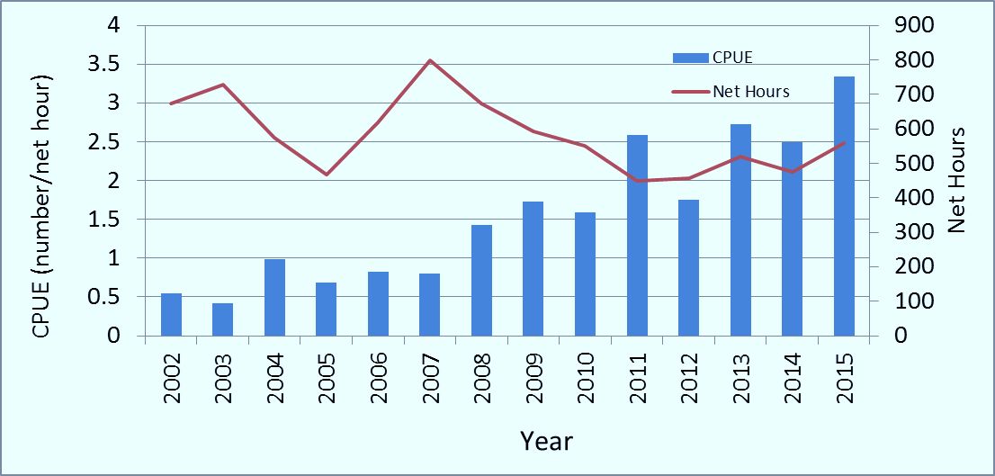
Juvenile Gillnet CPUE (No. juveniles/net hour) 2002 - 2015
CPUE increasing
Tripled since mid 2000’s
Effort consistent since 2010 (within a week)

Slide 12
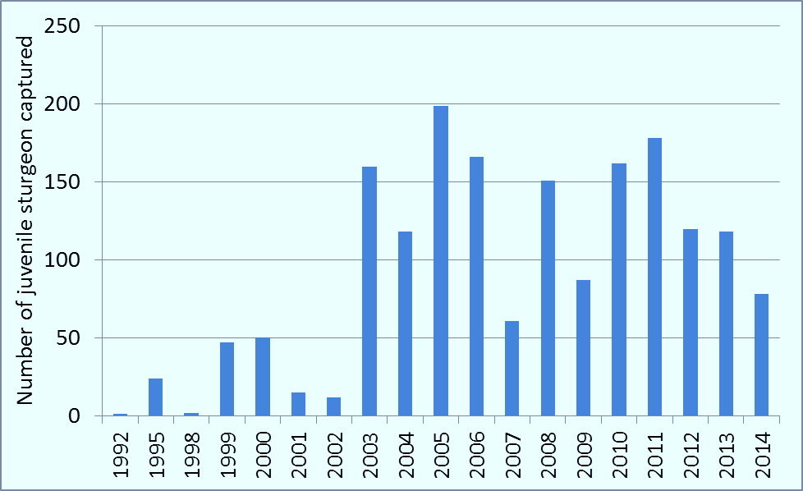
Brood Year Assignments from 2015 Juvenile Sturgeon Catch (gillnets only)
1749 total
All brood years well represented since 2003
2014 not fully recruited to gear

Slide 13
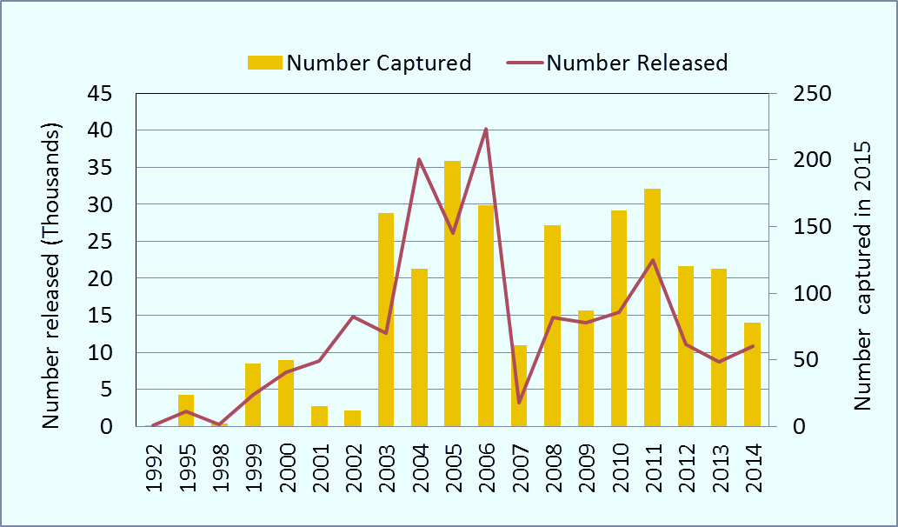
Recapture Frequency of Hatchery Released Juvenile Sturgeon in the Kootenai River in 2015
R²=0.69
Release numbers variable
Number release of a brood year correlates well with number recaptured of that brood year (in 2015)

Slide 14
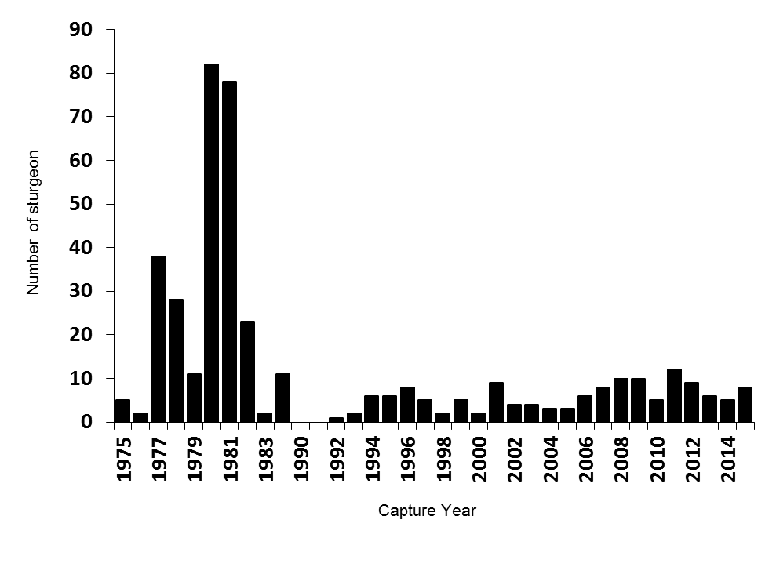
Natural Origin Juveniles
Number of wild juvenile Kootenai Sturgeon captured annually in the Kootenai River, Idaho, 1977-2015; no recaptures.

Slide 15
Natural Origin Juveniles – by year class
Number of wild juvenile Kootenai Sturgeon, by year-class, captured in the Kootenai River, Idaho 1977-2015.

Slide 16
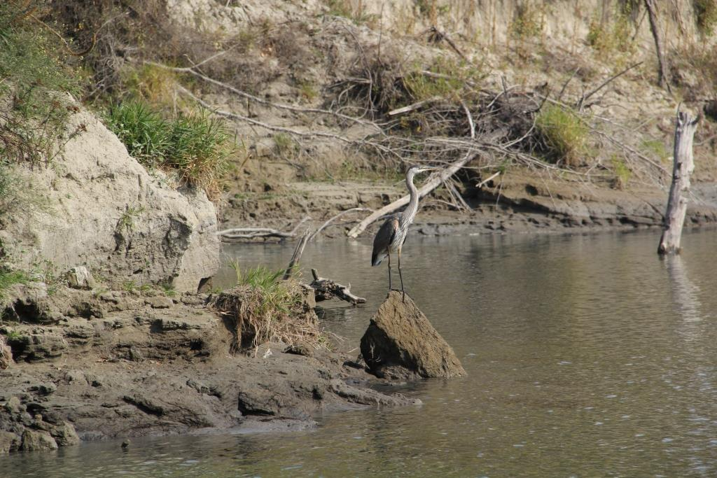








Thanks to Cooperators:
KTOI
BCMFLNRO – Sarah Stevenson
MFWP
USFWS
USACE – Greg Hoffman
Steve Dinsmore – Iowa State University
Sima Usvyatsov – Golder and Assoc.
BPA

Slide 17
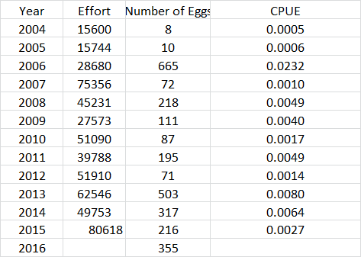

Slide 18
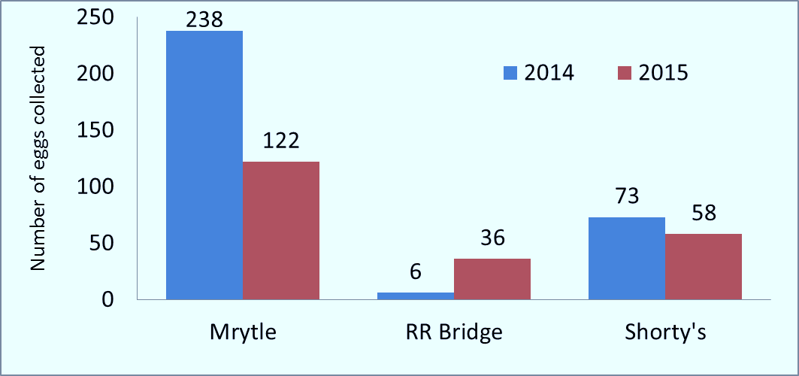
Number of eggs collected by site in 2014 and 2015
Will look for statistical differences among years among Strata with more data
Will also compare spawning events among years and Strata
Egg collections may not be a good metric for changes in use of SEPPs

Slide 19
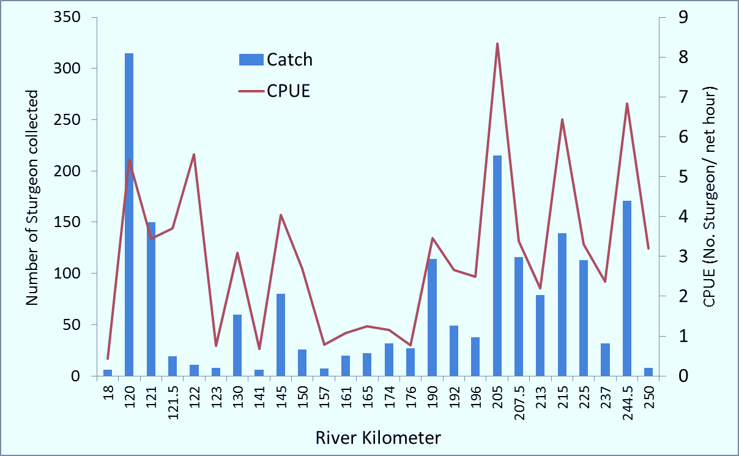
Juvenile Sturgeon Gillnet CPUE by Site (RKM) 2015
Typical sites with high catch and catch rates
Delta still highest catch
Juveniles well distributed throughout system

Slide 20
From IUCN summary
To date, the increased Kootenai River flows provided through the flow augmentation program has resulted in documented spawning each year but not survival beyond the egg stage.
the operation of Libby Dam in 1974 is considered to be a primary reason for the population’s continued decline (Apperson and Anders 1991). When Libby Dam began regulating the Kootenai River, average spring peak flows were reduced by more than 50% and winter flows increased by more than 300%.

Slide 21
In the September 6, 1994, final rule listing the Kootenai River population of white sturgeon as endangered (59 FR 45989) the Service identified the lack of natural flows in the Kootenai River below Libby Dam as the primary threat to this white sturgeon population.

