Slide 1
2017 Smolt Monitoring Program
Juvenile Passage, Fish Condition, & Gas Bubble Trauma Monitoring Data
2017 TMT Year-end Review
December 12, 2017
Brandon R. Chockley
Fish Passage Center

Slide 2
Juvenile Timing
Present 2017 timing compared to 10-year average, based on passage index
Several factors can affect juvenile timing:
  Hatchery releases (both magnitude and timing)
  Flows
  Temperatures
  Spill Volumes
  Survival to point of interest
  Sampling schedule (e.g., LGR in 2017)
Purpose of presentation is to display 2017 timing relative to 2016 and 10-year average.
  More detailed analysis would be needed to identify and explain differences

Slide 3
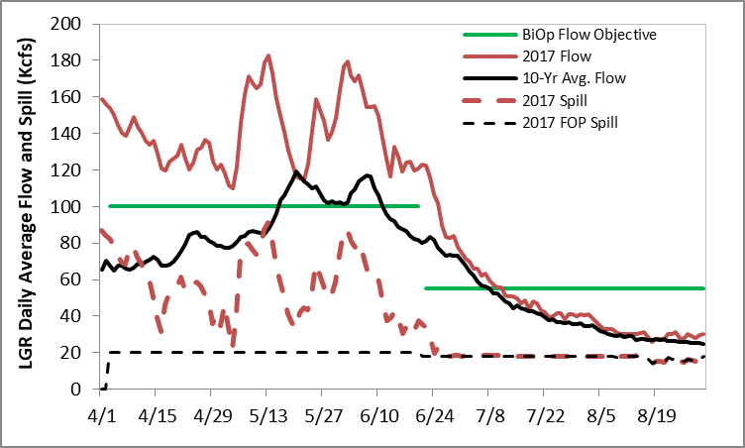
Lower Granite Dam
Snake River runoff volume (Jan-Jul) at LGR ranked 9th, over last 89 years
BiOp flow objective met in spring, not met in summer
Spill exceeded FOP for all of spring
Spill exceeded FOP for small portion of summer, otherwise FOP spill met in summer

Slide 4
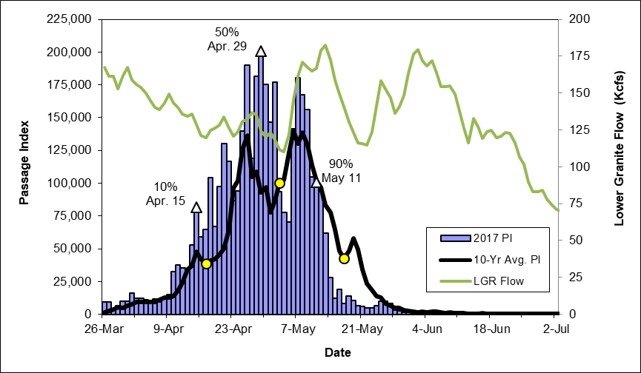
Lower Granite Dam
Yearling Chinook
Some hatchery releases earlier than usual due to DWOR operations
Collection for transportation began on May 1st, first barge on May 2nd
  Based on PI, ~56% of CH1 passed LGR prior to start of transport

Slide 5
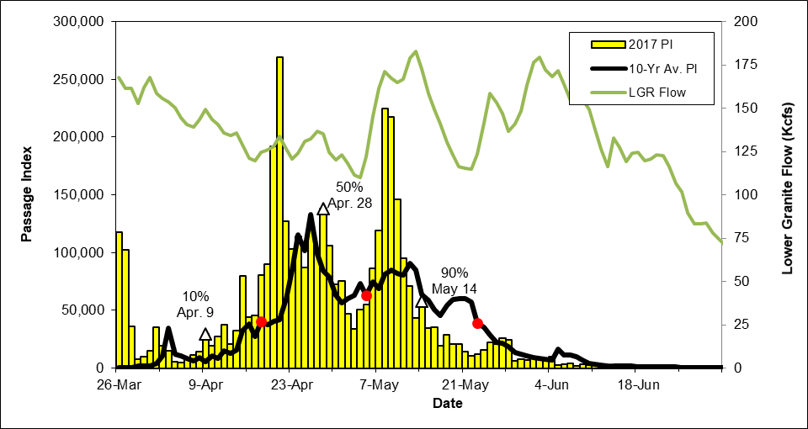
Lower Granite Dam
Steelhead
Some hatchery releases earlier than usual due to DWOR operations
Collection for transportation began on May 1st, first barge on May 2nd
  Based on PI, ~58% of ST passed LGR prior to start of transport

Slide 6
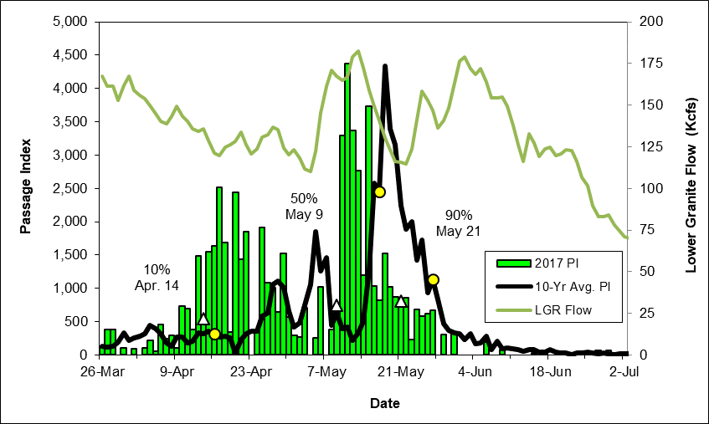
Lower Granite Dam
Sockeye
Sockeye collected in March and April likely kokanee from DWOR
  DWOR spilled from early Jan through most of spring and summer
  Hatchery releases began on April 17th, earlier than usual
1st PIT-tag detection was April 30th
  HSK from Springfield Hatchery
  1st wild detection was May 6th
1st PIT-tag Detection

Slide 7
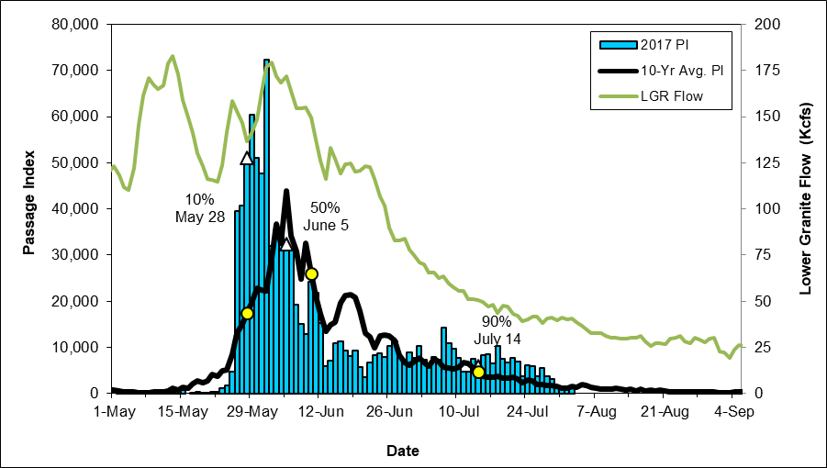
Lower Granite Dam
Subyearling Chinook
Quicker start to CH0 passage than previous years
Sampling at LGR ended ~Sept 1st, two months earlier than usual (due to construction)

Slide 8
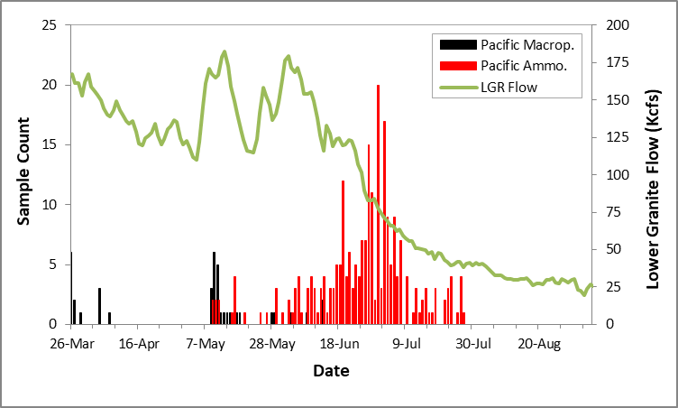
Lower Granite Dam
Juvenile Lamprey

Slide 9
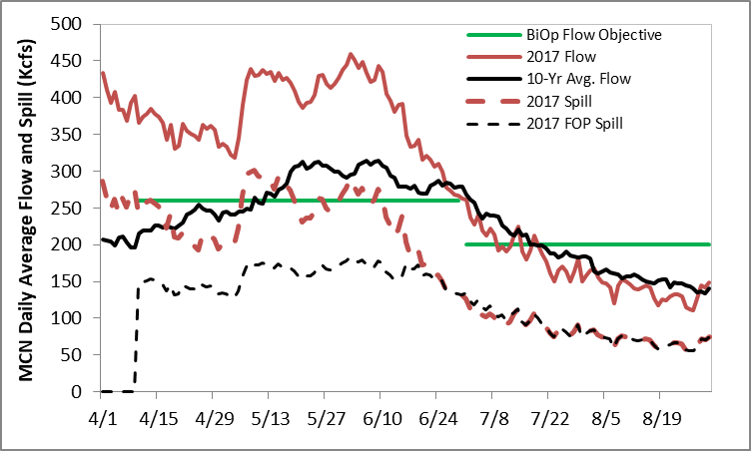
McNary Dam
Mid-Columbia runoff volume (Jan-Jul) at TDA ranked 8th, over last 89 years
BiOp flow objective met in spring, not met in summer
Spill exceeded FOP specified levels for all of spring
Spill exceeded FOP for small portion of summer, otherwise FOP spill met in summer

Slide 10
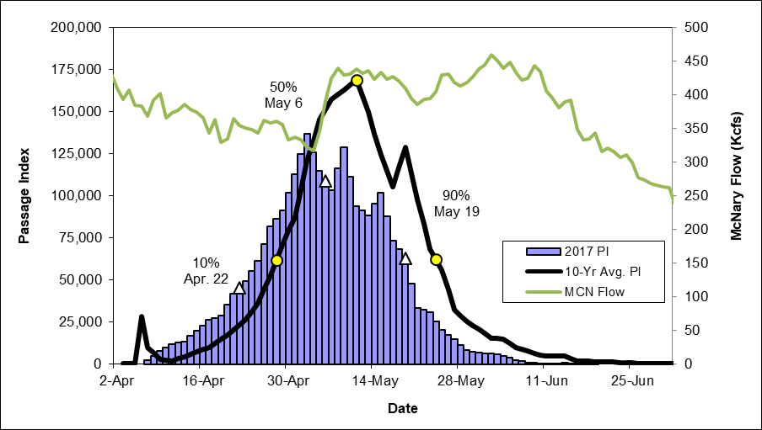
McNary Dam
Yearling Chinook

Slide 11
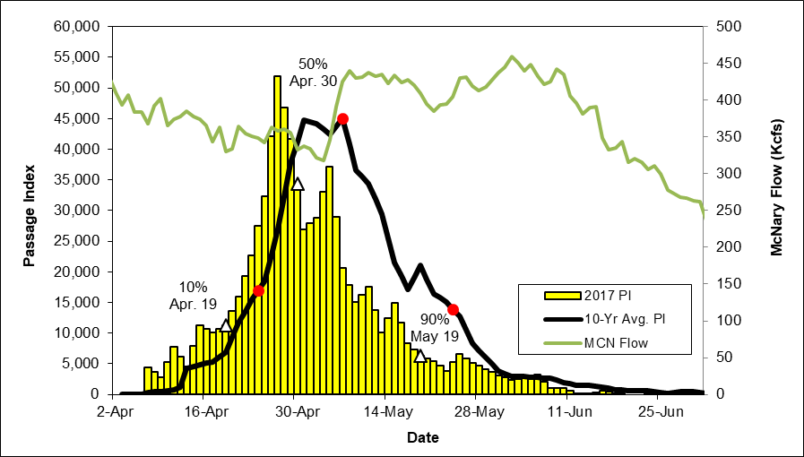
McNary Dam
Steelhead

Slide 12
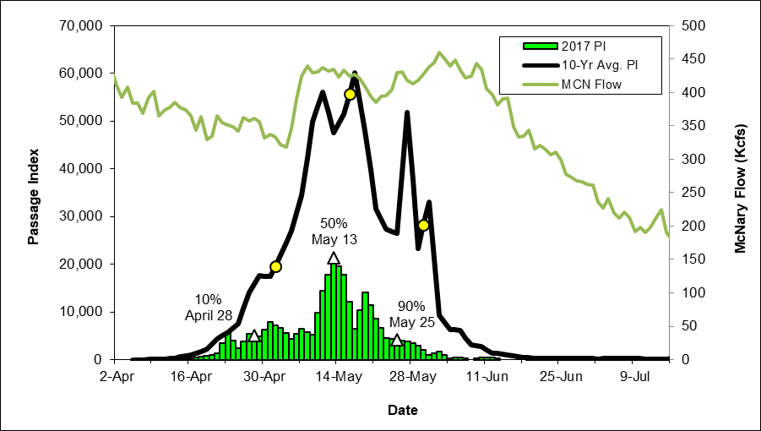
McNary Dam
Sockeye

Slide 13
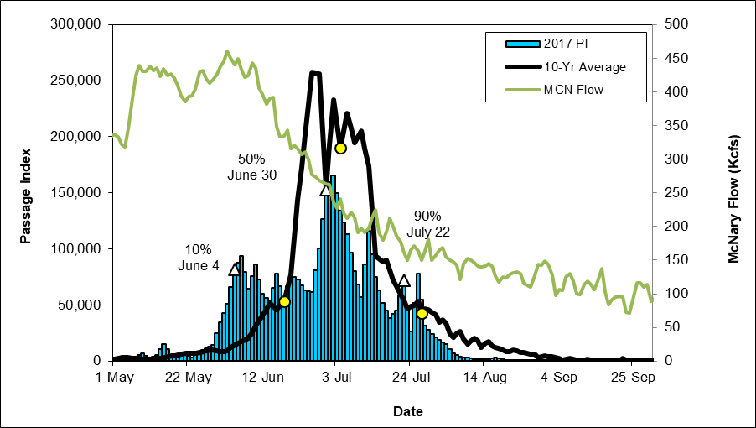
McNary Dam
Subyearling Chinook

Slide 14
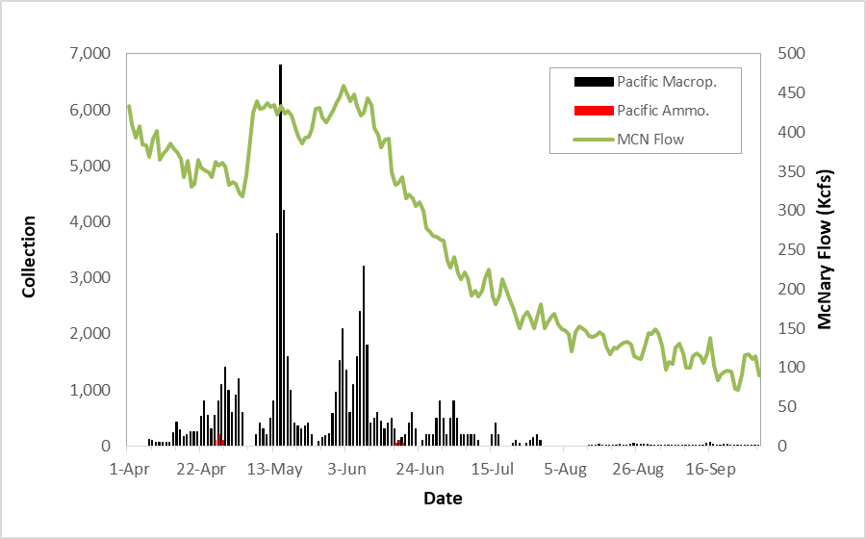
McNary Dam
Juvenile Lamprey
Similar to other years, very few ammocoetes collected at MCN

Slide 15
Bonneville Dam
Mid-Columbia runoff volume (Jan-Jul) at TDA ranked 8th, over last 89 years
Average spring flows above MCN flow objective, below in summer
Spill exceeded FOP specified levels for all of spring
Spill exceeded FOP for small portion of summer, otherwise FOP was met in summer

Slide 16
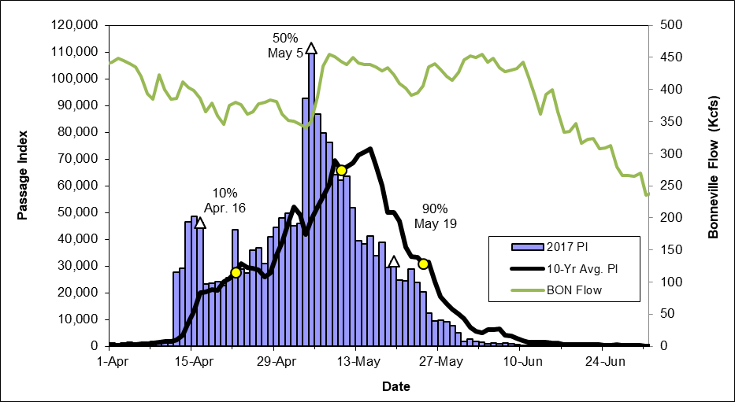
Bonneville Dam
Yearling Chinook

Slide 17
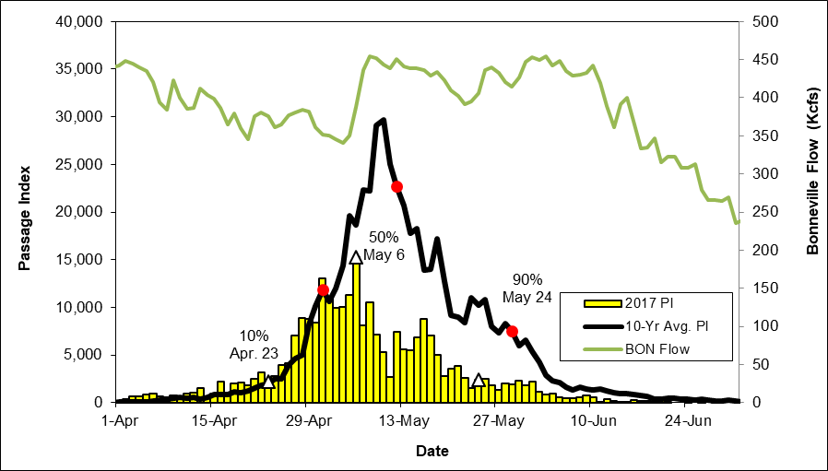
Bonneville Dam
Steelhead

Slide 18
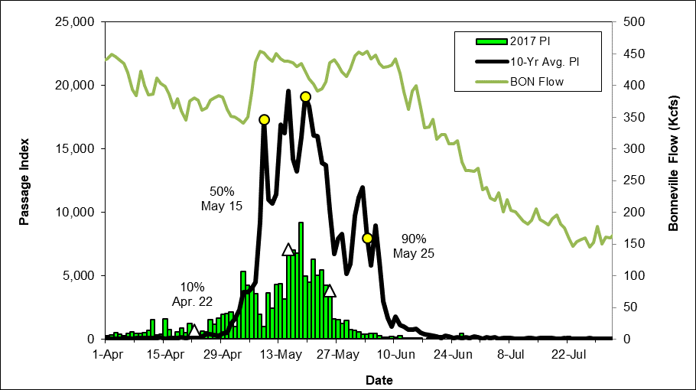
Bonneville Dam
Sockeye

Slide 19
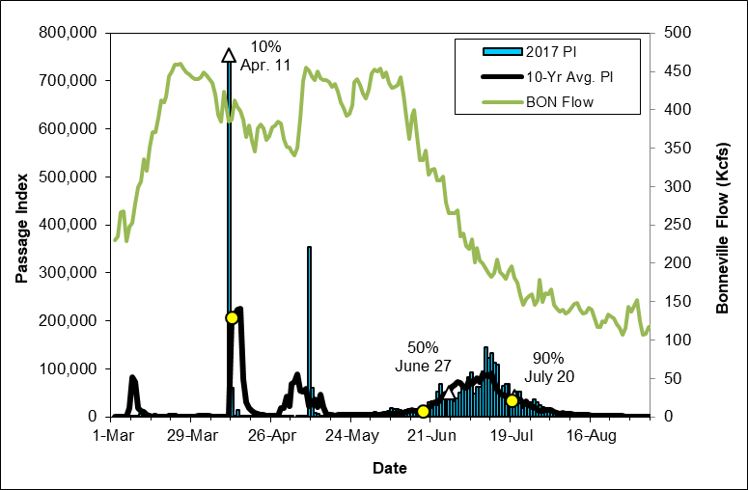
Bonneville Dam
Subyearling Chinook

Slide 20
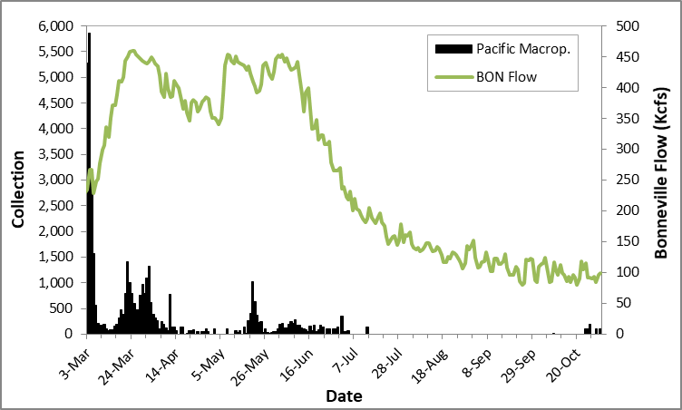
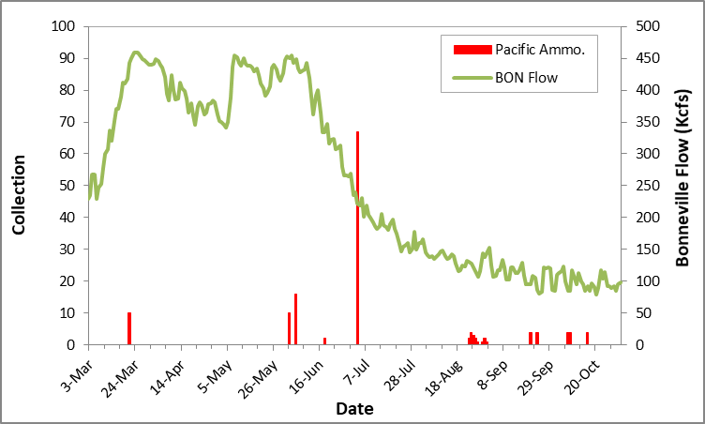
Bonneville Dam
Juvenile Lamprey

Slide 21
Noteworthy Events:
Weighted Average Mortality
CH0 and CO at LGR highest mortality in last ten years
ST at LGS, tied for highest in last ten years
ST at MCN highest in last ten years
SO at RIS highest in last ten years
Lowest MP in last ten years at MCN and BON
Site | CH0 | CH1 | CO | SO | ST | MP*
LGR | 1.7 | 0.6 | 1.3 | --- | 0.3 | ---
LGS | 0.4 | 0.6 | 0.0 | --- | 0.2 | 2.2
LMN | 0.3 | 0.4 | 0.3 | --- | 0.4 | ---
MCN | 0.4 | 0.3 | 0.0 | 0.7 | 0.7 | 1.2
JDA | 0.3 | 0.3 | 0.0 | 1.0 | 0.1 | 0.1
BON | 1.2 | 0.3 | 0.2 | 1.5 | 0.2 | 1.4
RIS | 0.1 | 0.0 | 0.0 | 0.8 | 0.0 | ---
--- Unable to estimate due to no or too few samples with ≥20 fish sampled
* Weighted by estimated collection or sample count, instead of passage index

Slide 22
Noteworthy Events:
Weighted Average Descaling
Site | CH0 | CH1 | CO | SO | ST
LGR | 0.9 | 1.6 | 2.4 | --- | 2.5
LGS | 0.7 | 2.3 | 0.6 | --- | 1.6
LMN | 1.4 | 2.2 | 1.9 | --- | 3.0
MCN | 1.0 | 3.9 | 2.2 | 1.4 | 4.1
JDA | 1.5 | 2.5 | 6.9 | 6.2 | 3.9
BON | 0.3 | 2.4 | 1.6 | 6.9 | 3.2
RIS | 0.7 | 0.2 | 0.2 | 2.2 | 0.2
CH1 at LGS, highest descaling in last ten years
CO at JDA, highest descaling in last ten years
CO and ST at RIS, lowest descaling in last ten years
--- Unable to estimate due to no or too few samples with ≥20 fish examined

Slide 23
Noteworthy Events:
Weighted Average Injury
Several instances where weighted average injury rates for salmonids were highest or second highest among nine years in dataset (2009-2017)
Lowest injury rate for MP at MCN (six year dataset)
Site | CH0 | CH1 | CO | SO | ST | MP*
LGR | 8.5 | 5.3 | 4.2 | --- | 5.7 | N/A
LGS | 10.4 | 8.8 | 9.0 | --- | 4.6 | N/A
LMN | 7.7 | 7.6 | 4.9 | --- | 7.6 | N/A
MCN | 1.2 | 3.1 | 1.6 | 1.5 | 4.5 | 0.0
JDA | 4.2 | 4.7 | 4.2 | 4.8 | 5.8 | 2.7
BON | 5.8 | 11.2 | 8.8 | 13.1 | 16.6 | 3.6
--- Unable to estimate due to no or too few samples with ≥20 fish examined
* Weighted by estimated collection or sample count, instead of passage index

Slide 24
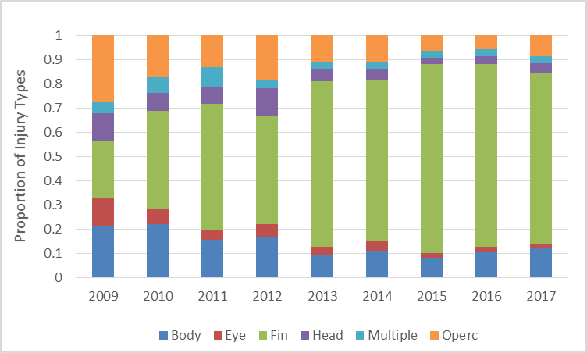
Noteworthy Events:
Injury Types
As in previous years, most common injury in 2017 was Fin Injury
Fin injury is any cut, abrasion, laceration, swelling, or other injury to the fins. Split fins should only be reported when the split reaches from the outer margin of the fin to where the fin meets the body

Slide 25
GBT Monitoring Results
GBT Monitoring Program has been implemented since 1995
Objective is to provide measure of exposure to harmful levels of total dissolved gas (TDG) experienced by migrating juvenile salmonids
Provides an “early warning” of potentially harmful levels of TDG
GBT Monitoring Program conducted at six projects:
  3 Snake River (LGR, LGS, LMN) - One sample per site per week
  1 Upper Columbia (RIS) – Two samples per week
  2 Middle Columbia (BON, MCN) – Two samples per site per week
Target 100 total CH and/or ST to assure sample observation accurately represents population incidences of signs of GBT

Slide 26
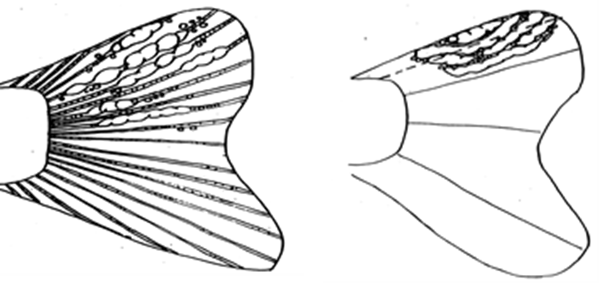
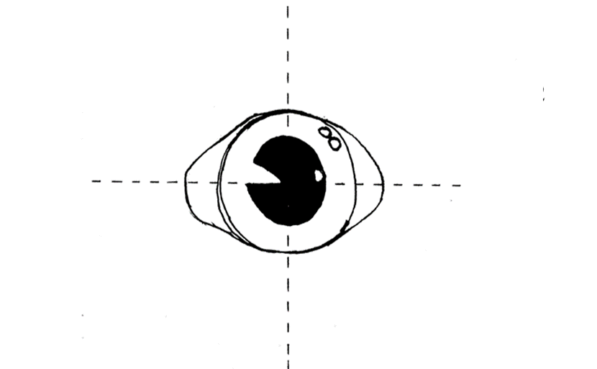
GBT Monitoring Results
Fish are anesthetized and examined under dissecting microscopes
Unpaired fins and eyes are examined and bubbles present are quantified and ranked
Rank | Sign
0 | No bubbles present
1 | Up to 5% of fin or eye covered in bubbles
2 | 6%-25% of fin or eye covered in bubbles
3 | 26%-50% of fin or eye covered in bubbles
4 | >50% of fin or eye covered in bubbles
Action criteria for reducing spill (i.e., TDG) based on GBT Monitoring Results:
  15% of fish showing any signs of fin GBT OR
  5% of fish showing severe signs of GBT (Rank 3 or 4)

Slide 27
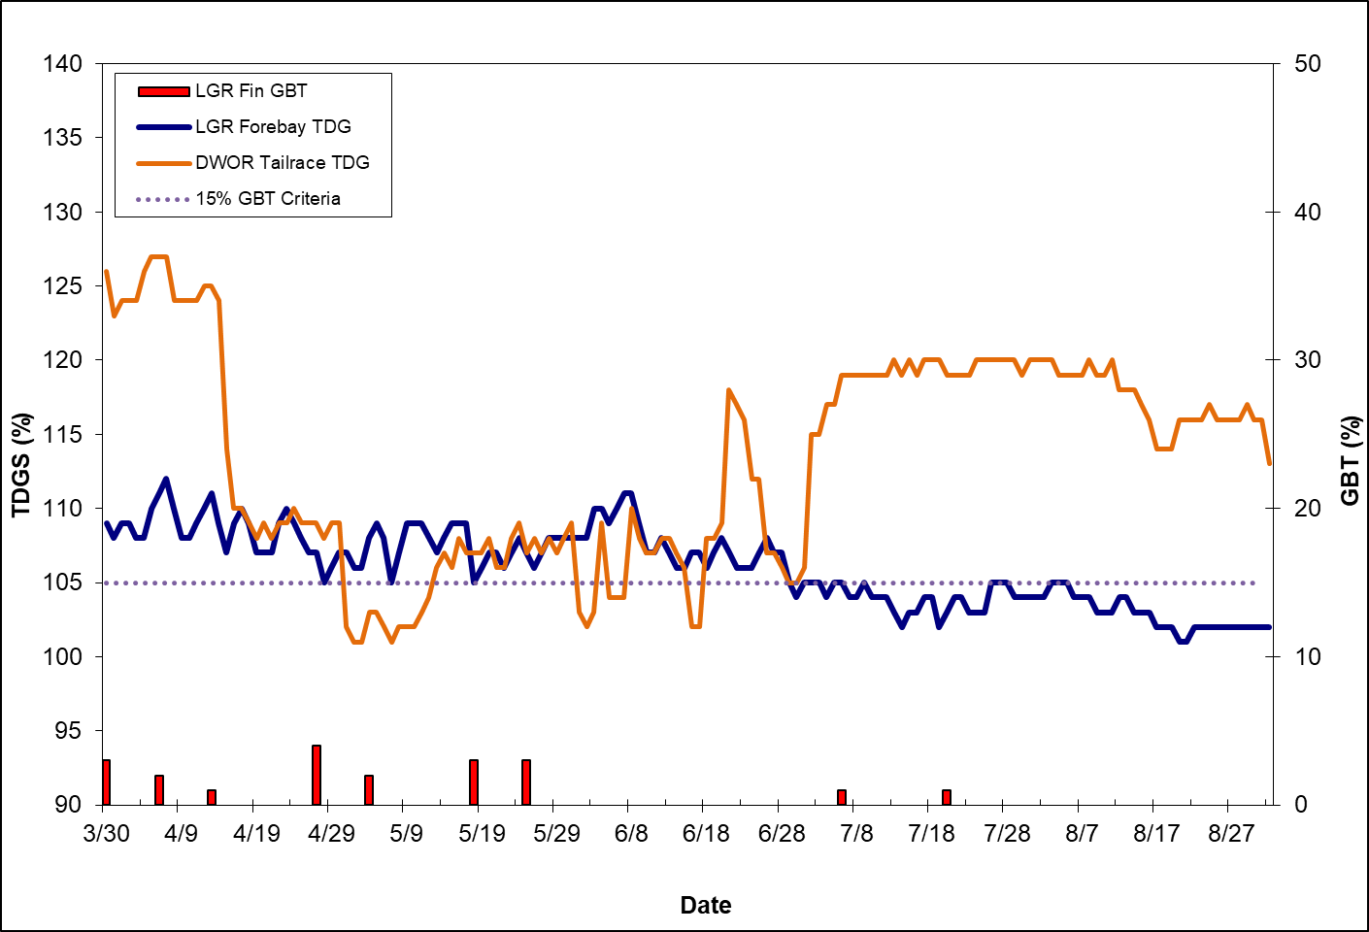
GBT Monitoring Results
Lower Granite Dam
Monitoring at LGR extended due to high spill from DWOR
  Started earlier (3/30) and ended later (7/27)
9 of 16 samples had fish with signs of GBT, all of which were below 15% criterion
All fish with GBT at LGR were Rank 1

Slide 28
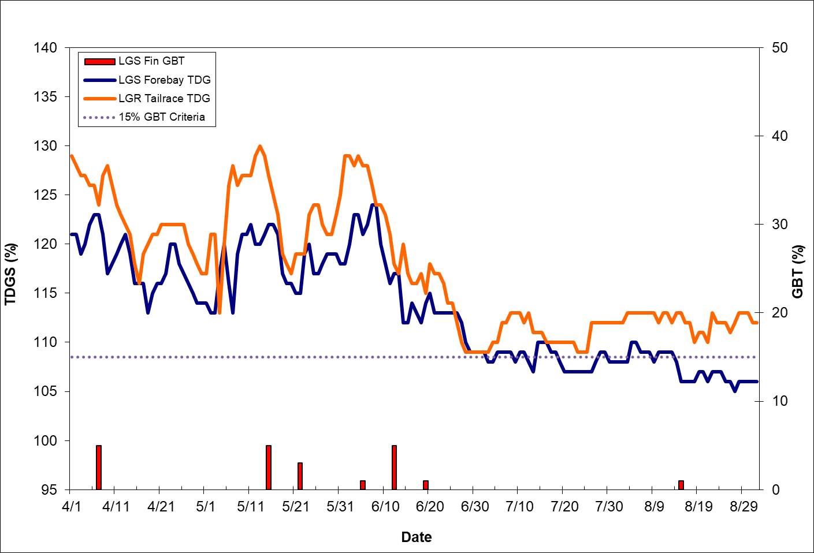
GBT Monitoring Results
Little Goose Dam
TDG at LGR TR exceeded 120% for most of spring
TDG at LGS FB exceeded 115% for most of spring
7 of 21 GBT samples had fish with signs of GBT, all of which were below 15% criterion
All fish with GBT at LGS were Rank 1 or 2

Slide 29
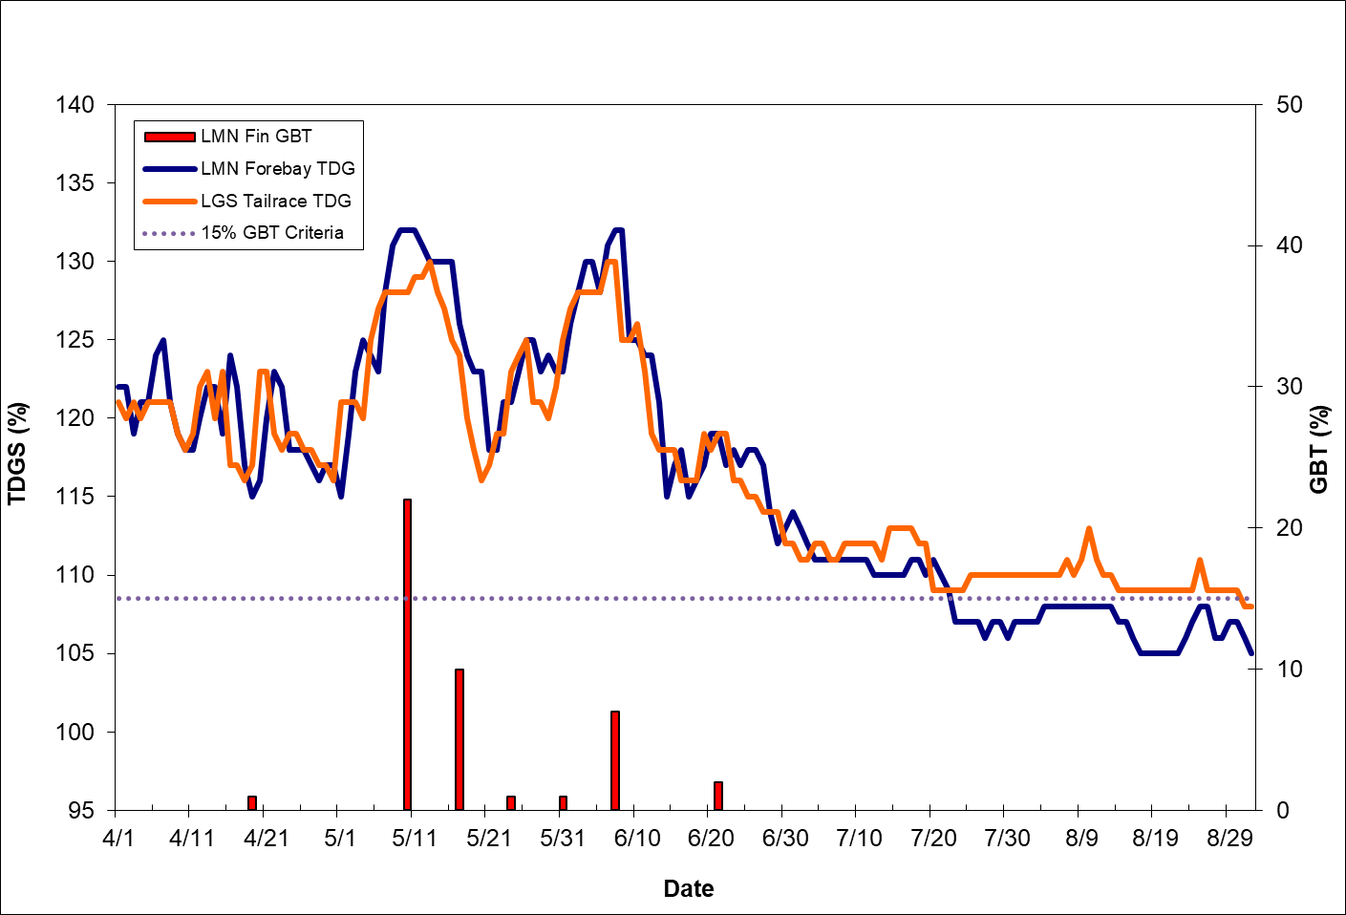
GBT Monitoring Results
Lower Monumental Dam
TDG at LGS TR exceeded 120% for most of spring
TDG at LMN FB exceeded 115% for most of spring
7 of 18 samples had fish of signs of GBT, one of which exceeded 15% criterion
  22% on May 10th, when TDG in LMN FB was 132%
  High flows precluded ability to reduce spill (i.e., TDG) upstream
Of 44 total fish with signs of GBT, 3 had severe signs (Rank 3)

Slide 30
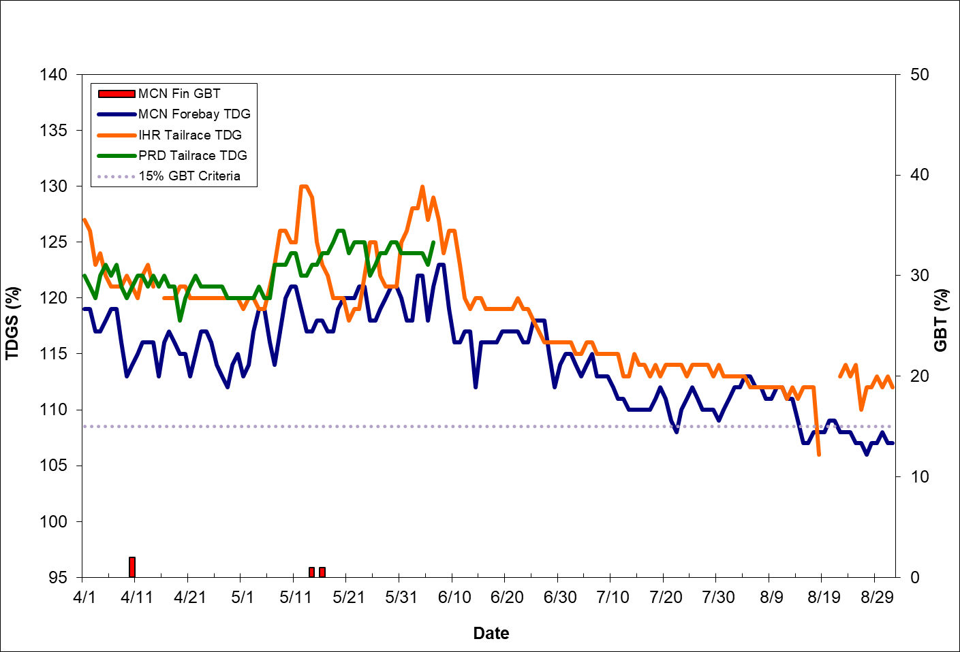
GBT Monitoring Results
McNary Dam
TDG at IHR TR and PRD TR exceeded 120% for most of spring
TDG at MCN FB exceeded 115% for most of spring
3 of 33 samples had fish with signs of GBT, all of which were below 15% criterion
All fish with signs of GBT were Rank 1 or 2

Slide 31
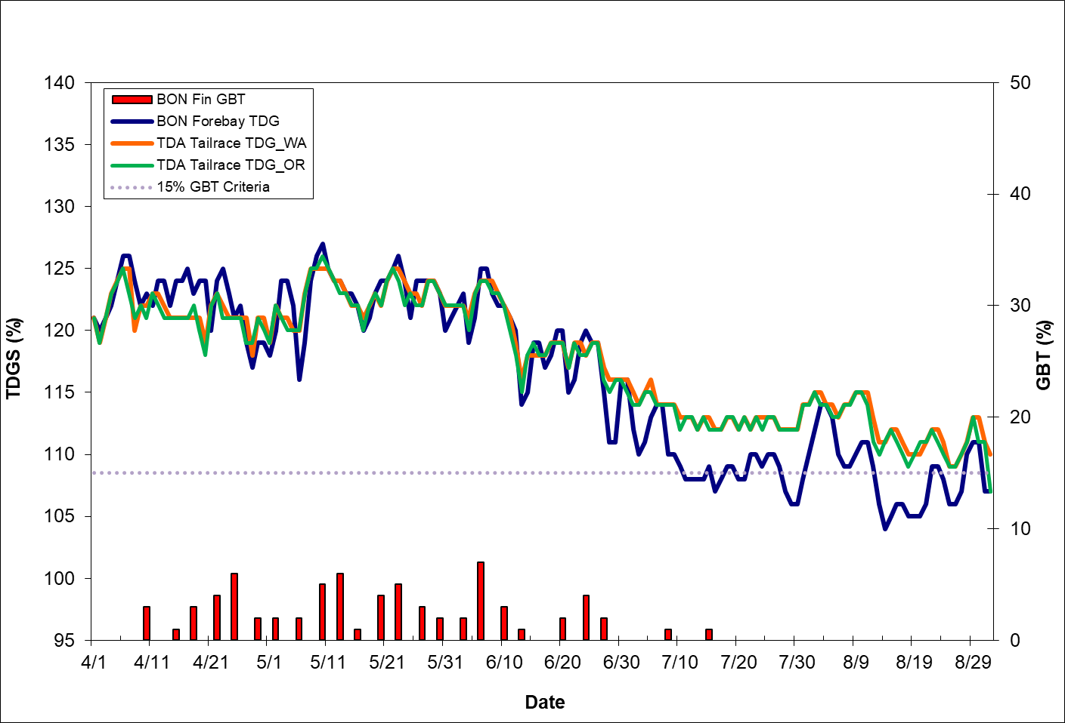
GBT Monitoring Results
Bonneville Dam
TDG at TDA TR exceeded 120% for most of spring
TDG at BON FB exceeded 115% for most of spring
24 of 33 samples had fish with signs of GBT, all of which were below 15% criterion
All fish with signs of GBT were Rank 1 or 2

Slide 32
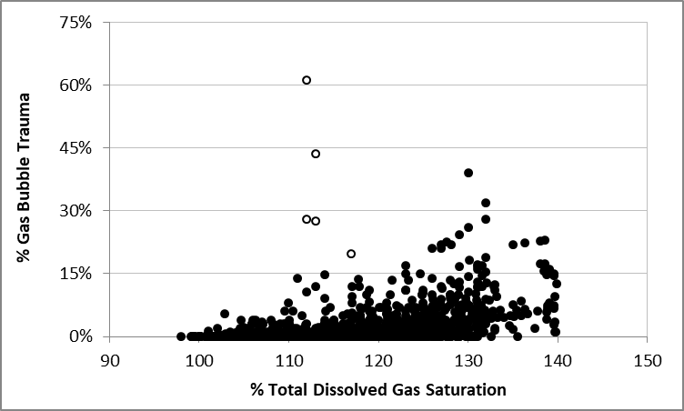
GBT Monitoring Results
Historical Summary
Over the 20+ years, GBT samples conducted at wide range of TR TDG levels
Of 2,771 GBT samples conducted, 35 (1.3%) have exceeded 15% action criteria
  5 attributed to late migrating ST in 2002 and 2007
  3 corresponded with upstream TR TDG between 120% and 125%
  27 corresponded with upstream TR TDG of >125%
Of 303 GBT samples conducted with corresponding TR TDG ≥125%, only 27 (8.9%) had GBT of ≥15%

