Slide 1
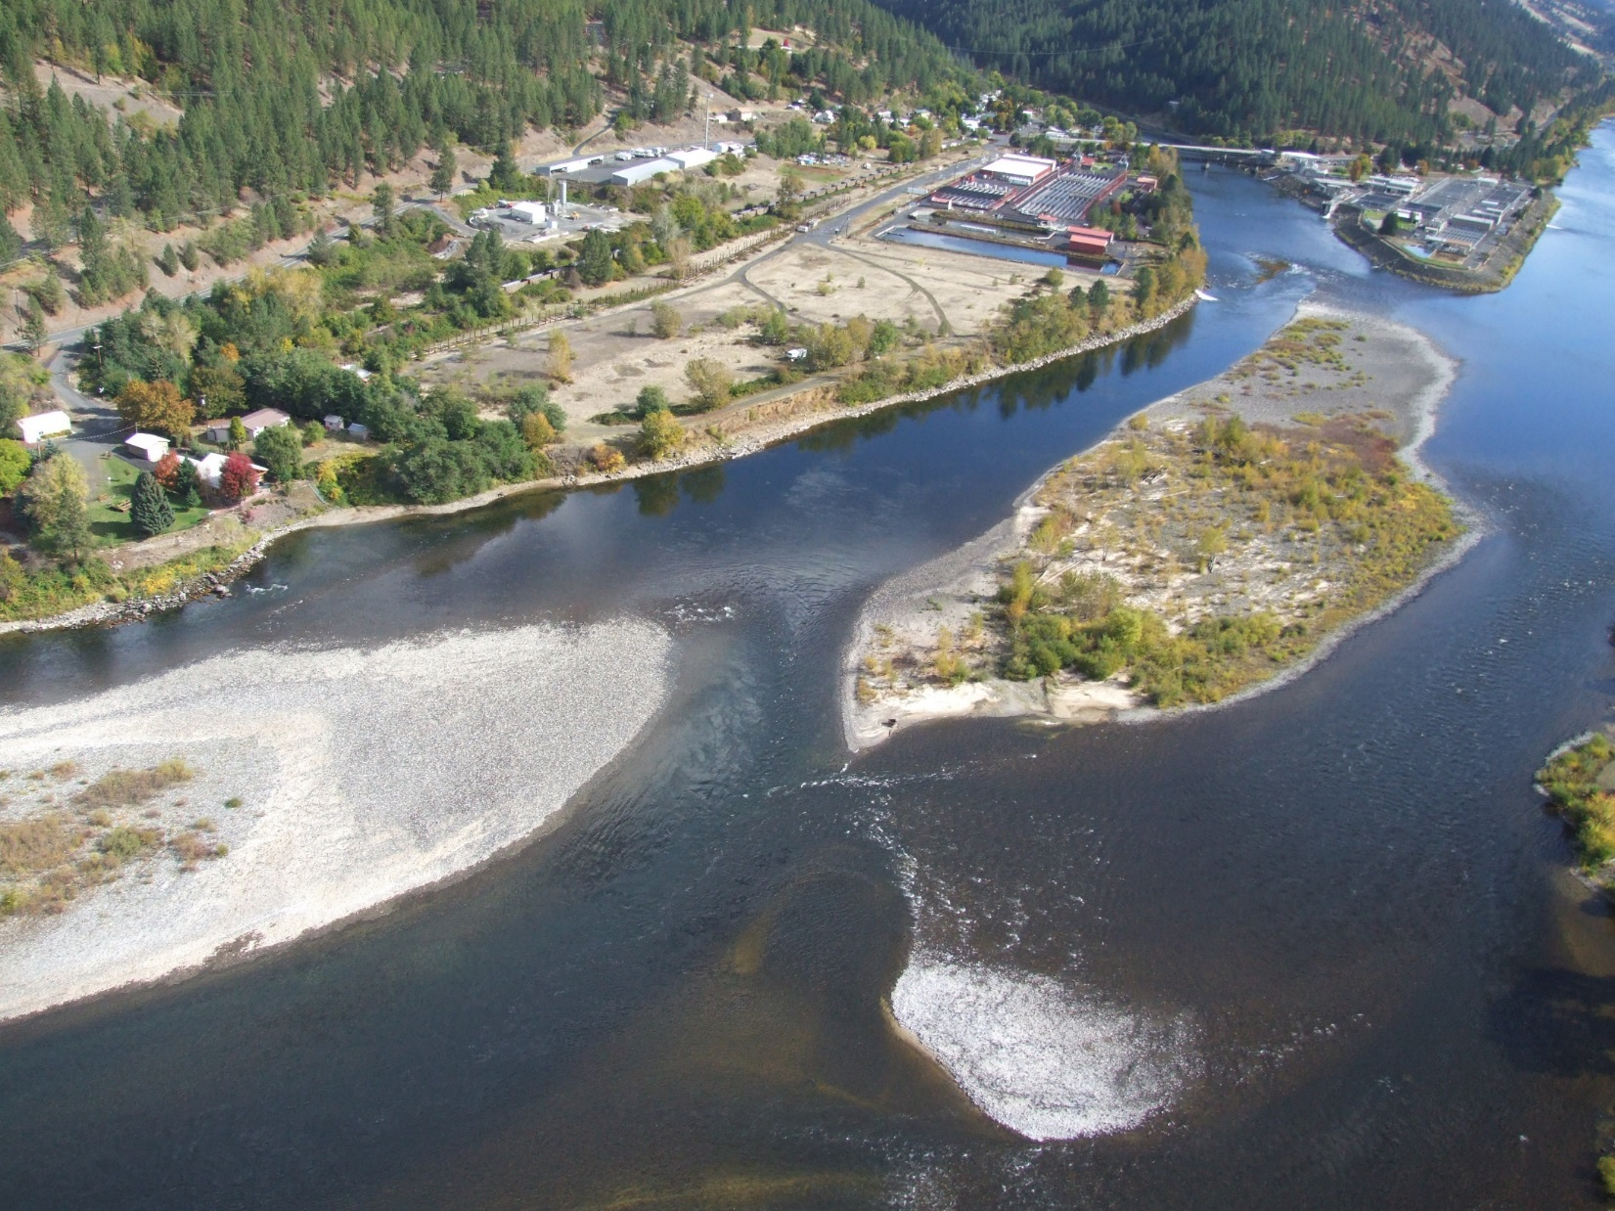
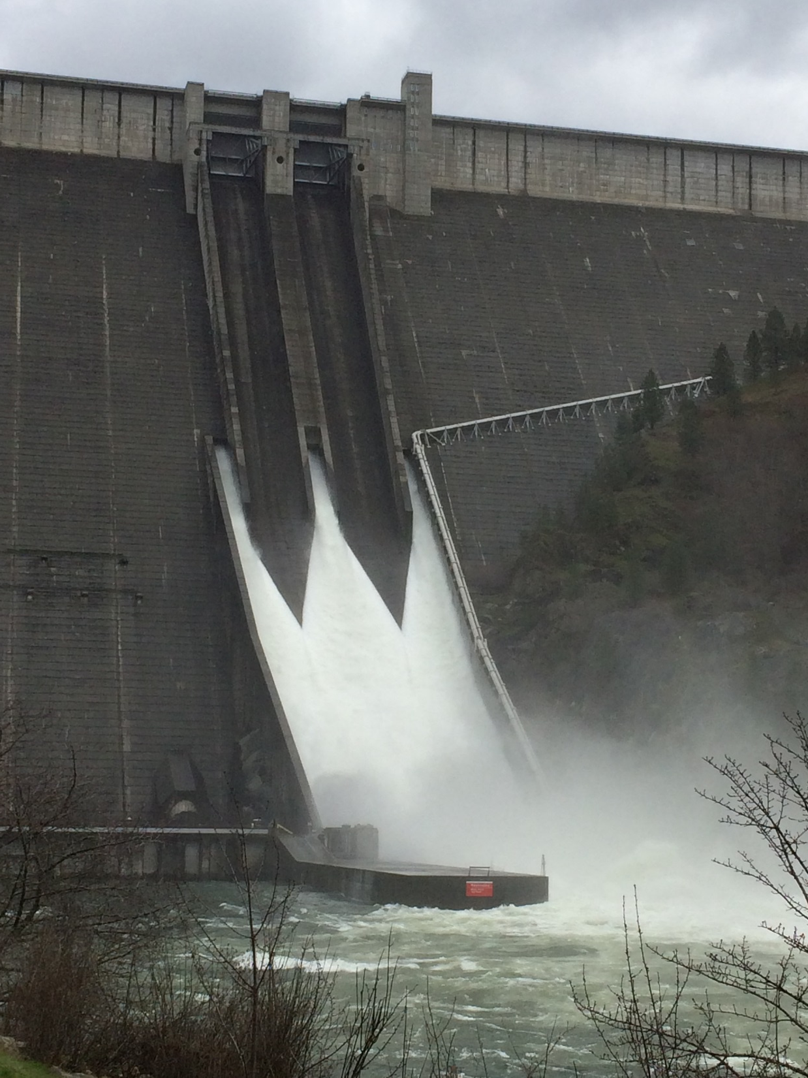
2017 Dworshak Dam Effects on Clearwater In-river Fish

Slide 2
Elevated Total Dissolved Gas (TDG)
Fish Exposure and Risk Assessment

Slide 3
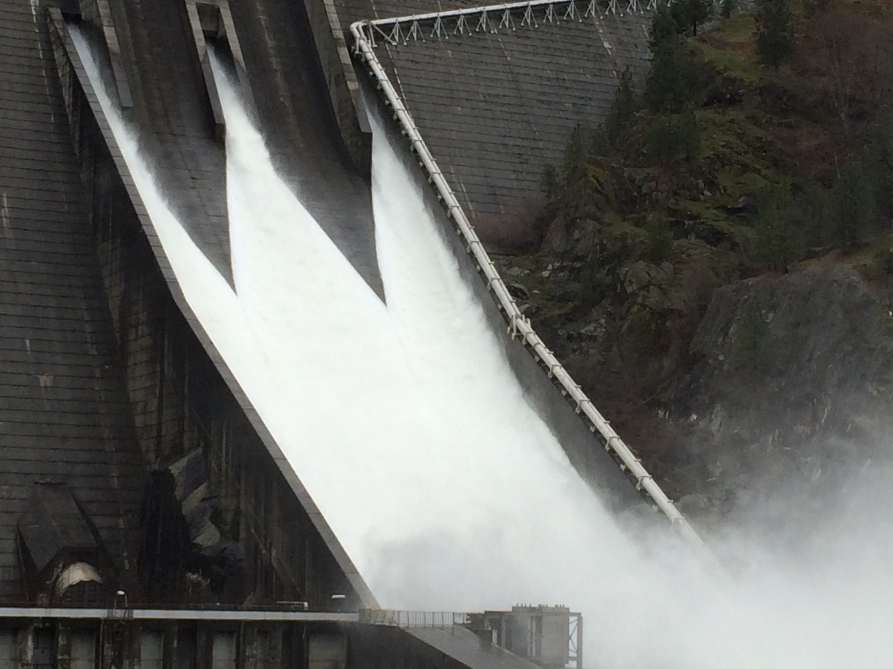
TDG Related Mortality
TDG Level
Depth
Duration
Specie
Life Stage

Slide 4
TDG Related Mortality
Don E. Weitkamp & Max Katz (1980): A Review of Dissolved Gas Supersaturation Literature, Transactions of the American Fisheries Society, 109:6, 659-702
Don. E. Weitkamp. 2008. Total Dissolved Gas Supersaturation Biological Effects, Review Of Literature 1980-2007, June 2008 Draft
Eggs: 0% regardless of TDG level
Fry: 68-75% with TDG 120-124%
Juveniles: 0-100% with TDG 110-120%

Slide 5
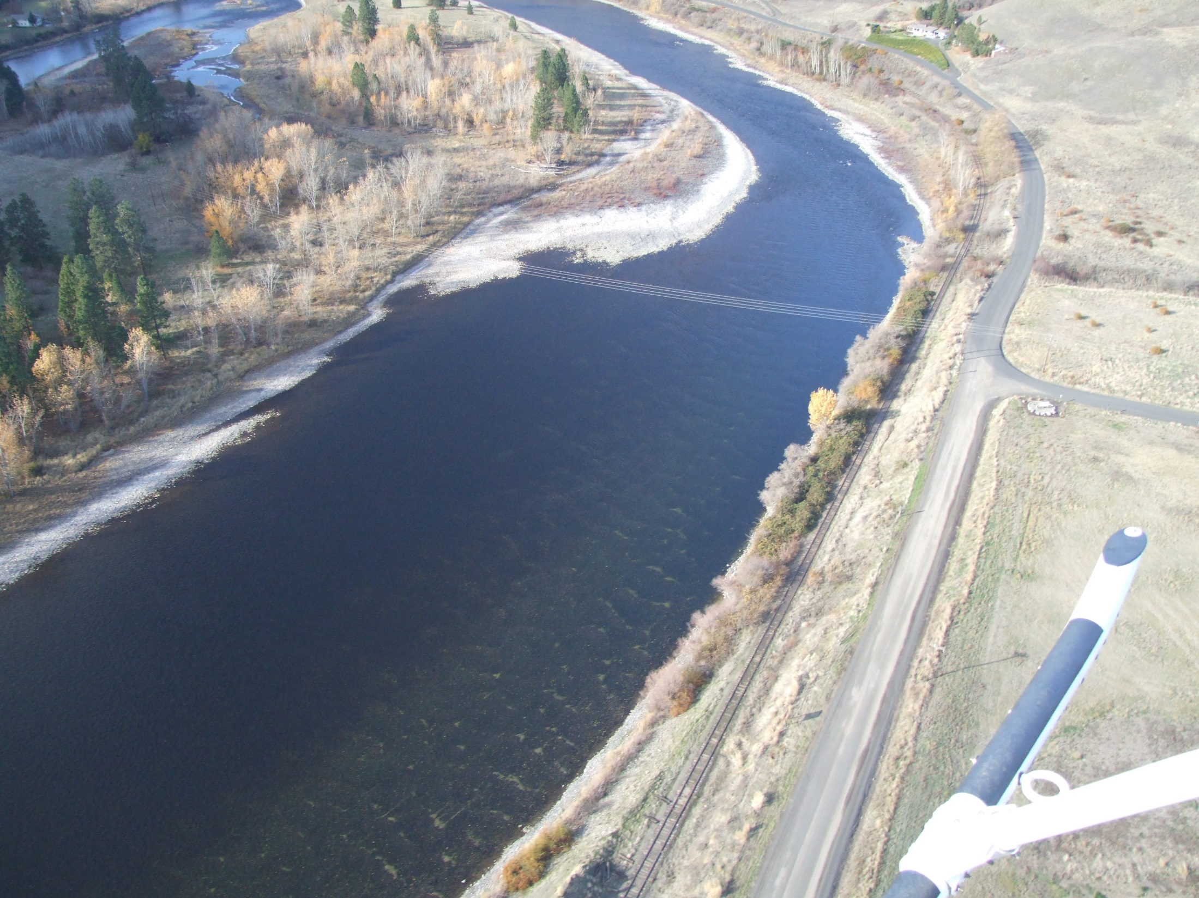
2016 Fall Chinook Salmon
Redd Abundance and Distribution
Redds below NPTH (n=724)

Slide 6
51.3% of the Snake River redds occurred in the lower Clearwater (92.2%) or North Fork Clearwater rivers (7.8%)

Slide 7
Ahsahka Islands

Slide 8
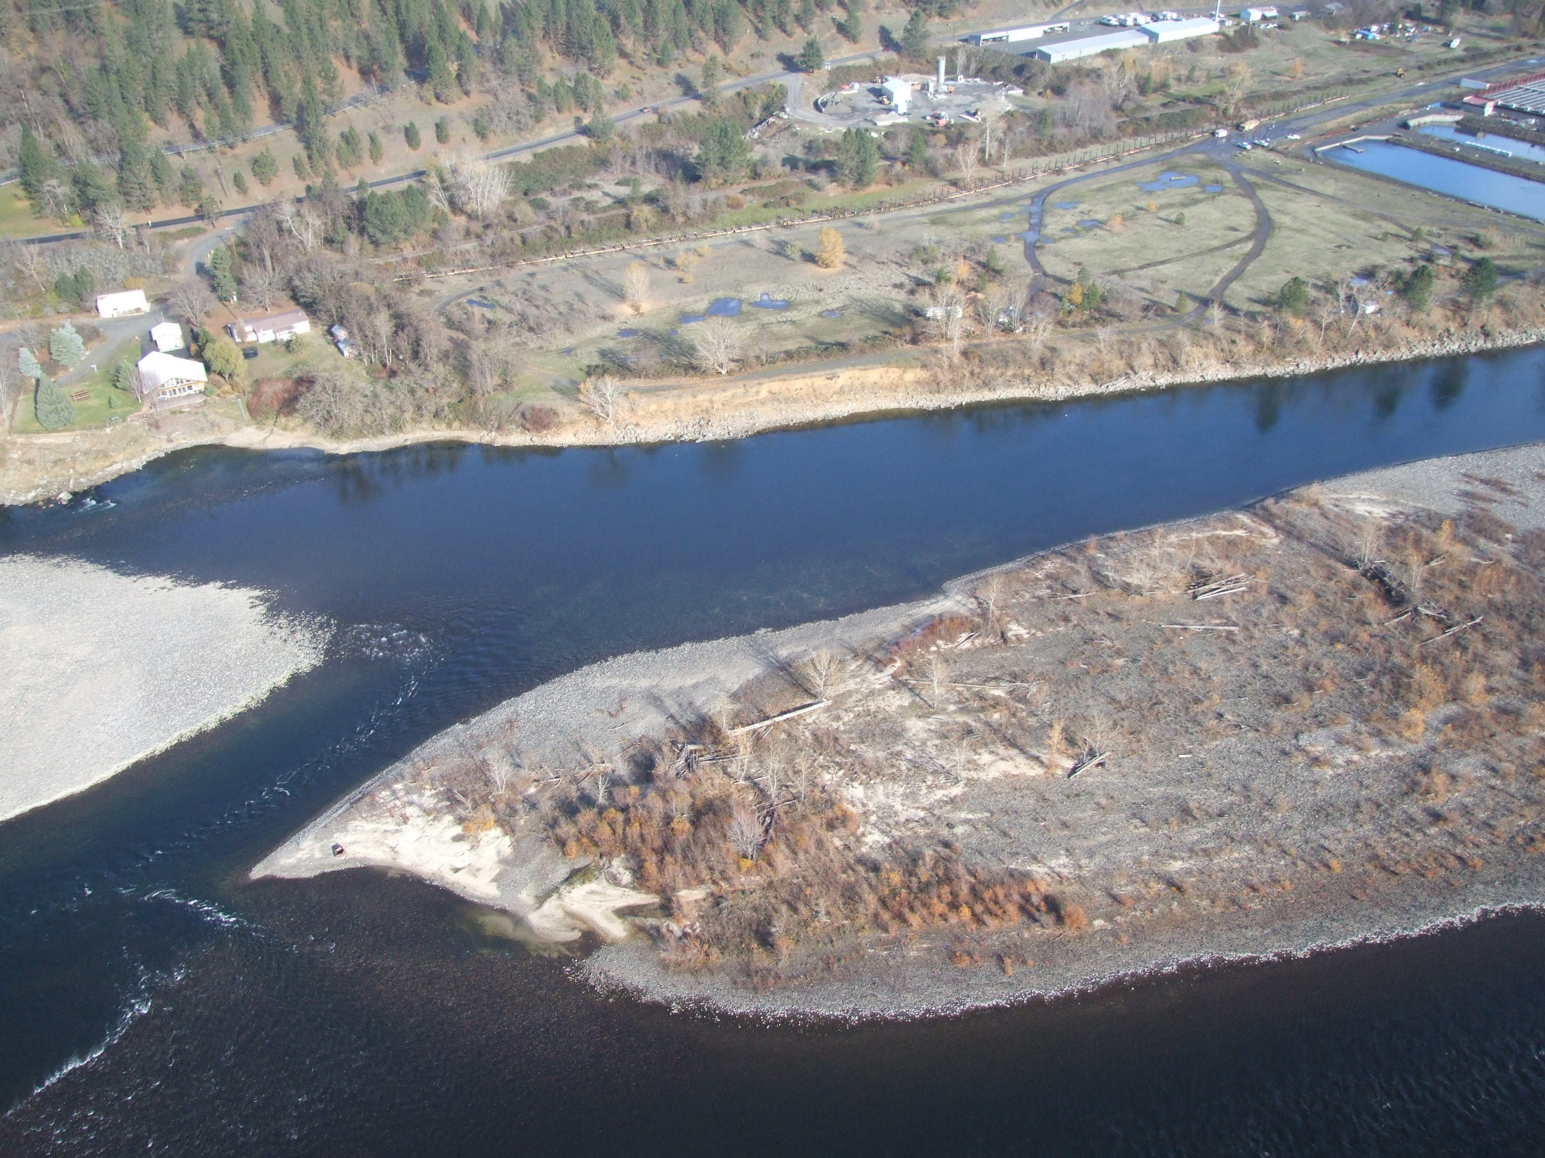
Ahsahka Island
Redds (n=241)

Slide 9
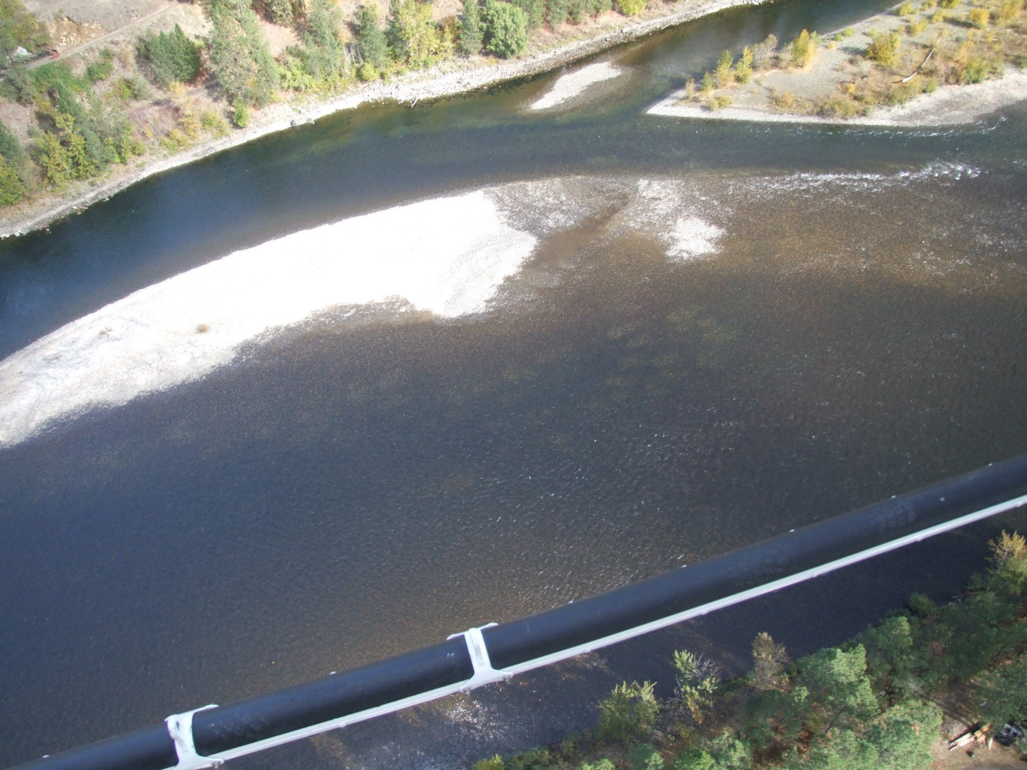
Ahsahka Island
Redds

Slide 11
Estimated Emergence Timing and TDG Induced Mortality
March 4 to April 14 TDG < 120%
4.5% of Clearwater juveniles potentially exposed
TDG Related Mortality 0 to 4.5%, likely <2%

Slide 12
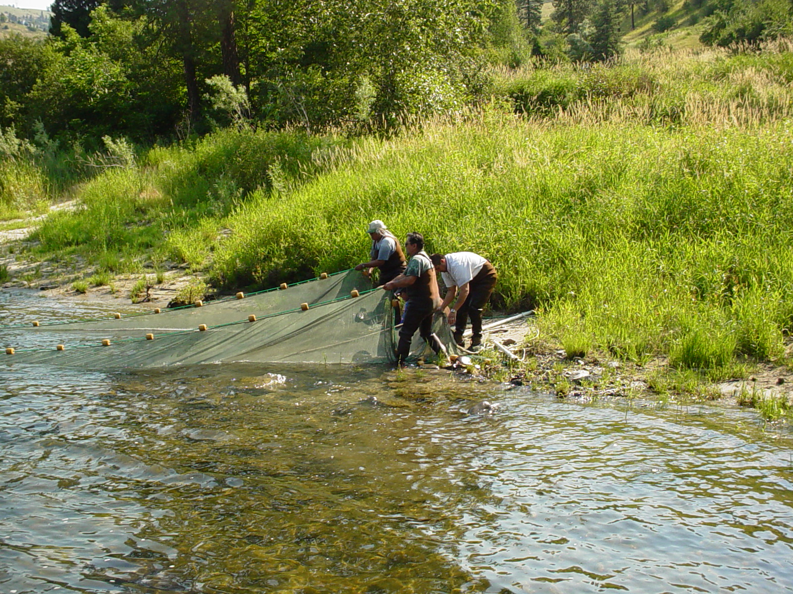

Slide 13
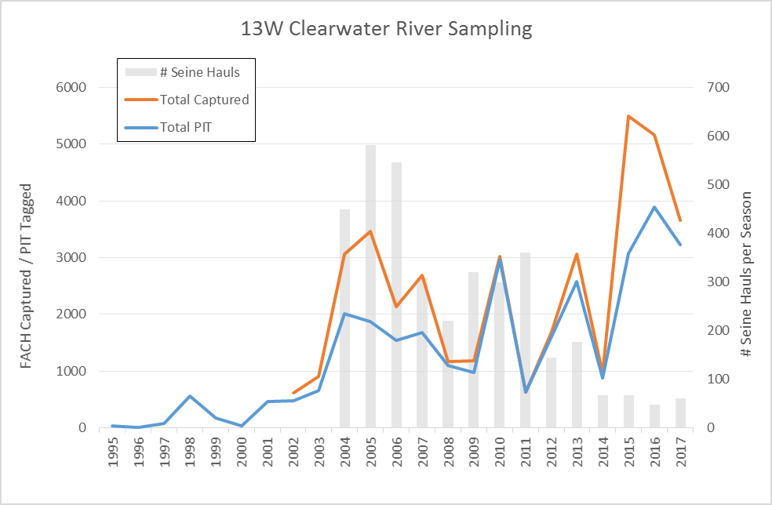
Beach Seining
CPUE
Demonstrates successful juvenile fall chinook incubation, eye-up and rearing.
Does not quantify potential direct or indirect mortality from TDG exposure.

Slide 14
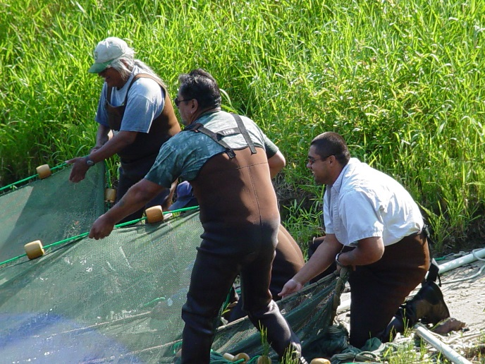
Beach Seining
Fish Condition
TDG 103-112%
GBT symposiums in most fish, but limited to gills and lateral line.
Feeding appeared normal.
Growth appeared normal.

Slide 15
Elevated Total Dissolved Gas (TDG)
Fish Exposure and Risk Assessment (Preseason)

Slide 16
Elevated Total Dissolved Gas (TDG)
Fish Exposure and Risk Assessment (Updated)

Slide 17
Nez Perce Tribe
Priorities for 2018 Operations
Achieve full pool for summer flow augmentation.
Maintain in-river TDG levels at 100% to the greatest extent possible.
Maintain in-hatchery TDG levels at or below 101% (in-river TDG 115% or less).
Provide spring flow augmentation flows, consistent with natural hydrograph, to the greatest extent possible.

Slide 18
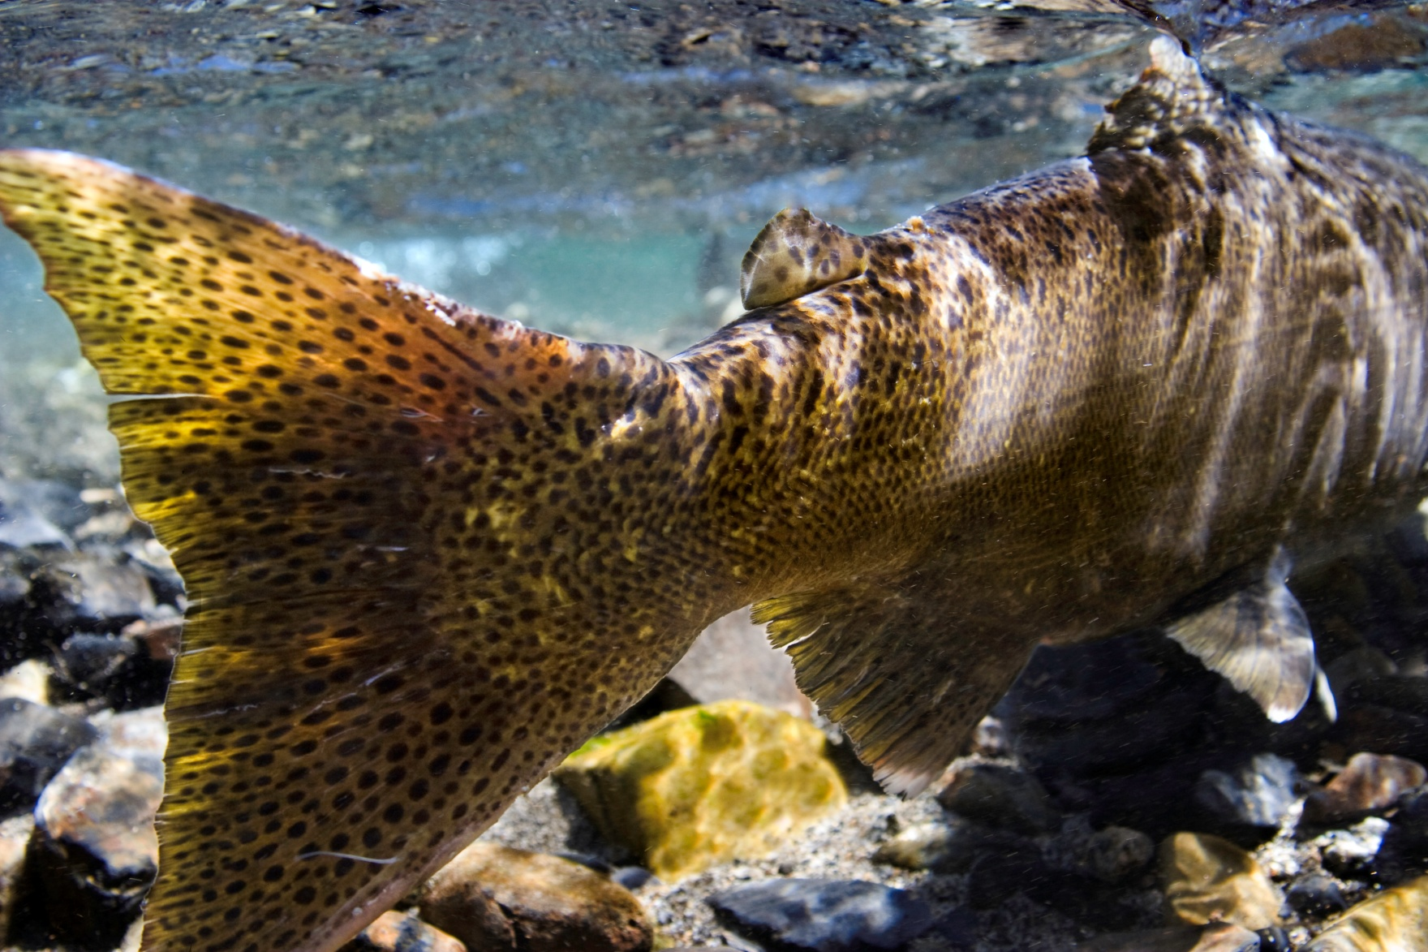
Acknowledgments: Bill Arnsberg, Scott Kellar, Thomas Tall Bull, Billy Connor, USGS, COE
Photos by Mary Edwards (www.maryedwardsphotography.com)

Slide 19
Nez Perce Tribe
Priorities for 2018 Operations
Achieve full pool for summer flow augmentation.
Increase risk probability of not refilling from 5 to 10 percent for planning between now and the end of December.
Target end of December elevation of 1520’ by managing flows up to maximum powerhouse capacity.
Maintain in-river TDG levels at 100% to the greatest extent possible.
If powerhouse capacity must be exceeded, target periods that will have minimal impacts on juvenile production and adult behavior and survival.
January and February have least amount of risk.
Post fall Chinook juvenile emergence (March 1st) has greatest risk.
Maintain in-hatchery TDG levels at or below 101% (in-river TDG 115% or less).
Provide spring flow augmentation flows, consistent with natural hydrograph, to the greatest extent possible.
Reduced powerhouse capacity in 2018 incompatible with this objective due to elevated TDG generation.

