Slide 1
Kootenai River Habitat Restoration Project 2017 Update
TMT Year-End Review
Jason Flory
US Fish & Wildlife Service

Slide 2
What is the Kootenai River Habitat Restoration Program?
Multi-year habitat restoration program in Idaho portion of Kootenai River
Data collection, analysis and modeling
Multiple habitat restoration projects to address reach-specific limiting factors
Compliments other efforts to restore fish and wildlife populations and their habitats

Slide 3
Major Types of Treatments Implemented 2011-2016
Pool forming structures & pool creation or enhancement to encourage Kootenai sturgeon to migrate to upstream habitat & to provide holding habitat for sturgeon, burbot & other native fish
In river & bank structures to create more diverse & complex habitats for sturgeon & other native fish

Slide 4
Major Types of Treatments Implemented 2011-2016
Side channel reconnection & floodplain creation or enhancement to enhance the food web & provide habitat for juvenile Kootenai sturgeon & other native fish
Riparian enhancement (& riparian buffer fencing) to enhance the food web & provide cover for native fish

Slide 5
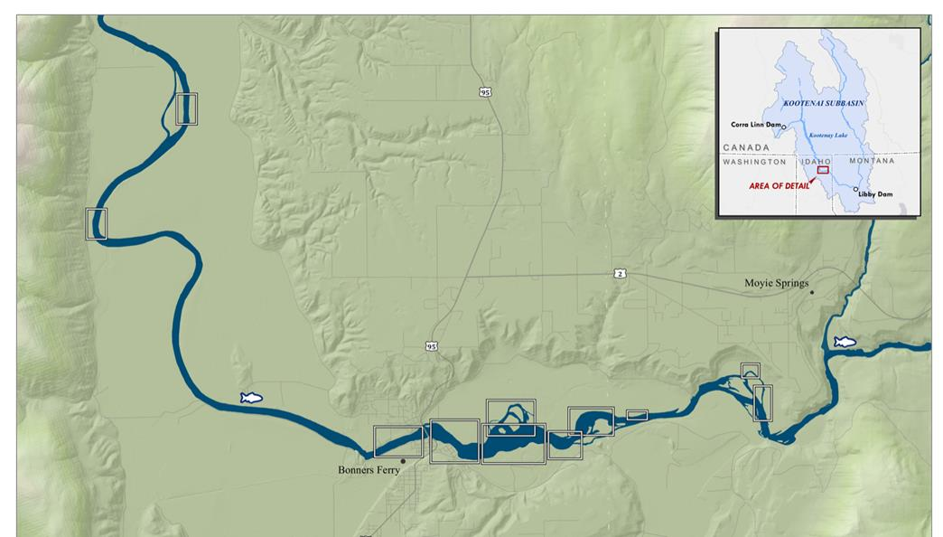
2011 through 2018 10 projects on the ground

Slide 6
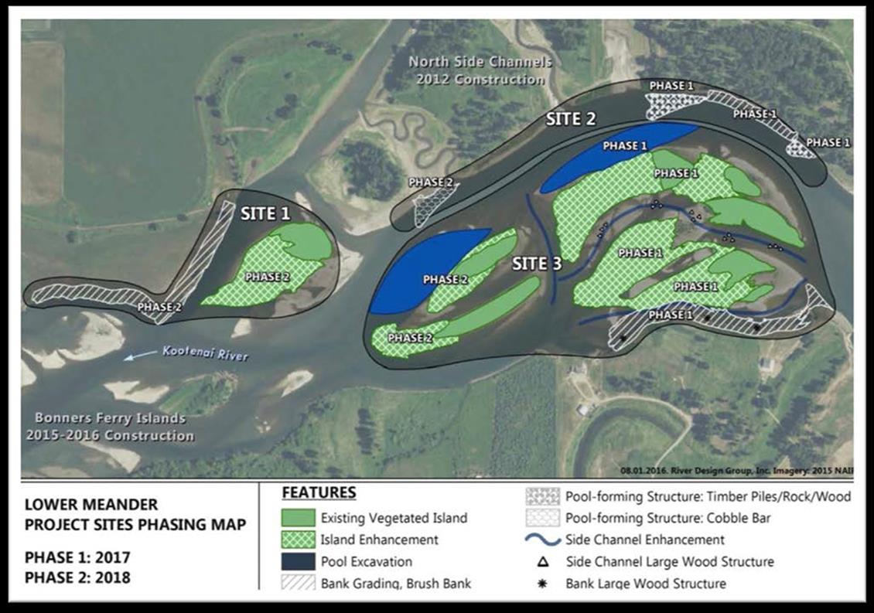

Slide 7
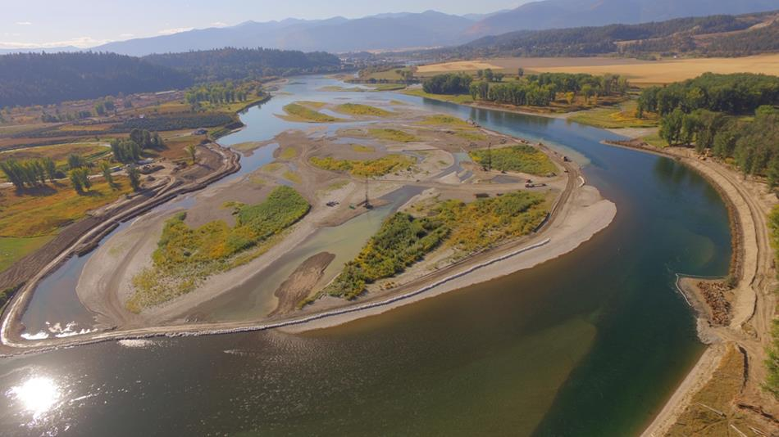
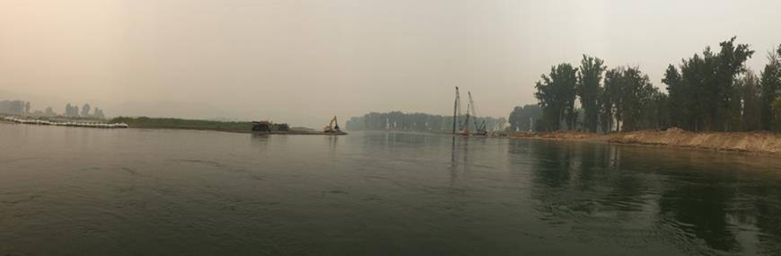

Slide 8
Thanks!
Kootenai Tribe of Idaho thanks the TMT for reviewing and approving the 2017 SOR that lowered Kootenai River flows for the Lower Meander Project
Another, very similar SOR will be coming in 2018 for Phase 2 of the Lower Meander Project
A great big “THANK YOU” to Sue Ireland and the Kootenai Tribe for helping with this presentation

