Slide 1

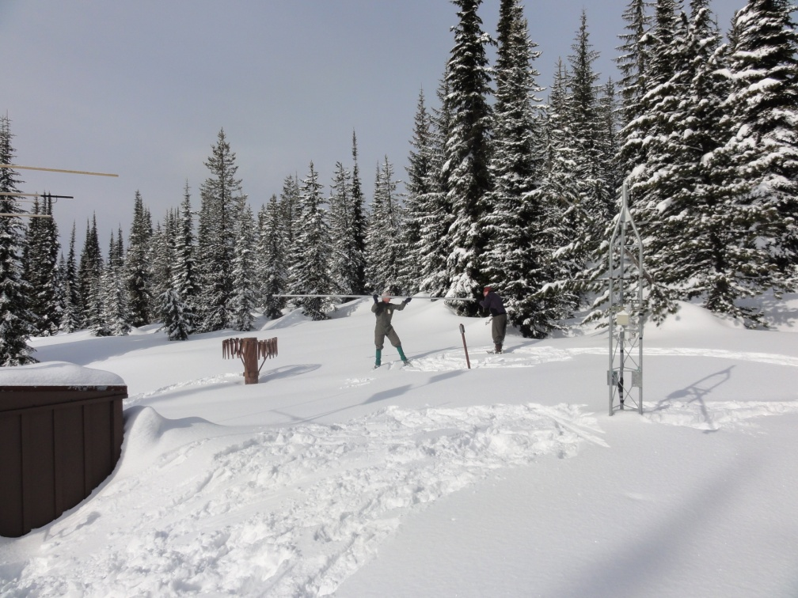



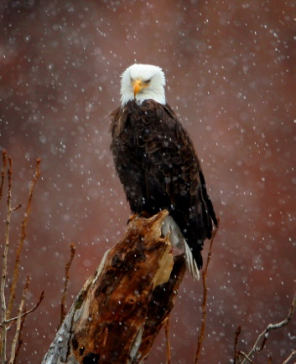
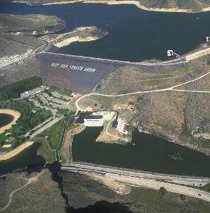
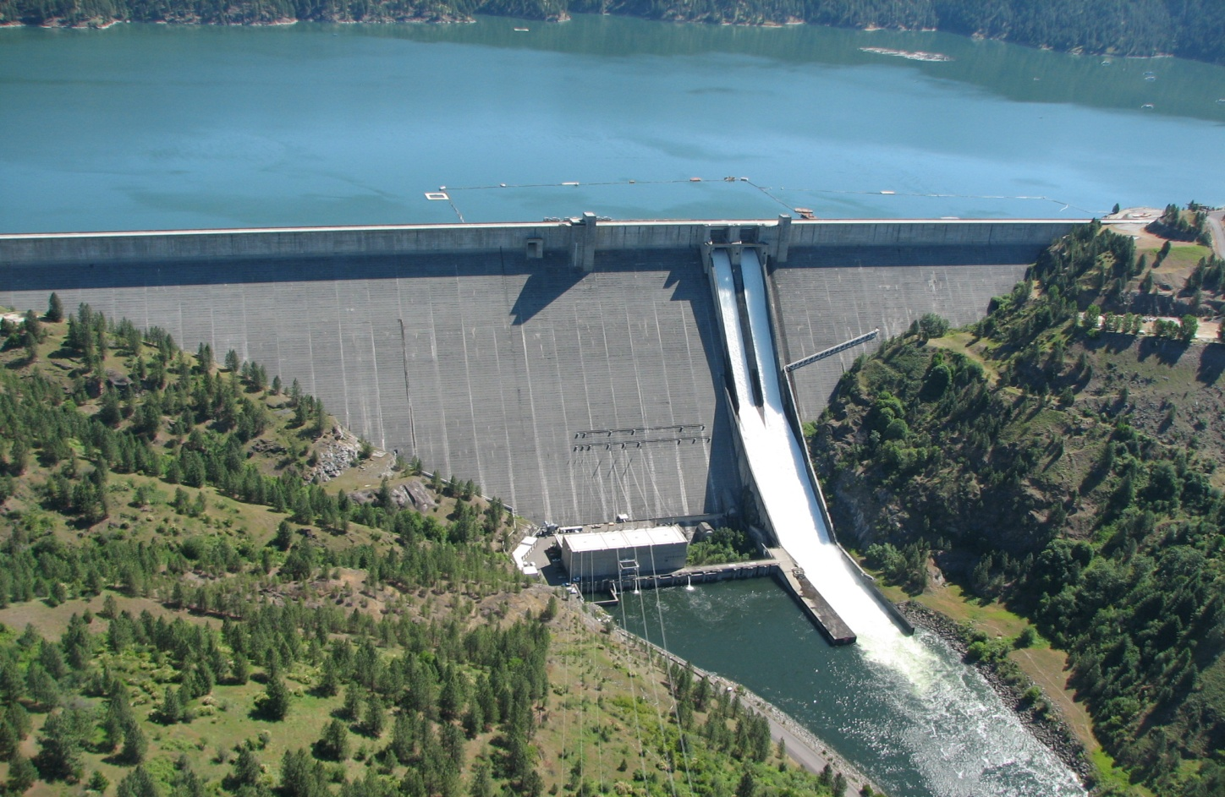
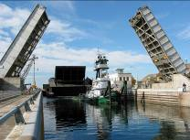


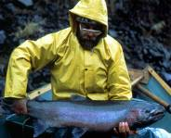
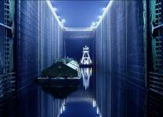
Dworshak Reservoir Regulation Water Year 2017
Stephen Hall P.E.
Water Management Program Manager
Walla Walla District
December 12th, 2017
US Army Corps of Engineers
BUILDING STRONG®

Slide 2
So What about 2017??
Unit 3 Outage…
Power house discharge limited
To 45% of normal
+
Record runoff in March…
=

Slide 3
A Perfect Storm

Slide 4
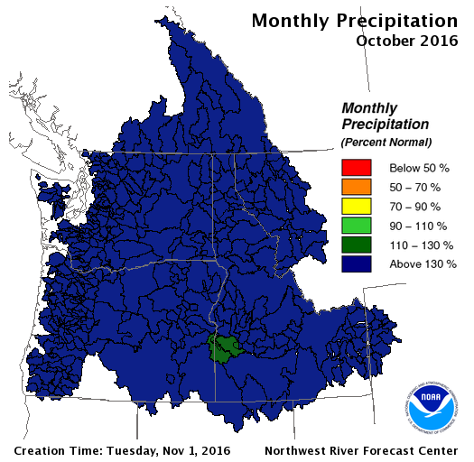
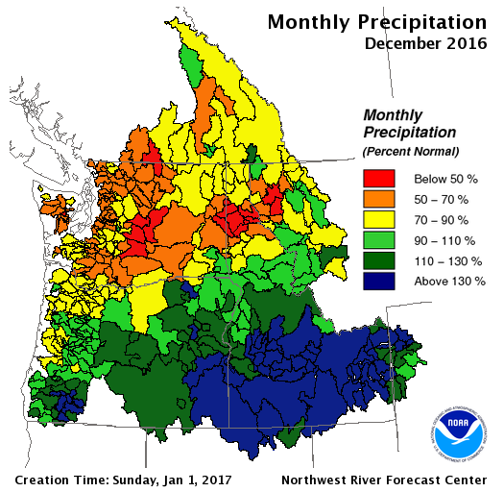
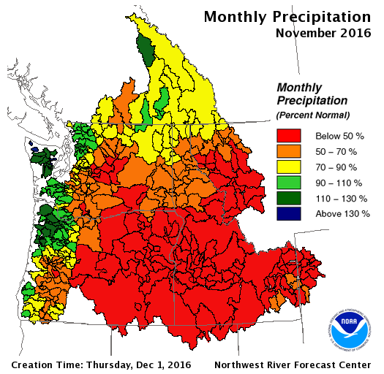
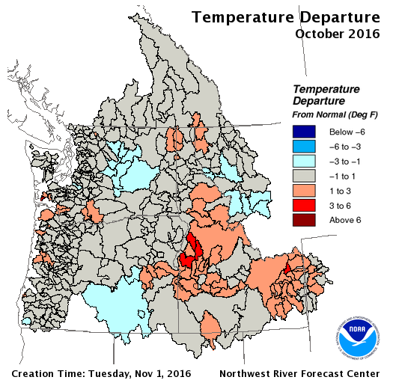
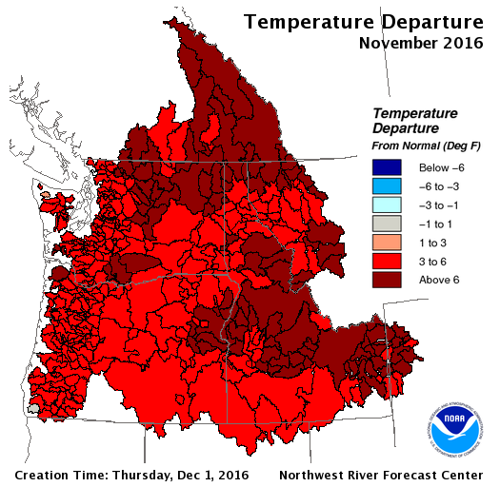
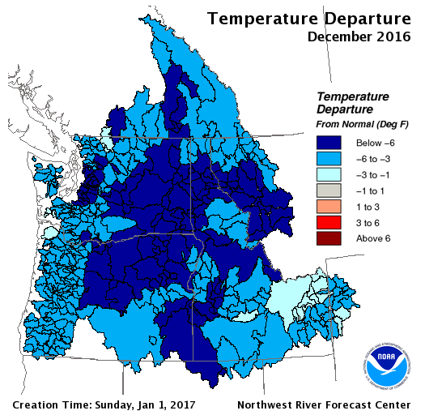
Brief Recap of Weather

Slide 5
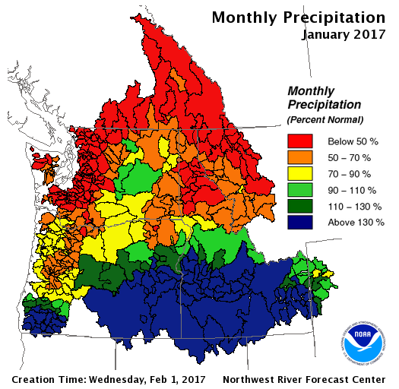
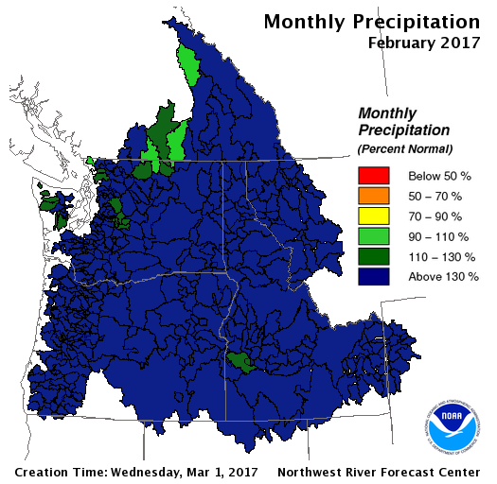
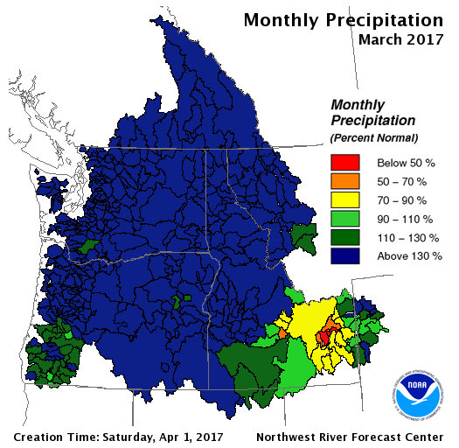
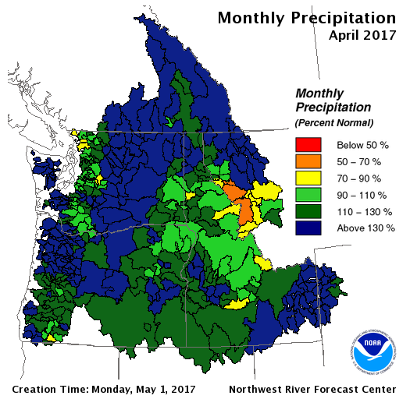
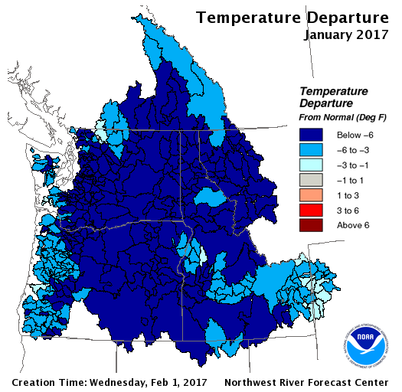
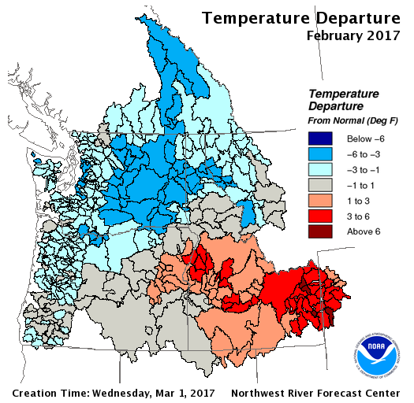
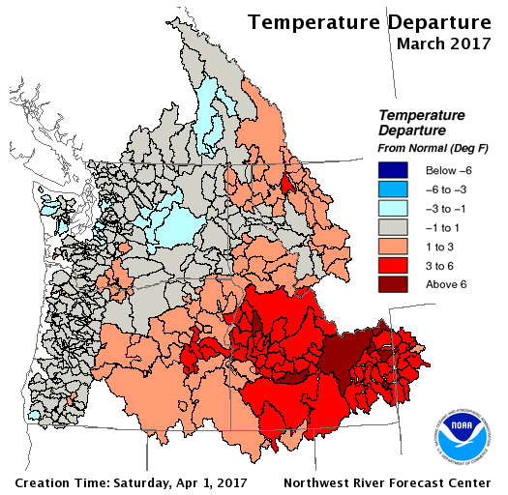
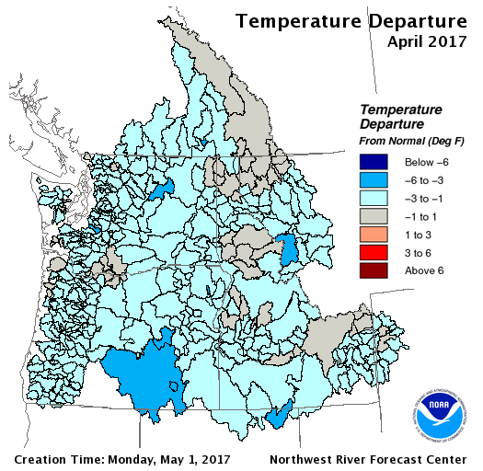

Slide 6
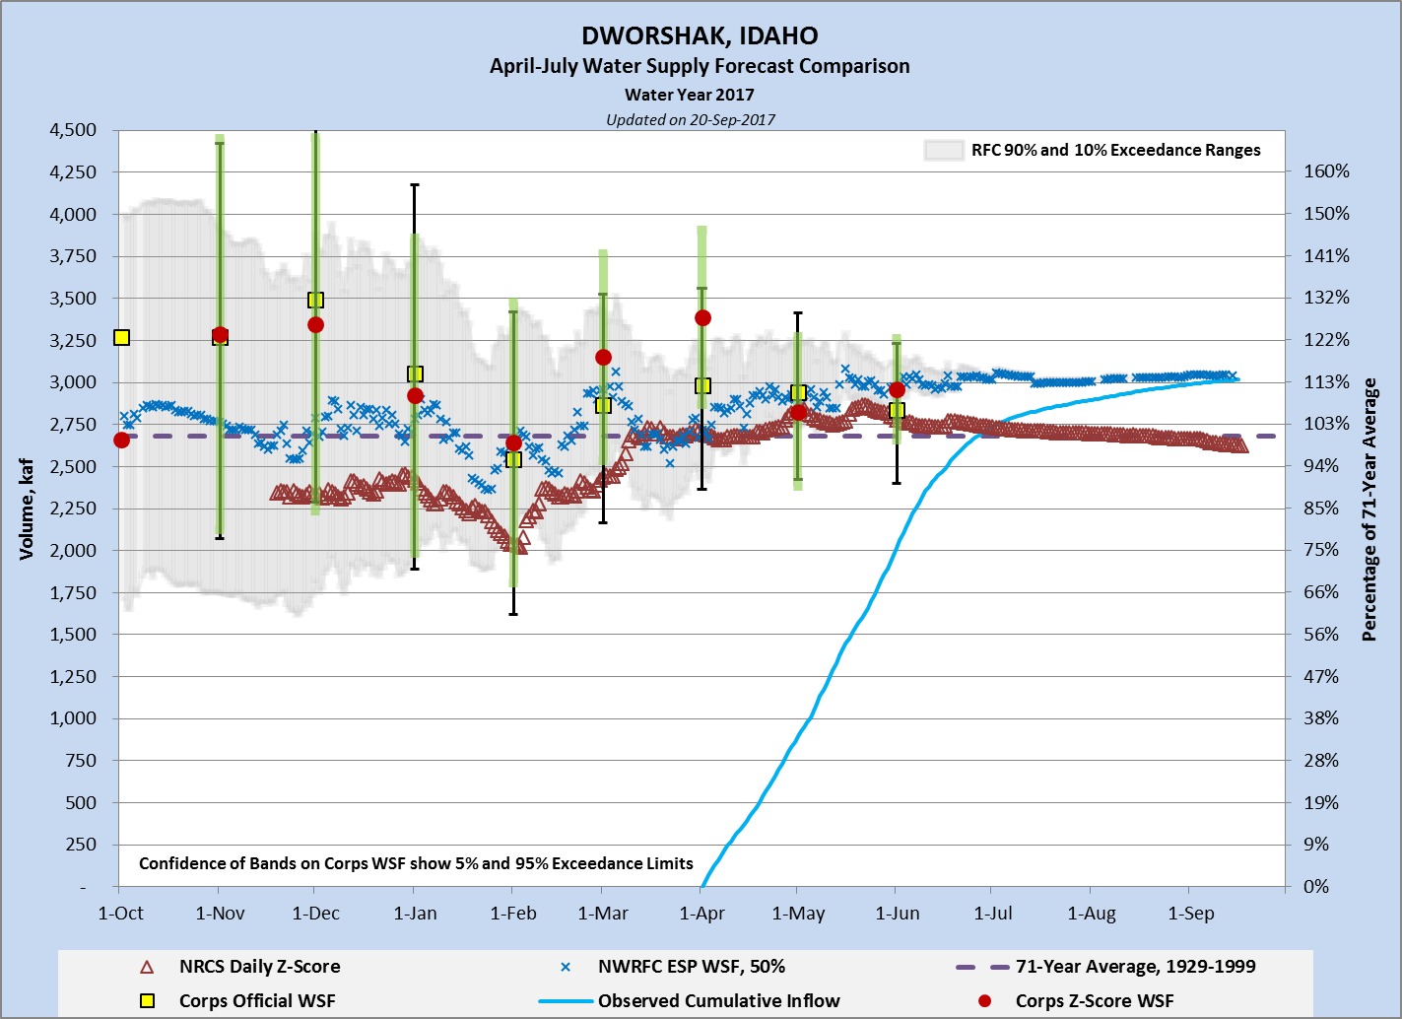

Slide 7
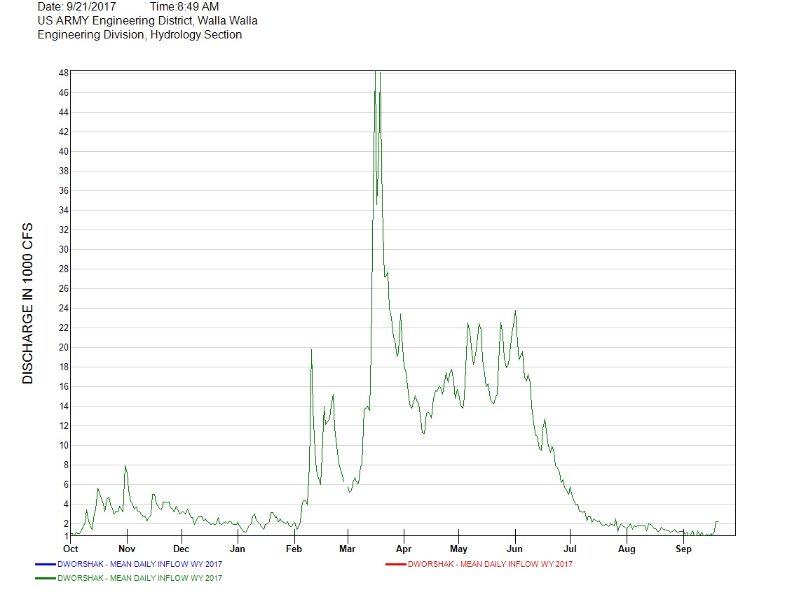
March to June = 3.98 MAF
April to July = 2.90 MAF

Slide 8
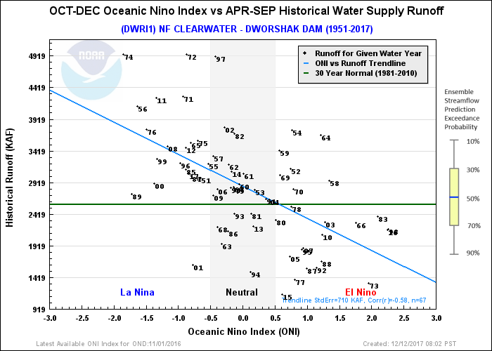
2017

Slide 10
TMT Meetings

Slide 11
Dworshak USACE Proposed Operations

Slide 16
Questions?

Slide 17

Temperature Control Augmentation FY17 Operations Review
Stephen Hall, P.E., PMP
Water Management Program Manager, CENWW
US Army Corps of Engineers
BUILDING STRONG®

Slide 18
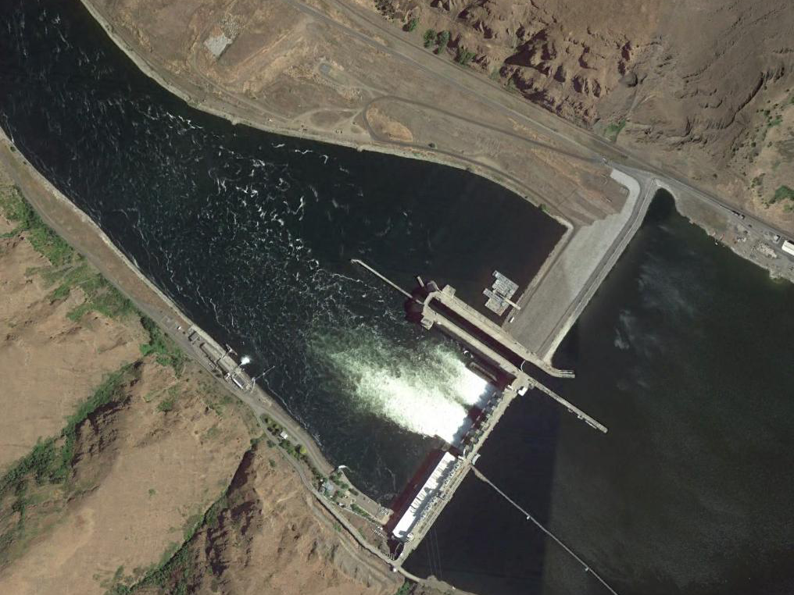

LOWER GRANITE LOCK & DAM
LGNW
TDG STATION
THERMISTER STRING
> 68.0
66.0 - 68.0
65.0 - 66.0
60.0 - 65.0
< 60.0

Slide 19
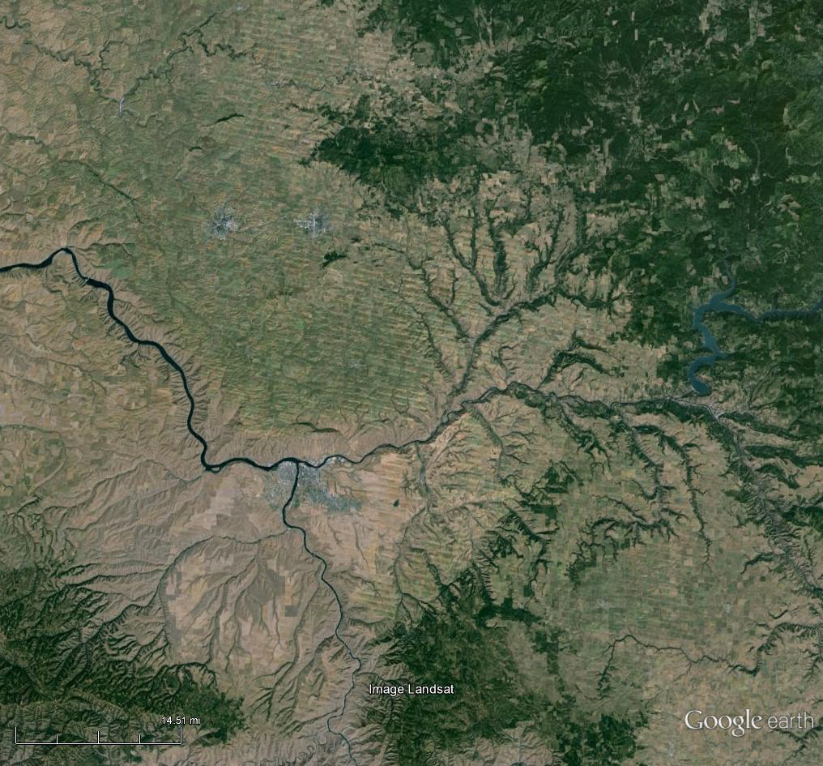
DATA COLLECTION STATIONS USED IN MODELING
SNAKE RIVER BELOW LOWER GRANITE (LNGW)
LOWER GRANITE LOCK & DAM
SILCOTT ISLAND WEATHER
CLEARWATER AT PECK (PEKI)
DWORSHAK DAM
CLEARWATER AT OROFINO (ORFI)
LEWISTON AIRPORT WEATHER
SNAKE RIVER AT ANATONE (ANAW & ANQW)

Slide 31
1565.0
QUESTIONS ????

