Slide 1
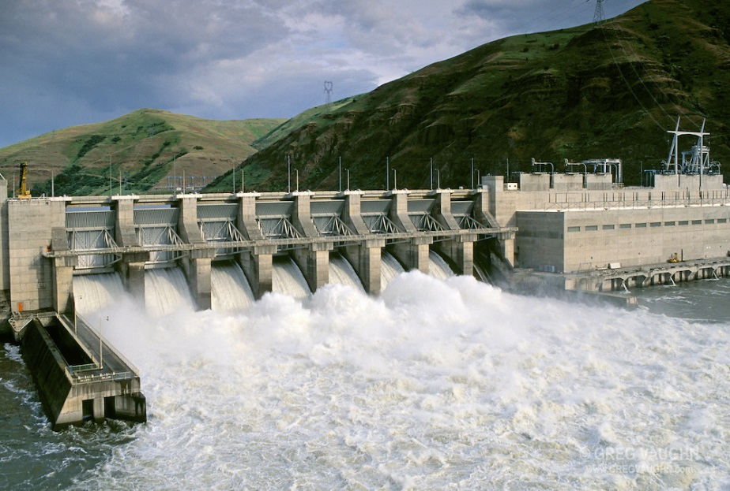
2017 Flow, Debris, spill and TDG
TMT Year-end Review, 12/12/2017
Doug Baus
Dan Turner

Slide 2
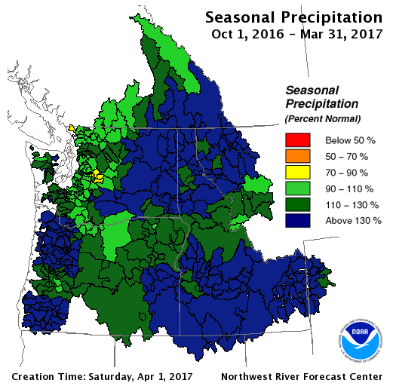
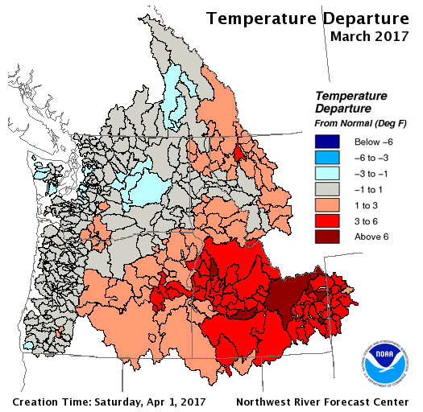
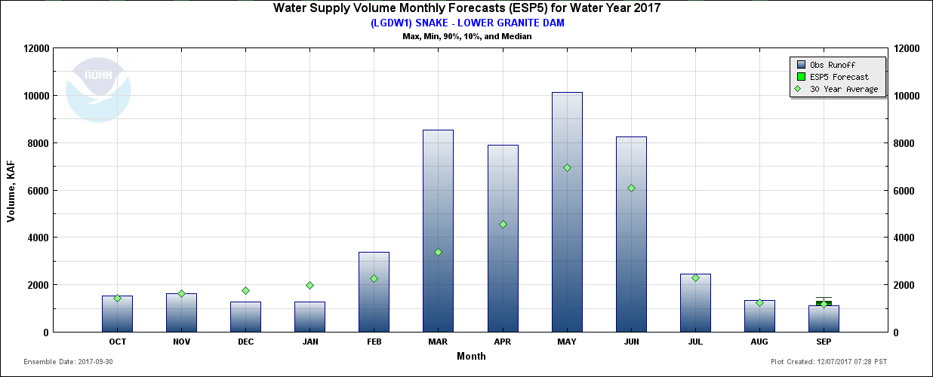
Lower Granite: 2017 Runoff
Early runoff due to heavy snowpack, rain, and warm temperatures
Seasonal precipitation well above normal throughout Columbia Basin
March precipitation in Clearwater Basin was 224% of normal
March runoff at Lower Granite was 254% of normal
Total volume: 8.5 MAF
Lower Granite Peak Q: 192 kcfs
Snake @ Anatone Peak Q: 134 kcfs
Clearwater @ Spalding Peak Q: 102 kcfs
February-June runoff was 165% of normal
Total volume: 38.2 MAF

Slide 3
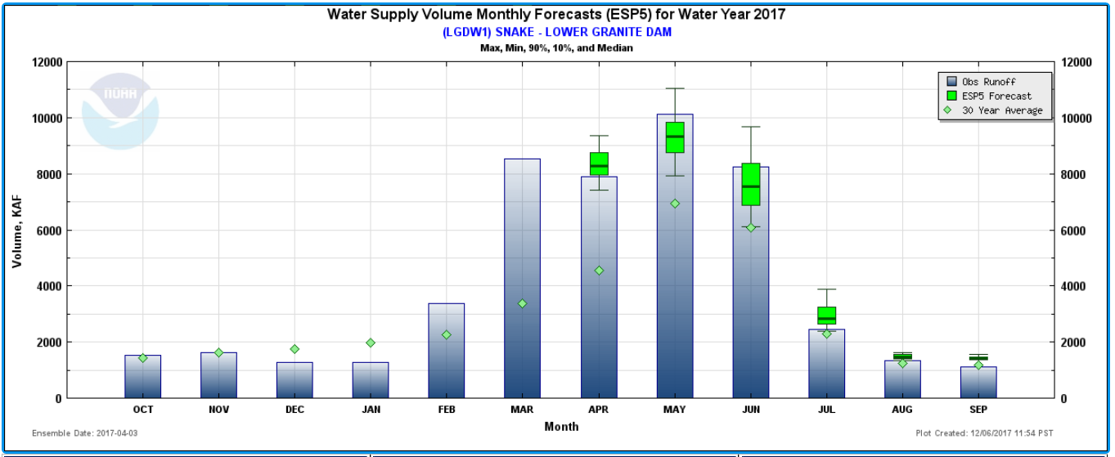
High runoff volume and Debris
Lower Granite Dam - April to July runoff volume (145 % of normal @ 29 MAF) mobilized debris during the spring of 2017 (Photo - LWG forebay debris 5/15/17).
Debris impacts on juvenile salmon and steelhead - types of impacts included separator mortalities, transport loading mortalities, and orifice blockages (See - 17LGS05, 17LGS06, and 17LGS07).
Types of operations implemented to minimize debris impact on salmon and steelhead included debris spills, bypassing to river, and/or backflushing orifices.

Slide 4
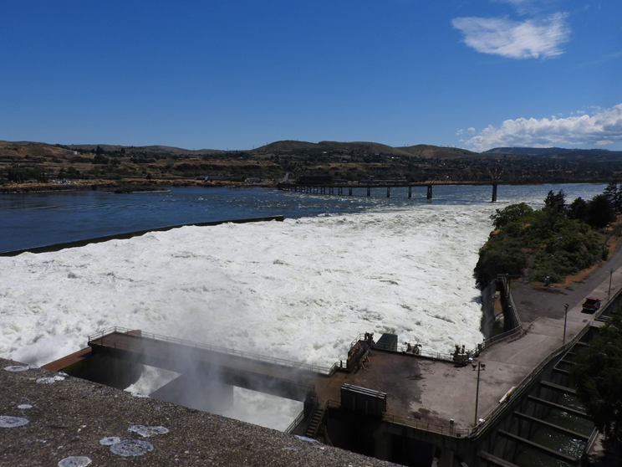
Overview
Review total flow, spill and generation at key projects
Spill and TDG time series
Spill and TDG relationships

Slide 5
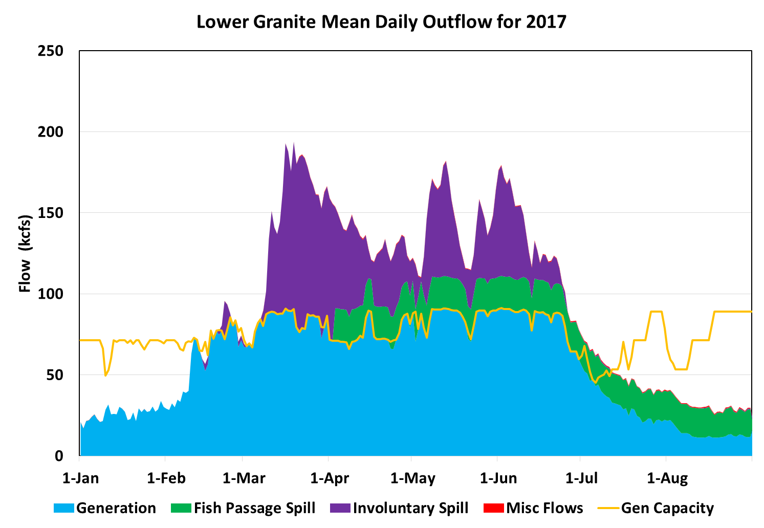
Lower Granite Mean Daily Outflow, 2017
Variable generation capacity impacts spill
FOP spill 20 / 18 kcfs
Involuntary spill in spring
Quick drop in flow in late June and early July
Operating at minimum generation in August (12 – 15 kcfs)

Slide 6
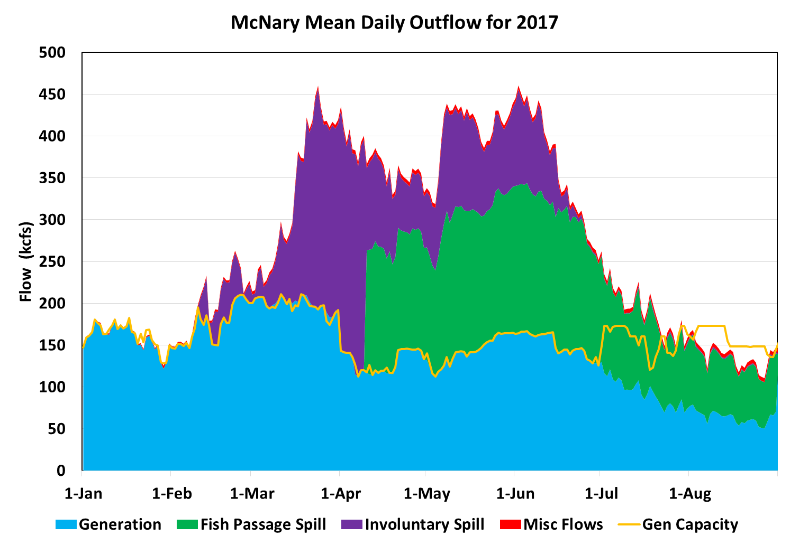
McNary Mean Daily Outflow, 2017
Fish passage spill is 40% / 50% of project outflow
Generation flow limited to the 1% range starting in April (50 kcfs drop).

Slide 7
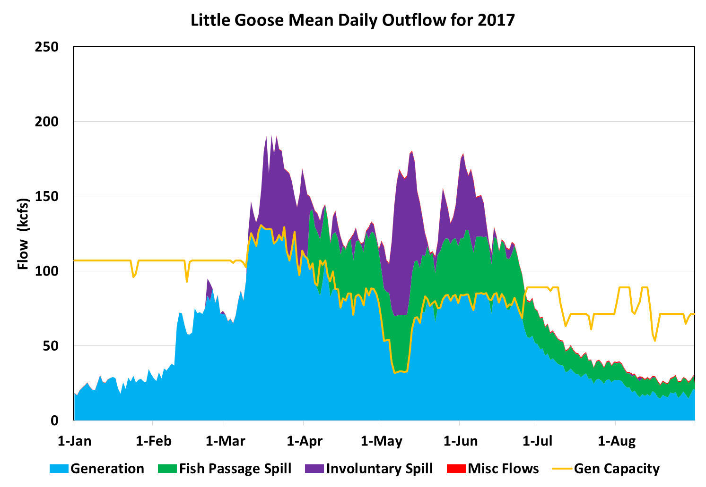
Little Goose Mean Daily Outflow, 2017
Usually, 4 units are available in May.
Only 2 units available from 5/5 to 5/12 due to raking of trash, debris and torn screens.

Slide 8
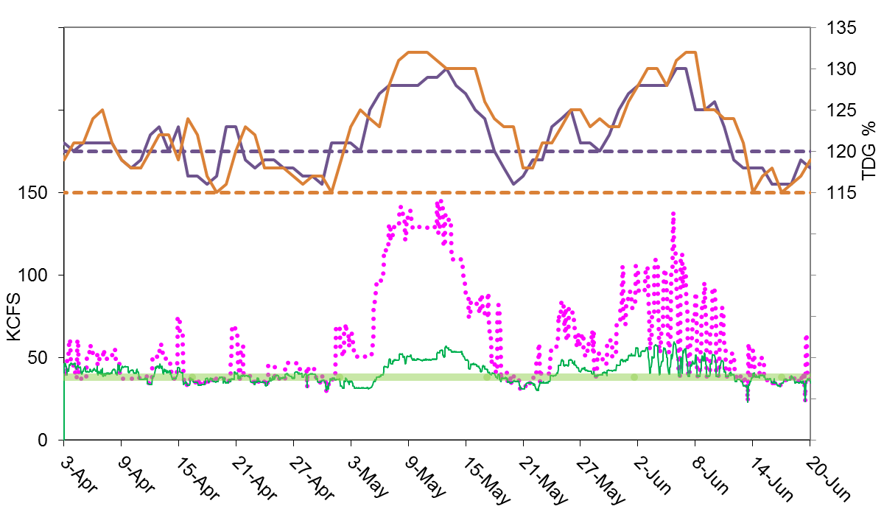
Little goose dam – 2017 spill and tdg
Spill Cap: the spill rate that is predicted to achieve a target TDG.
The fish passage target spill rate is the lesser of the spill cap or the 30% spill.
Unit outages May 5 - 12
Adult fish passage operation in early June, 30% spill in morning hours to help alleviate adult delay (coordinated through TMT)
Little degassing to next downstream forebay
TW TDG
d/s FB TDG
Actual spill
30% spill
Spill Cap

Slide 9
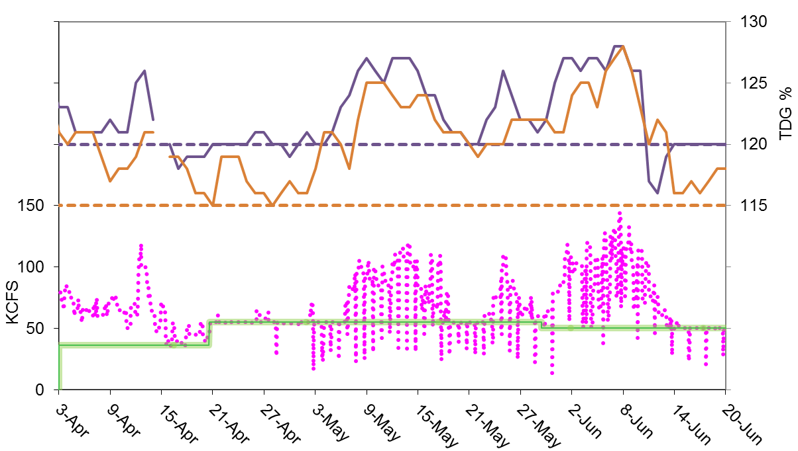
Lower monumental – 2017 spill and tdg
Gas Cap spill cap not attainable during involuntary spill or minimum generation.
Uniform pattern operation started on April 3
Switched to bulk pattern on June 26
Spill was reduced for safe passage of fish barges crossing project tailwater (1-2 hours).
TW TDG
d/s FB TDG
Actual spill
Spill cap

Slide 10
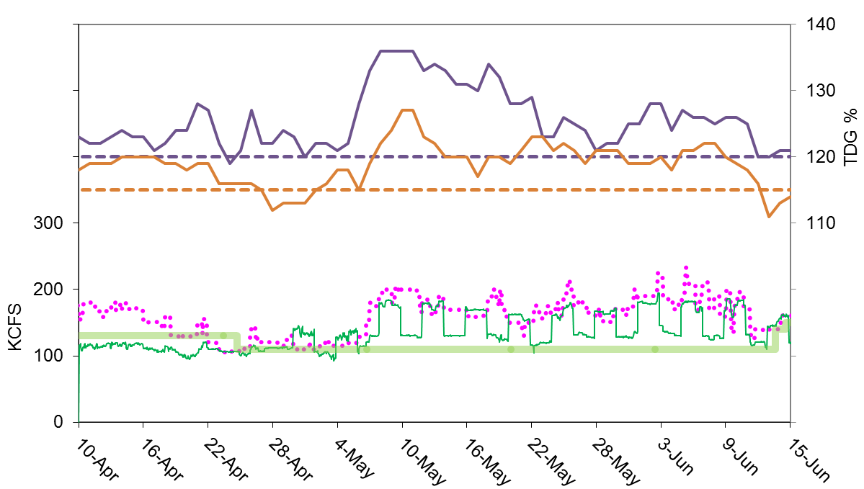
John Day – 2017 spill and tdg
Highest TDG = 136 % from 5/8 – 5/11
Spill bays 3 and 5 out of service 4/19 – 5/22
TW TDG
d/s FB TDG
Actual spill
30% / 40% spill
Spill cap

Slide 11
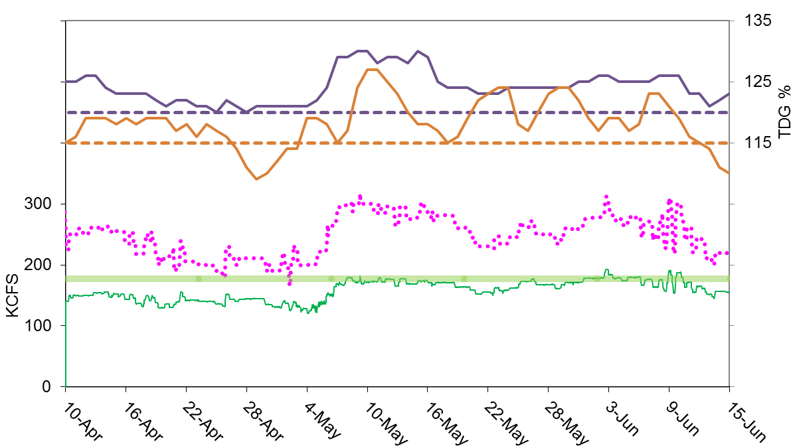
McNary – 2017 spill and tdg
Periods of high TDG:
4/1 to 4/14: 124 to 129% TDG
5/7 to 5/16: 128 to 130% TDG
Discussion in TMT/FPOM regarding:
Carrying “contingency” reserves outside of 1%;
Operating at “best operating point” above 1%.
Predicted impact to TDG of TMT options:
~25 kcfs increase generation and decrease in spill, estimated decrease of 2 - 5% TDG
TW TDG
d/s FB TDG
Actual spill
Spill cap
40% spill
Notes:
Contingency (non-spinning) reserves are deployed if necessary to respond to unexpected increased load, voltage, or frequency (~2-4% of the time).

Slide 12
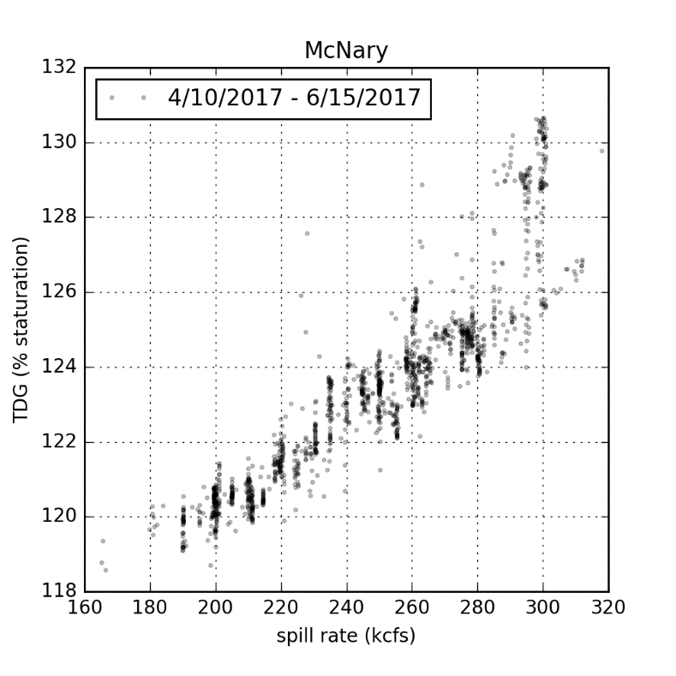
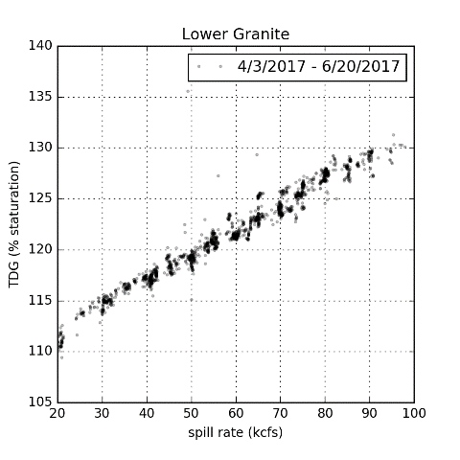
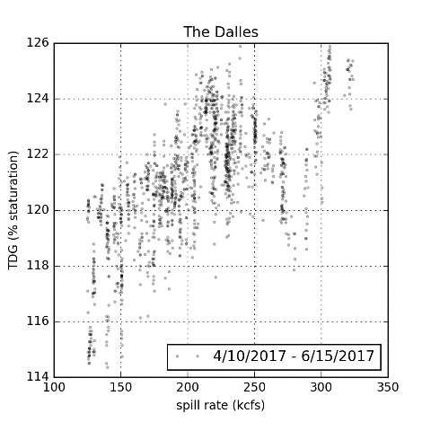
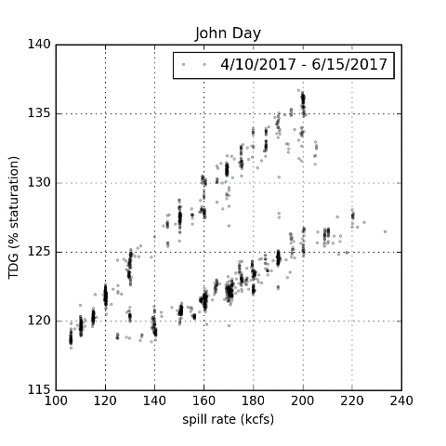
TDG to spill Relationships
Non linear
There is uncertainty in predicting TDG
Spill pattern changes affect predictive relationships:
JDA 4/19 – 5/22
Need to account for travel time in downstream forebay TDG (i.e. SYSTDG).
Well behaved
SB 3 + 5 closed
Poorly behaved

Slide 13
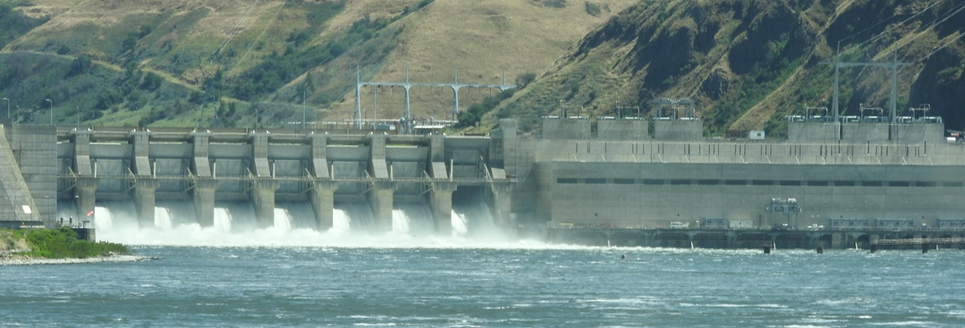
Conclusions
In 2017 we saw involuntary spill and high TDG due to high runoff
TDG predictions are uncertain, especially at certain gauges.
Potential adaptive management tools that could be used to reduce TDG:
Shift “contingency” reserves from TDA upper 1% to MCN above 1%:
allows TDA to operate in upper 1% = ~30 kcfs additional TDA turbine capacity and ~1-3% less TDG
Operate MCN turbines at “best operating point” above 1%:
~28 kcfs additional MCN turbine capacity (~2 kcfs/unit) and ~2-5% less TDG
Notes:
Contingency (non-spinning) reserves are deployed if necessary to respond to unexpected increased load, voltage, or frequency (~2-4% of the time).

