Slide 1
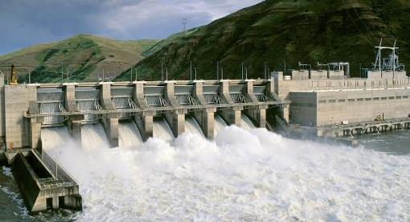
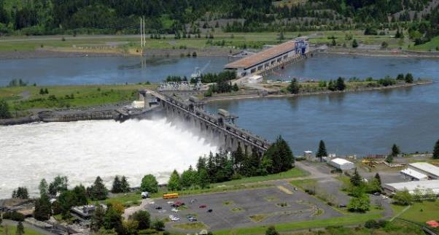
Total Dissolved Gas and Flexible Spill Operations
Dan Turner
Water Quality Team Lead
Northwestern Division, Reservoir Control Center
Date: 11 December 2019

Slide 2
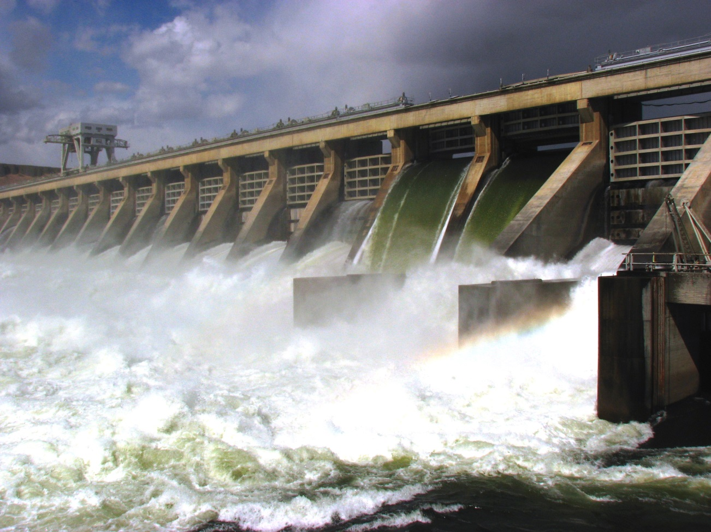
Outline
Recap of 2019 spill season conditions
2019 Flexible spill operations
Summary of total dissolved gas targets and levels
Look ahead to 125% TDG in 2020 – planned operations, issues relevant to in-season decisions
Takeaways and lessons learned to carry into future TMT decision making.

Slide 3
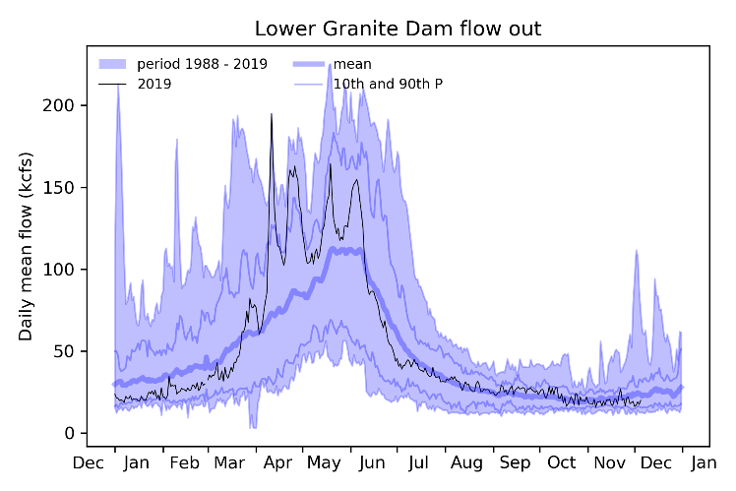
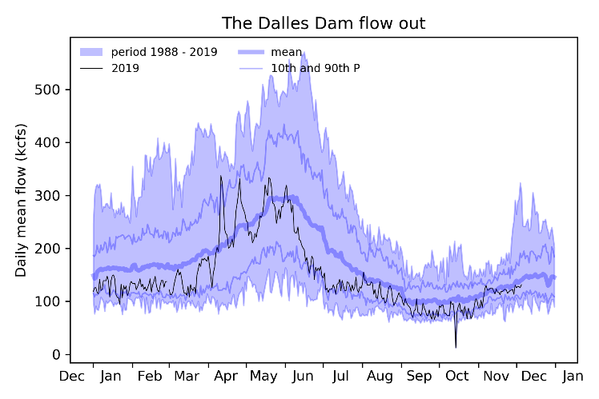
Recap of 2019 spill season conditions
The April-August runoff:
Lower Granite totaled 24.6 Maf, or 116% of average.
The Dalles totaled 81.0 Maf, or 93% of average.

Slide 4
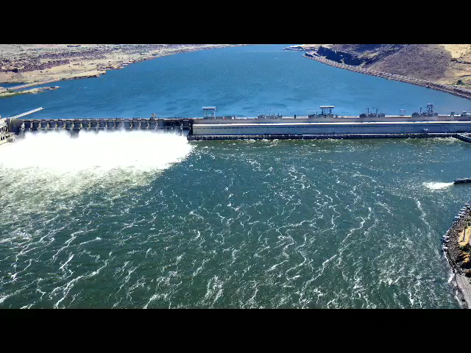
Flexible Spill operations
Fish passage spill: flow through spillway to aid fish passage (i.e. voluntary spill).
Spill cap: the estimated spill level that maximizes spill to a level that meets, but does not exceed, the gas cap.
Performance standard spill: spill level determined by NOAA fisheries to meet performance standard objectives.
Generation flow: flow through the powerhouse, minimum and maximum constraints (i.e. powerhouse flow).
Involuntary spill: flow through spillway when powerhouse capacity is exceeded (i.e. forced spill).
John Day Dam tailrace, June 14, 2019, ~10:50 to 11:10 AM
From: 142 kcfs fish passage spill (gas cap spill) + 78 kcfs generation
To: 65 kcfs fish passage spill (performance standard) + 129 kcfs generation

Slide 5
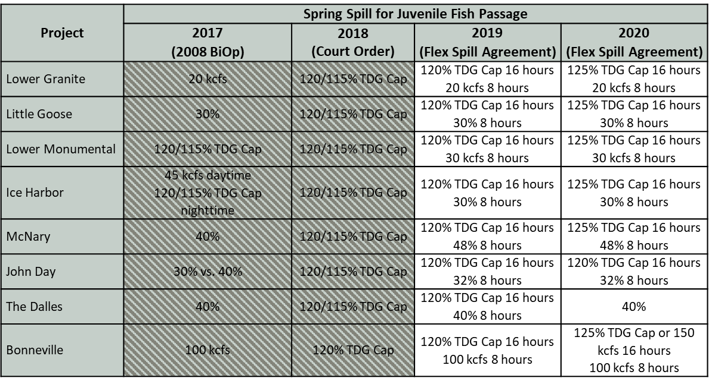
Flex spill spring operations for juvenile fish passage

Slide 6
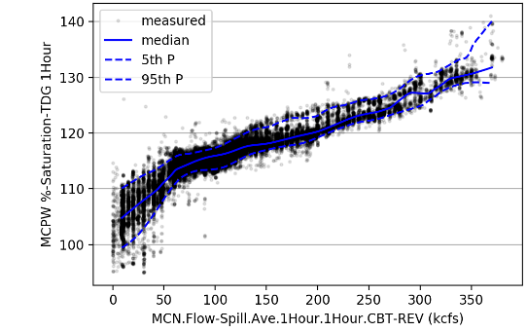
Procedure to set spill caps for Gas CAP spill
Spring Spill Operations:
April 3 – June 20 for lower Snake projects
April 10 – June 15 for lower Columbia projects
Summer Spill Operations until August 31
Daily Process (7 days/week)
Review data and flow / weather forecast
Run SYSTDG, as needed
Estimate maximum spill level that meets but does not exceed the gas cap, considering:
Spill and TDG relationship
Forecasted environmental factors
Most restrictive gauge
Travel time
Coordinate with NOAA
Notify projects and BPA
Post spill caps on web
Weekly coordination at TMT
Monthly reporting
McNary tailwater, 2011-2019
125
226 274 302

Slide 7
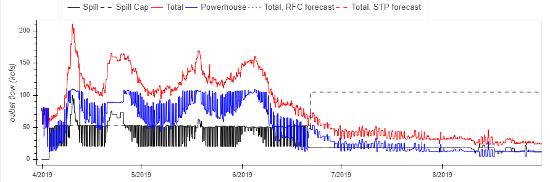
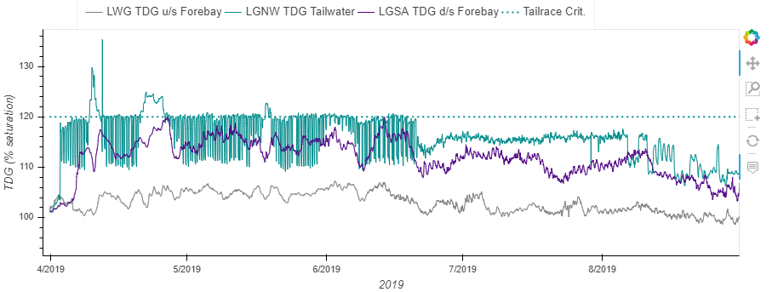
Example: lower granite

Slide 8
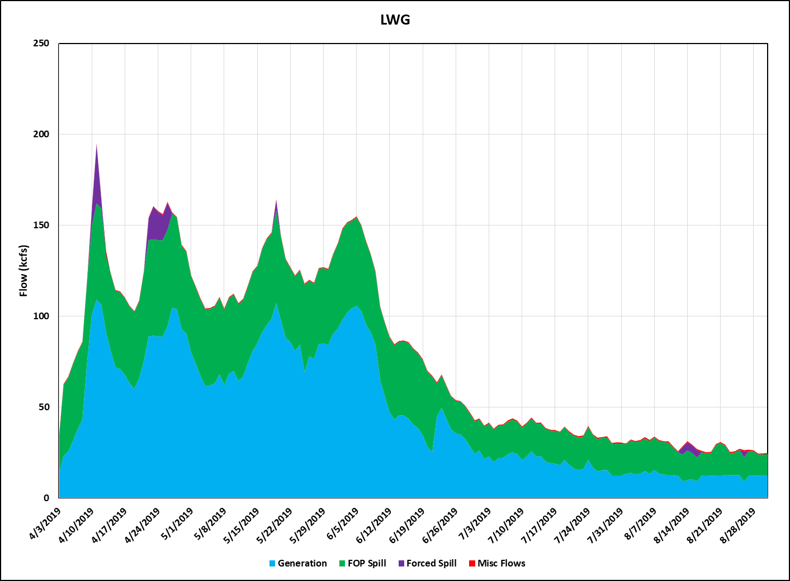

Slide 9
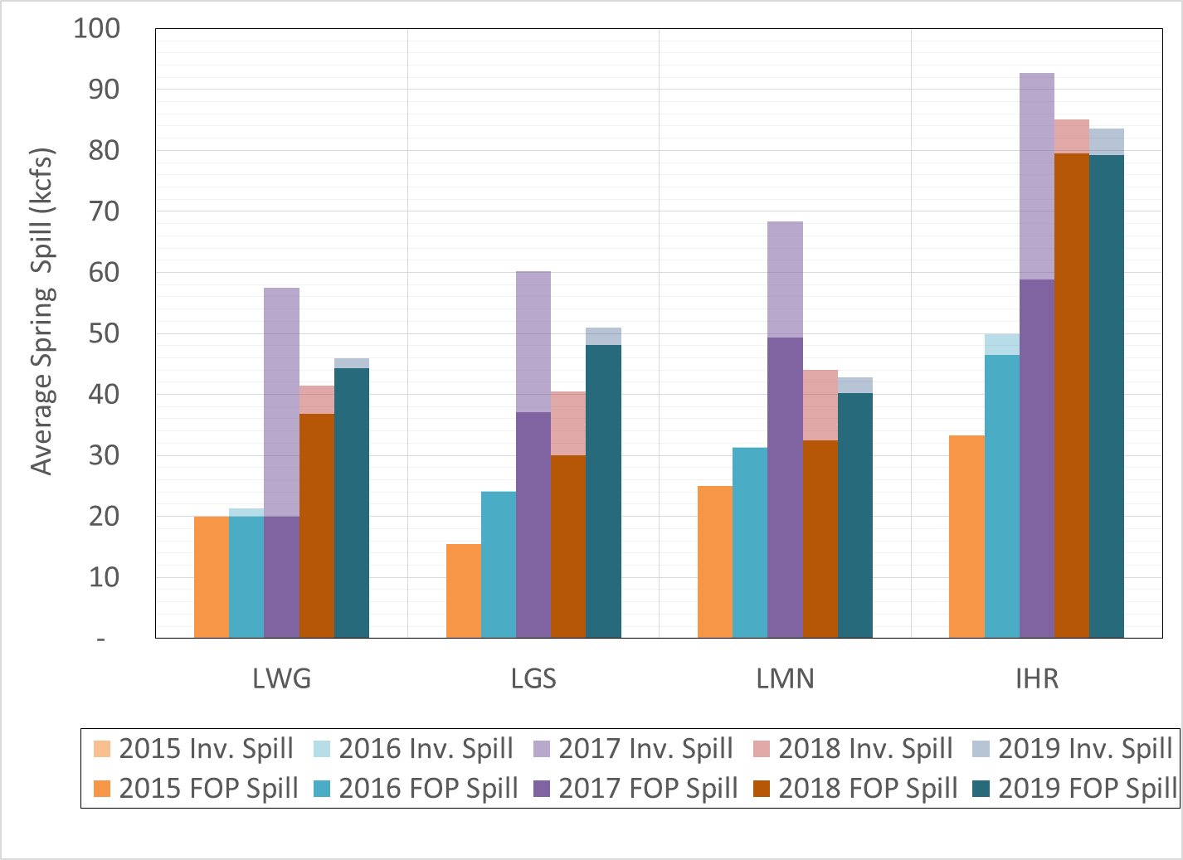
Snake Average spring spill: 2015 - 2019
Total spill is influenced by total flow and planned spill operation.
Voluntary spill levels have generally increased since the NOAA 2014 Supplemental BiOp spill operations (2015 – 2017).
7

Slide 10
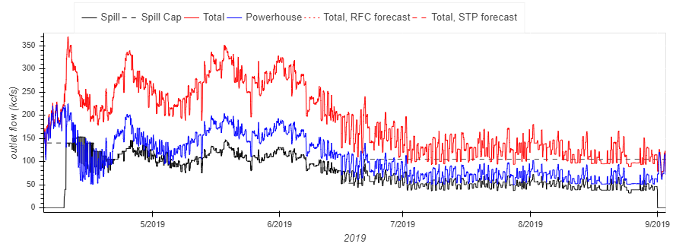
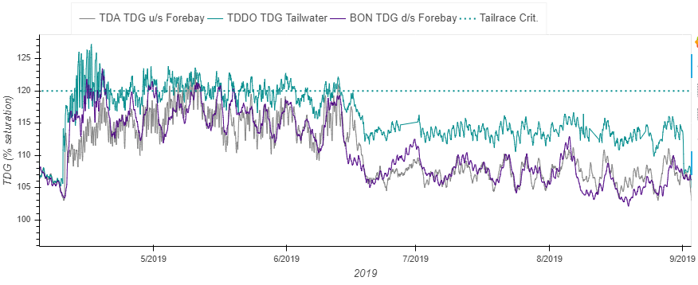
Example: The Dalles

Slide 11
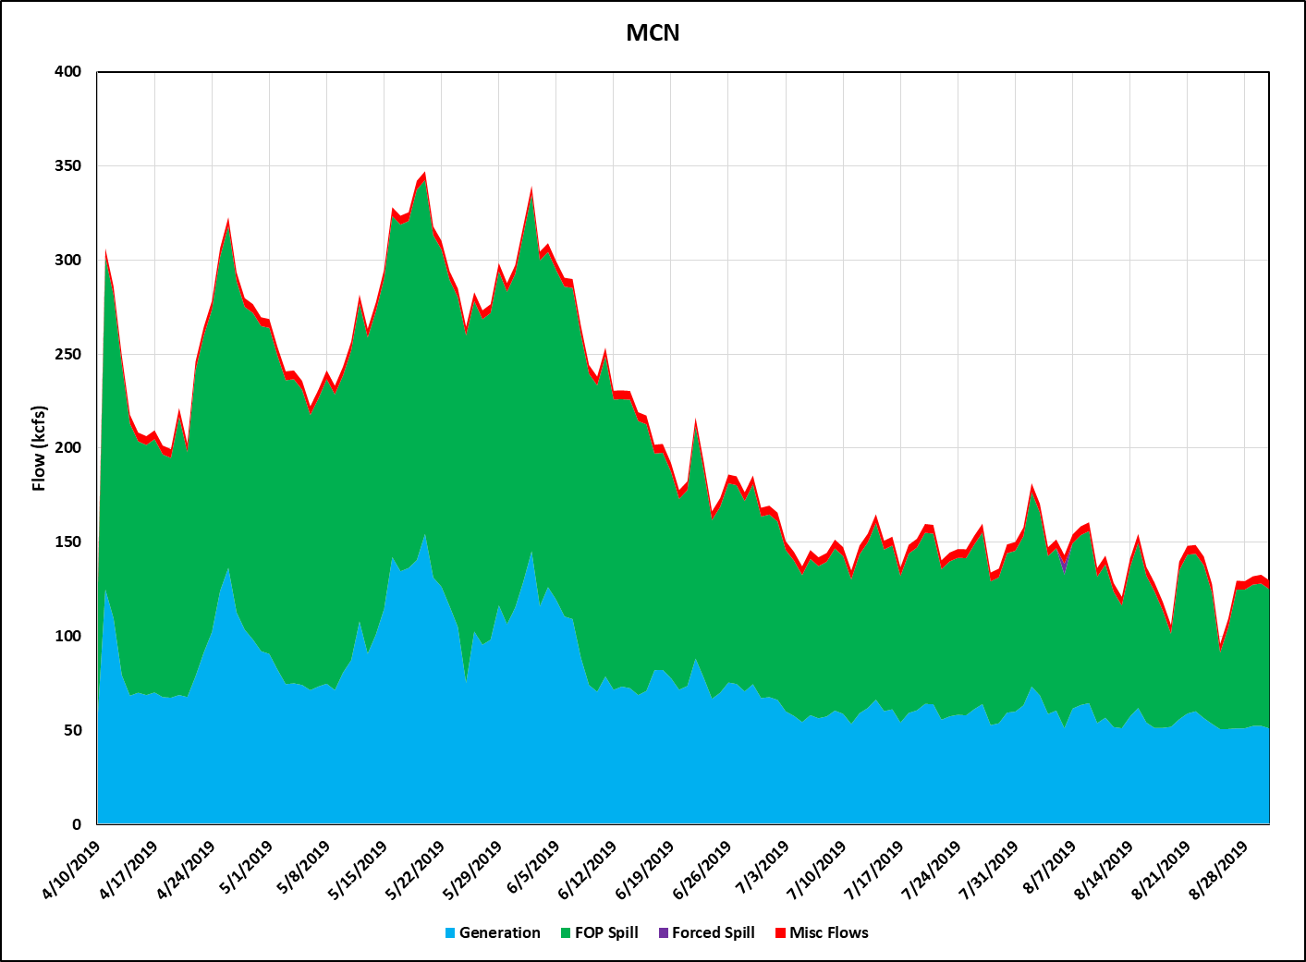

Slide 12
Columbia Average spring spill: 2015 - 2019
Total spill is influenced by total flow and planned spill operation.
Voluntary spill levels have generally increased since the NOAA 2014 Supplemental BiOp spill operations (2015 – 2017).
McNary John Day The Dalles Bonneville
7

Slide 13
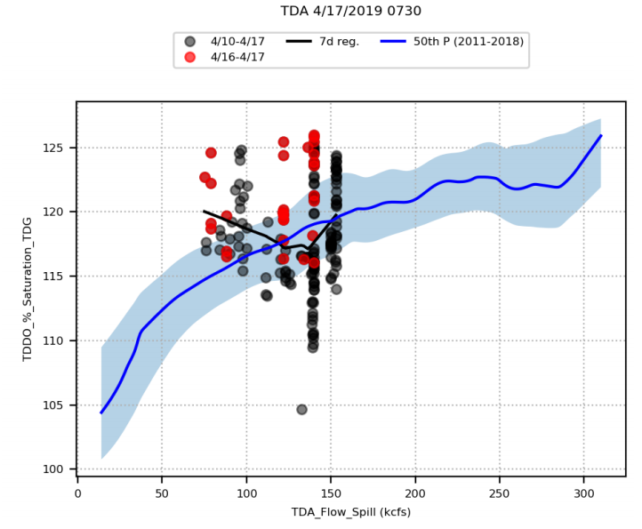
2019 Adaptive spill management
April 8: Lower Monumental, performance standard spill, bulk to uniform spill pattern, TDG exceedance.
April 25: The Dalles, change the 120% TDG spill cap from a specific rate (kcfs) to a percent of total flow.
May 10: Joint spill operation with The Dalles and John Day.
May 29: 120% TDG at all 8 tailwater gauges.
May 29 to June 20: Little Goose adult passage issues (discussed elsewhere).

Slide 14
Summary statistics, during spill cap spill, spring 2019
 | Spill caps (kcfs) |  |  | 2019 Flex Spill |  | Spill At Spill Cap # days | Relationship of TDG to gas cap (% of days) |  |  |  | Range of actual spill (% of total flow) |  |  |  | 2018 % spill
Project | Min | Ave | Max | Cap Est |  | SR 79 CR 67 | Below | At | Above |  | Min | Ave | Max |  | Ave
Lower Granite | 49 | 52 | 53 | 45 |  | 67 | 24% | 75% | 1% |  | 31% | 39% | 63% |  | 44%
Little Goose | 52 | 54 | 56 | 52 |  | 61 | 20% | 75% | 5% |  | 36% | 44% | 61% |  | 37%
Lower Monumental | 40 | 44 | 52 | 44 |  | 59 | 31% | 53% | 17% |  | 27% | 38% | 70% |  | 41%
Ice Harbor | 85 | 90 | 93 | 87 |  | 45 | 18% | 51% | 31% |  | 62% | 69% | 75% |  | 81%
McNary | 184 | 192 | 198 | 180 |  | 47 | 26% | 68% | 6% |  | 48% | 62% | 70% |  | 65%
John Day | 139 | 156 | 172 | 146 |  | 67 | 63%* | 31% | 6% |  | 40% | 50% | 60% |  | 45%
The Dalles 4/10 - 4/24 | 105 | 128 | 153 | 135 |  | 67 | 22% | 21% | 57%** |  | 39% | 42% | 58% |  | 37%
4/25 – 6/15 | 40% | 41% | 49%
Bonneville | 118 | 125 | 130 | 122 |  | 61 | 26% | 61% | 13% |  | 33% | 43% | 56% |  | 42%

Slide 15
Look Ahead to 2020 Spring Spill

Slide 16
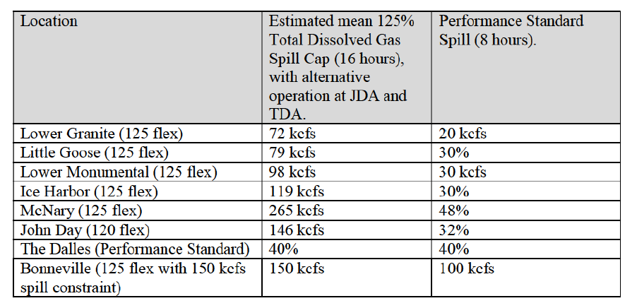
Look Ahead to 2020 Spring Spill
156 kcfs

Slide 17
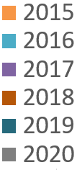
Look Ahead to 2020 Spring Spill
(predicted range using 2015 and 2017 hydrology and estimated spill caps)
Faded color indicates involuntary spill
Estimated Spill Cap

Slide 18
Look Ahead to 2020 Spring Spill
(predicted range using 2015 and 2017 hydrology and estimated spill caps)
Faded color indicates involuntary spill
Estimated Spill Cap

Slide 19
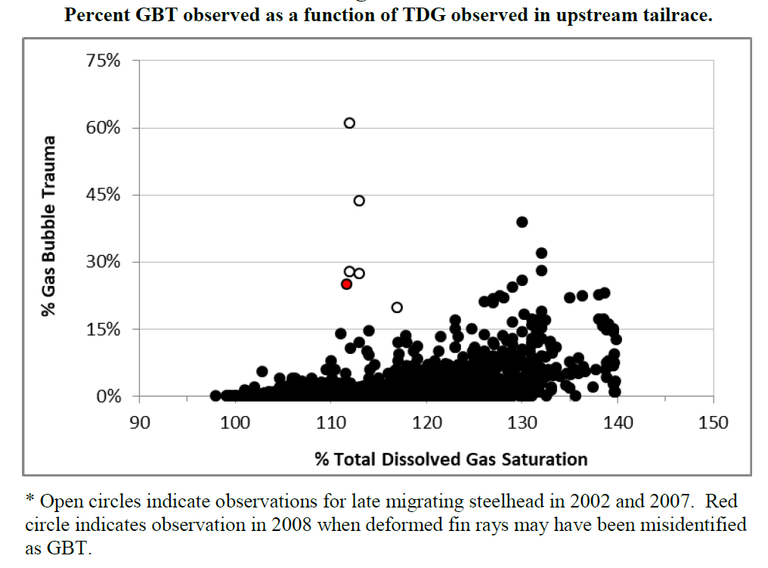
Look ahead: Gas bubble trauma monitoring
Possibility of resident aquatic life monitoring.
Increased risk of reaching thresholds which trigger spill reduction.
Uncertainty in the process:
data collection » review of data » decision » implementation » communication
Figure from FPC, Gas Bubble Trauma Monitoring and Data Reporting for 2019

