Slide 1
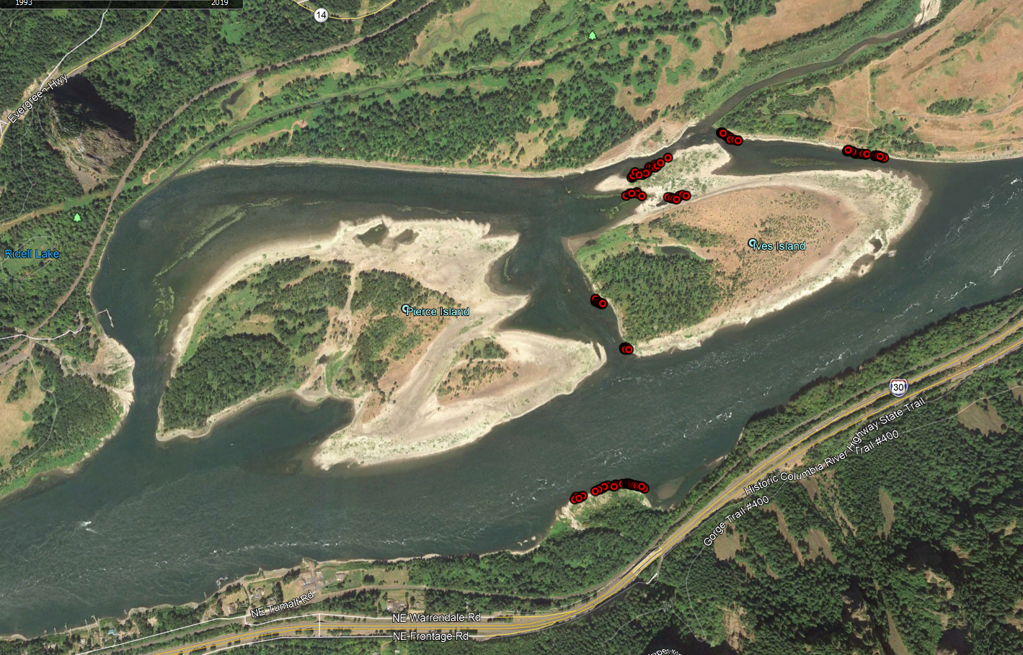
2020 Redd Locations
Ives Channel
Ives Pocket
Strawberry
Breaks
McCord
Woodard (Redds deep and not surveyed)

Slide 2
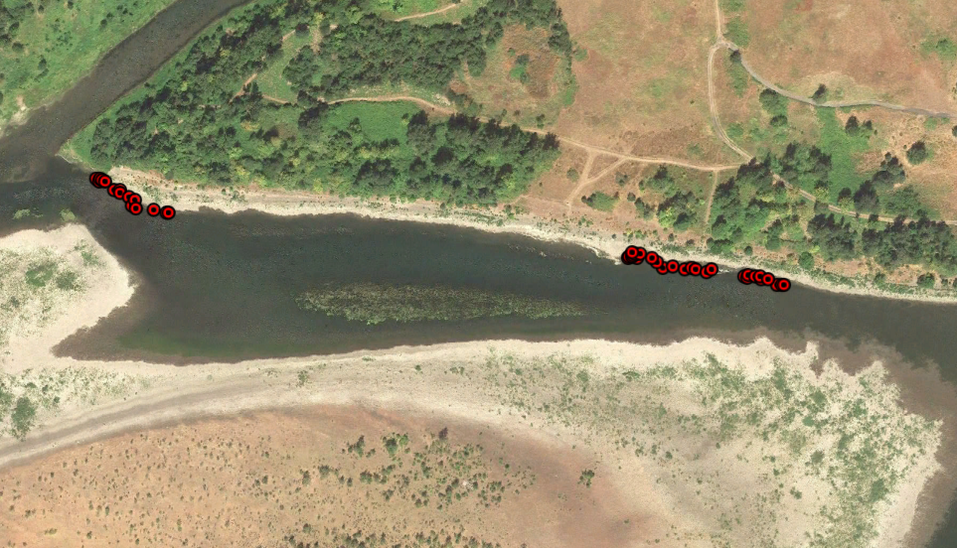
Strawberry Redd Locations

Slide 3
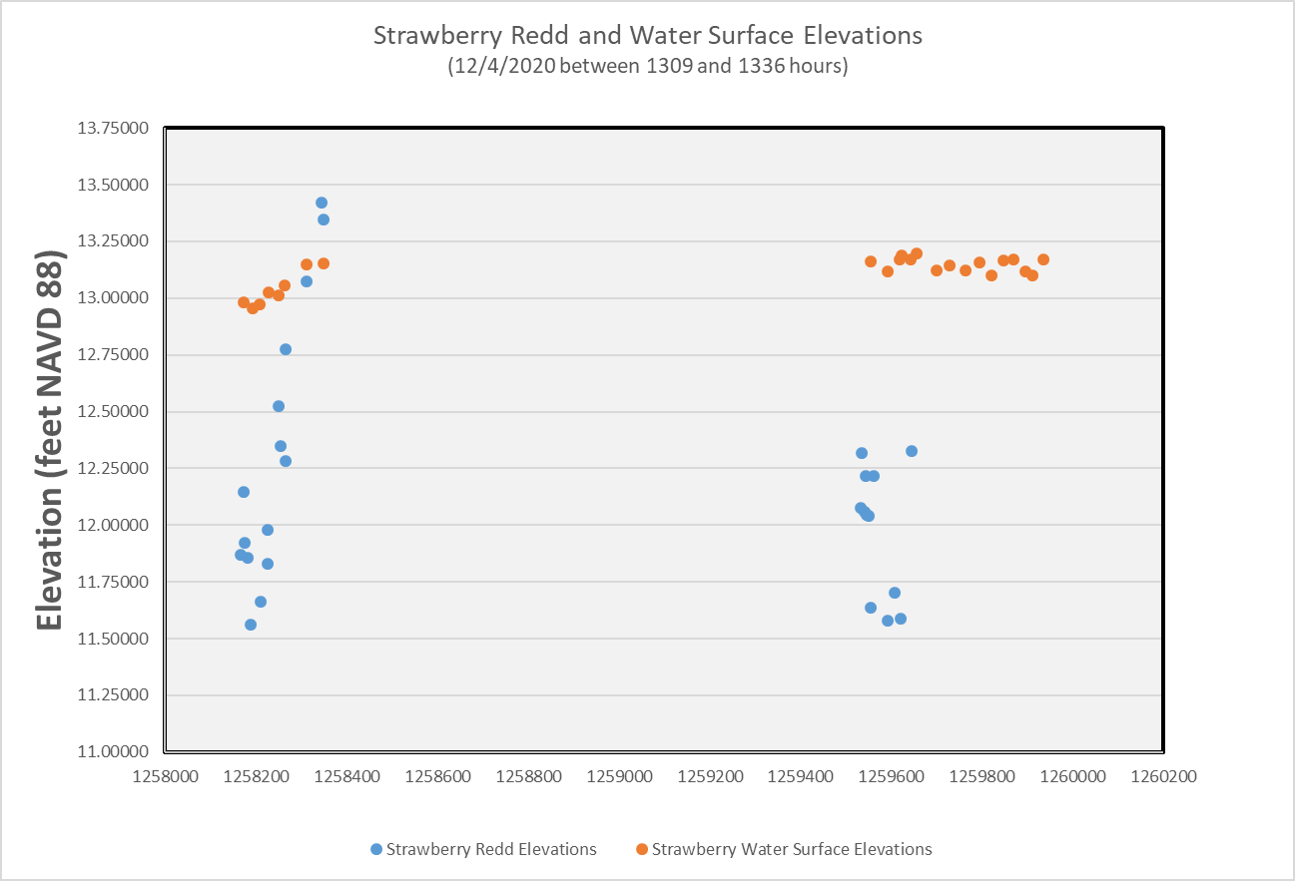
BON TW=11.9’

Slide 4
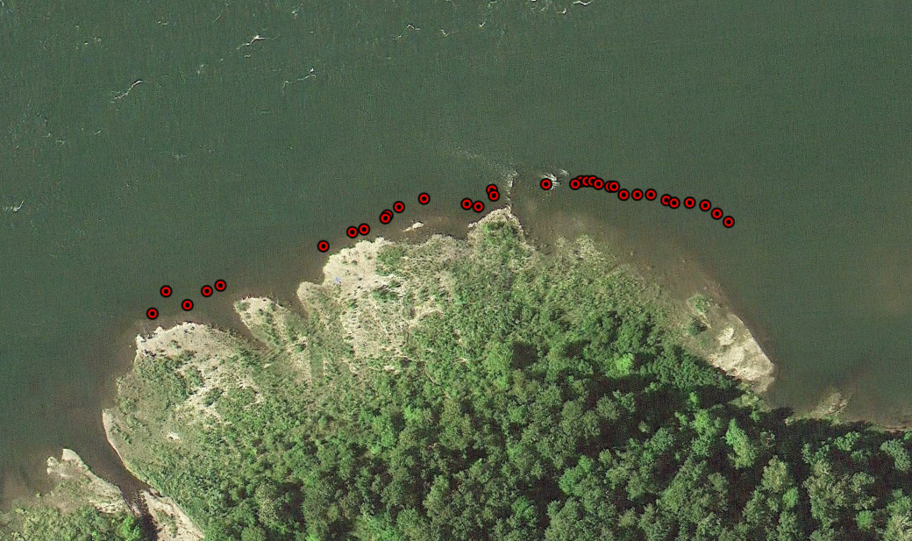
McCord Creek Redd Locations

Slide 5
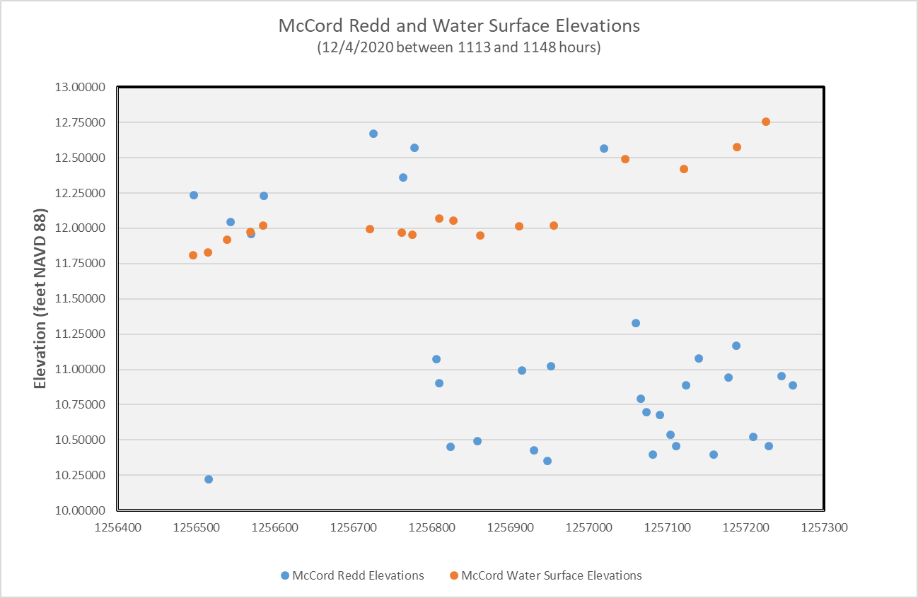
BON TW=11.9’

Slide 6
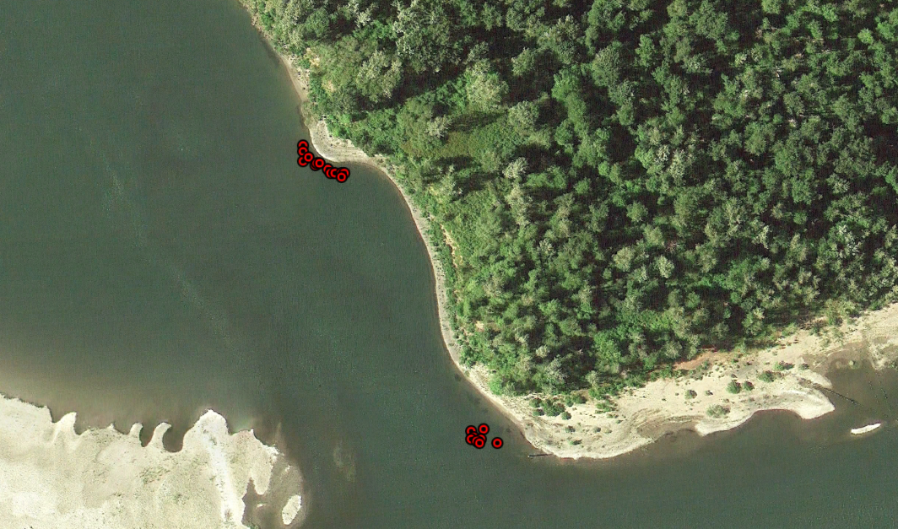
Breaks Redd Locations

Slide 7
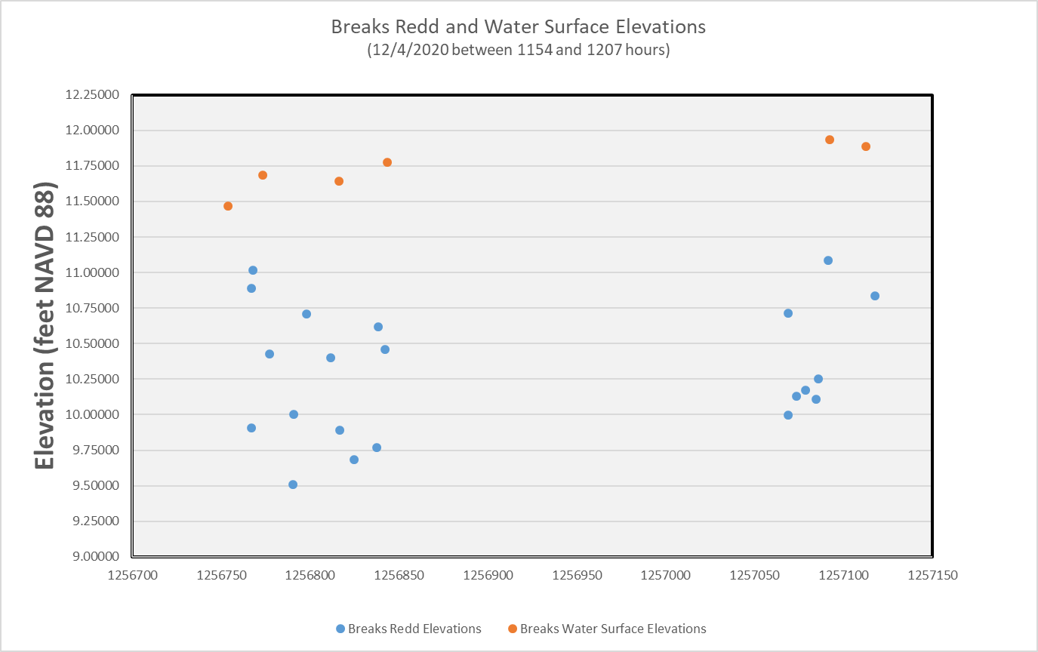
BON TW=11.8’

Slide 8
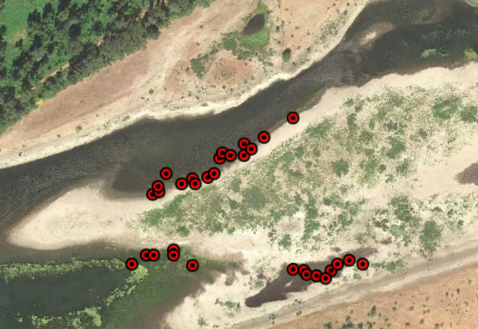
Ives Redd Locations

Slide 9
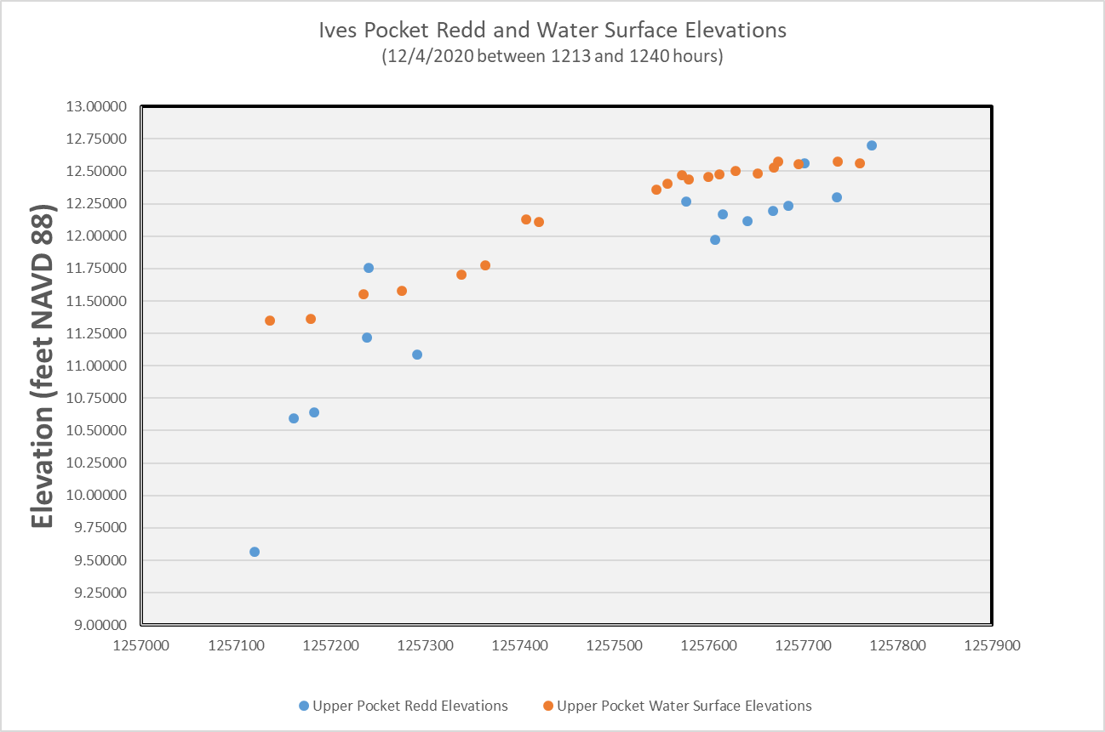
BON TW=12.0’

