Slide 1
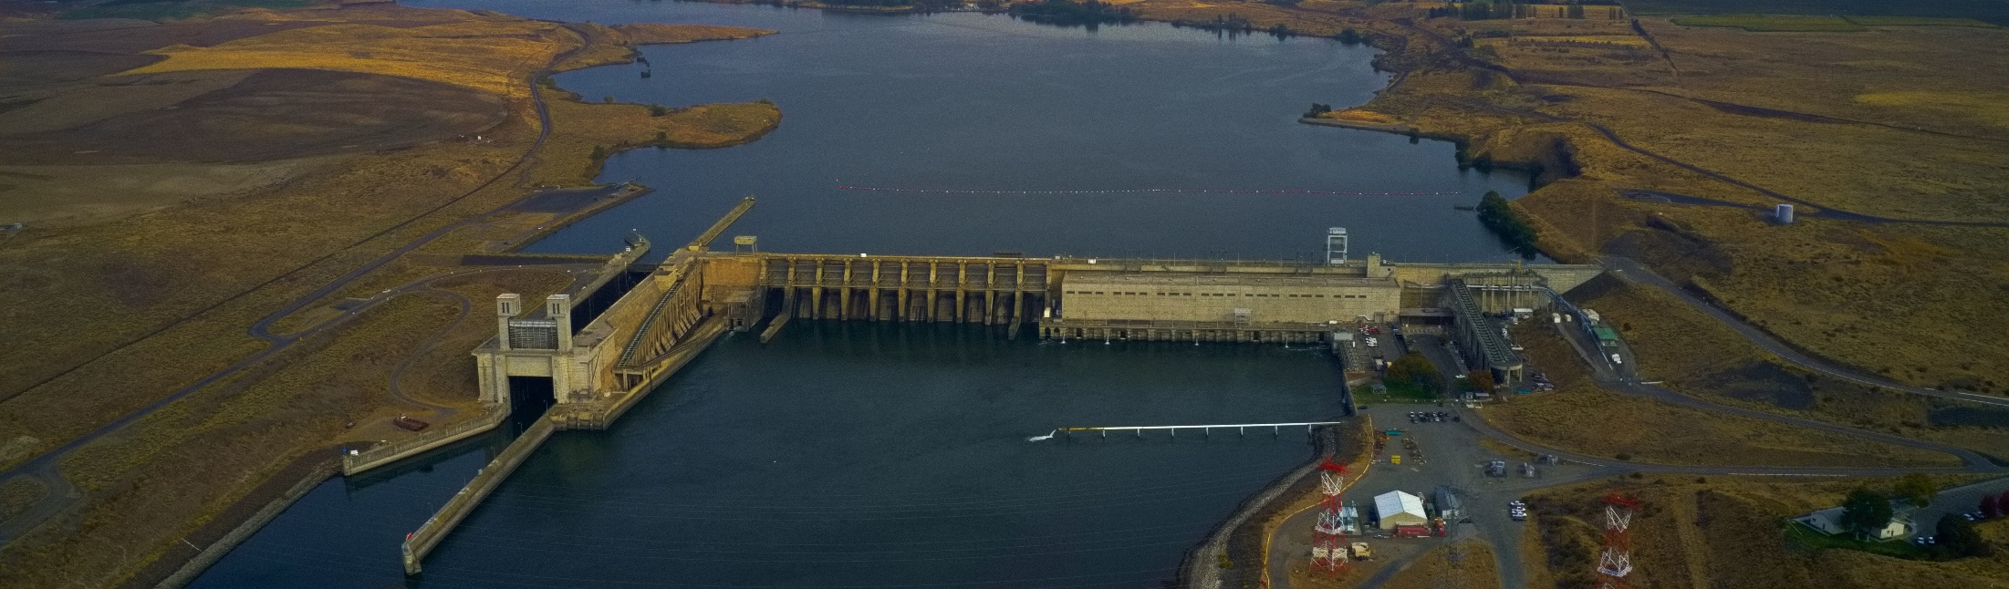
Lower Snake River Zero Generation Operations
Between October 15, 2020 and December 15, 2020

Slide 2
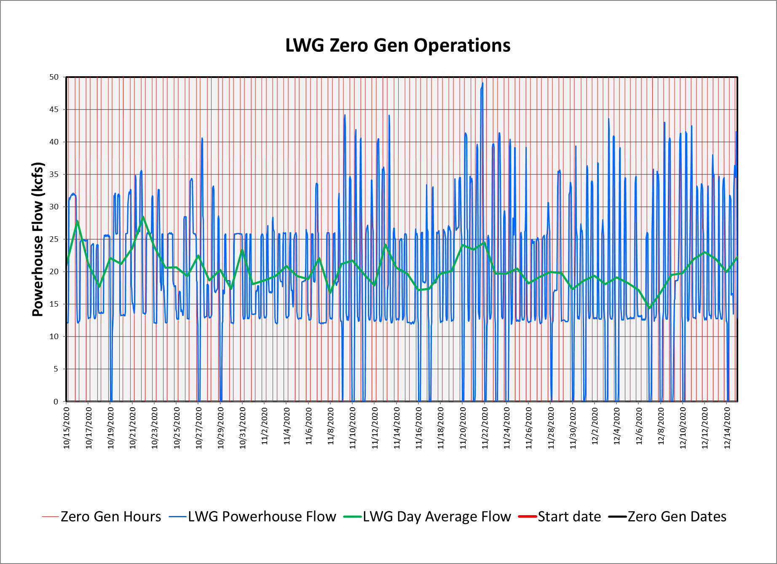

Slide 3
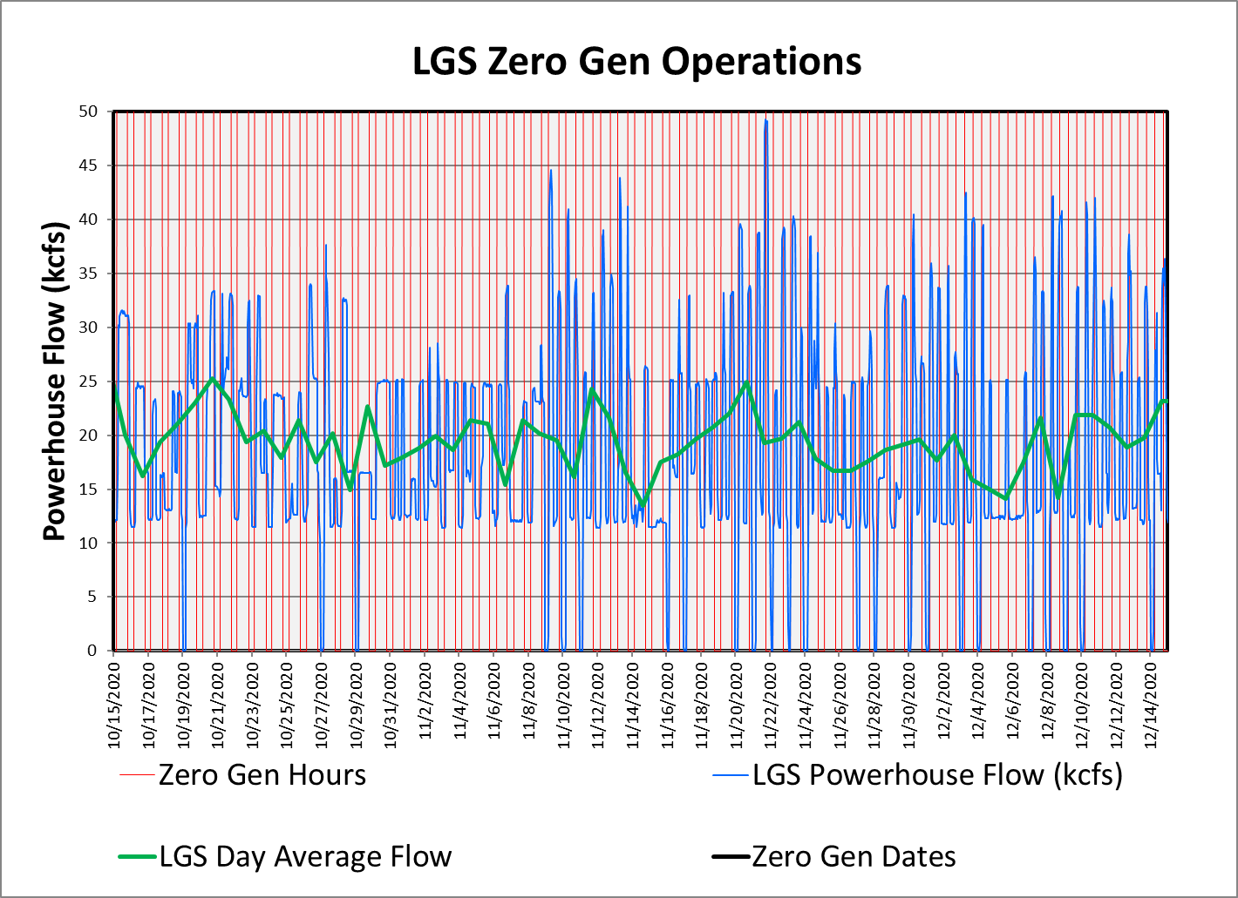

Slide 4
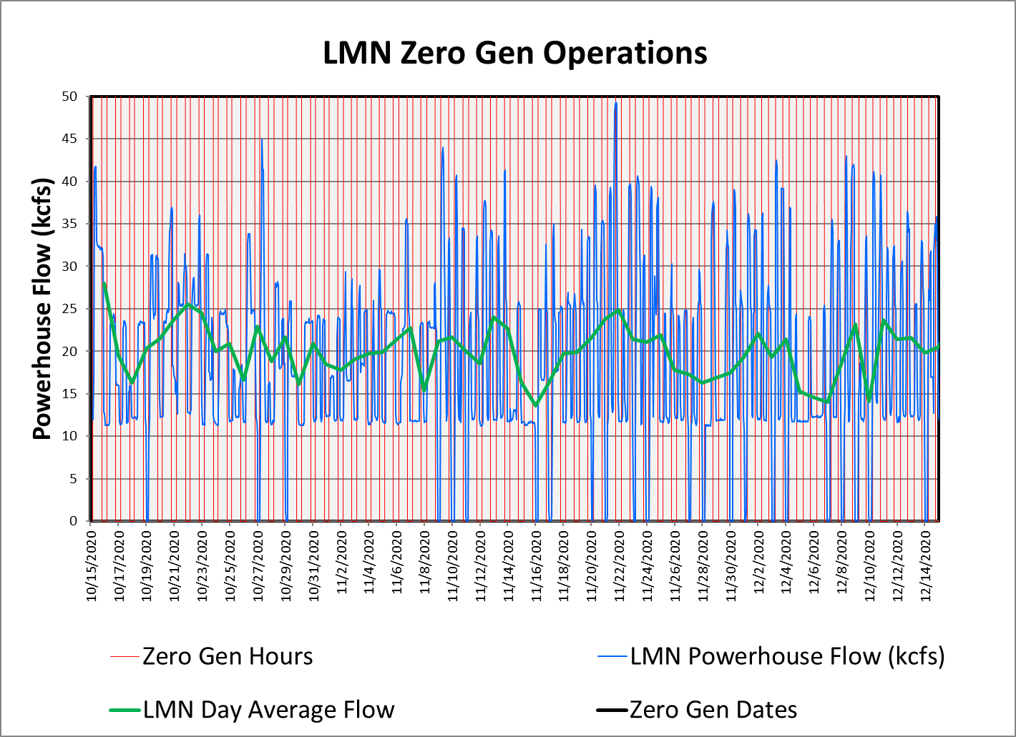

Slide 5
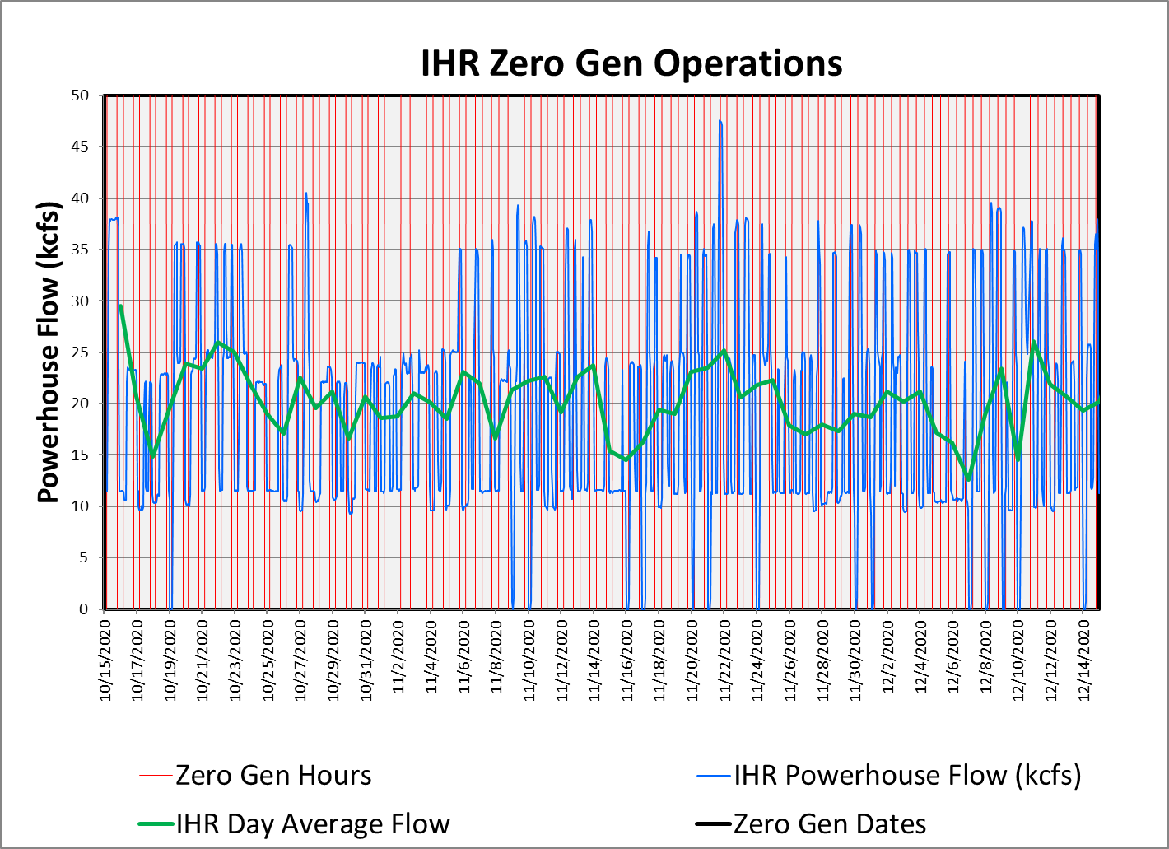

Slide 6
Frequency of Use (10/15/20-12/15/20)
Percent of Available Hours Used = 15.6%
Average Percentage of Available Days Used = ~34%
Percent of All Hours (24 hours per day) = 6.7%

Slide 7
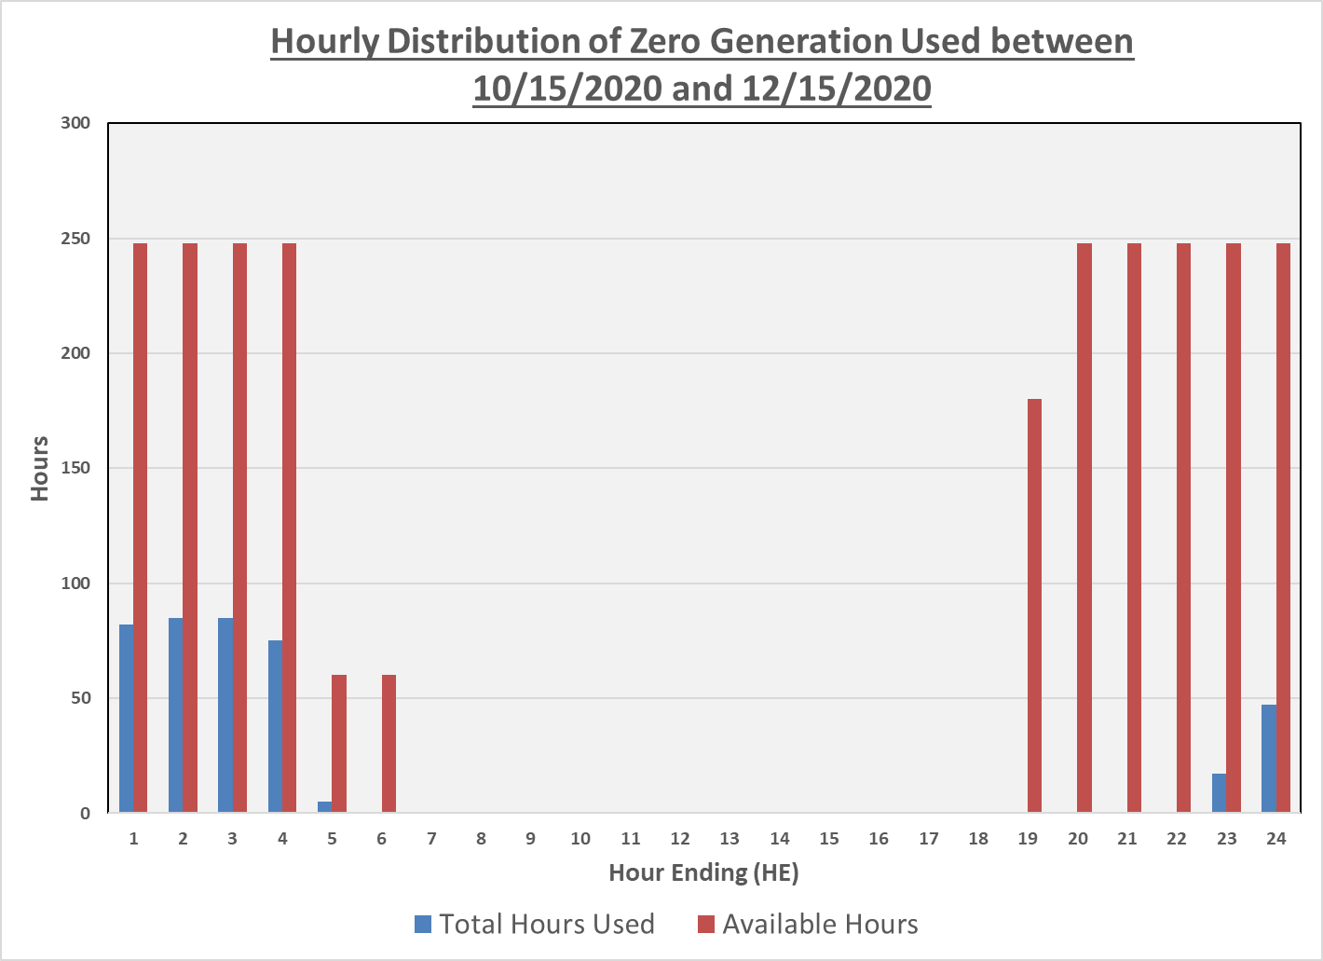

Slide 8
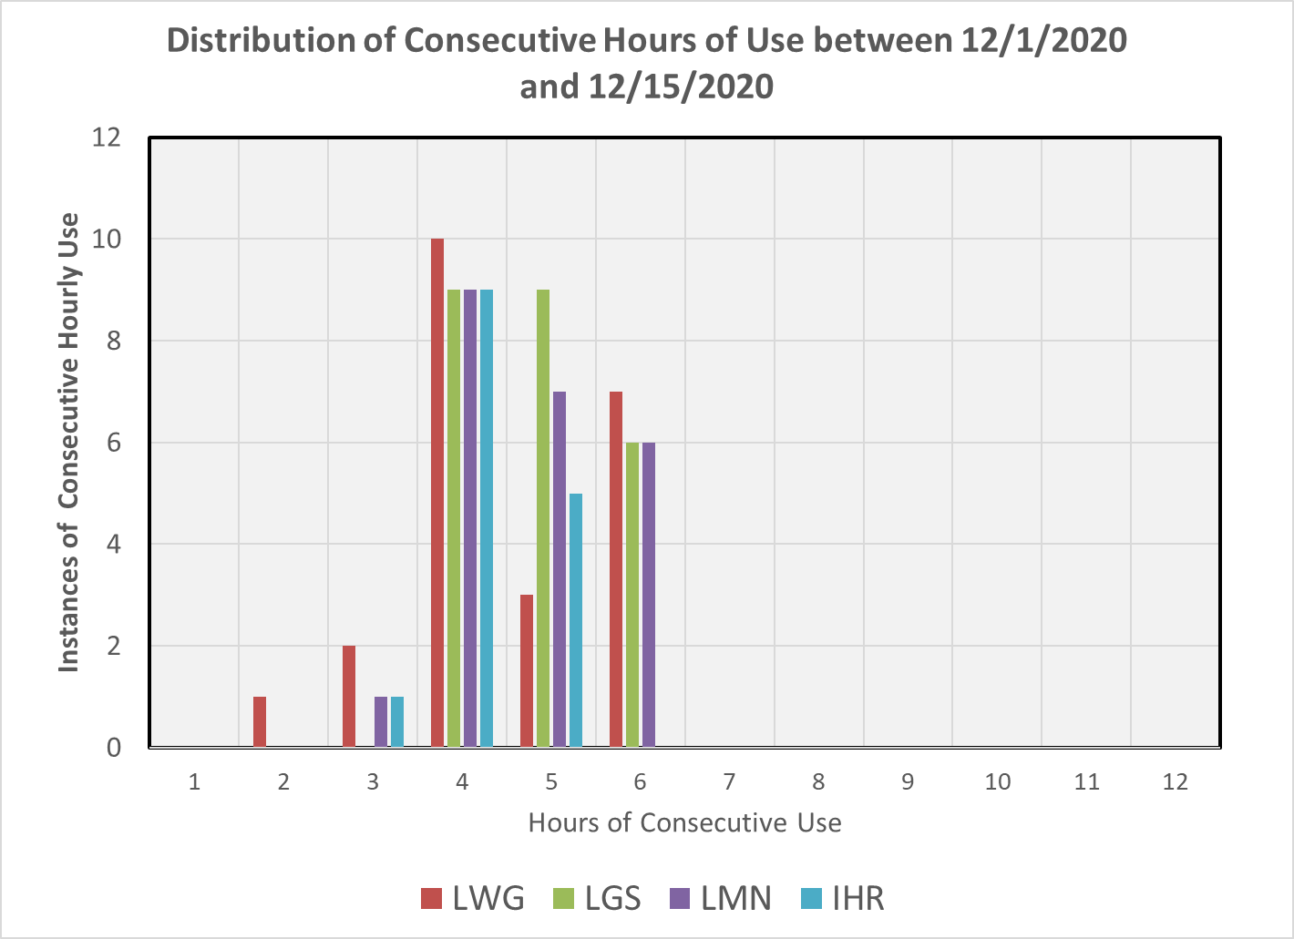

Slide 9
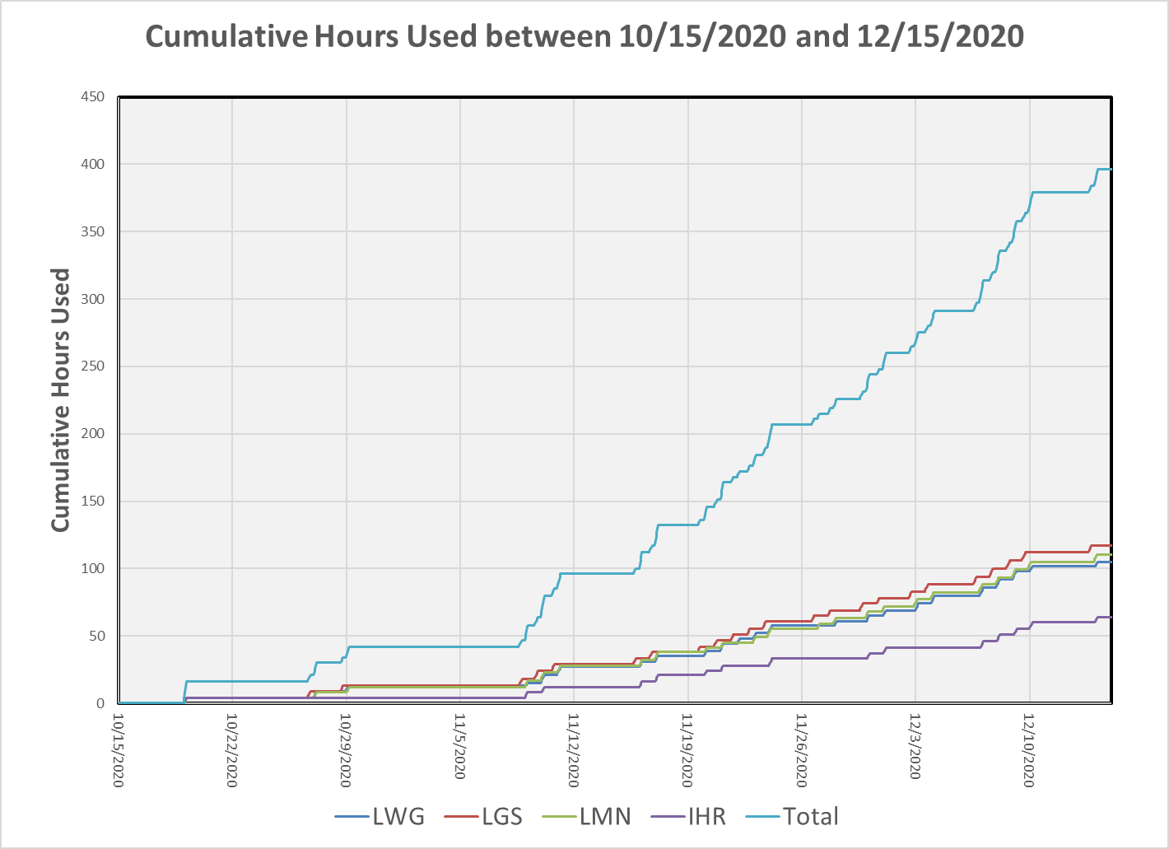

Slide 10
Frequency of Use (10/15/20-10/31/20)
Percent of Available Hours Used = 6.9%
Average Percentage of Available Days Used = ~15%
Percent of All Hours (24 hours per day) = 2.6%

Slide 11
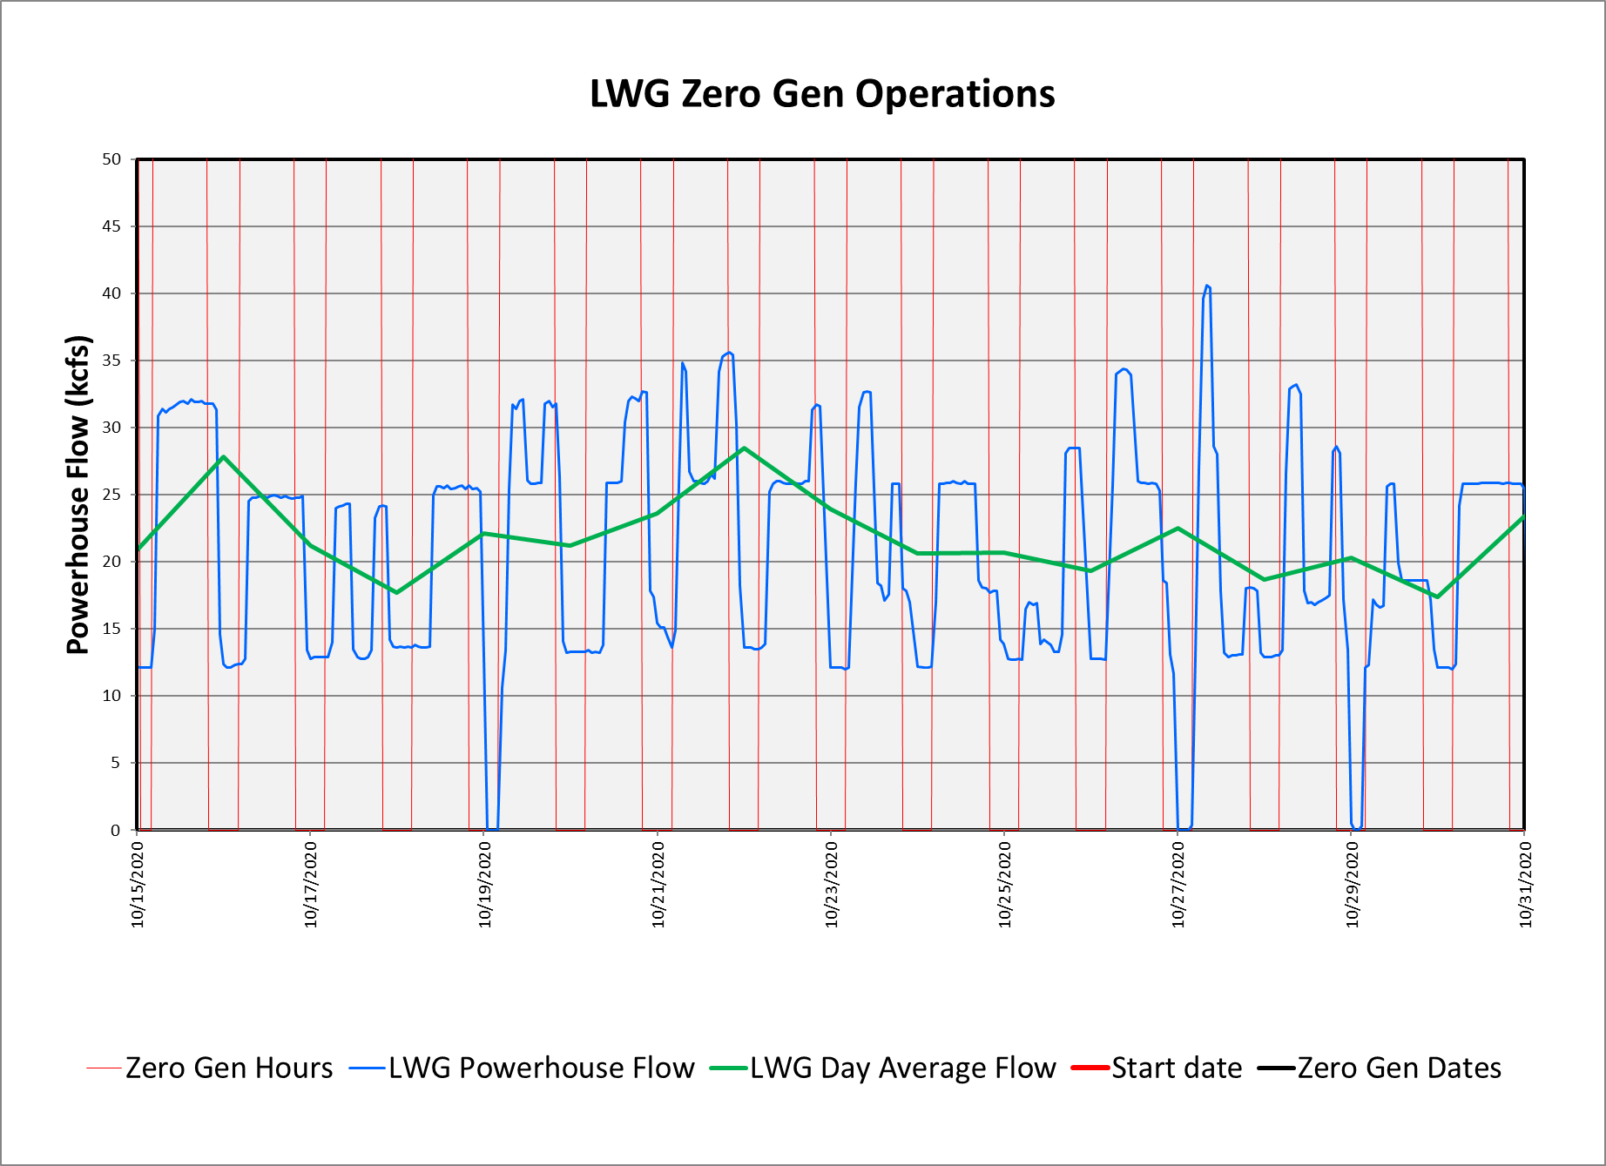
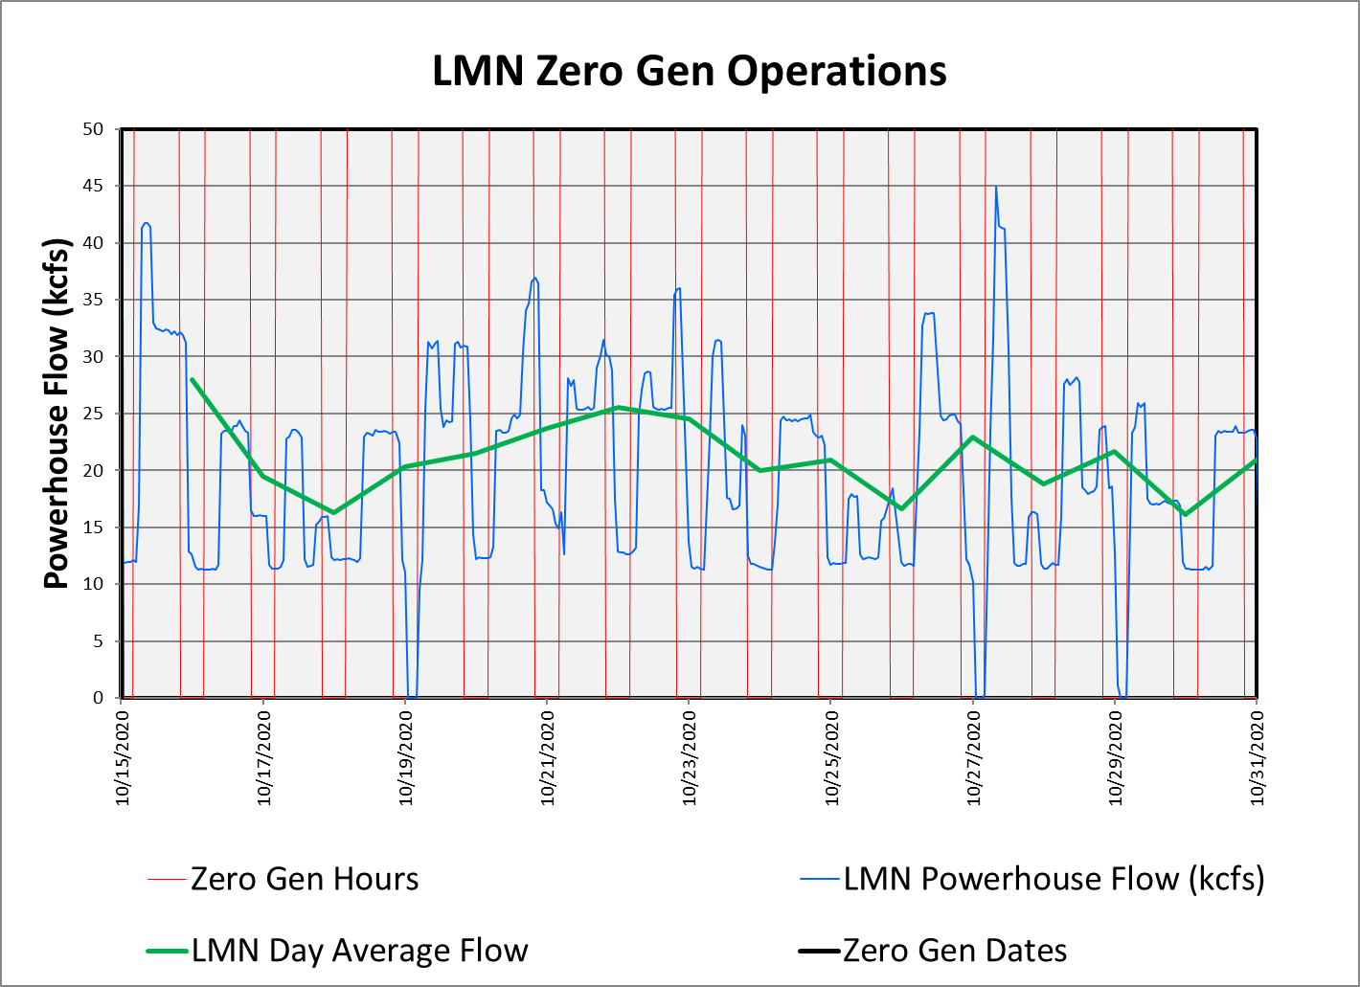
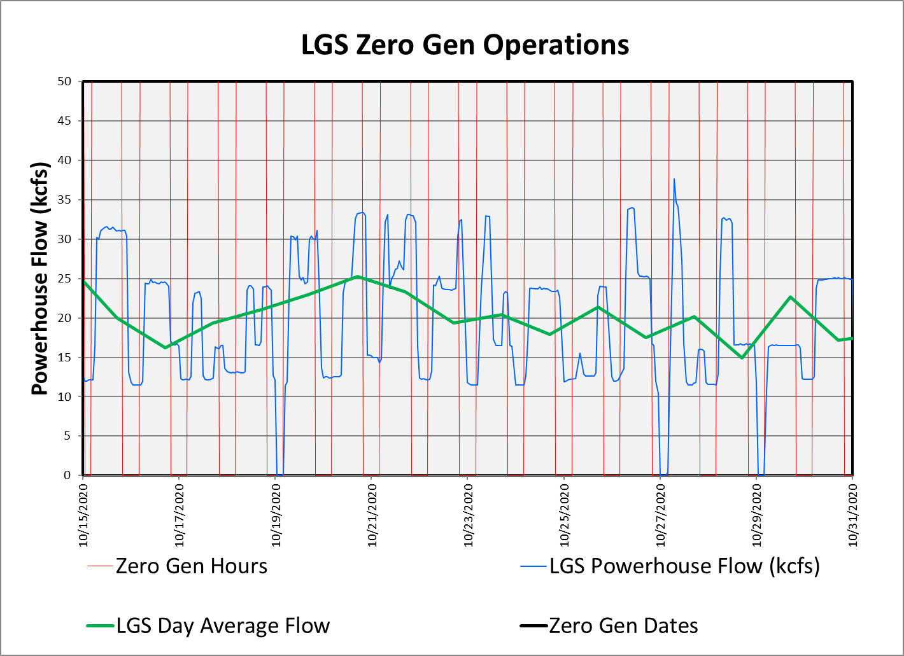
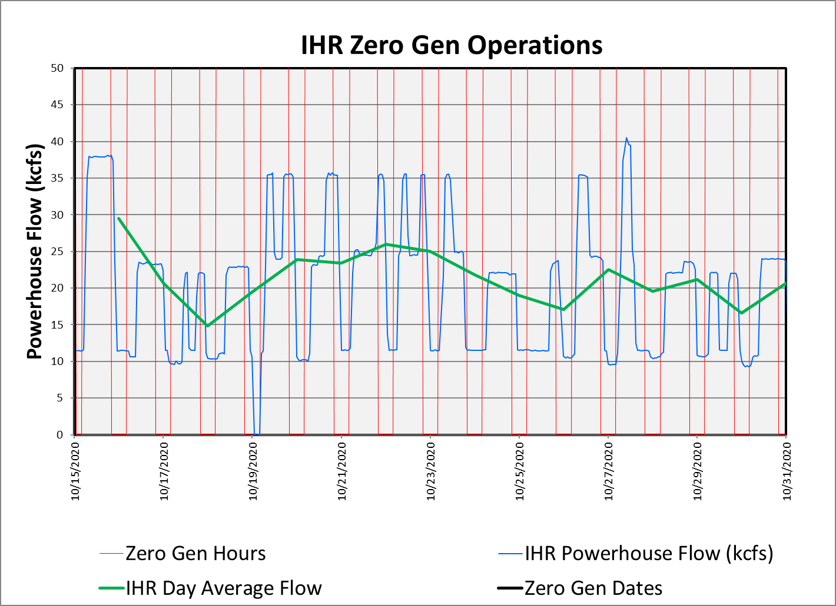
Frequency of Use (10/15/20-10/31/20)

Slide 12
Frequency of Use (November 2020)
Percent of Available Hours Used = 16.8%
Average Percentage of Available Days Used = ~38%
Percent of All Hours (24 hours per day) = 7.0%

Slide 13
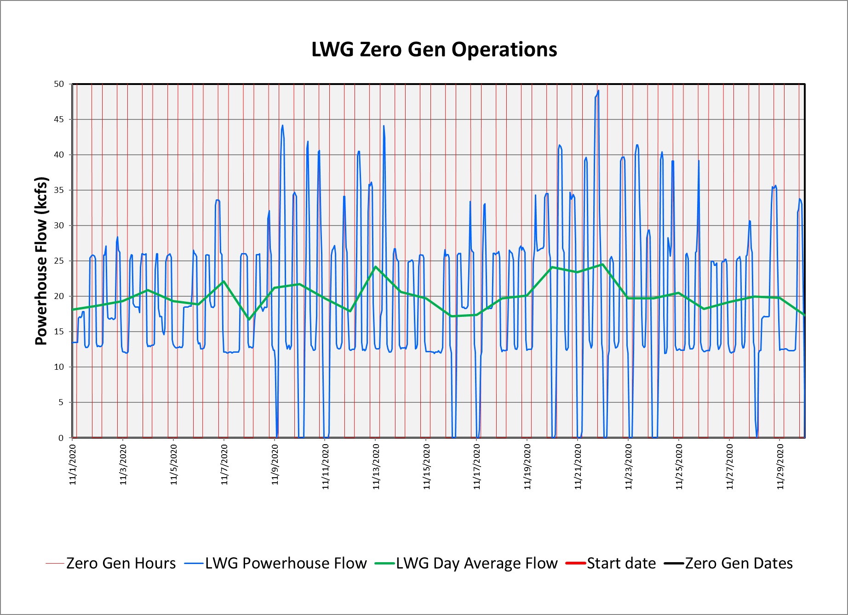
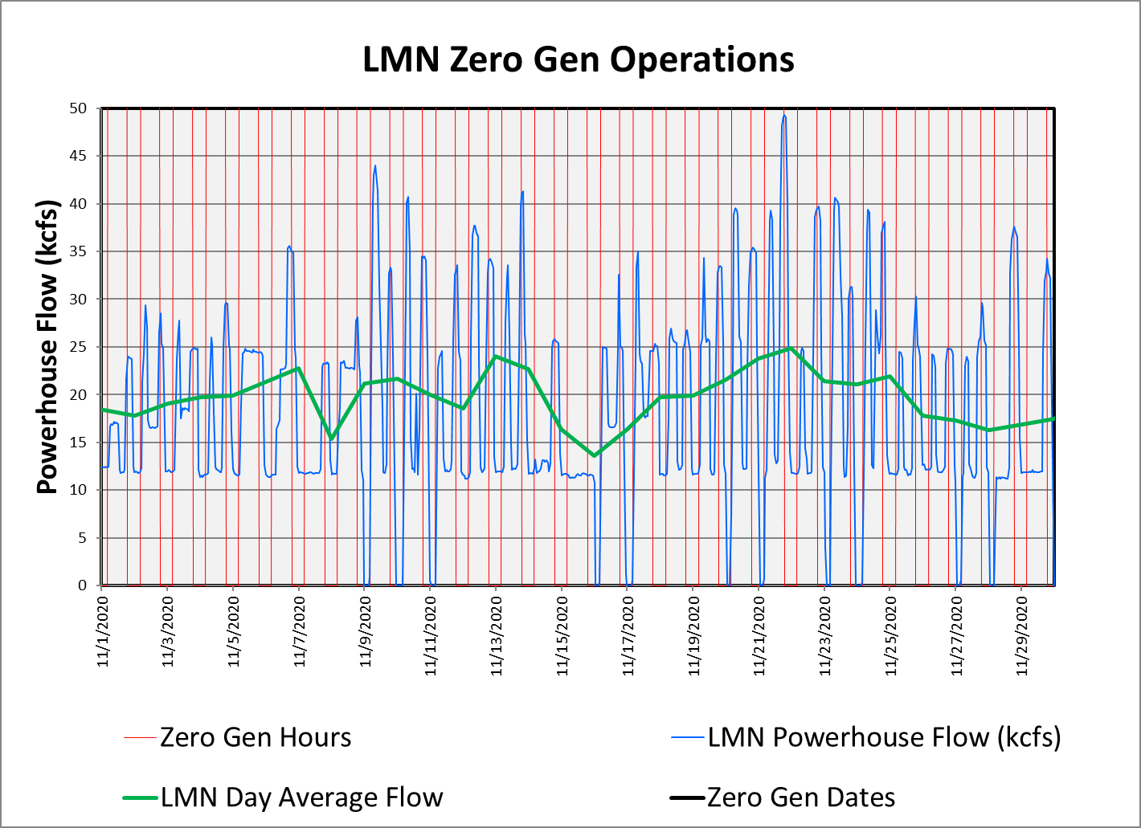
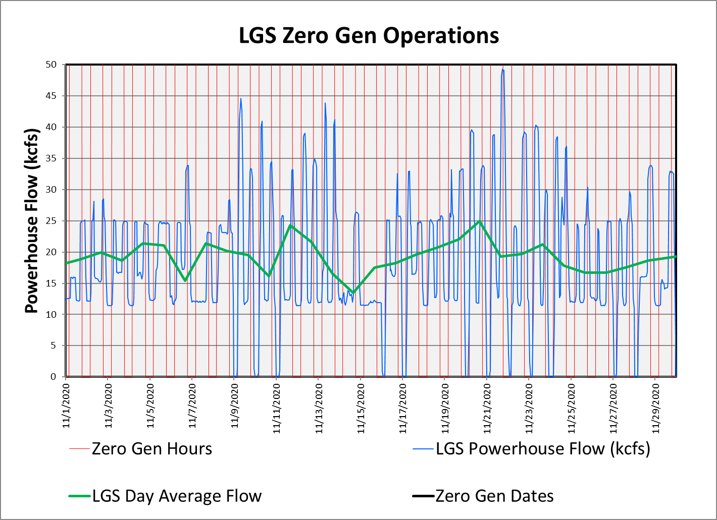
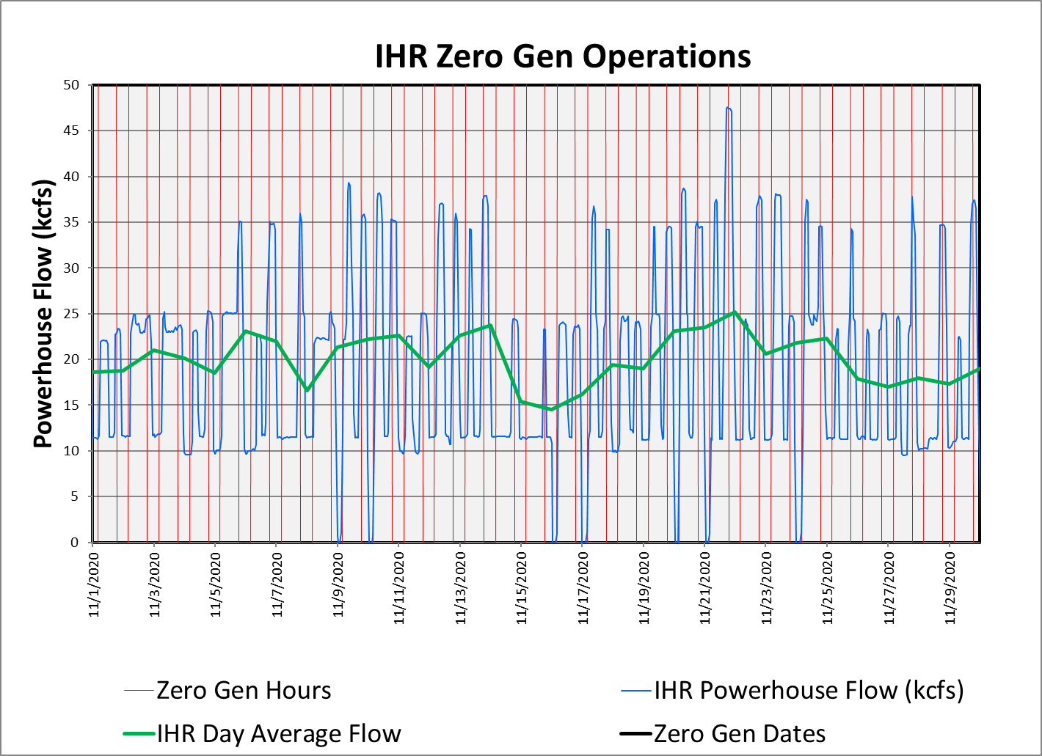
Frequency of Use (November 2020)

Slide 14
Frequency of Use (12/1/20-12/15/20)
Percent of Available Hours Used = 21.0%
Average Percentage of Available Days Used = ~50%
Percent of All Hours (24 hours per day) = 10.6%

Slide 15
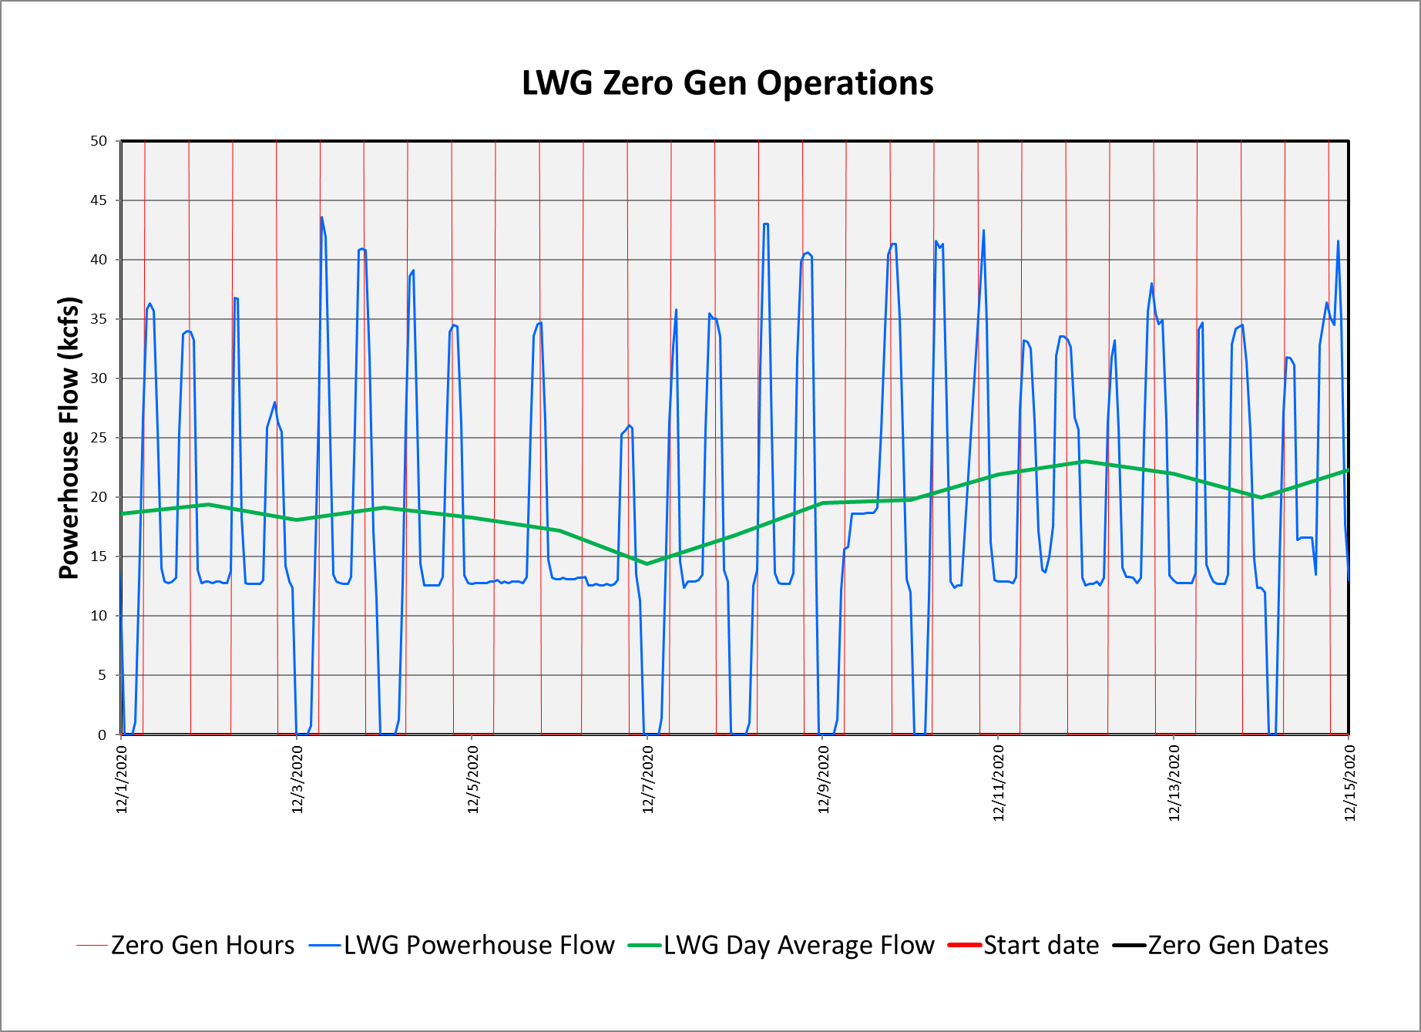
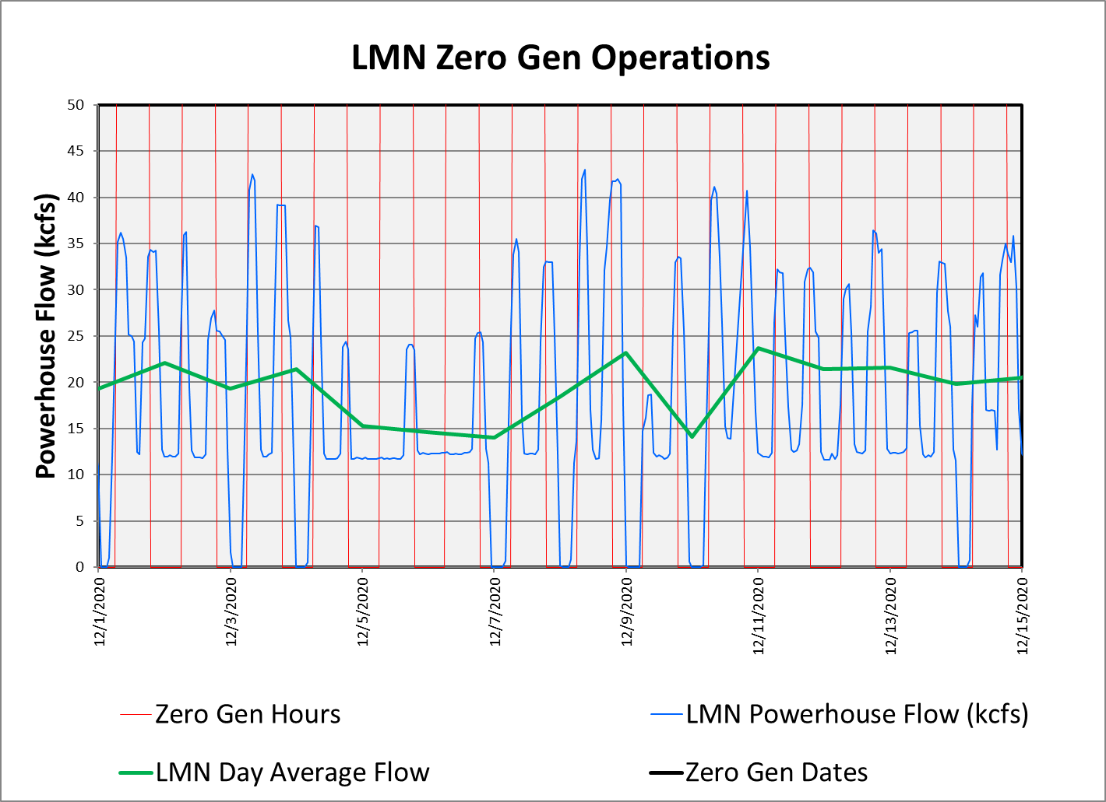
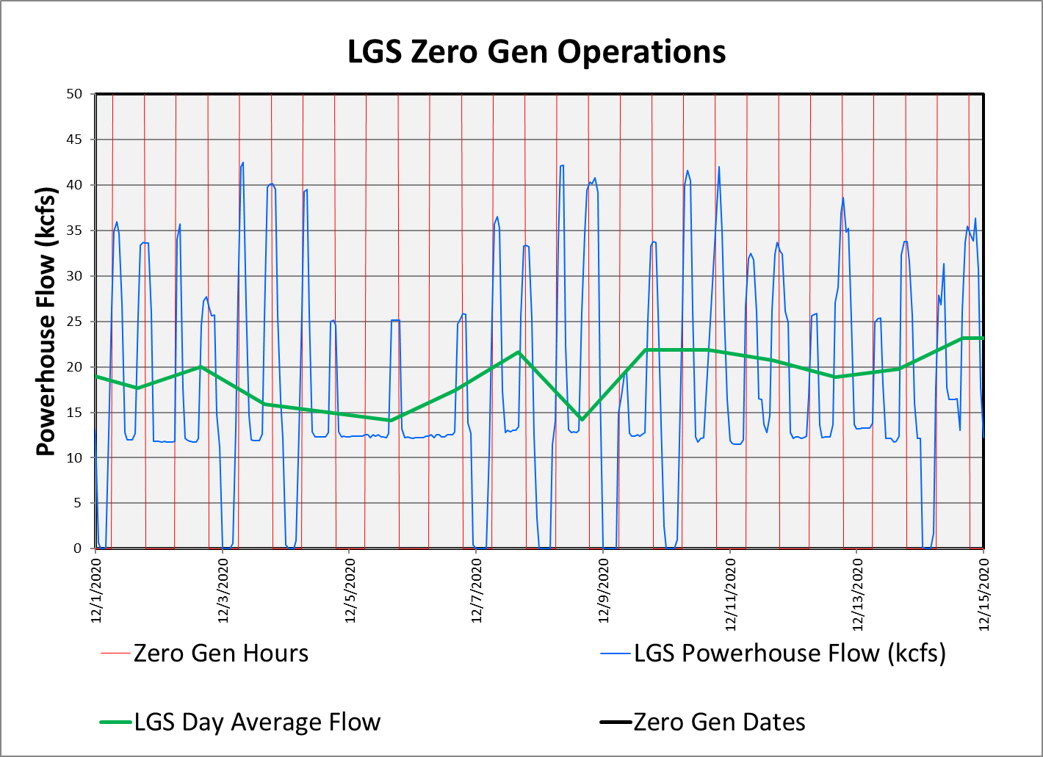
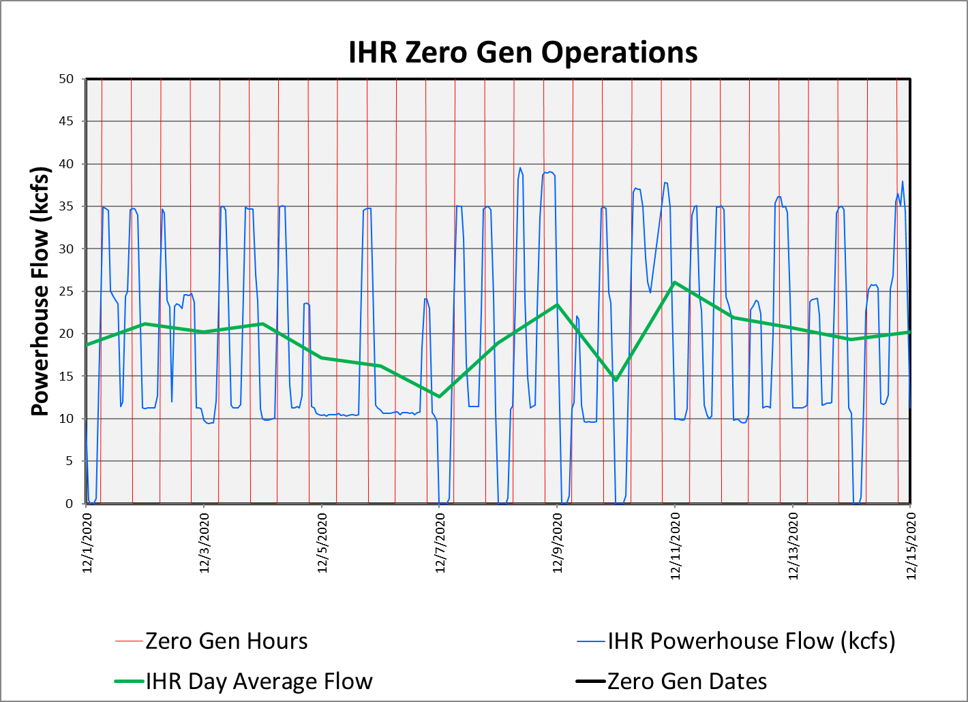
Frequency of Use (12/1/20-12/15/20)

Slide 16
Diel Timing of PIT Tagged adult fall Chinook 2005-2020
98% entered during
the day,
(August – December)
(<2 h before sunrise and
< 2 h after sunset )
2020 records in orange
Source: Iltis et al. (2021)
Notes:
Figure 1. PIT Tag Adult fall Chinook salmon Lower Granite fishway entry hour, August 18-December 31, with sunrise/sunset times, 2005-2020

Slide 17
Diel Timing of PIT Tagged adult fall Chinook 2005-2020
98% entered during
the day,
(August – December)
(<2 h before sunrise and
< 2 h after sunset )
2020 records in orange
Hours available for zero gen implementation
Source: Iltis et al. (2021)
Notes:
Figure 1. PIT Tag Adult fall Chinook salmon Lower Granite fishway entry hour, August 18-December 31, with sunrise/sunset times, 2005-2020

Slide 18
Diel Timing of PIT Tagged adult fall Chinook 2005-2020
98% entered during
the day,
(August – December)
(<2 h before sunrise and
< 2 h after sunset )
2020 records in orange
Hours available for zero gen implementation
Hours primarily utilized for zero gen implementation
Source: Iltis et al. (2021)
Notes:
Figure 1. PIT Tag Adult fall Chinook salmon Lower Granite fishway entry hour, August 18-December 31, with sunrise/sunset times, 2005-2020

Slide 19
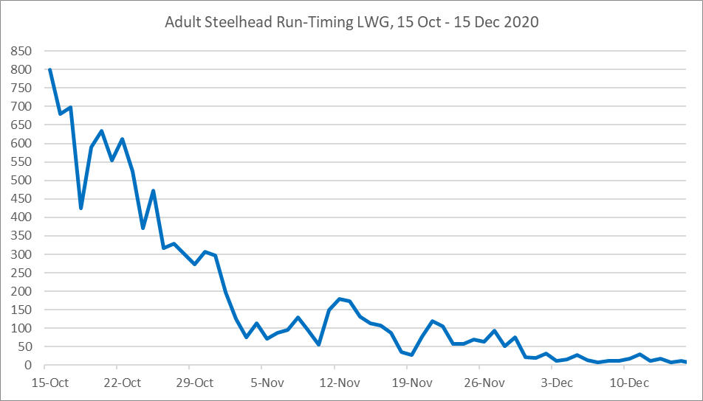
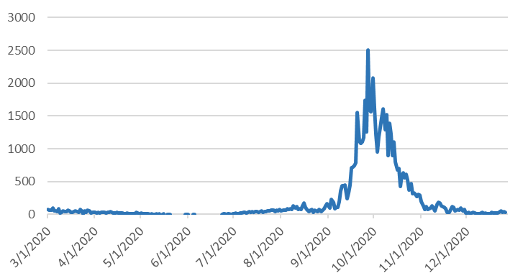
Lower Granite Dam: Steelhead Run-Timing, 2020
October 15 – November 30:
Night ops. only, with restrictions
(no ops. within 2 h of dawn and dusk)
December 1 – 14:
Night ops. only

Slide 20
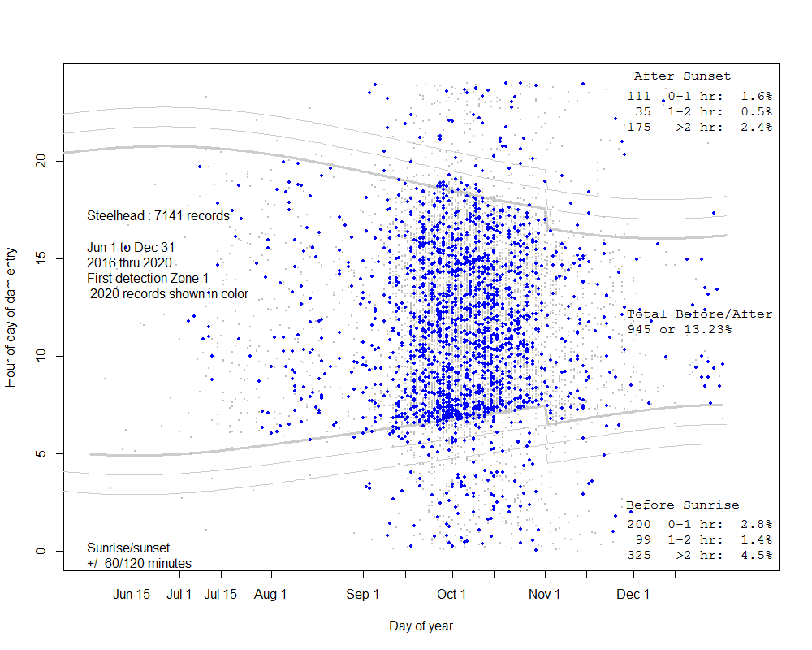
Diel Timing of PIT Tagged adult steelhead 2016-2019
95% entered
during the day
(June – December)
(<2 h before sunrise and
< 2 h after sunset )
2020 records in blue
Source: Itlis et al. (2020, 2021)
Notes:
Figure 1. PIT Tag Adult steelhead Lower Granite fishway entry hour, June 1 –December 31, with sunrise/sunset times, 2016-2019
Adult steelhead entry into Lower Granite Dam was evaluated using 2016-2019 PIT Tag detections, June 1 – December 31. Entrance during the nighttime hours was 13.3% (6.9% >2 h after sunset and >2 h before sunrise).
There were no steelhead entry detections associated nighttime zero generation operations in December.

Slide 21
Diel Timing of PIT Tagged adult steelhead 2016-2019
95% entered
during the day
(June – December)
(<2 h before sunrise and
< 2 h after sunset )
2020 records in blue
Hours available for zero gen implementation
Source: Itlis et al. (2020, 2021)
Notes:
Figure 1. PIT Tag Adult steelhead Lower Granite fishway entry hour, June 1 –December 31, with sunrise/sunset times, 2016-2019
Adult steelhead entry into Lower Granite Dam was evaluated using 2016-2019 PIT Tag detections, June 1 – December 31. Entrance during the nighttime hours was 13.3% (6.9% >2 h after sunset and >2 h before sunrise).
There were no steelhead entry detections associated nighttime zero generation operations in December.

Slide 22
Diel Timing of PIT Tagged adult steelhead 2016-2019
95% entered
during the day
(June – December)
(<2 h before sunrise and
< 2 h after sunset )
2020 records in blue
Hours available for zero gen implementation
Hours primarily utilized for zero gen implementation
Source: Itlis et al. (2020, 2021)
Notes:
Figure 1. PIT Tag Adult steelhead Lower Granite fishway entry hour, June 1 –December 31, with sunrise/sunset times, 2016-2019
Adult steelhead entry into Lower Granite Dam was evaluated using 2016-2019 PIT Tag detections, June 1 – December 31. Entrance during the nighttime hours was 13.3% (6.9% >2 h after sunset and >2 h before sunrise).
There were no steelhead entry detections associated nighttime zero generation operations in December.

Slide 23
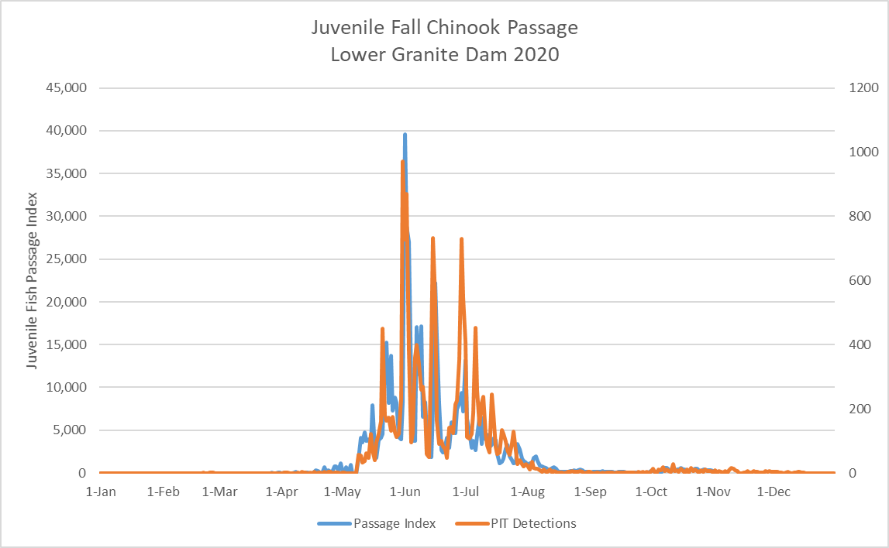
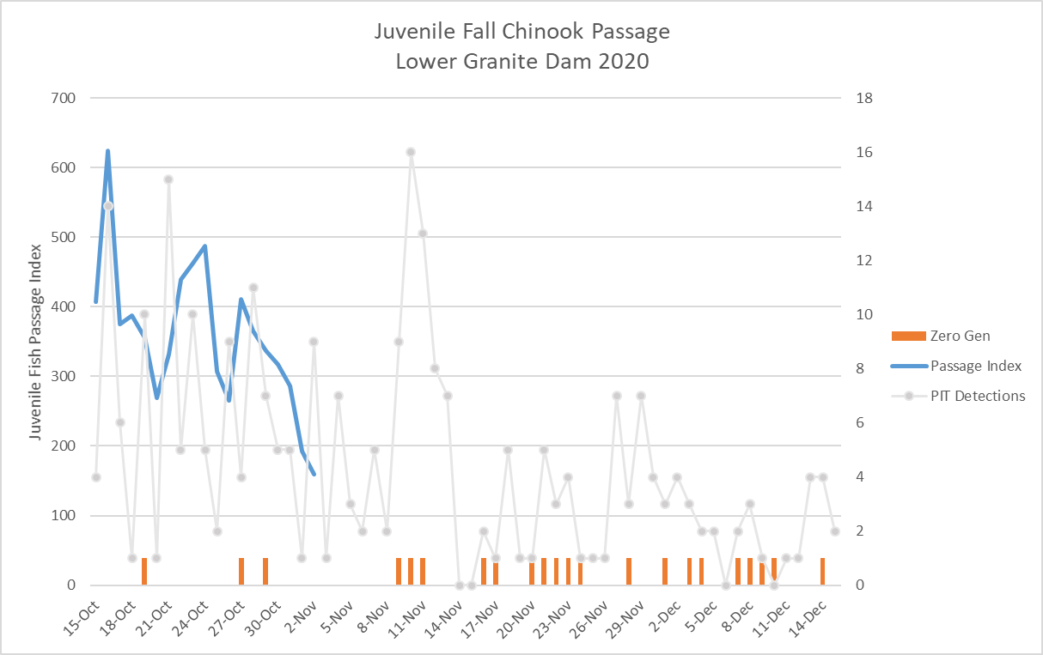
Juvenile Fall Chinook Passage – Lower Granite Dam 2020

Slide 24
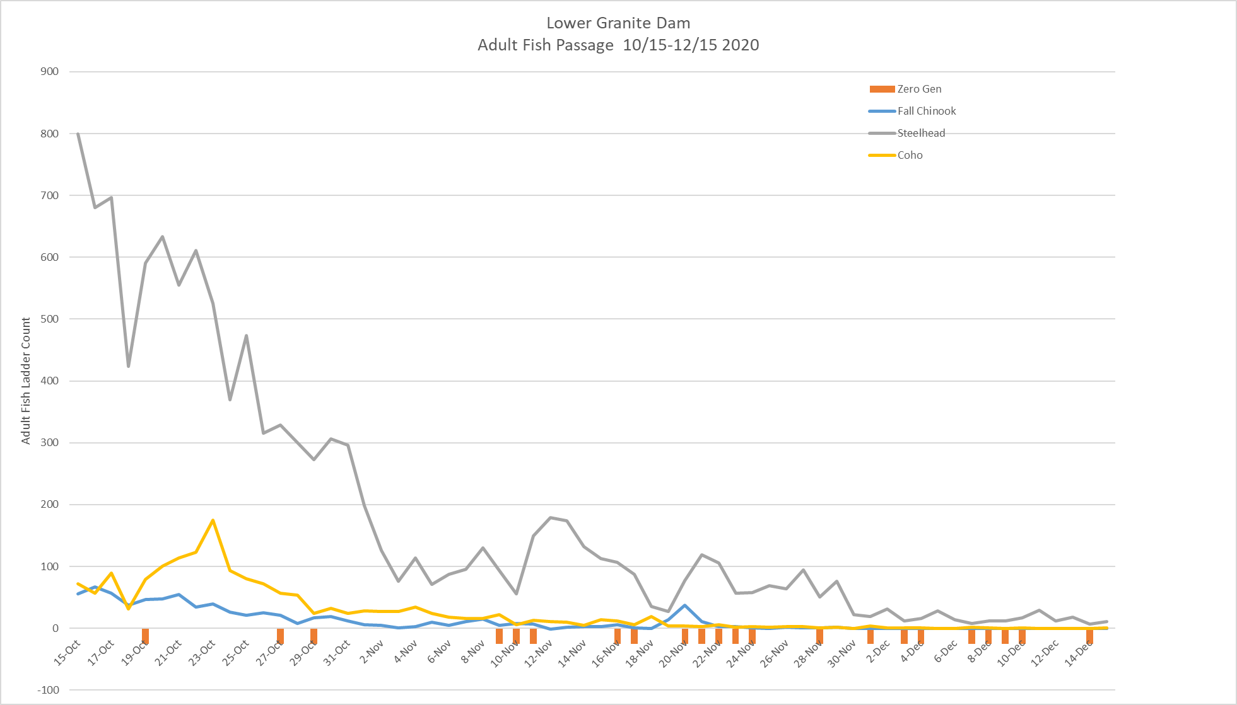
Adult Passage Zero Generation Operations

Slide 25
Summary
Zero Generation during the 10/15-12/15 was used with a frequency that closely resembled the average historical usage rates.
Zero Generation was used on only 3 days prior to the first week of November.
Frequency of use increased after mid-November.
In Late November Zero Generation was used on 5 consecutive days, which is consistent with historical use.
The period of 5 consecutive days coincided with reduced power production at CGS in November.

