Slide 1
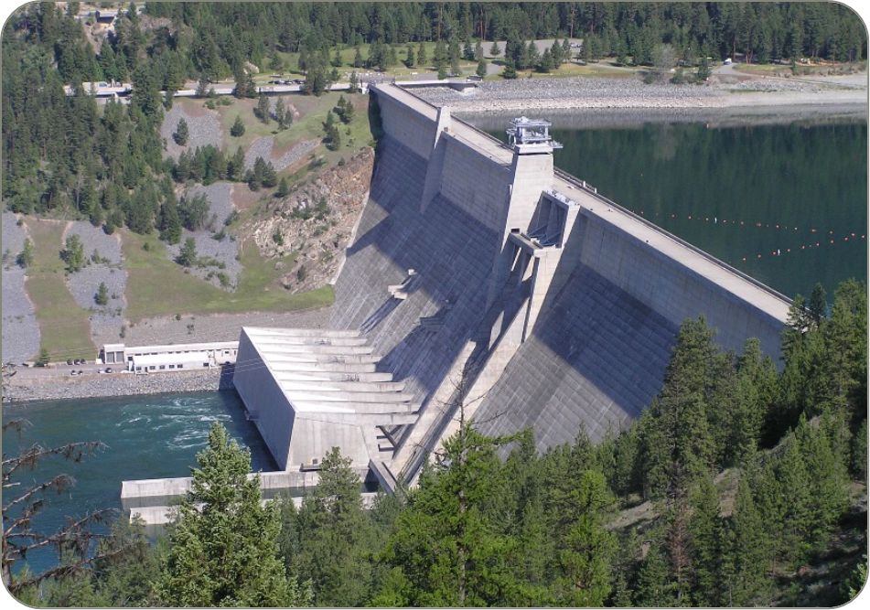

Libby dam Sturgeon operations 2021
12 May 2021
TMT Meeting

Slide 2
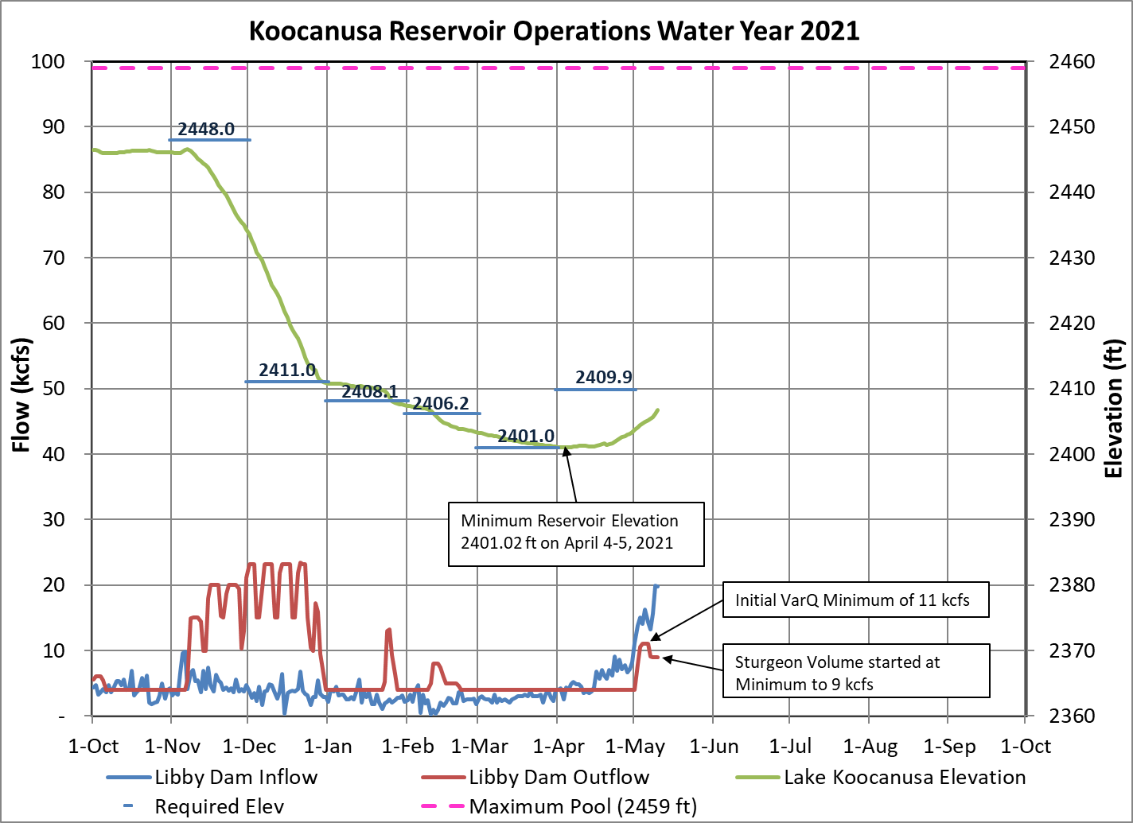
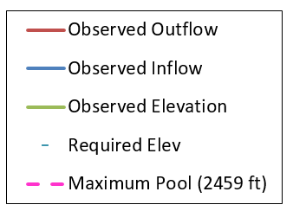

Slide 3
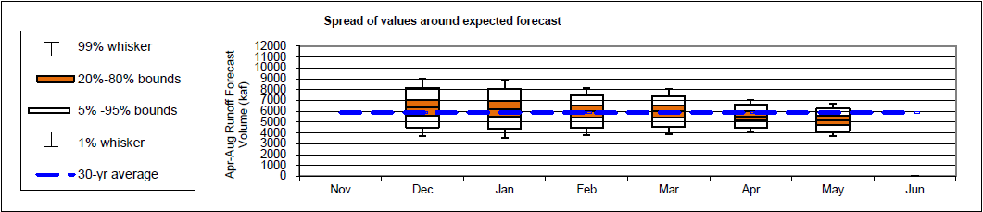
MAY 1st Water Supply Forecast and biop objectives
April-August inflow forecast for Libby Dam is 5.19 million acre-feet (MAF)
Forecast is 88% of average
Sturgeon Volume is 0.80 MAF
Bull trout minimum flows following the Sturgeon Pulse through Aug 31 is 7 kcfs
Libby Water Supply Forecast Trend:
Libby flow augmentation draft to 10 ft from full (2449 ft) end of September (35th percentile)

Slide 4
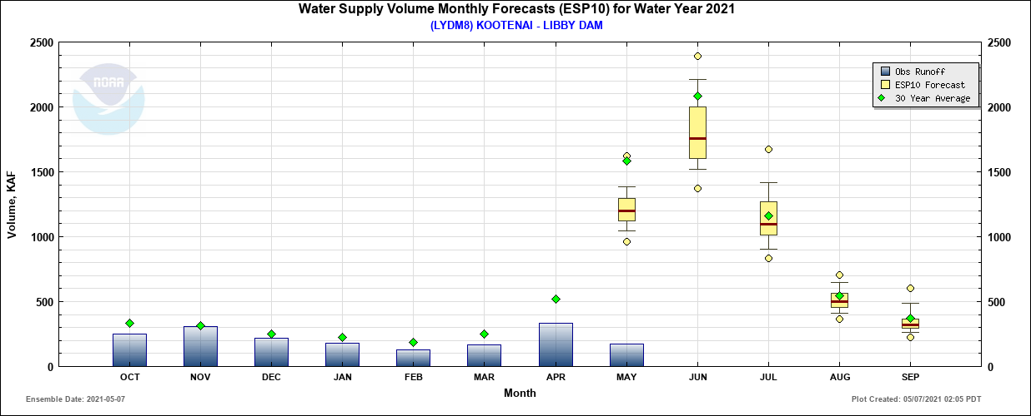
Monthly Water Supply volume

Slide 5
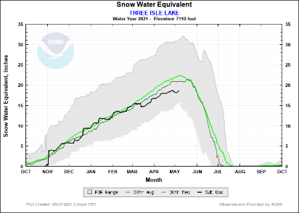
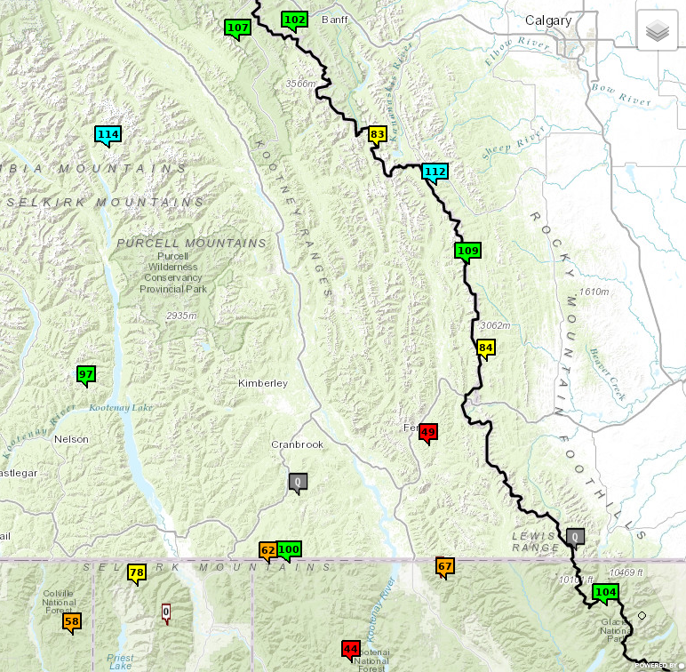
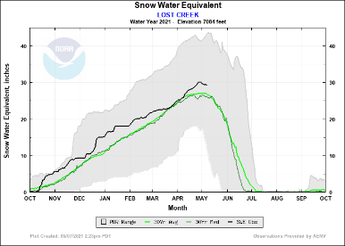
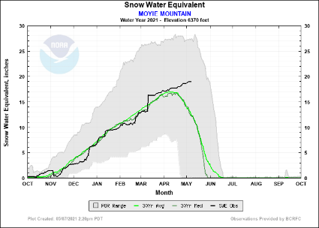
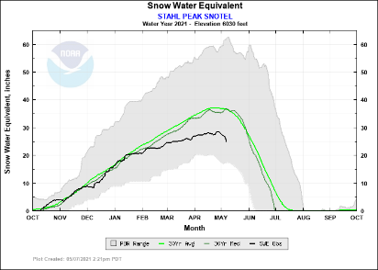
Snowmelt So Far
Data: May 7th 2021

Slide 6
Flow Augmentation PLAN
Sturgeon augmentation flow operations began on May 6th at 9 kcfs total.
Initial VarQ of 11 kcfs increased wetted perimeter and inundated vegetated beds.
Subsequent VarQ of ~5.9 kcfs would have left those zones dry.
Sturgeon volume used to maintain submergence.
On May 13th increase discharge from Libby Dam to ~25 kcfs (powerhouse capacity) following BiOp ramping rates. Full Powerhouse release is projected to last for 15 Days, and the Sturgeon operation is projected to end June 2nd.
Decrease discharge (post-pulse) at Libby Dam to summer flat flow following BiOp ramping rates.
*in season management by FPIP may cause this value to vary slightly.

Slide 7
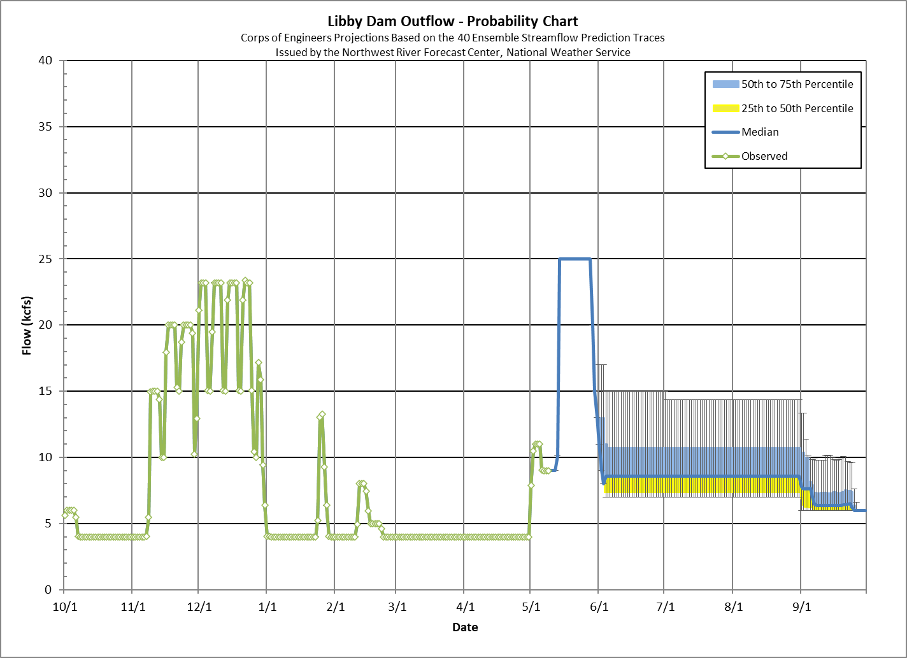
The data presented in this graph are provisional and are intended to provide an estimate of outflow from Libby Dam.
How to read this graph:
75th percentile means that on that day, 75 percent of the traces were below this value. The median points indicate the values such that half of the traces were above and half were below on that day.
The River Forecast Center public site for Libby Dam Forecasts is:
http://www.nwrfc.noaa.gov/river/station/flowplot/flowplot.cgi?lid=KBDM8
Start of refill
Sturgeon Pulse Volume

Slide 8
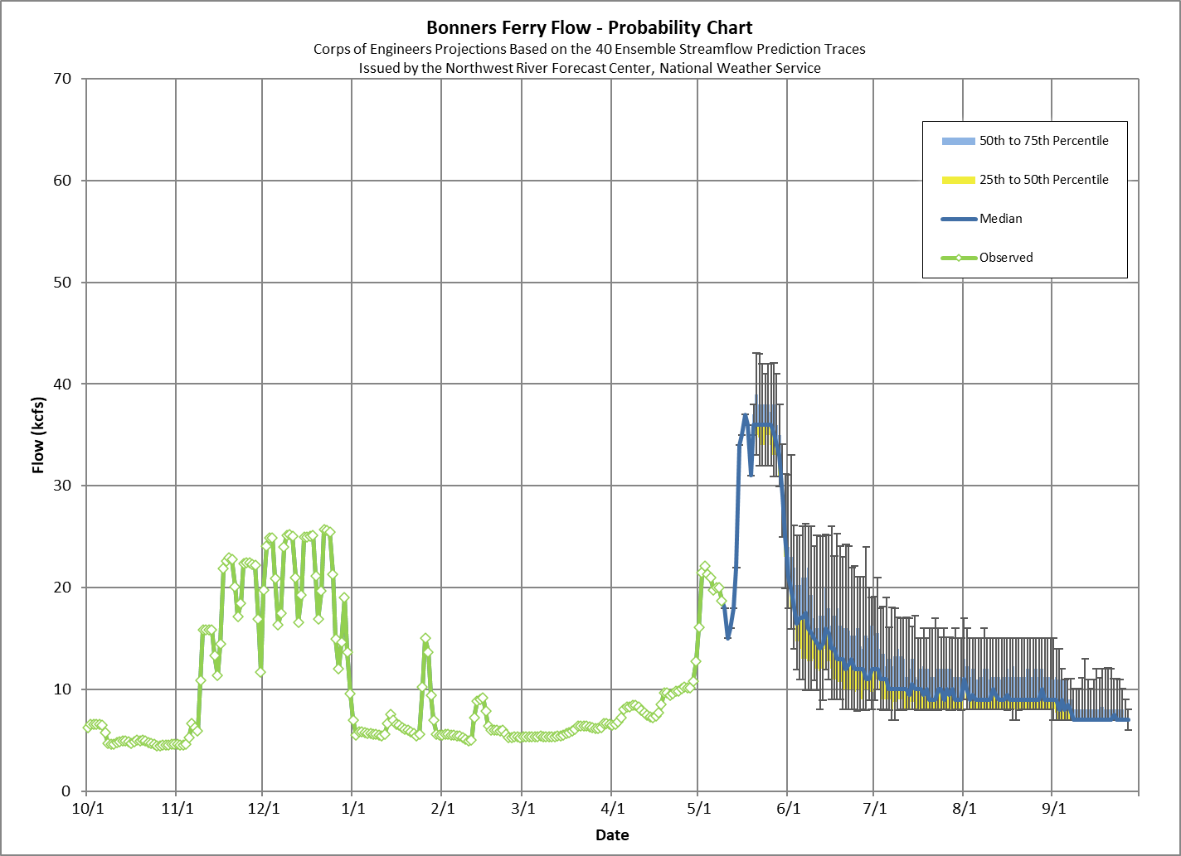
15 Days Median
30 kcfs Goal
Notes:
Add flow plot

Slide 9
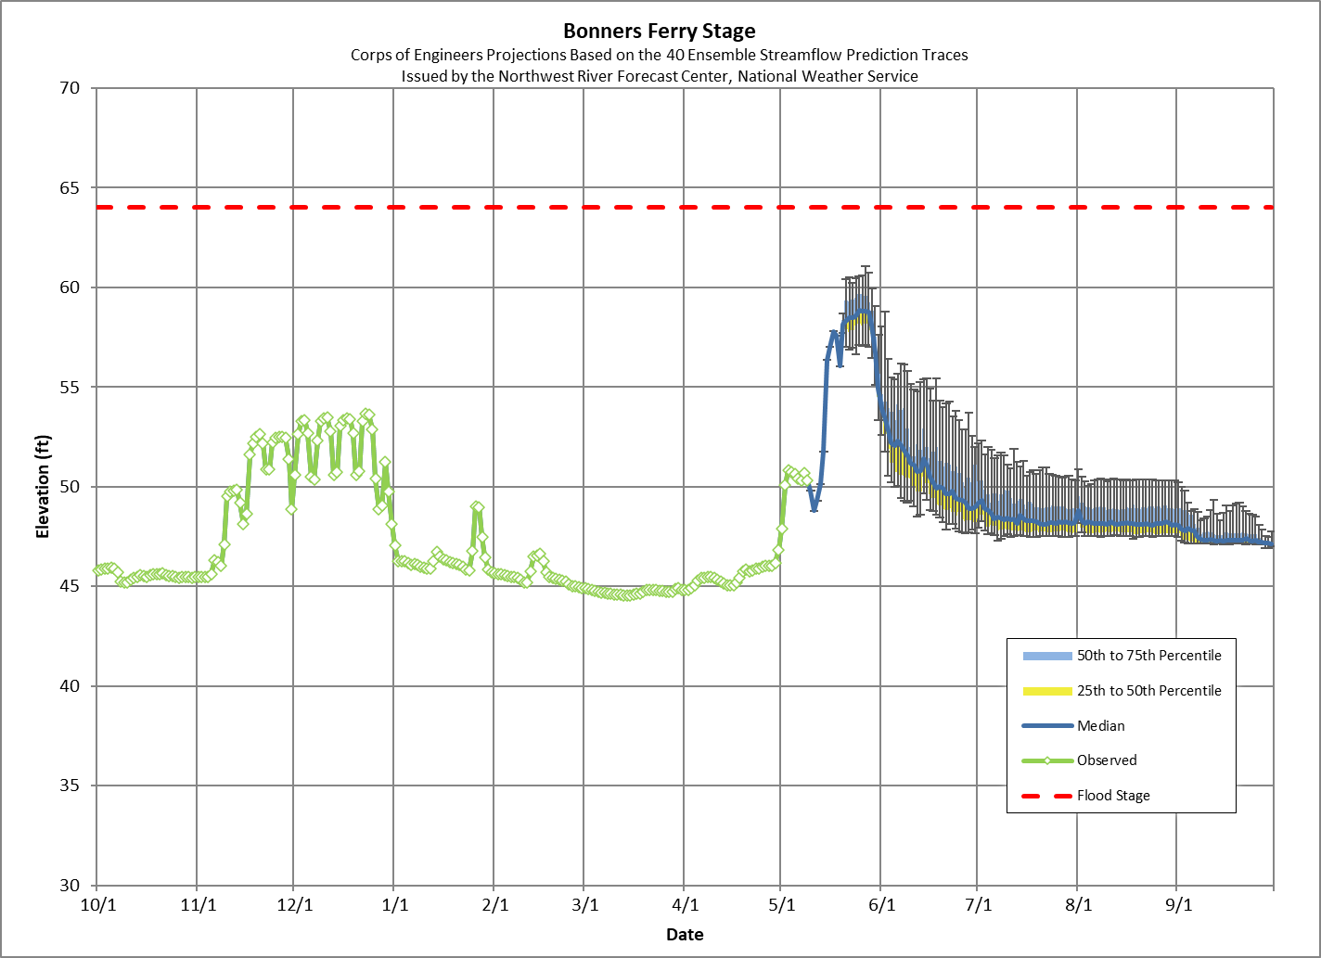
10 Days Median
1758 ft Goal
Notes:
Add flow plot

Slide 10
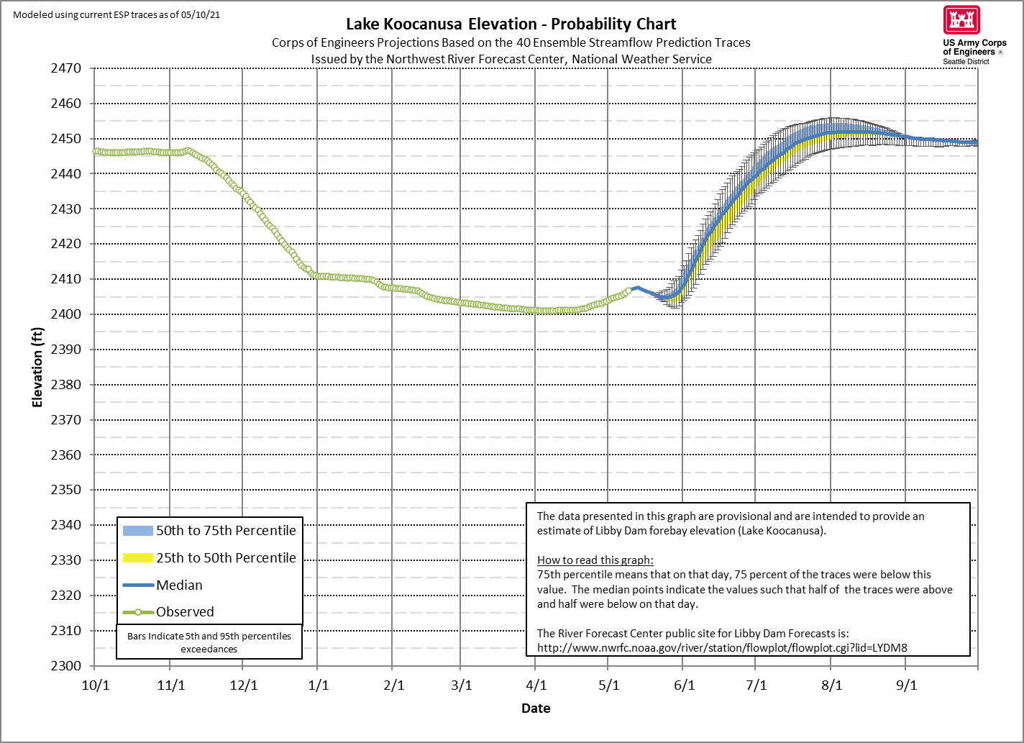
Projected Elevation Percentiles (25-50-75)
May 31st: 2405.6 – 2407.4 – 2410.3
June 30th: 2435.9 – 2439.0 – 2441.9
July 31st: 2449.9 – 2451.7 – 2454.3
Peak Elev.: 2451.3 – 2451.9 – 2454.3
Peak Date: 7/31 8/13 8/18
August 31st: 2450.6 – 2450.6 – 2450.7
September 30th: 2448.6 – 2448.9 – 2449.1
*based on May 10th ESP Traces

Slide 11
STURGEON VOLUME SUMMARY
Sturgeon augmentation flow started on May 6th at 9 kcfs total.
On May 13th increase discharge from Libby Dam to 25 kcfs (powerhouse capacity). Maintain pulse discharge until May 29th.
Target to Maintain Bonners Ferry above 30 kcfs: 15 Days Median
Target to Maintain Bonners Ferry stage above 1758’: 10 Days Median
Decrease discharge (post-pulse) at Libby Dam to summer flat flow on/around June 2nd.
Likely Range of Peak Lake Elevation (25-50-75 %-tile): 2451.3 – 2451.9 – 2454.3

Slide 12
Questions?

