Slide 1
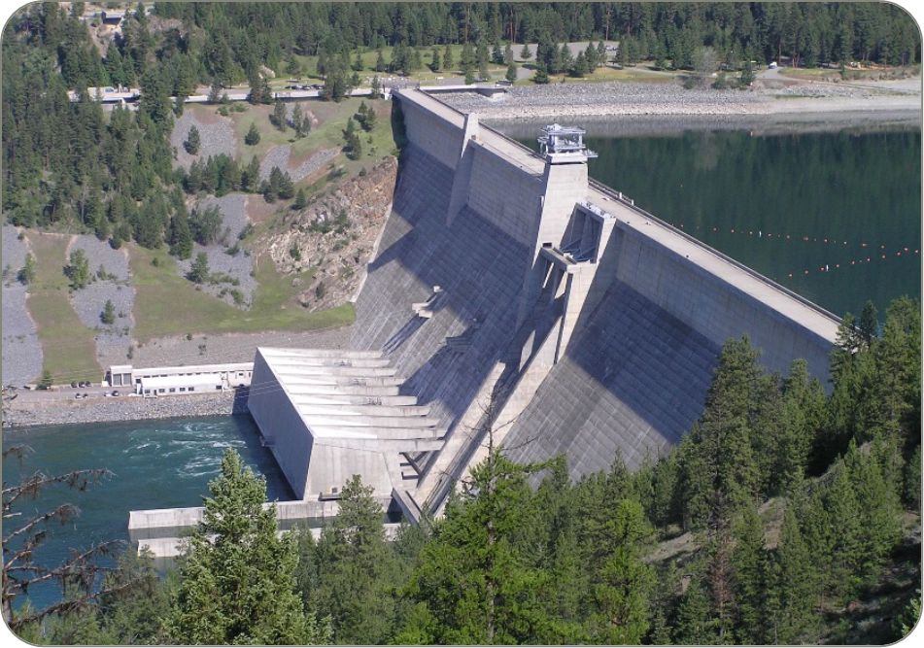

Libby dam Sturgeon operations 2021 - UPDATE
26 May 2021
TMT Meeting

Slide 2
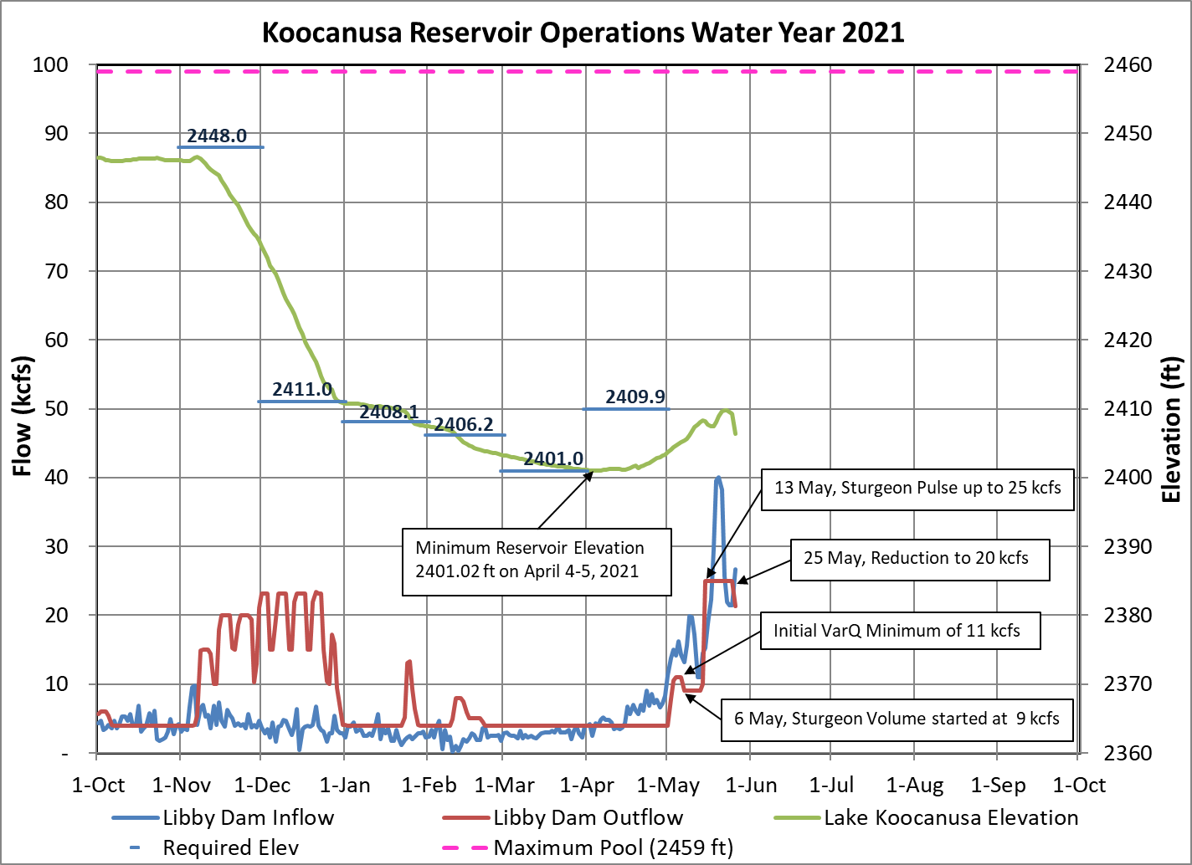
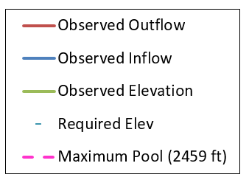

Slide 3
UPDATED Flow Augmentation PLAN
Sturgeon augmentation flow operations began on May 6th at 9 kcfs total.
On May 13th increased discharge from Libby Dam to ~25 kcfs (powerhouse capacity) following BiOp ramping rates. Full Powerhouse release lasted for 11 Days.
On May 24th emergency line outage to begin on May 25th for repairs to damaged transmission line. Powerhouse limited to ~20 kcfs.
On May 25th decreased discharge to 20 kcfs. Hold 20 kcfs until May 30th (2 days longer).
Decrease discharge (post-pulse) at Libby Dam to summer flat flow following BiOp ramping rates, and the Sturgeon operation is projected to end June 4th (was June 2nd).
Same Sturgeon Volume (0.8 MAF) in updated plan.
* in season management in coordination with FPIP may cause these values to vary slightly.

Slide 4
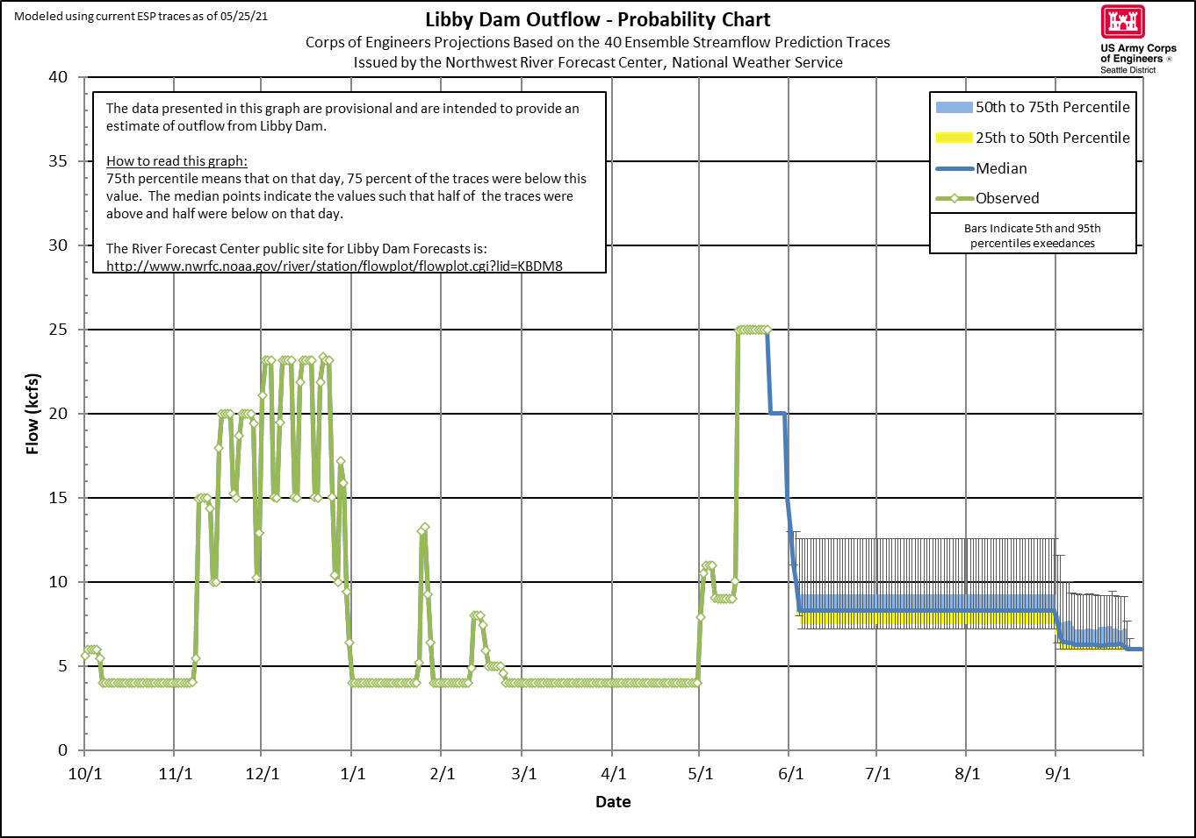
Sturgeon Pulse 2021 UPDATE
Emergency Outage May 25, 2021

Slide 5
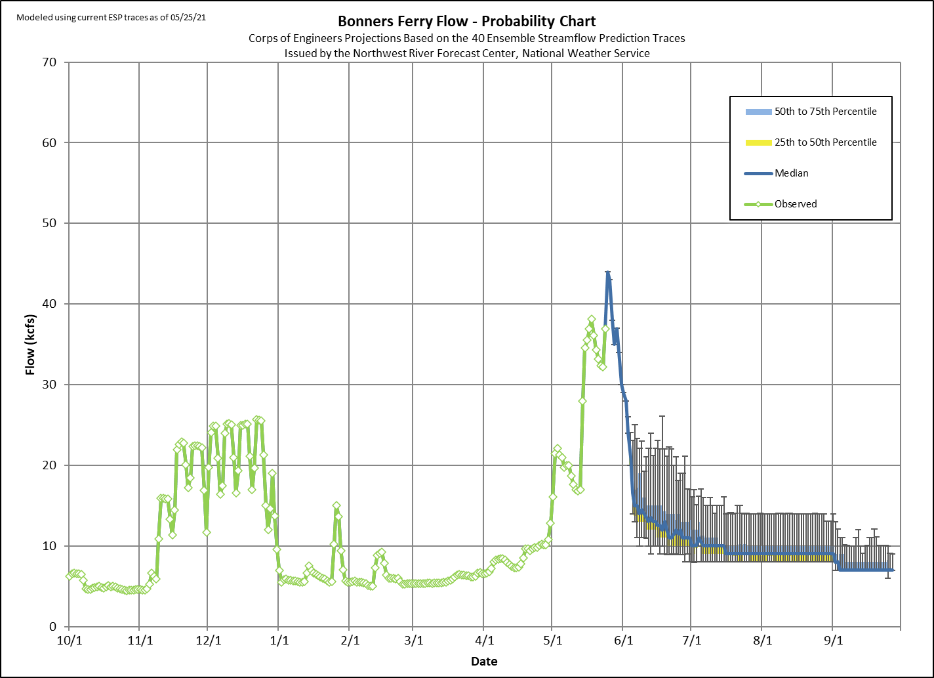
17 Days Median
30 kcfs Goal
Notes:
Add flow plot

Slide 6
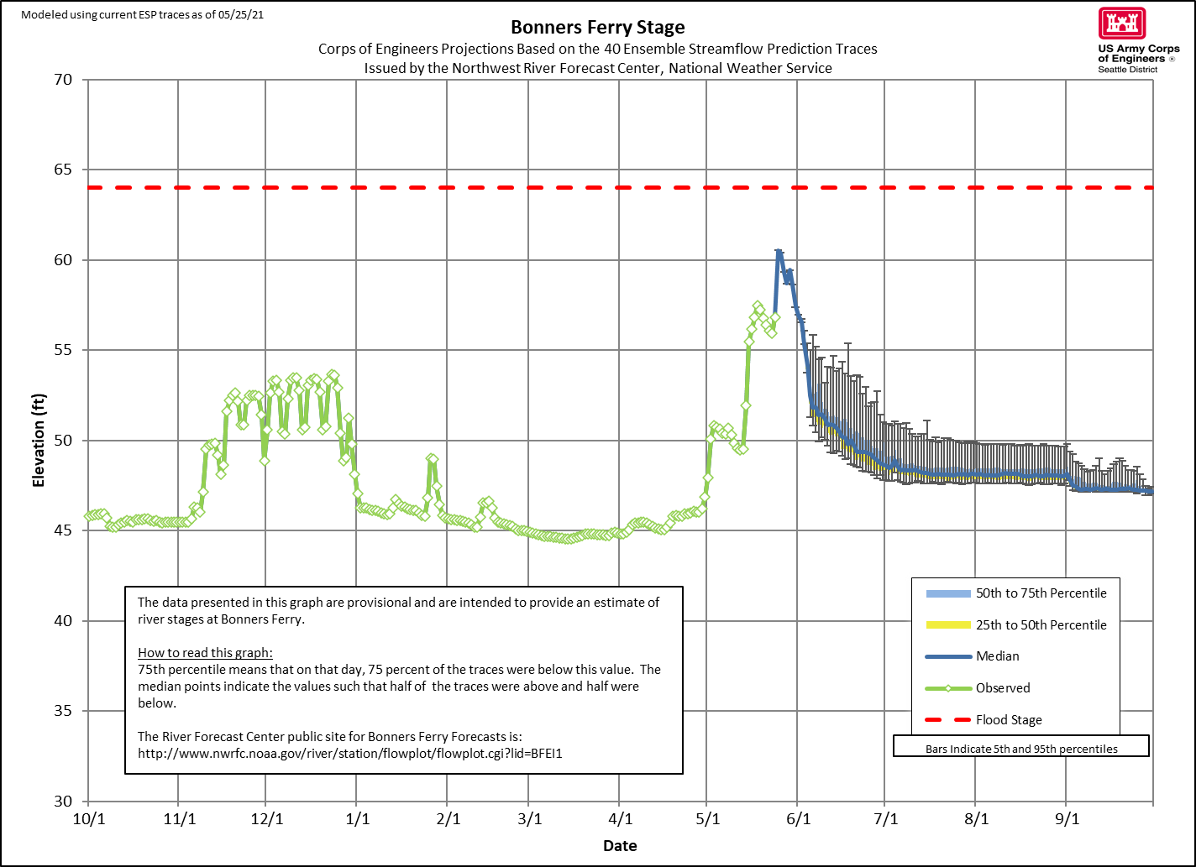
6 Days Median
1758 ft Goal
Notes:
Add flow plot

Slide 7
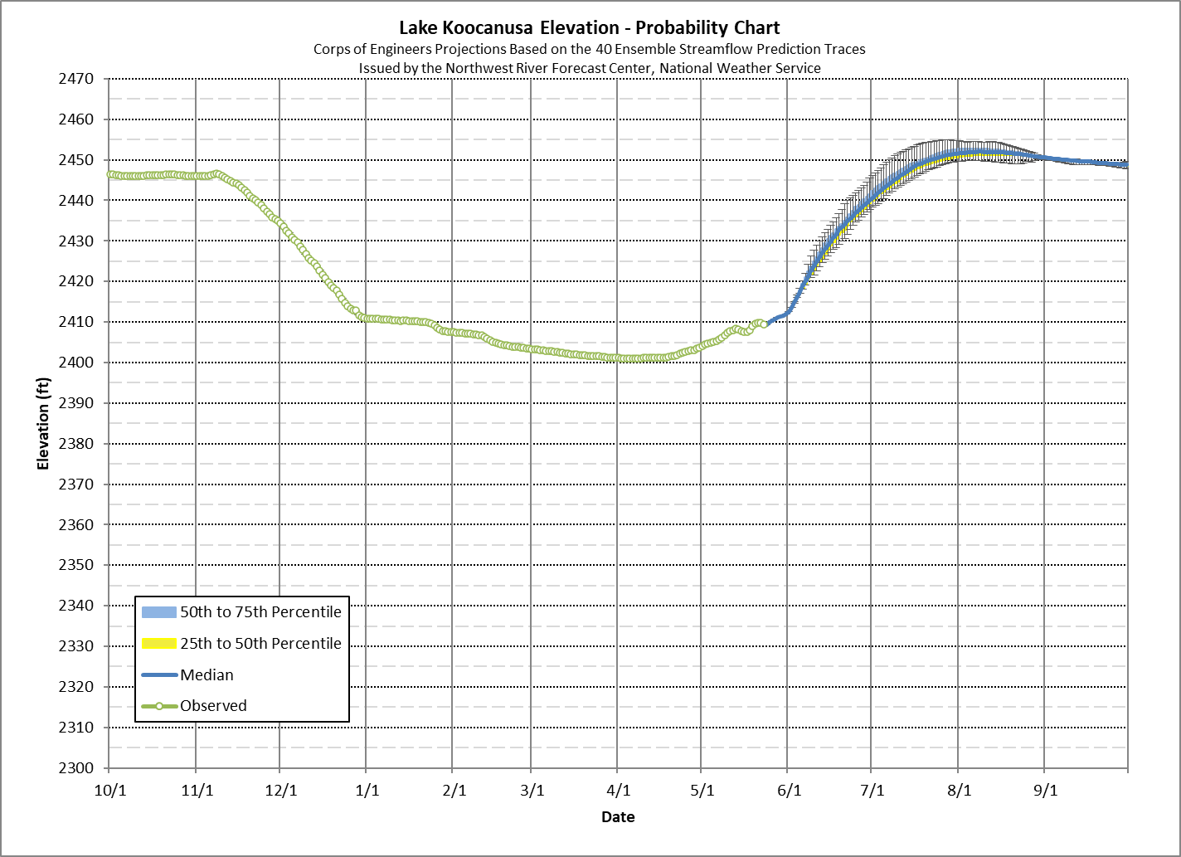
Projected Elevation Percentiles (25-50-75)
May 31st: 2412.0 – 2412.0 – 2412.0
June 30th: 2439.3 – 2440.0 – 2441.6
July 31st: 2450.6 – 2451.5 – 2452.6
Peak Elev.: 2451.2 – 2452.0 – 2452.8
Peak Date: 8/11 8/8 8/6
August 31st: 2450.6 – 2450.6 – 2450.7
September 30th: 2448.5 – 2448.7 – 2449.1
*based on May 25th ESP Traces

Slide 8
SUMMARY OF STURGEON PULSE CHANGES
On May 13th increased discharge from Libby Dam to ~25 kcfs (powerhouse capacity) following BiOp ramping rates. Full Powerhouse release lasted for 11 Days.
On May 24th emergency line outage to begin on May 25th for repairs to damaged transmission line. Powerhouse limited to ~20 kcfs.
On May 25th decreased discharge to 20 kcfs. Hold 20 kcfs until May 30th (2 days longer). Ramp down to summer flat flow following BiOp ramping rates, and the Sturgeon operation is projected to end June 4th (was June 2nd).
Same Sturgeon Volume (0.8 MAF) in updated plan.
* in season management in coordination with FPIP may cause these values to vary slightly.

Slide 9
Questions?

