Slide 1
Kootenai River White Sturgeon Migration, Flow, and Temperature Management
Ryan Bart
Kootenai River White Sturgeon Lead
U.S. Fish and Wildlife Service
Idaho Fish and Wildlife Office

Slide 2
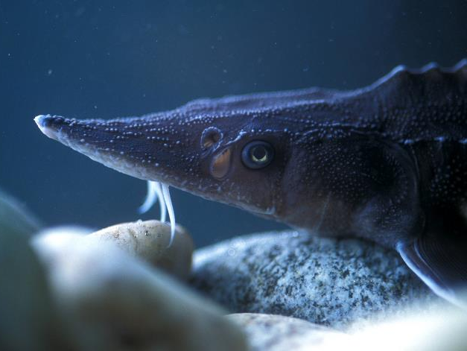
Kootenai River White Sturgeon
Endemic white sturgeon population to the Kootenai River and Kootenay Lake
Became isolated from the Columbia River during the last ice age
Makes annual spawning migrations from Kootenay Lake to the Kootenai River

Slide 3
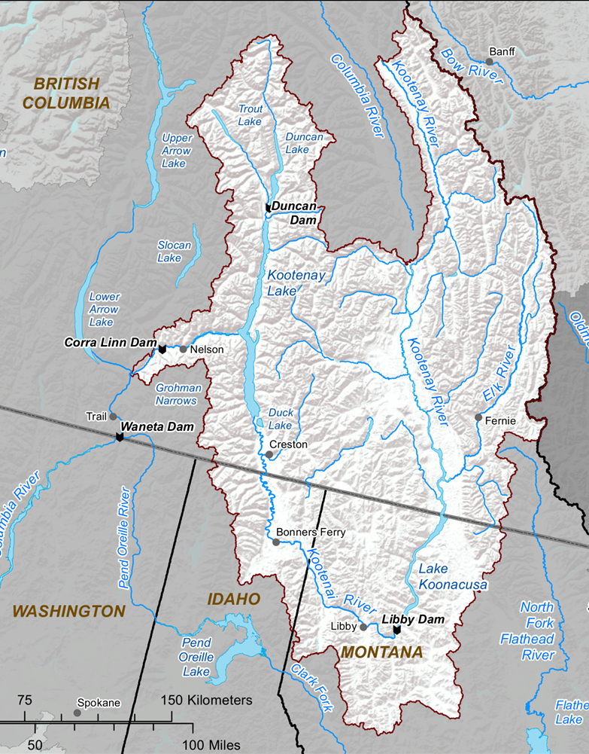

Kootenai River White Sturgeon
IKLBC

Slide 4
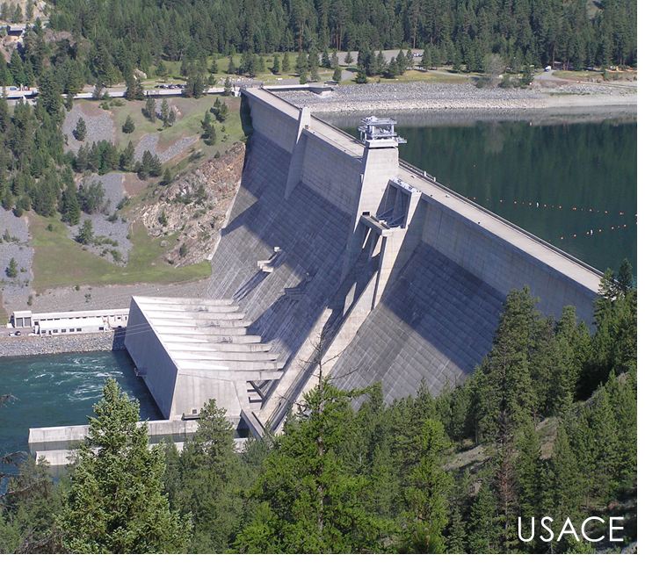
Kootenai River White Sturgeon
High spring flows act as a cue for sturgeon to move upstream
Descending limb of peak flows cue spawning
Upstream movement increases likelihood of spawning over suitable substrate

Slide 5
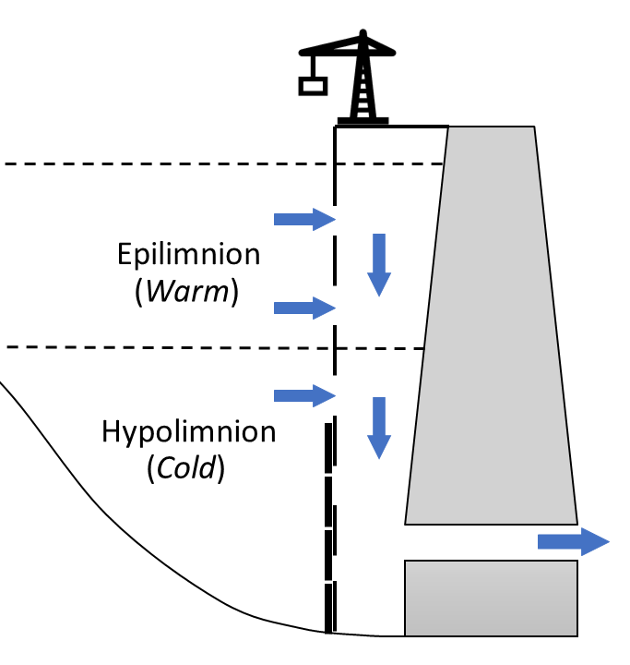
Recovery Actions
Flow and Temperature Management
Selective Withdrawal
Flow Planning Implementation Protocol (FPIP)
Habitat Enhancement
Kootenai River Habitat Restoration Plan

Slide 6
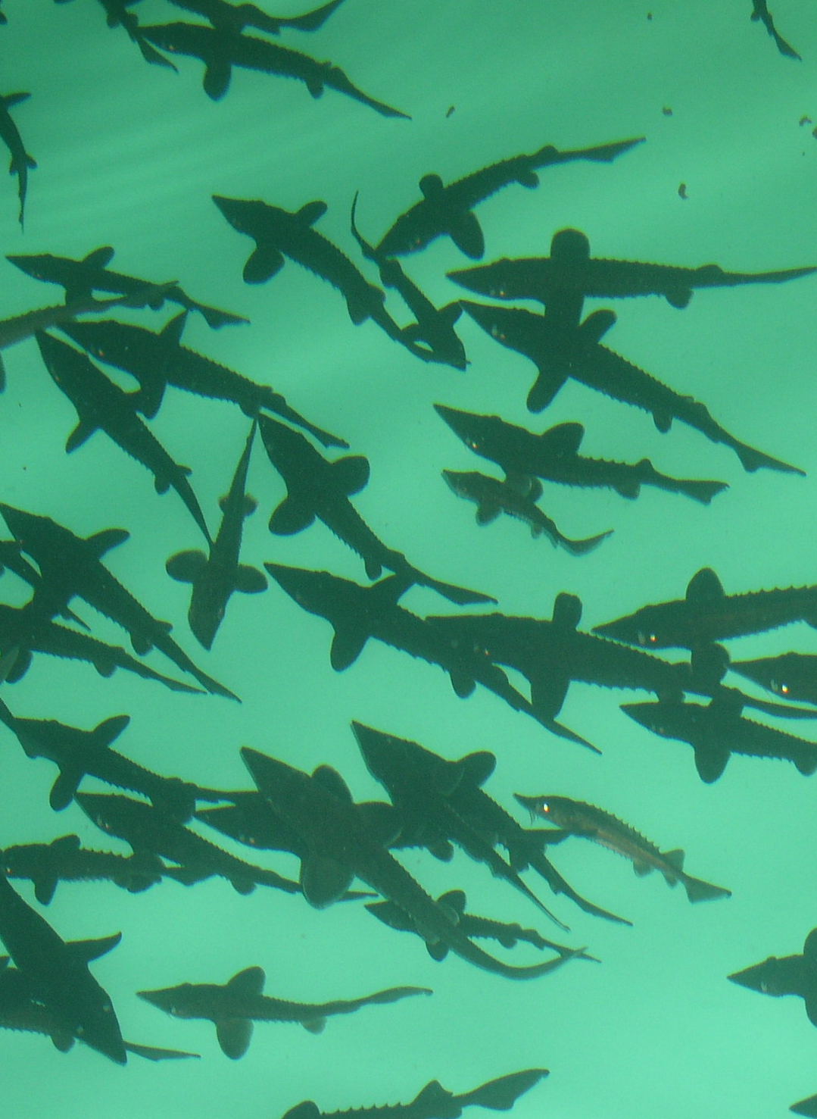
Recovery Actions
Nutrient Addition KTOI & IDFG
Nutrient addition site at Idaho/Montana border
KTOI Conservation Hatchery
First year-class release 1992
Annual production

Slide 7
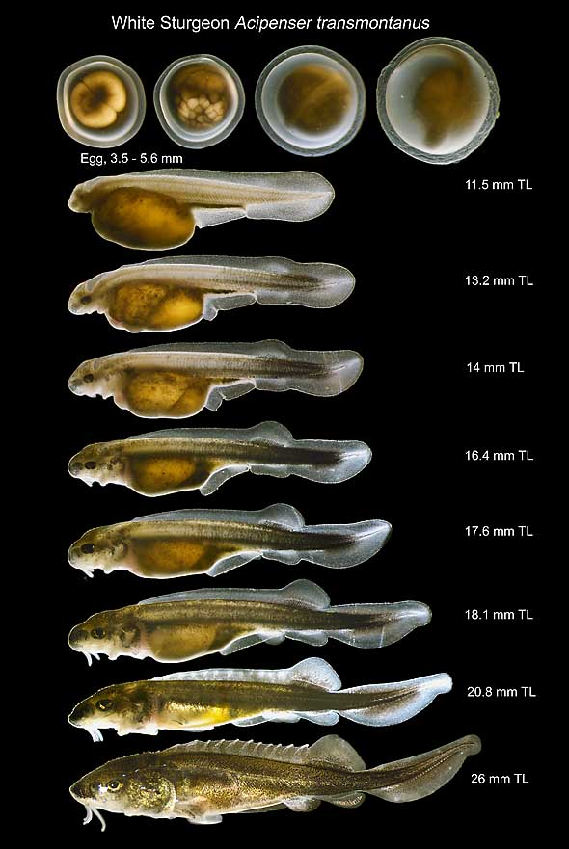
Current Population
Wild Population and Recruitment
Consist of pre-Libby year-classes
Larval capture June 2021
Hatchery Population
Early year-classes reaching sexual maturity
Representative pre-Libby broodstock
USBR Wang and Reyes

Slide 8
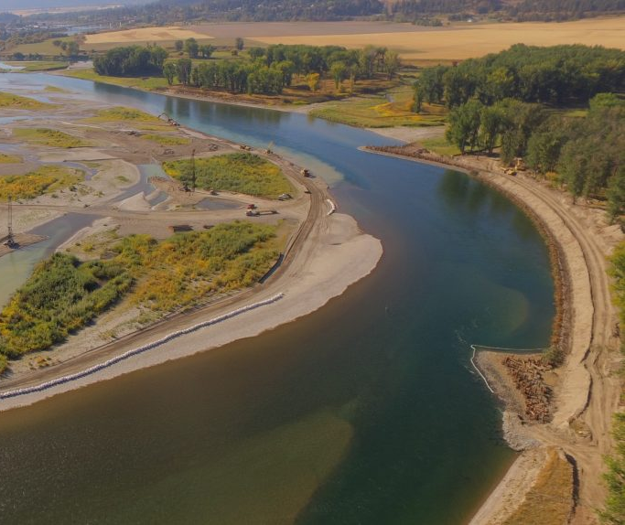
Path Forward
Better understand how the current ecosystem and population can be managed to support natural recruitment
Resiliency
Redundancy
Representation
GBI

Slide 9
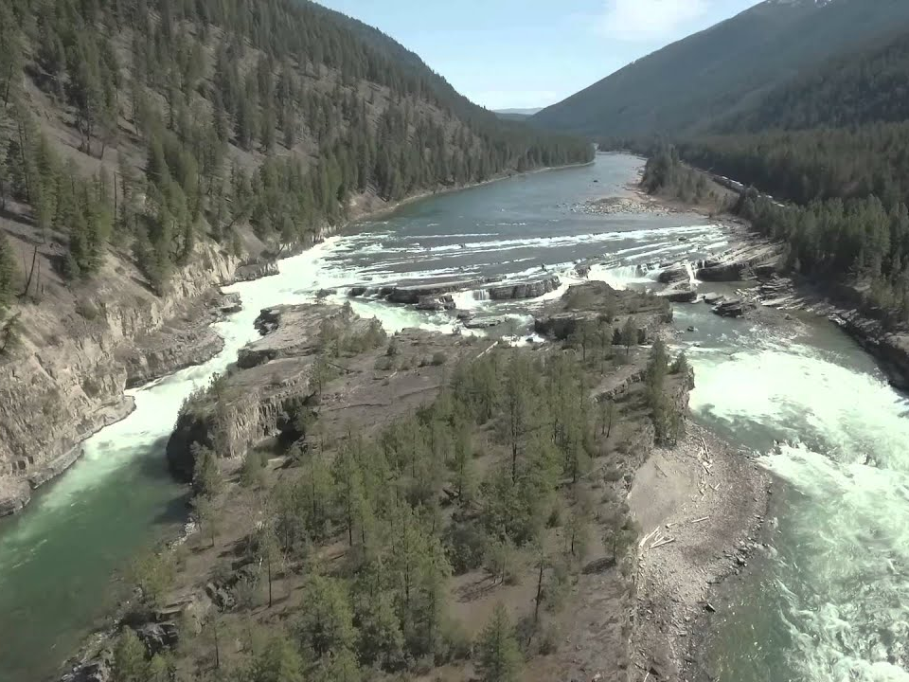
Questions and Acknowledgments
Kootenai Tribe of Idaho
Idaho Department of Fish and Game
Montana Fish, Wildlife, and Parks
B.C. Ministry of Forests, Lands, Natural Resource Operations and Rural Development
U.S. Geological Survey
U.S. Army Corps of Engineers
Bonneville Power Administration
KRO

