Slide 1
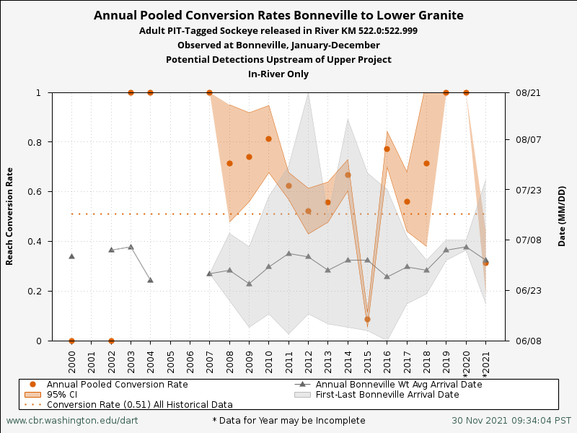

Slide 2
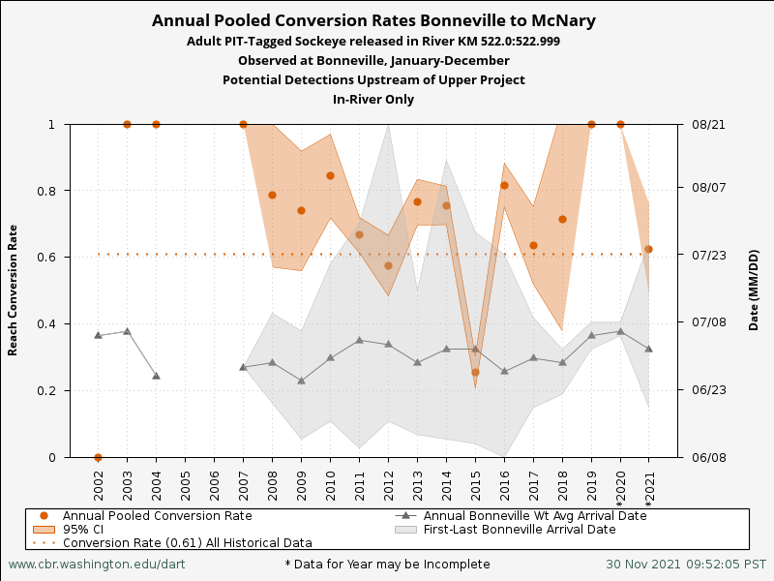

Slide 3
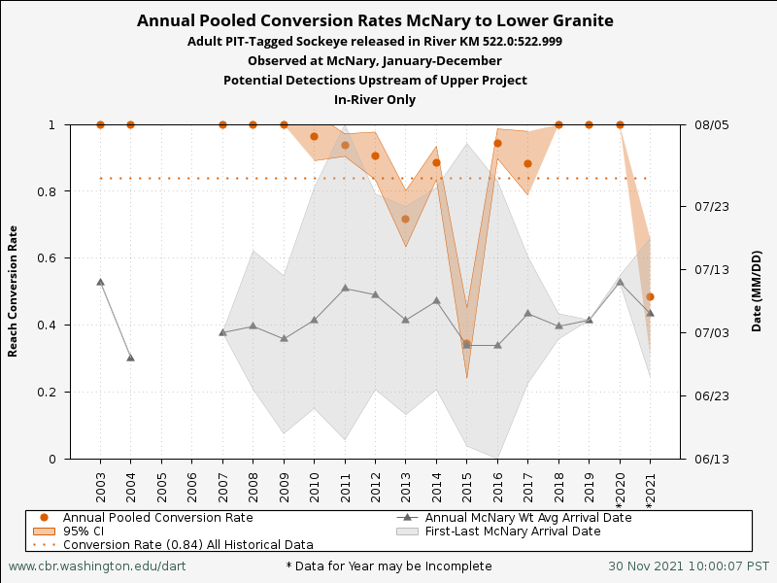

Slide 4
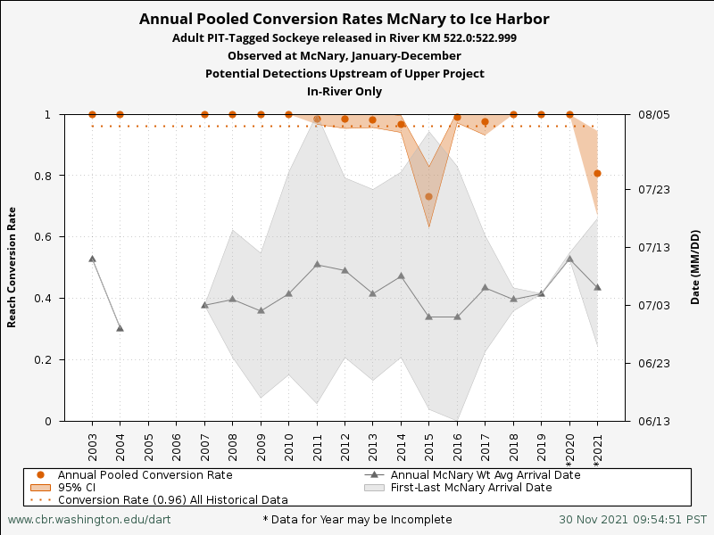

Slide 5
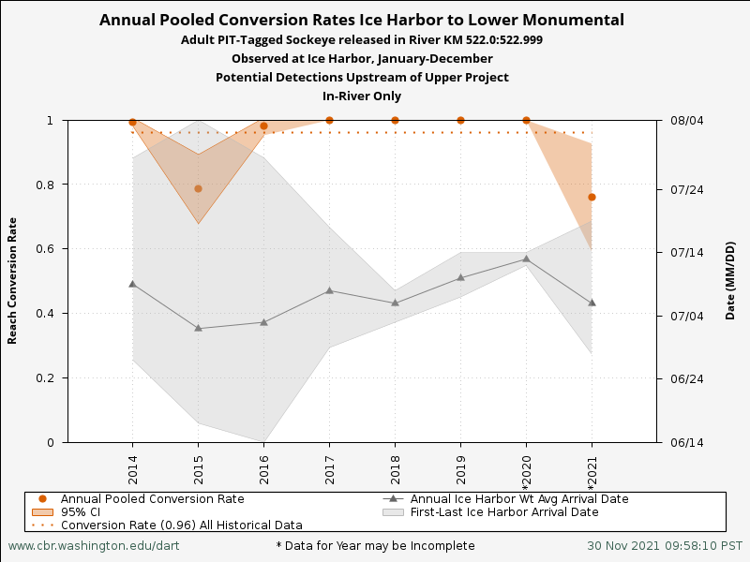

Slide 6
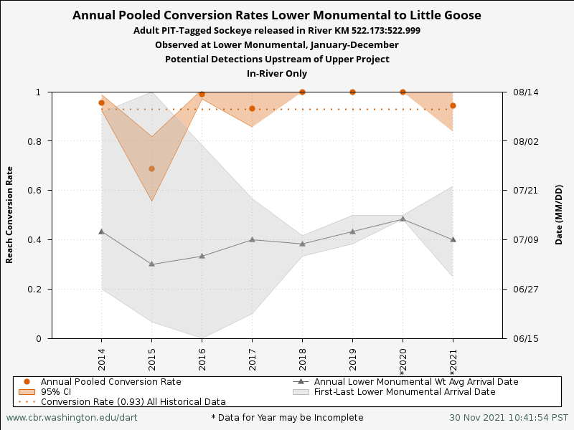

Slide 7
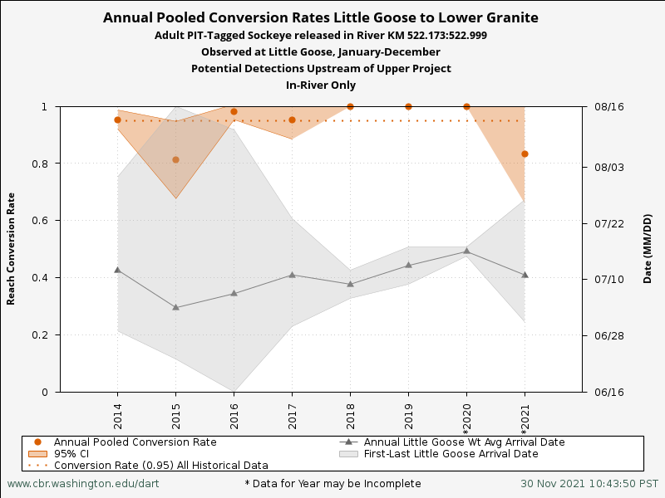

Slide 8
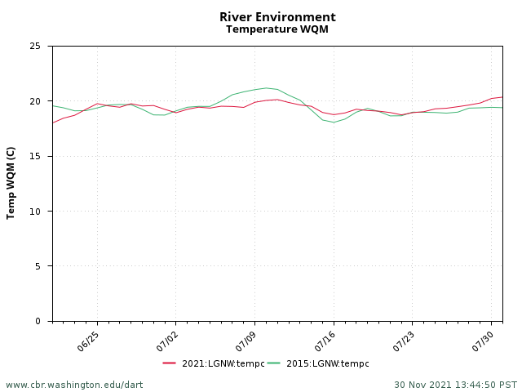

Slide 9
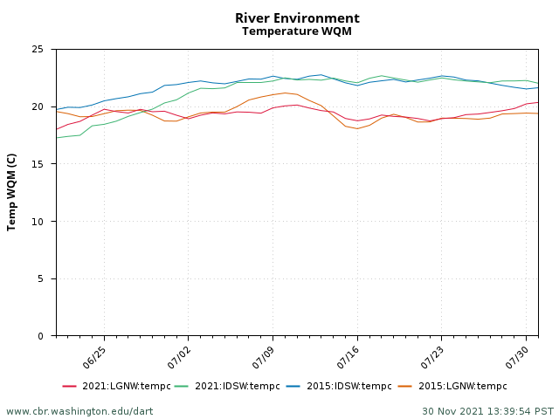

Slide 10
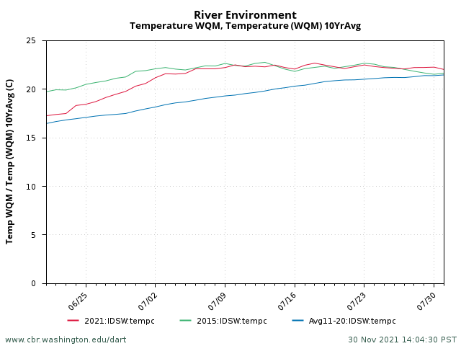

Slide 11
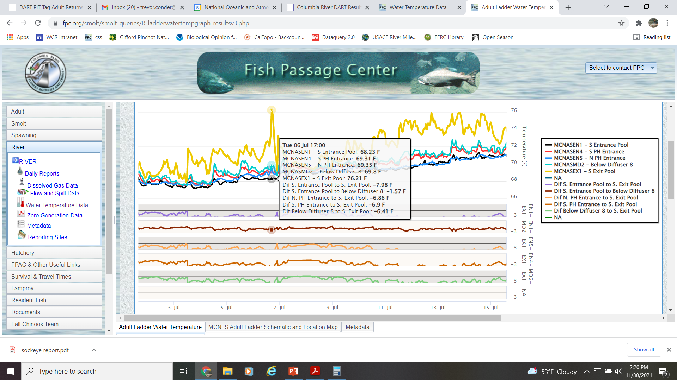

Slide 12
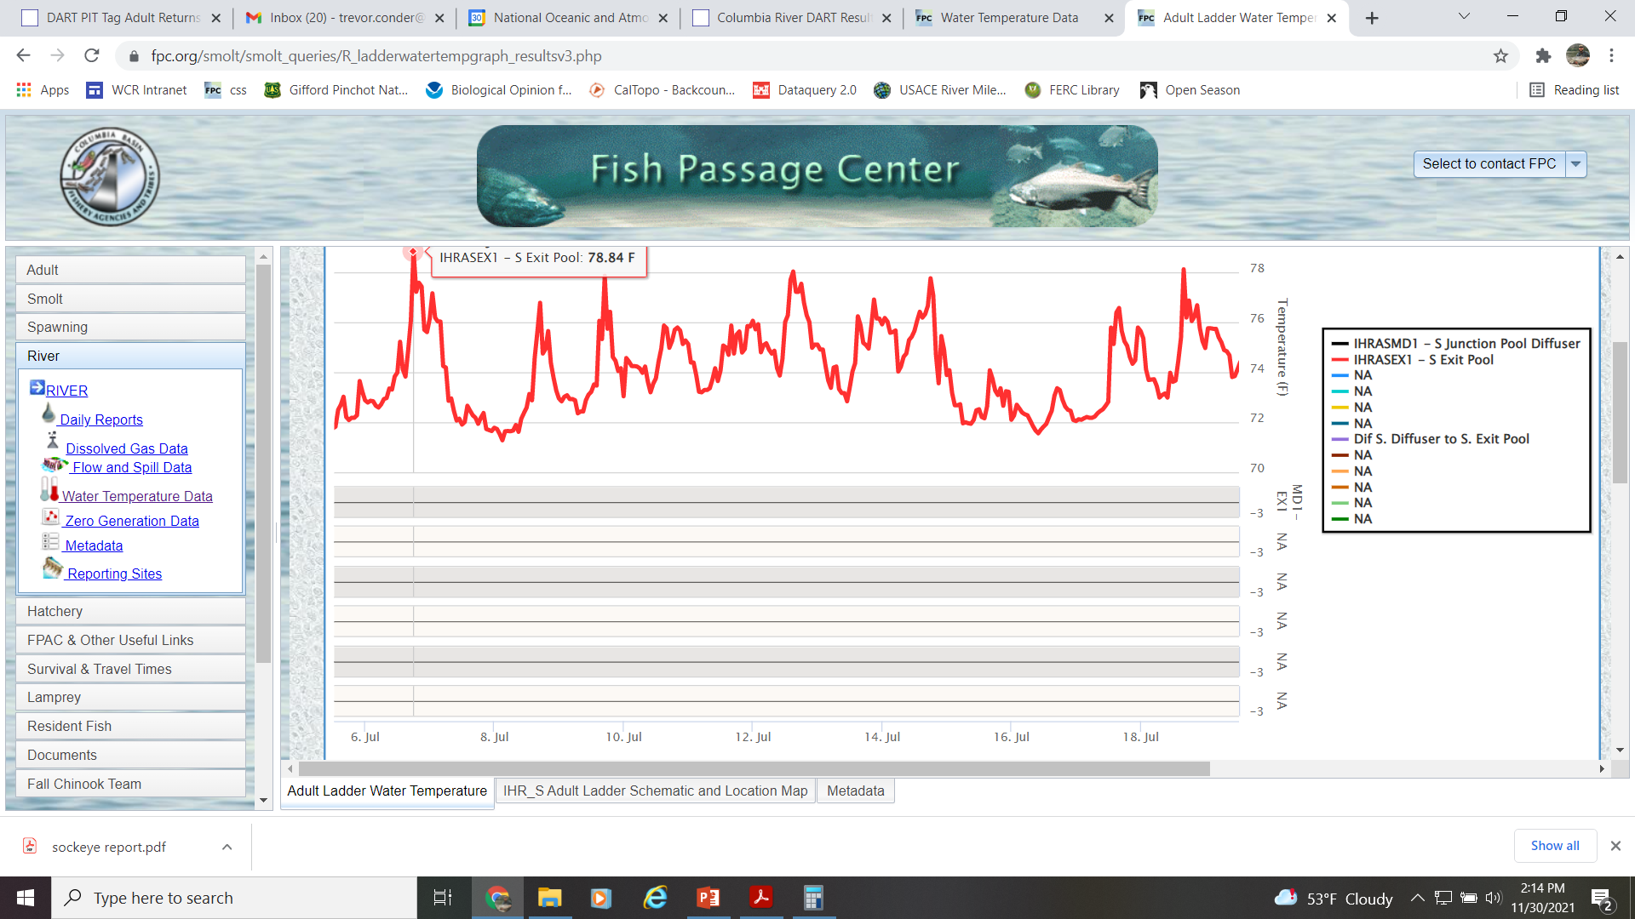

Slide 13
Conclusion
Recent SR sockeye conversions are highly variable and appear to be worsening with increasing ambient temperature.
While the Corps has been very successful at maintaining temps below 68F at Lower Granite Dam per the regional goal, accomplishing this was not sufficient in 2015 and 2021 at reducing mortality and maintaining acceptable conversion rates of adult sockeye salmon.
In some years, high river temps in the lower Snake and Columbia Rivers lead to ladder temps and differentials that do not support successful adult sockeye migration.

Slide 14
NOAA 2015 Sockeye Report
Recommendation #8
Investigate methods to reduce maximum temperatures and temperature differentials in
adult fish ladders at mainstem lower Snake and Columbia dams identified as having these
problems, and implement if feasible.
Recommendation #10
Evaluate the Dworshak cold water release program to maintain temperatures in the
lower Snake River below 18°C during June and most of July to reduce adult
sockeye salmon mortality in the lower Snake River.

Slide 15
Proposed Path Forward
Develop a new approach to manage temperature within sockeye tolerance zones in the entire lower Snake River for effective passage.
More aggressive action to install ladder cooling structures to reduce high ladder temps and excessive differentials.

Slide 16
Notes
1536 sockeye to Bonneville, 240 sockeye returned to spawn in Idaho in 2021
Lower Granite Trap and Haul: 185
Redfish Lake Creek Trap: 50
Sawtooth Fish Hatchery Trap: 5
Total: 240
Genetically assigned to out of basin 16 (8.6%)
Just Ideas
Draft DWR deeper and impact other objectives and increase refill risk
Sacrifice August Temp for cooler water in June and July
In emergency years such as 2015 and 2021, manage the proportion of Snake River to Clearwater flow so that DWR cooling is more effective
Closely watch returns while managing and saving water for emergency cooling.

