Slide 1
Zero Generation Flexibility 2021-2022 Usage 12/20/2021 – 1/4/2022
 | LWG | LGS | LMN | IHR | Total Hours Used | Available Hours
Total Hours Used | 19 | 56 | 52 | 50 | 177 | 772
Available Hours | 193 | 193 | 193 | 193 | 193 | 772
 | LWG | LGS | LMN | IHR | Average
% of Available Hours Used | 9.8% | 29.0% | 26.9% | 25.9% | 22.9%
% of Total Hours Used | 4.9% | 14.6% | 13.5% | 13.0% | 11.5%
% of Available Days Used | 19% | 81% | 75% | 69% | 61%

Slide 2
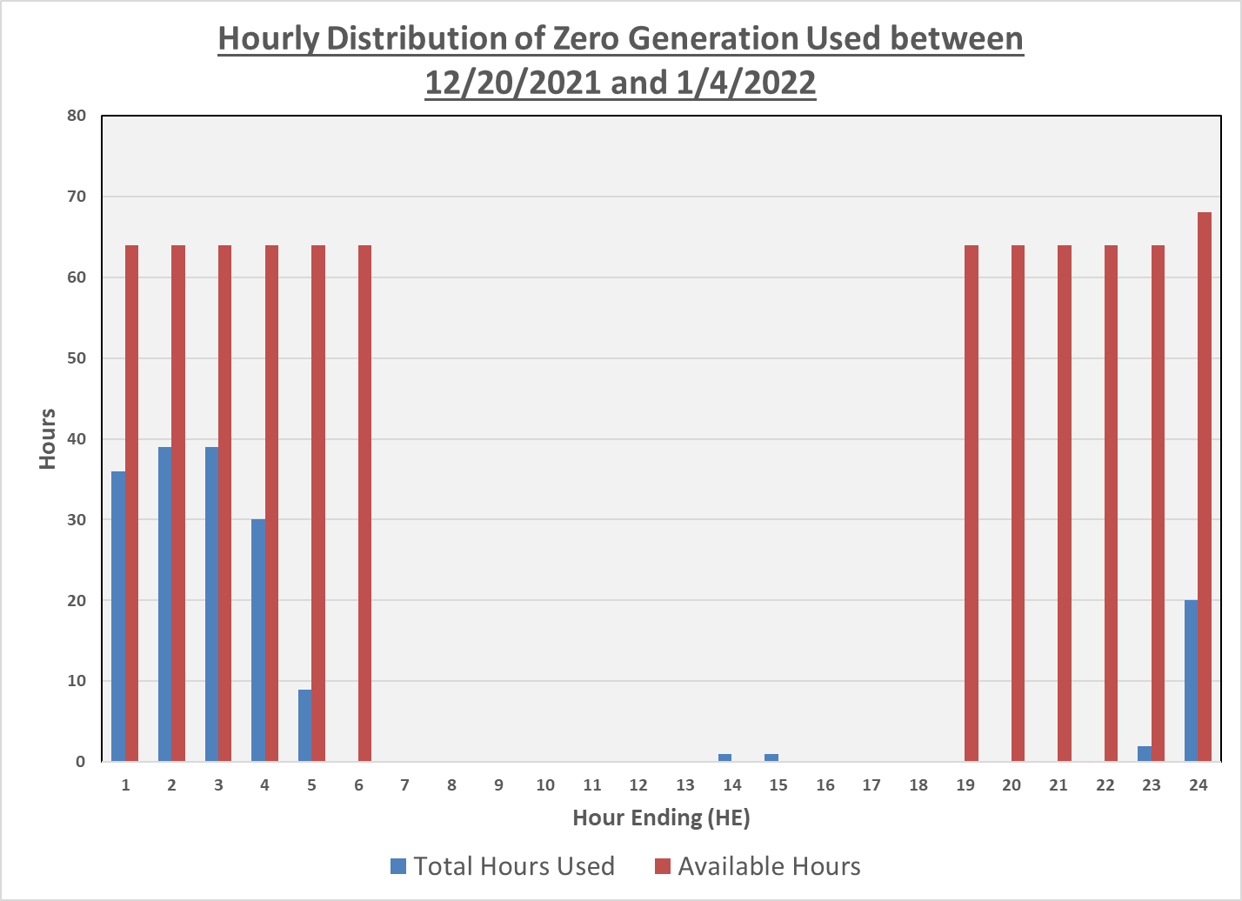
Zero Generation Flexibility 2021-2022 Usage 12/20/2021 – 1/4/2022

Slide 3
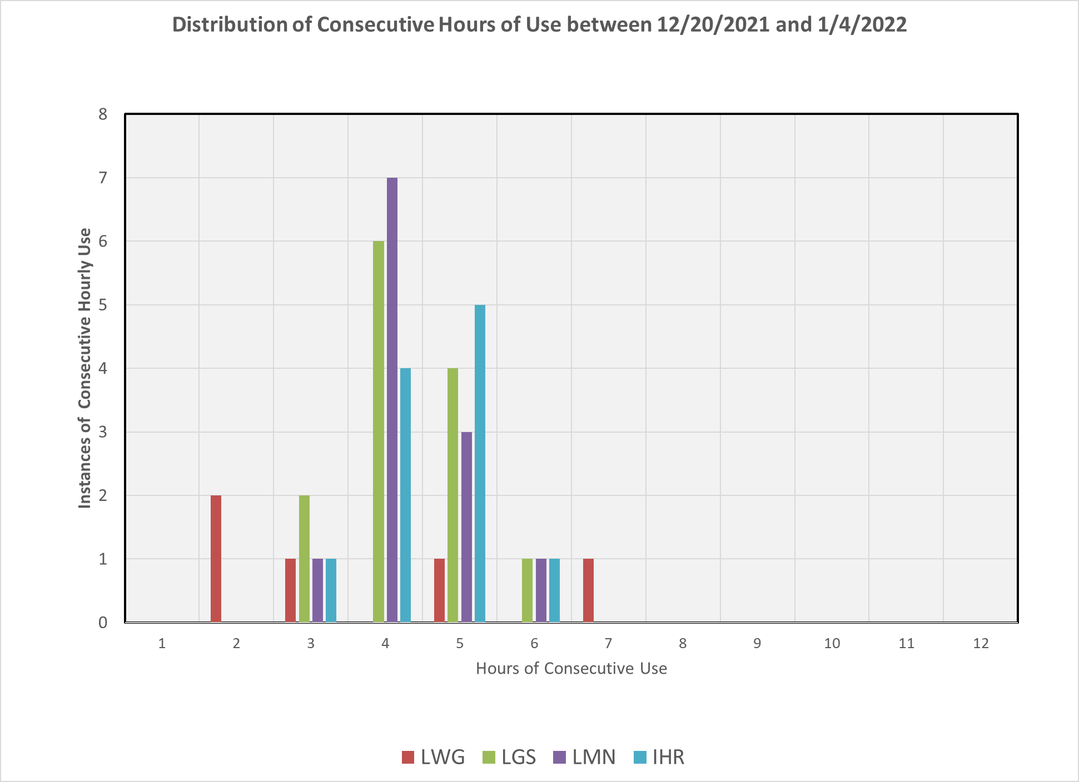
Zero Generation Flexibility 2021-2022 Usage 12/20/2021 – 1/4/2022

Slide 4
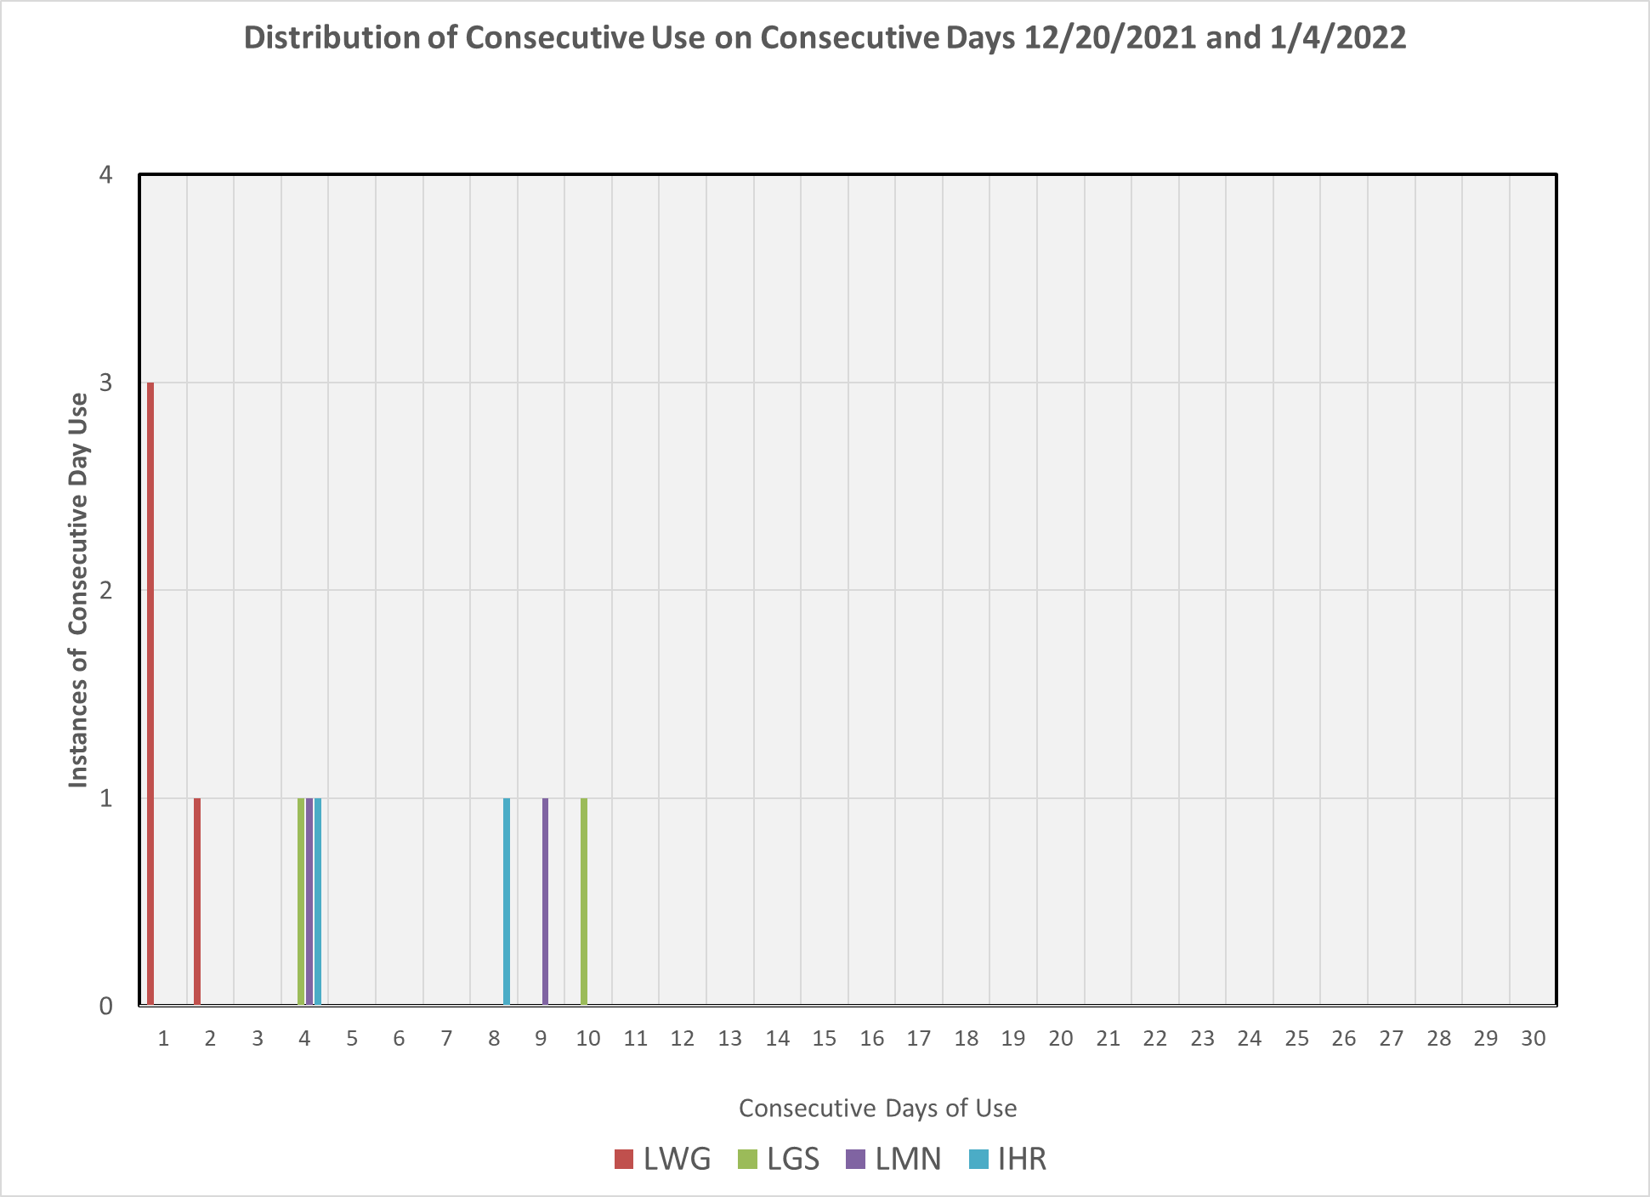
Zero Generation Flexibility 2021-2022 Usage 12/20/2021 – 1/4/2022

Slide 5
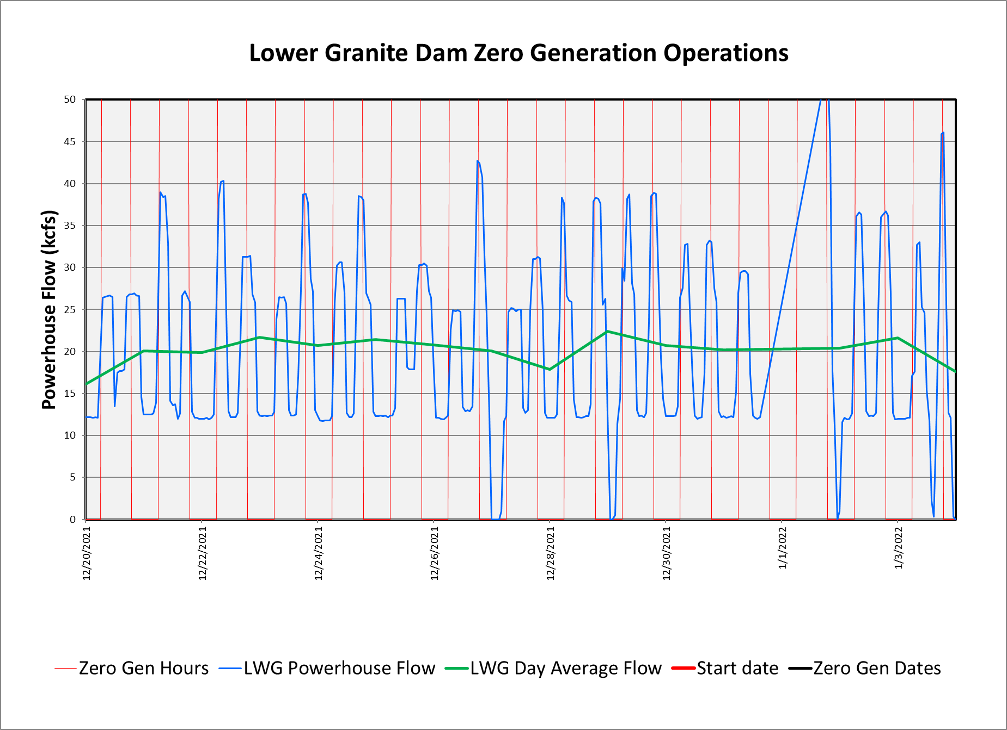
Zero Generation Flexibility 2021-2022 Usage 12/20/2021 – 1/4/2022

Slide 6
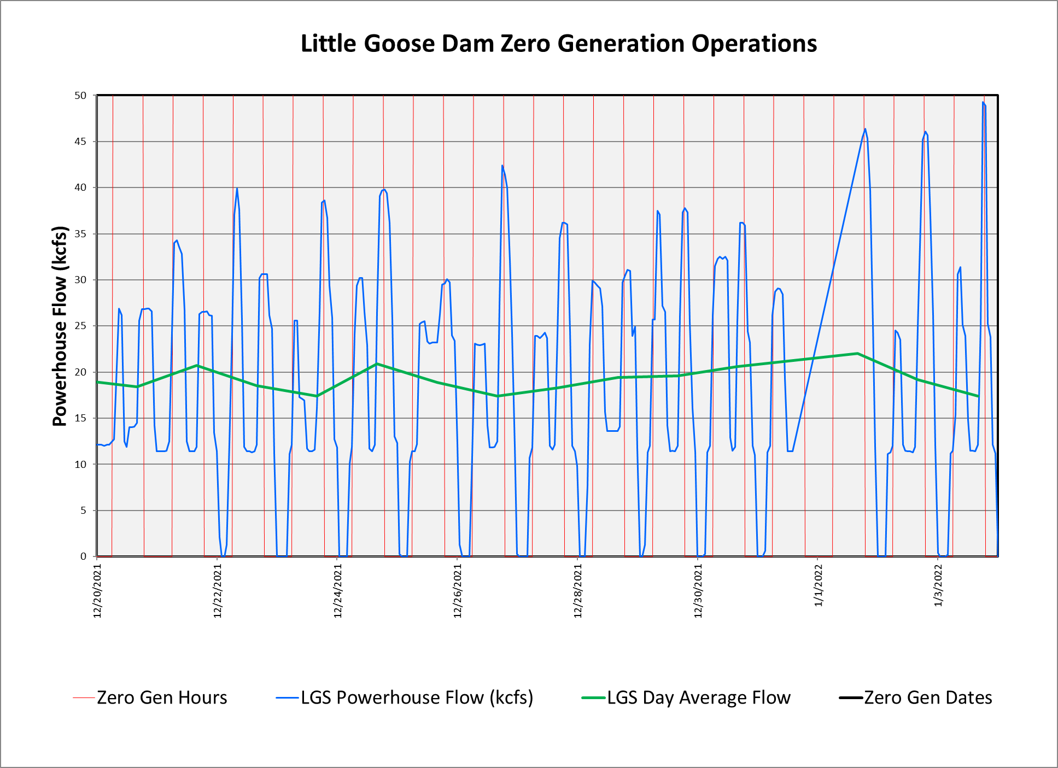
Zero Generation Flexibility 2021-2022 Usage 12/20/2021 – 1/4/2022

Slide 7
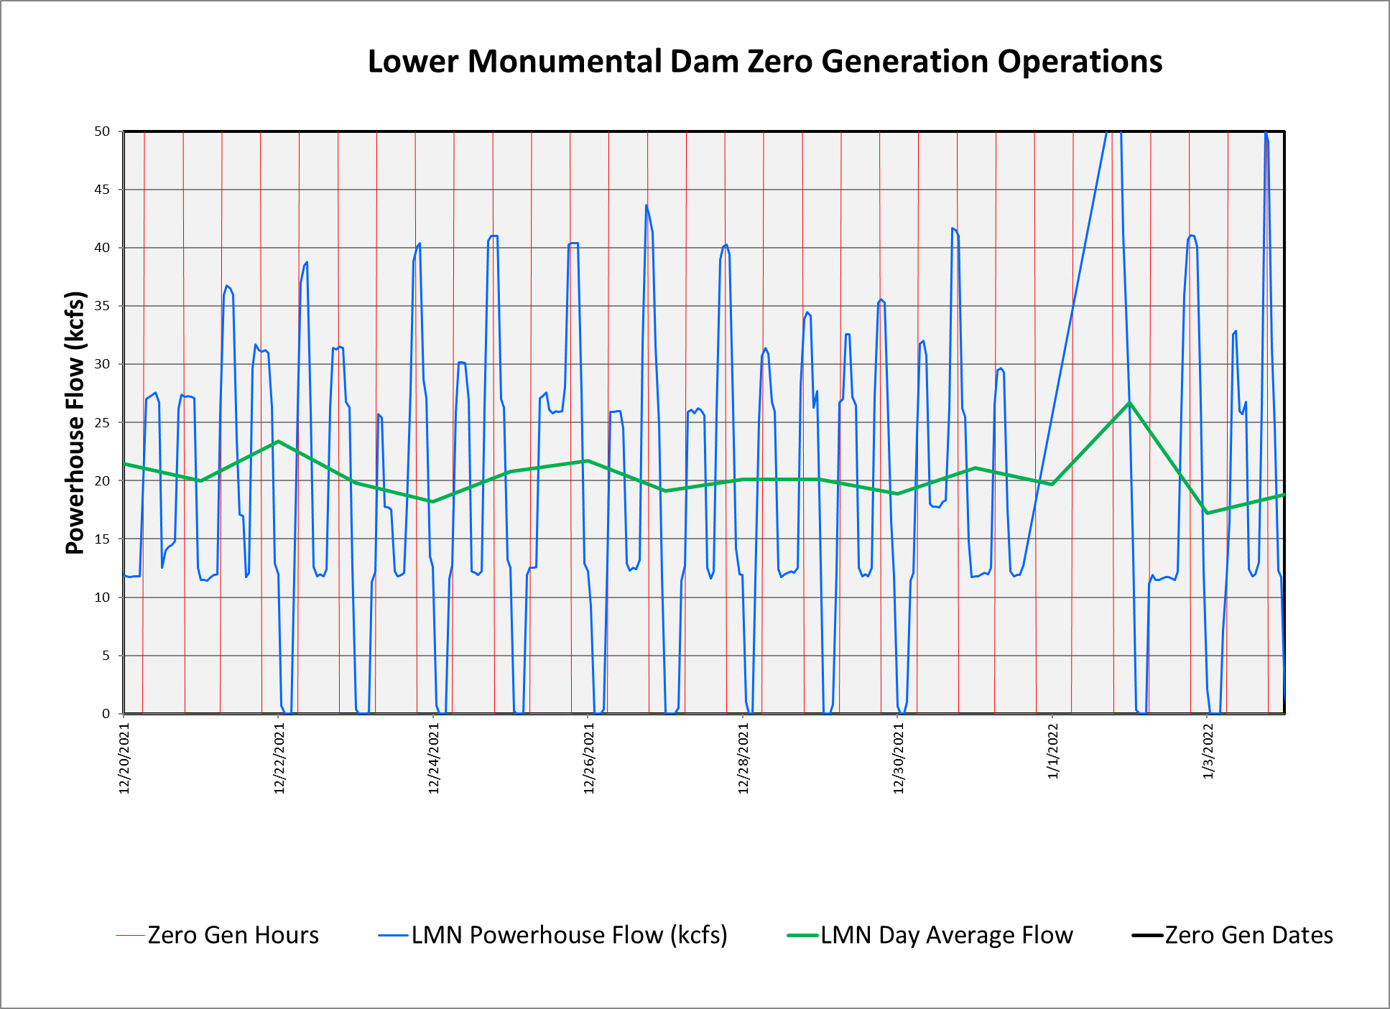
Zero Generation Flexibility 2021-2022 Usage 12/20/2021 – 1/4/2022

Slide 8
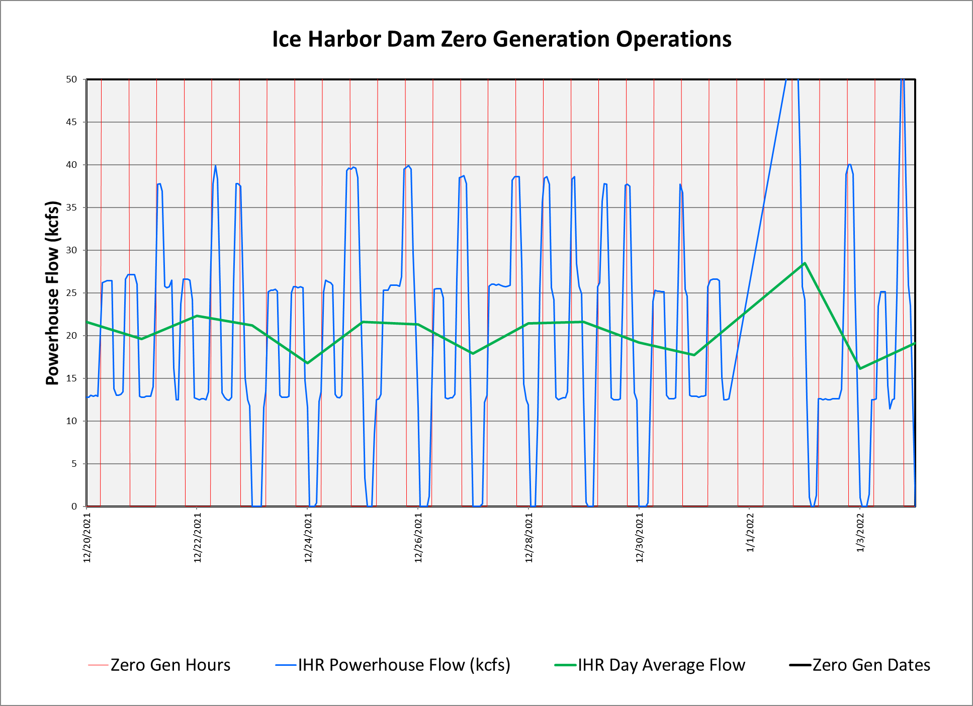
Zero Generation Flexibility 2021-2022 Usage 12/20/2021 – 1/4/2022

