Slide 1
Zero Generation Flexibility 2021-2022 Usage 12/17/2021 – 1/18/2022
 | LWG | LGS | LMN | IHR | Total Hours Used | Available Hours
Total Hours Used | 27 | 82 | 77 | 71 | 257 | 1924
Available Hours | 481 | 481 | 481 | 481 |  | 1924
 | LWG | LGS | LMN | IHR | Average
% of Available Hours Used | 5.6% | 17.0% | 16.0% | 14.8% | 13.4%
% of Total Hours Used | 3.5% | 10.7% | 10.0% | 9.2% | 8.4%
% of Available Days Used | 13% | 56% | 50% | 47% | 41%

Slide 2
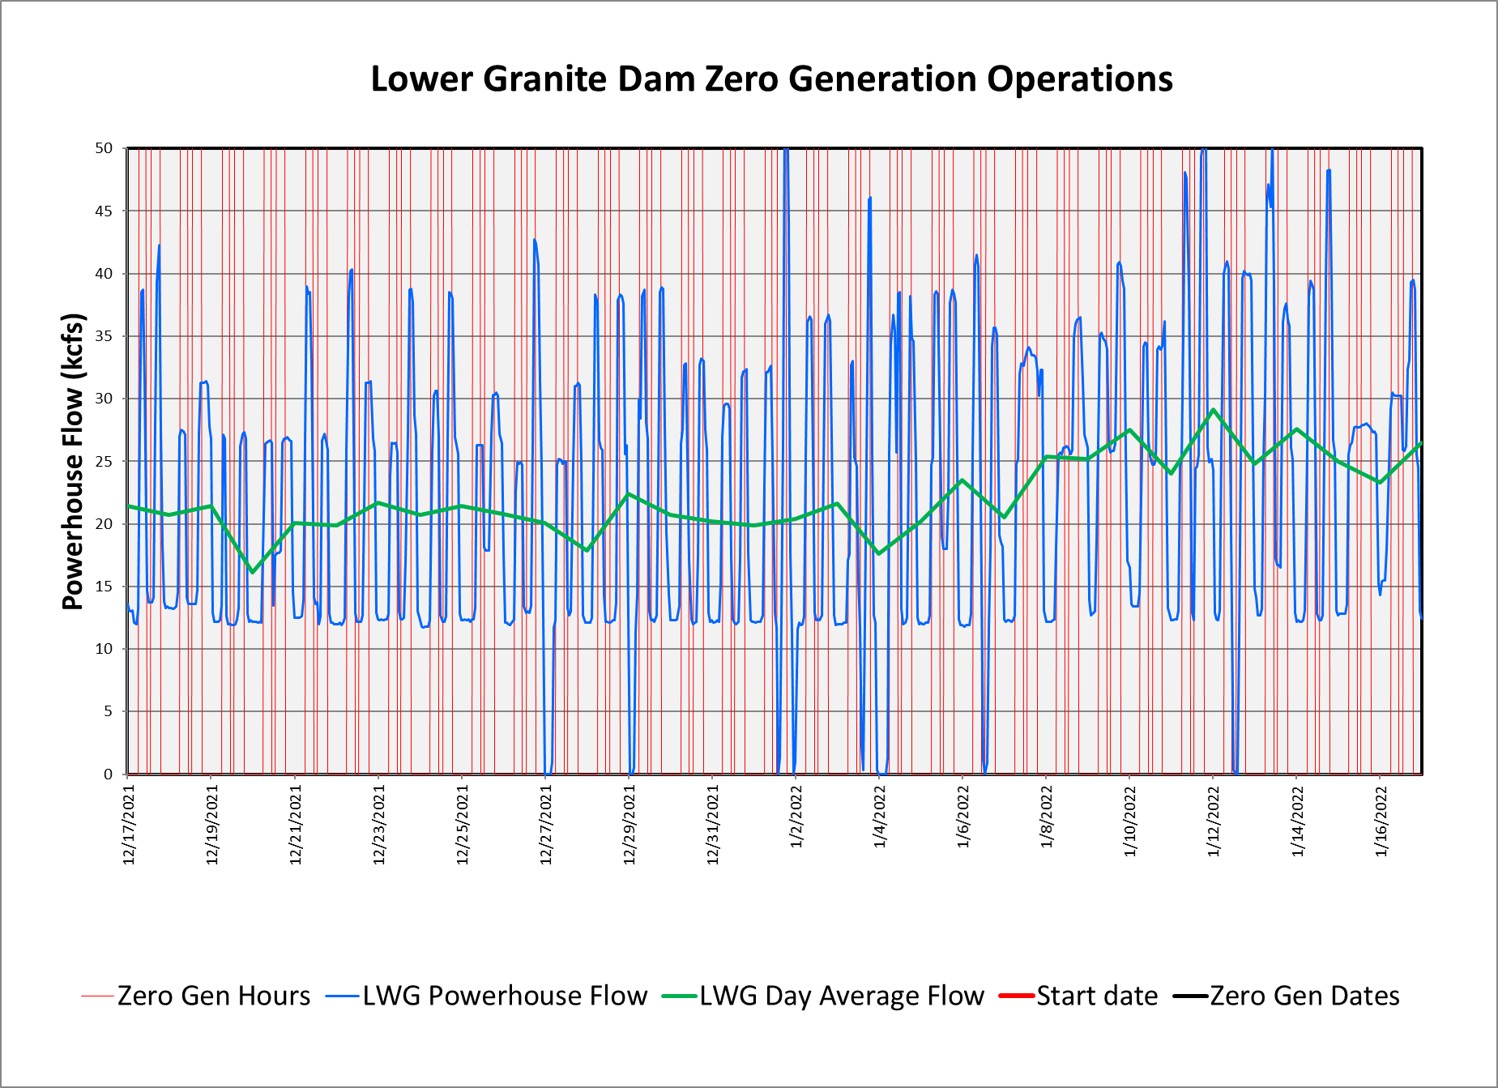
Zero Generation Flexibility 2021-2022 Usage 12/17/2021 – 1/18/2022

Slide 3
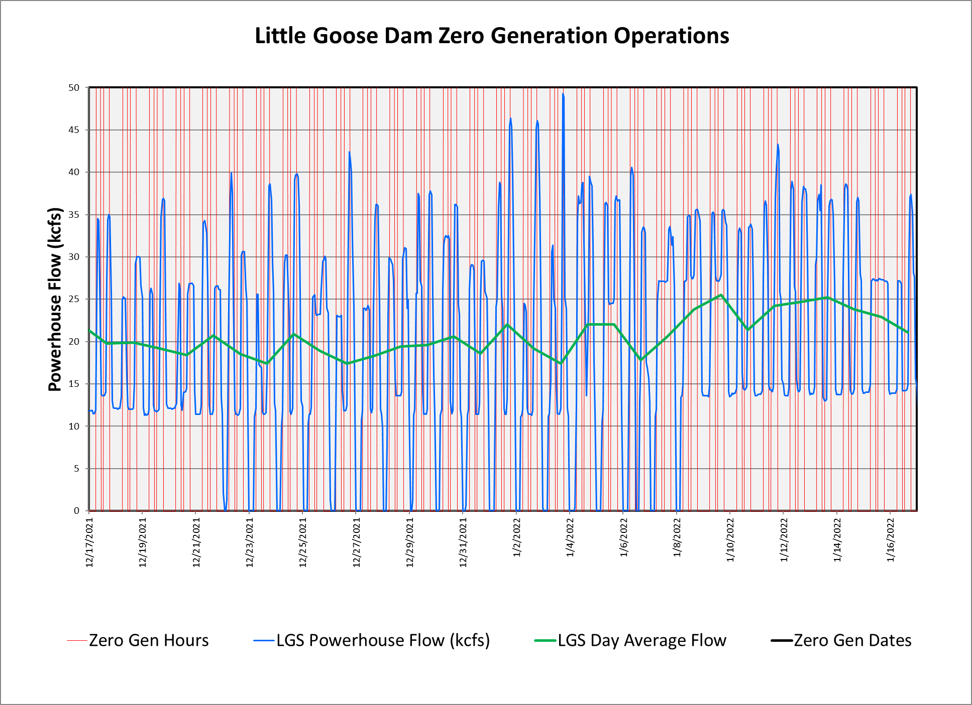
Zero Generation Flexibility 2021-2022 Usage 12/17/2021 – 1/18/2022

Slide 4
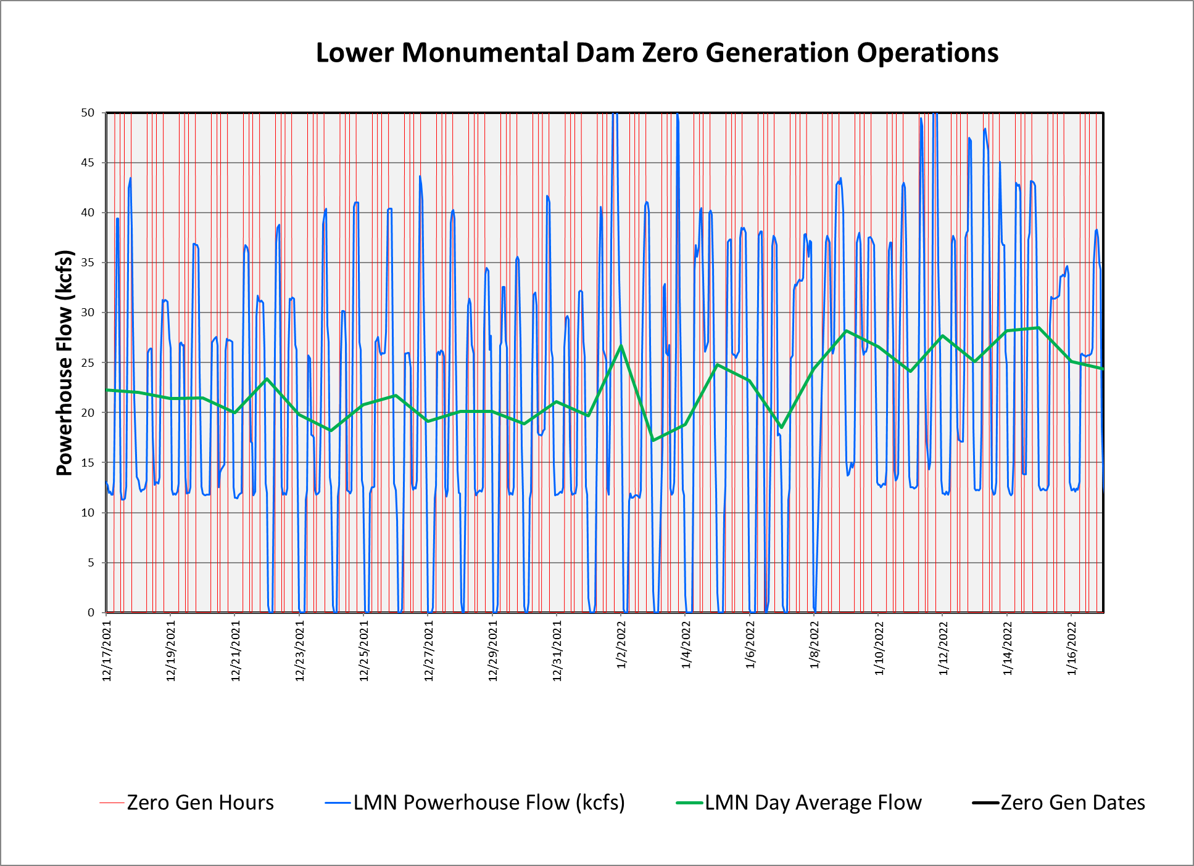
Zero Generation Flexibility 2021-2022 Usage 12/17/2021 – 1/18/2022

Slide 5
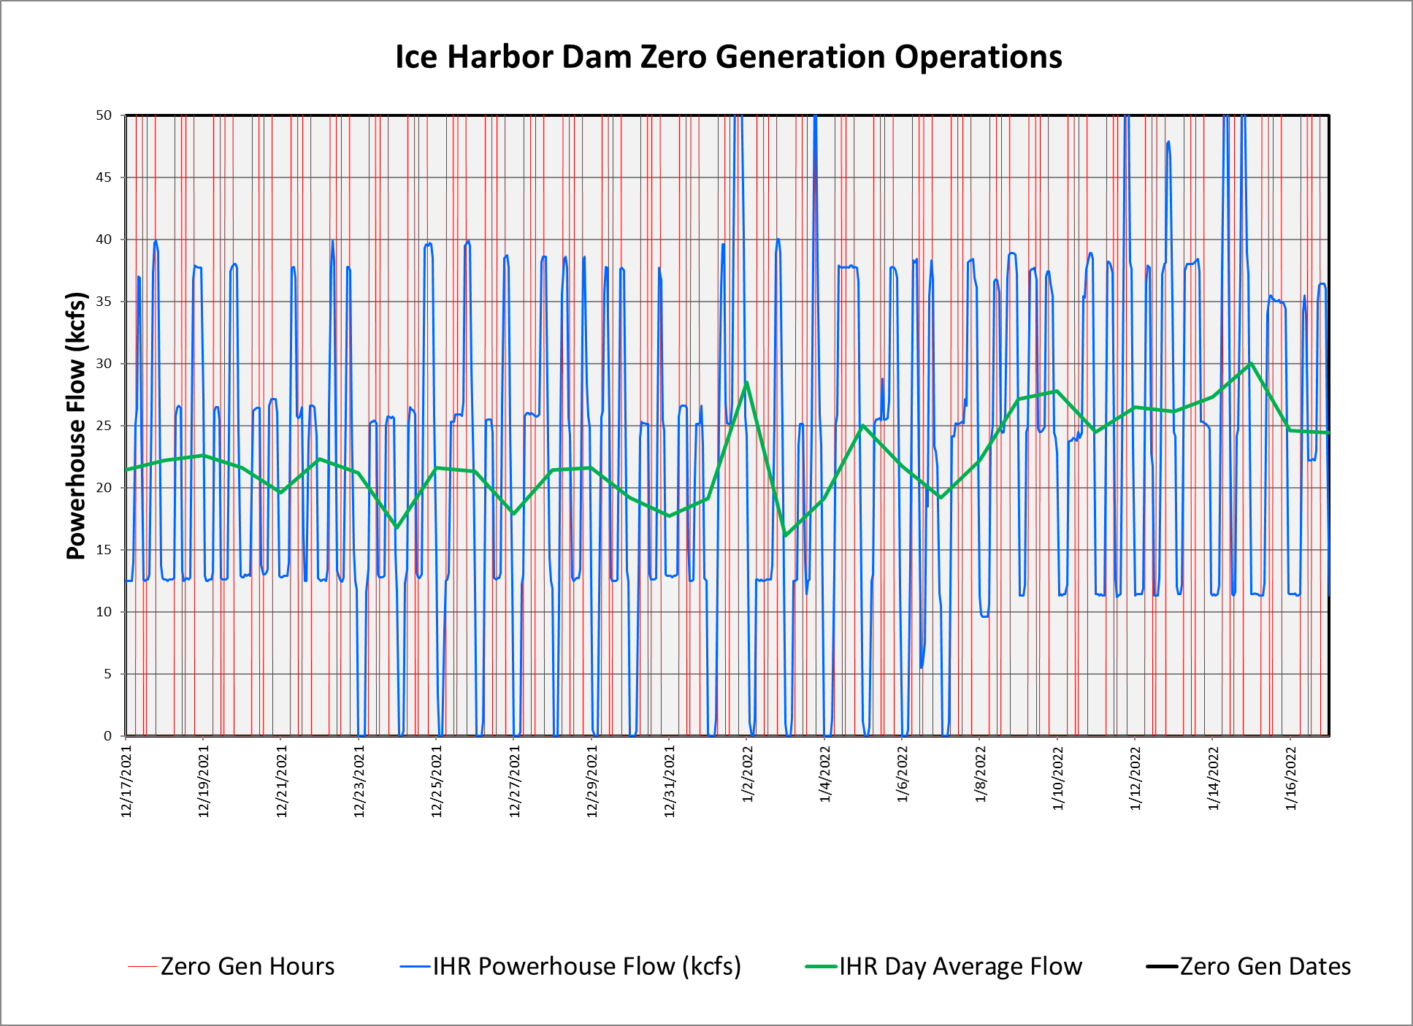
Zero Generation Flexibility 2021-2022 Usage 12/17/2021 – 1/18/2022

Slide 6
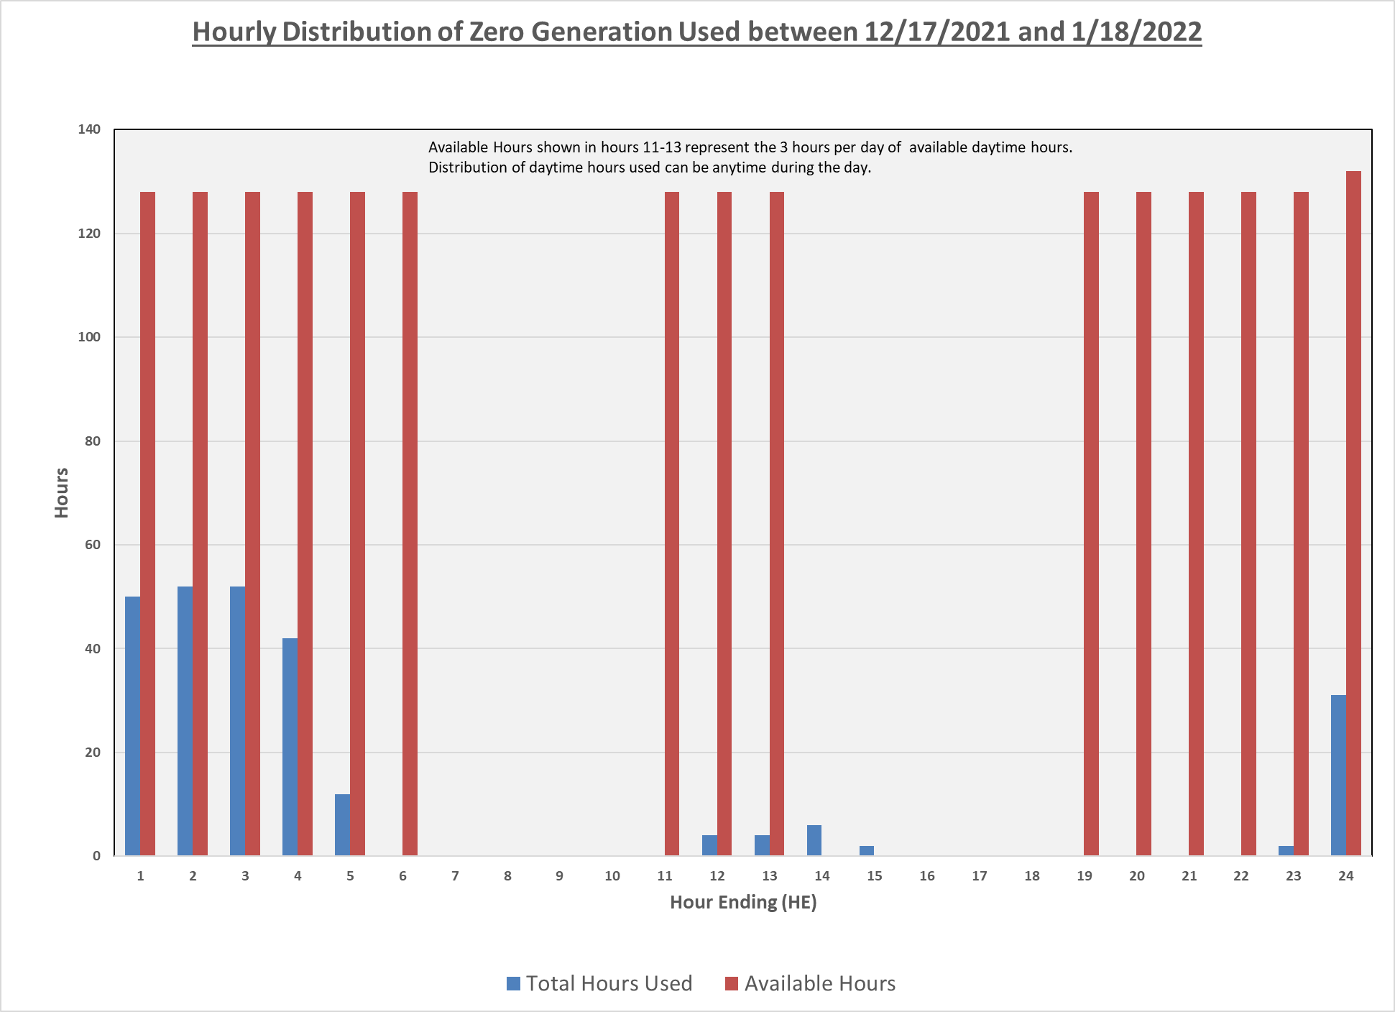
Zero Generation Flexibility 2021-2022 Usage 12/17/2021 – 1/18/2022

Slide 7
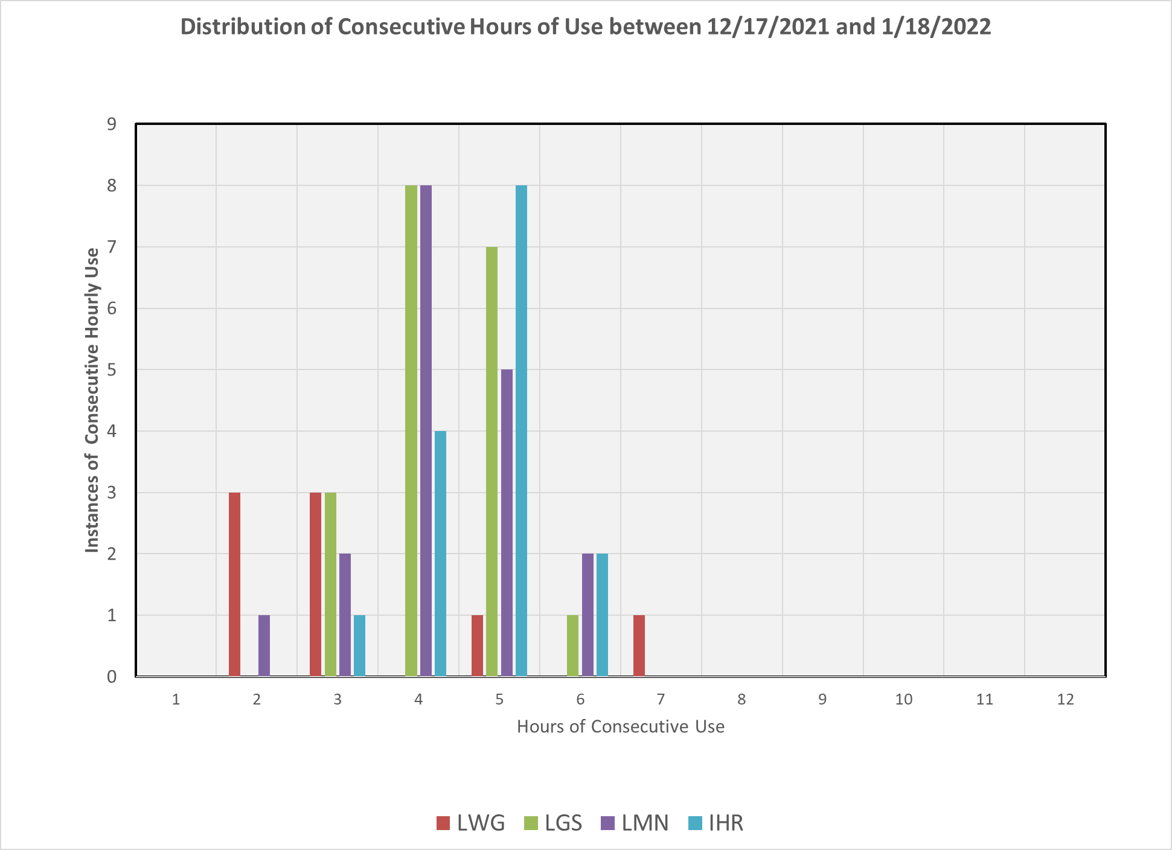
Zero Generation Flexibility 2021-2022 Usage 12/17/2021 – 1/18/2022

Slide 8
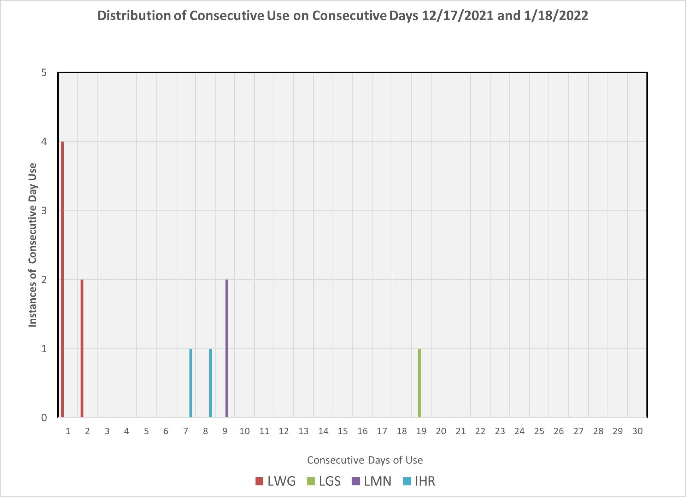
Zero Generation Flexibility 2021-2022 Usage 12/17/2021 – 1/18/2022

