Slide 1
Scenario | 125% TDG spill cap (kcfs)
7 Spillbays plus RSW | 106
6 Spillbays plus RSW | 104
4 Spillbays plus RSW | 97
3 Spillbays plus RSW | 82
3 Spillbays no RSW | 75
2 Spillbays plus RSW | 60
Based on SYSTDG modeling.
These scenarios assume minimum generation, 8 kcfs flow through the RSW, a tailwater elevation of 440 ft and the upstream forebay at 120 % TDG.
These estimates are based on empirical formulas.
There is additional uncertainty because we have not seen the impact of these spill patterns before.
Per normal procedures, we will be evaluating spill and TDG on a daily basis and will adjust the spill cap as needed.

Slide 2
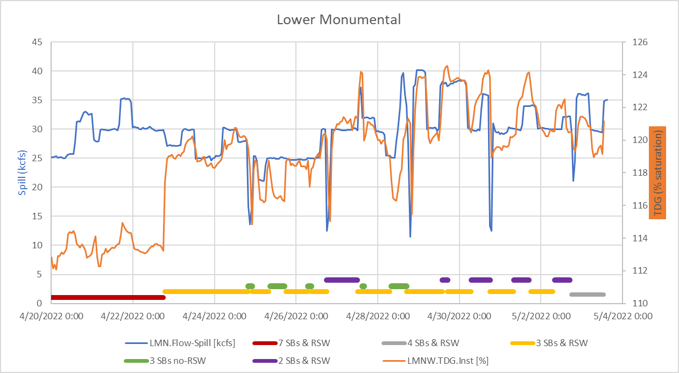

Slide 3
