Slide 1
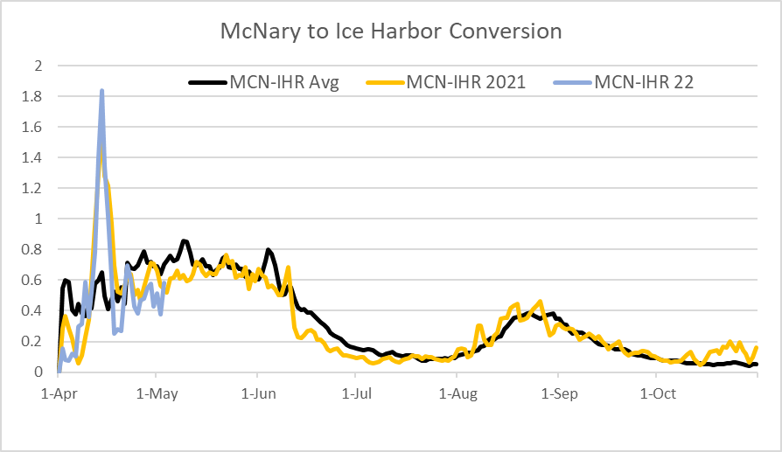
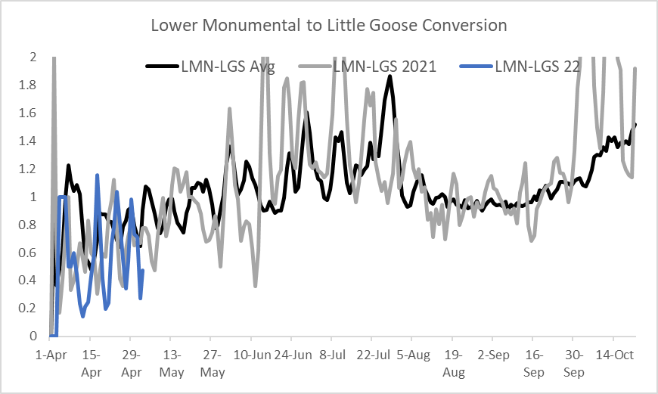
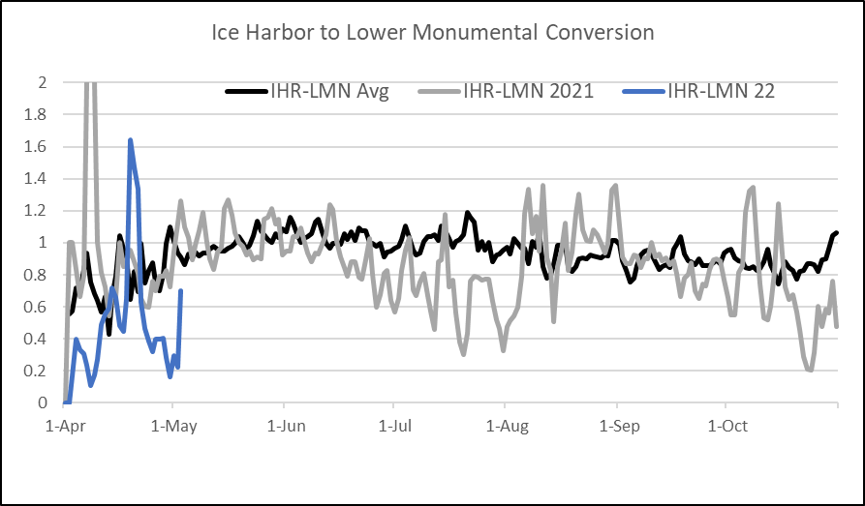
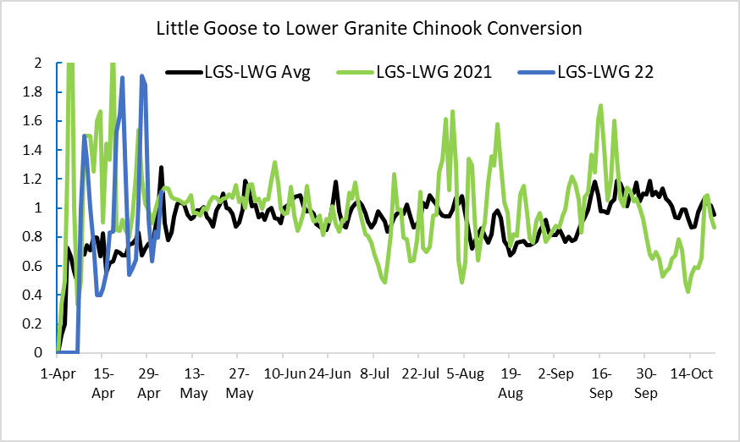
Chinook salmon conversions, 2022, 2021 and 10-year average

Slide 2
Comparison of hourly Chinook salmon counts
And spill and TDG data, Lower Monumental Dam
May 1-3, 2022
https://pweb.crohms.org/ftppub/water_quality/tdg/
https://www.fpc.org/adults/R_adultcoequeries_hourlyladderspecies_results.php

Slide 3
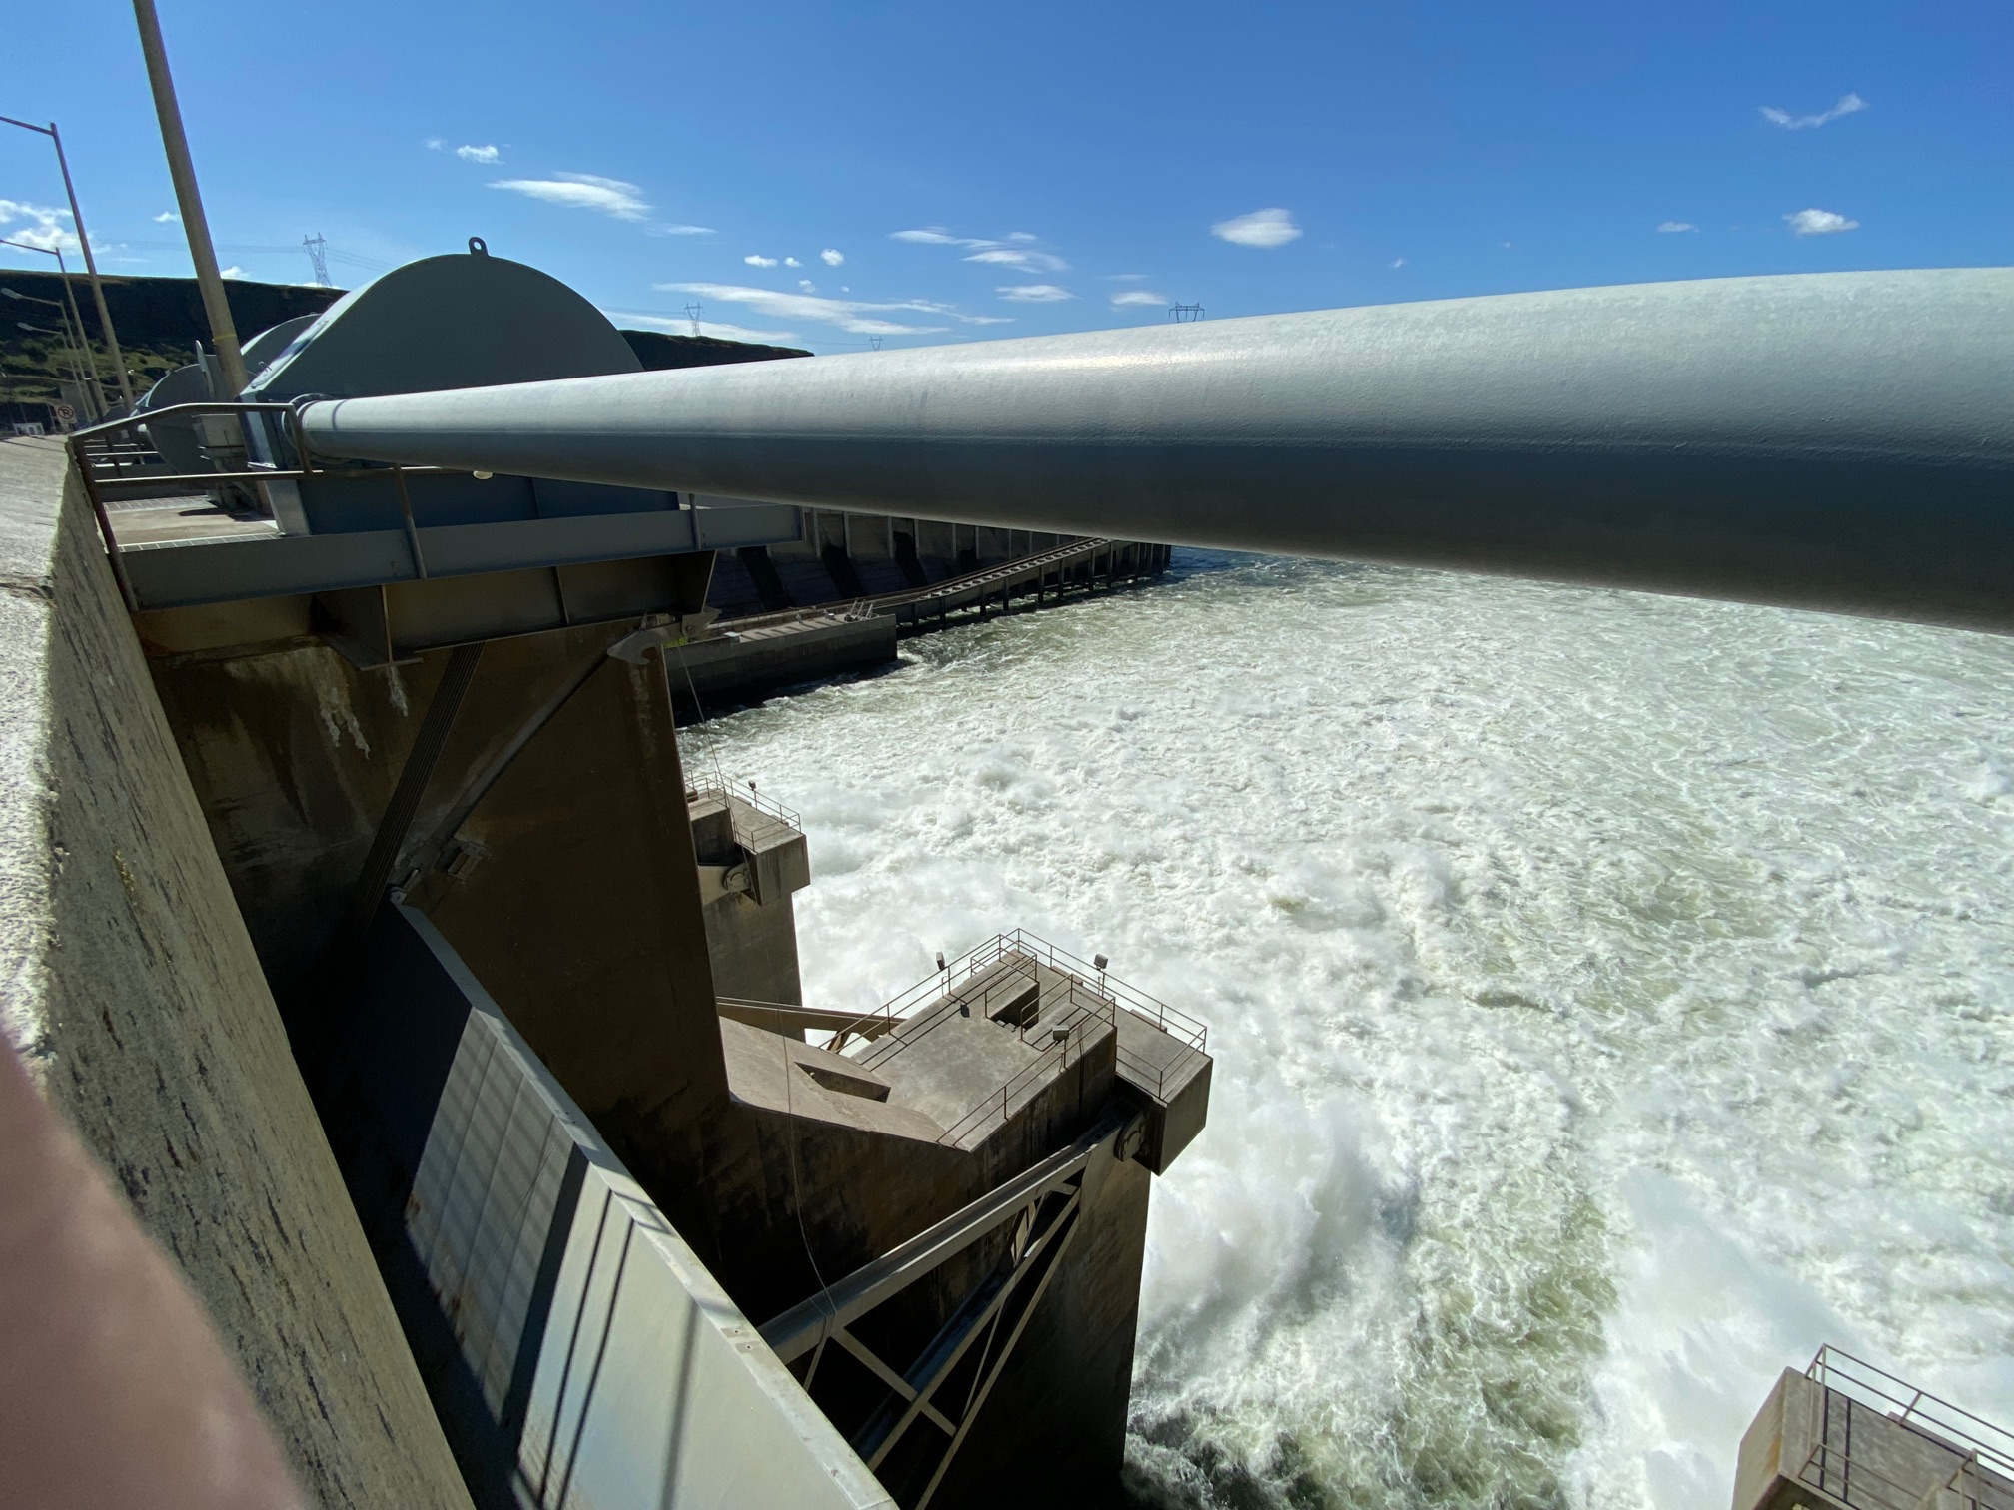
Trunion bushing

