Slide 1
2022 Preliminary Survival Estimates

Slide 2
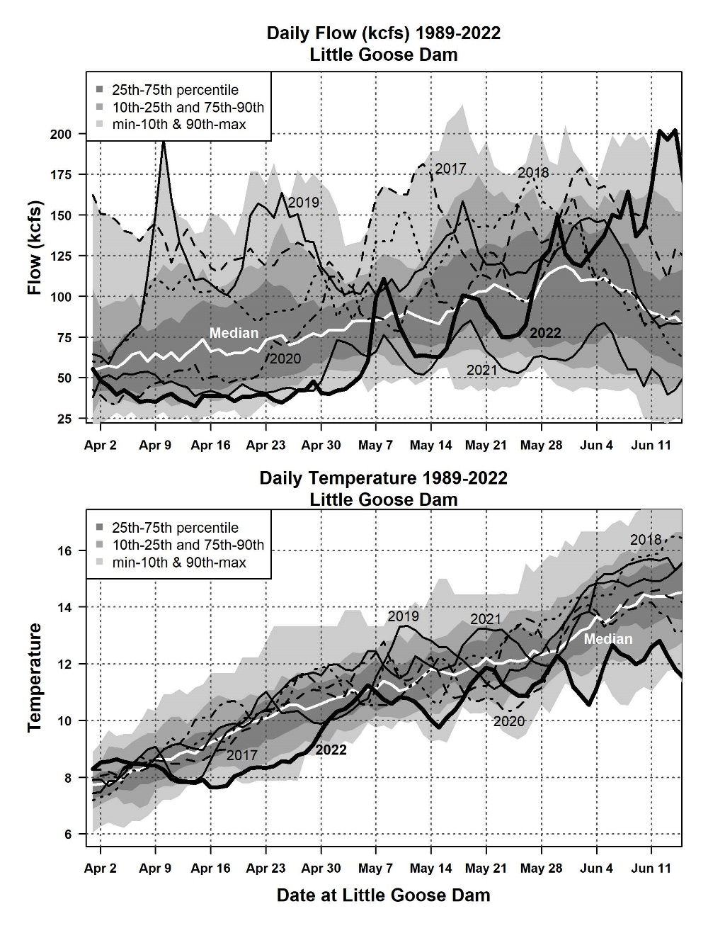
2022 Flow and Temperature
Low flow early
High flow late
Low temperatures

Slide 3
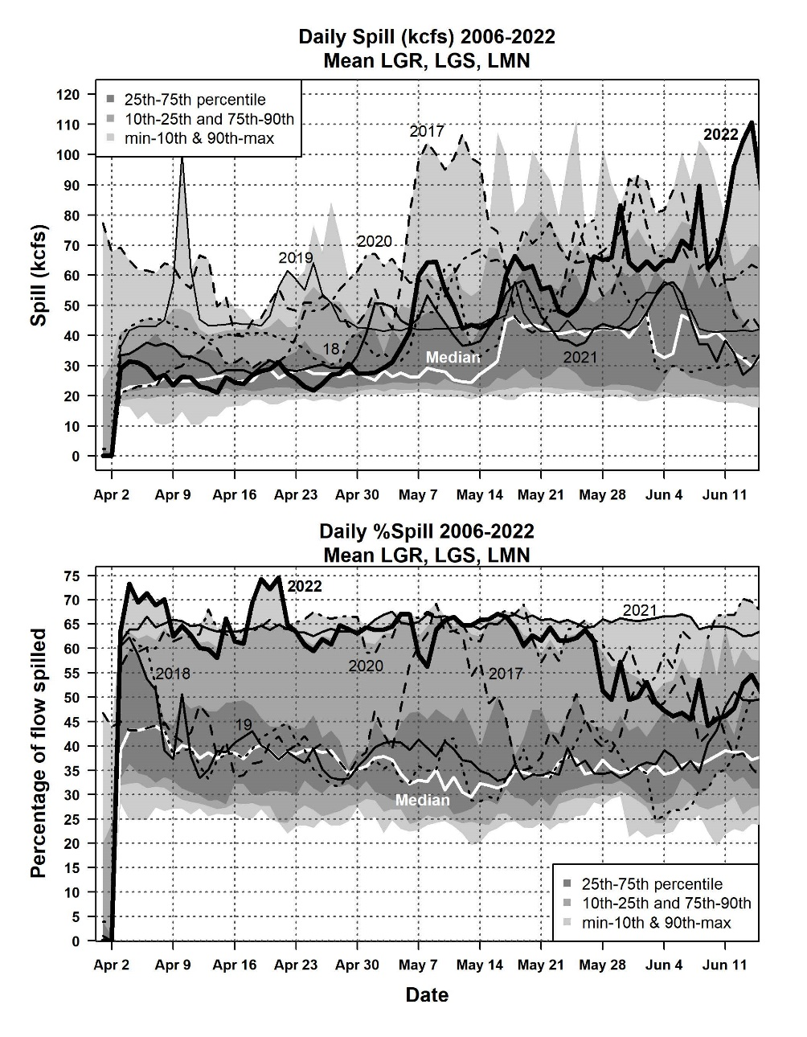
2022 Snake River Spill Volume and Percentage
Spill volume average early
Spill volume well above average middle and late
Spill percentage was very high season wide, decreased later
Notes:
Mean spill discharge at the Snake River dams was 46.6 kcfs, which was well above the 2006-2022 mean of 36.3 kcfs.
Spill discharge started out average, but increased to the highest on record in mid June.
Spill as a percentage of flow at Snake River dams averaged 59.5%, which was far above the long-term (2006-2022) mean of 39.3%.
Daily mean spill percentages were close to 65% through April and early May (Figure 8). However, spill percentages dropped to levels substantially below those maintained in 2020 and 2021.

Slide 4
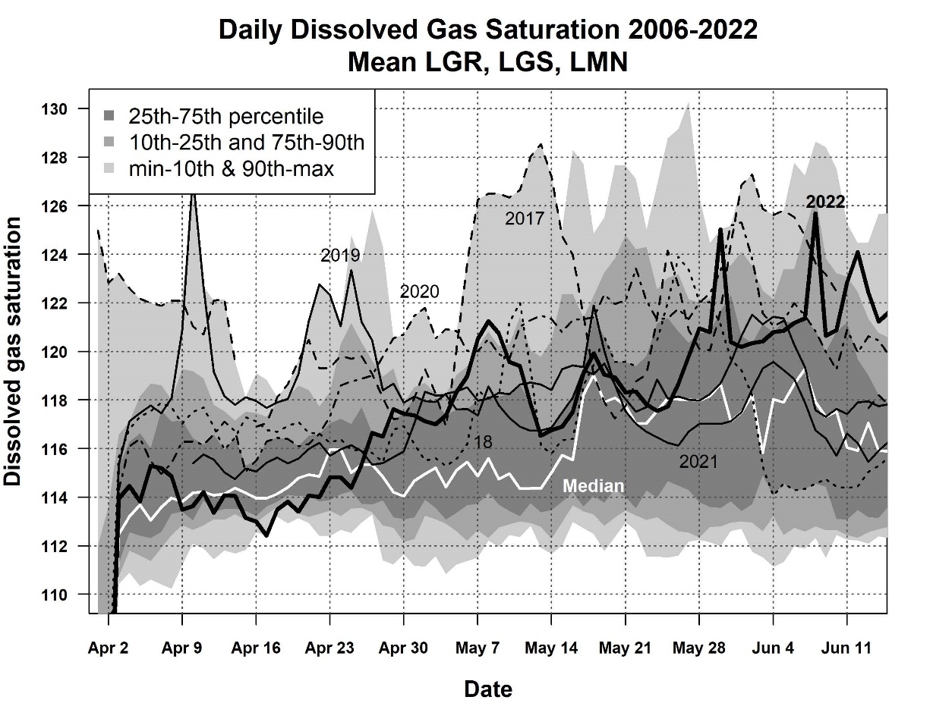
Total Dissolved Gas
Similar to median April
Above average May
High in June

Slide 5
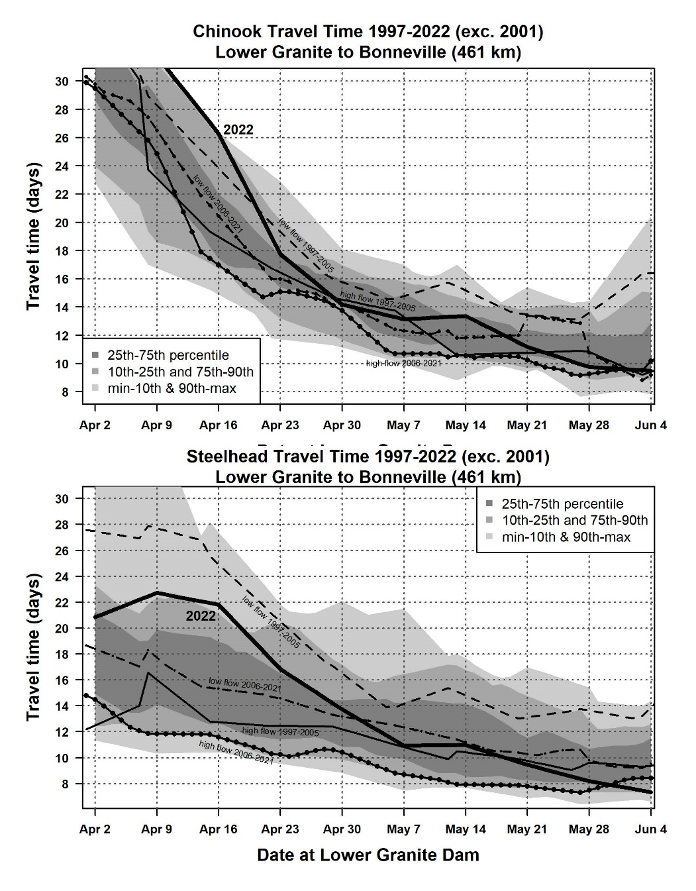
Travel Time
Unusually long in April
More typical in May
Very fast in June
Temperature, flow, and spill likely factors
Notes:
travel times for both Chinook and Steelhead were unusually long.
Despite very high rates of spill, travel times for both species were substantially longer than in other recent years through April and most of May.
In late May, migrating smolts finally started to move faster, and by early June travel times were roughly equal to those in recent high-flow years.
This unusual pattern in travel time is almost certainly related to unusual environmental conditions (low temps early)

Slide 6
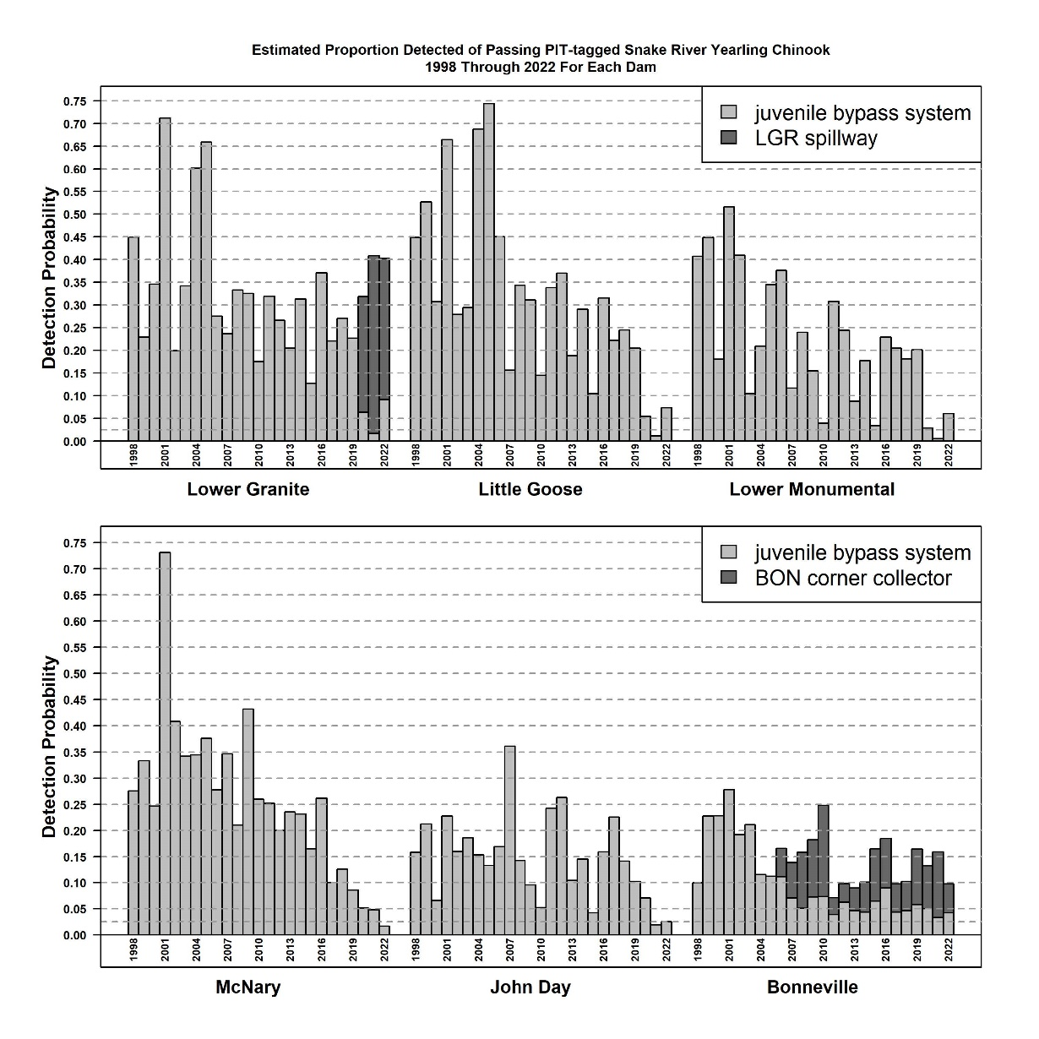
Detection Efficiency
Detection at Lower Granite and Bonneville Dams similar
Detection at all other dams very low
Leads to higher variability in the survival estimate

Slide 7
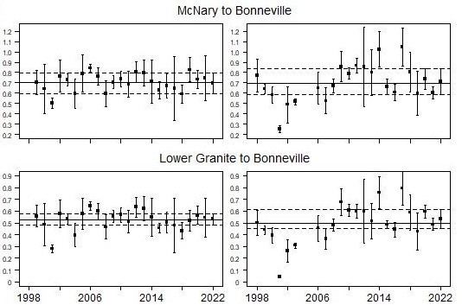
Survival 2022 Chinook Steelhead
Notes:
The combined yearling Chinook salmon survival estimate from the Snake River trap to Bonneville Dam tailrace was 50.6% which was slightly above the long-term mean of 48.5%
For wild Snake River yearling Chinook, mean estimated survival from Lower Granite Dam tailrace to Bonneville Dam tailrace of 54.0% This was above the long-term mean of 47.5%
Combined steelhead above average across the combined reach from Lower Granite to Bonneville, but below-average estimated survival from Lower Granite to McNary
Mean estimated survival for steelhead from Lower Granite Dam to McNary Dam in 6 2022 was 62.4% (95% CI: 51.2-73.6%).
Mean estimated survival from McNary Dam to Bonneville Dam was 71.3% (58.8-83.8%).
Mean estimated survival for steelhead from Lower Granite Dam to Bonneville Dam was 53.3% (45.3-61.3%).
Estimated survival for wild steelhead from Lower Granite Dam tailrace to Bonneville Dam tailrace was 44.3% which was similar to the long-term mean of 43.0%. These estimates resulted in a survival estimate from the Snake River trap to Bonneville Dam tailrace of 42.2% which was close to the long-term mean of 42.0%.

Slide 8
Sockeye
Snake River sockeye LGR-BON = 37.9% (mean 40.6%)
Columbia River sockeye (Wenatchee River) 46.4% (mean 25.8%)
Both estimates imprecise
Notes:
Estimated survival in 2022 of Snake River sockeye salmon (hatchery and wild combined) from the tailrace of Lower Granite Dam to the tailrace of Bonneville Dam was 37.9% (95% CI: 29.6-48.5%; Table 8). This estimate was slightly below the long-term mean of 40.6%.
Estimated survival in 2022 of Columbia River sockeye salmon (hatchery and wild combined) from the lower Wenatchee River screw trap to the tailrace of Bonneville Dam was 46.4%. This estimate was above the long-term mean of 25.8%

Slide 9
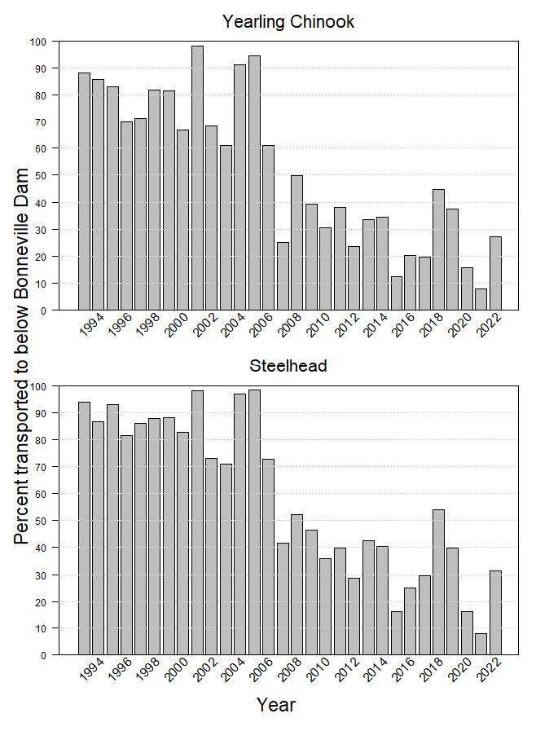
Transport
Notes:
Our preliminary estimates of the percentage transported of nontagged wild and hatchery spring-summer Chinook salmon smolts in 2022 are 30.6% and 23.9%, respectively.
For steelhead, the estimates are 36.7% and 24.0% for wild and hatchery smolts, respectively.
Estimated percentages transported in 2022 were below average, but substantially higher than in 2020 or 2021.
The overall proportion of smolts transported in 2022 was about equal to the 2006-2022 average run timing contributed to increased transportation rates

Slide 10
Conclusion
Survival in 2022 was generally average
Estimates include Trawl, Pile Dikes, Adult ladder
Estimates could change 3-4% using bird colonies
Low detection rates JBS + less tagging = low precision
The cooler than average water temperatures and late runoff likely affected smolt survival and transport
Region should place high priority on increasing detection capabilities

