Slide 1
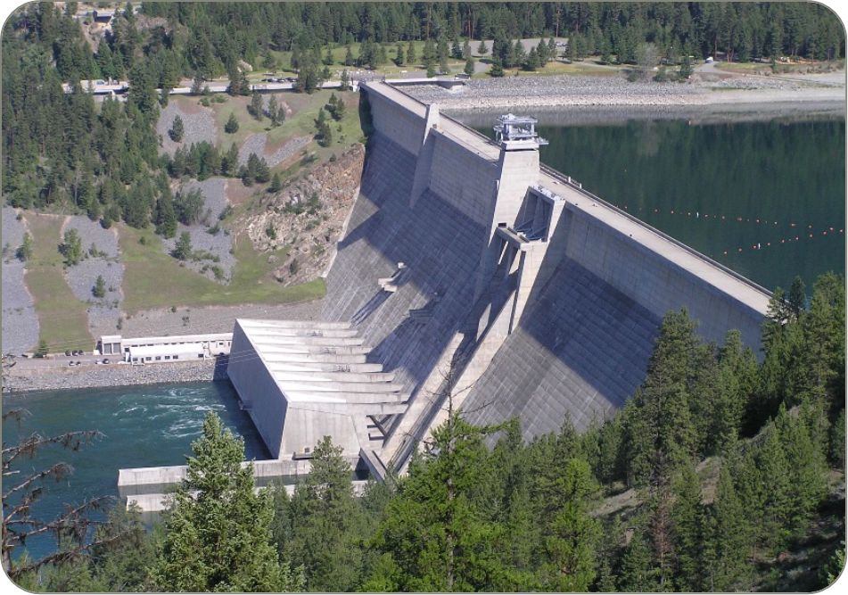
Libby dam sturgeon operations 2023
Date: 03 May 2023

Slide 2
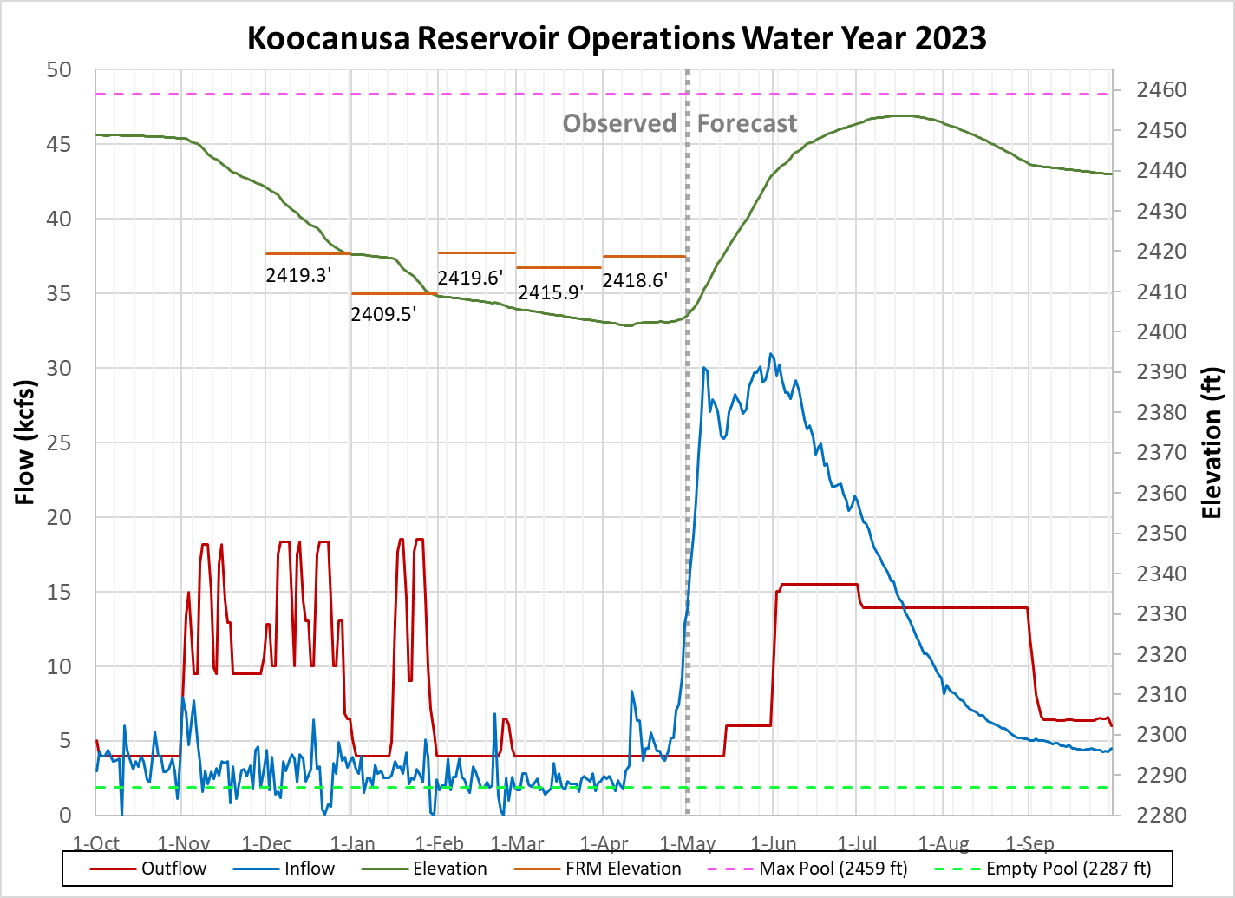
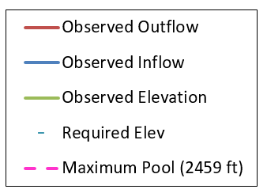
Median Forecast Values are
Conceptual Plan
Minimum Reservoir Elevation
2401.5 ft on Apr 10, 2023
Bull trout minimum 6 kcfs (no sturgeon pulse volume)
May VarQ ~4 kcfs

Slide 3
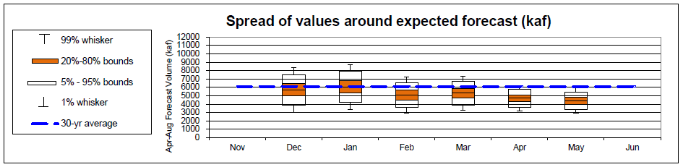
MAY 1st Water Supply Forecast and biop objectives
April-August inflow forecast for Libby Dam is 4.41 million acre-feet (MAF)
Forecast is 72 % of average
Sturgeon Volume is 0.0 MAF, WSF < 4.8 MAF
Bull trout minimum flows May 15th through Sept 30 is 6 kcfs
Libby Water Supply Forecast Trend:
Libby flow augmentation draft to 2439 ft end of September (< 15th percentile)
Notes:
2001 last time no pulse 3.5 maf

Slide 4
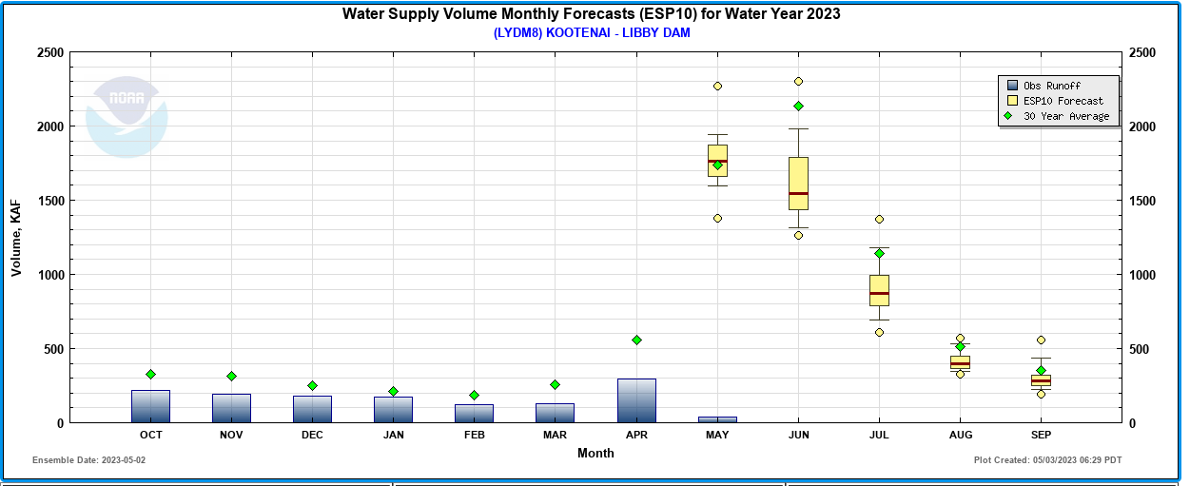

Slide 5
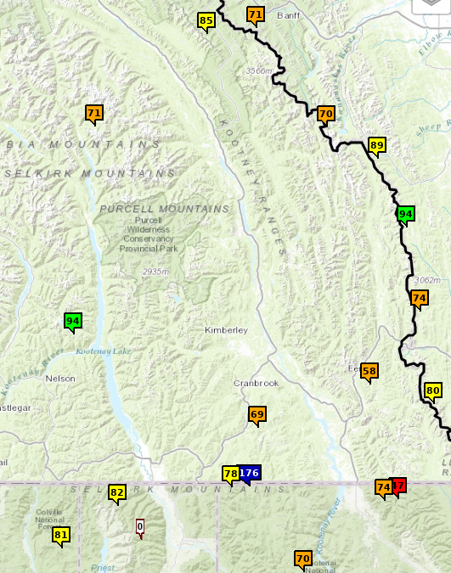
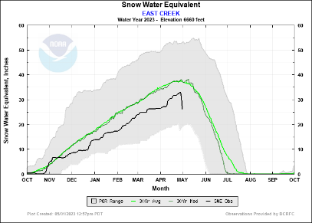
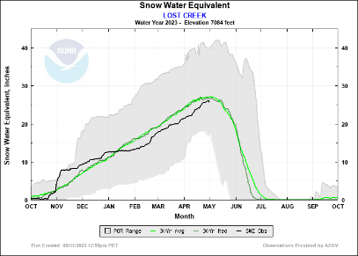
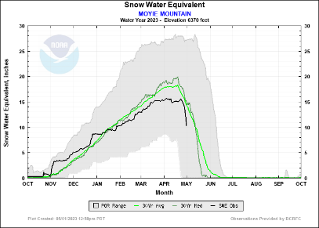
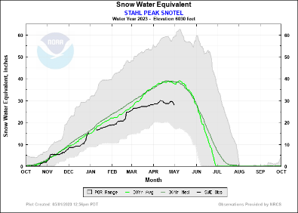
Snowmelt So Far
Data: May 1st 2023

Slide 6
General Flow PLAN
Spring Refill Began on May 1st
Operate to VarQ and bull trout minimums, whichever is greater
Refill Lake Koocanusa to 2454.0’, depending upon inflows
Lake Koocanusa end of September Target is 2439.0’
We have operational flexibility to smooth flows as compared to modeled results that follow
Avoid double peaking and smooth to descending outflow hydrograph after peak has passed

Slide 7
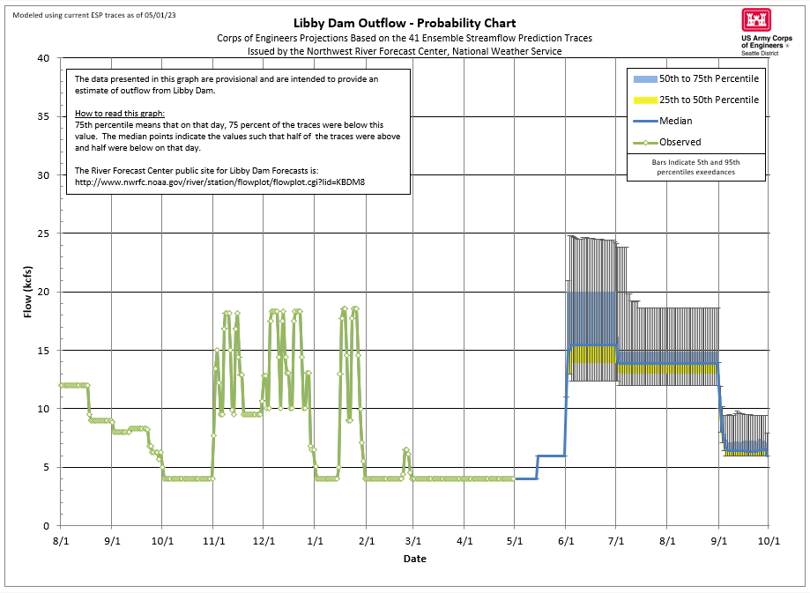
General
Guidance
Only

Slide 8
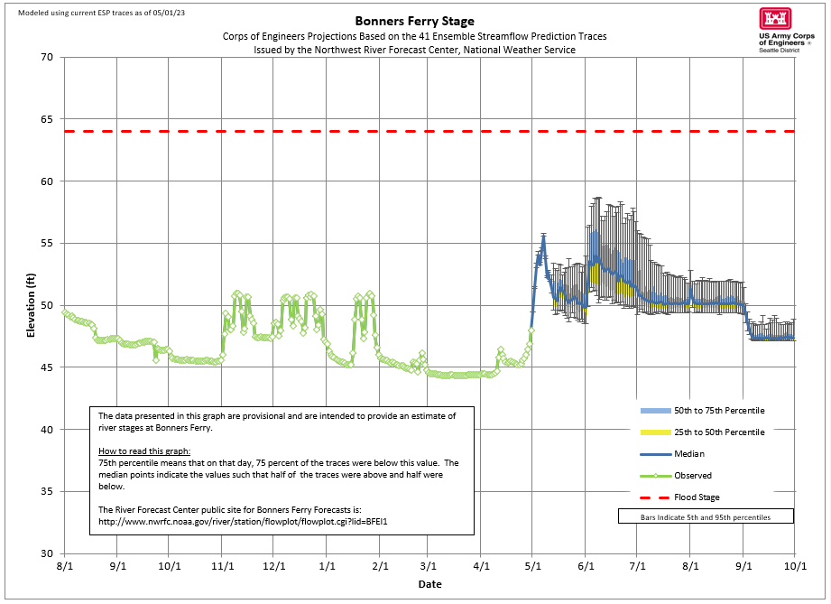
Early peak due to local inflows between Libby and Bonners Ferry
General
Guidance
Only

Slide 9
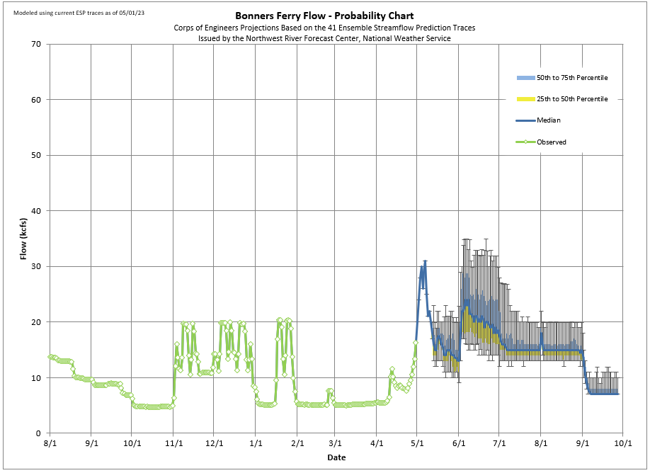
General
Guidance
Only
Early peak due to local inflows between Libby and Bonners Ferry

Slide 10
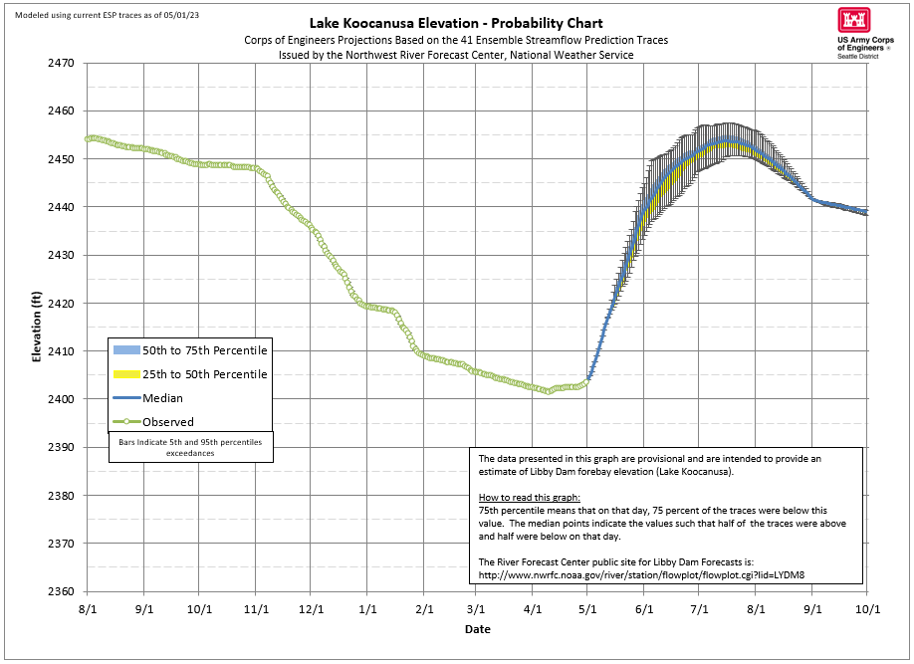
2453.7 ‘ Peak, July 7th
2439.1’ September 30th
General
Guidance
Only

Slide 11
Questions?

