Slide 1
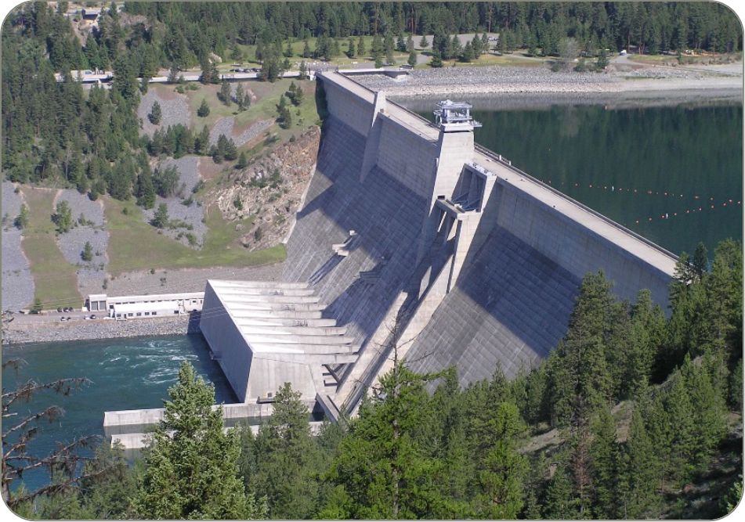
Libby dam operations update - summer 2023
Date: 28 June 2023
Leon Basdekas

Slide 2
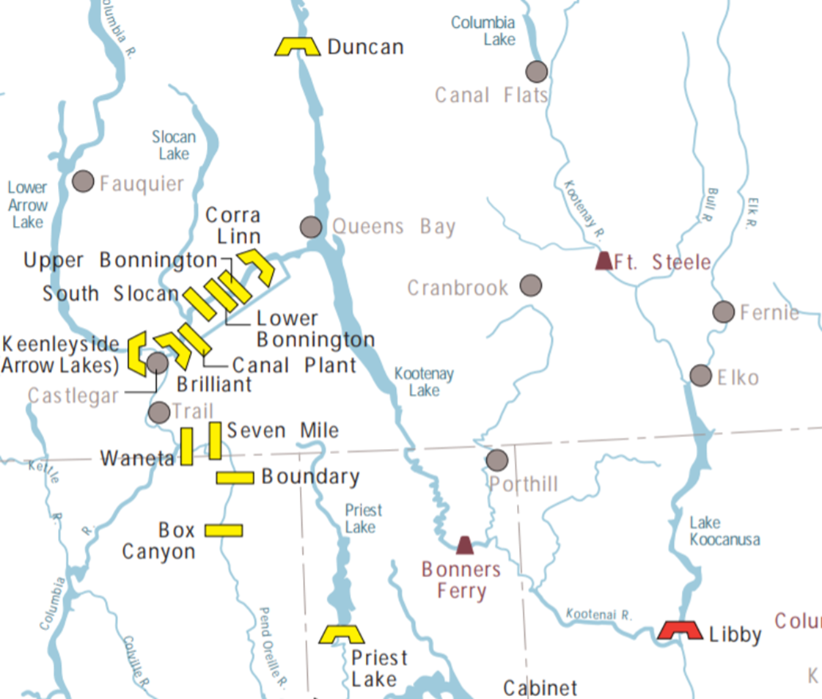
General background

Slide 3
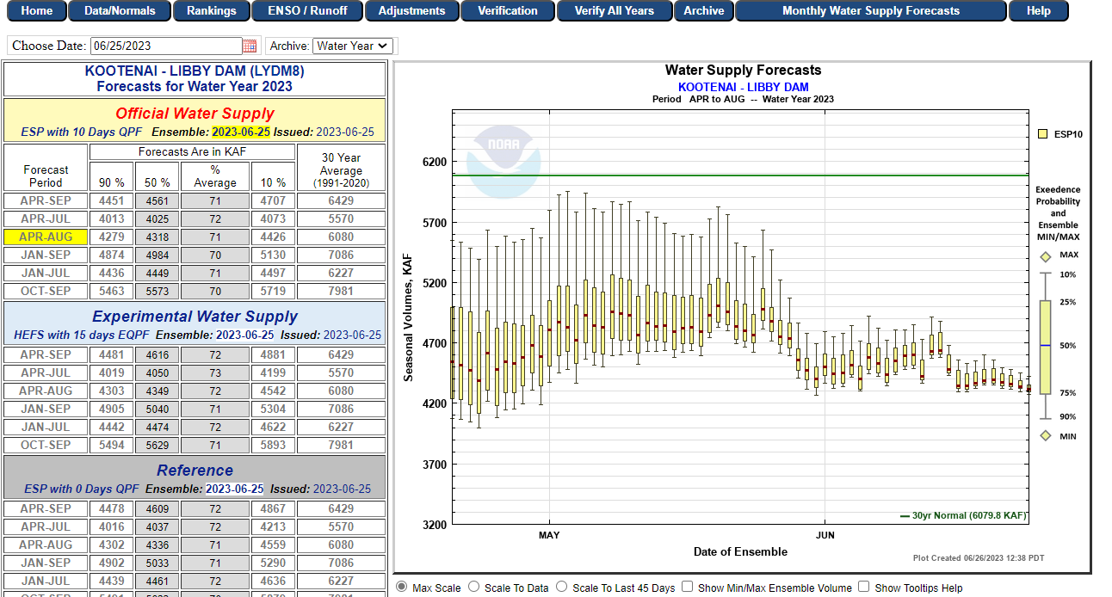
declining Forecasts

Slide 4
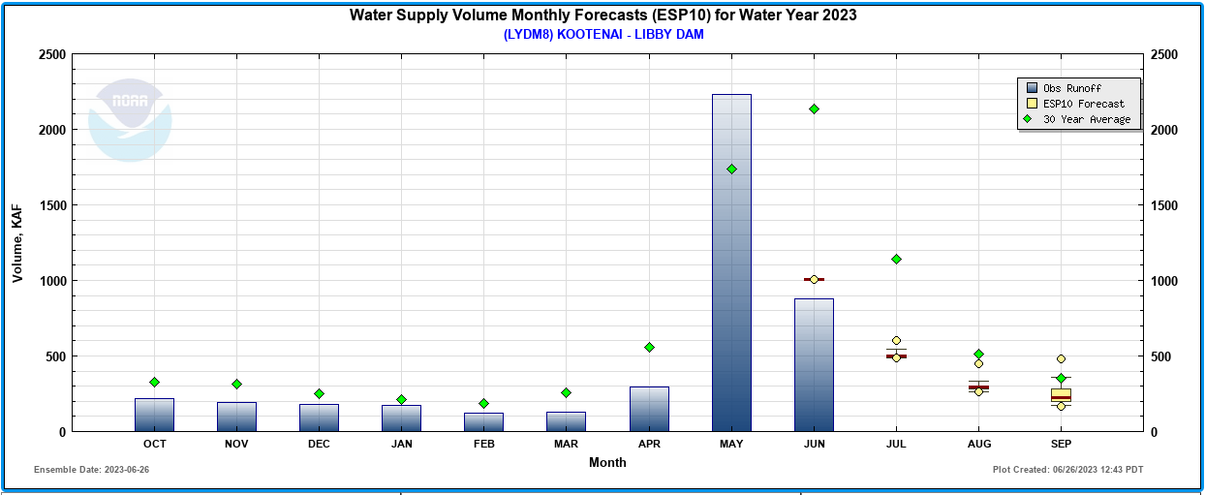
Observed and forecast inflows

Slide 5
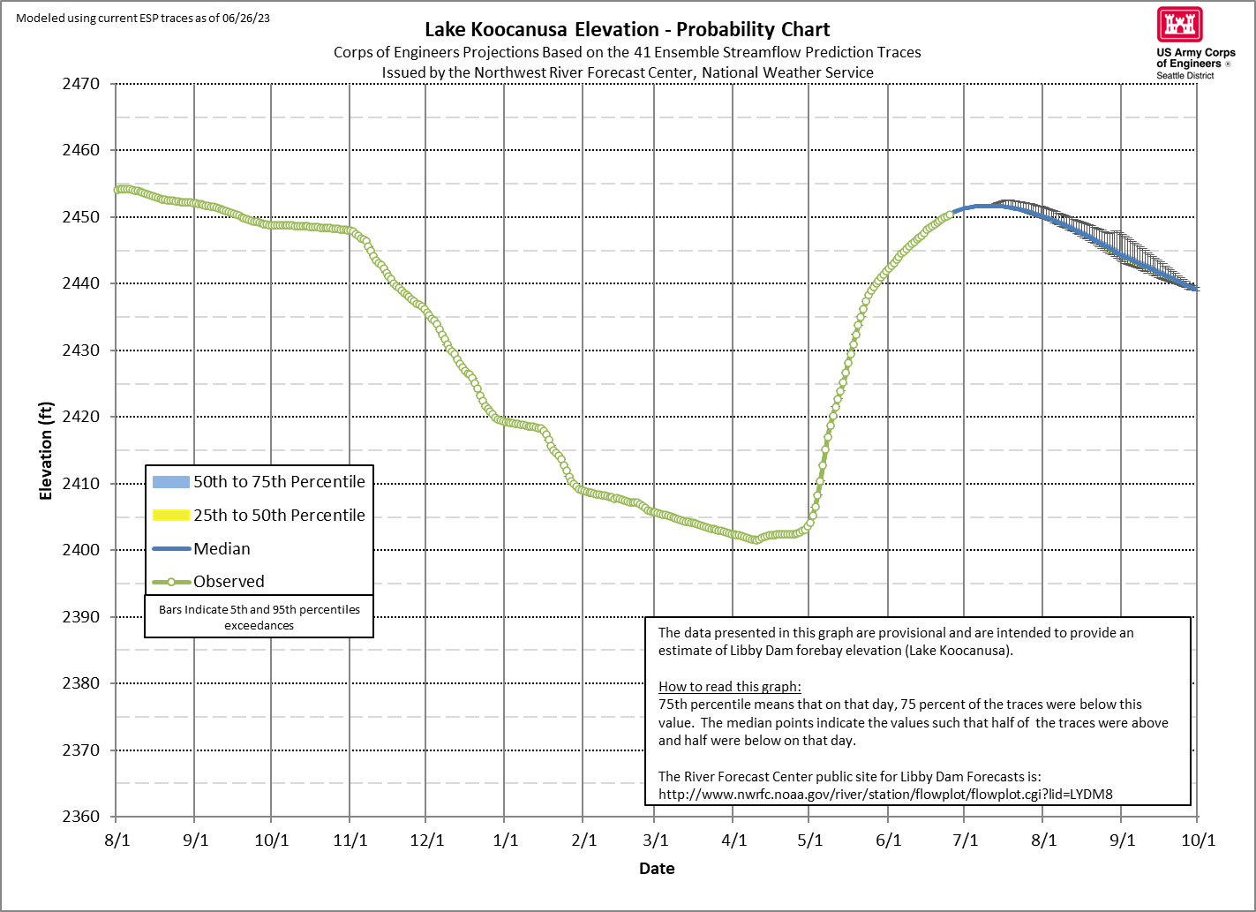
RESERVOIR OPERATIONS 2023

Slide 6
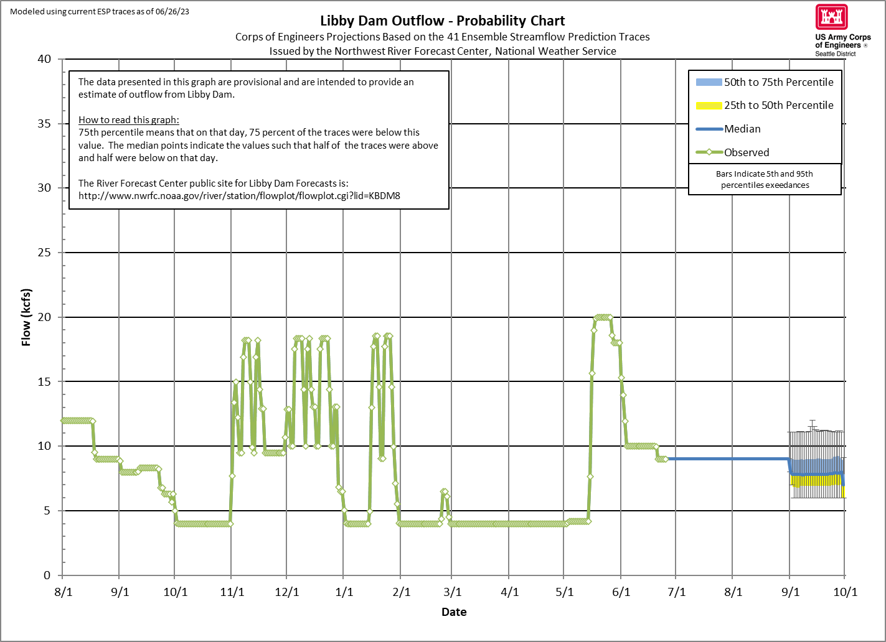
RESERVOIR Outflow 2023
Mid - July onward flows could average ~8.25 kcfs.

Slide 7
current Flow Plan status
River Forecast Center have decreased significantly since May.
Meet end of September draft requirement of 2439.0 ft.
If refill is as ESP data suggest, may need to drop outflows to around 8.25 kcfs in mid-July
If refill as empirical data suggest, might be able to hold near 9 kcfs through end of September.
Will reduce outflows if forecast persists
As with all our plans, we will adjust to real time conditions with more or less water than is currently forecast to best meet the above objectives.

Slide 8
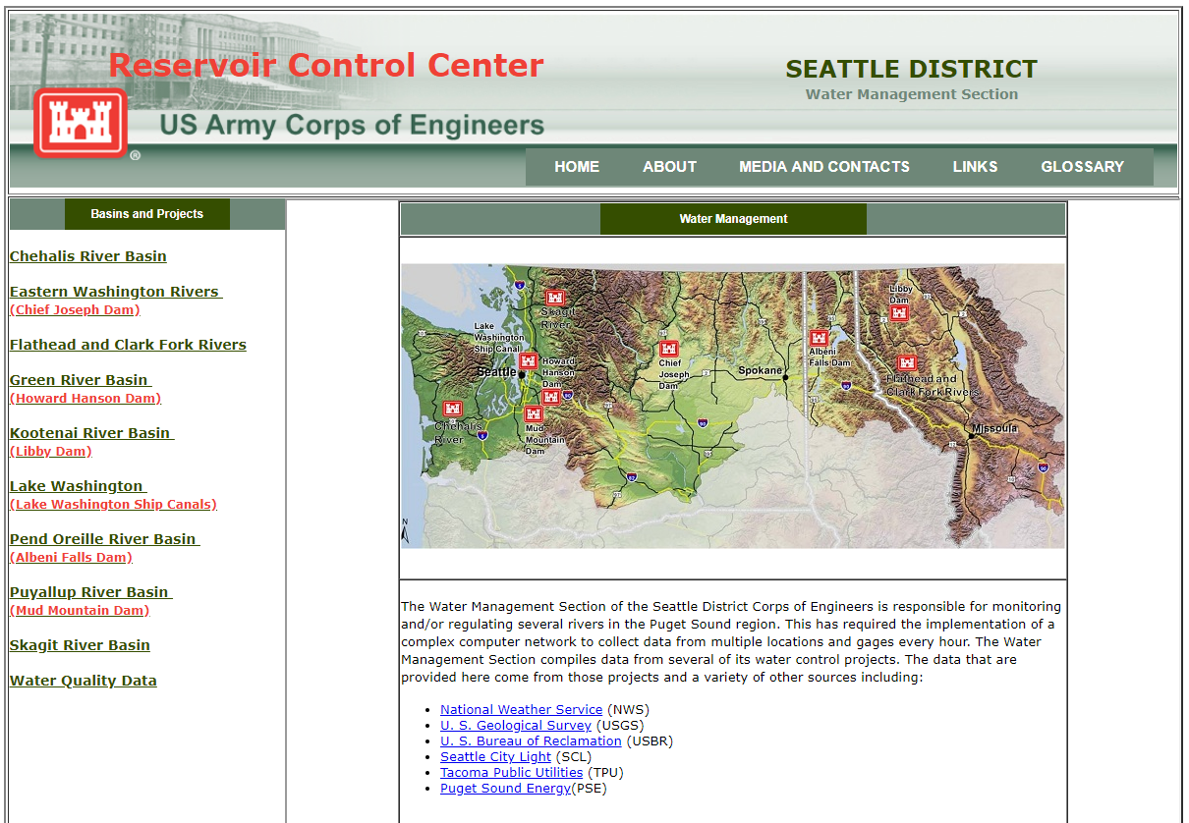
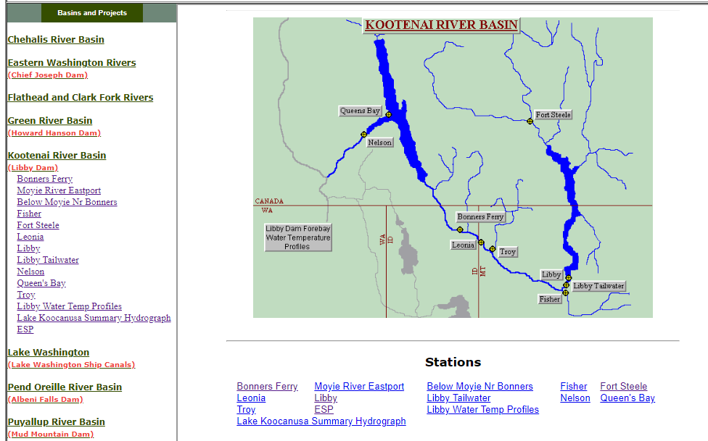
questions
For emails regarding release changes and lake level updates email
UpperColumbiaWM@usace.army.mil
Leon.Basdekas@usace.army.mil
General Queries call 206-764-6702
Seattle District water management data website :
http://www.nwd-wc.usace.army.mil/nws/hh/www/index.html#

