Slide 1
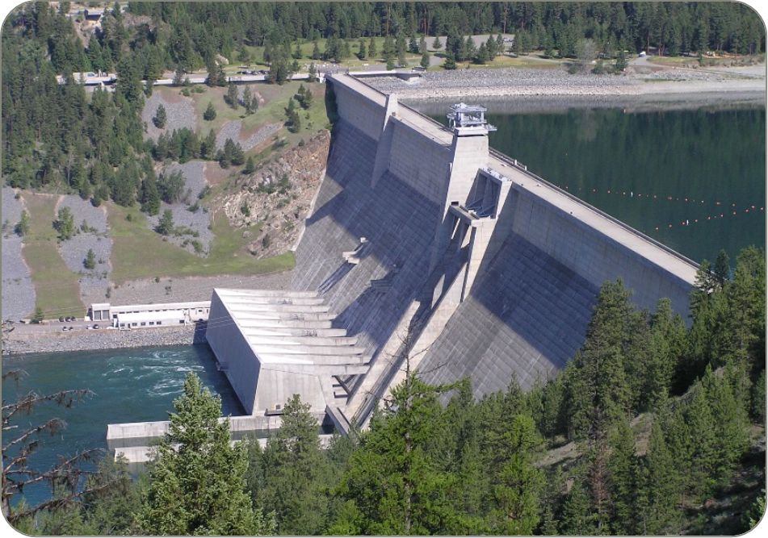
Libby dam sturgeon operations 2024
Date: 08 May 2024

Slide 2
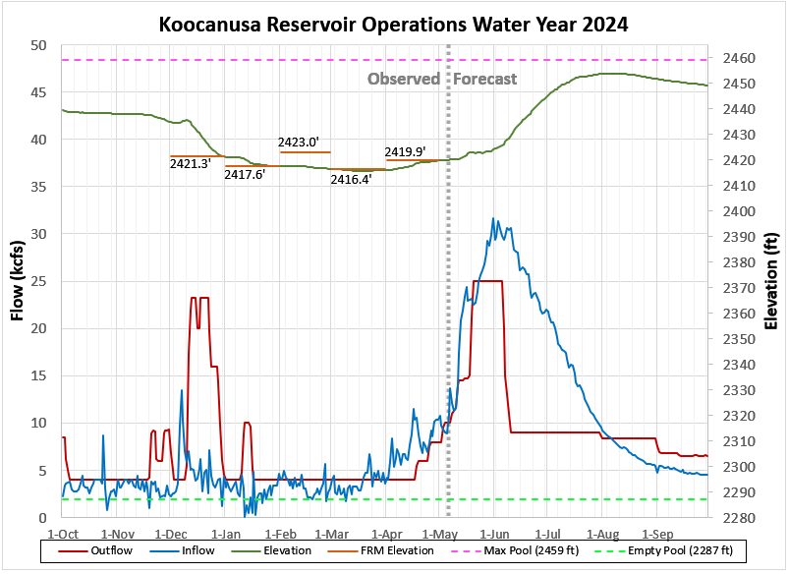
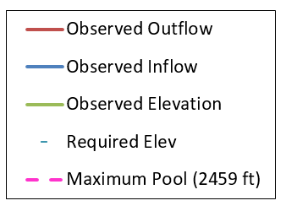
Minimum Reservoir Elevation
2415.46 ft on Mar 19, 2024
Forecast Values are
Conceptual Plan
Full QPHC for start
of sturgeon pulse
Sturgeon Pulse Volume
May VarQ 14.2 kcfs

Slide 3
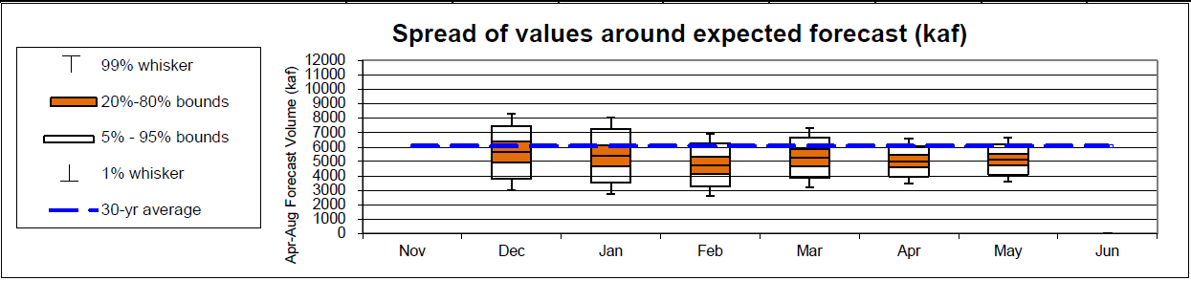
MAY 1st Water Supply Forecast and biop objectives
April-August inflow forecast for Libby Dam is 5.13 million acre-feet (MAF)
    Forecast is 82% of average
    Sturgeon Volume is 0.8 MAF
    Bull trout minimum flows following the Sturgeon Pulse through Aug 31 is 7 kcfs
  Libby Water Supply Forecast Trend:
    Libby flow augmentation draft to 10 ft from full (2449 ft) end of September

Slide 4
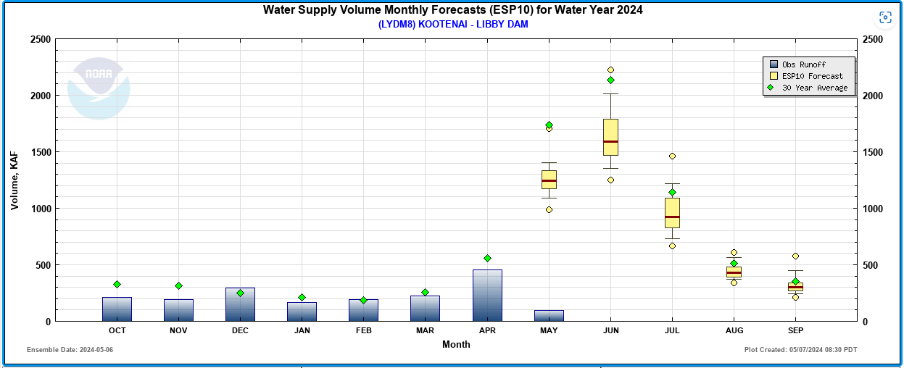

Slide 5
Flow Augmentation PLAN
Spring Refill Began on May 1st
Sturgeon augmentation flow modeled to start on May 18th and ramp up discharges from Libby Dam to ~25 kcfs (powerhouse capacity). Maintain powerhouse pulse discharge for approximately ~17* days, followed by a relatively quick recession to an approximate flat to descending summer flow.
  Target to Maintain Bonners Ferry at or above 30 kcfs: ~18 Days (Median)
  Likely unable to maintain Bonners Ferry stage at or above 1760’
Decrease discharge (post-powerhouse pulse) at Libby Dam to summer flat flow following BiOp ramping rates.
  Lake Koocanusa End of September Target is 2449.0 ft, depending upon inflows
  * in season management and observed inflows may cause these values to change.

Slide 6
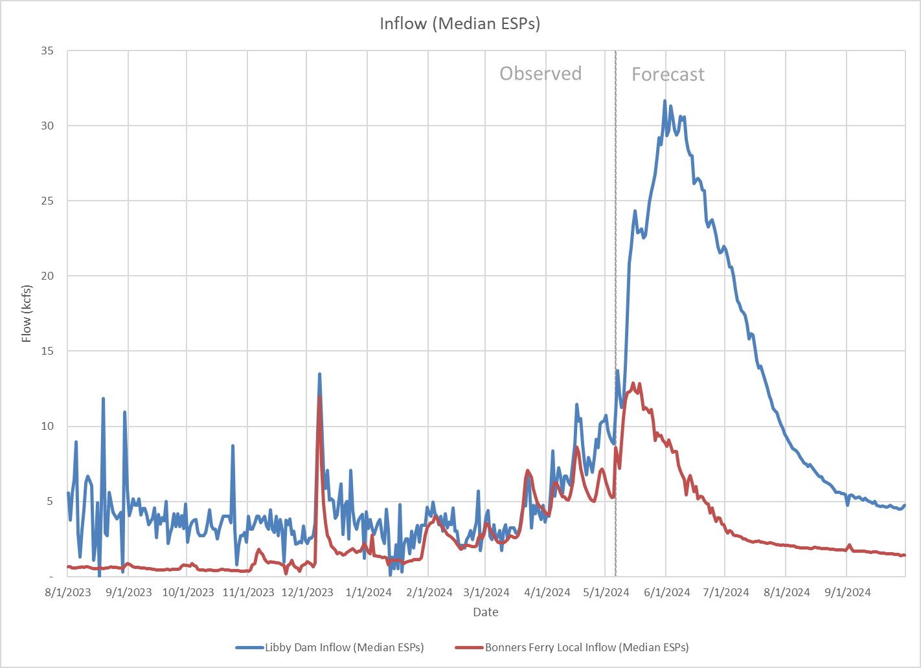

Slide 7
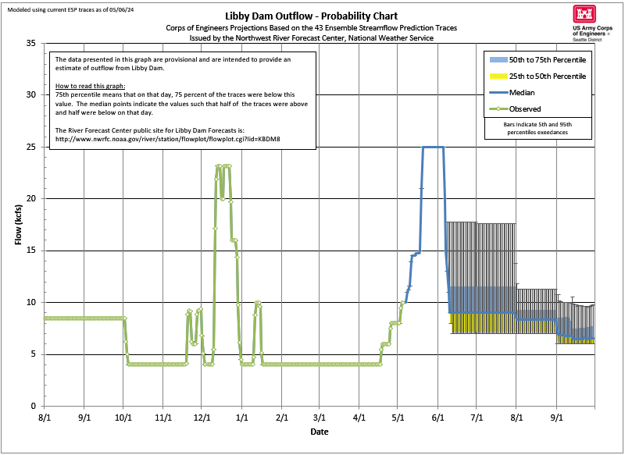
VarQ Flow 14.3 kcfs
Sturgeon Pulse Volume

Slide 8
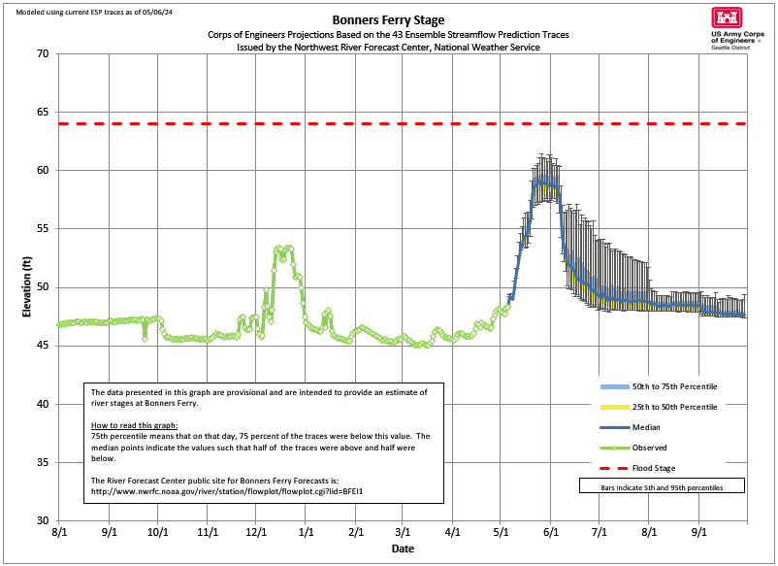
0 Days Median
1760 ft Goal

Slide 9
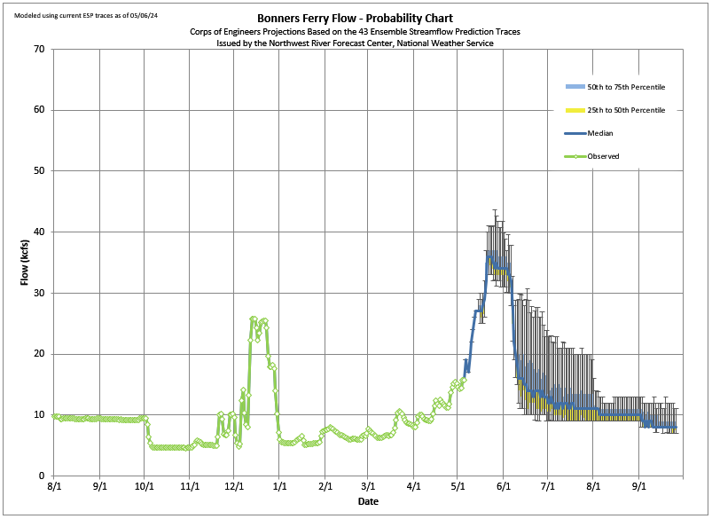
18 Days Median
30 kcfs Goal

Slide 10
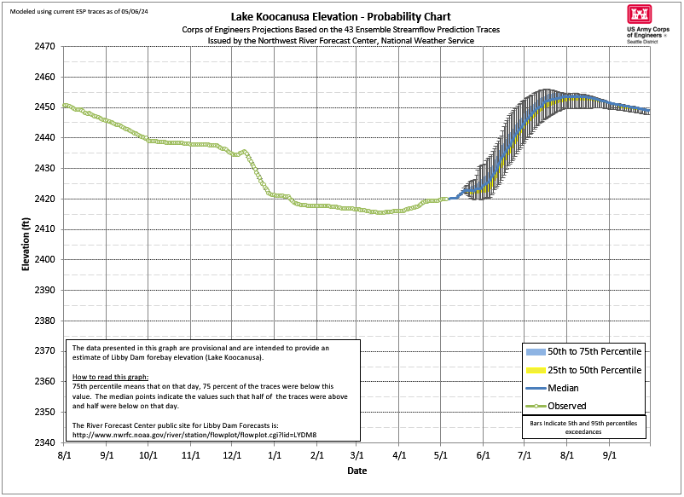

Slide 11
SUMMARY OF PLANNED REFILL OPERATIONS
Spring Refill Began on May 1st
Sturgeon augmentation flow modeled to start on May 18th and ramp up discharges from Libby Dam to ~25 kcfs (powerhouse capacity). Maintain powerhouse pulse discharge for approximately ~17* days, followed by a relatively quick recession to an approximate flat to descending summer flow.
  Target to Maintain Bonners Ferry at or above 30 kcfs: ~18 Days (Median)
  Likely unable to maintain Bonners Ferry stage at or above 1760’
Decrease discharge (post-powerhouse pulse) at Libby Dam to summer flat flow following BiOp ramping rates.
  Lake Koocanusa End of September Target is 2449.0 ft, depending upon inflows
  * in season management and observed inflows may cause these values to change.

Slide 12
Questions?

