Slide 1
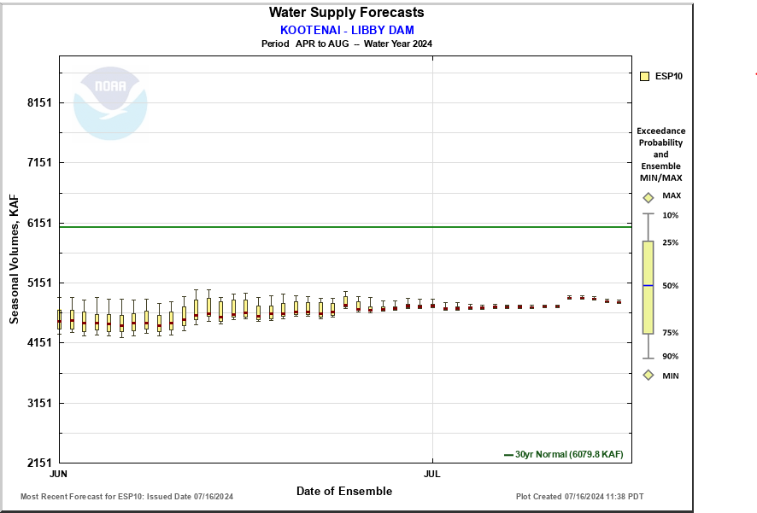
Changing Forecasts
July 10 ~4.75 maf
13 kcfs
July 3 ~4.73 maf
11 kcfs
June 26 ~4.7 maf
9 kcfs
July 12 ~4.90 maf
June 6-9 ~4.4 maf
8 kcfs
Notes:
July 11-12
~150 kaf increase
~3.3 feet at Libby dam

Slide 2
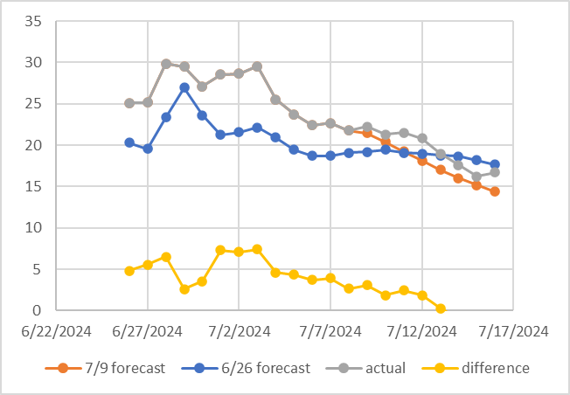
Ex. Forecast and actual inflows (kcfs)
Notes:
Inflows persistently higher than forecast.

Slide 3
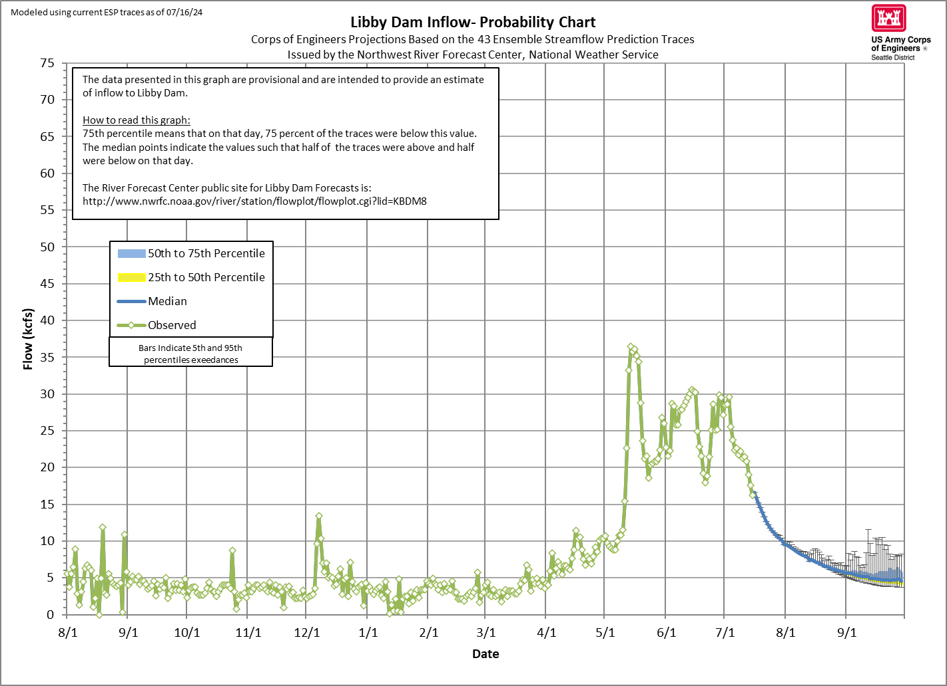

Slide 4
Refill and summer plan
Lake Koocanusa expected to reach peak elevation ~ 2456.3 ft around July 21.
Approximate flow schedule
13 kcfs through July 25,
11 kcfs through August 7,
9 kcfs through August 31, and
8 kcfs all of September.
As with all our plans, we will adjust to real time conditions with more or less water than is currently forecast to best meet end of September target of 2449.0 ft.

