Slide 1
Shift procedure and February estimates
05Feb2025

Slide 2
Poc/team
Hydrologic Engineering team creates the FRM Guidance and coordinates shift
POC: Kasi Underhill, 503-808-3950, kasi.a.Underhill@usace.army.mil

Slide 3
February timeline
ETA on FRM input data afternoon of Thursday 6 Feb
FRM data calculations, processing, QA that afternoon
FRM data due Friday 7 Feb

Slide 4
Shift calculation
The amount of storage that can be shifted is limited by a max allowable shift depending on WSF.
FRM returns to the unshifted 30 Apr FRM (barring early refill, in which case the reservoirs transition to refill FRM).
Shift is not allowable over a threshold WSF
3 Maf at DWR Apr-Jul
5.8 Maf at BRN Apr-Jul

Slide 5
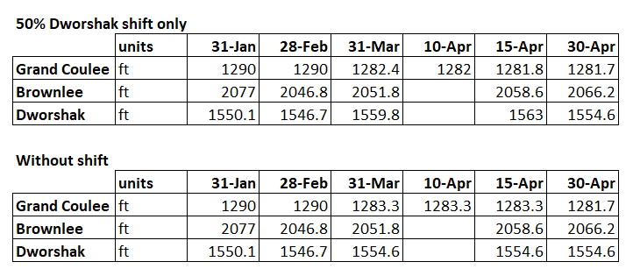
EARLYBird FRM – not final WSFs
31 Jan and 30 Apr values same/unshifted

Slide 6
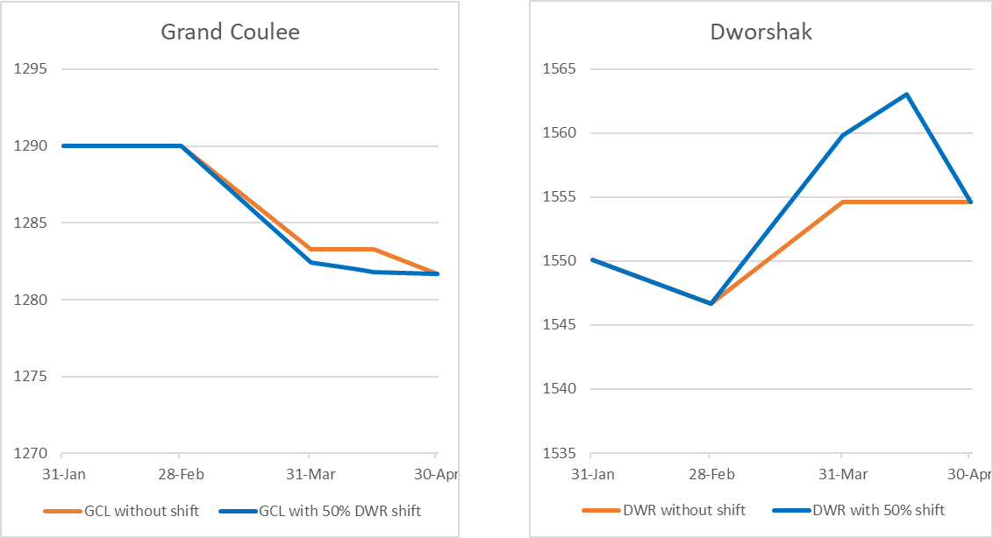
Earlybird Shift plots
Notes:
NOTE: not final WSFs
50% shift is 114 kaf

Slide 7
Where to find shift information
If this link is 2 pages long, there’s a shift active!
https://www.nwd-wc.usace.army.mil/report/colsum/

Slide 8
How to read this table
FRM at GCL prior to shift calculation
Possible space to shift constrained by draft rate limit
DWR System FRM draft prior to shift calculation
DWR Local FRM draft prior to shift calculation
Final shift given to DWR
Shift that was allowed to be given to DWR. For there to be shift, the local must be less than the system FRM at DWR
With shift, total draft at DWR from full
Final FRM elevation at DWR

Slide 9
How to read this table
New GCL FRM after DWR shift (draft from full)
Ability remaining for GCL to shift
With shift, total draft at GCL from full
Shift that was allowed to be given to BRN – this number looks like it was not calculating correctly – will be corrected from now on!
With shift, total draft at BRN from full
New GCL FRM after DWR shift (elevation)
Final shift given to BRN
Final FRM elevation at BRN
Final FRM elevation at GCL

