Slide 1
KOOTENAI RIVER
ECOSYSTEM FUNCTION RESTORATION FLOW PLANNING
IMPLEMENTATION PROTOCOL
2025
Gregory Hoffman
Fishery Biologist
US Army Corps of Engineers
Seattle District
Libby Dam
28 May 2025
Notes:
Length of talk
STURGEON and BULL TROUT
Sturgeon flow augmentation started in 1991.
Process has evolved over time
Focus on 2006 through present

Slide 2

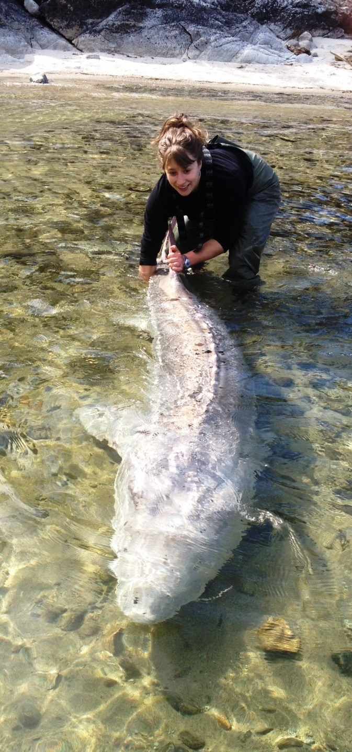

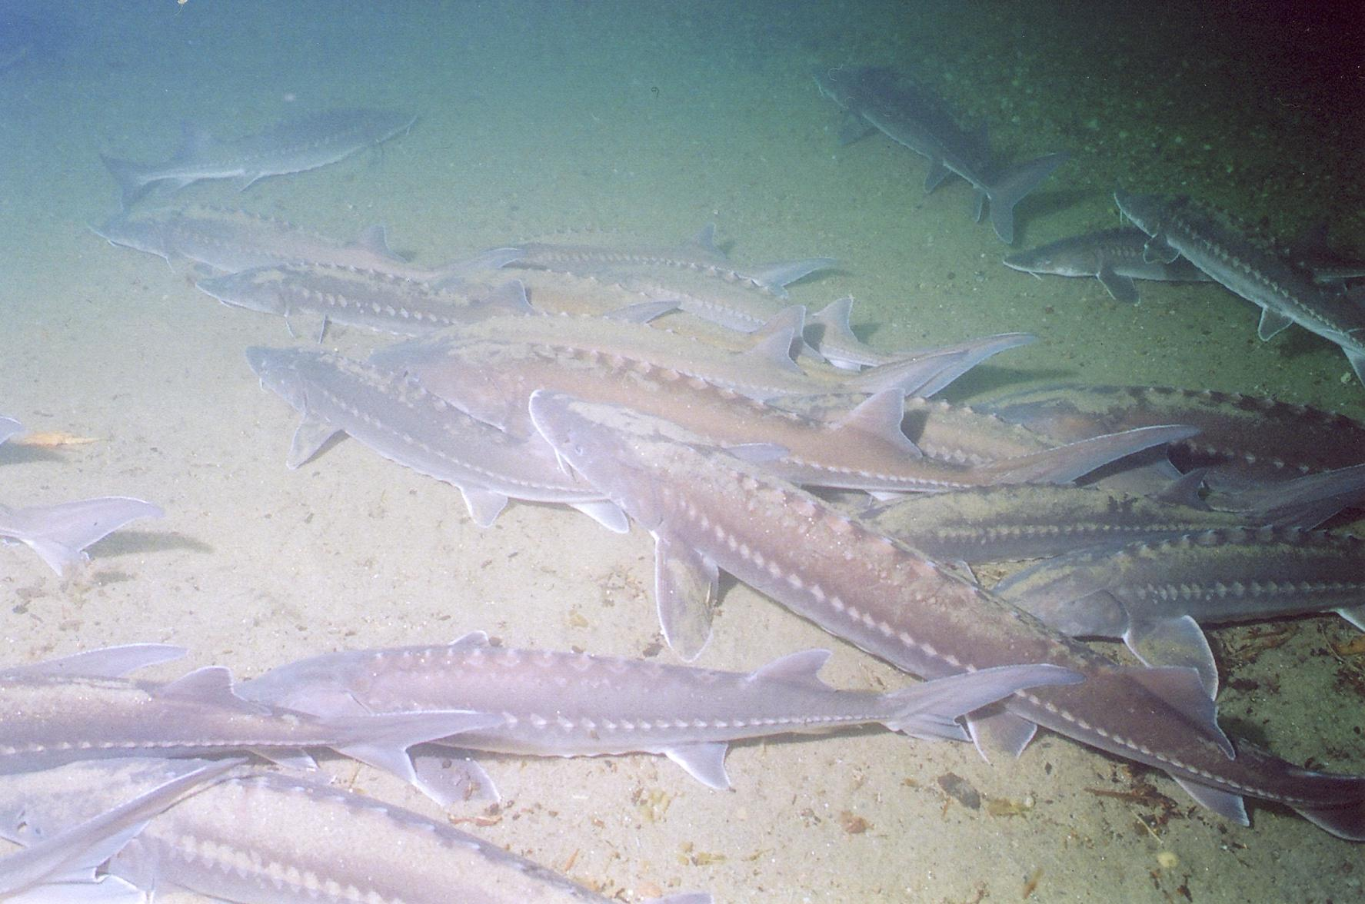
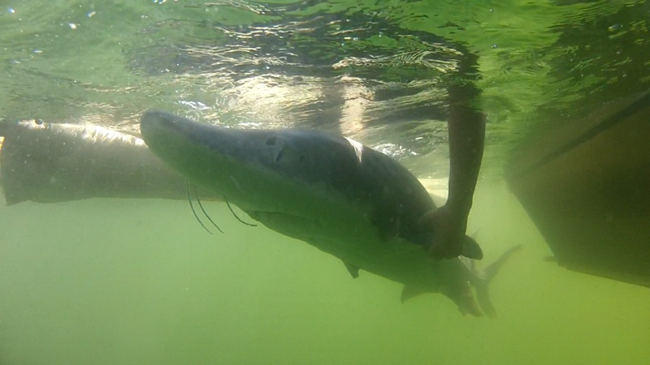

Slide 3
Notes:
Pre and Post Dam Hydrograph and Thermograph altered
Target is create a normative hydrograph and provide warming river temperatures on the receding limb – Sturgeon Spawning Period

Slide 4
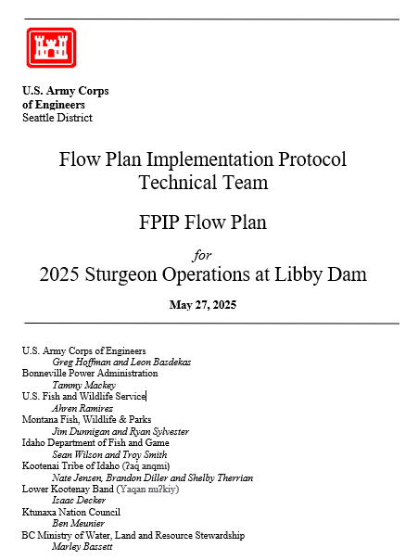
Notes:
2006 BiOp AND 2020 BiOp
Led by USACE, BPA and USFWS
Cooperation amongst agencies in planning for an adaptive experimental flow regimes for sturgeon flow operations within downstream FRM constraints.
2006 – ATTRIBUTE ATTAINMENT related to FISH SPAWNING
SUCCESS Criteria – Flow, Stage, Temperature, Fish Response
2020
Normative hydrograph based on WSF, Sturgeon Tier volume, fish behavior and movement, and discharge temperature

Slide 5
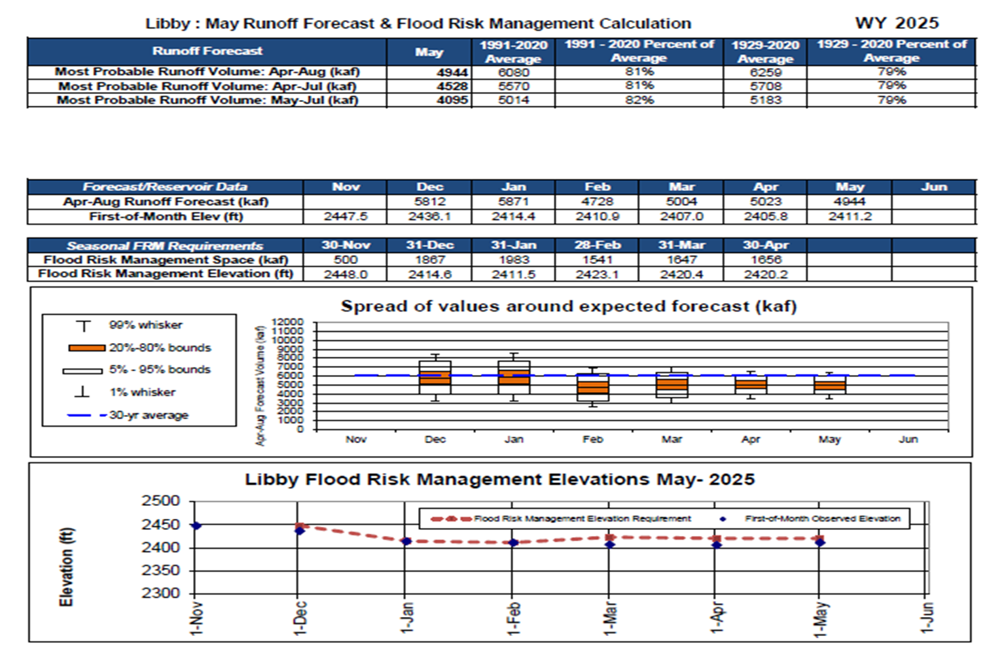

Slide 6
Tiered sturgeon volumes measured as discharge in excess of 4 kcfs minimum flow.
Apr-Aug Forecast (MAF) | Sturgeon Volume (MAF)
Less than 4.80 | 0.0
4.8 to 5.40 | 0.8
5.40 to 6.35 | 0.80 to 1.12
6.35 to 7.40 | 1.12 to 1.20
7.40 to 8.50 | 1.20
8.5 to 8.90 | 1.20 to 1.60
Greater than 8.90 | 1.60
Minimum bull trout releases from Libby Dam after sturgeon flow augmentation volume is exhausted through August 31, based on May final Libby Dam water supply forecast for April-August. Note: minimum bull trout flows from May 15–May 31 and all of September is 6,000 cfs.
Apr-Aug Forecast Runoff Volume at Libby | Min Bull Trout Flows (after Sturgeon Pulse and Through August 31)
forecast <4.80 MAF | 6,000 cfs
4.80 MAF≤ forecast < 6.00 MAF | 7,000 cfs
6.00 MAF≤ forecast < 6.70 MAF | 8,000 cfs
6.70 MAF≤ forecast | 9,000 cfs
Note: Linear interpolate between values as needed
End of September Target elevation for Koocanusa Reservoir
*MAF = million acre-feet
Libby Water Supply Forecast for April – August Inflow (percentile) | Libby Water Supply Forecast for April – August Inflow (MAF*) | End-of-September Target Pool Elevation (ft-NGVD29)**
<15th Percentile | 4.48 | 2439
25th Percentile | 5.08 | 2449
75th Percentile | 7.06 | 2449
>85th Percentile | 7.53 | 2454
*MAF = million acre-feet, value based on the current 1991 to 2020 30-year period
**Targets are interpolated between 15th and 25th percentile and between 75th and 85th percentile

Slide 7
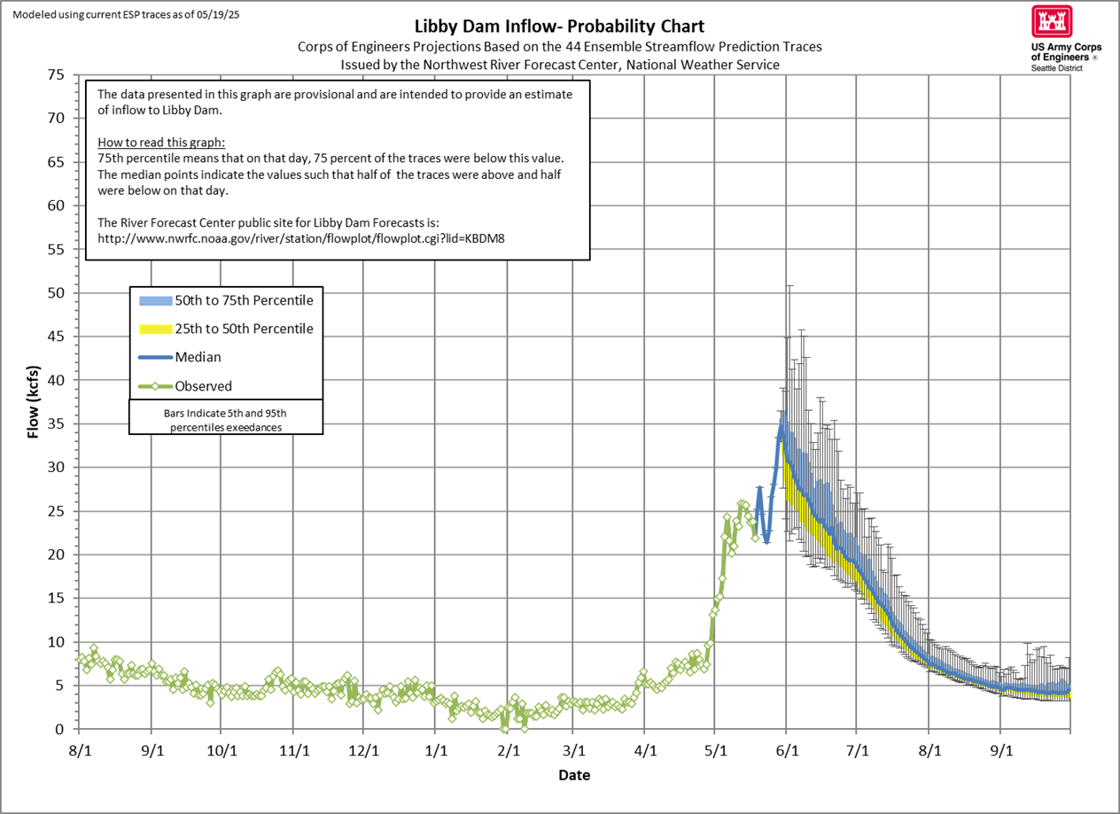

Slide 8
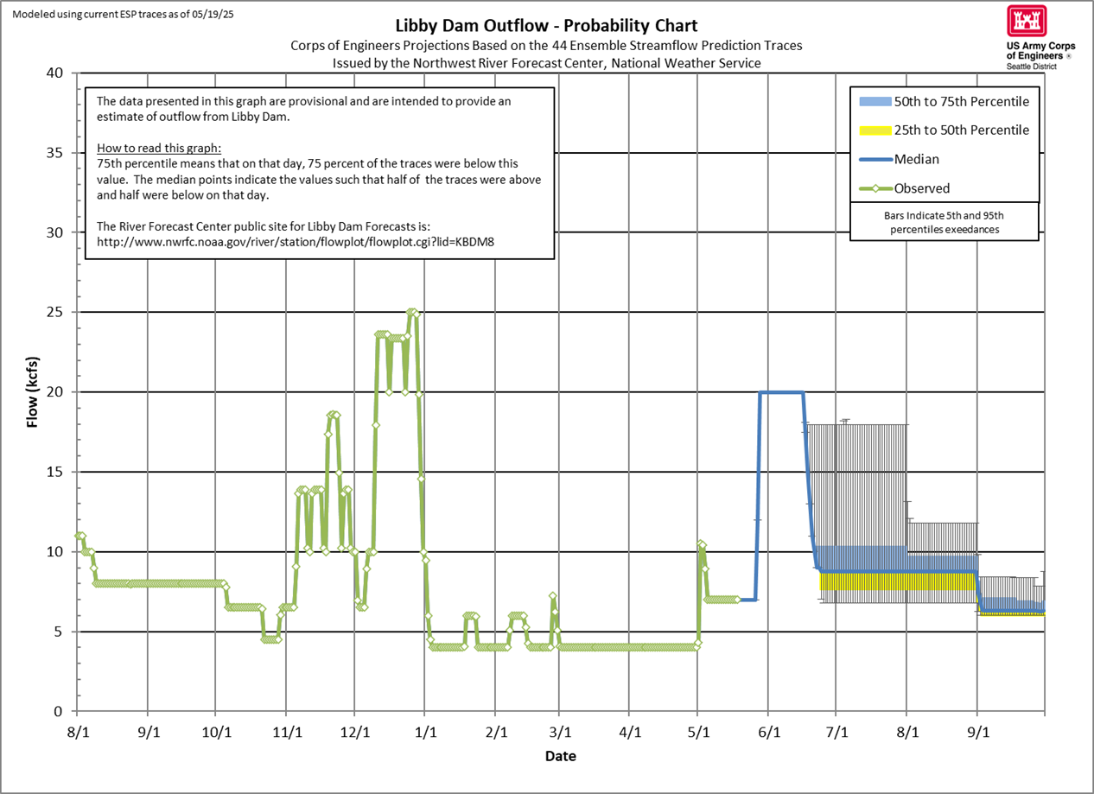
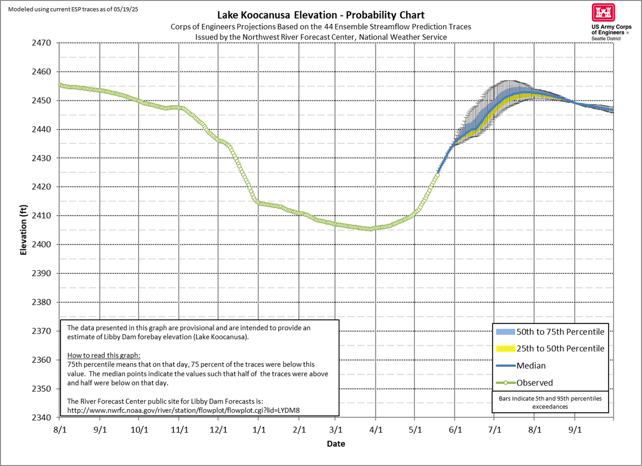
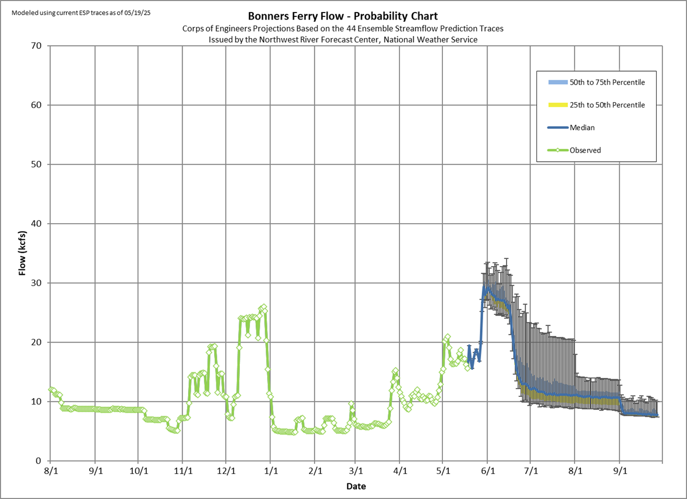
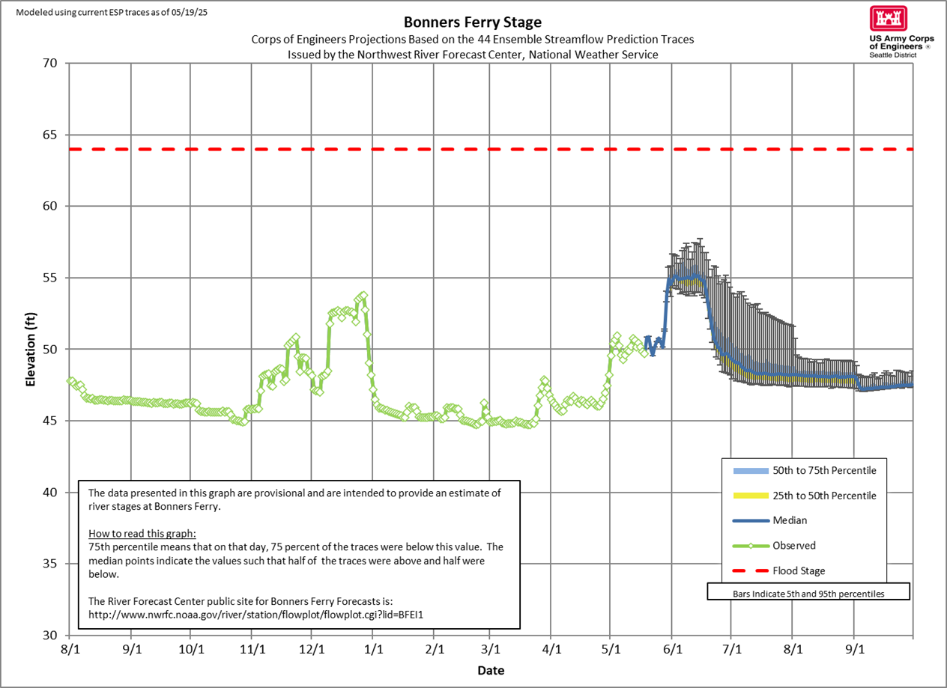

Slide 9
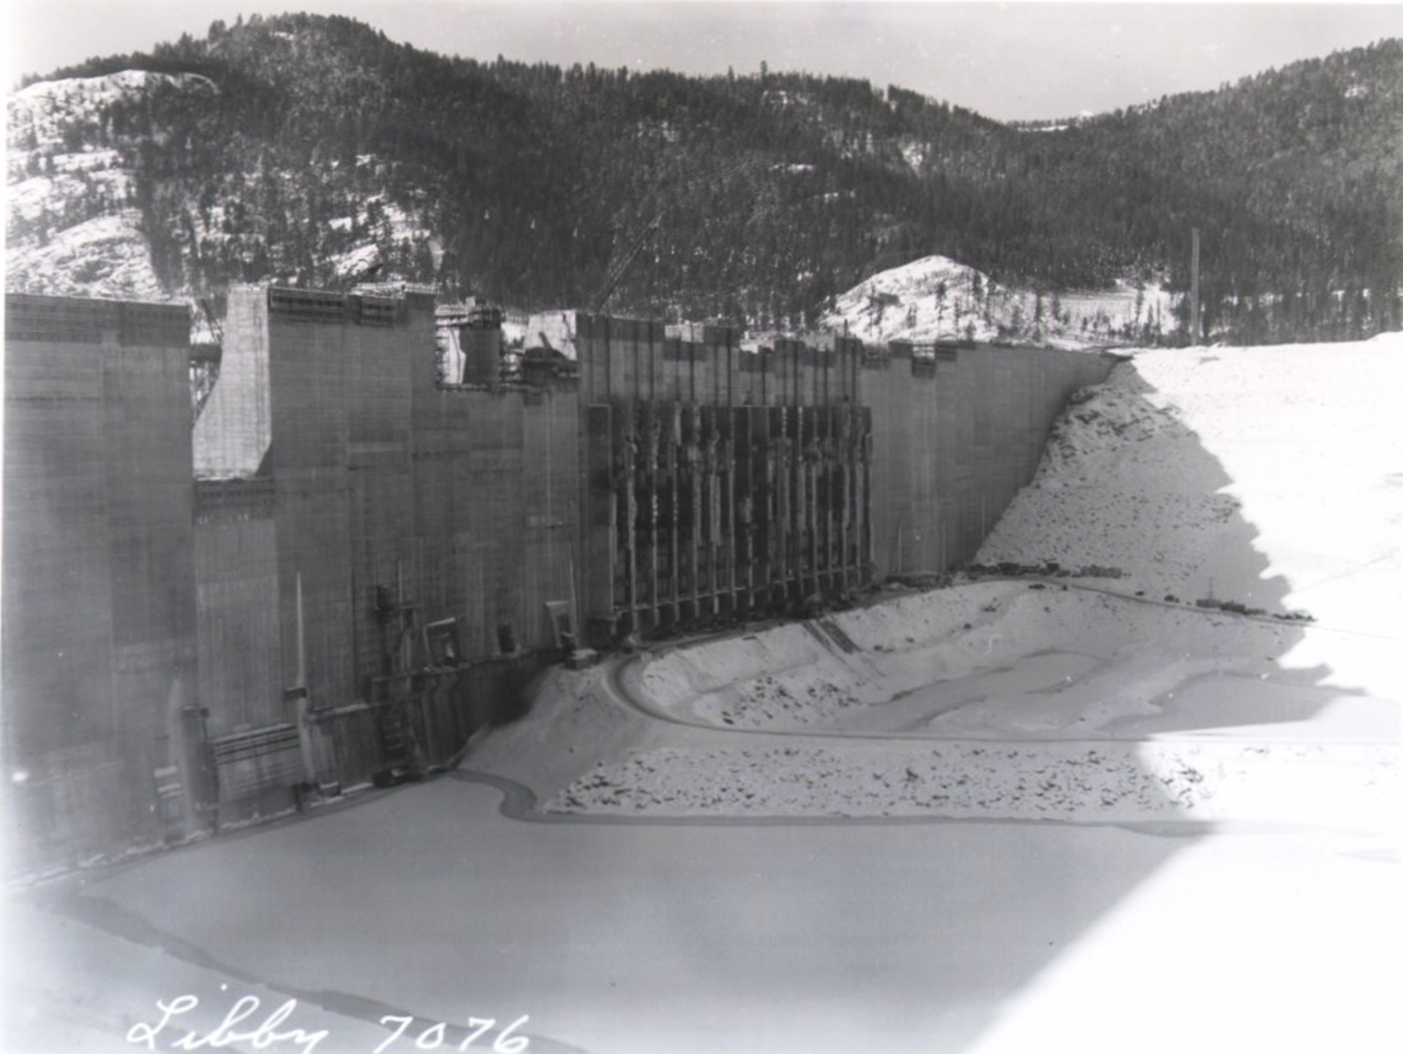
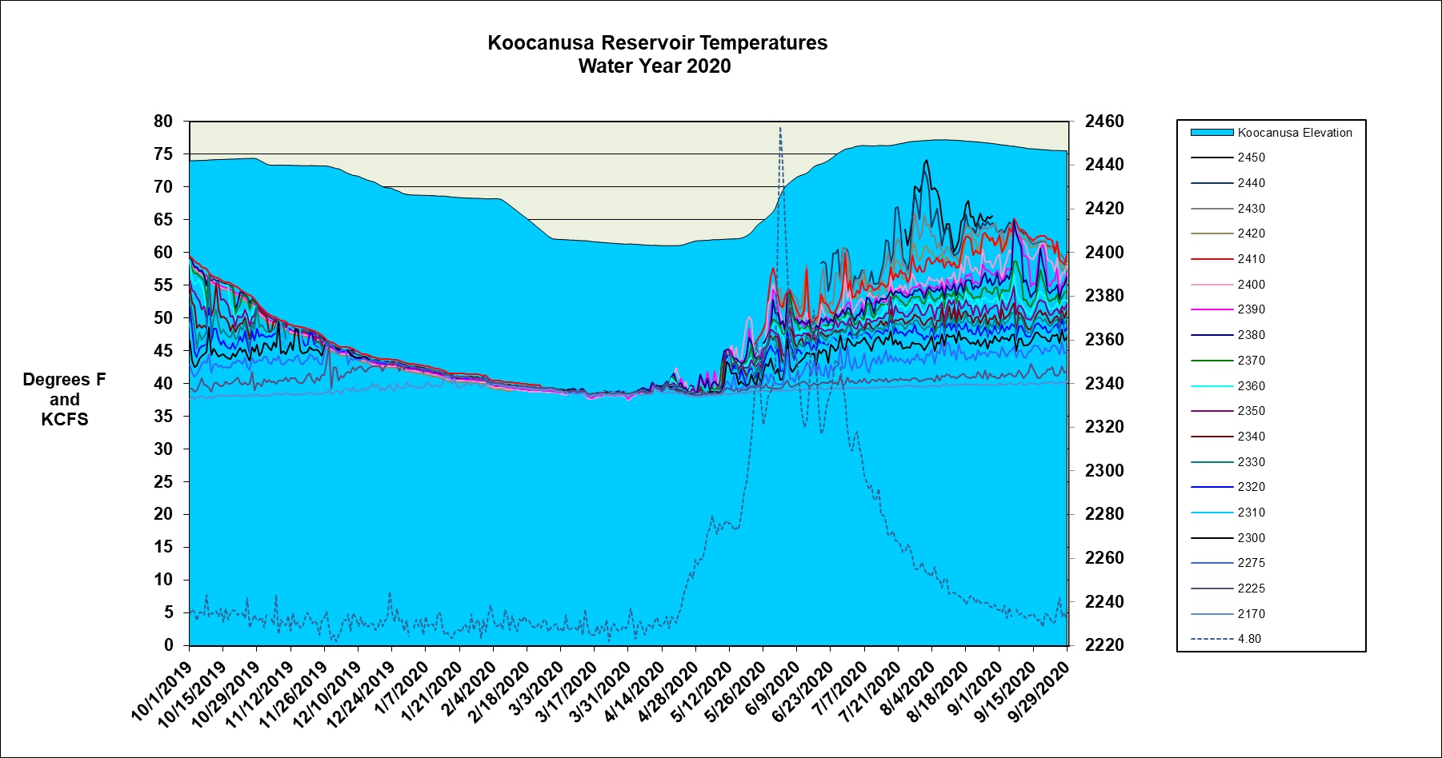
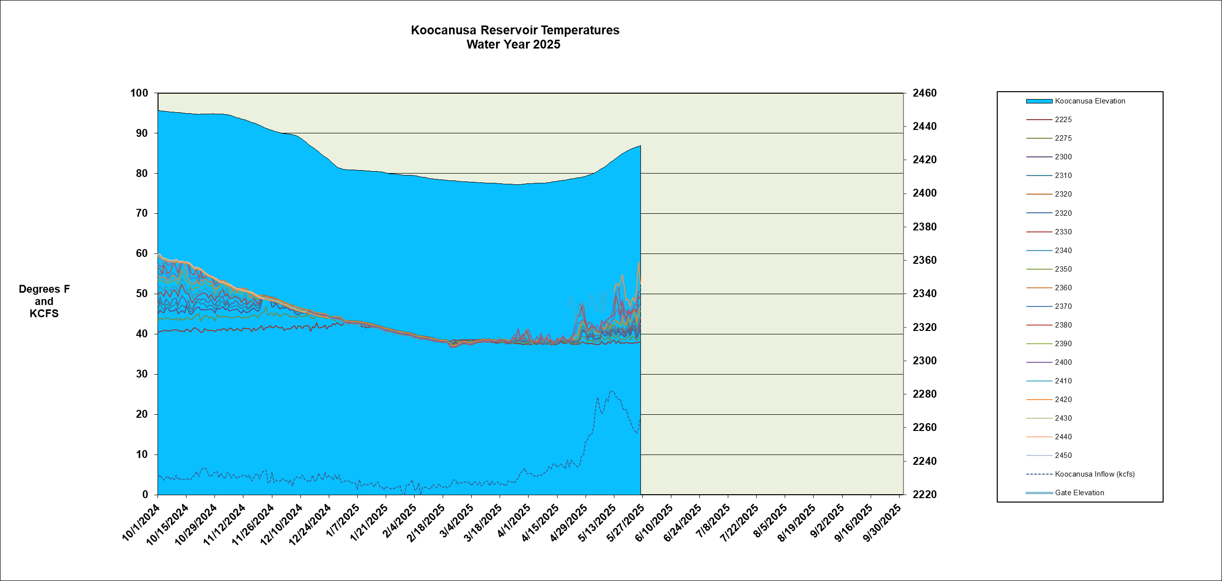
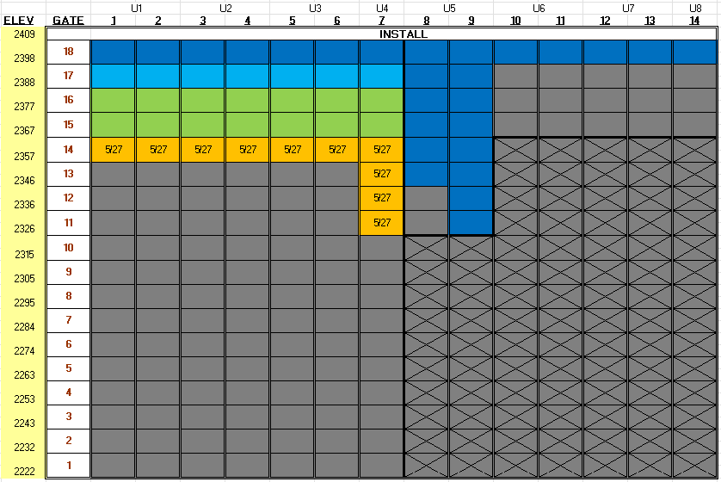
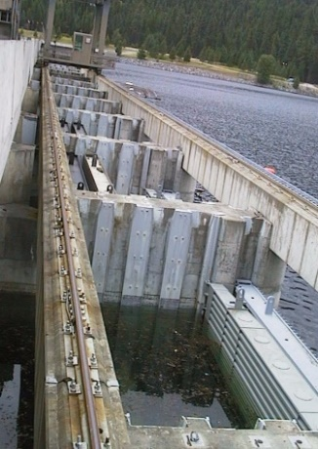
Notes:
Lower Left – SW Gate Install and temperatures/flows
Lower Right – 252 gates @ 30 minutes per gate.
PLANNING

Slide 10
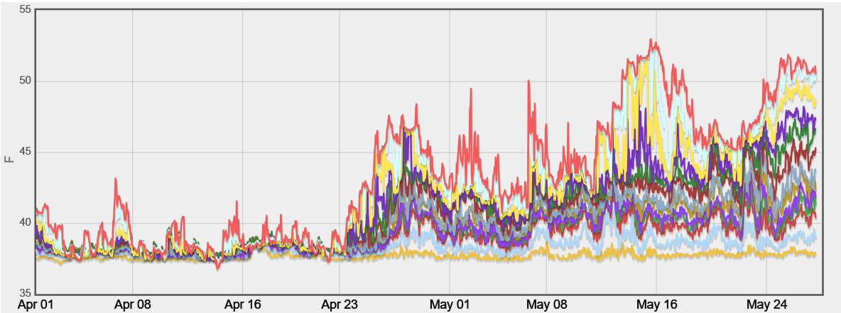
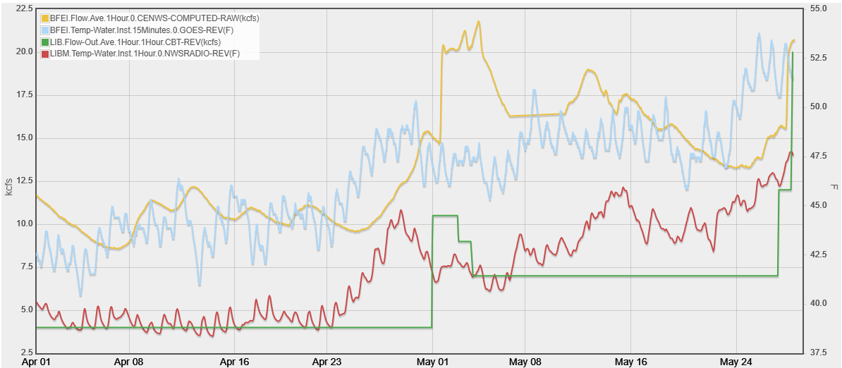

Slide 11
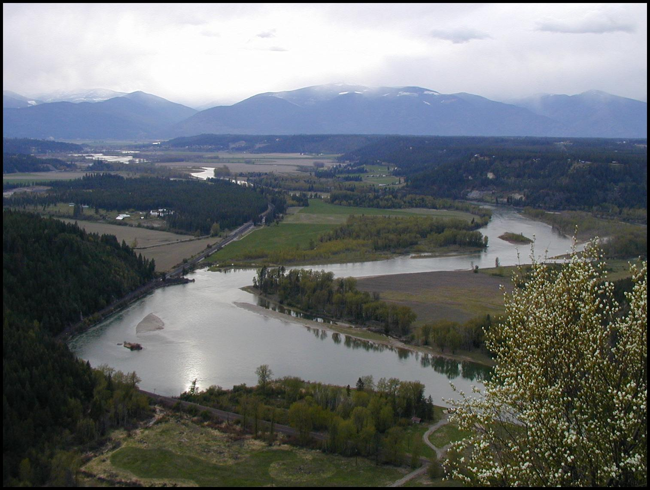










Notes:
Flow and Temperature Management through FPIP
Has become a “standard” operation
BiOp Habitat Actions
Created habitats upstream of Bonners Ferry AND flows of 30kcfs of better increase likelihood of fish migration into appropriate spawning habitats.
Riparian Recruitment
Dr. Stewart Rood
Informed CONSERVATION AQUACULTURE and HABITAT needs

