Slide 1
Bonneville Spill and Tailwater Impacts
Laurie Ebner
February 6th 2025

Slide 2
Major Findings
No dam safety concerns were identified with the high spill volume and lack of tailwater support (not an expected outcome).
TDG characteristics should be revisited based on the high spill volumes and the range of tailwater evaluated. The flow deflector jets are rarely skimming and meeting the original TDG design characteristics. CFD results are compared to available physical model results and the limitations of the physical model results are identified.
Particles were not released in the CFD model to represent juvenile fish but streamlines in the CFD model to provide insight into the flow characteristics downstream of the flow deflectors. Streamlines have been released off of the Elevation 14 foot flow deflectors (bays 4 – 15) and the Elevation 7 foot flow deflectors (bays 1-3 and 16-18). There is a strong interaction shown in the streamlines between the deflectors of different elevations (bays 3 and 4 and bays 15 and 16).

Slide 3
Dam Safety Concerns
At tailwater elevations lower than considered during the original design anticipated seeing hydraulic conditions that would be detrimental to the spillway.
The spill conditions are pushing too much energy downstream.
These conditions are not occurring during the freshet – they are occurring when spill is being maximized at low total river conditions.
Anticipated seeing low pressures and cavitation over the majority of the stilling basin – yes low but cavitation level is only around baffle blocks which is true for the design tailwater.
Rocks moving into the stilling basin are still a dam safety concern and monitoring needs to continue.

Slide 6
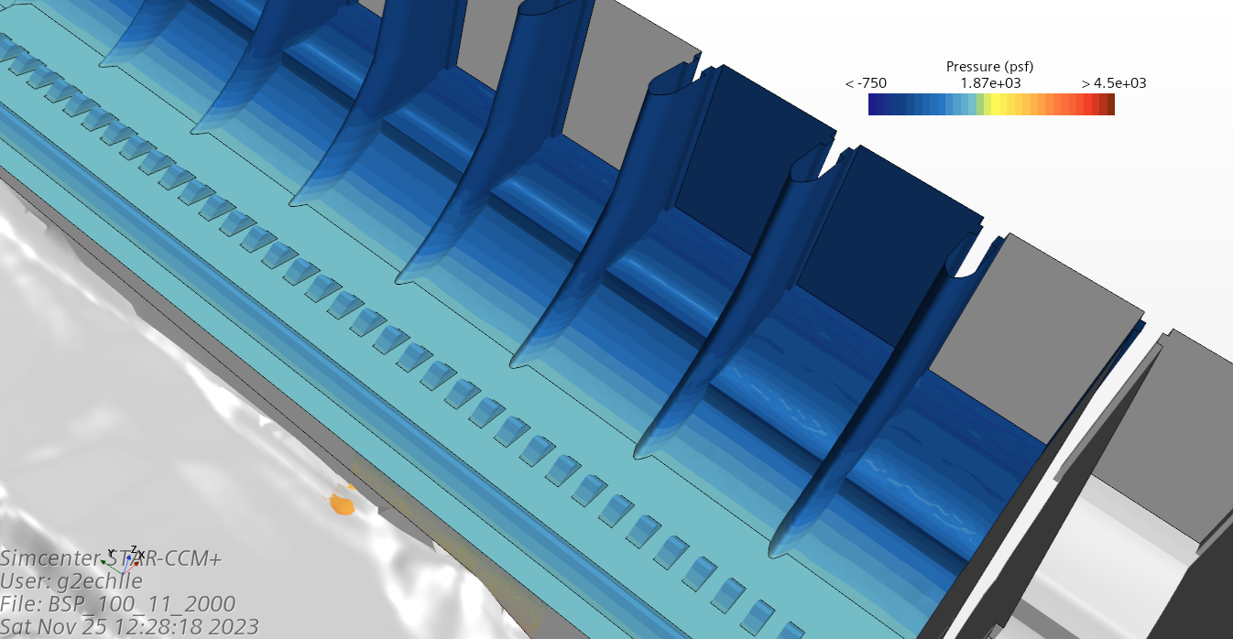

Slide 7
TDG Characteristics
Physical Model Test were not conducted over the range of TWs we are operating.
Physical Model Test did not test two different height flow deflectors adjacent to each other.
Still need both height flow deflectors because of spill for juvenile fish and passing high freshet flows.

Slide 8
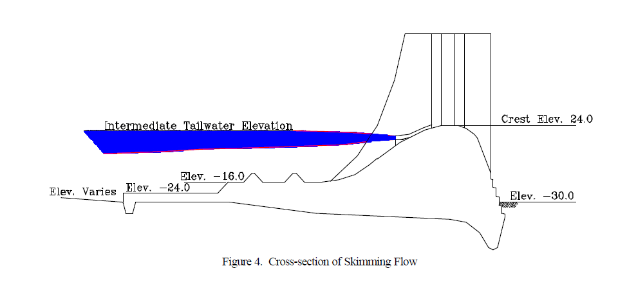
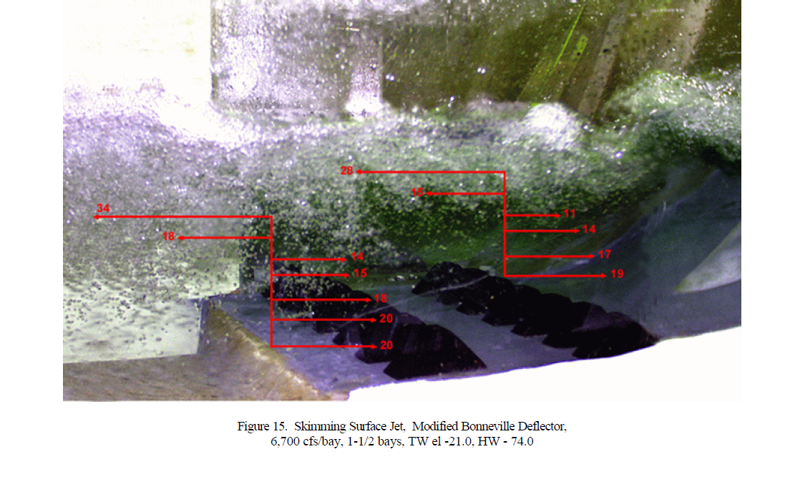

Slide 9
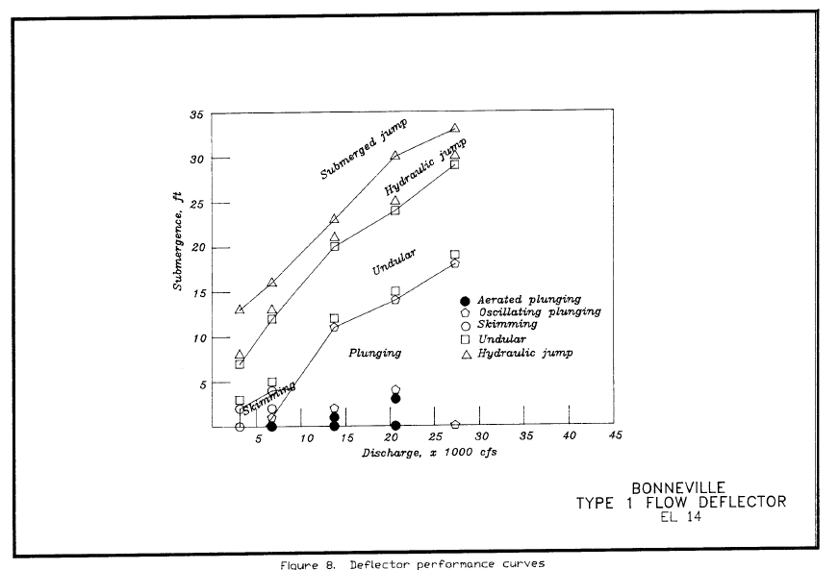
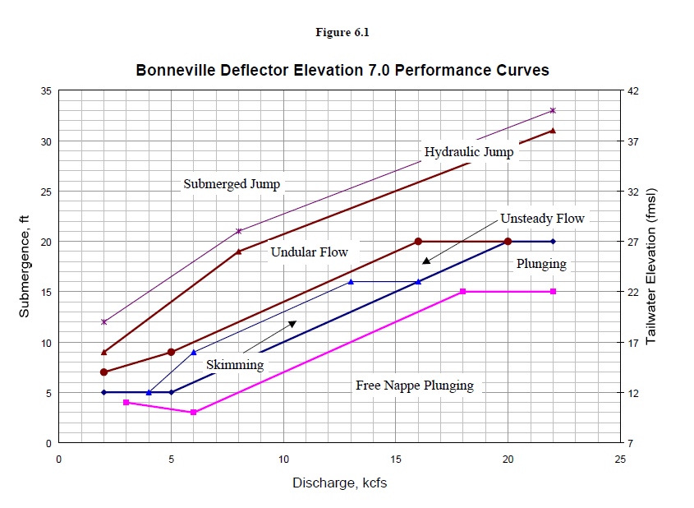

Slide 11
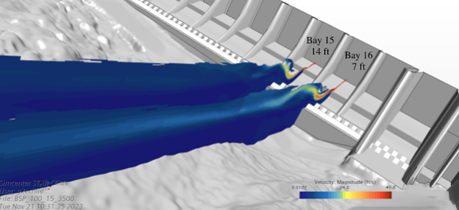
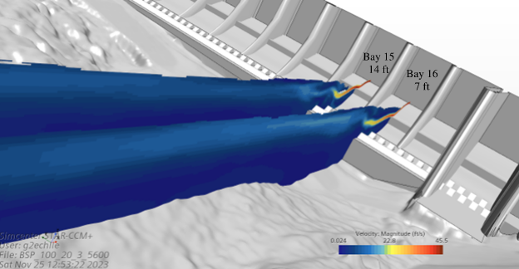
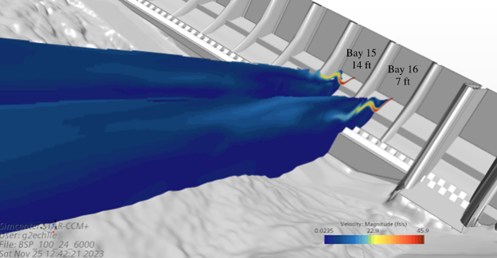
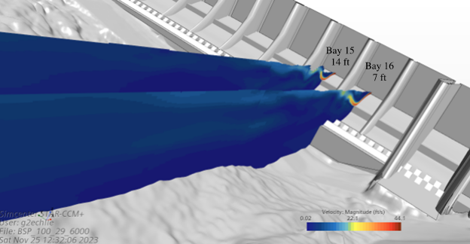

Slide 12
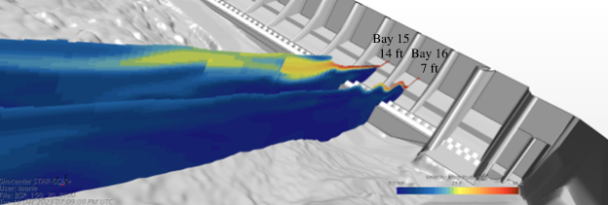
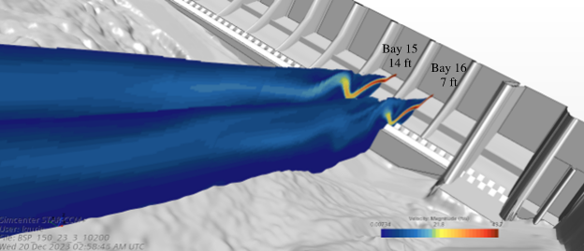

Slide 13
Streamlines
Different colored streamlines were released from different zones:
Blue streamlines at the downstream lip of the 14 foot deflector (bays 4-15)
Pink streamlines at the downstream lip of the 7 foot deflectors (bays 1-3 and 16-18)
Green streamlines in the upper 10 feet of the water column downstream of the flow deflectors (across the whole spillway) (Vertical column is TW-10)
The depth available for the streamlines is very different depending upon tailwater elevation
When depth is too little several streamlines leave the fluid domain
Very interesting interaction between streamlines

Slide 14
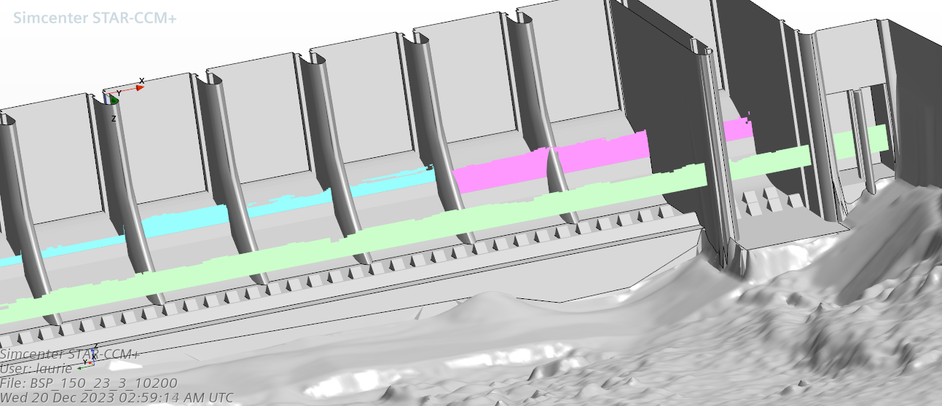
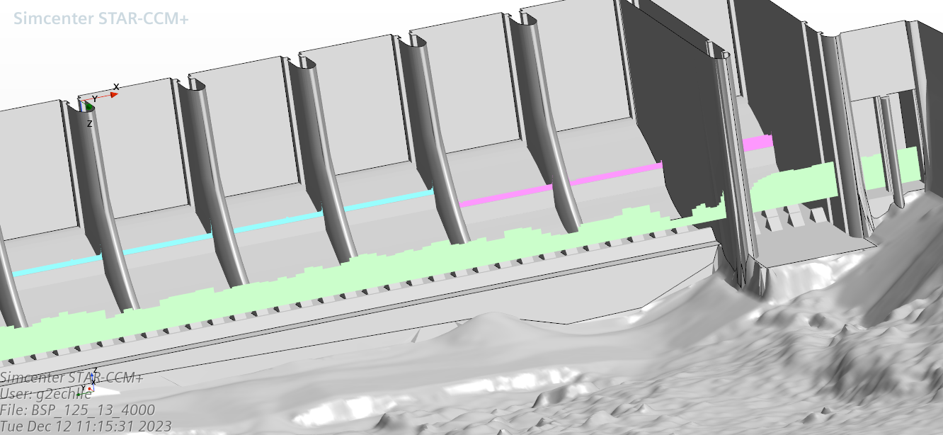

Slide 15
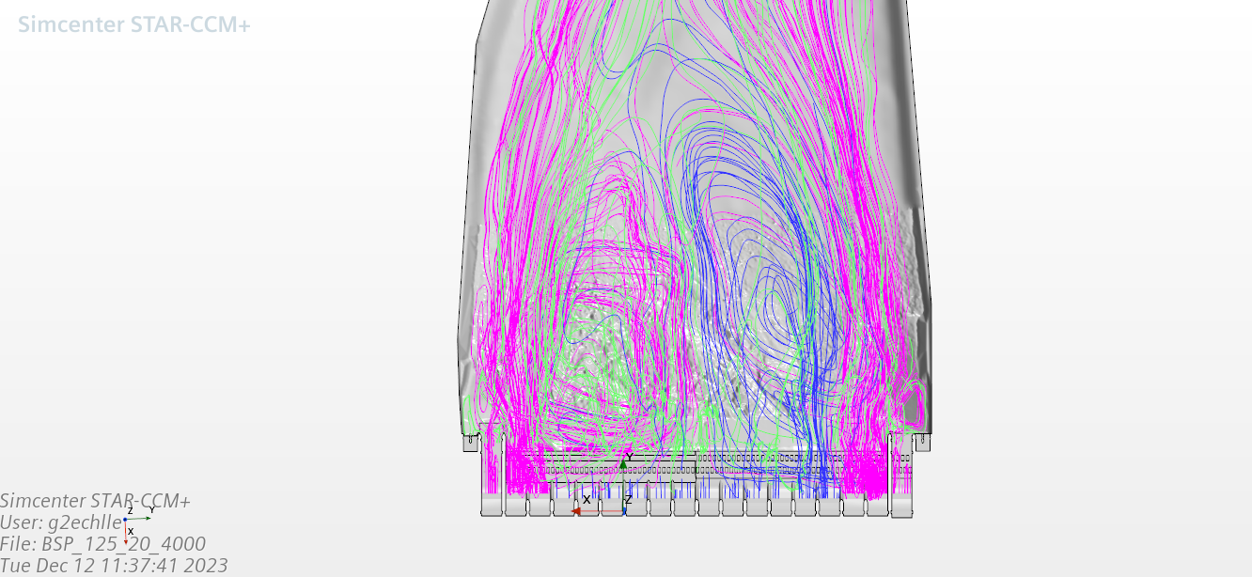
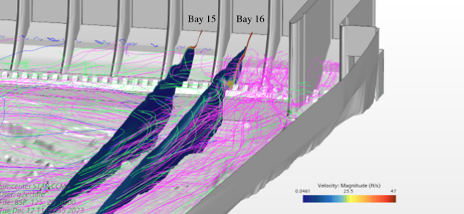

Slide 16
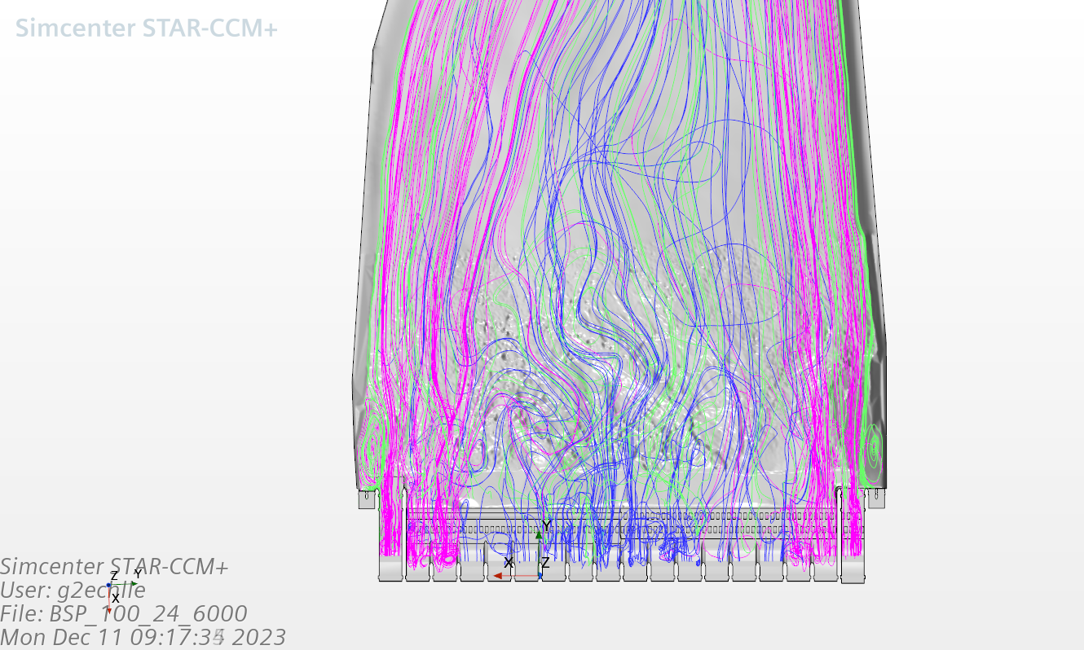
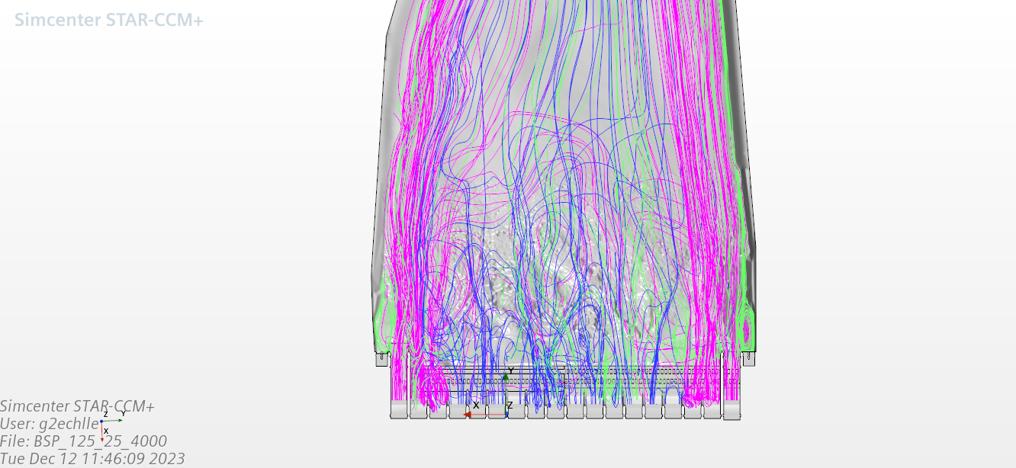

Slide 17
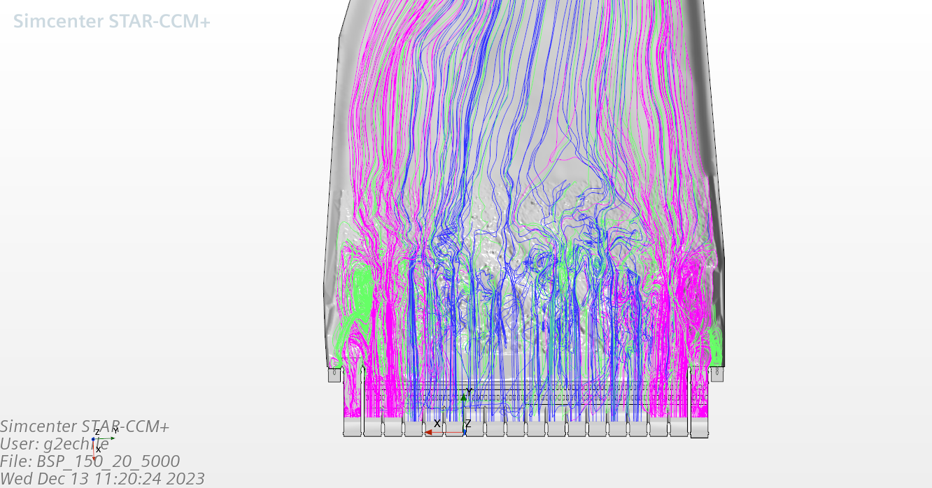
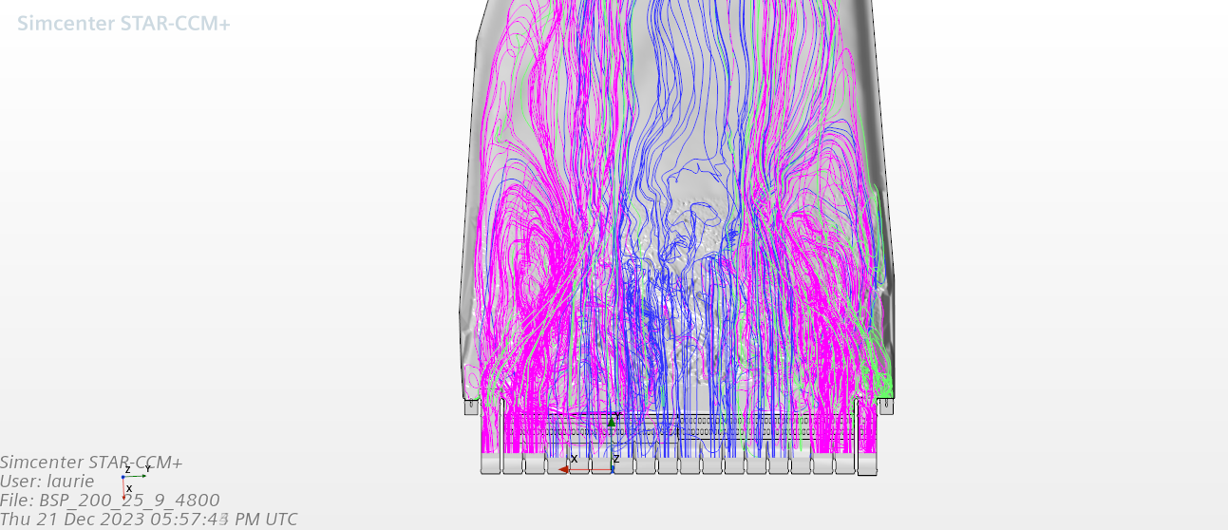

Slide 18
Following are all of the model images
Questions

Slide 19
CFD Model Runs
 | 80 Kcfs at TW of 9, 12,15,18.9,24,28
 | 100 Kcfs at TW of 11,15,20.3,24,29
 | 125 Kcfs at TW of 13,15,20,21.8,25,30
 | 150 Kcfs at TW of 14,20,23.3,25,31
 | 200 Kcfs at TW of 17,20,25.9,30,33
 | Saw Tooth Pattern at 80 Kcfs TW of 18.9

Slide 20
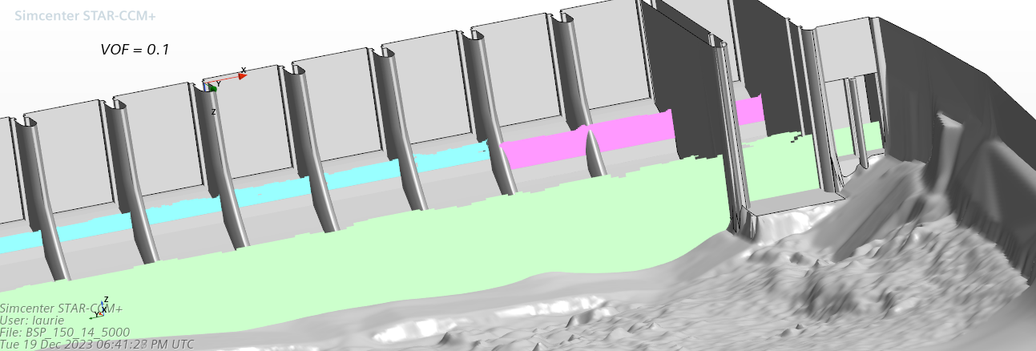
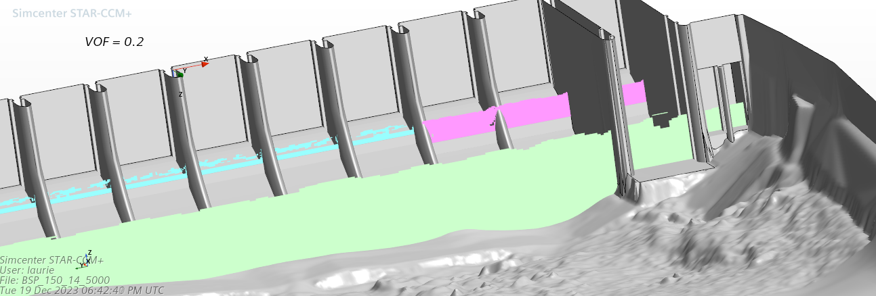
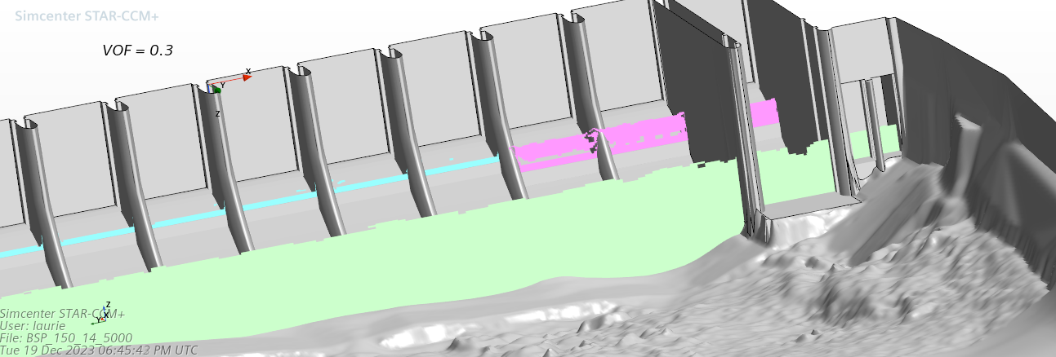
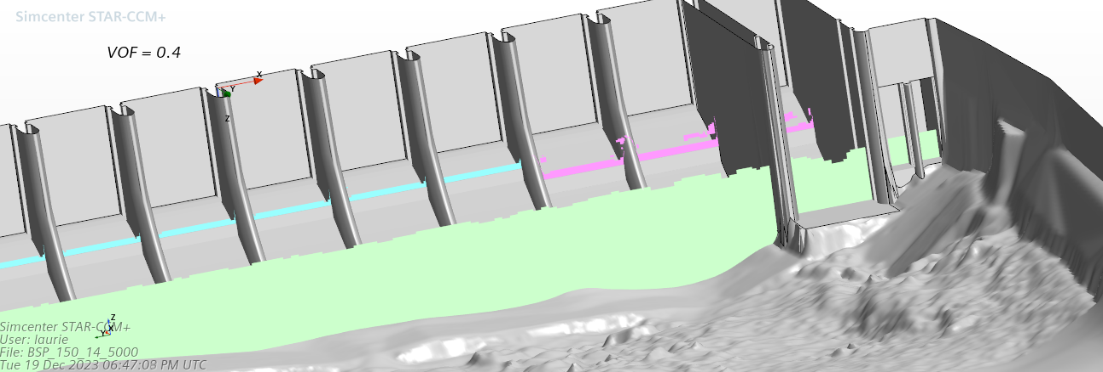

Slide 21
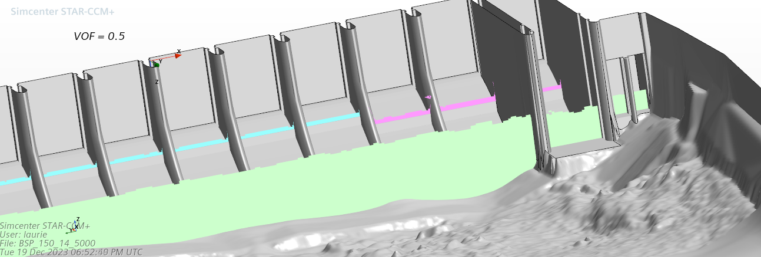

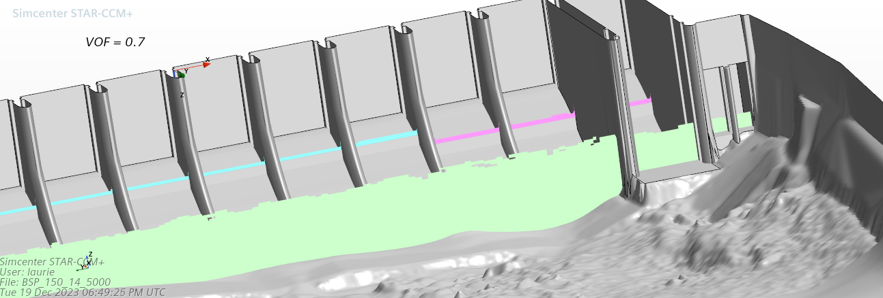
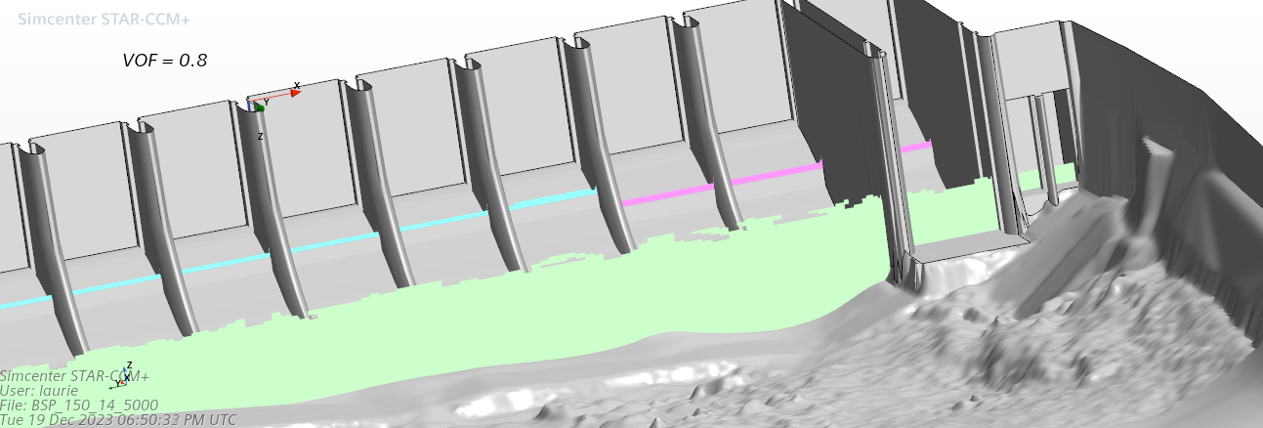

Slide 22


Slide 23
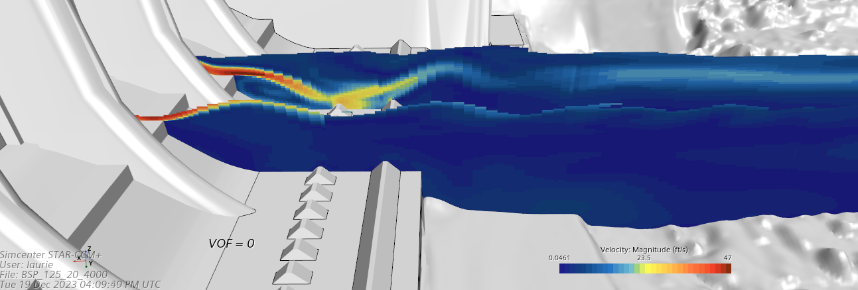




Slide 24





Slide 25


Slide 26
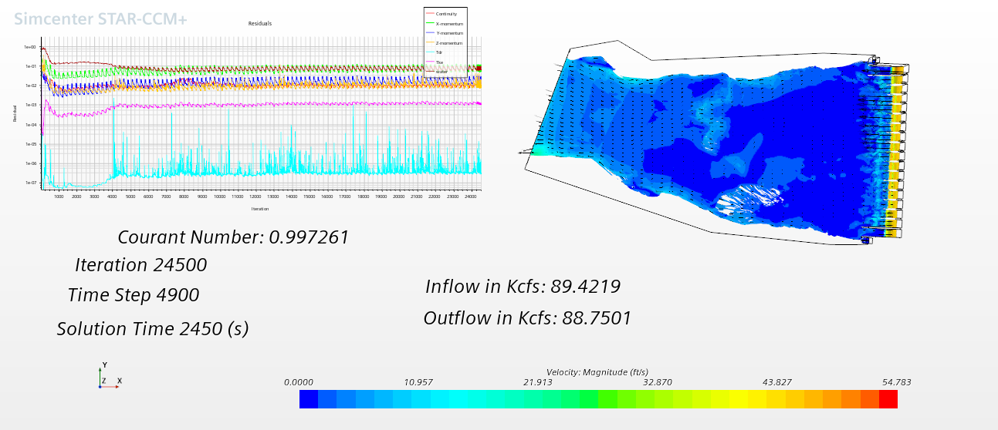
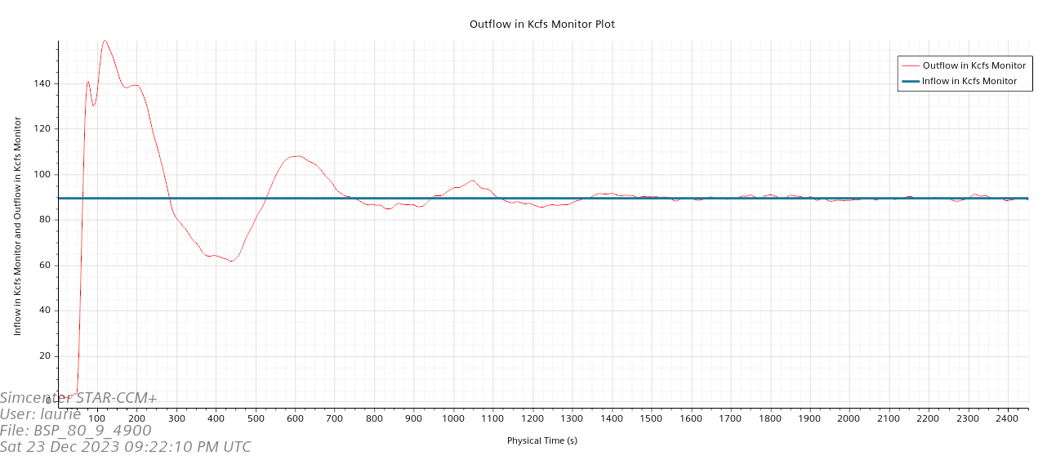
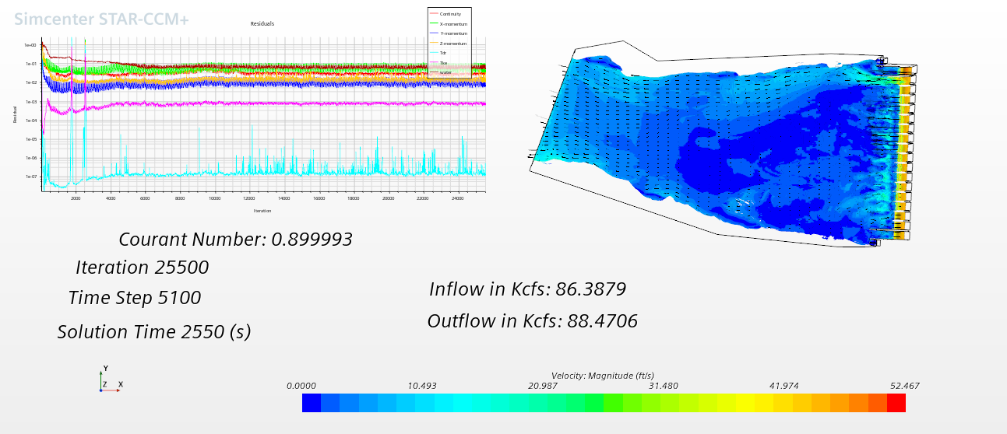
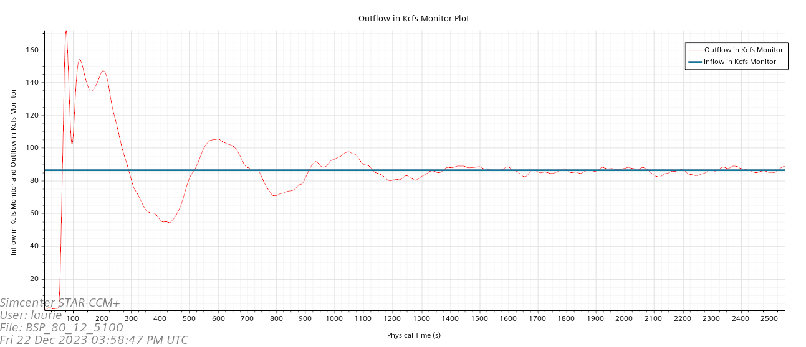

Slide 27
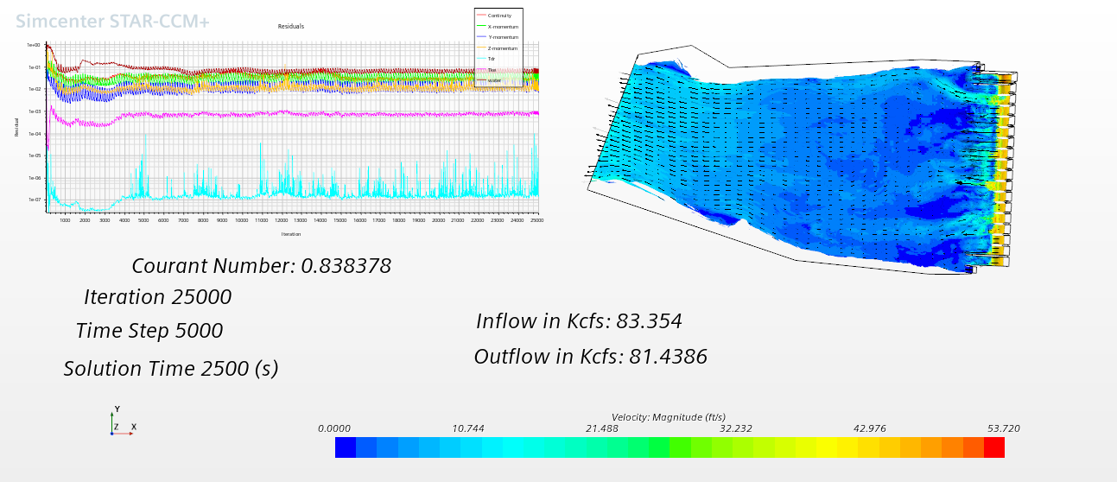
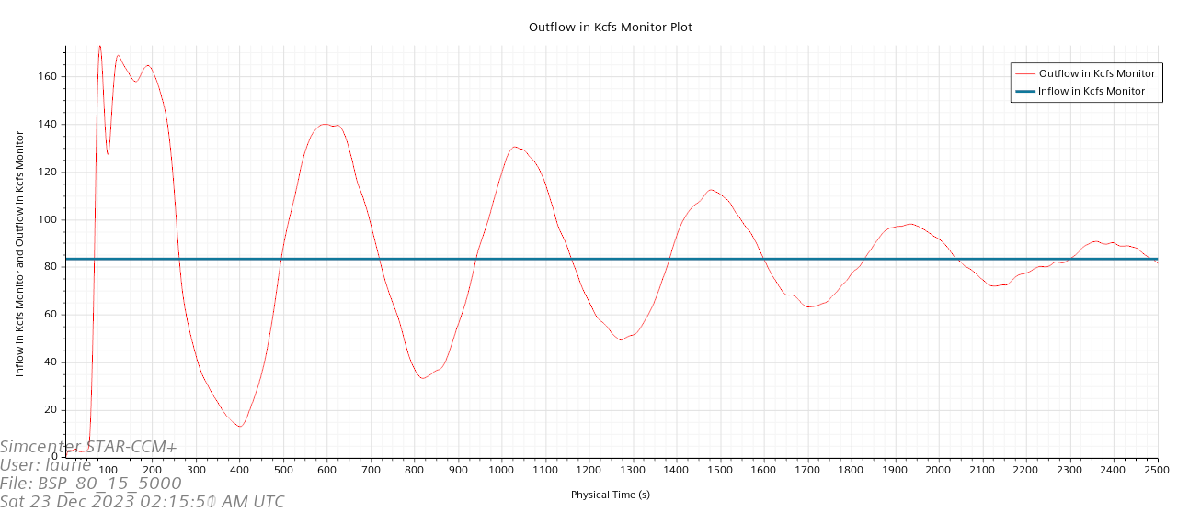

Slide 28
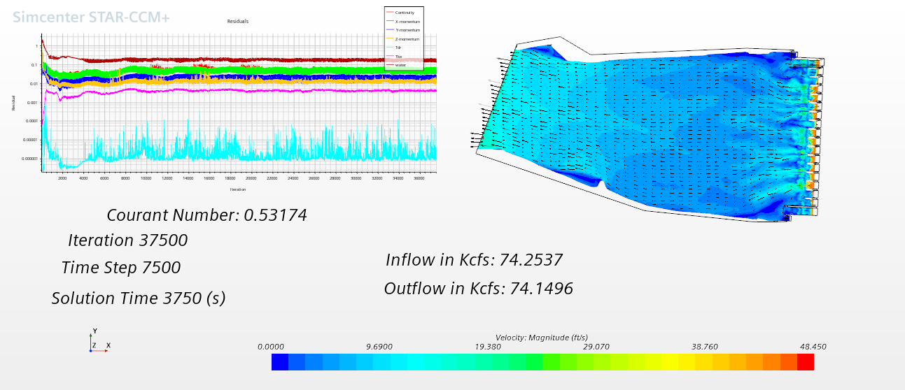
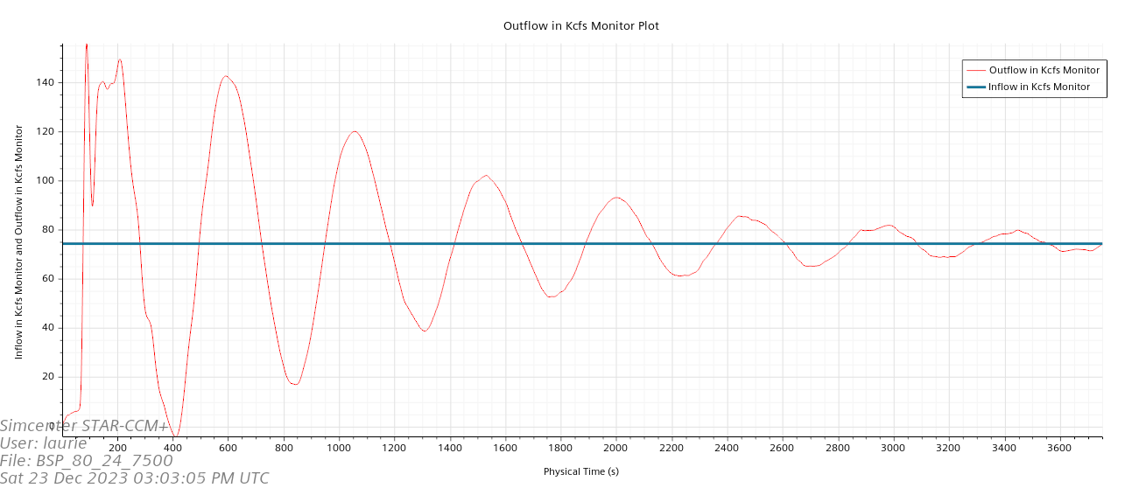
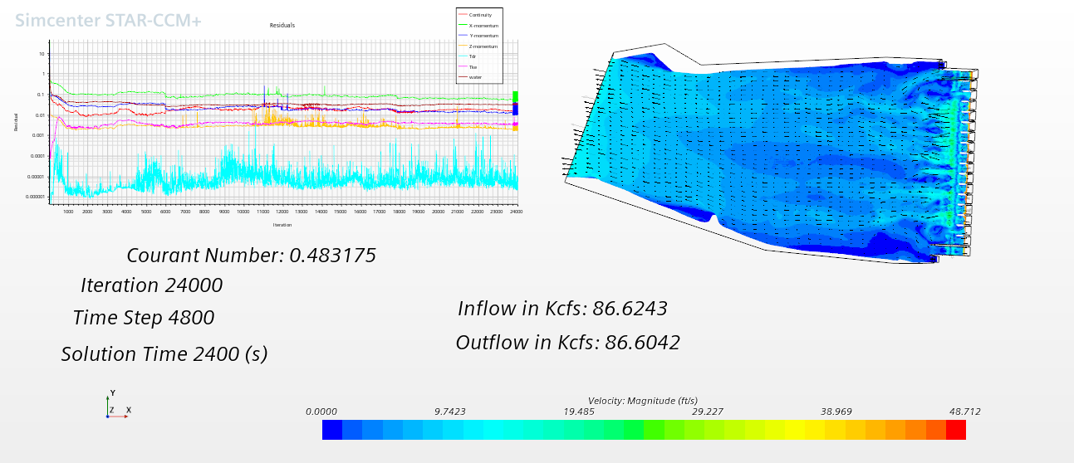
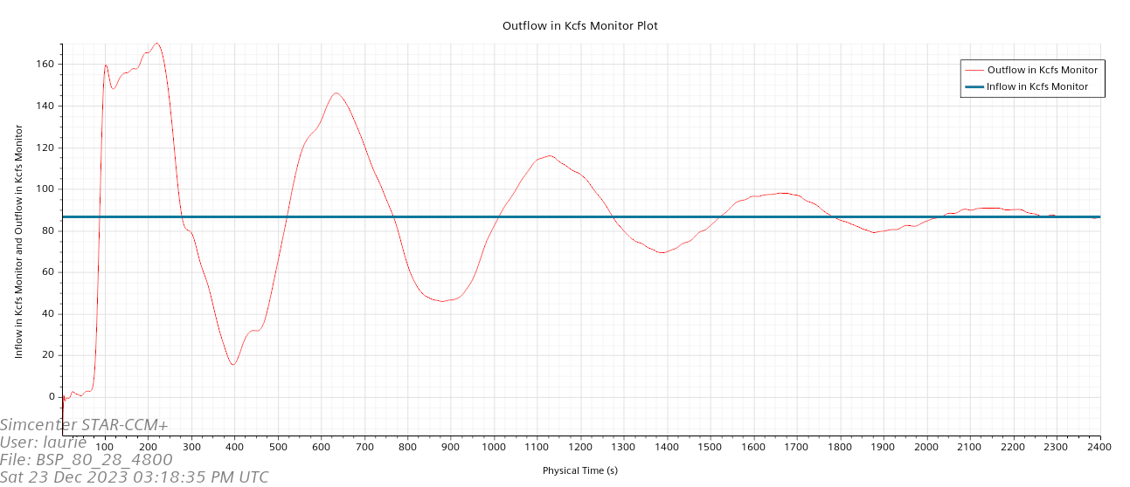

Slide 29
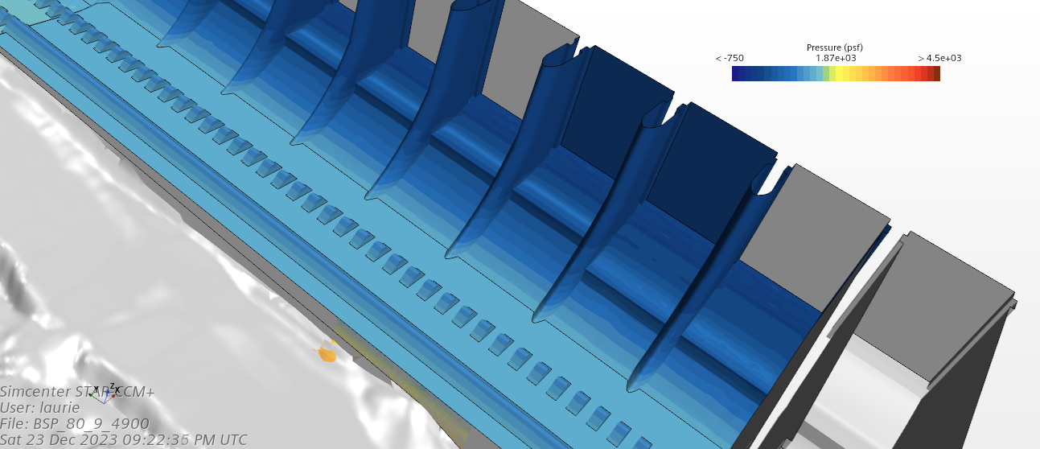
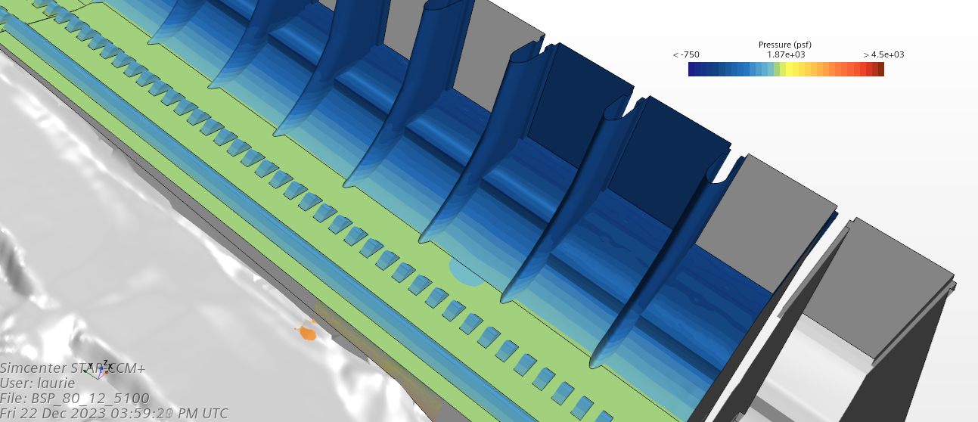
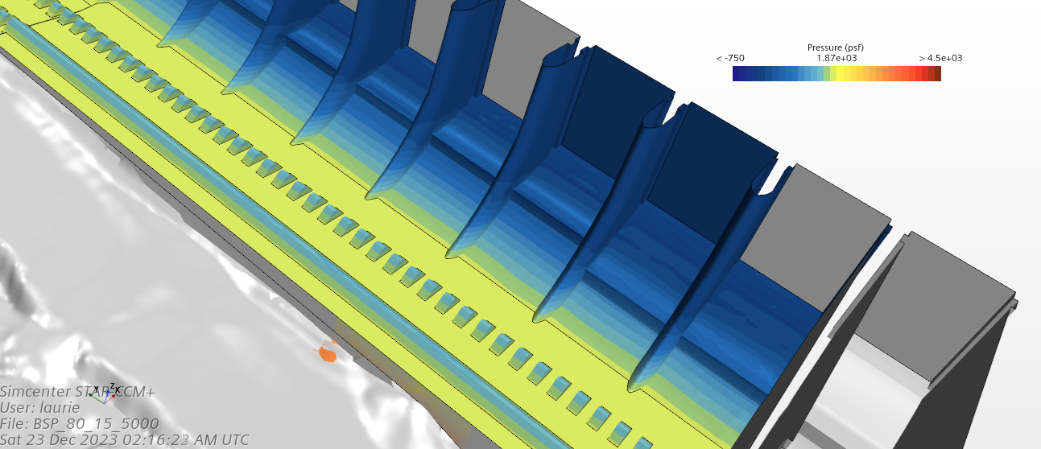
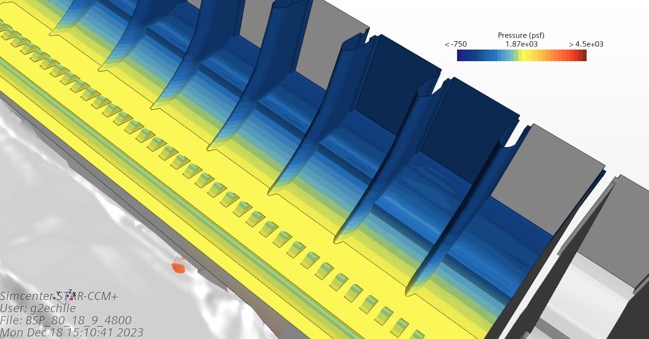

Slide 30
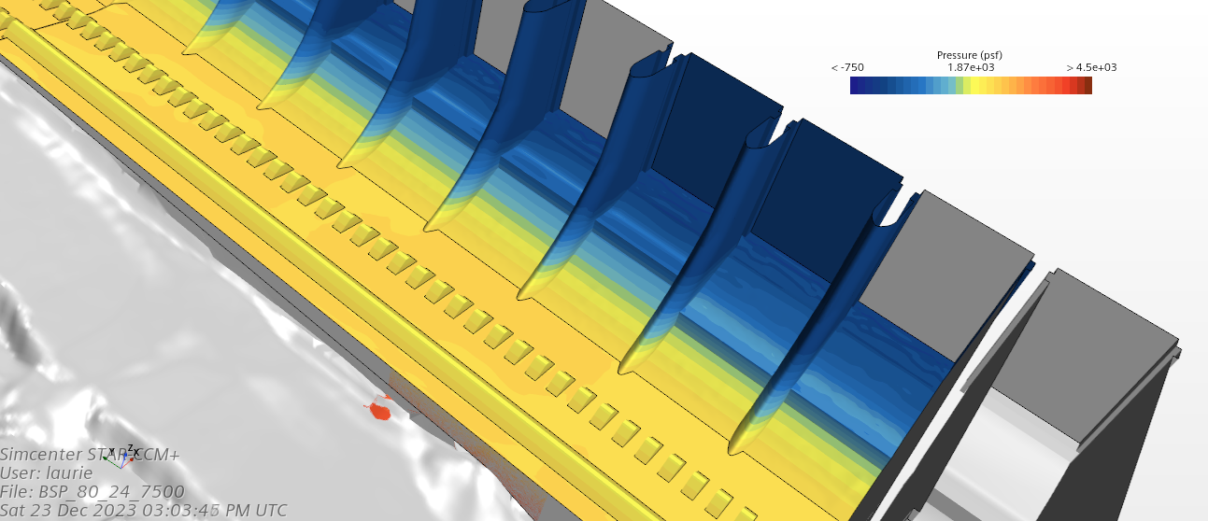
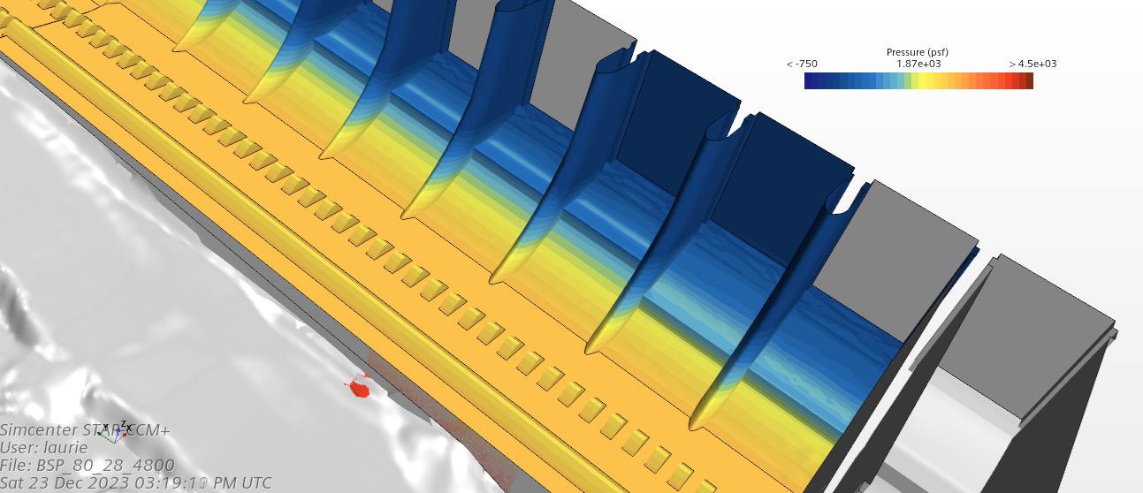

Slide 31
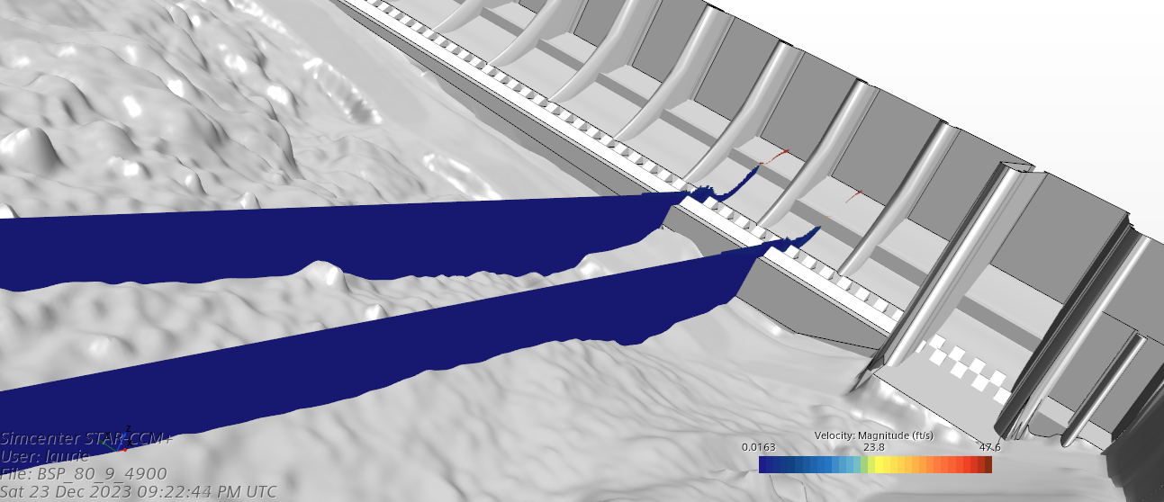
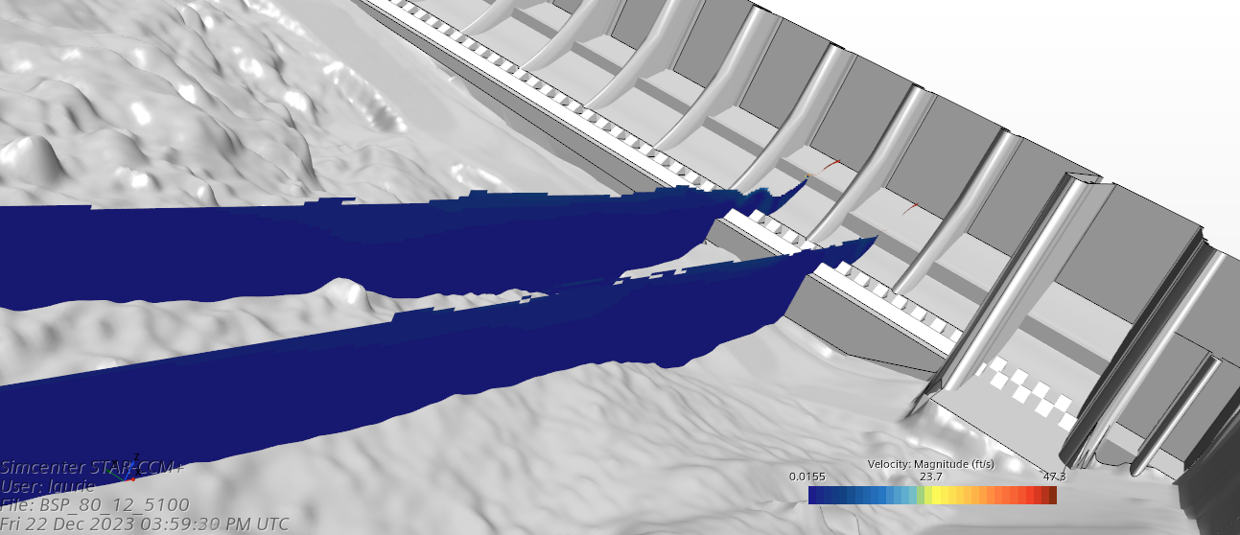
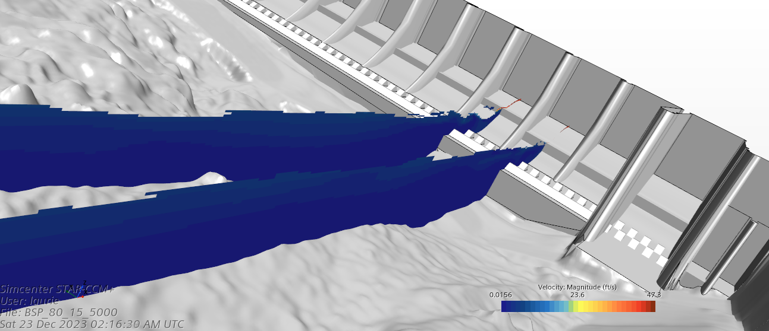
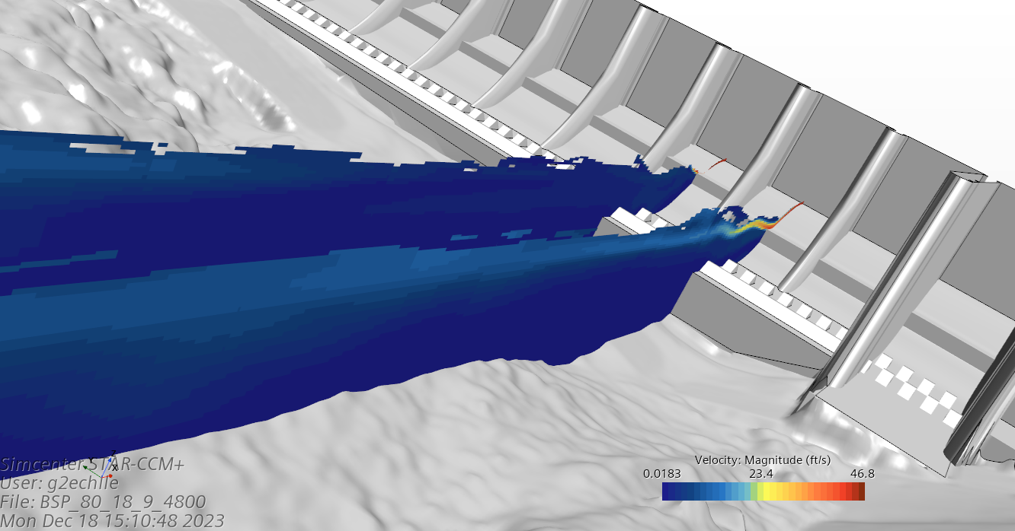

Slide 32
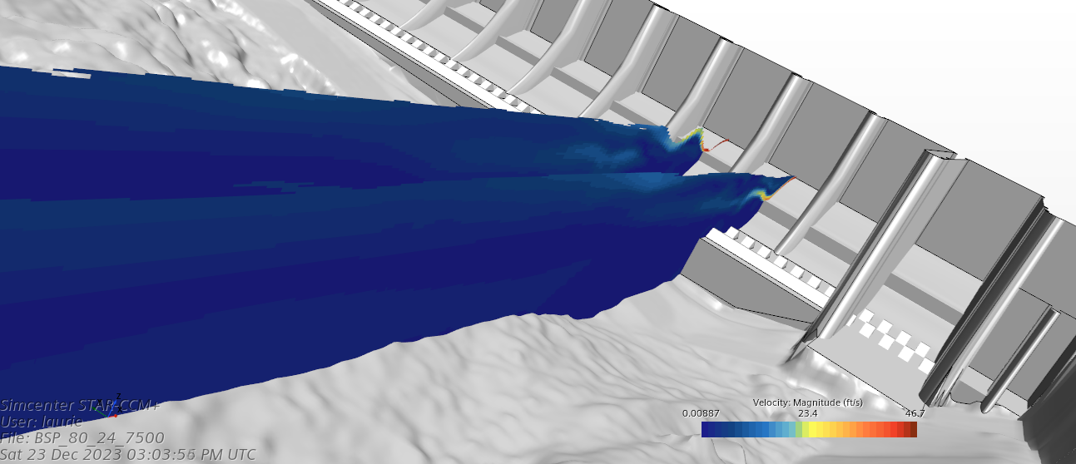
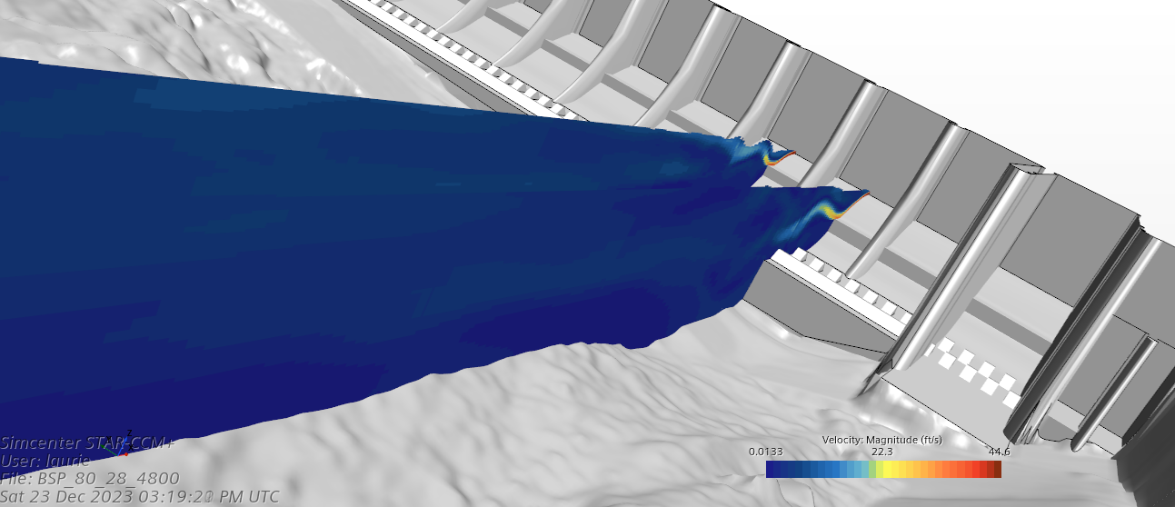

Slide 33
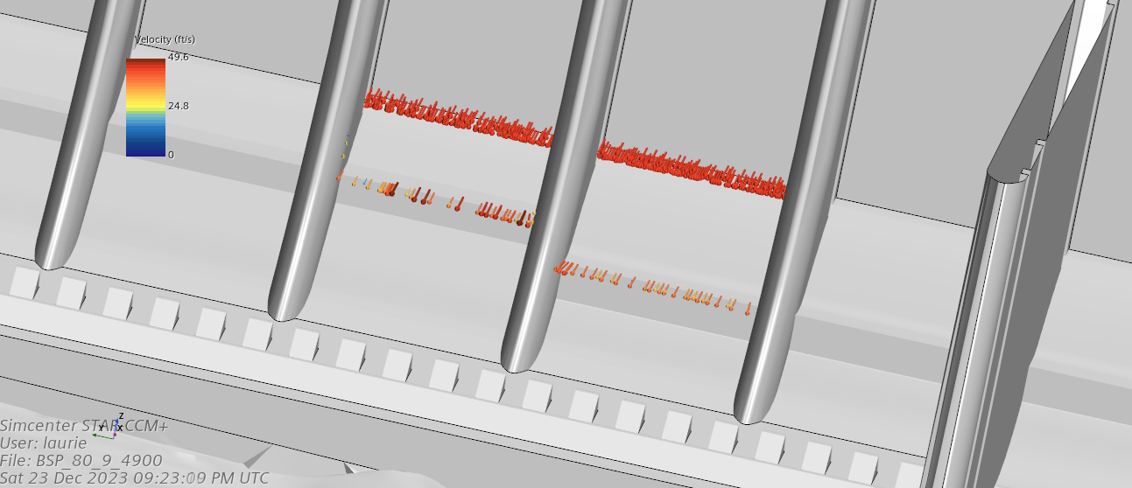




Slide 34



Slide 35





Slide 36



Slide 37





Slide 38





Slide 39



Slide 40





Slide 41





Slide 42



Slide 43




Slide 44

Pressures on the stilling basin floor are positive for the last two runs. There are low pressures over most of the stilling basin for the lowest tailwater and transitioning to the middle tailwater to localized spots on the baffle blocks.

Slide 45





Slide 46

All images are based on a VOF of 0.5. See discussion on how it changes based on different values.
The jets (-7 foot deflector vs -14 foot deflector) have different behavior depending on the TW.

Slide 47





Slide 48

The jets are very thin at the 11 foot and 15 foot tailwater. As the tailwater increases you start to see the energy recirculate above the flow deflector.

Slide 49





Slide 50

These series of slides highlight how thin the volume of flow is at low tailwater. VOF set at 0.5.
At the 11 foot tailwater there isn’t a solid column of water at the downstream slice. Fully aerated flow is getting all the way to the bottom of the stilling basin.

Slide 51




Slide 52

The pink streamlines are released at the downstream end of the -14 foot deflector, the blue streamlines are released at the downstream end of the -7 foot deflectors and the green streamlines are released downstream of the stilling basin in a band that is from the tailwater elevation down 10 feet. So for the 29 foot tailwater the ban is from 19 feet to 29 feet.
Streamlines are only moving in the positive time and any movement upstream of the release location is due to recirculation – there is lots of that.
If the streamlines are not there it means it is either exiting the model at the free surface or hitting the walls, floors, bathymetry and dying.

Slide 53





Slide 54

At a tailwater of 11 feet the streamlines are not moving downstream. They are either hitting the bottom or exiting the fluid volume into the air.
You can see the interaction between the two different elevation of flow deflectors.

Slide 55





Slide 56





Slide 57





Slide 58





Slide 59



Slide 60





Slide 61



Slide 62





Slide 63



Slide 64




Slide 65



Slide 66




Slide 67


Slide 68





Slide 69


Slide 70





Slide 71





Slide 72



Slide 73





Slide 74


Slide 75





Slide 76


Slide 77





Slide 78


Slide 79





Slide 80


Slide 81




Slide 82


Slide 83





Slide 84


Slide 85





Slide 86




Slide 87



Slide 88





Slide 89


Slide 90





Slide 91


Slide 92





Slide 93


Slide 94





Slide 95


Slide 96





Slide 97


Slide 98





Slide 99


Slide 100




80 Kcfs Spill, Top is current spill pattern, bottom is saw tooth, TW = 18.9

Slide 101

TDA Revised Spill Patterns

Slide 102



Slide 103


Existing
Revised

Slide 104



What am I going to do once I really retire

Slide 105




Slide 106



