Slide 1
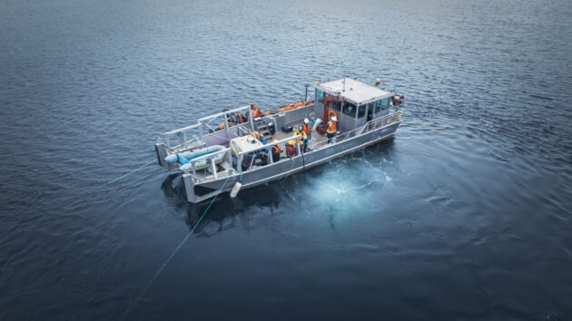
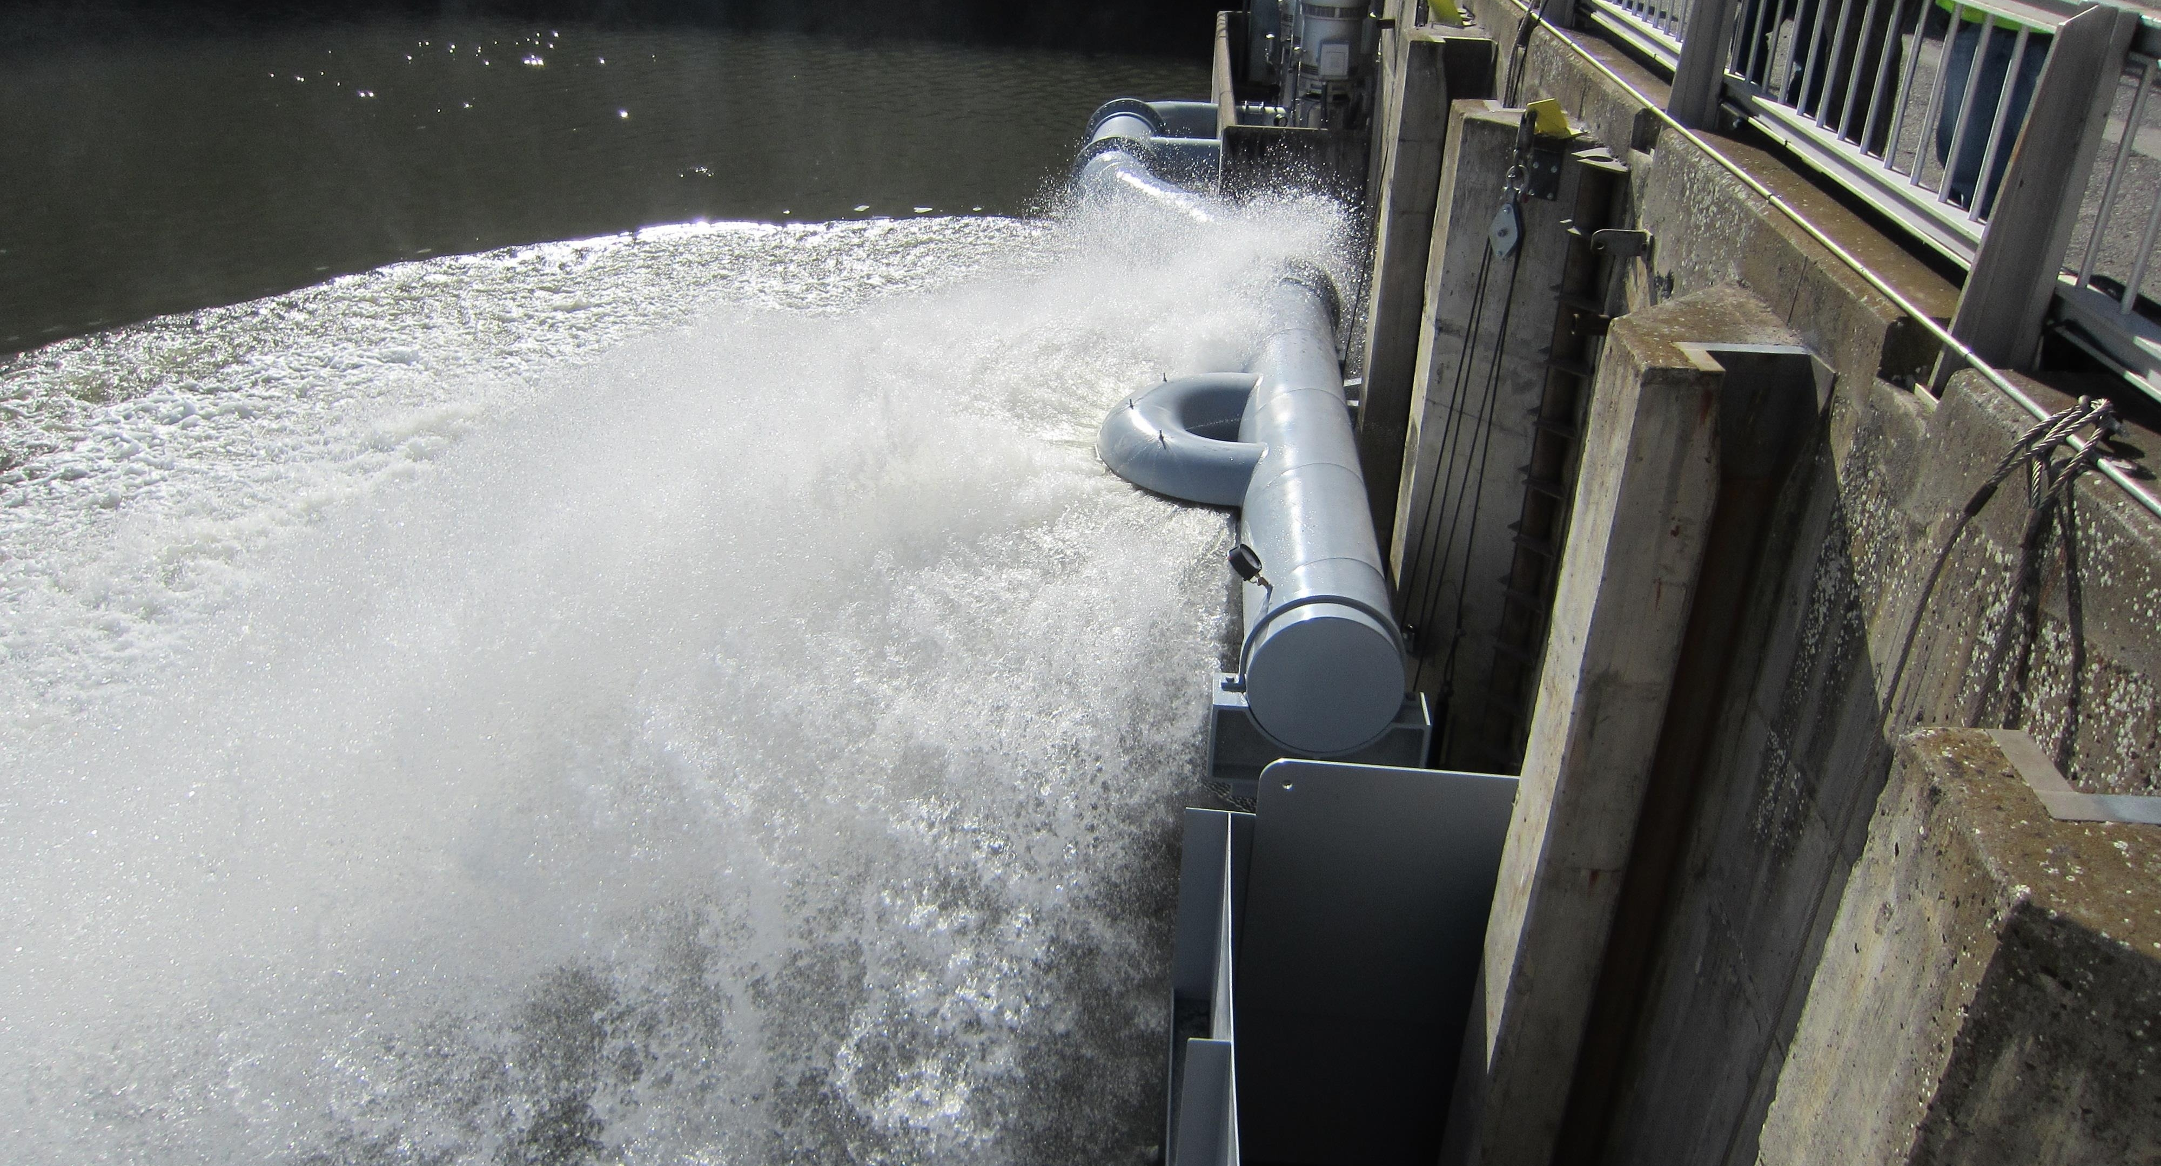
LOMO Ladder cooling
Process
Prototyping
CFD Modeling

Slide 2
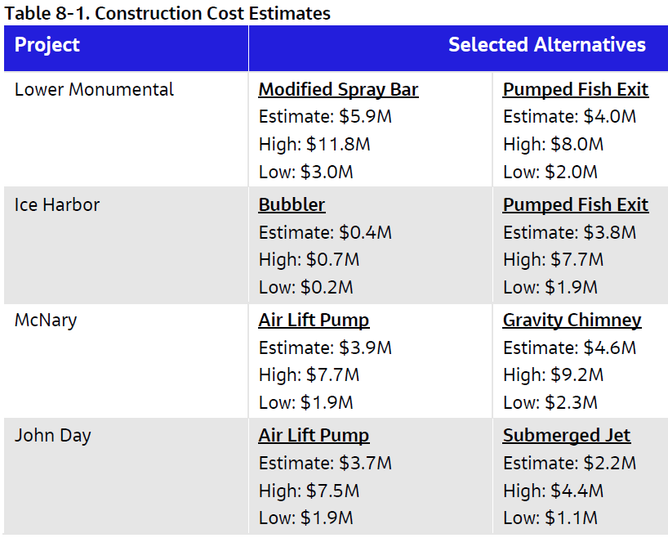
Overview
Continuing with DDR development
Will develop scope of work with FFDRWG for key the alternatives.
Intent is to develop and award contract for A/E 100% design while prototype testing on going.
Lower Monumental – Modified Spray Bar or Pumped Fish Exit
McNary - Air Lift Pump or Gravity Chimney w/ Pumped Fish Exit

Slide 3
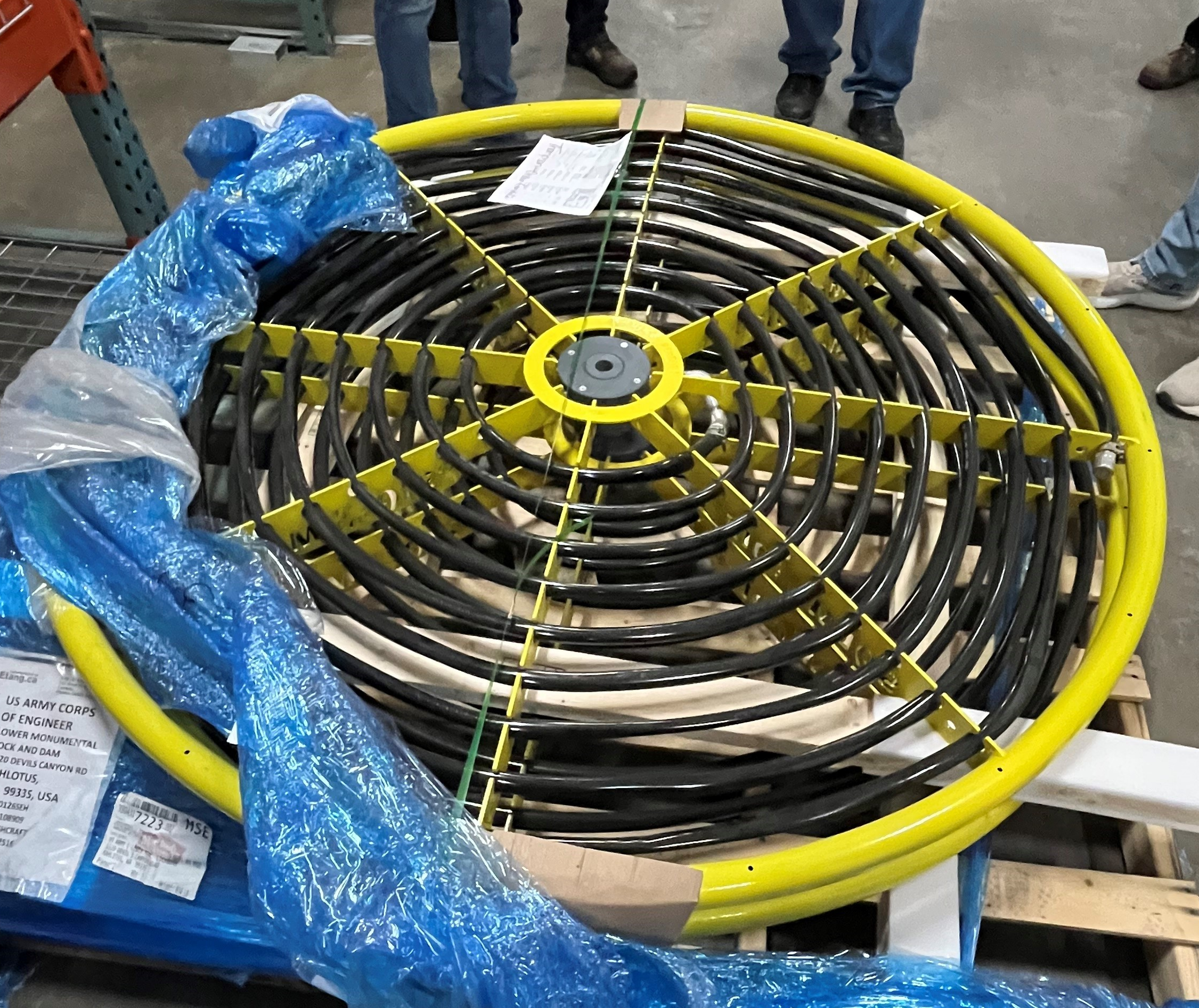
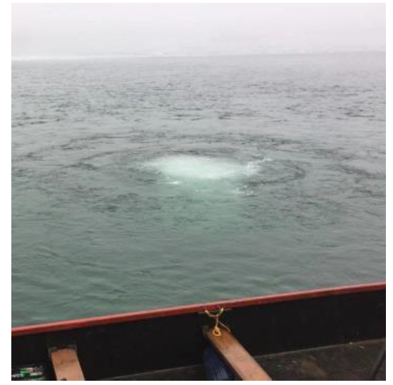
The Bubbler
Bubbler alternative had the lowest cost and least O&M among the alternatives considered and can be implemented in a short timeframe.
  Uncertainty in performance
Observed air wand test at anticipated diffuser location to assess initial flow patterns.
Hoping to implement and test before the end of February 2026.
Doubles as debris management tool for the project, have significant debris build up near ladder exit and inside corner near parking area.

Slide 4
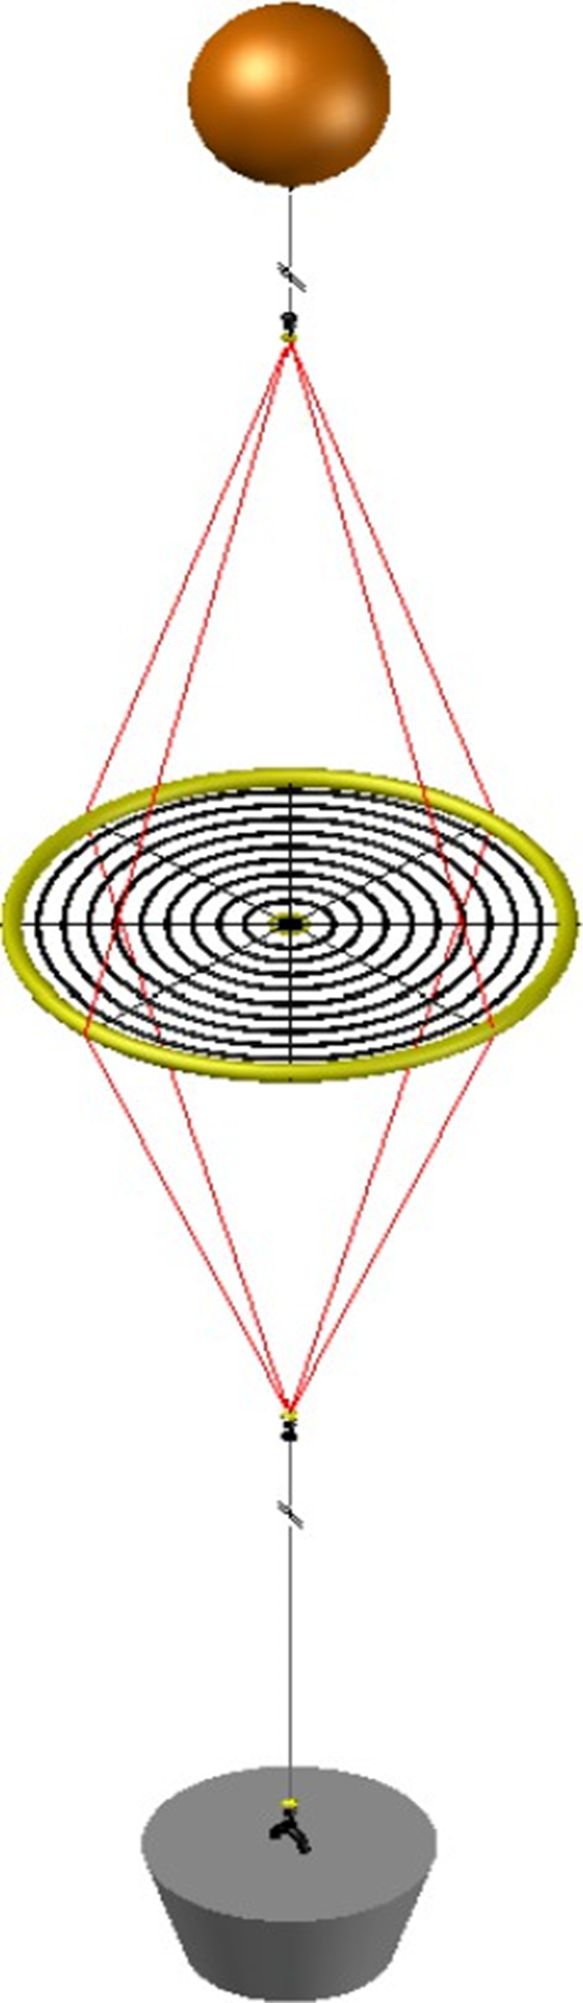
Prototyping
Our prototyping materials are onsite at Lower Monumental Lock and Dam.
Walla Walla District employees were onsite Wednesday to ensure everything is accounted for and develop a rigging and deployment plan.
Have plans to deploy the first bubbler before the end of February and testing shortly after. We have the means to measure velocities using an ADCP (acoustic doppler current profiler) system and plan to be onsite for tests following deployment.
Plan to deploy second bubbler near Lomo’s south fish ladder exit and diffuser on bubbler 1 testing day.

Slide 5
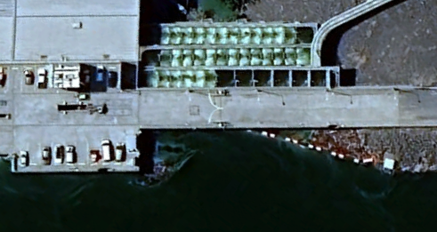
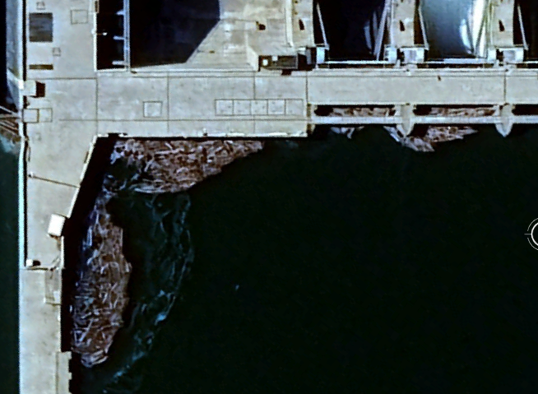
Prototyping Cont’d
Project is very optimistic regarding debris management aspect of the bubbler in addition to the cooling effects.
Plan to deploy second bubbler near Lomo’s south fish ladder exit on bubbler 1 testing day.
Temperature strings and TDG sensors will be implemented near each bubbler at both projects to determine bubbler effectiveness, monitor ladder deltas and ensure air is not getting into the diffuser intakes or ladders.
Bubbler for Oregon Shore ladder at McNary also.
  Lower Monumental modeling and monitoring will be primary investigation site. McNary currently anticipated to be ladder temp only observation, but looking for feedback.
N Diffuser Intake
N Ladder Exit
1st Bubbler Location
Debris
S Ladder Exit
S Diffuser Intake
Debris
2nd Bubbler Location*
* Approximate location, has not been decided

Slide 6
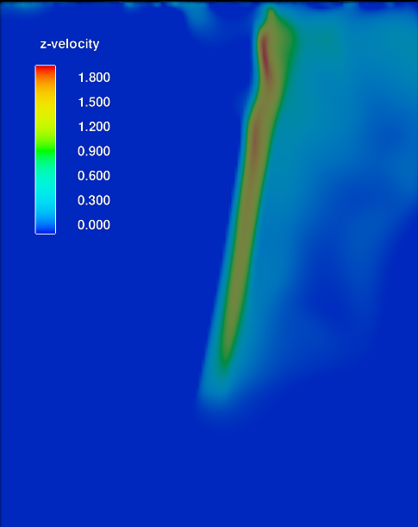
CFD Evaluation
Using the computational fluid dynamics (CFD) software, Flow-3D Hydro to model the bubbler with the goal of estimating upwell flow rates, thermal deltas and ladder exit temperatures.
Currently modeling SalmoAir diffuser tests conducted by ASME to calibrate model parameters to known physical measurements and models.
  Close to replicating those field tests and working with developers from FlowScience to refine settings.
  Note - Simulations above have same scale, different units. Top picture is our model using Flow-3D Hydro, bottom is from ASME study using STAR-CCM+.

Slide 7
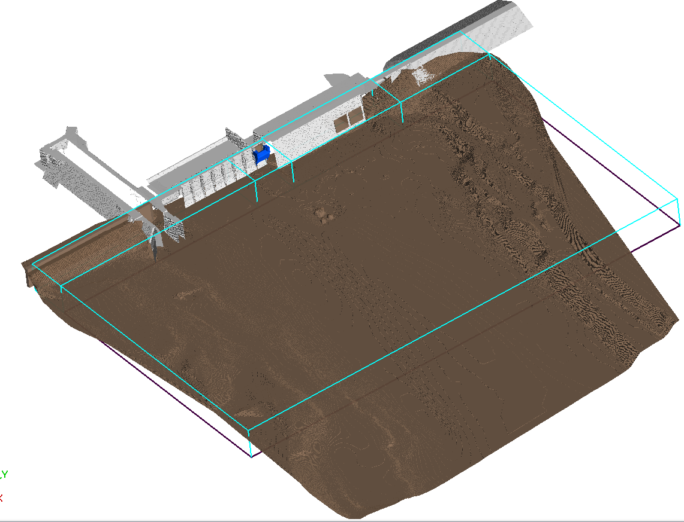
CFD Evaluation Cont’d
1st Bubbler Location
LOMO forebay bathymetry data.
  Modeling known forebay conditions for model validation.
  Next, we will model low flow conditions (35 kcfs) seen in July and August.
  Will use these results as boundary conditions for the bubbler model to determine the anticipated flow pattern and upwell conditions the bubbler creates.
  Once the bubbler model is complete, we will add stratified temperature layers to the forebay to predict ladder exit and diffuser intake temperatures.
2nd Bubbler Location
Flow

Slide 8
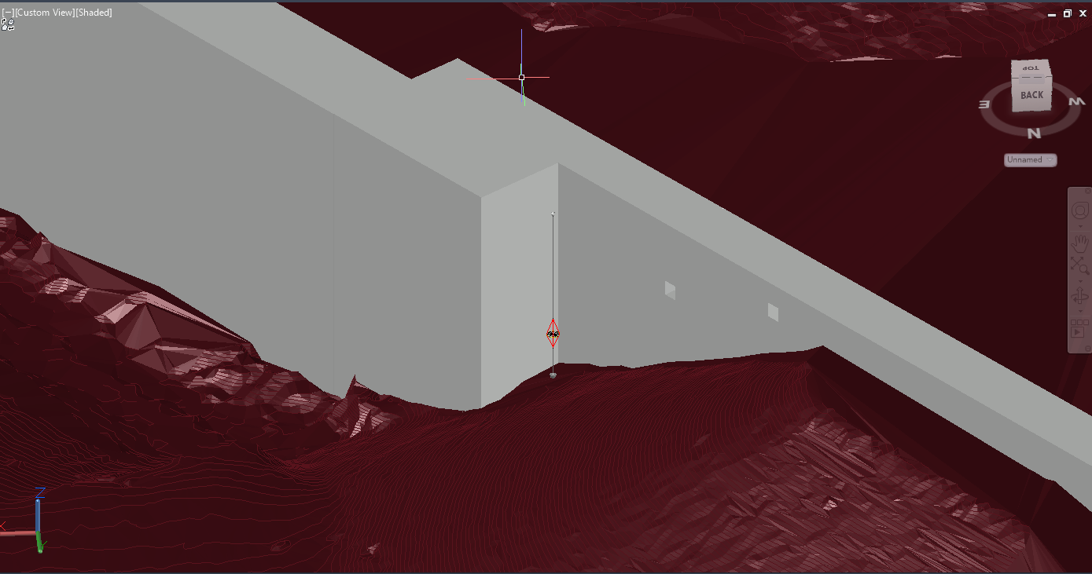
Diffuser 1 Placement
N Diffuser Intake
Turbine Intake Not shown
Bubbler System
N Ladder Exit

