Slide 1
Ecological Interactions between Hatchery Summer Steelhead and Wild Oncorhynchus mykiss in the Willamette River Basin, 2014
Ryan Harnish
Ethan green
Chris vernon
Geoff mcmichael

Slide 2
Background
Decline of wild winter STH in upper Willamette
  Listed as “threatened” under ESA
Hatchery summer STH releases
2013 study to evaluate potential for negative ecological effects
  RT and snorkeling
    Majority (65%) of RT hatchery STH were last detected in S. Santiam
      28% of RT hatchery STH did not volitionally emigrate from SSH
      No fate determination
    Hatchery STH and wild O. mykiss observed in sympatry
      Hatchery STH generally larger, more aggressive, and dominant
      No spatial distribution data collected

Slide 3
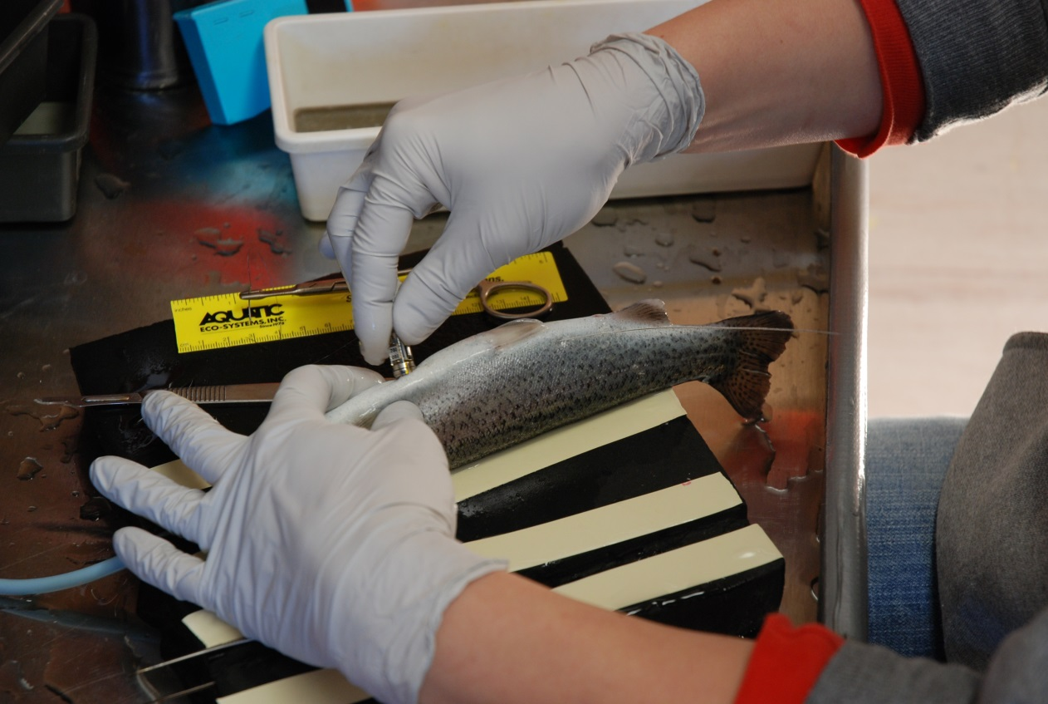
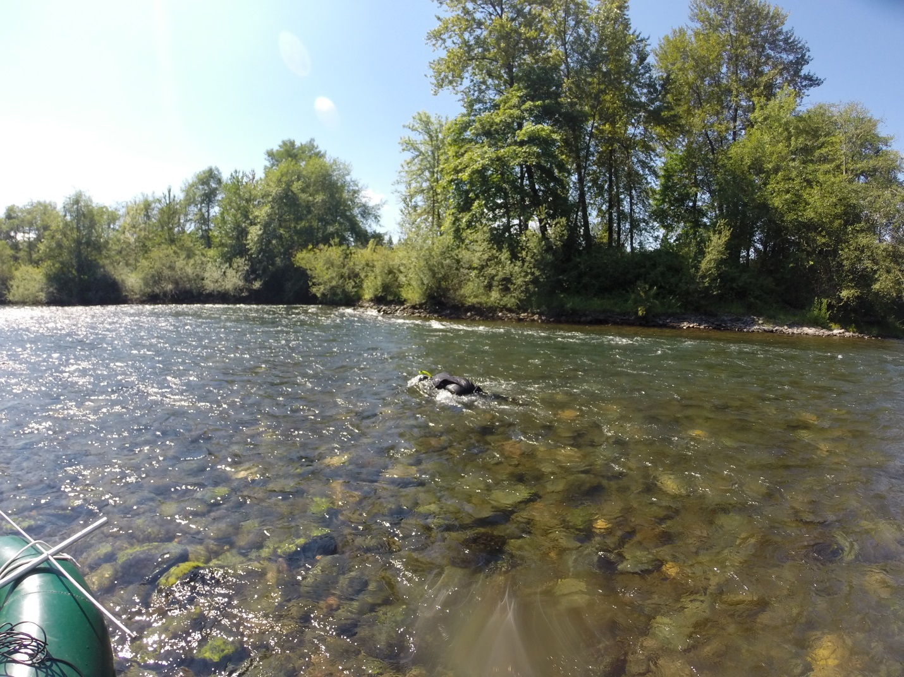
Objectives
Estimate the proportion of hatchery summer STH that residualized in the S. Santiam River
Determine the extent to which hatchery and naturally produced O. mykiss overlapped in space and time
Characterize the behavioral interactions between hatchery-origin juvenile summer STH and naturally produced O. mykiss

Slide 4
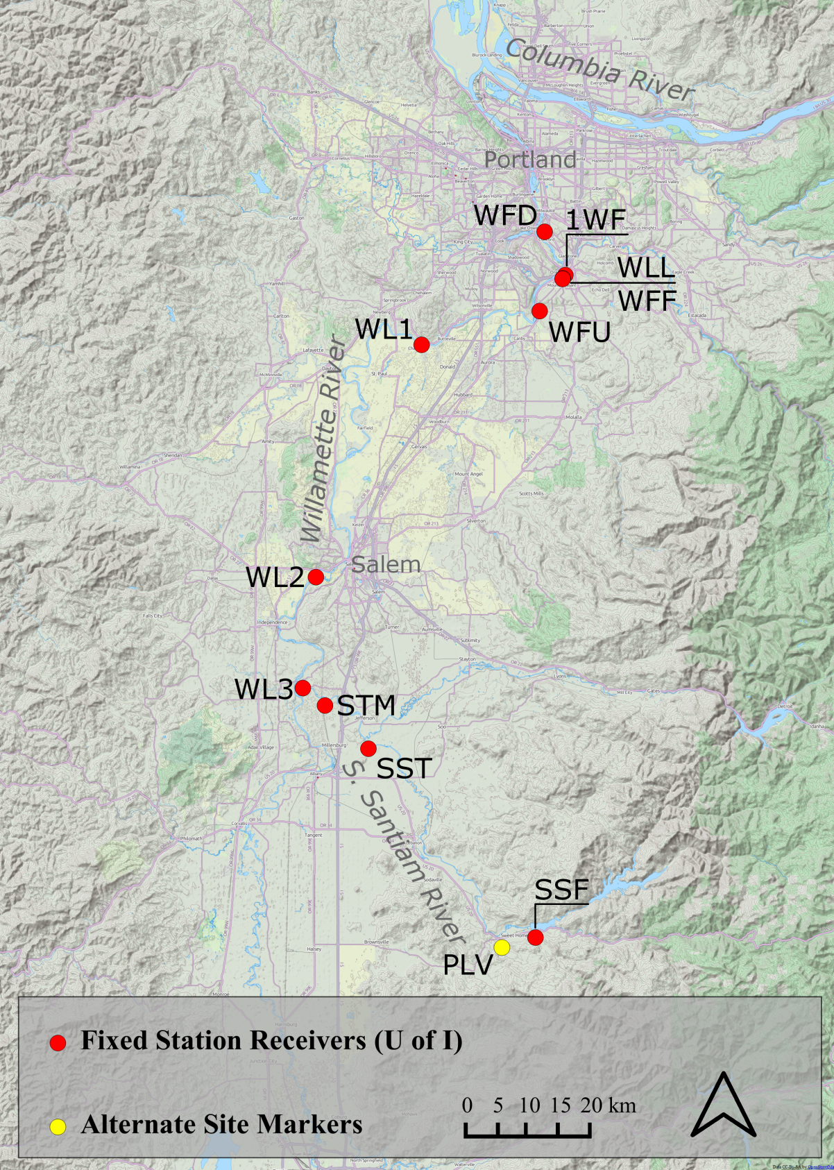
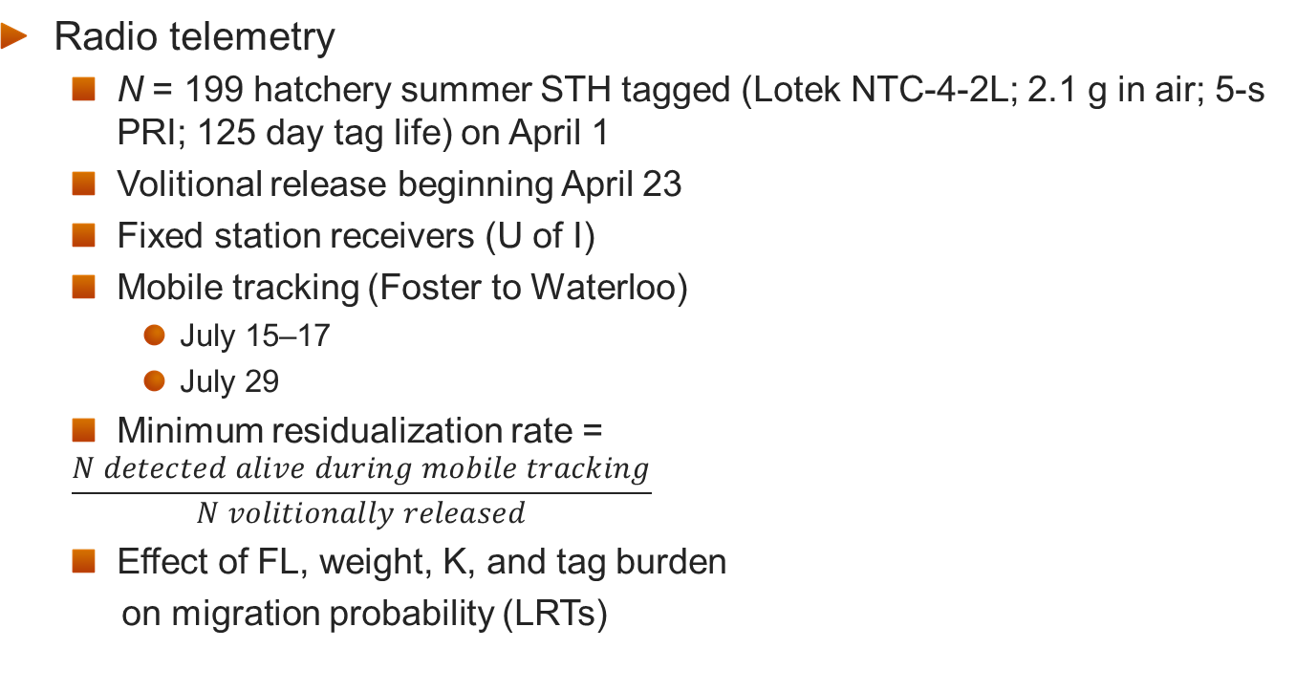
Methods
Radio telemetry
  N = 199 hatchery summer STH tagged (Lotek NTC-4-2L; 2.1 g in air; 5-s PRI; 125 day tag life) on April 1
  Volitional release beginning April 23
  Fixed station receivers (U of I)
  Mobile tracking (Foster to Waterloo)
    July 15–17
    July 29
  Minimum residualization rate =
  $$\frac{N detected alive during mobile tracking}{N volitionally released}$$
  Effect of FL, weight, K, and tag burden
  on migration probability (LRTs)
Waterloo

Slide 5
Methods (continued)
Direct observations
  Species, origin (wild or hatchery), and approximate length
  Behavioral interactions recorded using GoPro
    Number and type of interactions, origin and size of interacting fish, which fish initiated the interaction, which fish dominated the interaction, and whether the subordinate fish was displaced
    Interactions classified as threat, crowd, chase, nip, or butt
    Interaction rate = total interactions per fish per minute
    CPUE = fish observed per minute
      Assessed for spatial trends using general multiple linear regression models
Date | Site | Number of Observers | Total Observer Hours
June 14-15 | McDowell Creek Bridge | 1 | 1.75
 | Waterloo County Park | 1 | 4.5
July 2-3 | Waterloo County Park | 2 | 11
 | McDowell Creek Bridge | 2 | 6
July 17 | South Santiam Hatchery | 1 | 0.3
July 29-31 | South Santiam Hatchery to Waterloo County Park | 2 | 12.0

Slide 6
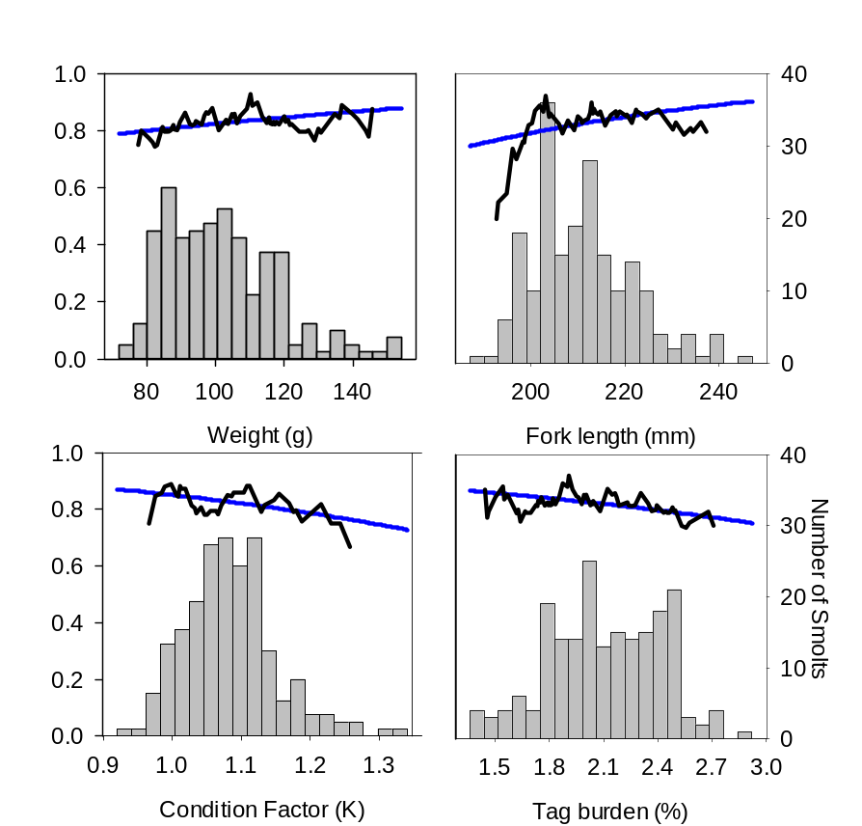
Results
Radio telemetry
  35 of 199 (17.6%) RT hatchery STH did not volitionally emigrate from the hatchery
    No significant effect of weight, FL, K, or tag burden (χ² ≤ 1.11; P > 0.29)

Slide 7
Results (continued)
Radio telemetry
  Of the 164 RT STH that volitionally left the hatchery
    65 (39.6%) were detected outside the S. Santiam R.
      12 last detected near the mouth of the Santiam R.
      53 last detected in the Willamette R.
        41 (25% of 164) successfully emigrated to Willamette Falls
    Last known location of the majority (99 of 164; 60.4%) was in the S. Santiam
      2 last detected at the mouth of the S. Santiam River
      50 last detected in the Foster Dam tailrace and 14 never detected after leaving the hatchery
        Assumed to have residualized below Waterloo or perished within the S. Santiam
      33 detected during mobile-tracking

Slide 8
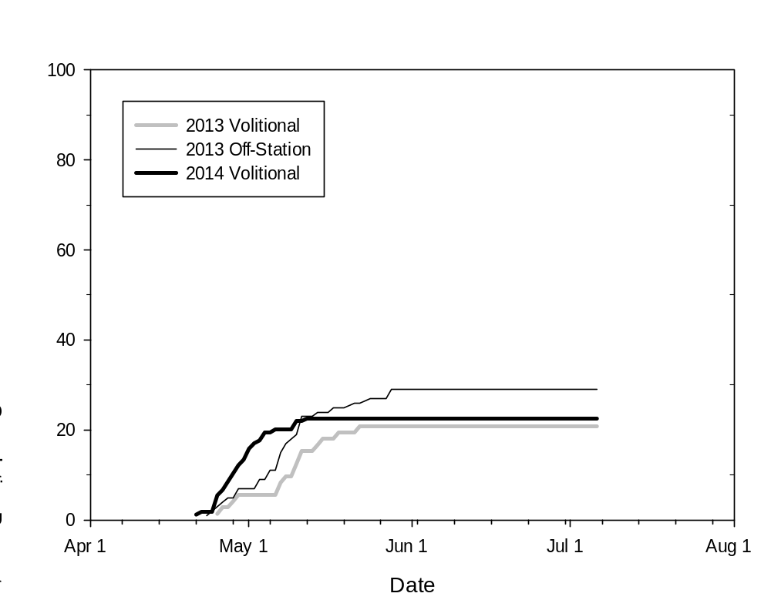
Results (continued)
Radio telemetry (fixed stations)
Reach | From | To | 2014 Volitional | 2013 Volitional
1 | SSF | SST | 60% | 65%
2 | SST | STM | 1% | 0%
3 | STM | WL3 | 7% | 4%
4 | WL3 | WL2 | 1% | 0%
5 | WL2 | WL1 | 0% | 4%
6 | WL1 | WFU | 1% | 6%
7 | WFU | WFF | 4% | 0%
8 | WFF | WLL | 0% | 0%
9 | WLL | 1WF | 1% | 0%
10 | 1WF | WFD | 2% | 0%
11 | WFD | Below WFD | 23% | 21%
2014: ~3 weeks
2013: ~4 weeks

Slide 9
Results (continued)
Radio telemetry (mobile tracking)
  33 RT hatchery summer STH detected 3-months after release
    21 found alive representing a minimum residualization rate of 12.8% (33/164)
      15 of 21 (71.4%) were found upstream of PLV
    9 found to be deceased
    3 with unknown fates

Slide 10
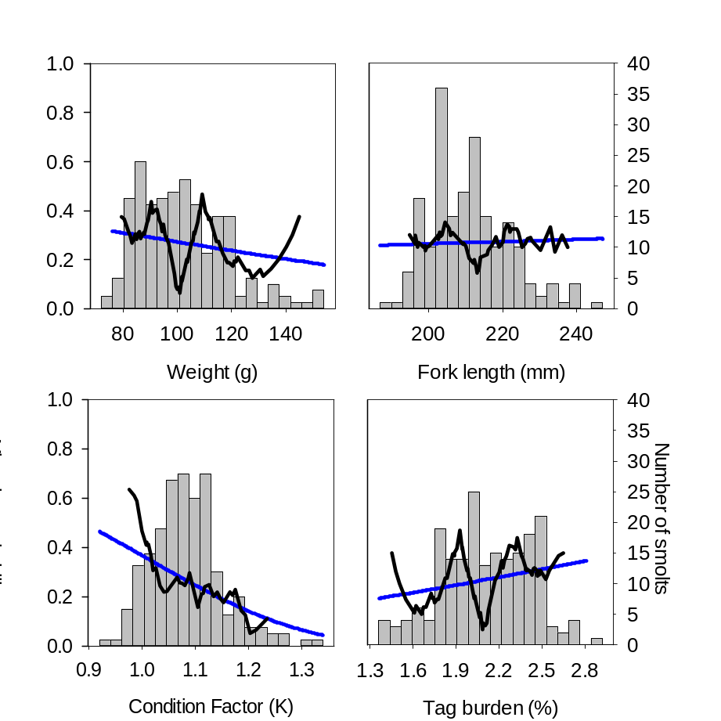
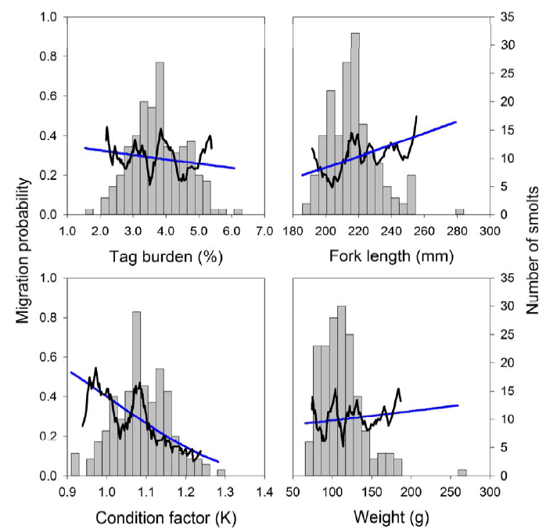
Results (continued)
Radio telemetry
  Significant effect of condition factor on probability of migration to Willamette Falls
2014
2013
χ² = 5.85
P = 0.02
χ² = 5.11
P = 0.02

Slide 11
Results (continued)
Direct observations

Slide 12
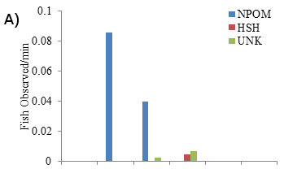
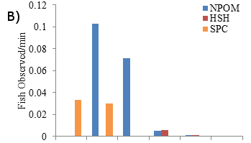
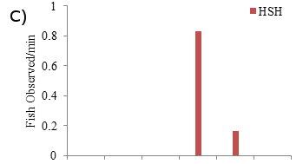
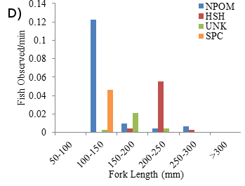

Results (continued)
Direct observations
  Hatchery STH were observed along side wild O. mykiss on each snorkeling trip
  Hatchery STH were considerably larger than wild O. mykiss
June 14–15
Waterloo &
McDowell Creek
July 2–3
Waterloo & McDowell Creek
July 17
S. Santiam Hatchery
July 29–31
Foster to Waterloo

Slide 13
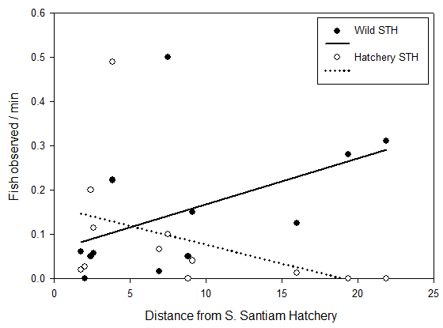
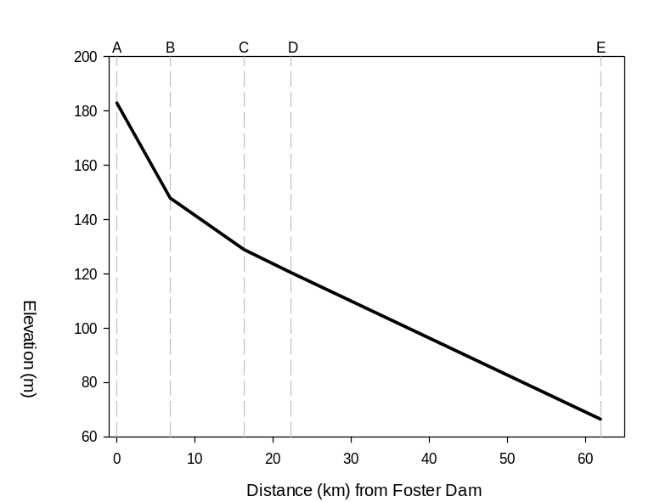
Results (continued)
Direct observations
  Trend of decreasing CPUE for hatchery summer STH and increasing CPUE for wild O. mykiss with increasing distance from SSH
    Significant interaction between fish origin and distance from SSH (χ² = 7.83; P = 0.049)
Foster Dam
Mouth
Pleasant Valley
McDowell Creek
Waterloo
Wild O. mykiss

Slide 14
Results (continued)
Direct observations
  Most behavioral interactions were of the less violent classifications
    Relatively low densities
 | 2014 |  | 2013
Interaction Type | N | Percent | N | Percent
Threat | 11 | 21% | 7 | 14%
Chase | 23 | 43% | 16 | 31%
Crowd | 14 | 26% | 24 | 47%
Nip | 4 | 8% | 3 | 6%
Butt | 1 | 2% | 1 | 2%
Total | 53 |  | 51

Slide 15
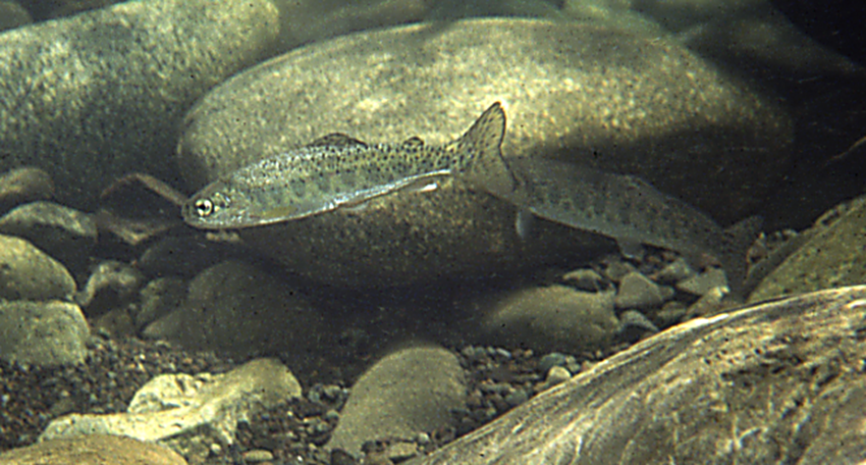
Results (continued)
Direct observations
  Larger fish typically dominated interactions
  90% of interactions were dominated by initiating fish
  84% of interactions resulted in displacement of subordinate fish
  Hatchery STH dominated 16 of 19 (84%) interactions with wild O. mykiss
  61.7% of all interactions observed were initiated by hatchery STH, which accounted for only 28.6% of the total number of O. mykiss observed

Slide 16
Conclusions
Similar results in 2013 and 2014
Majority of RT hatchery STH residualize or perish in the S. Santiam R.
  Minimum residualization rate of 12.8% (of RT STH) 3 months after release in 2014
    Represents 23,616 residual hatchery STH if applied to # released
      Likely an overestimate
  Migration probability negatively correlated with condition factor
Direct observations revealed hatchery STH were present in sympatry with wild O. mykiss at most locations surveyed
  Hatchery STH initiated more aggressive interactions than wild O. mykiss and generally dominated interactions with wild O. mykiss
  Hatchery STH were considerably larger than wild O. mykiss
RT and direct observation indicated the highest densities of residual hatchery STH in sites located <10 km of the SSH
  Potential mesohabitat-scale displacement of wild O. mykiss by hatchery STH

Slide 17
Limitations
Sampling effort used to identify longitudinal trends in relative abundance of hatchery STH and wild O. mykiss
Spatial scale of mobile tracking surveys
Representativeness of RT hatchery STH to the general hatchery population
  17.6% of RT fish did not volitionally migrate from SSH compared to ~1% of untagged population
However, we believe residualization may be a problem in the S. Santiam River due to the large numbers of residual hatchery STH observed during underwater observations

Slide 18
Summary & Direction
There is potential for negative ecological effects of hatchery summer STH releases on wild O. mykiss due to:
  Potentially high rates of residualization
  Initiation and domination of interactions by hatchery STH and resulting displacement of wild O. mykiss
Potential management & research actions
  Reduce feed levels during the last month of rearing (Tipping et al. 1995; Tipping an Byrne 1996)
    Condition factors 0.90–0.99 and FL ≥190 mm
    Re-evaluate residualization rate
  Estimate carrying capacity of the S. Santiam River downstream of SSH to determine appropriate number of hatchery STH to release
    Tinus and Friesen (2010) recommended the composite population (hatchery + wild) not exceed the theoretical juvenile carrying capacity to avoid density-dependent effects

Slide 19




Acknowledgments
S. Santiam Hatchery staff
  Brett Boyd
University of Idaho
  Chris Caudill
  Matt Knoff
  Tami Clabough
  Mark Morasch
  Grant Brink
  Mike Jepson
ODFW
  Cameron Sharpe
  David Hewlett
  Justin Huff
PNNL
  Kate Deters
  Ricardo Walker
  Bryan Jones
  Stephanie Liss
  Eric Oldenburg
USACE
  David Leonhardt
  Bob Wertheimer

