Slide 1
Season 1: The Portable Floating Fish Collector (PFFC) samples Cougar Reservoir
Dave Griffith
Greg Taylor
Todd Pierce
Jane Dalgliesh
WVP Fish Crew

Slide 2
PFFC Overview
PFFC Components
Challenges upon receiving the PFFC
Operations Design
Trap Operations
PIT detections
Fish data trends and patterns
Conclusion
Questions

Slide 3
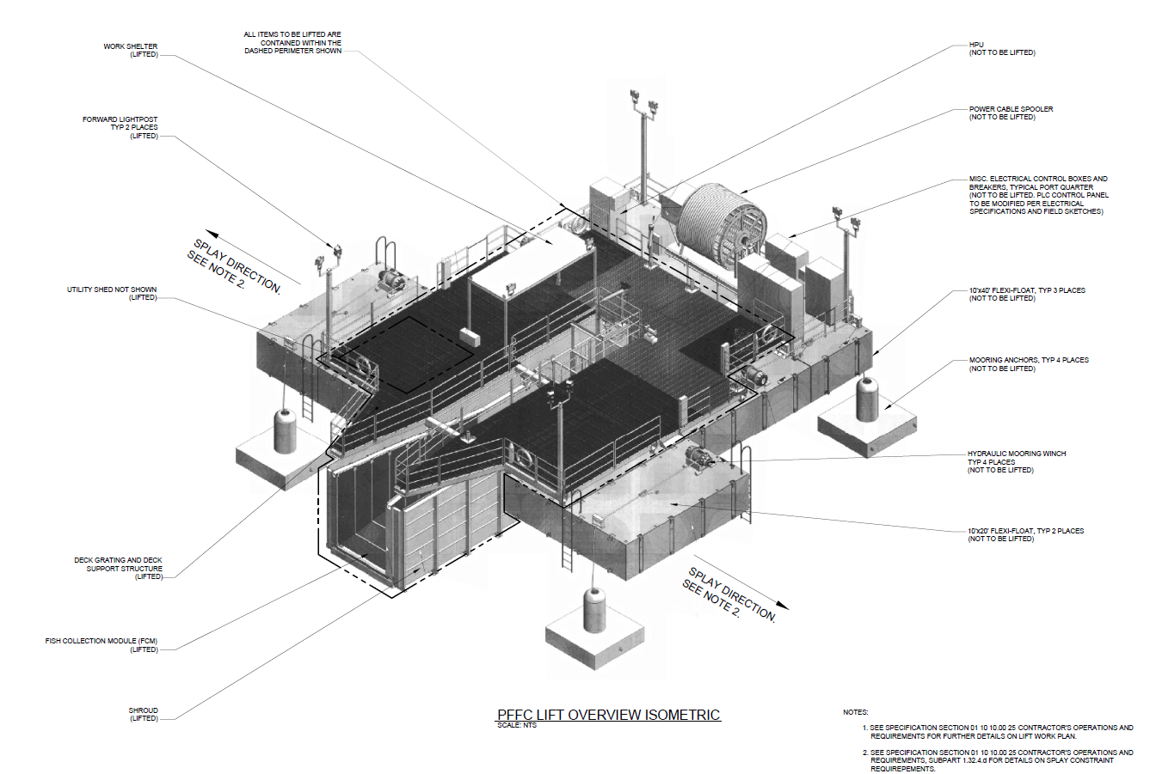

Slide 4
PFFC Components
480 Volt Submarine “power” cable
2 Attraction pumps (40 hp)
  Takes in water (through porosity screens) which creates inflow
Porosity Screens on walls and floor (port/ strarboard)
  Water travels through- creates velocity gradient into trap
1 Leveling pump (27 hp)
  Regulates flow downstream of throat & adjusts hopper water level
Ramped weir
  Decreases bypass flow leading into hopper
Flume
  Final dewatering section prior to hopper
Notes:
Add a few photos here to illustrate components

Slide 5
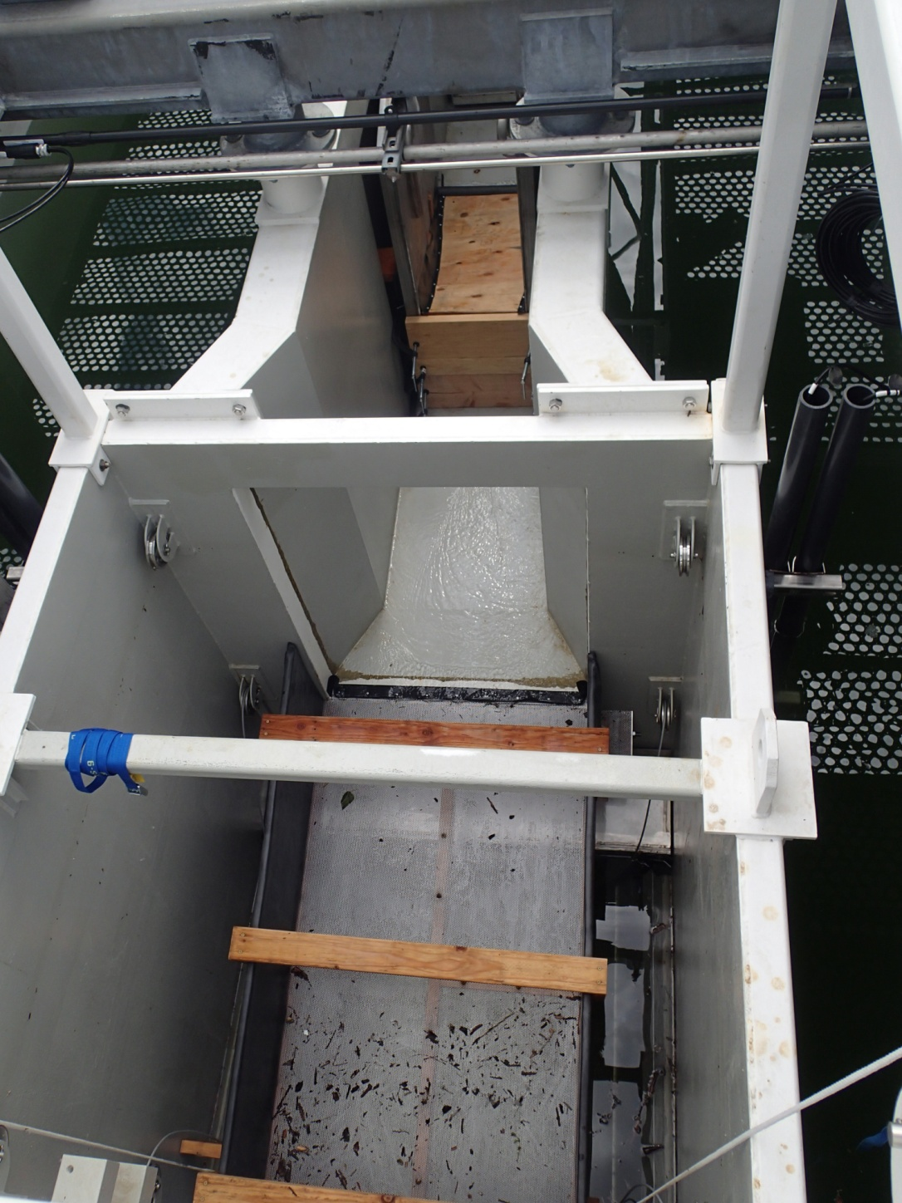
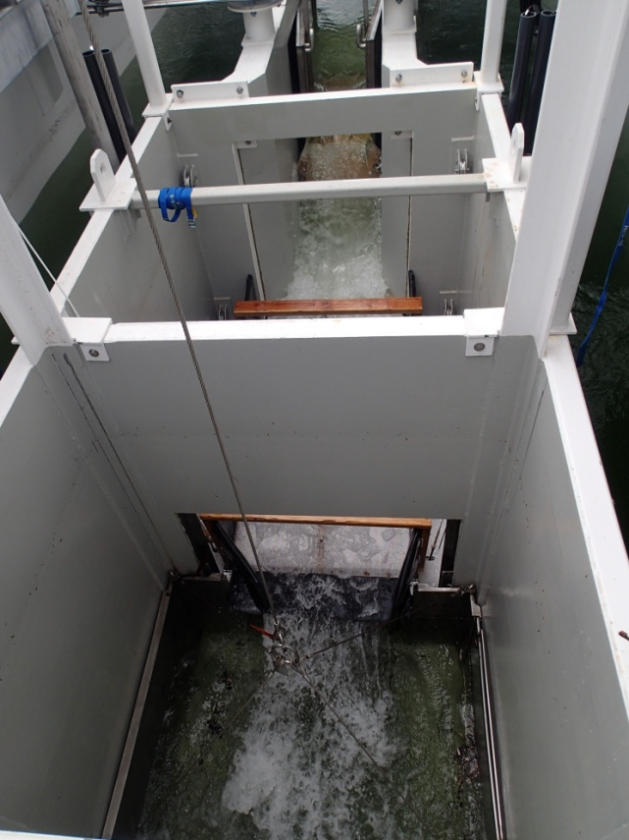
Challenges- Hydraulics
Ramp
Problem:
  PFFC is 1’ too low = high bypass flow
Solution:
  Ramped Weir– decreases bypass flow
  Flume – dewaters and improves fish safety into hopper
Weir
Flume
Hopper

Slide 6
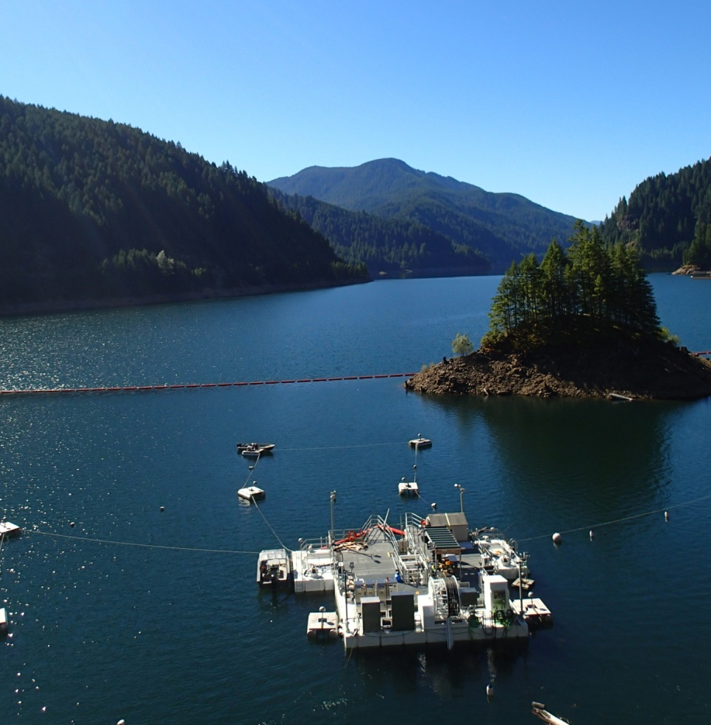
Challenges Continued…
Seasonal/ Biological Effects
  Water temperatures
    24.4C at surface
  Fish occupy depths below trap (>8’)
  Peak of migration in Nov/ Dec.
    100 cfs vs high outflows
We CANNOT control!

Slide 7
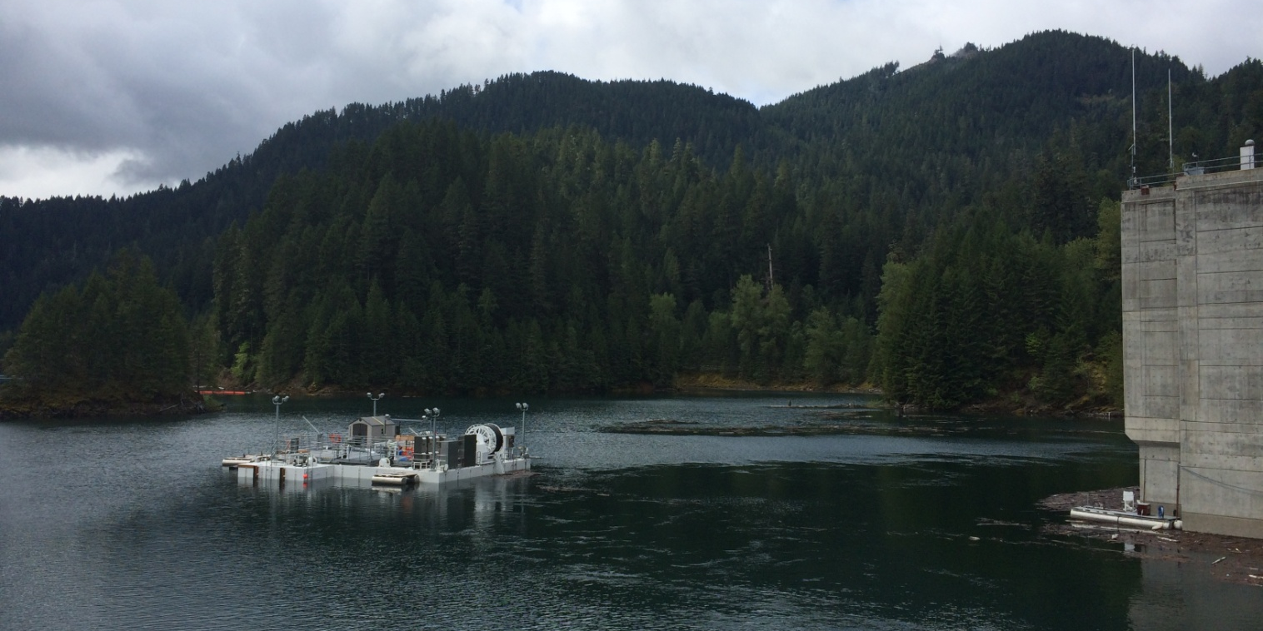
Challenges Continued…
Position and Orientation
  Trap is relatively far from intake tower (> or =150’)
  Not aligned with flow into temperature tower
Trap deficiencies
  Fish getting under flume and hopper
  Excessive debris into trap (hopper)
  We CAN control (after mid- Feb.)

Slide 8
Operations Design
Block Design (USGS)
  Alternate inflows weekly (random design though)
  Low flow/ High flow
    50/ 100 cfs (inflow)
    Adjust attraction pump power
  Variables associated with inflow changes
    Adjust ramped weir height
    “Noise” from pumps
      Vibrations on trap
    Flow exhaust from pumps (false attraction)
    Variable velocities into trap (fast, slow, fast, slow)

Slide 9
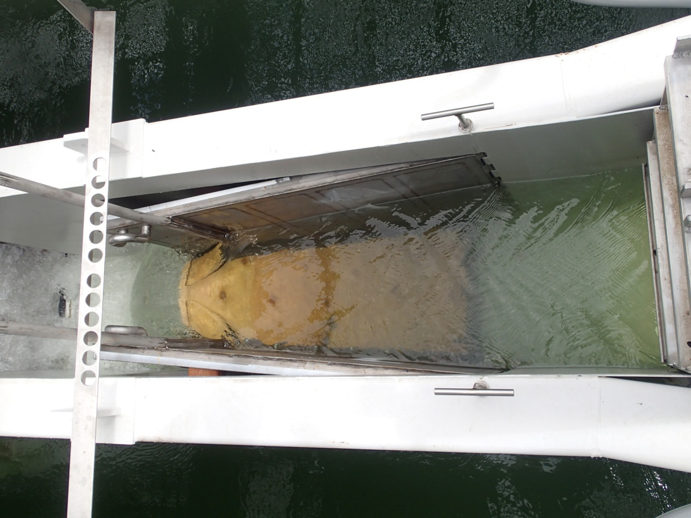
Trap Operations
Fish are drawn into entrance
enter throat section
approach ramped weir
fall over weir
travel over dewatering flume
drop into hopper
Biologists Arrive:
close slide gate
raise hopper with fish
collect relevant data
Then……..transport and release migrants downstream of Cougar Dam into South Fork Mckenzie River
Notes:
Animate this operation?

Slide 10
PIT Tag Reader Efficiency
Using CJS model in Program Mark by USGS
  Estimating Probability of detection = efficiency (92-100%)
  Virtual tags from PIT reader
  Lowest efficiency- in June AT1/2 at 90% later changed to 85%
  Highest efficiency- in winter (USGS electronic equipment removed)
  Missed 1 tag (fish)

Slide 11
PIT Tag Findings
(CGJ: Small- scale interrogation site)
PIT antenna sits inside throat (downstream of the entrance to trap)
  Only accounts for PIT fish that swim into the entrance and approach the throat
  Ramped weir may/ may not be affecting anything
12 unique fish detections
  Only 5 of 12 were subsequently found in hopper
  58.3% of PFFC PIT detected fish did not continue into throat and pass ramped weir
  3 of 12 PFFC PIT detected fish had 2-3 separate detections (multiple days on different dates)
    All fish that were detected on multiple days were never collected in hopper
RECAPs: 5… (well really 6)
  PIT antenna to hopper efficiency was 83.3% (missed 1 fish): PIT reader down?
  3 USGS (1 not detected by CGJ)
  3 ODFW (2 of 295 reservoir) and (1 of 812 SF)
USACE PIT tagged 25 wild juvenile Chinook
  6 fish were interrogated (passed) at Leaburg Dam
    2 spring tagging
    4 winter tagging

Slide 12
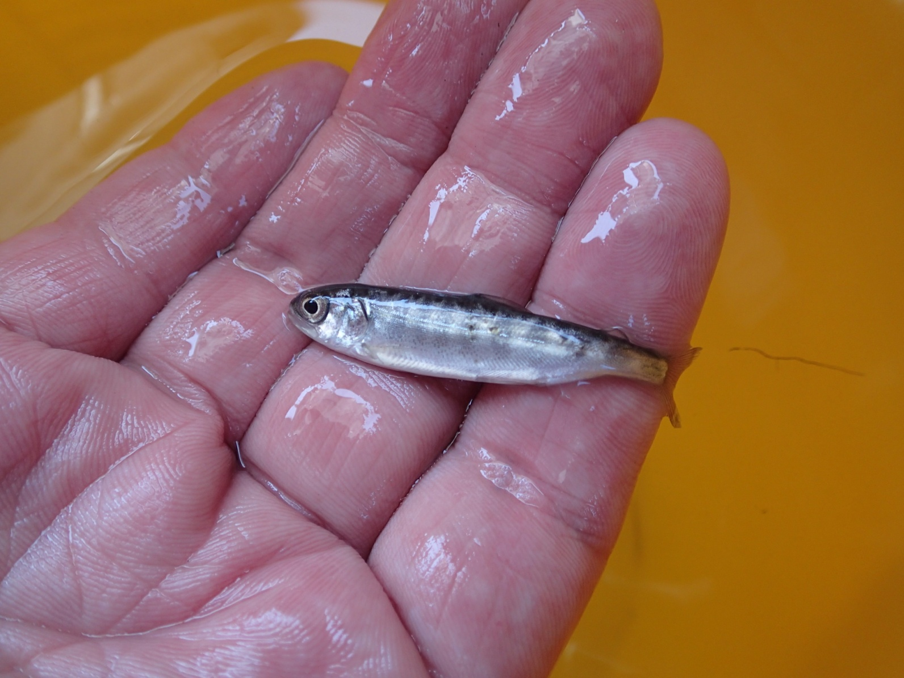
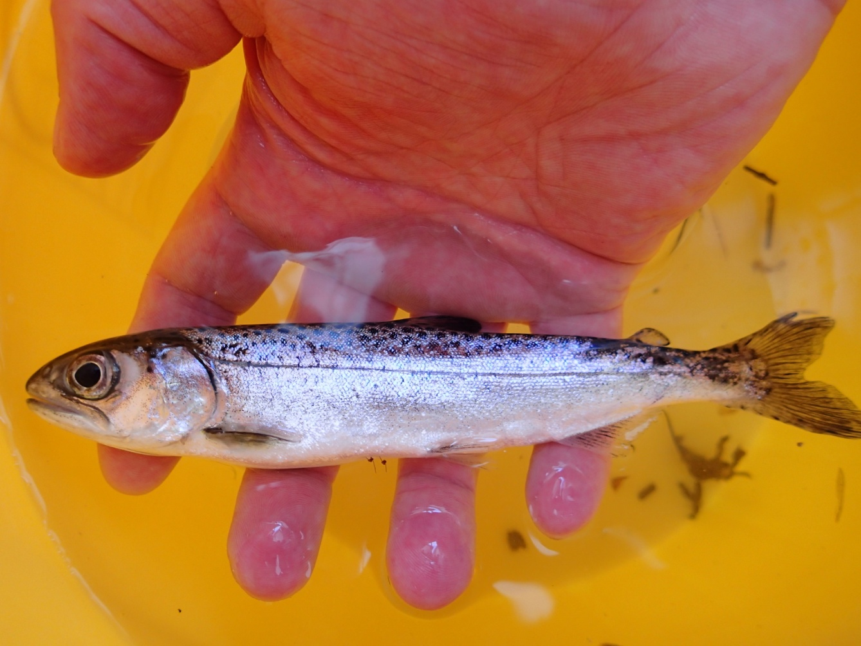
Monthly Chinook Catch
Notes:
>50% of catch occurred in several days of May and entire month of June!

Slide 13
Chinook Catch
PFFC vs. ODFW (screw traps)
Notes:
PFFC catches Chinook at same time that screw traps catch fish, predict that ODFW fry catches are reduced in this year…., How are August Chinook getting into tower?

Slide 14
Chinook Catch 2014 (27 May- 16 Dec.)
Notes:
July 8- August 28 surface temperature was >20C. Once surface temps reached 20 C all fish activity into PFFC ceased (July) and then we caught fish in September after surface cooled <20 C
Add animation (opening shot will show when temps are >20C, then animate Chinook catch to show how temp affects catch; add temp. line to y1 axis

Slide 15
Total Fish Catch
Chinook salmon (Oncorhynchus tshawytscha) 151
Speckled dace (Rhinichthys osculus) 119
Largemouth bass (Micropterus salmoides) 89
Dace spp. (Rhinichthys spp.) 38
Longnose dace (Rhinichthys cataractae) 23
Rainbow trout (Oncorhynchus mykiss) 4
Bluegill (Lepomis macrochirus) 4

Slide 16
Conclusion
Inflow changes didn’t seem to affect differences of catch
Trap will be closer to intake tower in 2015
Better hydraulics into trap
Raised trap = remove ramped weir
Less avoidance behavior around PIT antennae area
Layer of algae on white painted surfaces
1- piece debris boom with screens ☺
Commence sampling in February vs. May
  need full sampling season instead of abbreviated one

Slide 17
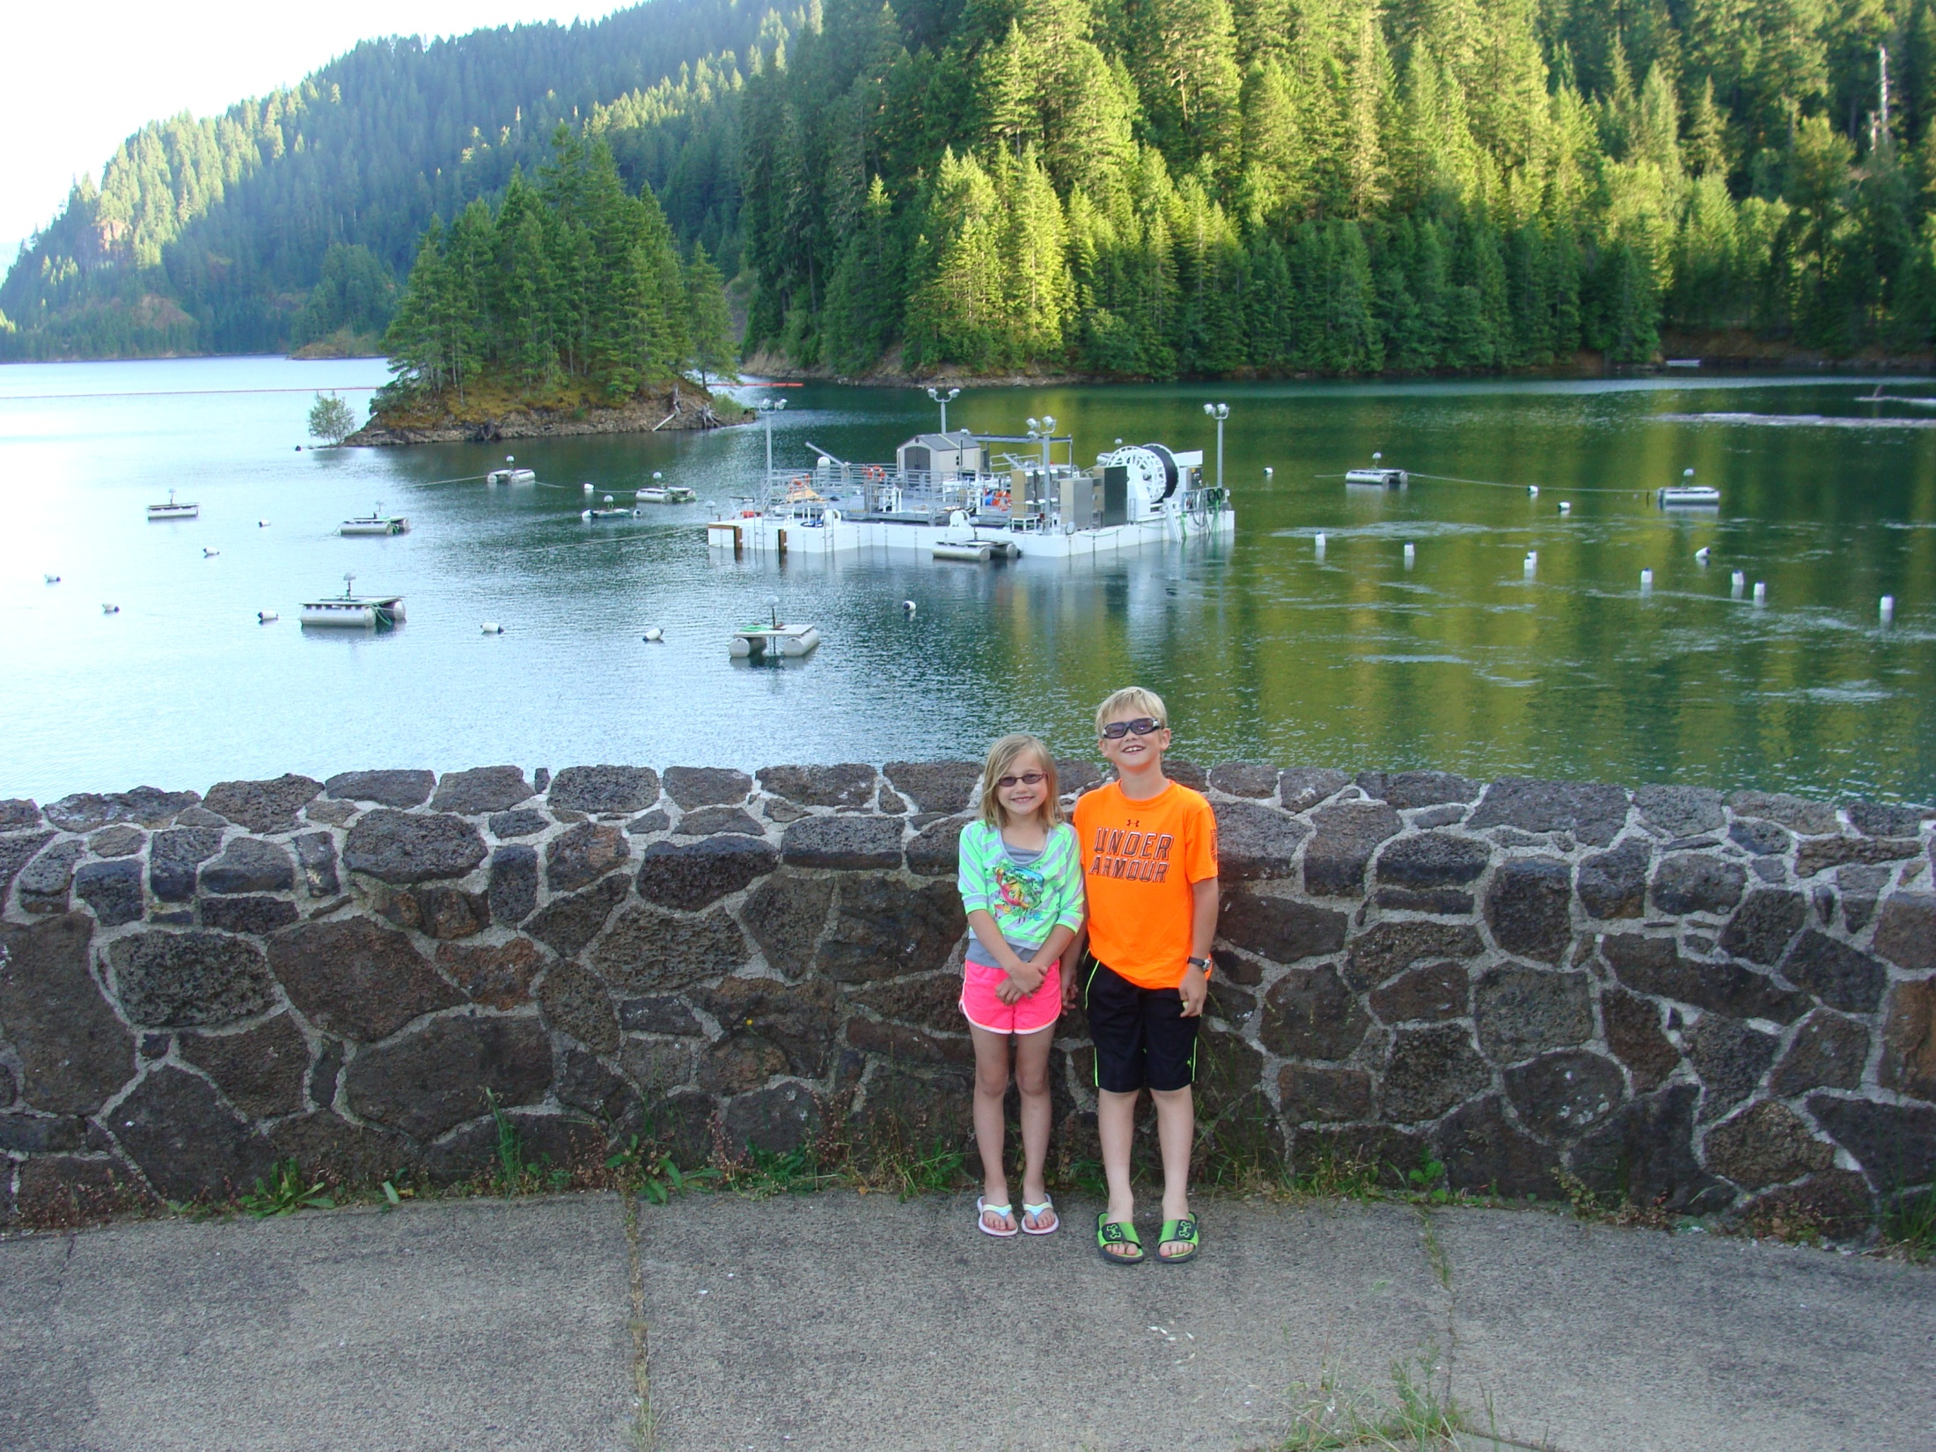
Questions?
Future tours…..

Slide 18
PFFC Trap Mortality- Chinook
  Chinook Mortality
    Excessive debris load into the trap
      Build- up on the dewatering flume
      Overwhelms the hopper
      FIX- Debris Boom
    High temperatures in epilimnion
      >23 C
      Deep thermocline
      Entrance of trap extends 8’ into epilimnion
      FIX- Submersible water pump/ shut off trap
    Initial- 22.5% (34/151)
    Upon handling- 28.5% (43/151)

Slide 19
PFFC Follow– on Work
Path Forward
Permanent Debris Boom
  Keeps out the big stuff
Install Jib Crane
  Allows hopper to be completely removed from pit
Raise FCM 18”
  Improved hydraulics and less bypass flow
Reposition Anchors
  Allows trap to be closer to Tower
  Better fish catch?

Slide 20

