Slide 1
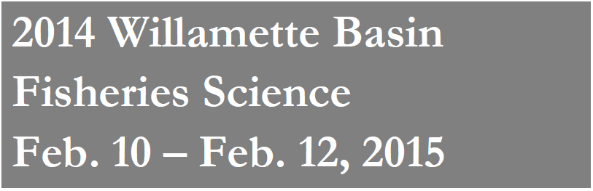

Evaluation of Habitat and Flow Relationships for Spring Chinook Salmon Spawning and Incubation in the Middle Fork Willamette and McKenzie Rivers, Oregon
Troy Brandt and Pete Gruendike
River Design Group, Inc.
Corvallis, Oregon
Jarvis Caldwell
HDR Engineering, Inc.
Sacramento, California
CONTRACT NO. W9127N-12-D-0006-03

Slide 2
Outline
Project need
Transect selection and data collection
SEFA – System for Environmental Flow Analysis
Analysis and preliminary results

Slide 3
Project Need
2008 BiOp included a reasonable and prudent alternative to further investigate how flow volumes relate to fish habitat for the target ESA-listed species (natural origin spring Chinook and winter steelhead) by life stages.
Project Goal - Determine how UWR spring Chinook salmon spawning/incubation habitat is influenced by changes in flow in the MF Willamette River, McKenzie River, and SF McKenzie River

Slide 4
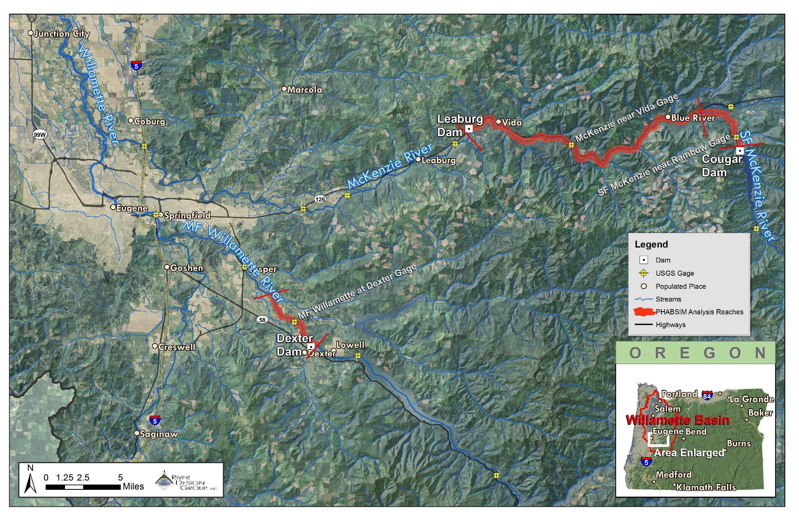
Reach Overview - Geography

Slide 5
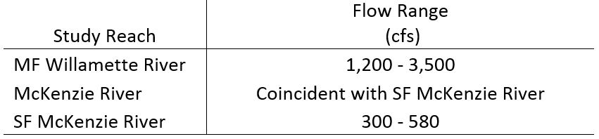
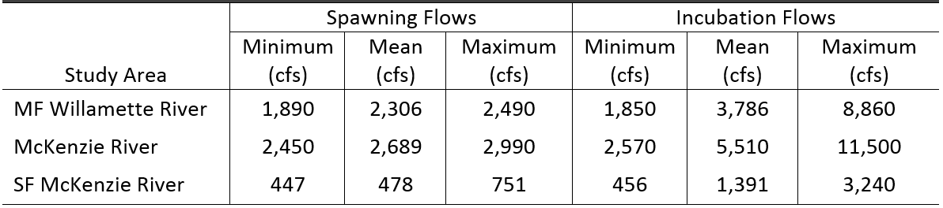
Reach Overview - Flows
Willamette BiOp flow targets for September-October spawning period
Actual flows during post-BiOp (2009-2012)

Slide 6
Project Workflow
Transect Selection
Data Collection
Data Processing
Agency
Collaboration
June and
September 2014
Excel, QA/QC
Habitat Modeling
Velocity Calibration
Hydraulic Calibration
HSC - Santiam
ODFW Review
Results
Reporting
AWS – By Reach,
By Transect
March 31, 2015

Slide 7
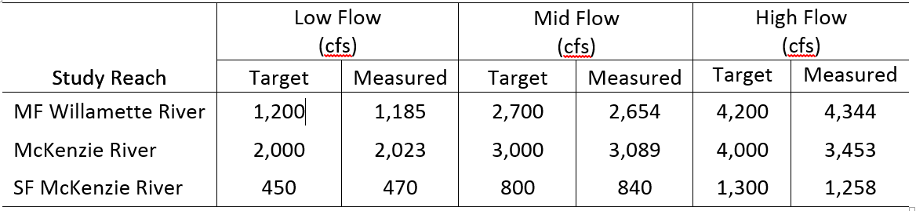
Study Design
3 reaches
10 XS/reach focused on known spawning areas
Transects primarily located in mainstem riffles and side channel habitats
Measured stage and discharge at 3 flows
Measured channel XS, velocity, bed material, and cover

Slide 8
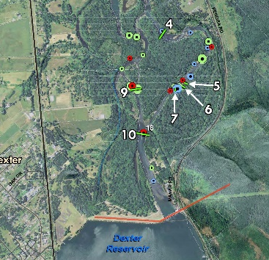
Study Design – MF Willamette Sections

Slide 9
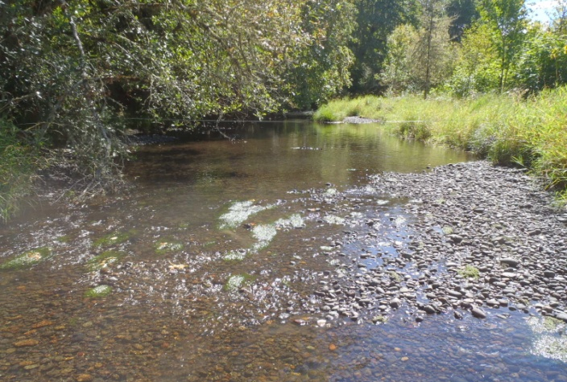
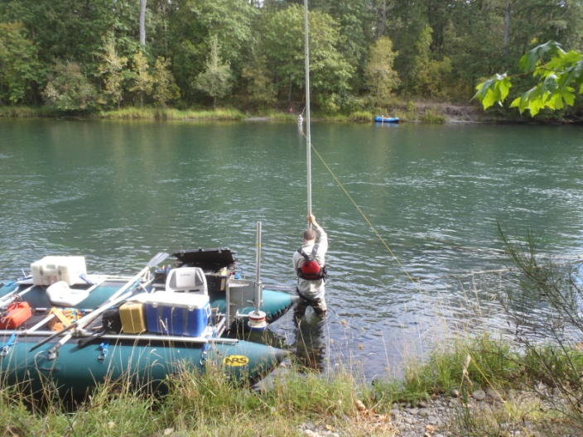
Reach Overview – Habitat Conditions
MF Willamette River
Side Channel
Mainstem

Slide 10
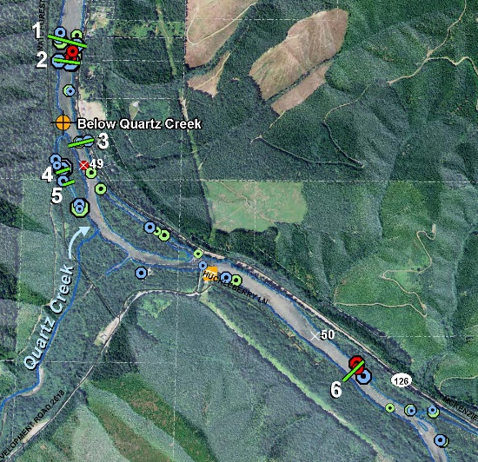
Study Design – McKenzie Sections

Slide 11
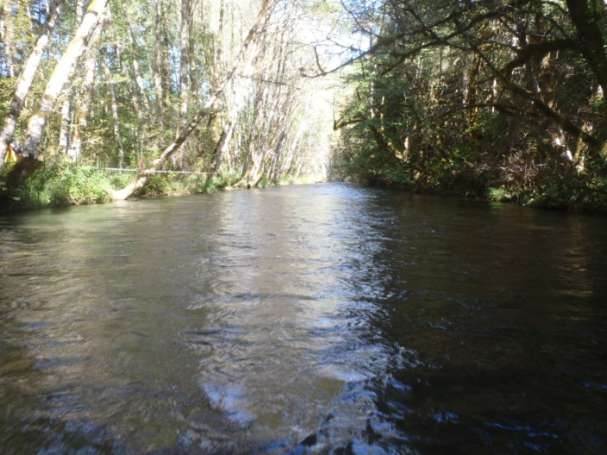
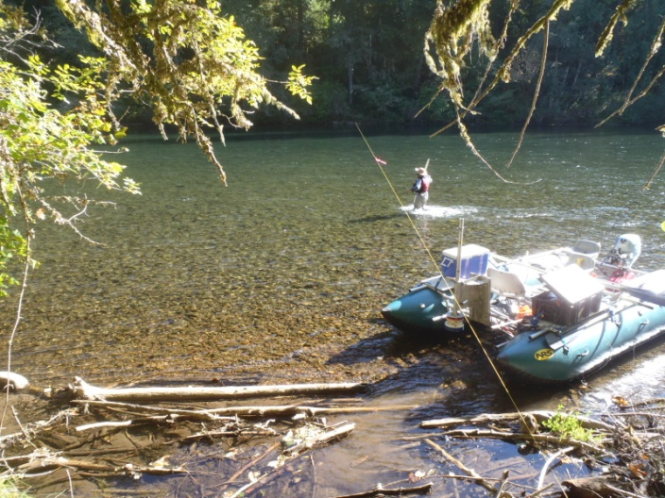
Reach Overview – Habitat Conditions
McKenzie River
Side Channel
Mainstem

Slide 12
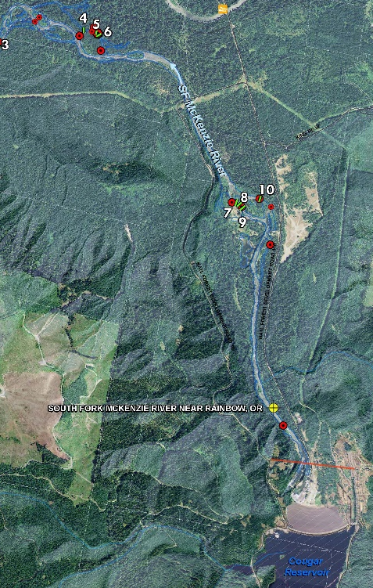
Study Design – SF McKenzie Sections

Slide 13
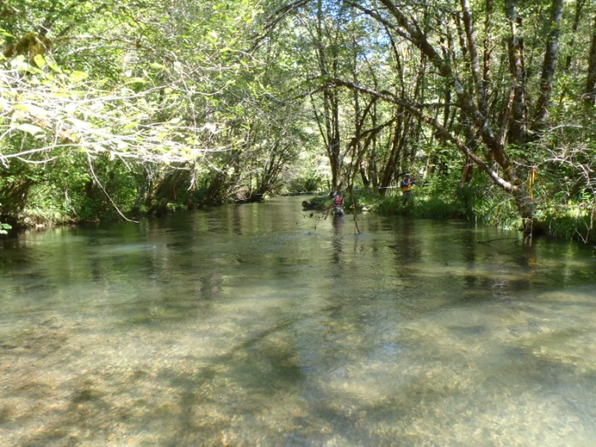
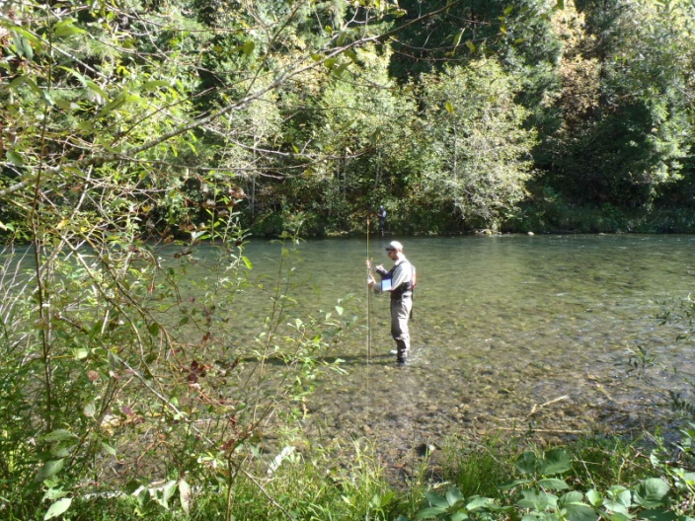
Reach Overview – Habitat Conditions
SF McKenzie River
Side Channel
Mainstem

Slide 14
Project Workflow
Transect Selection
Data Collection
Data Processing
Agency
Collaboration
June and
September 2014
Excel, QA/QC
Habitat Modeling
Velocity Calibration
Hydraulic Calibration
HSC - Santiam
ODFW Review
Results
Reporting
AWS – By Reach,
By Transect
March 31, 2015

Slide 15
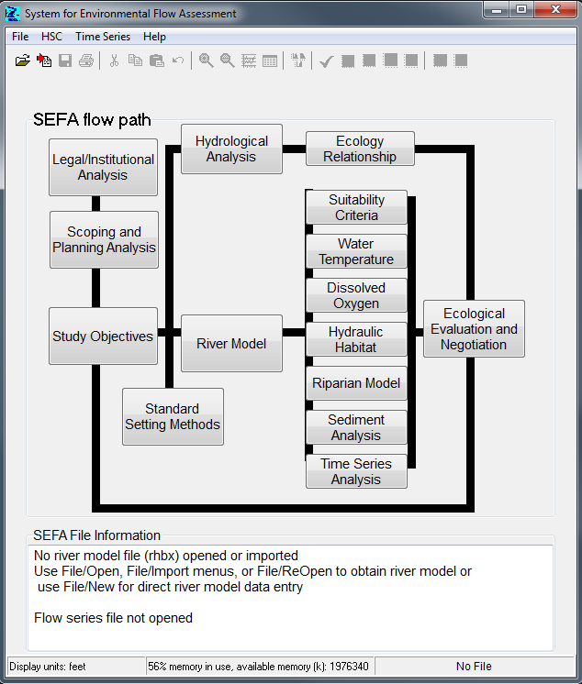
SEFA
System for Environmental Flow Analysis (SEFA)
Instream Flow Incremental Methodology software
2014 - Repackaged PHABSIM/RHABSIM
Also Includes Water Temp, DO, Riparian, Sediment
http://sefa.co.nz/
Notes:
System for Environmental Flow Analysis

Slide 16
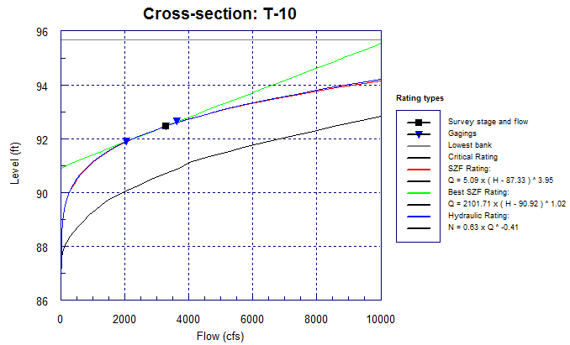
Hydraulic Calibration
First step in the modeling process is the hydraulic calibration.
Develop stage-discharge relationship for each transect using measured stage and discharge at the low, mid, and high flow
To reduce mean error between measured and modeled discharges, we made small adjustments to observed stage

Slide 17
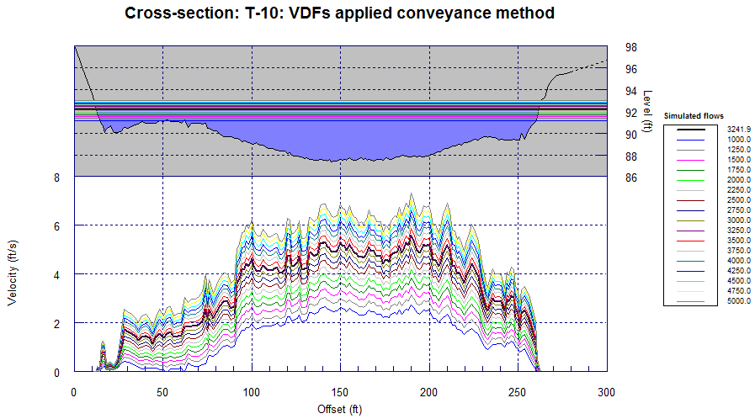
Velocity Calibration
Second step in the modeling process is the velocity calibration
Velocity measured at one flow (mid) per transect
Compare pattern of measured velocities vs. modeled velocities
Correct anomalous velocities with roughness adjustment
We made minimal adjustments

Slide 18
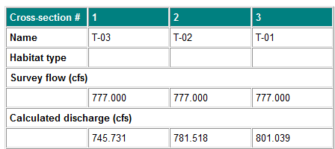
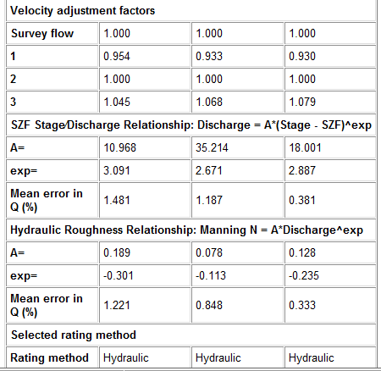
Model Calibration Results
Predicted discharge vs. Measured discharge
Goal = Mean Error <5%
Fewer calibration adjustments are better
Notes:
Mean error in Q relates the difference between measured and predicted discharge when using Hydraulic roughness relationship. Utilizes Manning’s roughness equation and channel shape ( hydraulic radius ) to determine discharge. Validated by stage / discharge rating curve.

Slide 19
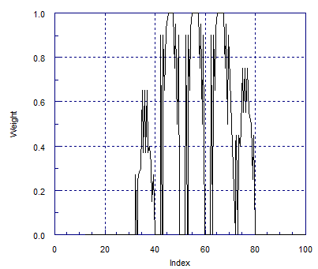
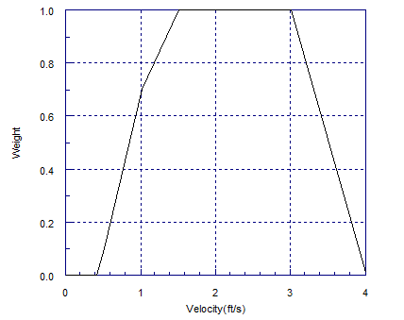
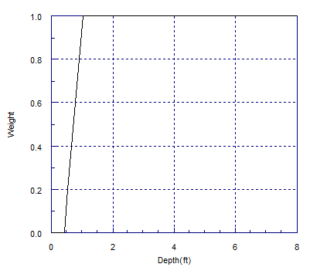
Habitat Suitability Curves
Chinook Spawning – Santiam, 2013
SILT
BOULDER
LOW
HIGH
Notes:
Index refers to substrate- classified by dominant and subdominant particle size along with percentage of dominant. Starting at 30 is small gravel, 80 is boulder. Smaller or larger is unsuitable.

Slide 20
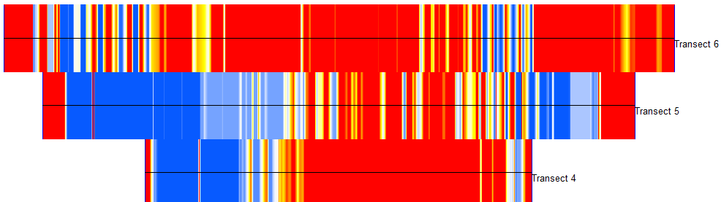
Habitat Modeling - AWS
Combine hydraulic model and habitat suitability criteria to determine Area Weighted Suitability (AWS) by transect
Red – 0.0 Poor Spawning Habitat
Yellow – 0.5 Moderate Spawning Habitat
Blue – 1.0 Optimal Spawning Habitat
Notes:
Equal weighting for transects because all assumed to be known spawning habitat. Can weight different transects heavier or lighter if wanted

Slide 21
Habitat Modeling - AWS
AWS normalized to 1,000 linear feet of stream
Habitat comparison units – square ft/1,000 ft
Equal Transect Weighting – 10 transects at 10%
  Can vary transect contributions – mainstem vs. side channel, habitat units % of total reach
Assess individual and combined sections

Slide 22
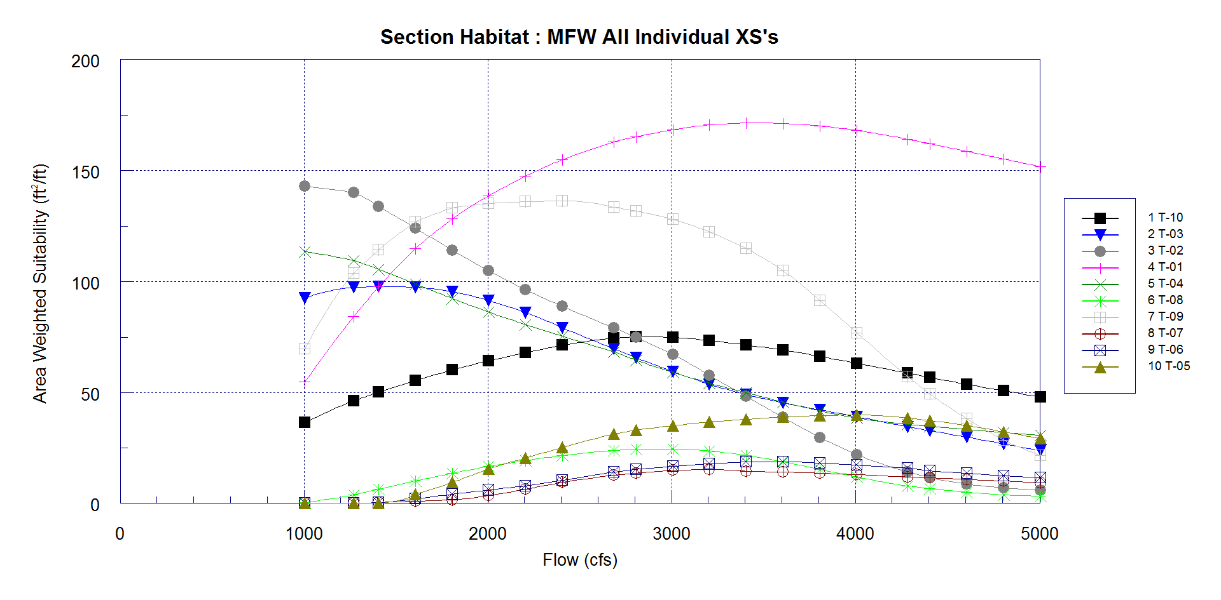
Preliminary Results - AWS
MF Willamette River – Individual Transect Results

Slide 23
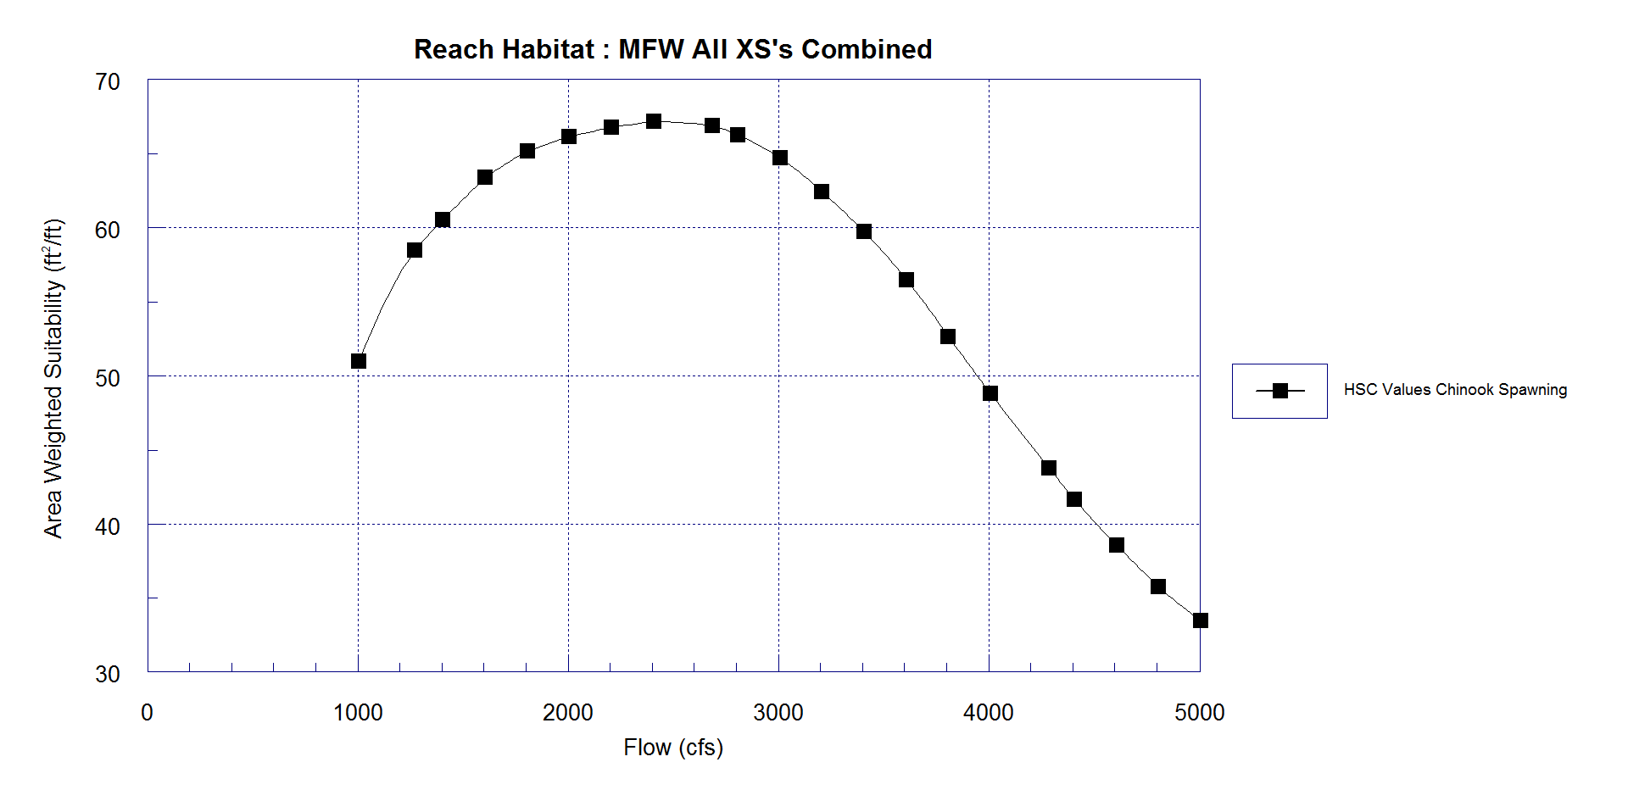
Preliminary Results - AWS
MF Willamette River – Combined Transect Results
Notes:
1800-3000

Slide 24
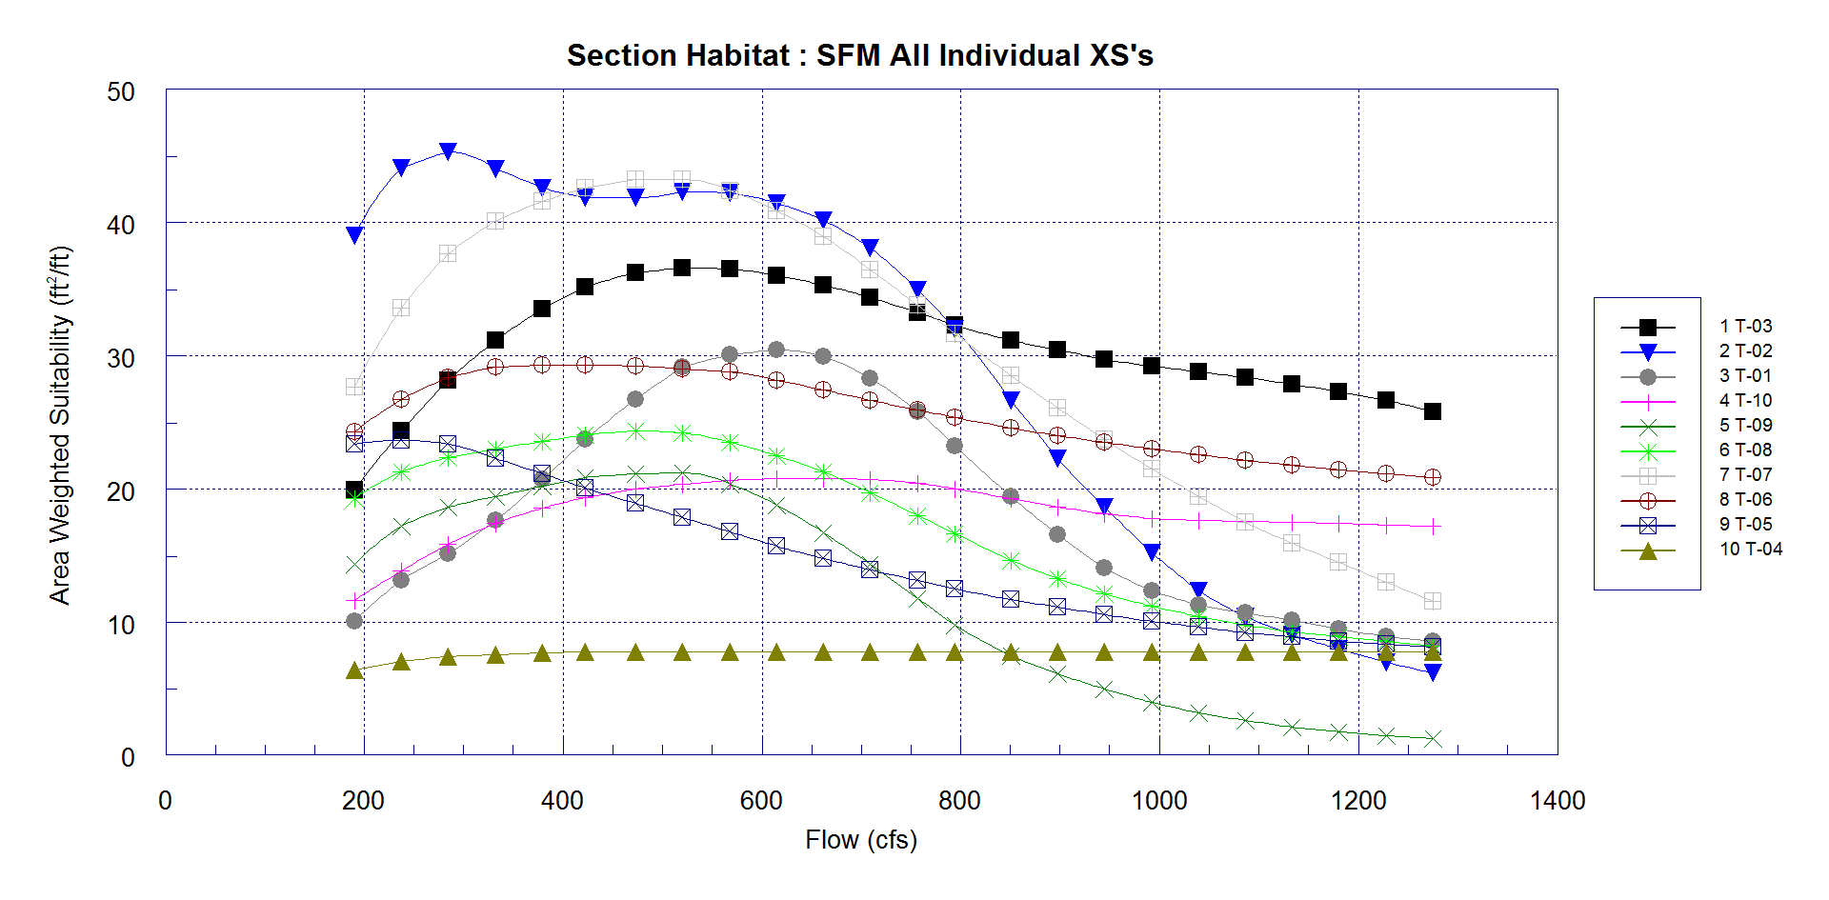
Preliminary Results - AWS
SF McKenzie River - Individual Transect Results

Slide 25
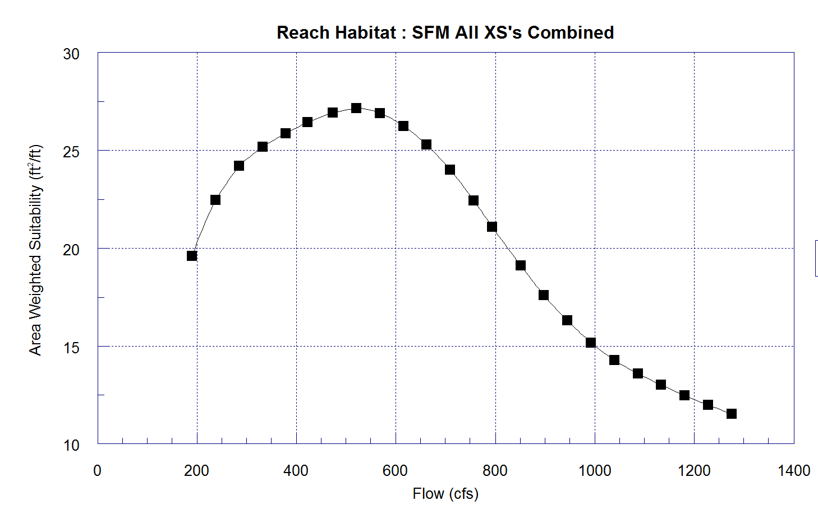
Preliminary Results - AWS
SF McKenzie River - Combined Transect Results
Notes:
350-650

Slide 26
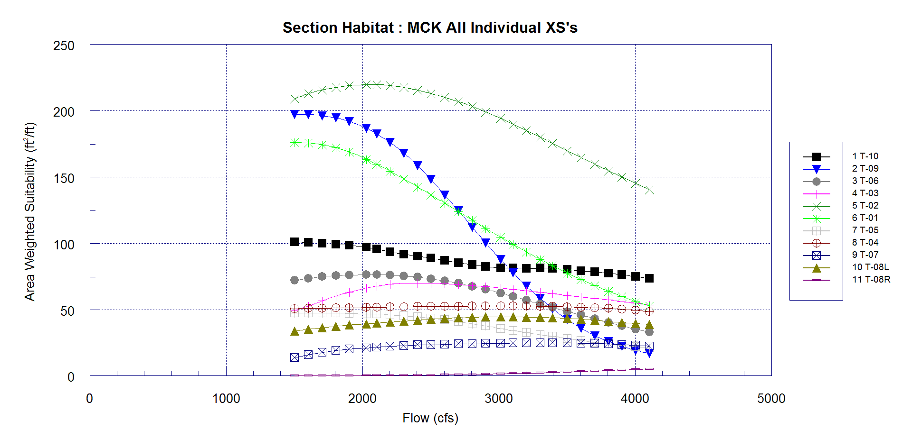
Preliminary Results - AWS
McKenzie River – Individual Transect Results

Slide 27
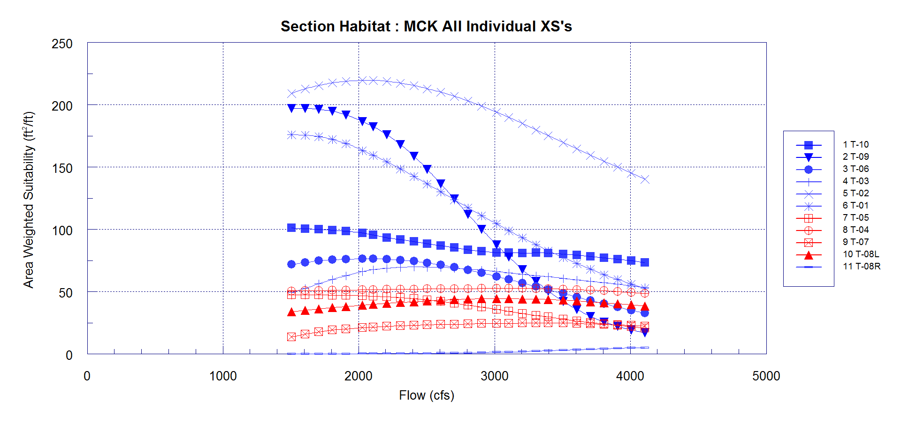
Preliminary Results - AWS
McKenzie River – Categorized Transect Results
Mainstem
Side Channel
Notes:
1500-2200

Slide 28
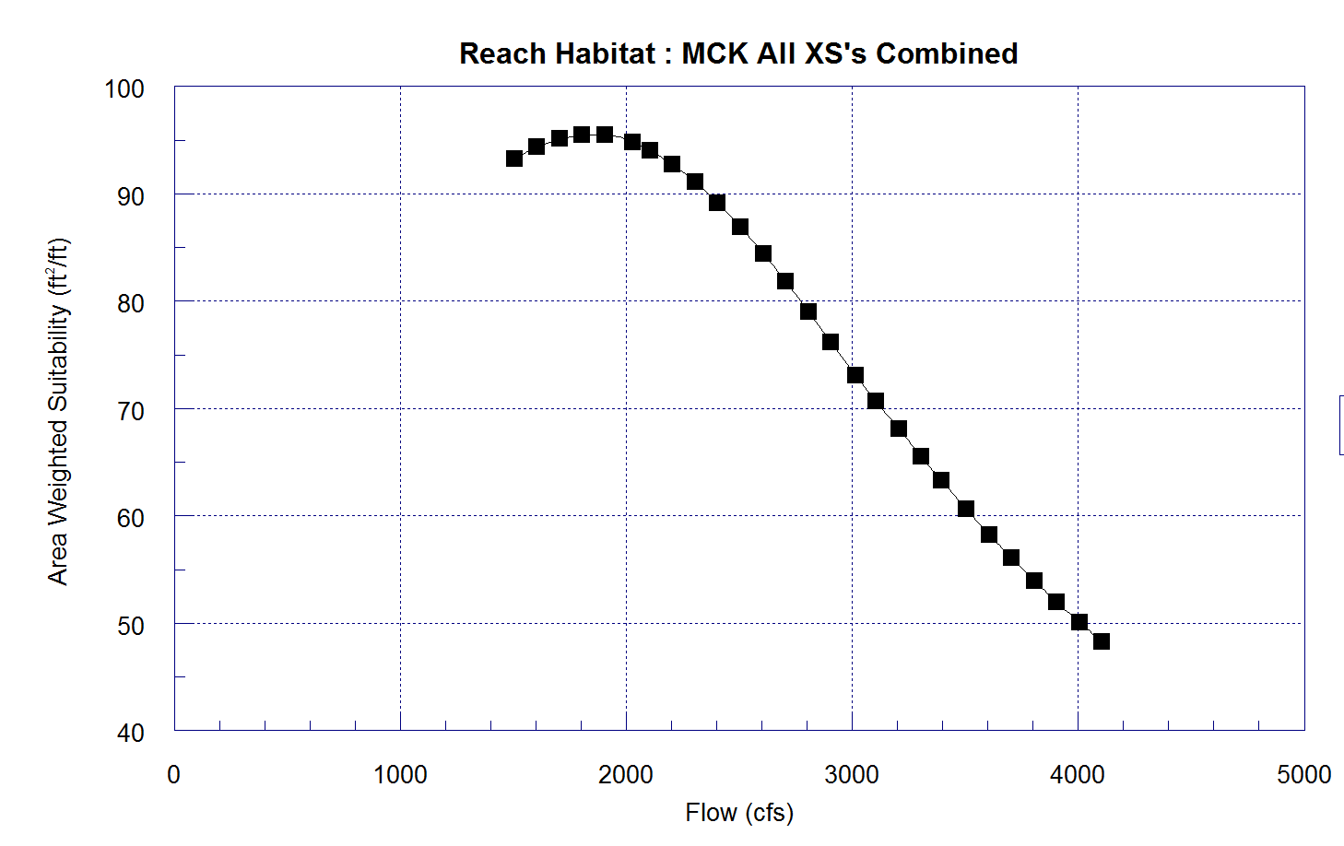
Preliminary Results - AWS
McKenzie River – Combined Transect Results
Notes:
1500-2200

Slide 29
Preliminary Results
Study Reach | BiOp Flow Range (cfs) | (Preliminary) Optimal Flow Range (cfs) | (Preliminary) Optimal Target Flow (cfs)
MF Willamette River | 1,200 – 3,500 | 1,800 – 3,000 | 2,400
McKenzie River | Coincident with SF McKenzie | 1,500 – 2,200 | 1,800
SF McKenzie River | 300 - 580 | 350 - 650 | 519

Slide 30
Summary
Preliminary optimal flows overlap with BiOp flows
Currently preparing analysis and tech team review
Report due March 2015

Slide 31
Acknowledgements
USACE
  Dave Leonhardt
  Tim Kuhn
  Mary Karen Scullion
  Greg Taylor
ODFW
  Tim Hardin
  Paul Olmstead
  Cameron Sharpe
  Mike Hogansen
OWRD
  Rachel LovellFord
NOAA-Fisheries
  Rich Domingue

