Slide 1
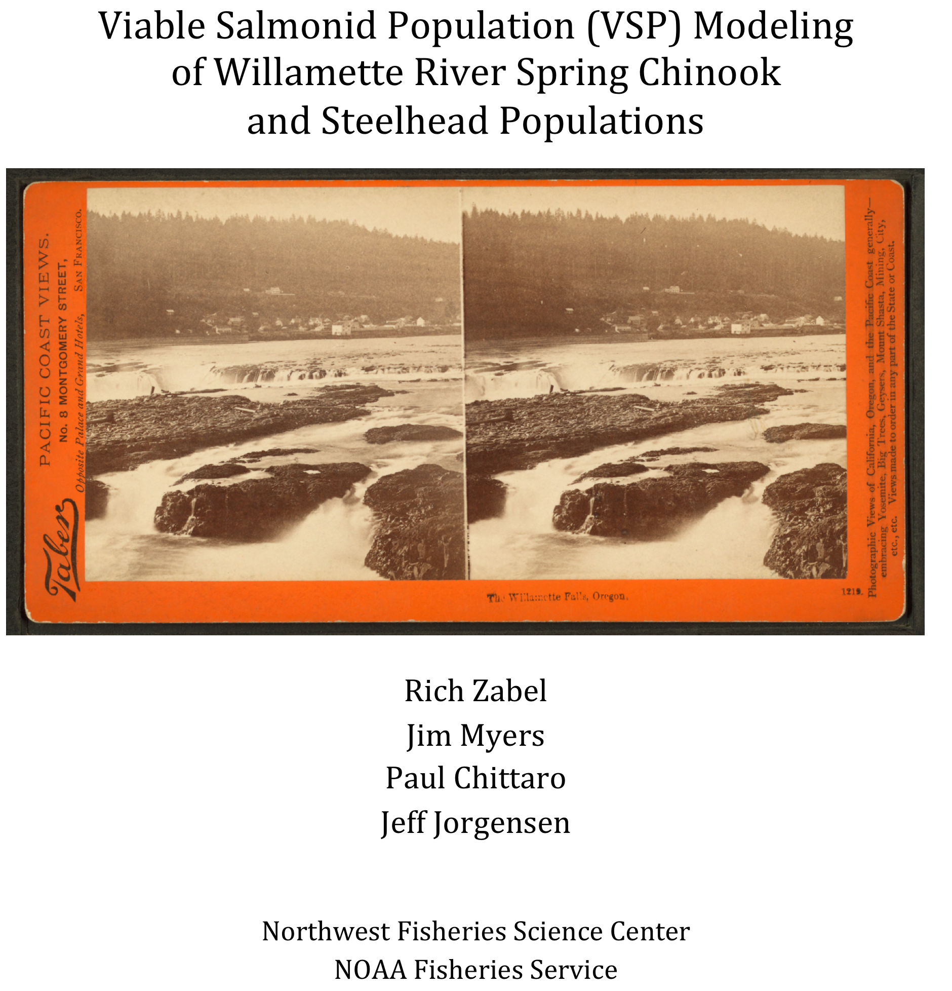

Slide 2
Outline
Status of Models
Modeling Background
Model Runs for the COP analysis
Sensitivity Analyses
Future Directions

Slide 3
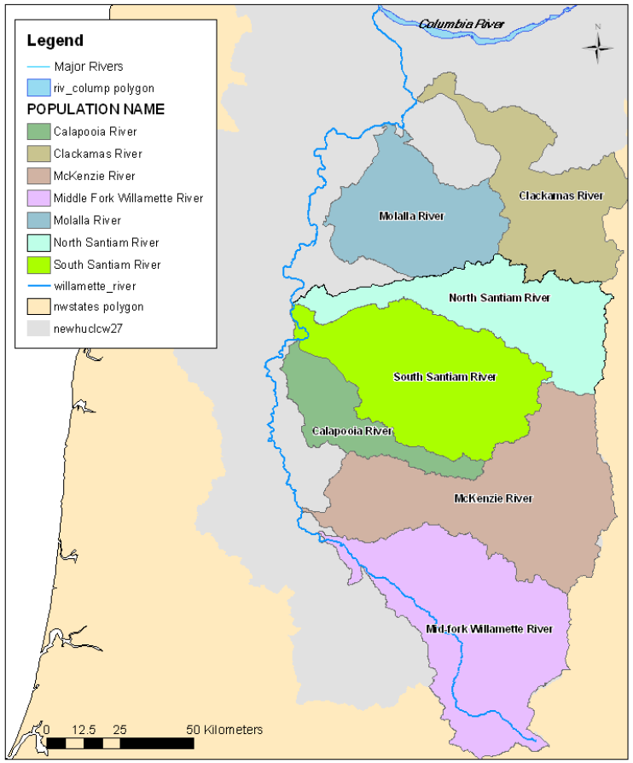
Spring Chinook
Population Models

Slide 4
Winter Steelhead
Population Models

Slide 5
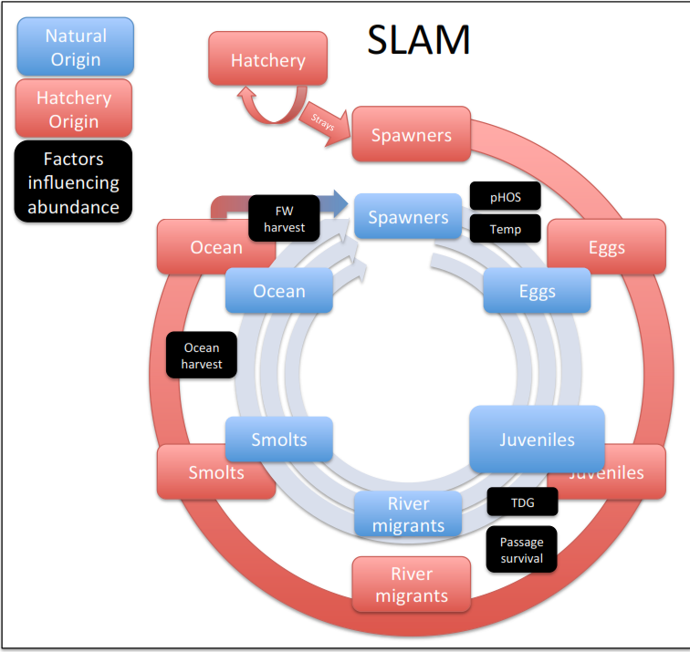
UWR Spring Chinook Population Model

Slide 6
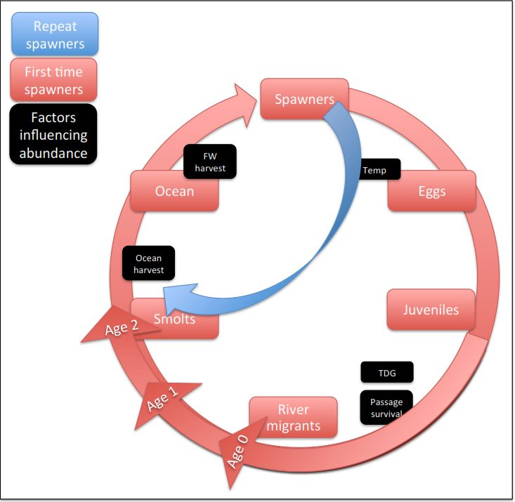
UWR Winter Steelhead Population Model

Slide 7
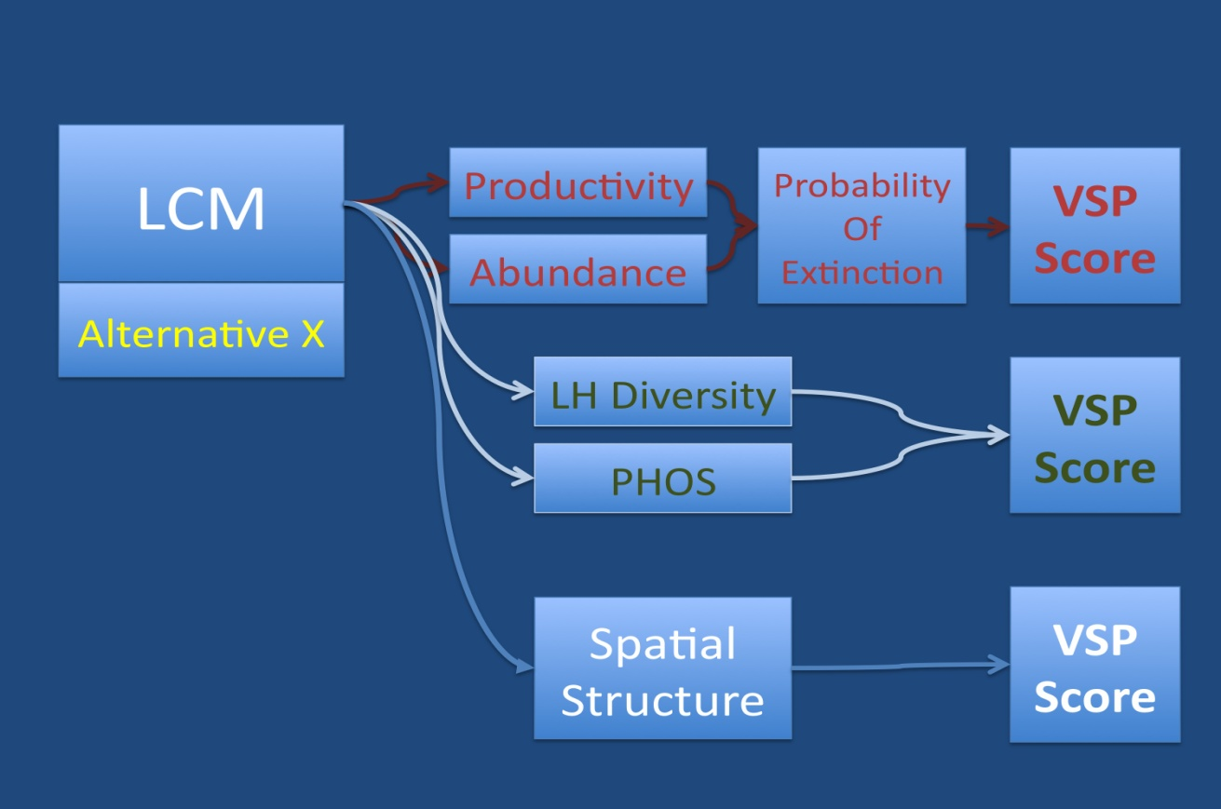
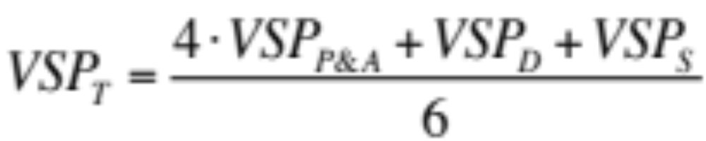

Slide 8
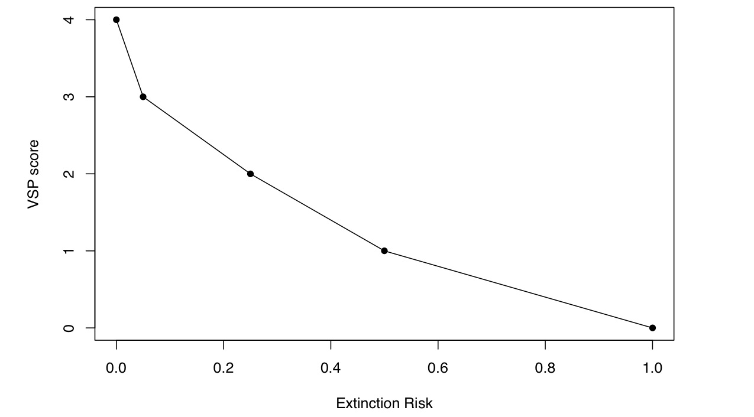
McElhany et al. (2000). NOAA Tech Memo

Slide 9
Size and time of passage for juvenile Chinook salmon at Willamette Falls 1965-1966
(Data from Massey 1967)

Slide 10
From UWTRT (2007)

Slide 11
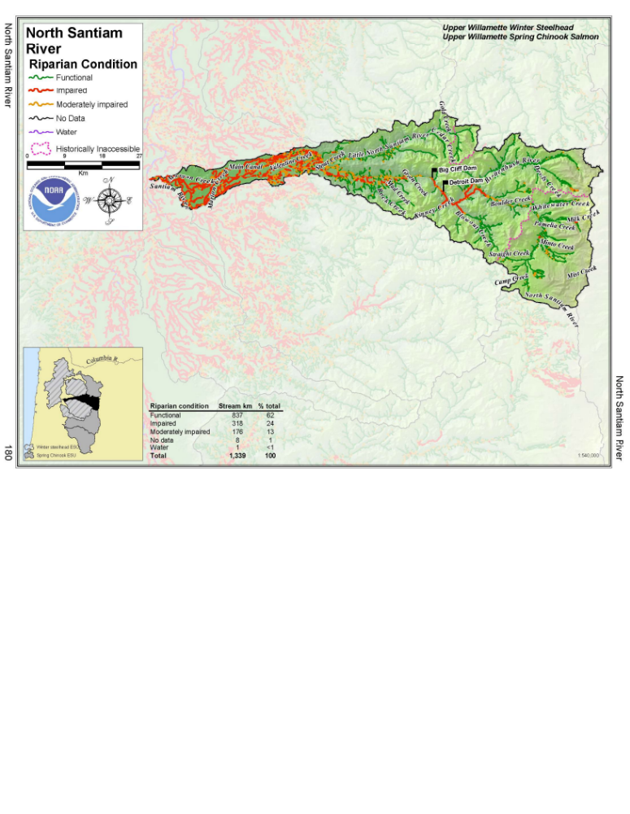
Maher, M., M.B. Sheer, E.A. Steel, and P. McElhany. 2005. Report for the Willamette-Lower Columbia Technical Recovery Team.

Slide 12
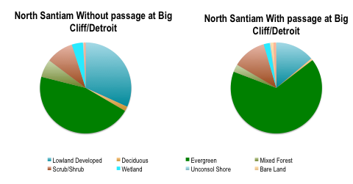
data from Sheer and Steel 2006

Slide 13
Higher Total VSP scores means –
Properly functioning population
+ Life history diversity
+ Lower Hatchery influence
+ Greater utilization of diverse habitats
+ Greater resilience to stressors
such as climate change

Slide 14
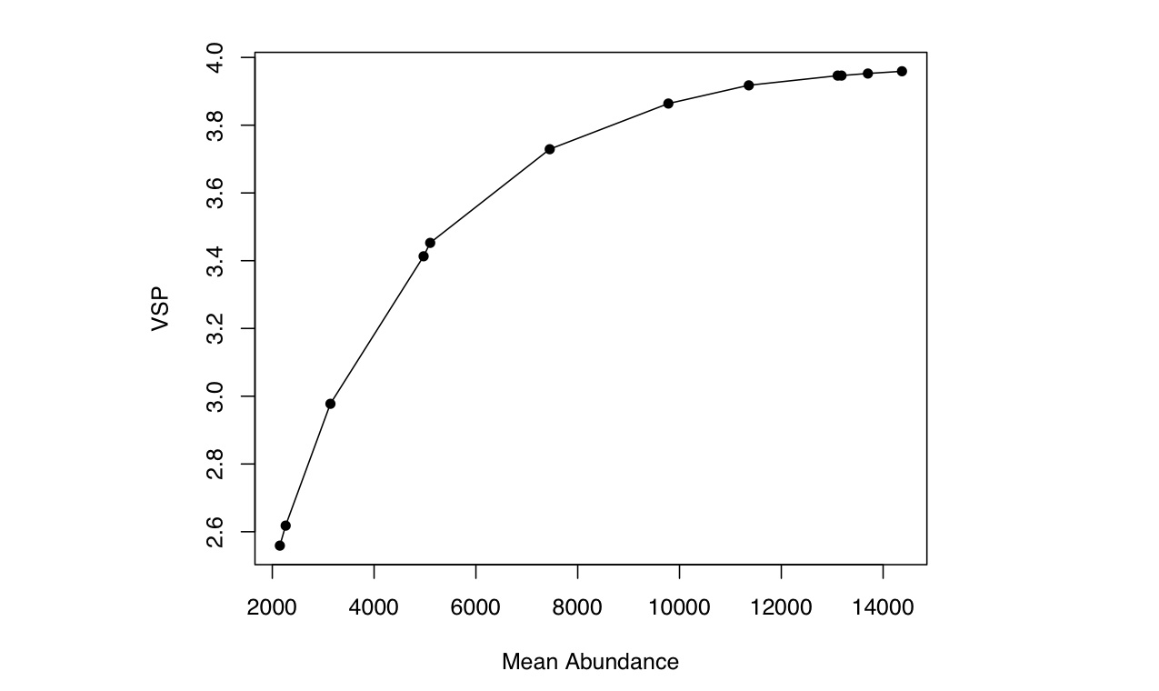
McKenzie River Spring Chinook Alternatives

Slide 15
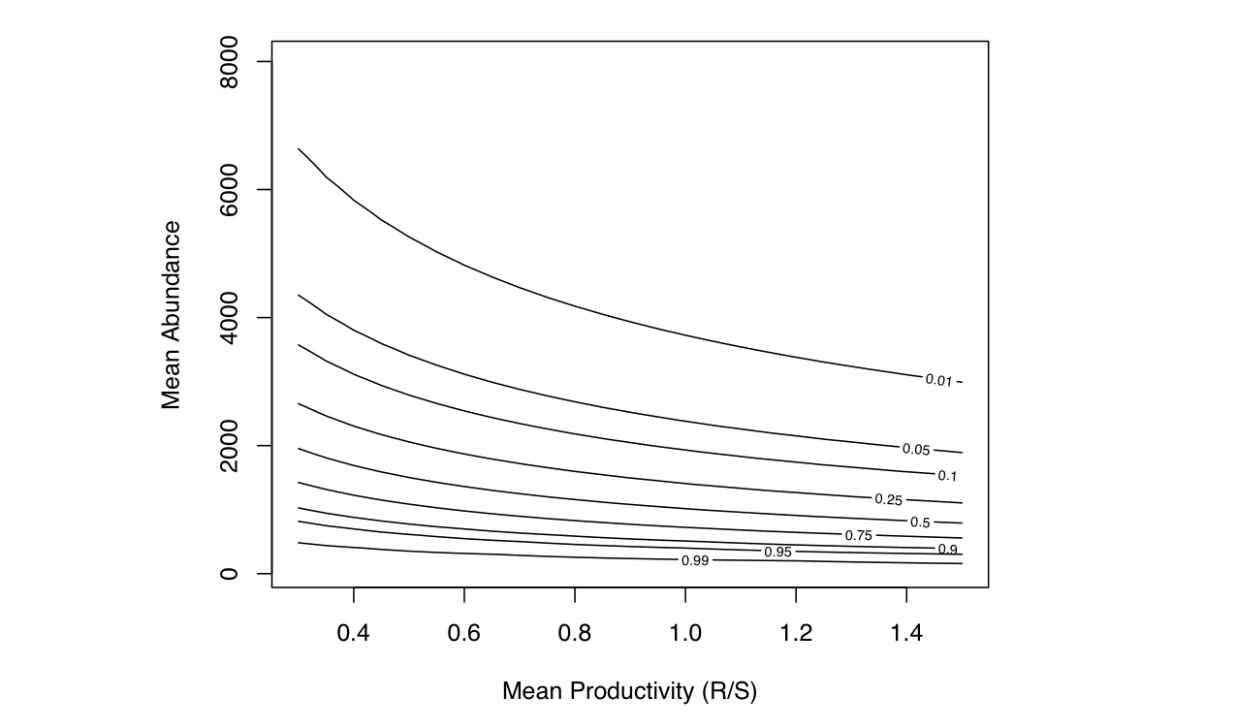
Calculating Uncertainty about Abundance and Productivity VSP scores
McKenzie River Spring Chinook
Step 1) Isoclines of extinction probability versus Productivity and Abundance
based on logistic regression

Slide 16
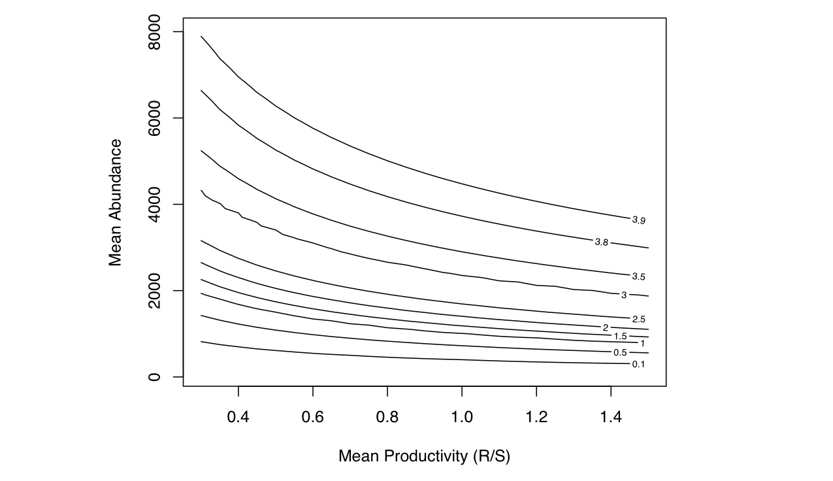
Calculating Uncertainty about Abundance and Productivity VSP scores
McKenzie River Spring Chinook
Step 2) Convert extinction probability to VSP scores

Slide 17
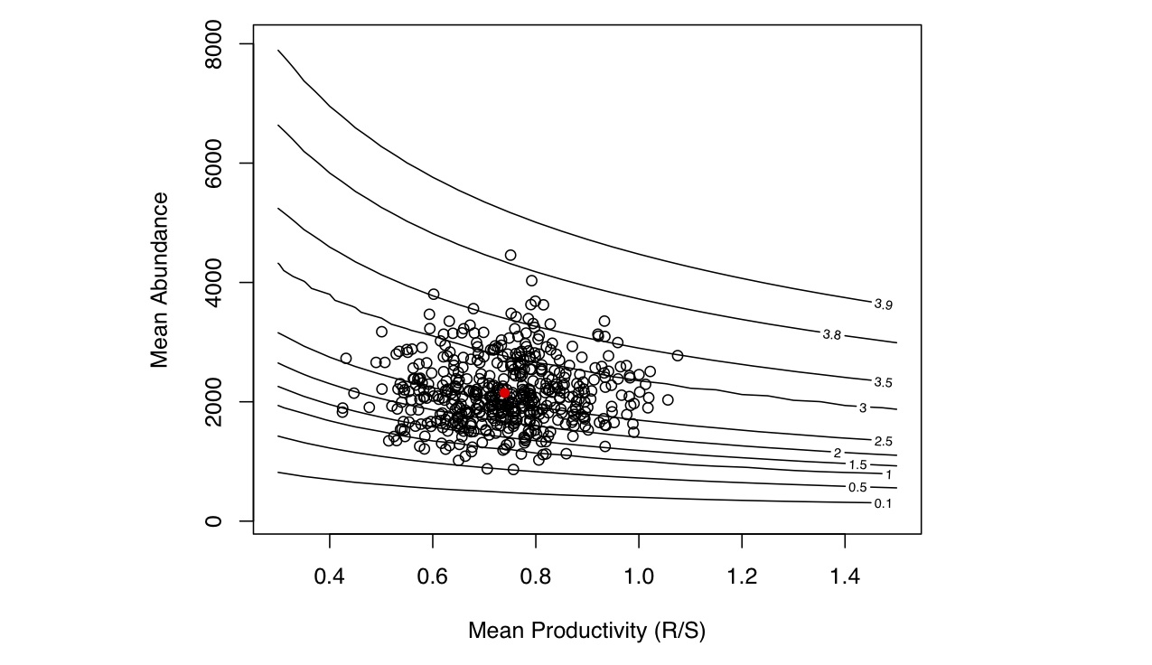
Calculating Uncertainty about Abundance and Productivity VSP scores
McKenzie River Spring Chinook
Step 3) Plot results for all model runs for a given Alternative (baseline).
Red dot is the mean.

Slide 18
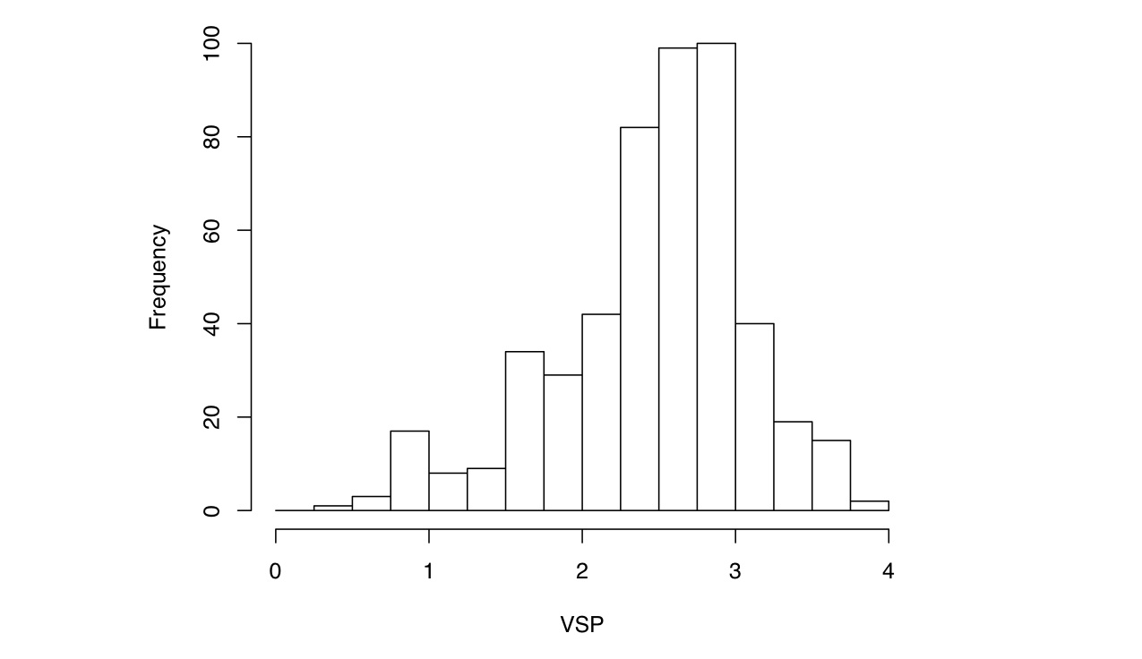
Calculating Uncertainty about Abundance and Productivity VSP scores
McKenzie River Spring Chinook
Step 4) Distribution of VSP scores of individual runs with 95% C.I.

Slide 19
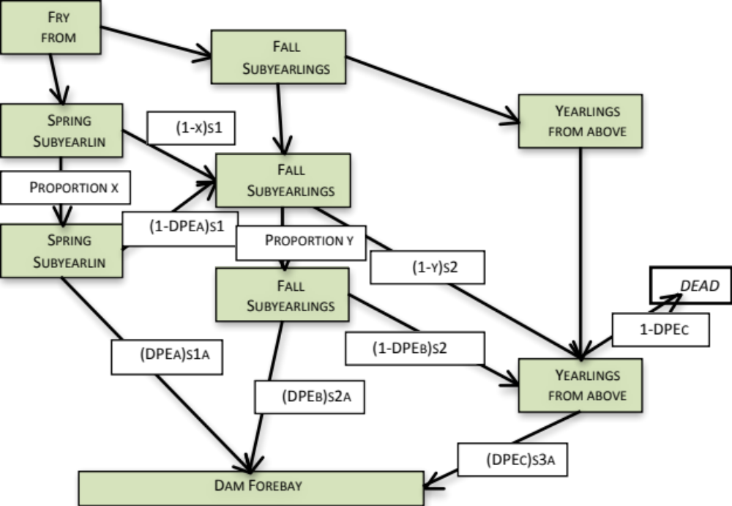
Expert opinion process for Reservoir Survival
and Passage Probabilities
ODFW
NWFSC
NOAA RO
USACOE
BPA
USFWS
NWPCC

Slide 20
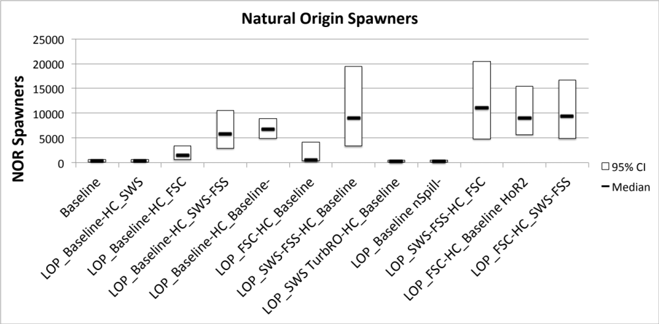
RESULTS: Middle Fork Spring Chinook

Slide 21
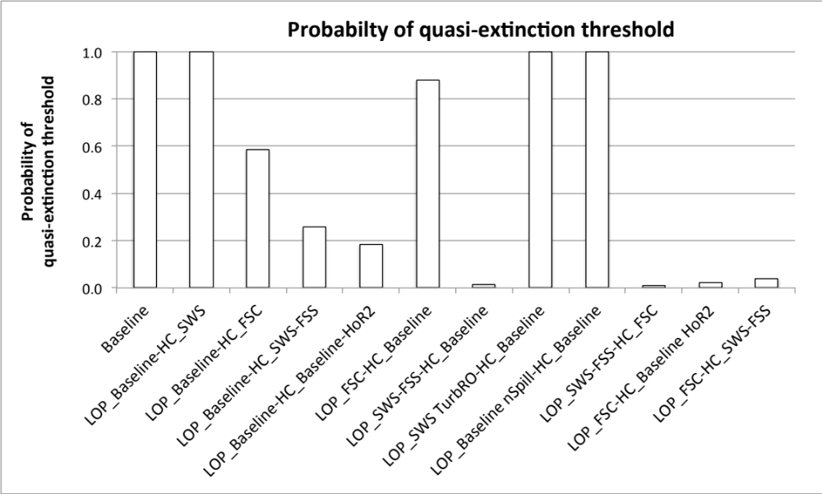
RESULTS: Middle Fork Spring Chinook

Slide 22
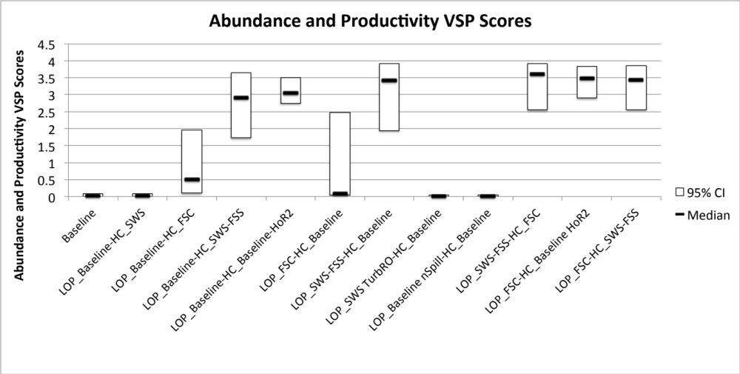
RESULTS: Middle Fork Spring Chinook

Slide 23
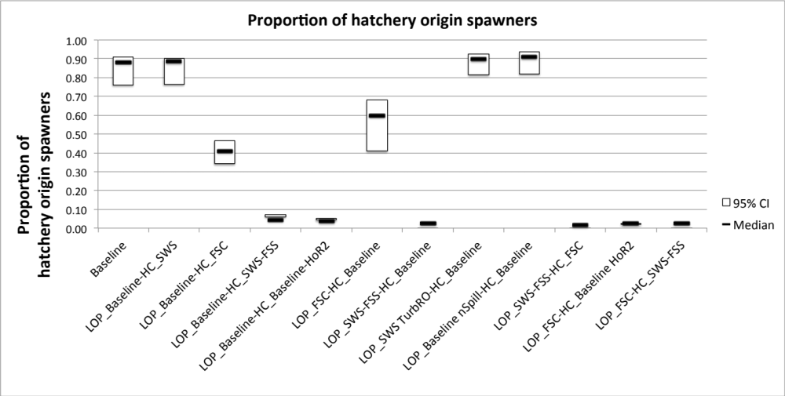
RESULTS: Middle Fork Spring Chinook

Slide 24
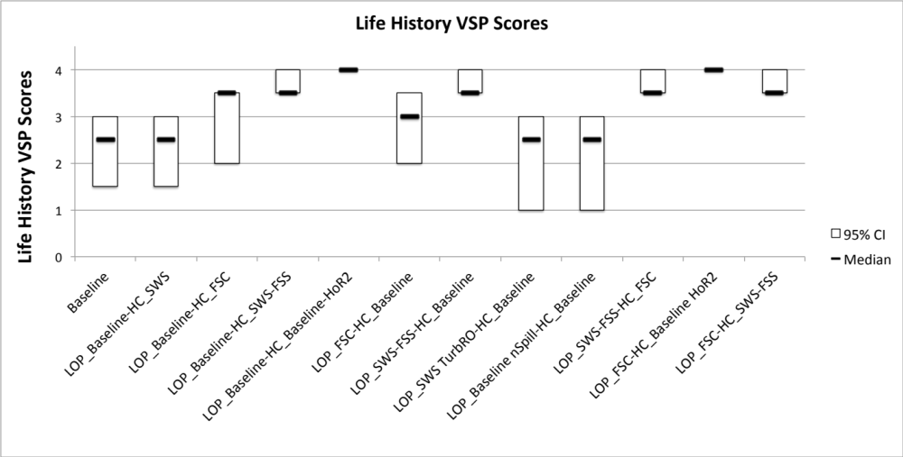
RESULTS: Middle Fork Spring Chinook

Slide 25
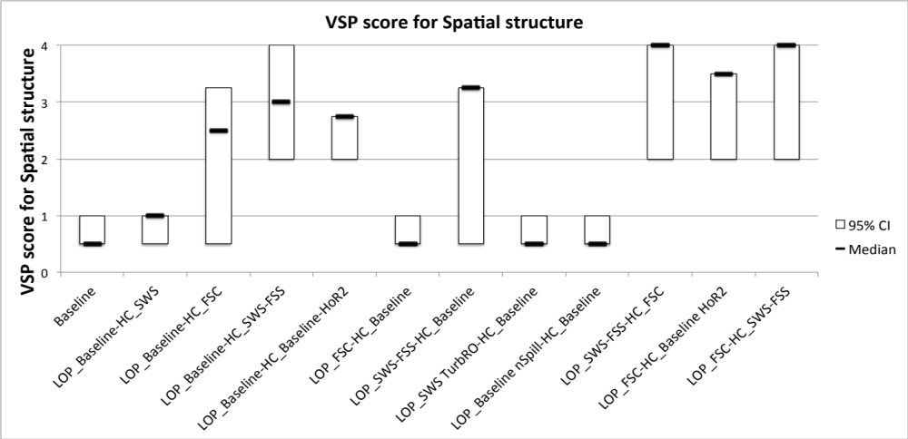
RESULTS: Middle Fork Spring Chinook

Slide 26
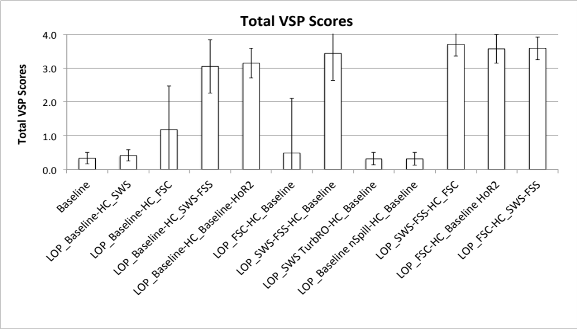
RESULTS: Middle Fork Spring Chinook

Slide 27
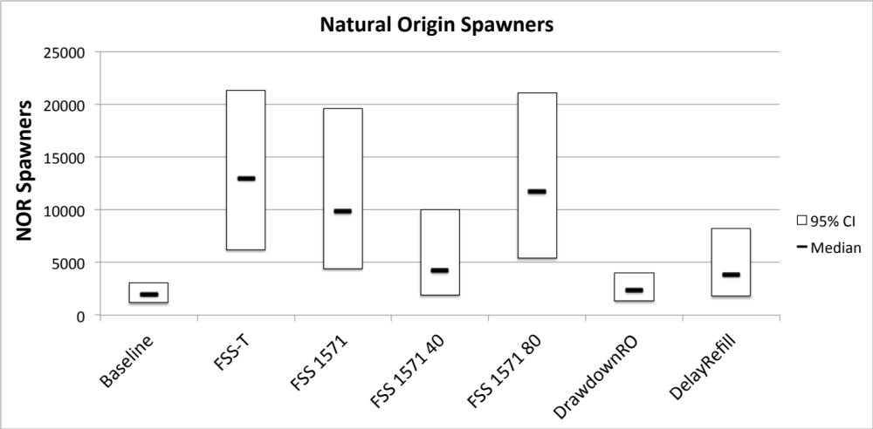
RESULTS: McKenzie River Spring Chinook

Slide 28
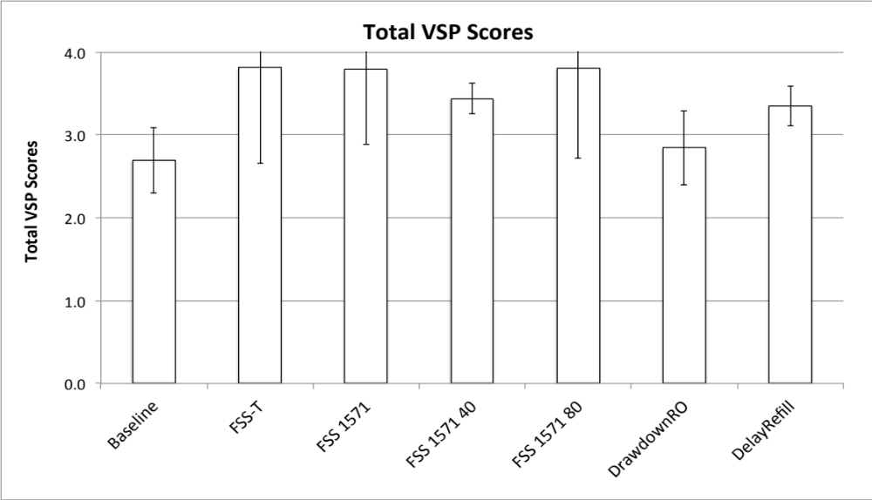
RESULTS: McKenzie River Spring Chinook

Slide 29
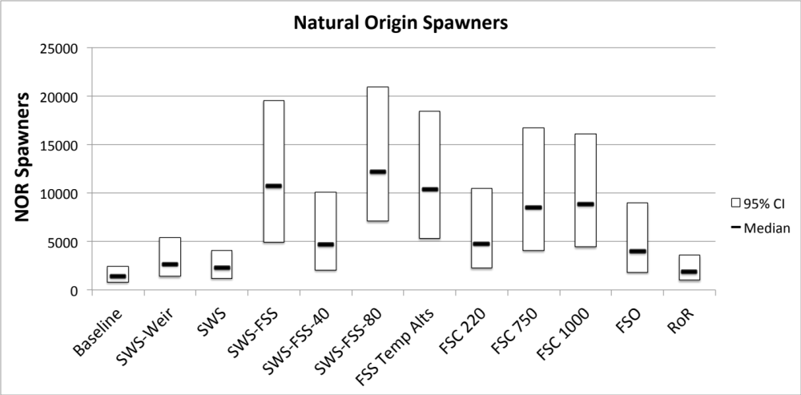
RESULTS: North Santiam Spring Chinook

Slide 30
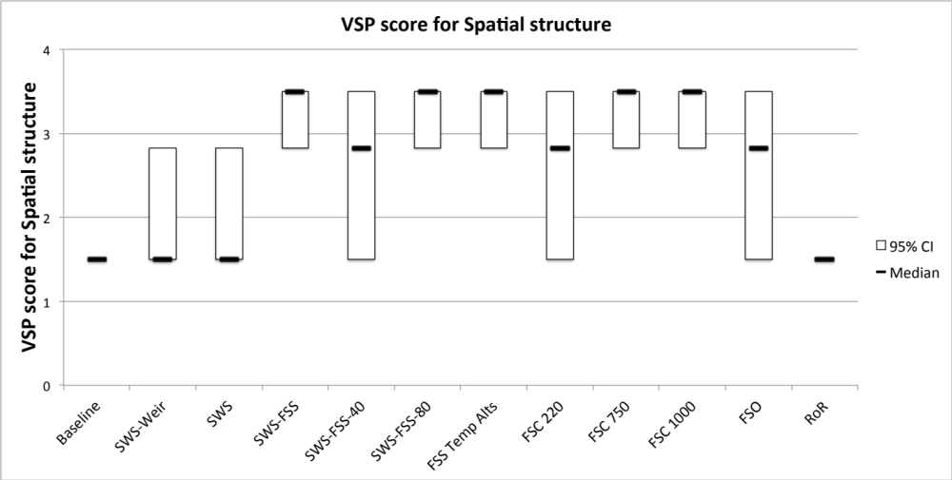
RESULTS: North Santiam Spring Chinook

Slide 31
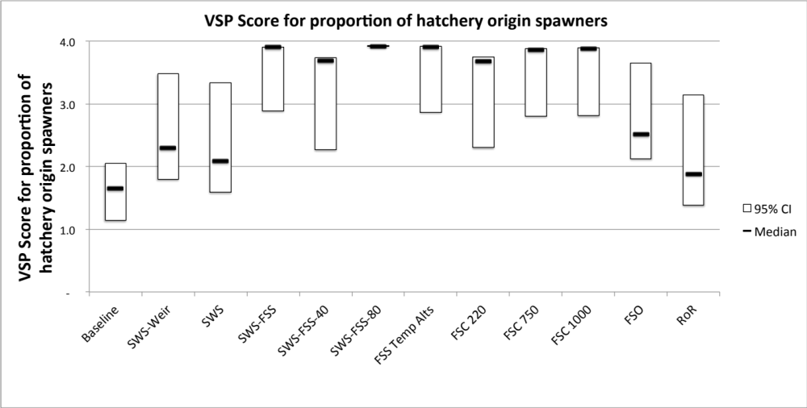
RESULTS: North Santiam Spring Chinook

Slide 32
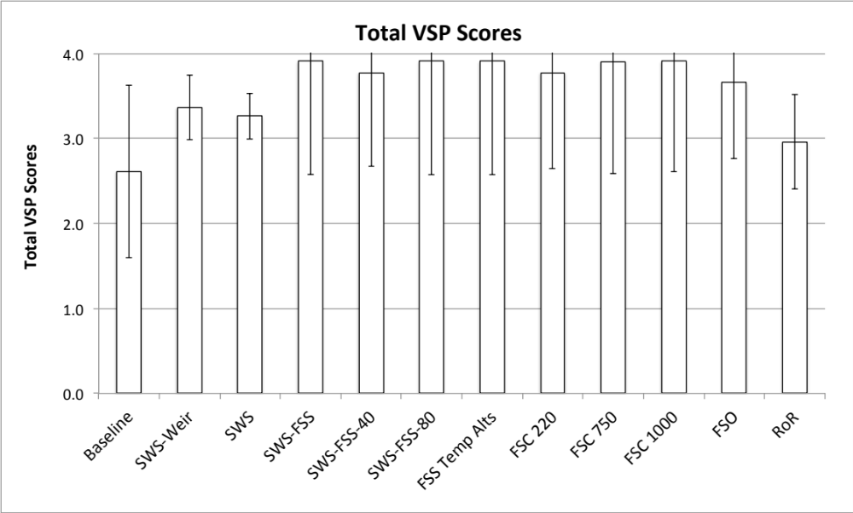
RESULTS: North Santiam Spring Chinook

Slide 33
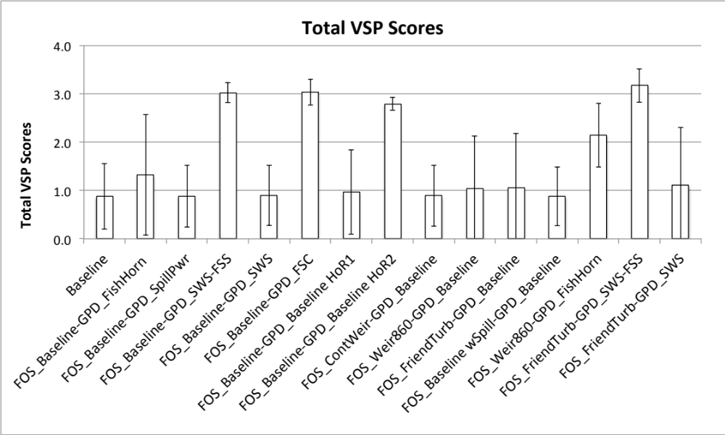
RESULTS: South Santiam Spring Chinook

Slide 34
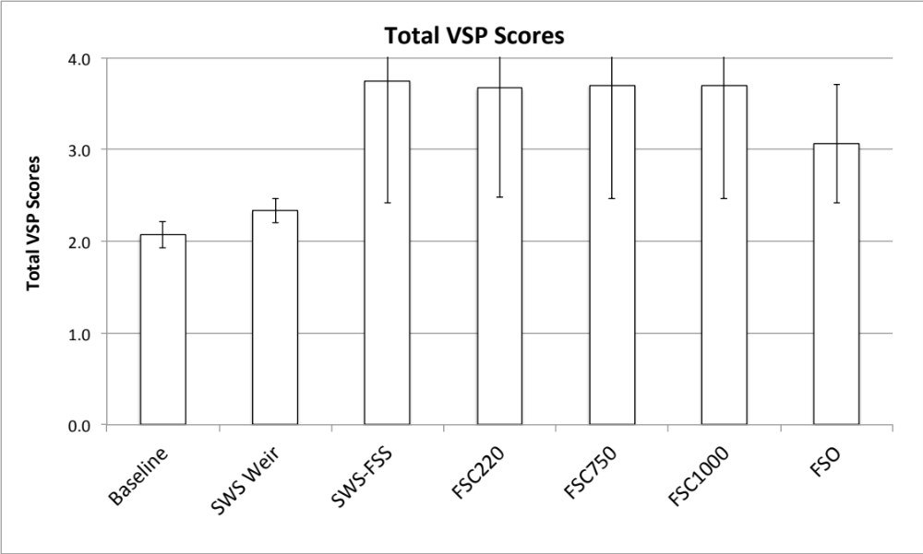
RESULTS: North Santiam Winter Steelhead

Slide 35
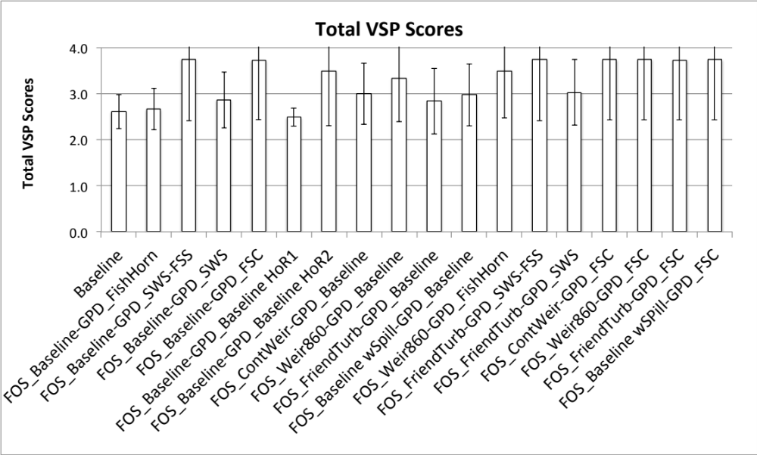
RESULTS: South Santiam Winter Steelhead

Slide 36
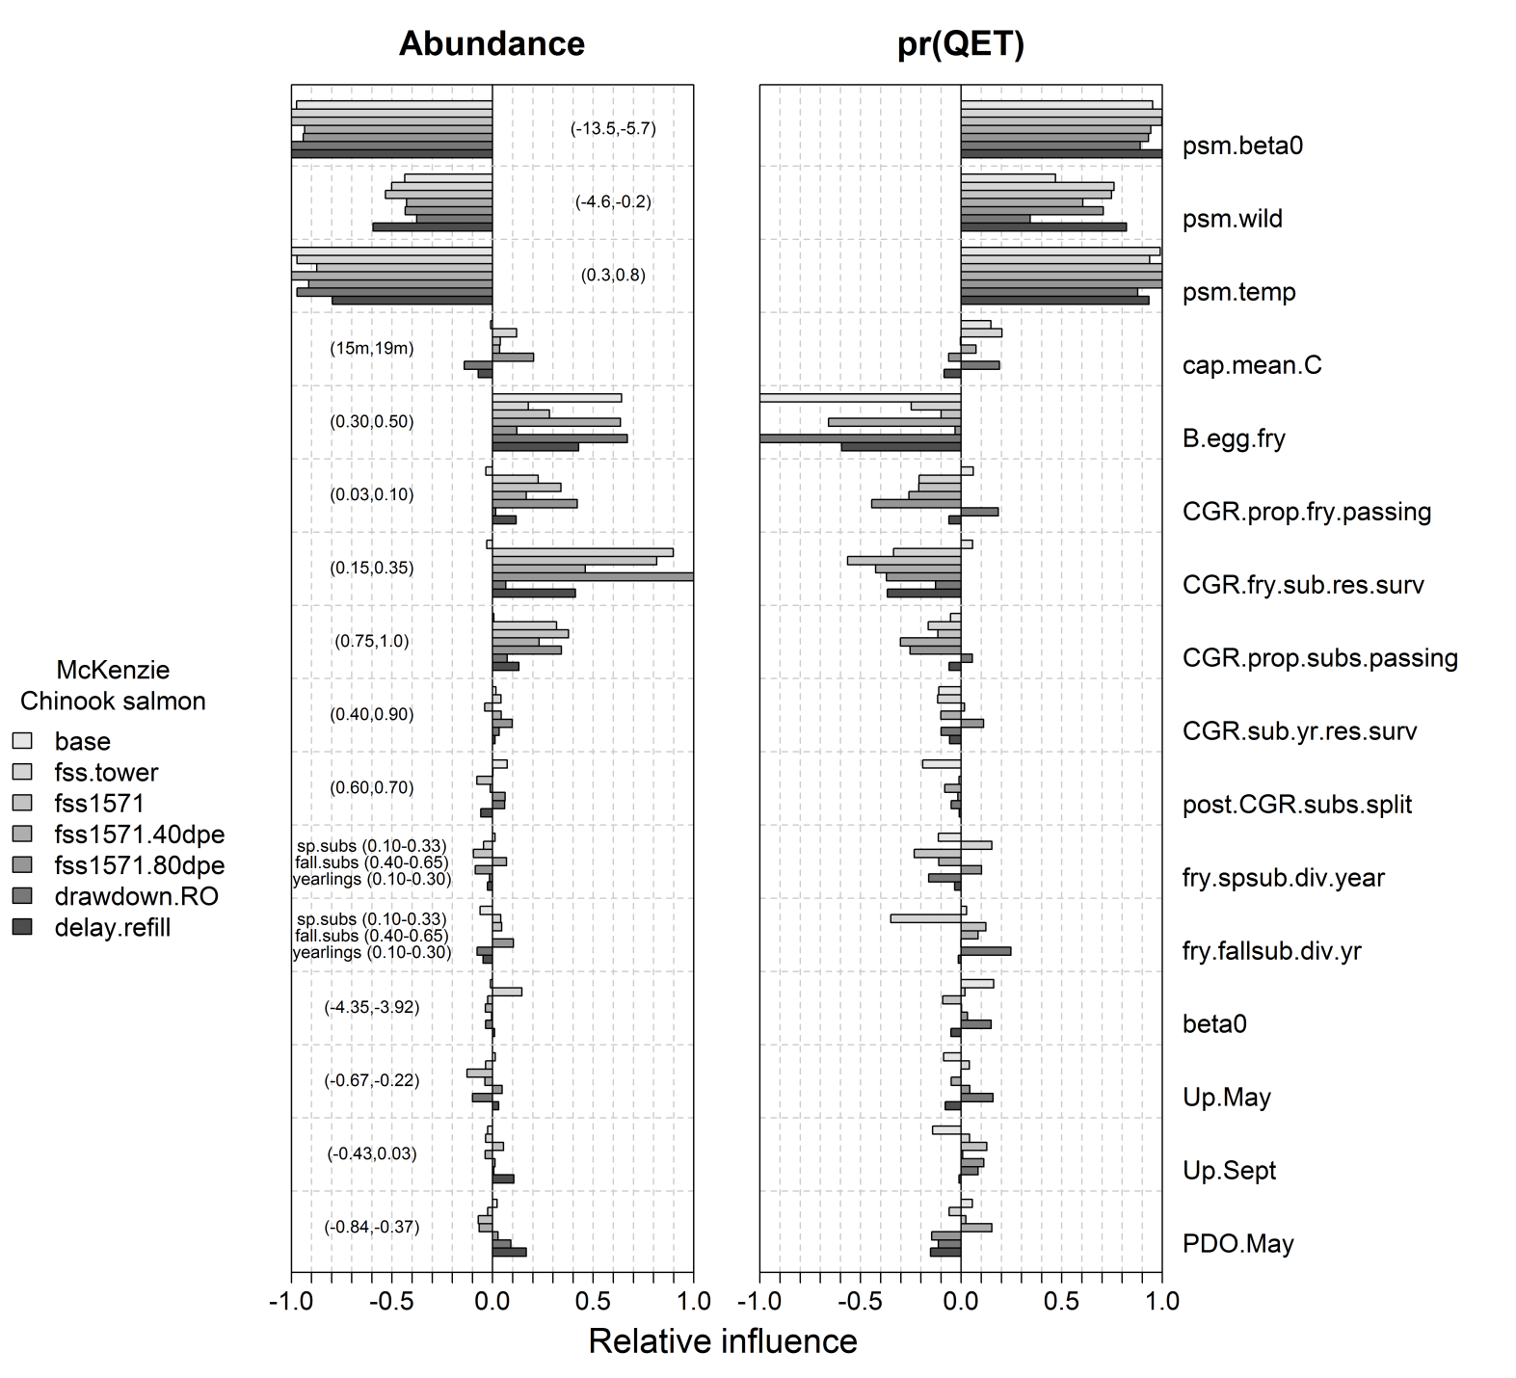
Sensitivity Analysis: McKenzie R Spring Chinook

Slide 37
Sensitivity Analysis: McKenzie R Spring Chinook

Slide 38
Sensitivity Analysis: McKenzie R Spring Chinook

Slide 39
Sensitivity Analysis: McKenzie R Spring Chinook

Slide 40
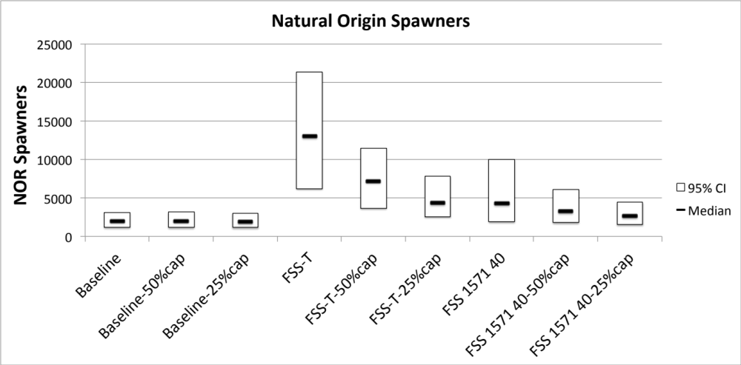
Sensitivity Analysis: Capacity above Cougar

Slide 41
FUTURE DIRECTIONS: Conversion to R code
• R: Free Statistical Software Package
• All 6 models currently implemented
• Computationally must faster
• Sensitivity Analyses
• Calibration Routine – Under Development

Slide 42
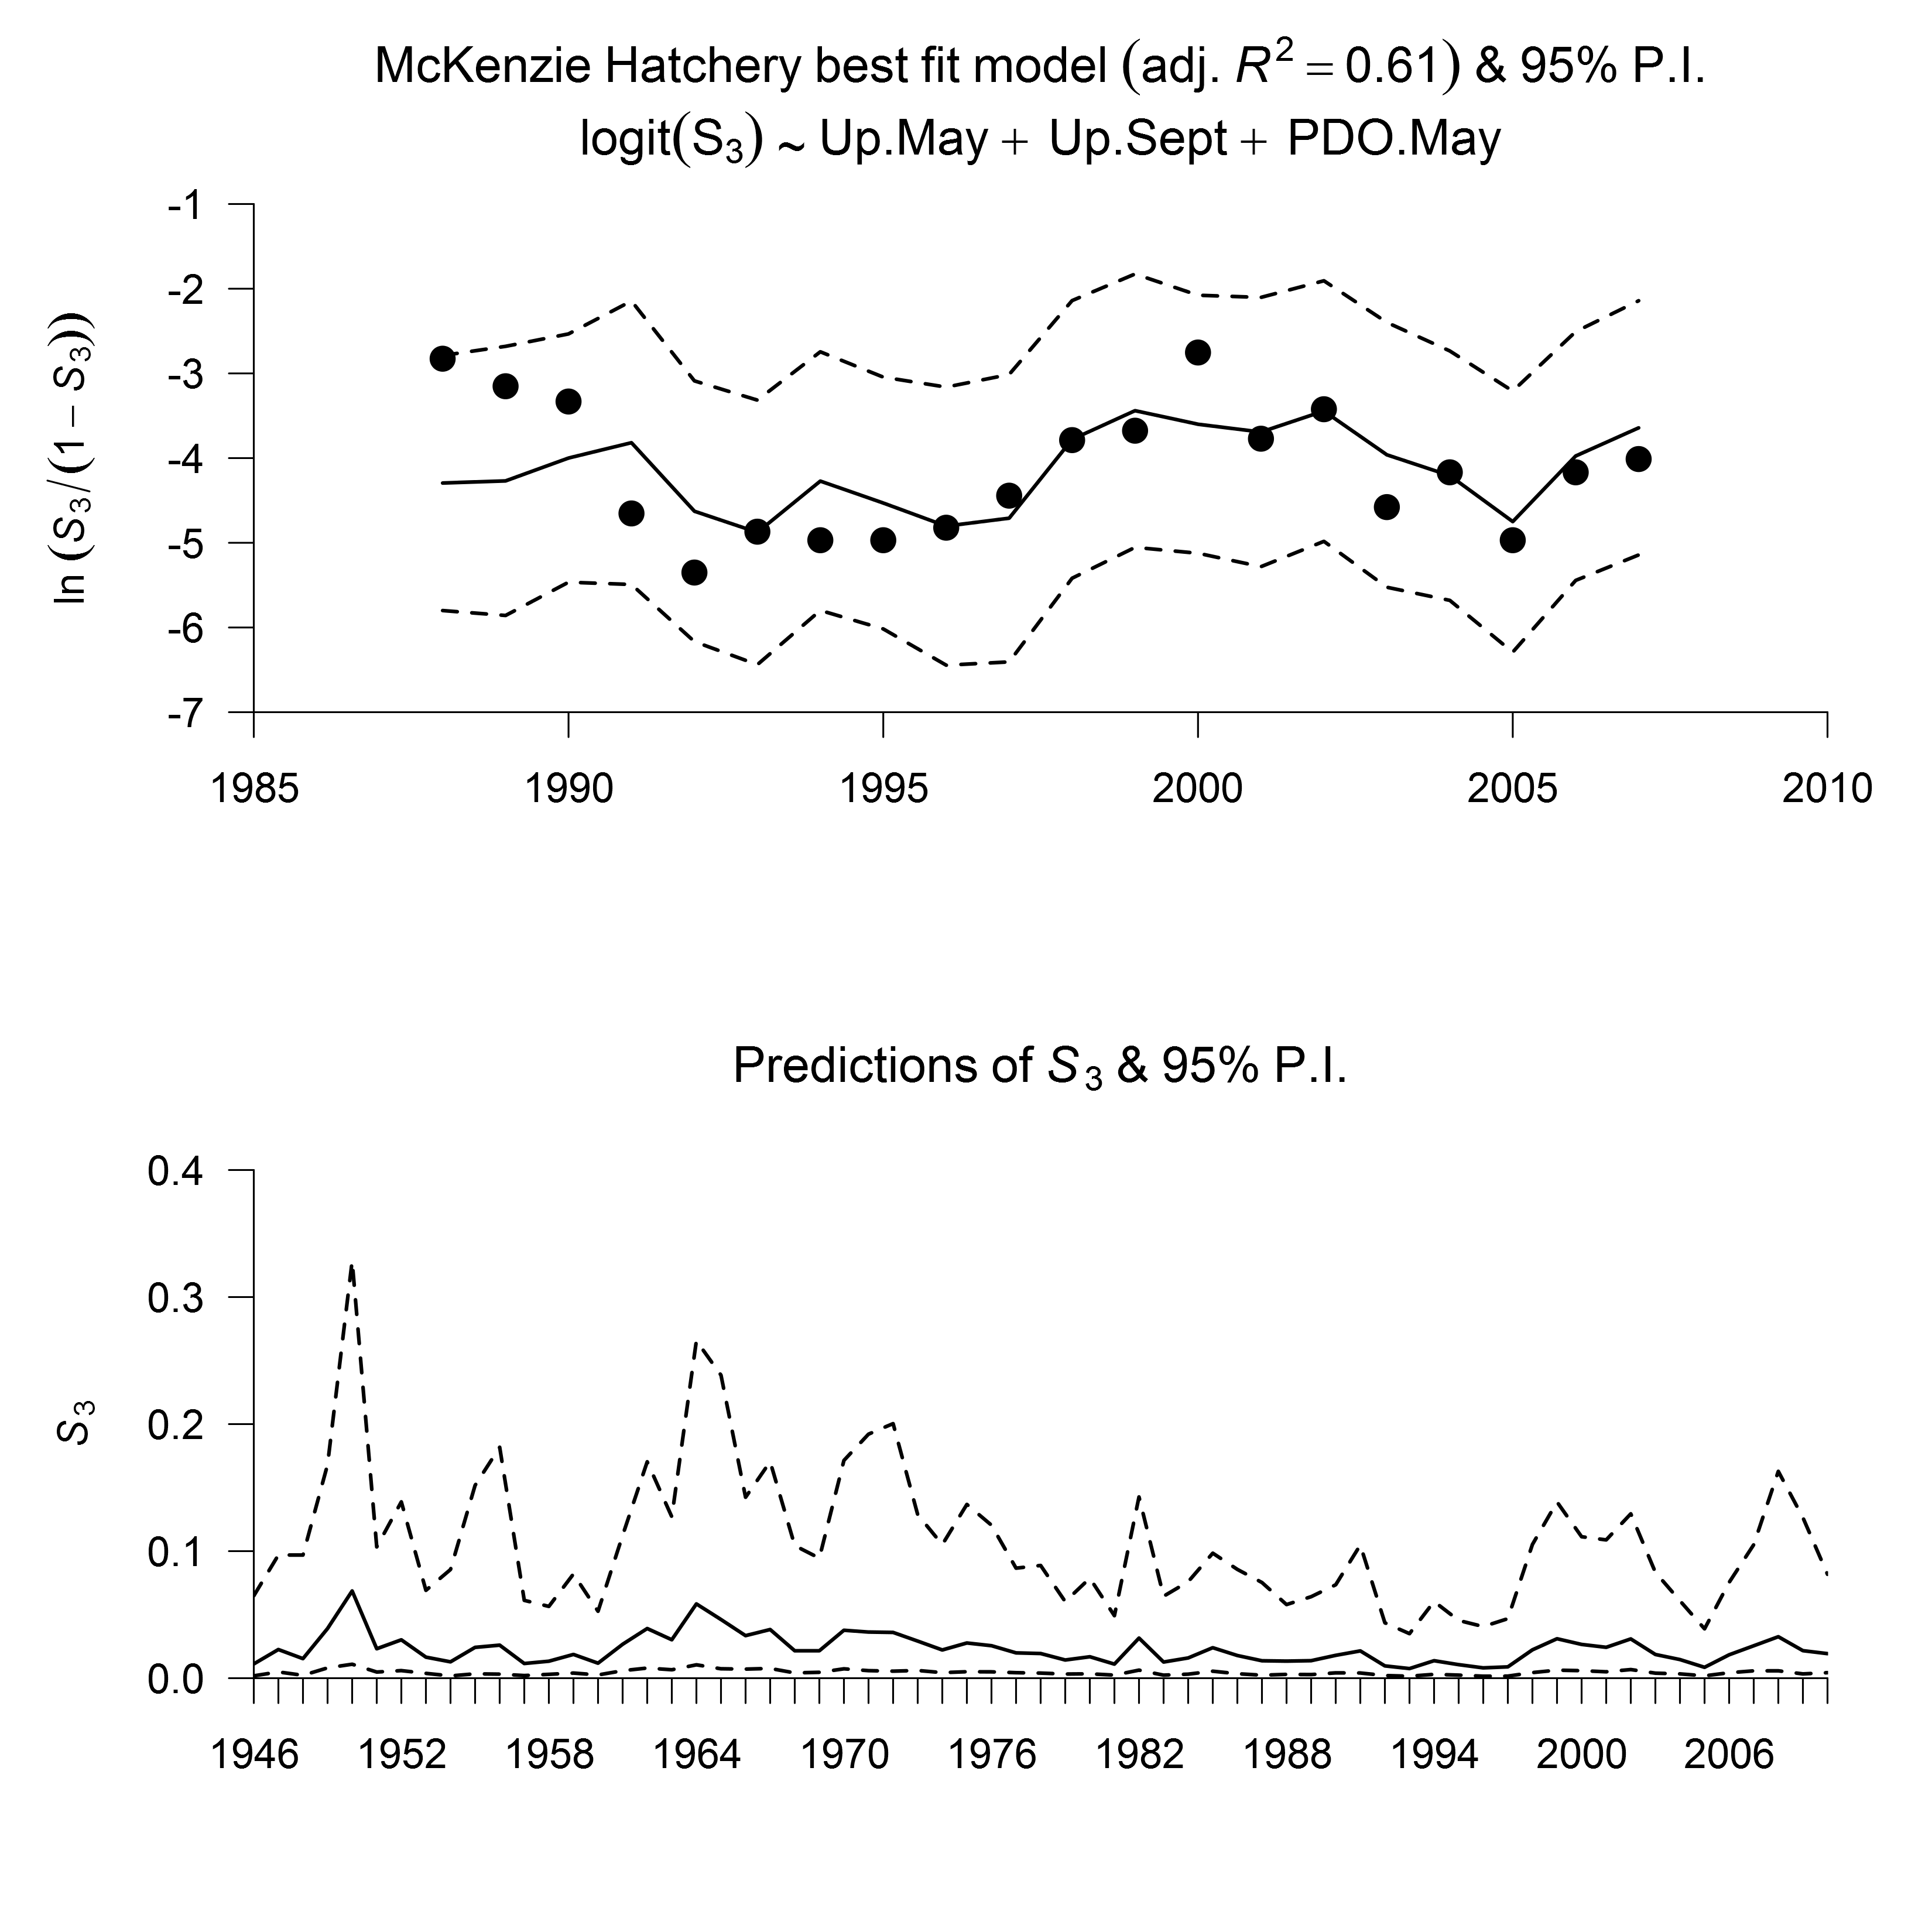
FUTURE DIRECTIONS: Ocean Survival

Slide 43
FUTURE DIRECTIONS: New Data/Analyses
• Pre-Spawn Mortality
• Reproductive Success
• Habitat Analyses – Upstream and Downstream
Reservoir Survival Algorithms
Climate Change

Slide 44
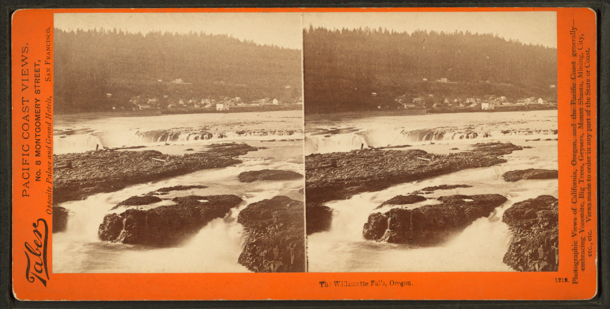
Thanks!
FUNDING: ACOE
Collaborators:
ODFW, NOAA RO, USACOE, BPA, USFWS, NWPCC

